Slide 1
Institutional and social challenges to land use strategies in a multilevel governance context: the case of southwestern Ethiopia
Conference on Land Policy in Africa
(CLPA-2017)
Addis Abeba, ethiopia
Tolera Senbeto Jiren, Ine Dorresteijn, Arvid Bergesten, Jannik Schultner, Jan Hanspach, Joern Fischer

Slide 2
Introduction
Ensuring food security and biodiversity conservation are the contemporary global challenges
A successful harmonization strongly dependent on the effectiveness of land governance
The governance approaches for attaining this dual goal varies
E.g. green revolution vs food sovereignty
E.g. land sparing vs land sharing strategy
Governance comprises both the structures and processes influencing food security and biodiversity conservation outcomes
land governance involves all structures and processes related to the introduction, implementation or monitoring of land use policies

Slide 3
Why to study land governance?
linkages between stakeholders lay the foundation for how different interests, policies and strategies on the land are integrated and implemented
E.g. collective action, integration of diverse interests, sharing of knowledge and implementation can all be fostered/hindered by the land governance structures
E.g. poor coordination, lack of participation, and limited capacity can hamper effectiveness of land governance
Addressing how the existing land governance arrangements help or hinder the harmonization is crucial because many countries of the Global South are biodiverse and food insecure at the same time.
The synergies or trade-offs between production and conservation are most pertinent in smallholder-dominated rural landscapes

Slide 4
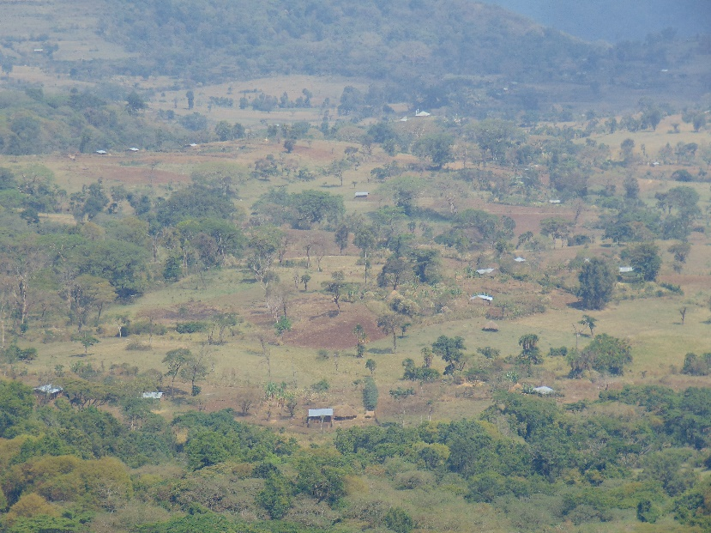
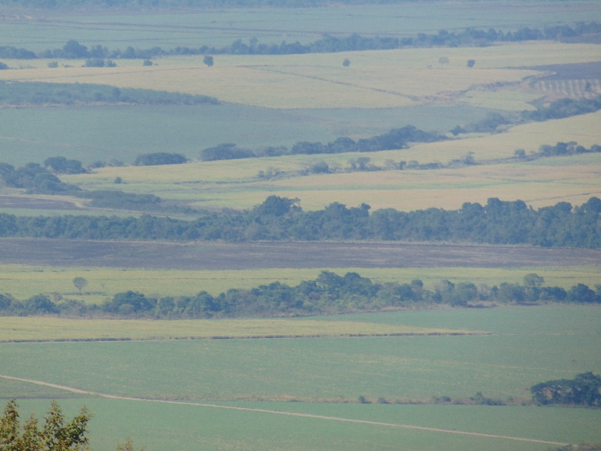
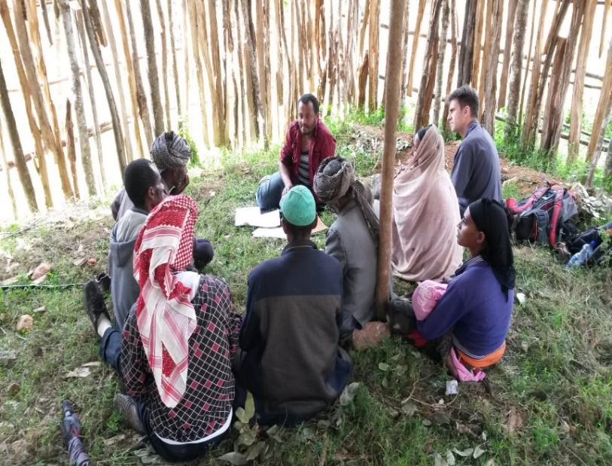
Aim of the study
Mapping structural interaction of stakeholders in land governance for harmonizing food security and biodiversity in a multilevel governance context
Assess governance challenges hampering land governance for harmonizing food security and biodiversity
Investigate stakeholder’s preferences of land use strategies for future land governance

Slide 5
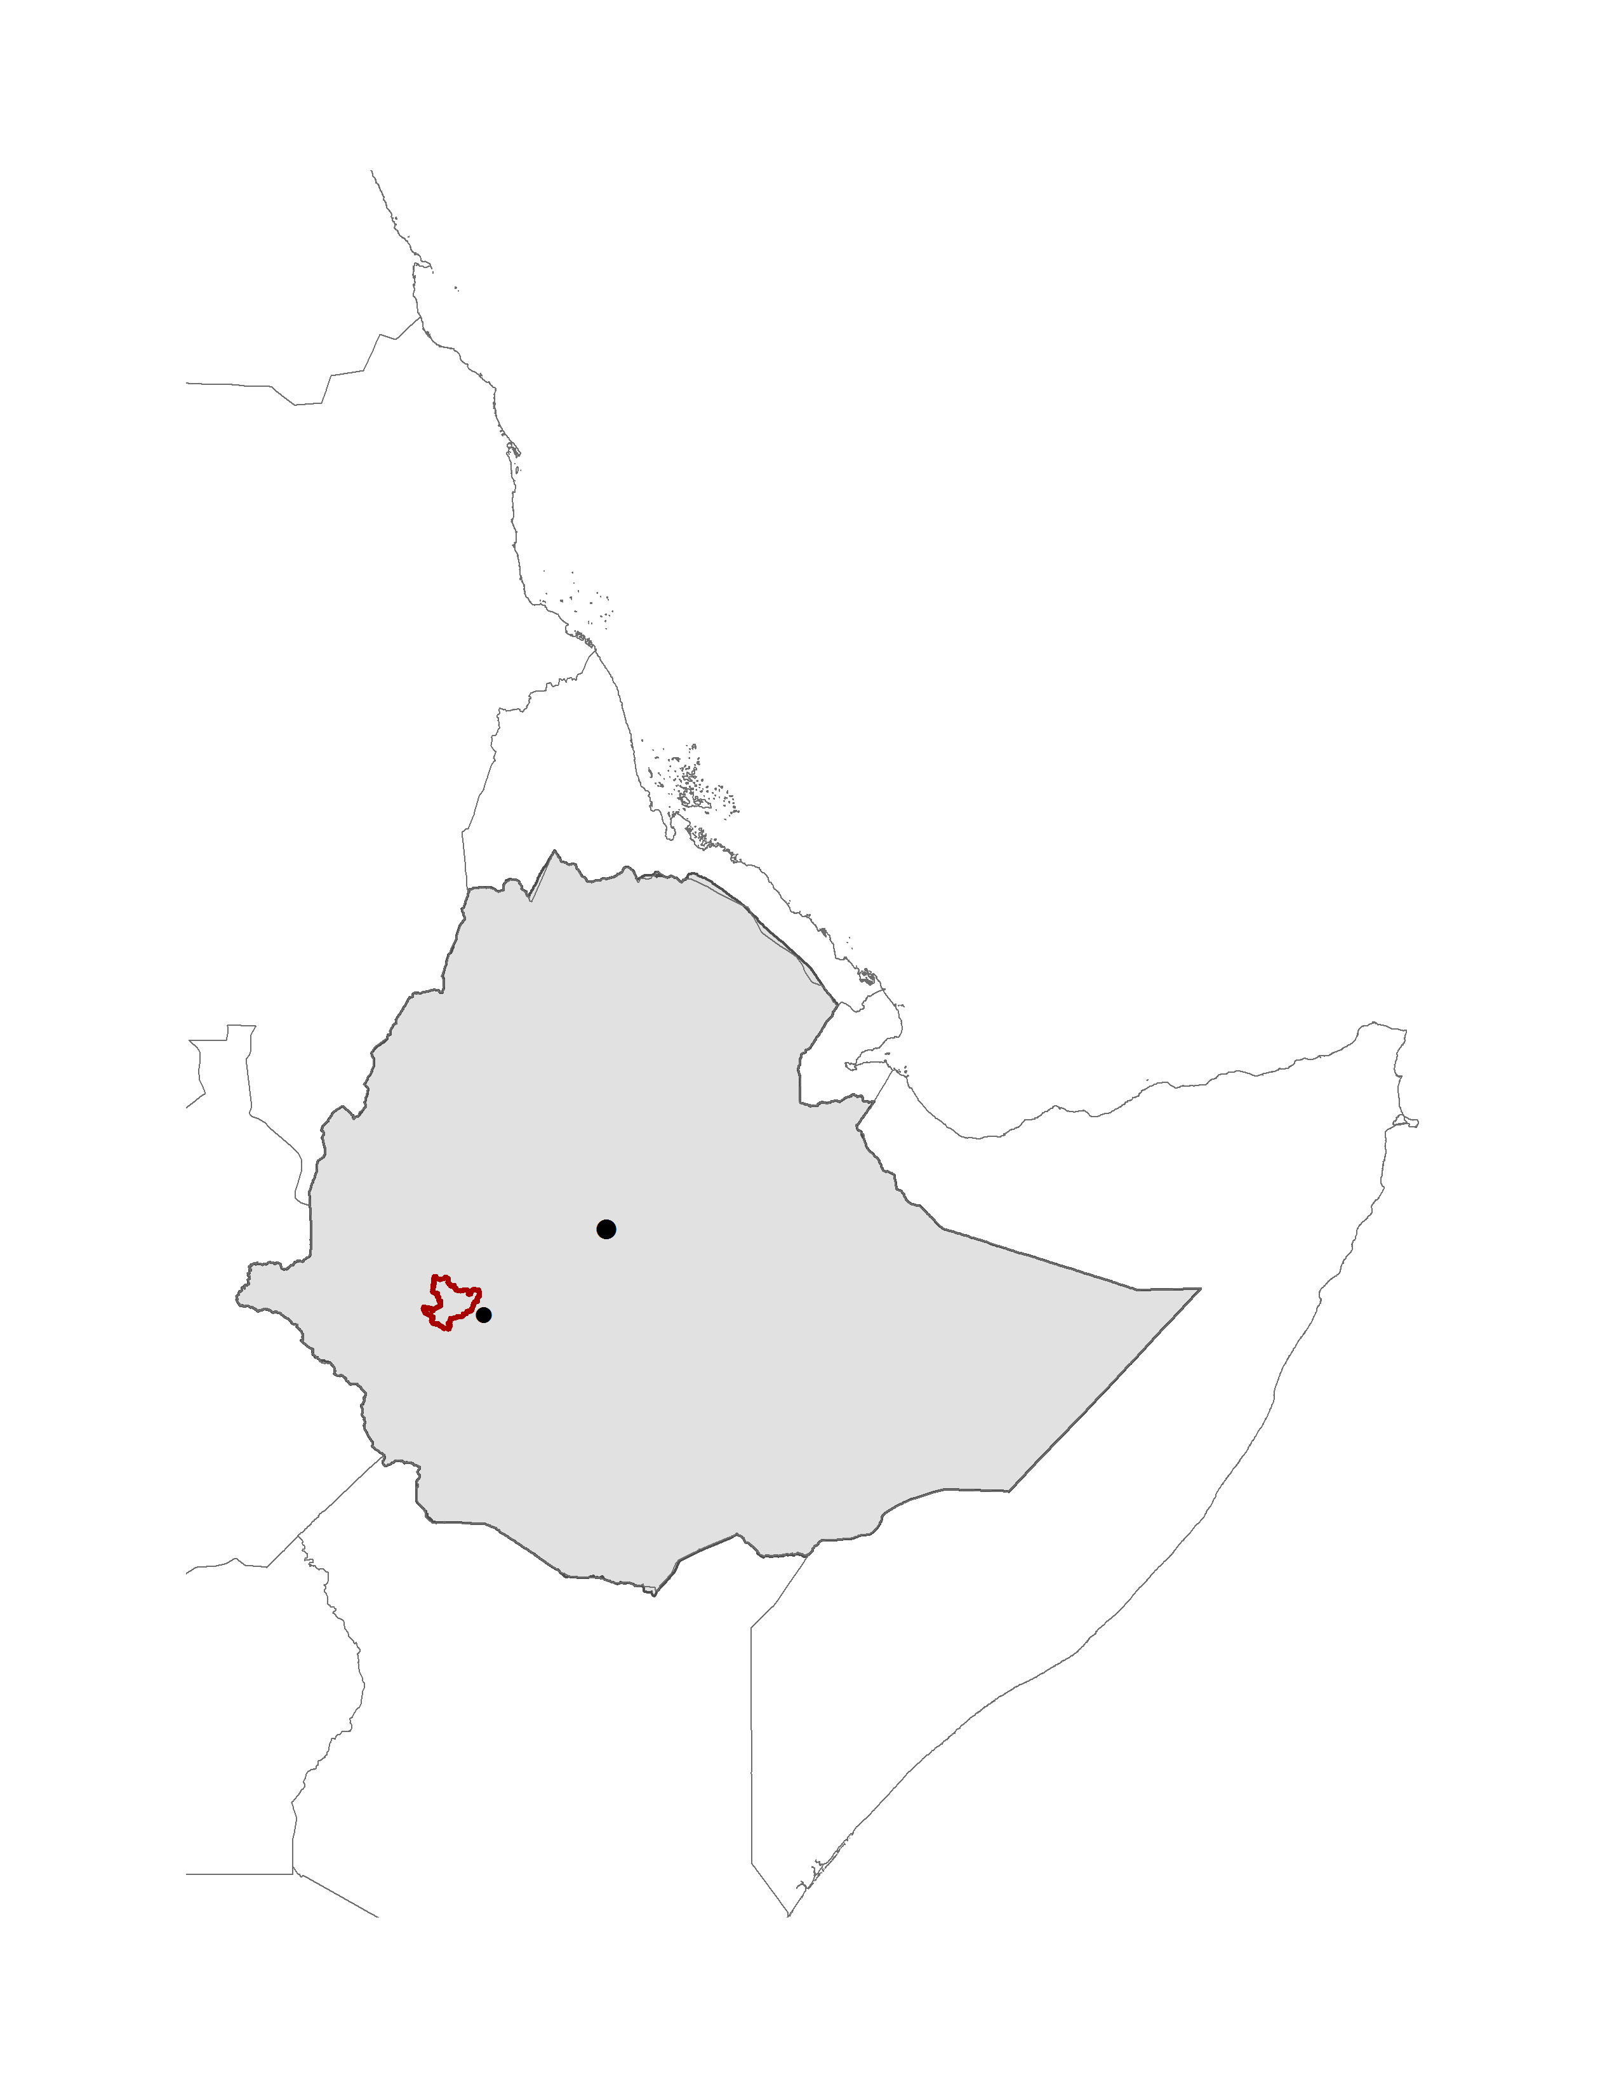
Background of the country
Federal
Regions
Zone
Woreda
Kebele
Nearly 40% of the population are still food insecure (USDA, 2014)
Rich but declining biodiversity (IUCN, 2007)

Slide 6
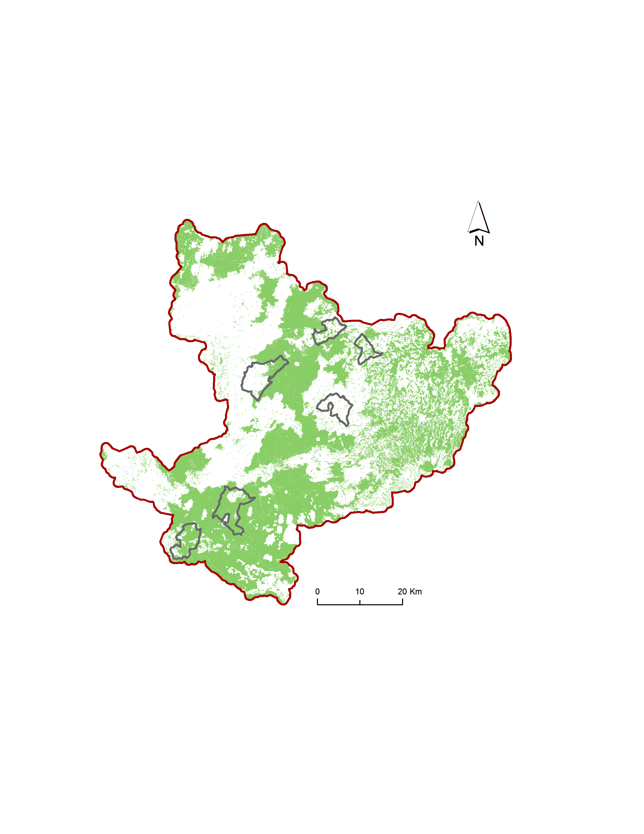
Map of the study area

Slide 7
Methods
Snow-ball sampling for the identification of stakeholders across multilevel governance
Stakeholders from kebele-national level in both food security and biodiversity sectors were involved
24 Focus group discussions were conducted at 6 kebeles
220 Key Informant interviews were administred
Methods
Social Network Analysis for stakeholders network mapping
    SNA with “R” program
Qualitative content analysis for governance challenges
    NVIVO V.11

Slide 8
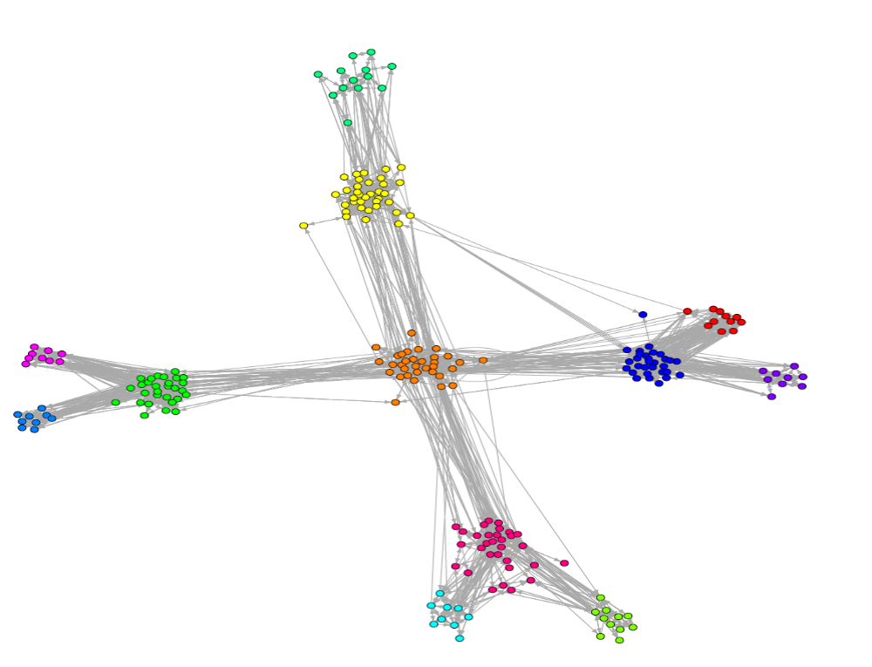
Stakeholders governance network
244 stakeholders, 80 of which were directly involved in land governance
Highly homogeneous stakeholders
72% of the food security links and 51% of the biodiversity links were reciprocated.
Governance was strongly hierarchical, exhibiting many vertical links between the five governance levels

Slide 9
Stakeholders governance network
Hierarchical
Zone is the central liaison broker
Federal
Regional
Zonal
Woreda
woreda
Woreda

Slide 10
Stakeholders governance network
Hierarchical
No horizontal linkages between woredas
Kebeles
Woreda
woreda
Woreda

Slide 11
Stakeholders governance network
Hierarchical
No horizontal linkages between Kebeles
Kebeles
Kebeles
Kebeles

Slide 12
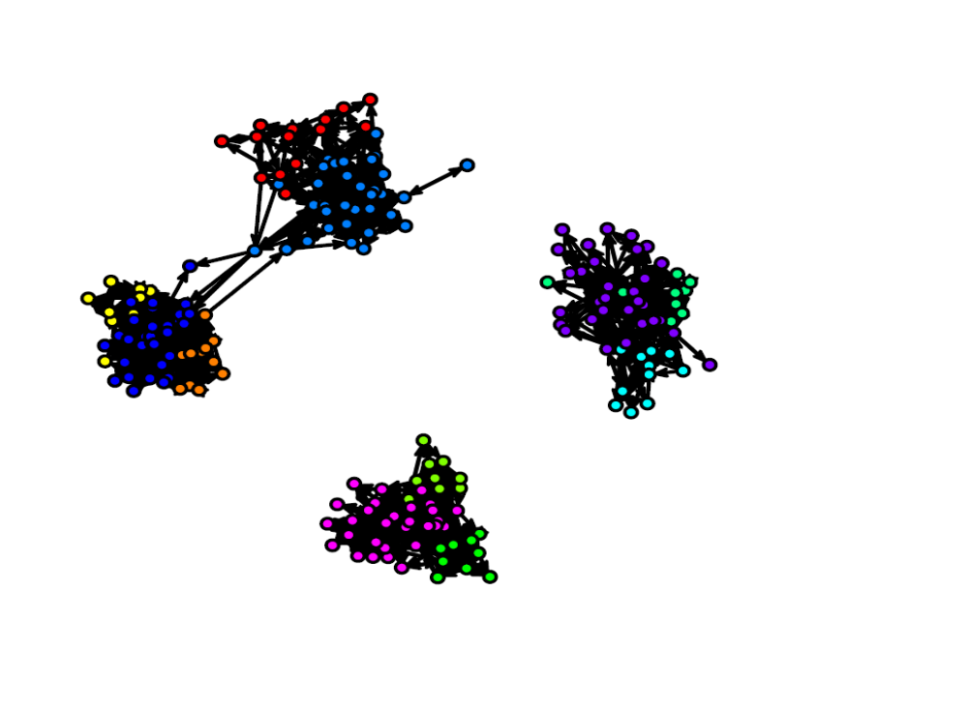
Stakeholders governance network
Zone is the broker between policy makers and implementers
NGO brokering across level
No interaction without NGO between policy makers and implementers
Strongly hierarchical
Structural gap leads to implementation deficit
NGO
Federal
Oromia region
Setema woreda and kebeles
Gumay woreda and kebeles
Gera woreda and kebeles
Union

Slide 13
Land governance process challenges
Classification |  | Governance challenges
 | Institutional overlap | High institutional density, overlapping responsibilities and inconsistencies Policy enforcement or implementation gaps Structural segregation of stakeholders Multiple accountability and decision sources
 | Land use strategy | Policy element contradictions with regard to land use governance Contradicting interest over land
 | Coordination gaps | Poor coordination of stakeholders both vertically and horizontally Missing or weak coordinating institutions on the land governance

Slide 14
Land governance process challenges
Classification | Governance challenges
Capacity challenges | Land governance tasks versus implementers capacity mismatch Low local capacity to implement land policy and land use plans
Procedural challenges | Lack of participation in decision making Governance procedural incompatibility with land governance goals
Political traps | Unequal treatment and favoritism Lack of merit based bureaucracy at the implementation level

Slide 15
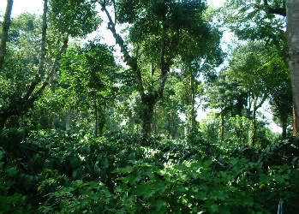
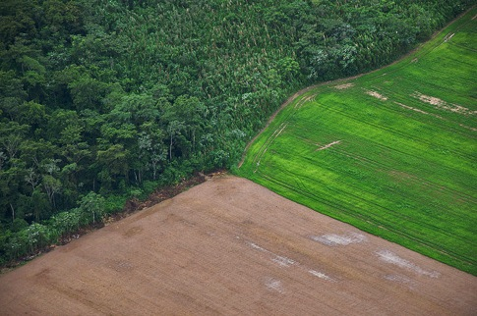
Preference of land use by stakeholders
Governance level and community wealth determined land use preference
land sharing strategy was more popular at the implementation level (45%, n = 62)
land sparing and a mixture were preferred at the policy-making level (39% each, n=18)
Poor community members unanimously preferred land sharing (100%, n=11).
Rich community preferred land sparing followed by a mixed land use strategy (50% and 33%, n=12)
Land sharing
Land sparing

Slide 16
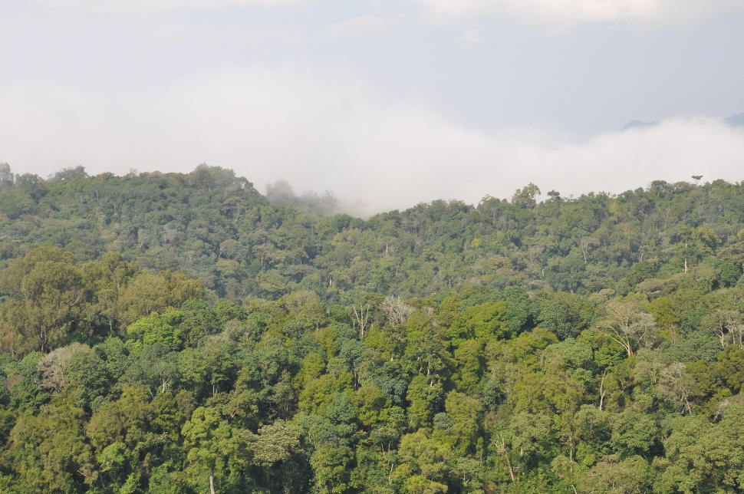
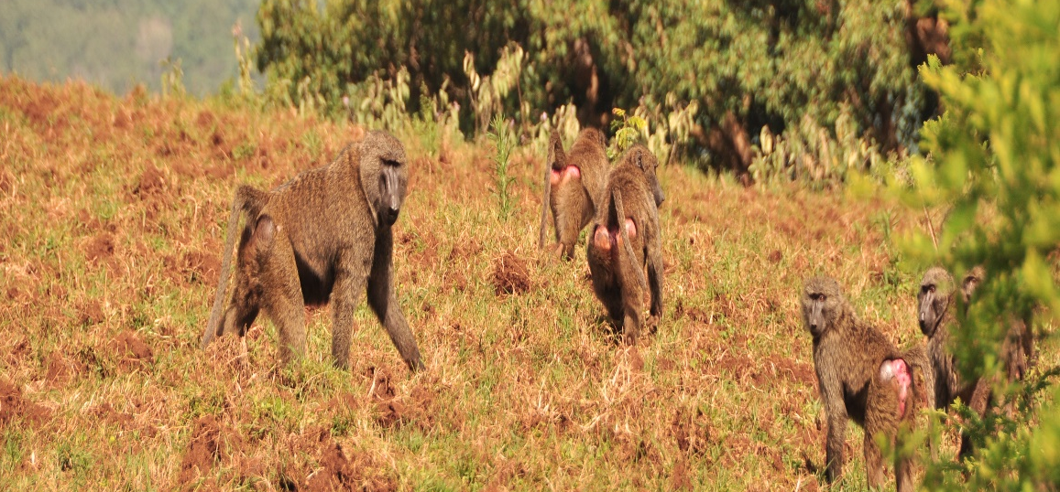
Conclusion
With regard to the study area, the study produced three main findings:
The governance structure of food security and biodiversity was strongly hierarchical and this could lead to implementation deficits;
Main governance challenges were emanating from institutional, governance process and capacity limitations for policy enforcement;
There were mismatches in strategic preferences of land use between policy-making and policy implementing stakeholders.

Slide 17
Recommendation
Based on our findings we stress the following two issues for further consideration:
Governance structure supporting interactions across multiple layers of governance, and across jurisdictions, would likely improve land use governance.
Fostering stakeholders coordination, enhancing the capacity of implementing stakeholders and promoting institutional fit needs priority attention for the sustainable land governance
To minimize land use preferences mismatches, land use policies should ensure stakeholder participation and coordination between sectors.

Slide 18
Thank you for your attention!!!
Acknowledgements:
ERC-project to Joern Fischer
Local community and all stakeholders who provided the data
Oromia National Regional State
Federal Democratic Republic of Ethiopia

