Slide 1
ScaLING UP PRO-POOR LAND RECORDATION
findings and consequences of three peri-urban cases from sub-Saharan Africa
Paul van Asperen
Jaap Zevenbergen
Bob hendriks
CONFERENCE ON LAND POLICY IN AFRICA, Addis abeba, 14-17 November 2017

Slide 2
introduction
Pro-poor land recordation tool
11 design elements
Case studies
Findings: exploring 3 design elements
Conclusions and recommendations

Slide 3
Pro-poor land recordation tool (PPLRT)
2012: Release of GLTN Pro-Poor Land Recordation Tool:
  A set of design principles for establishing and maintaining land records for improved protection and access to land for a community’s poorest members.
2013-2015: Further refinement of PPLRT under GLTN Partnership Land Tool Development Project:
  Unpacking the broad notion of ‘community’
  4 rural cases (Tanzania, Kenya, Uganda, Mexico)
2017: Does PPLRT withstand (peri-)urban dynamics?
  3 (peri-)urban cases (Namibia, Zambia, Botswana)

Slide 4
11 design elements
Apply macro and micro political-economy analysis
Enable mobilization
Build on inclusive community tenure practices
Introduce acceptable local recognition and a para-legal officer
Recordation of all tenure forms
Joint inspection of land records
Affordable and accessible dispute resolution
Land records, indexes and a record keeper for a specified area
Multiple sources of evidence and local weighting
System ownership and co-management by state and community – as a public good
Emphasis on continuum of land recording.
Evaluation of economic, social and environmental outcomes

Slide 5
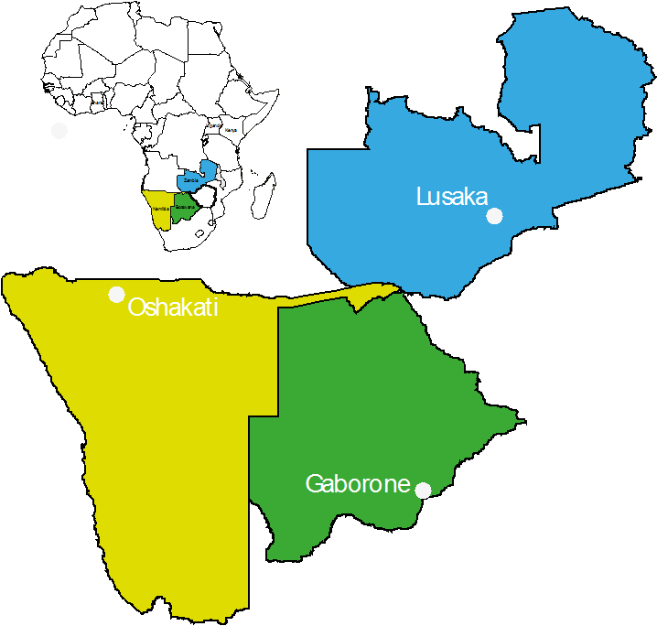
Case studies

Slide 6
Characteristics
Peri-urban settlements 20,000 – 50,000 inhabitants
Both customary and statutory influence
Recordation through:
  Oshakati: Registration of occupation
  Chazanga: Occupancy licences (Housing (Statutory and Improvement Areas) Act,1975)
  Peri-urban Gaborone: Certificate of customary land grant (Tribal Land Act, 1970)

Slide 7
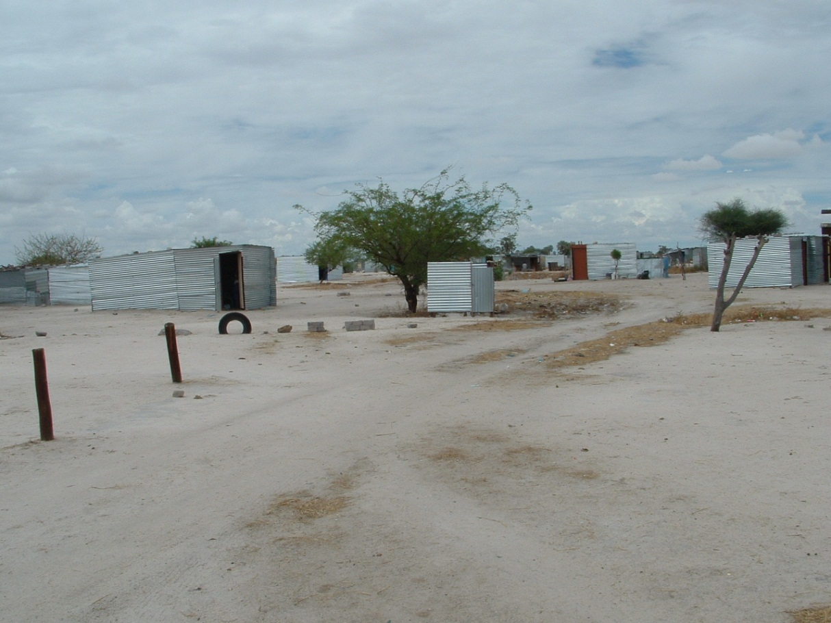
Notes:
Illegal shacks in Oshakati

Slide 8
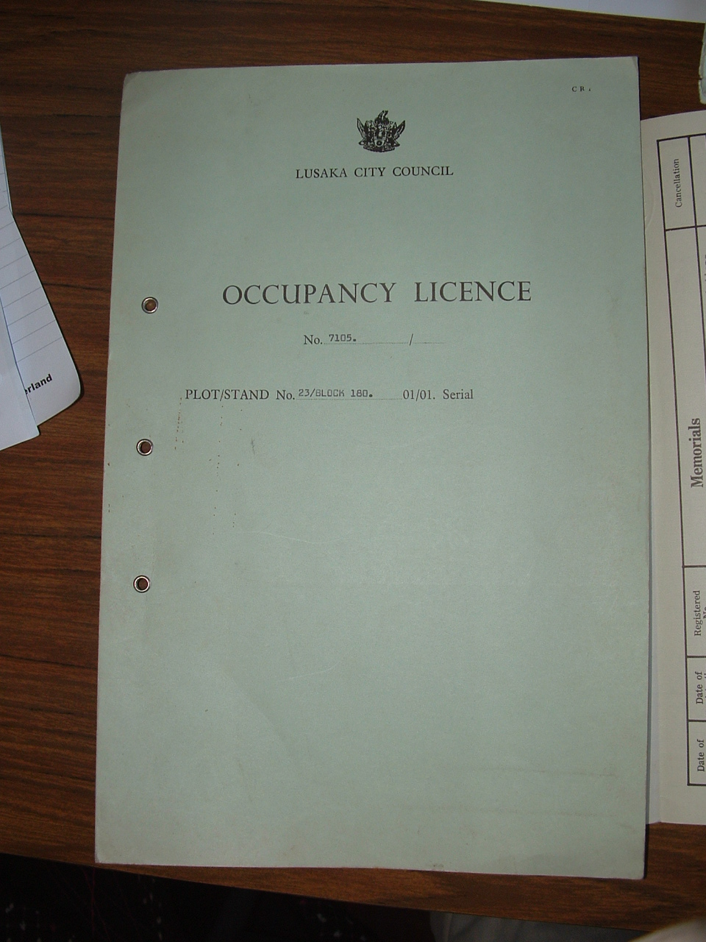
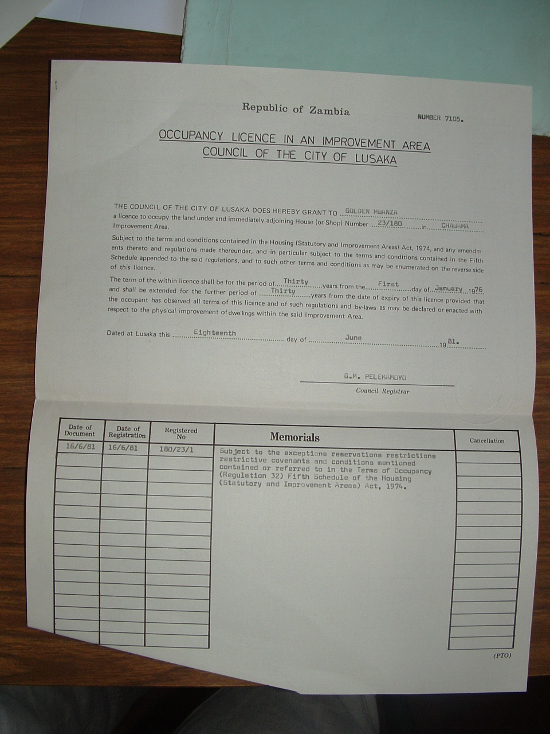

Slide 9
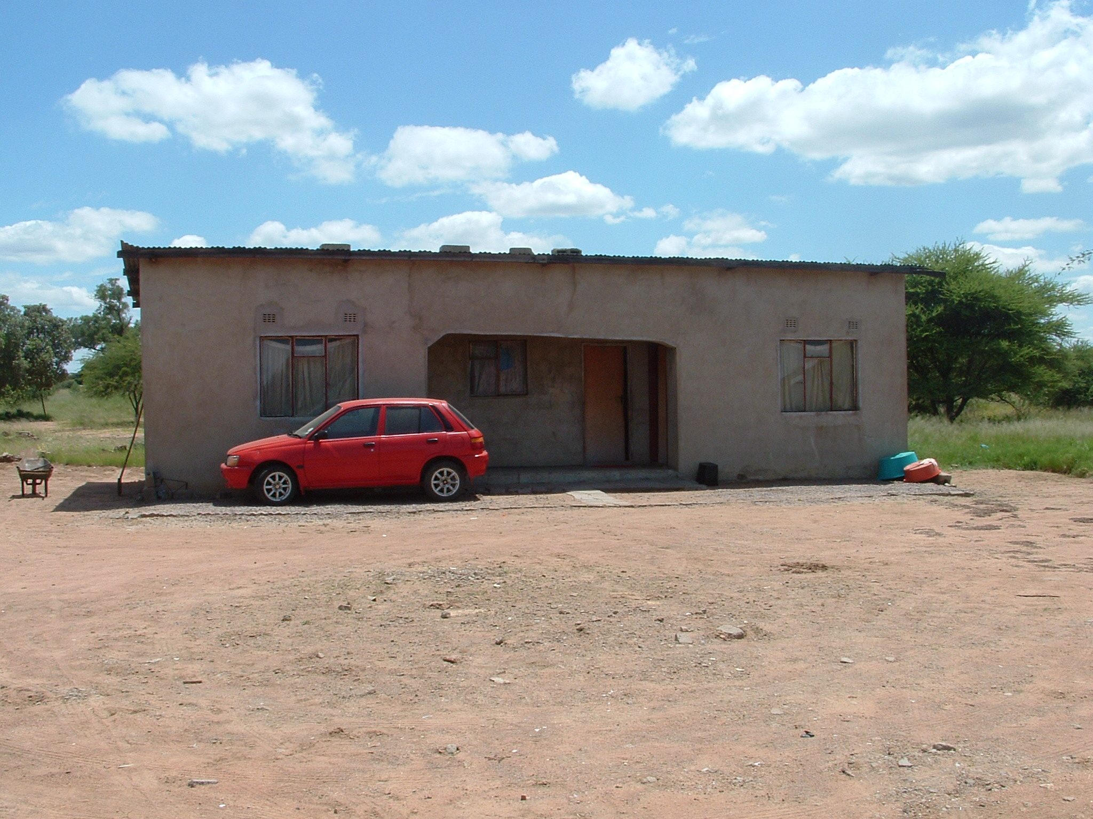
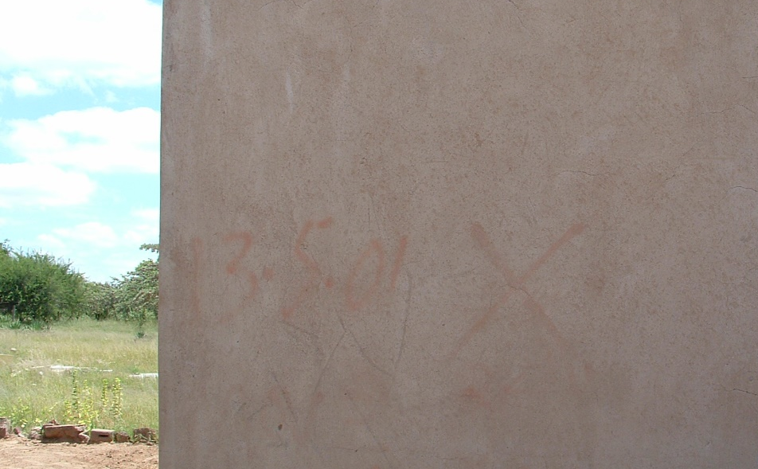
Notes:
Mogoditshane: House earmarked for demolution; due to ‘self-allocation’

Slide 10
Recordation of all tenure forms
The recognition by all stakeholders and subsequent recordation of all existing tenures and rights:
  All claims
  With or without documents
  With or without official certificates
  Shadow registers:
  Headmen in Oshakati and Namibia
  Saving scheme in Oshakati
  Therefore: ‘unambiguous’ recordation

Slide 11
Affordable and accessible dispute resolution
PPLRT should result in a decrease of land disputes, although the mechanisms still need to be affordable and accessible.
People went to various institutions (in the neighborhood, at low cost), however they lacked knowledge if those institutions were the right ones: affordable, accessible and ‘well-informed’ dispute resolution.

Slide 12
multiple sources and local weighting
People may access land through a variety of channels, with a variety of evidence:
  Oshakati: shadow register headman and saving scheme
  Chazanga: shadow register headman, witnesses for transfers
  Peri-urban Gaborone: mapping and imagery
No regulations and no evidence found on how local weighting was executed. It will be challenging to see how this can be achieved in peri-urban areas: need for show-cases.

Slide 13
Conclusions and recommendations
The findings in the studied cases largely confirmed the validity of the PPRLT design elements in peri-urban contexts
The co-existence and contestation of customary and statutory authorities lead to two recommendations for refinement:
  ‘Unambiguous’ recordation of all tenures.
  Affordable, accessible and ‘well-informed’ dispute resolution.
General recommendations:
  Para-professional instead off para-legal officer
  Need for showcases/research on local weighting
Notes:
Para professional can also be used for record keeper (eight design element) and land surveyor (when applicable in PPLRT).

Slide 14
Thank you for your attention!
Questions?

