Slide 1
Gender Dimensions of Youth Access to Agricultural Land under Customary Tenure System in the Techiman Traditional Area of Ghana
BY:
JOSEPH KWAKU KIDIDO
JOHN TIAH BUGRI (PROF.)
&
RAPHAEL KASIM KASANGA (PROF.)
Department of Land Economy
Faculty of Built Environment
KNUST, Kumasi

Slide 2
Presentation Outline
Introduction and Research Problem
Study Area
Methods
Results
Recommendations

Slide 3
Introduction
The youth constitute an important human capital for the socio-economic development of Ghana.
-they constitute 34.1% of Ghana’s population (GSS, 2014)
The youth are economically marginalized (Abbink, 2005),
-Youth unemployment rate in Ghana estimated at 5.5% (GSS, 2014),
-11.7% for Sub-Saharan Africa (ILO, 2013)
Agriculture remains the world’s single biggest source of employment (World Bank, 2014; White, 2011; IFAD, 2010).
Do youth have access to land on favourable terms and viable sizes for agricultural purpose?

Slide 4
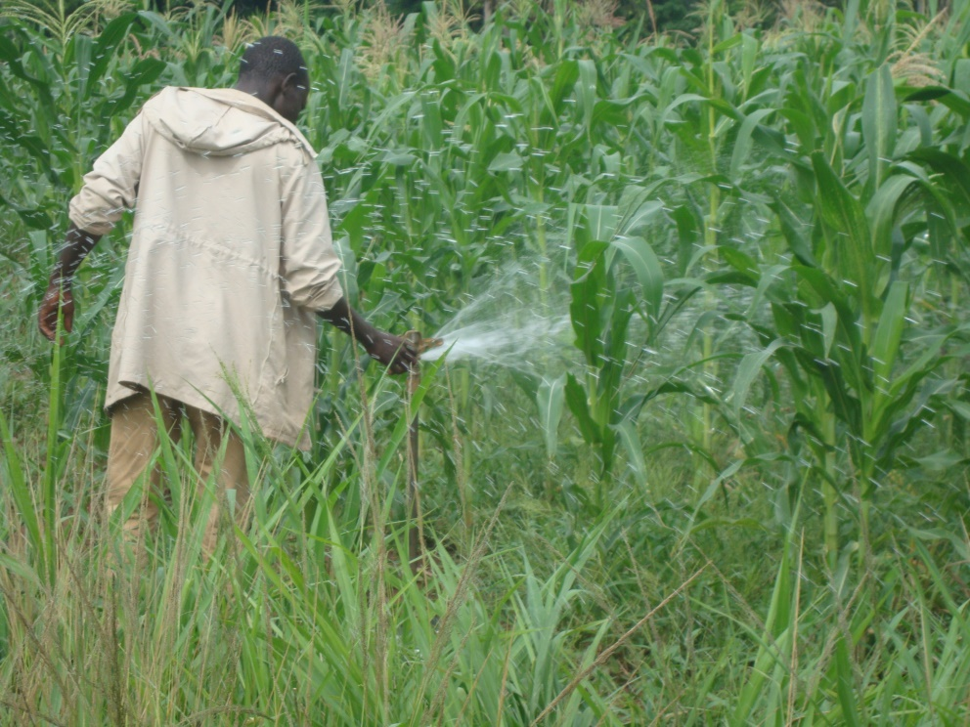
Introduction Cont.
Land is a key productive resource.
Access mechanisms reflect
the prevailing land tenure system
The customary land tenure system dominates in Ghana
-constitute about 80% (Sulemana, 2011; Bugri, 2013).
-Excludes groups such as the youth and women from equitable access to land (Kwapong, 2009).
Existing studies; Kidido et al. (2017), Amanor (2010), Boni (2008)
The study investigated youth access to agricultural land under the customary tenure regime.
-Understanding Gender Dimensions

Slide 5
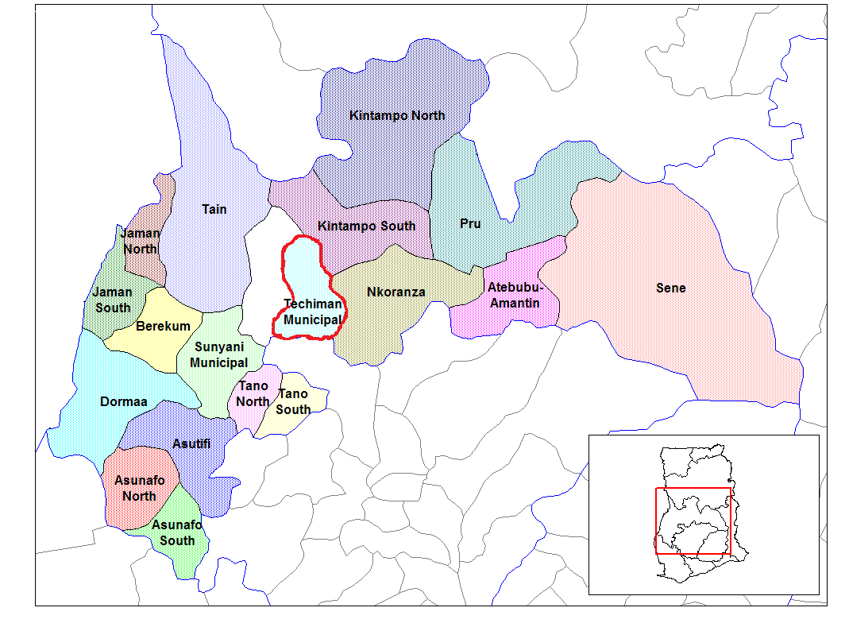
The Study Area
The study purposively selected Techiman Traditional Area
Covers two administrative districts:
-Techiman Municipality
-Techiman North district
Figure 1: District Map of Brong Ahafo Region Highlighting the Study Area Districts

Slide 6
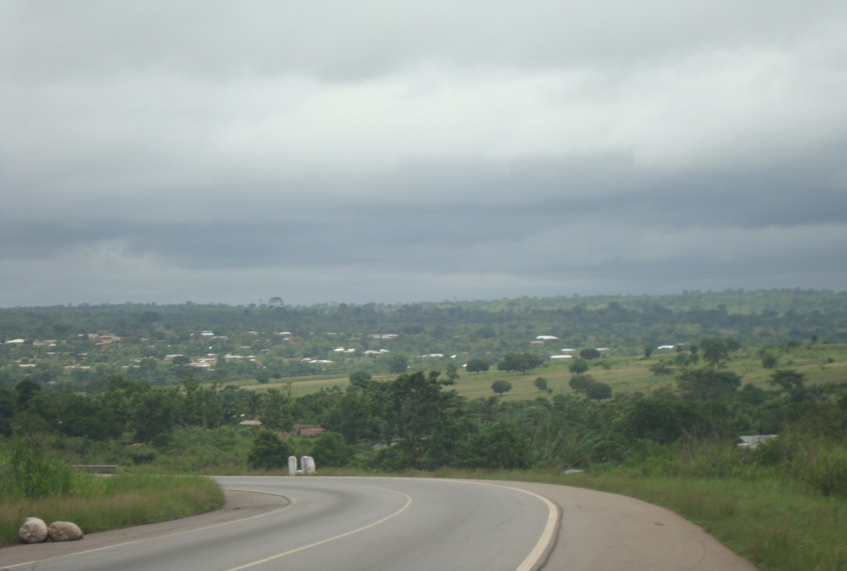
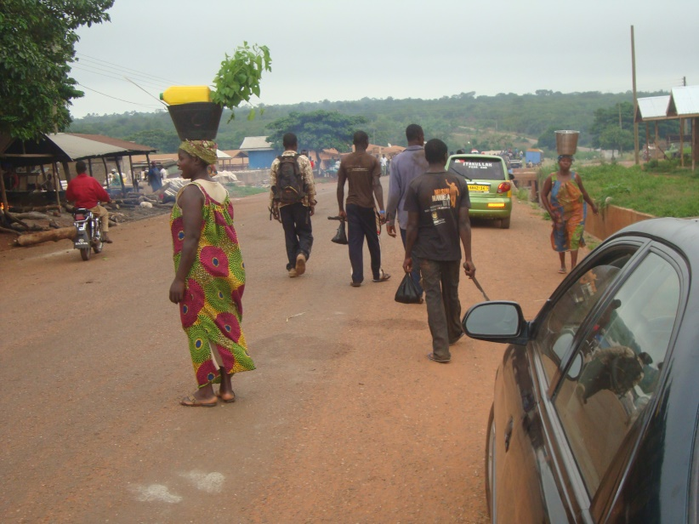
Study Area Cont.
Why Techiman Area?
Contributes substantially to Ghana’s food production (TENDA, 2013).
Strategically located.
Has one of the biggest agricultural markets in Ghana (GSS, 2014).
Preferred area by some youth to engage in agriculture (Okali and Sumberg, 2012).

Slide 7
Methods (1)
Sampling Approach
Multistage sampling (communities, respondents)
Sampling of communities
Purposive selection of nine zonal councils capitals (Techiman Municipality 4; Techiman North District 5).
Selection of 11 additional towns using simple random approach.
Total of 20 communities sampled for the study.

Slide 8
Methods (1)
Sampling of the Youth Respondents
Households were used as the reference point for the sampling of the youth.
-The youth respondents were then purposively sampled based on the age range of 15-34 years and involvement in on-farm agricultural activities.

Slide 9
Methods (3)
Table 1: Respondents in the communities
Community | Youth
Hansua | 20
Krobo | 27
Tuobodom | 89
Nkwaeso | 20
Bamiri | 12
Twimia-Koase | 21
Mesidan | 8
Sansama | 13
Kuntunso | 12
Aworowa | 39
Nsuta | 18
Buoyem | 14
Tanoso | 53
Adieso | 5
Tadieso | 11
Amangoase | 9
Tanoboase | 6
Offuman | 51
Kokroko | 5
Fiaso | 22
Total | 455

Slide 10
Methods (4)
Analytical Approach
The use of Statistical Package for Social Sciences (SPSS) software tool.
Statistical descriptions, cross-tabulations etc.

Slide 11
Results
Gender composition of the respondents
299 (65.7%) male
156 (34.3%) female youth
Fairly reflects level of youth involvement in agriculture in Ghana.
45.1% of male youth were employed by the agricultural sector compared to 38.3% among the female youth (GSS, 2014)

Slide 12
Land Ownership and Access Mechanisms
Table 2: Gender Dimension of Youth Land Access and Ownership
Item | Gender
Owns land | Male | Female
Yes | 43 (14%) | 31 (20%) | 74
No | 256 (86%) | 125 (80%) | 381
Total | 299 | 156 | 455
Access mechanism | Male | Female | Total
Purchase | 1 (0.3%) | 0 | 1
Gift | 32 (11%) | 21 (14%) | 53
Sharecropping | 46 (15%) | 14 (9%) | 60
Inherited | 10 (3%) | 10 (6%) | 20
Customary Licence | 132 (44%) | 92 (59%) | 224
Pledged | 1 (0.3%) | 0 | 1
Rented | 77 (26%) | 19 (12%) | 96
Total | 299 (100%) | 156 (100%) | 455
Source of land acquired | Male | Female | Total
Community elders | 0 | 1 (0.6%) | 1
In-law | 6 (2%) | 5 (3%) | 11
Chief/ Queen mother | 2 (0.7%) | 2 (1%) | 4
Father/ Mother | 126 (42%) | 84 (54%) | 210
Government | 1 (0.3%) | 0 | 1
Family head | 13 (4%) | 5 (3%) | 18
Other land owners/Usufructs | 129 (43%) | 37 (24%) | 166
Grand Father/Mother | 14 (5%) | 8 (5%) | 22
Uncle | 2 (0.7%) | 3 (2%) | 5
Others | 6 (2%) | 11 (7%) | 17
Total | 299 (100%) | 156 (100%) | 455
Item | Gender
Owns land | Male | Female
Yes | 43 (14%) | 31 (20%) | 74
No | 256 (86%) | 125 (80%) | 381
Total | 299 | 156 | 455
Access mechanism | Male | Female | Total
Purchase | 1 (0.3%) | 0 | 1
Gift | 32 (11%) | 21 (14%) | 53
Sharecropping | 46 (15%) | 14 (9%) | 60
Inherited | 10 (3%) | 10 (6%) | 20
Customary Licence | 132 (44%) | 92 (59%) | 224
Pledged | 1 (0.3%) | 0 | 1
Rented | 77 (26%) | 19 (12%) | 96
Total | 299 (100%) | 156 (100%) | 455
Source of land acquired | Male | Female | Total
Community elders | 0 | 1 (0.6%) | 1
In-law | 6 (2%) | 5 (3%) | 11
Chief/ Queen mother | 2 (0.7%) | 2 (1%) | 4
Father/ Mother | 126 (42%) | 84 (54%) | 210
Government | 1 (0.3%) | 0 | 1
Family head | 13 (4%) | 5 (3%) | 18
Other land owners/Usufructs | 129 (43%) | 37 (24%) | 166
Grand Father/Mother | 14 (5%) | 8 (5%) | 22
Uncle | 2 (0.7%) | 3 (2%) | 5
Others | 6 (2%) | 11 (7%) | 17
Total | 299 (100%) | 156 (100%) | 455

Slide 13
Youth Land Access Cont.
Figure 2: Land sizes of both male and female youth in the area.
Source: Field data, 2016 Male (n=299; Female (n=156)

Slide 14
Youth Land Sizes
Table 3 Landholding sizes of both male and female youth
Chi-square value= 6.720, df = 1, p-value= 0.01) at 95% confidence interval and a margin of error of 5%
Residence | Land Size
 | 1- 3 acres | ≥ 4 acres | Total
Male | 182 (60.9%) | 117 (39.1%) | 299 (100%)
Female | 114 (73.1%) | 42 (26.9%) | 156 (100%)
Total | 296 | 159 | 455

Slide 15
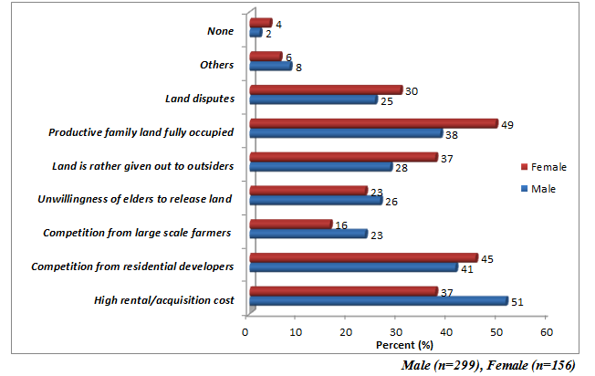
Access Challenges
Figure 3: Access challenges from gender dimension

Slide 16
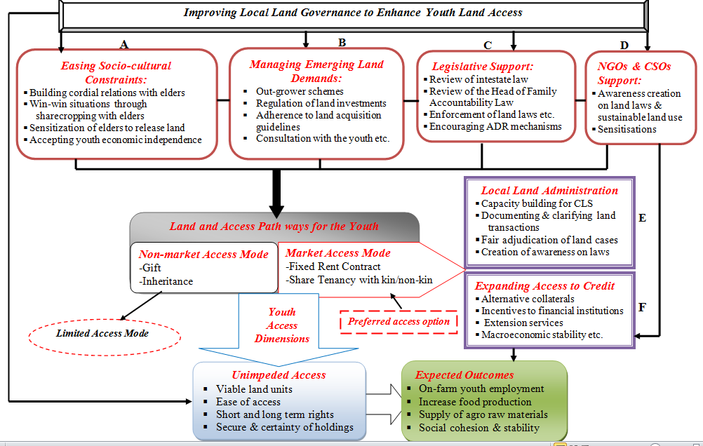
Recommendation

Slide 17
Recommendations Cont.
The model need to function under a land policy which focuses on the youth.
“Sound land policies can safeguard the livelihood of the very vulnerable by giving them access to land …through rental markets..”. (World Bank, 2012)
-There is the need for youth agricultural land access policy or a review of the existing National Land Policy to capture the model interventions and special provisions to assist the youth.
The study recommends further research into youth access to agricultural land under the main customary tenure regimes across the country as a means of formulating an evidence-based youth agricultural land access policy.

Slide 18


