Slide 1

Tackling Gender Gaps in the
Ethiopian Rural Land Administration
Selam Gebretsion, LAND project
Yalemzewid Demssie, MoA

Slide 2
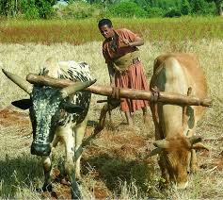
Background
In recognition of the importance of women’s land rights (WLRs) to inclusive development, WLRs are included in:
  United Nations Sustainable Development Goals (SDG)
  African Union Declaration on Land Issues and Challenges in Africa
  AU Resolution calling on Member States to realise the 30 percent target for women’s documented land rights

Slide 3
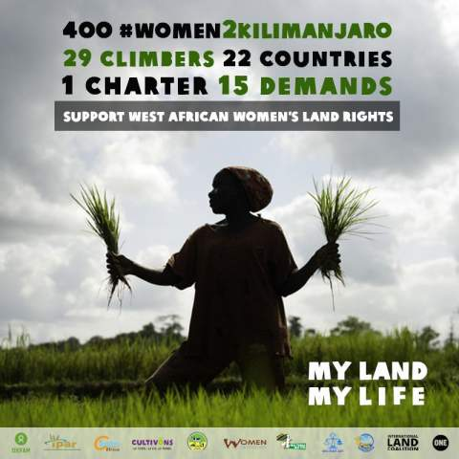
Background
At the national level, the Government of Ethiopia has made commitments and taken significant steps. For example:
  Convention on the Elimination of All Forms of Discrimination against Women ( CEDAW)
  Protocol to the African Charter on Human and Peoples’ Rights of Women in Africa

Slide 4
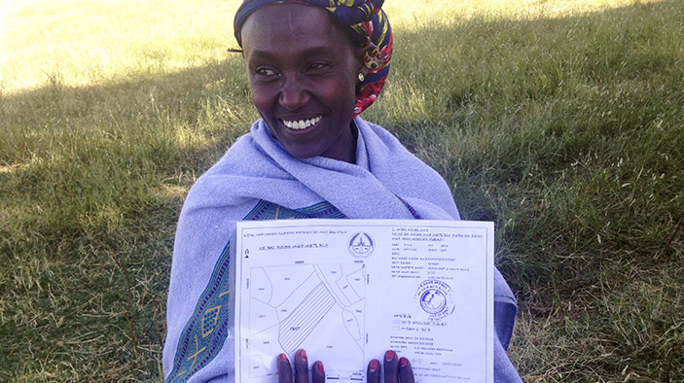
Women’s Land Rights in Ethiopia
Legal Framework
Right to ownership of land is vested in the state. Hence, it is impossible to transfer the land holding to others in sale or in exchange for another property.
In line with the Constitution, federal and regional rural land laws include provisions that explicitly grant women equal rights to acquire, inherit, administer and transfer land.
Federal Constitution mandates joint ownership of land by husbands and wives

Slide 5
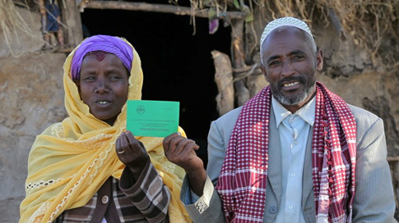
Women’s Land Rights in Ethiopia
Women’s rights to land are influenced by customs and norms.
  Men possess greater and better land rights to land because prevailing inheritance and marital norms/practices favor men and sons.
  E.g. In some communities, sons marry and remain on the farm and usually inherit land under custom (patrilineal system).

Slide 6
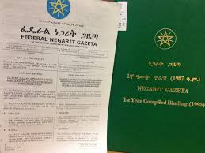
Ethiopian Rural Land Law
Ethiopian Rural Land Proclamation is currently being amended.
  A gender review of the Rural Land Proclamation concluded that while the Proclamation included some positive provisions, it did not adequately and systematically incorporate the concerns of women, the elderly, orphans and other marginalized groups
  The assessment recommended a revision and provided good practices/set of options for addressing identified gaps and inconsistencies
Currently, there are no local women’s group outside of the state system that work on policy issues related to women rights to land.

Slide 7
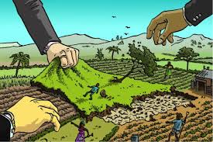
Mechanisms for Addressing WLRs
The leading government institution responsible for ensuring the right of women in all aspects of the State’s intervention sits in the Ethiopian Ministry of Women and Children’s Affairs.
It also has representatives in each sector, region, zone and at woreda levels.
However, the institution has limited financial, technical and human resource capacity to engage in all sectors as needed.

Slide 8

Women Land Rights Task Force (WLRTF)
In accordance with the recommendations of the gender assessment, the Ministry of Agriculture and Natural Resource, in collaboration the Land Administration to Nurture Development (LAND) project, established a federal Women’s Land Right Task Force (WLRTF) in February 2015.
WLRTF is composed of governmental and non-governmental institutions (land projects)

Slide 9
Members include;
Ministry of Agriculture and Natural Resource (Chair)
Ministry of Women’s, Children and Youth Affairs; (Vice-Chair)
Ministry of Justice;
Ministry of Federal Affairs;
Ministry of Labor and Social Affairs;
Federal Supreme Court;
Land Administration to Nurture Development (LAND) Project,
USAID/Pastoralists’ Areas Resilience Improvement through Market Expansion PRIME Project,
DFID/Land Investment for Transformation (LIFT) Programme
UNWOMEN (new member)
Notes:
Slide missing title

Slide 10

WLRTF: Objective
To consult women and deliberate on women’s land rights issues in order to inform formulation and implementation of gender responsive land policy and legislation in Ethiopia

Slide 11

WLRTF: Roles and Responsibilities
Participate in the drafting process
  Review and comment on legislations
  Draft policy briefs on women’s land rights issues
  Lobby on women’s land rights issues to influence the drafting process
Organize annual conference, public lectures, seminars, symposia and workshops on women’s land and property rights, land tenure and administration issues
Disseminate information through publications of newsletters, reports, fact sheets
Enhance the capacity of stakeholders

Slide 12
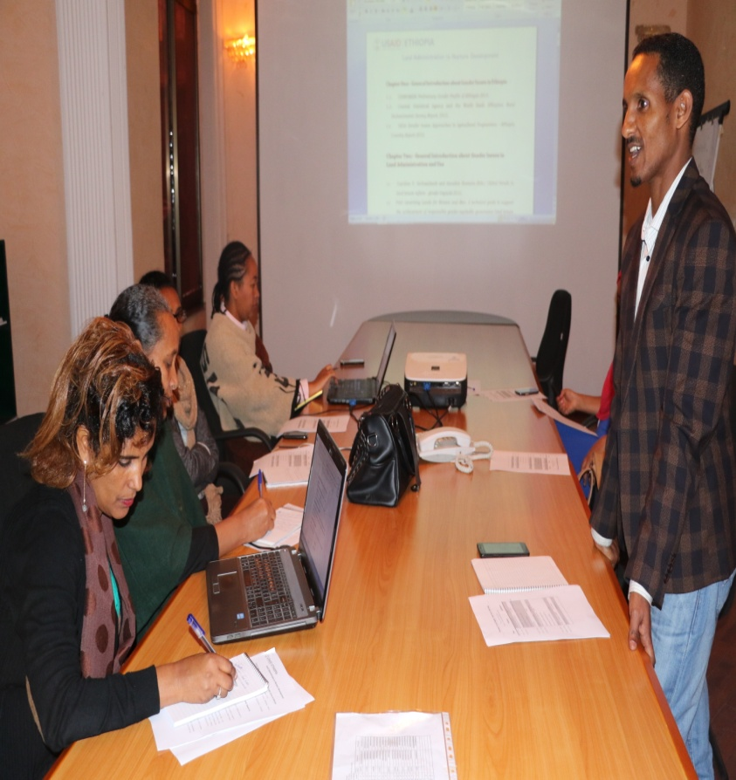
WLRTF: Process & Progress
WLRTF and drafting committees received intensive training on women’s land rights by land and gender experts
WLRTF
  Identified entry points
  Deliberated on the draft rural land administration law
  Provided on-going technical assistance to the drafting committee
  Support the establishment of regional task forces (Tigray, Amhara, Oromia and SNNPR)
Notes:
Gender analysis of the legal framework and recommendations for addressing the identified spelled out in the GAAP

Slide 13
WLRTF: Accomplishments
Advocated for gender sensitive and responsive provisions in the amendment of Proclamation No. 456/2005
Raised awareness among gender networks and at different platforms
Worked with universities and researchers to encourage more research on gender and land issues
Compiled laws and research papers on gender issues in land administration system
Developed a fact sheet
Established WLRTF in four regions (Oromia, Tigray, SNNPR and Amhara)
Identified gender gaps in their respective regional laws

Slide 14

Challenges
Limited awareness and commitment to address gender issues among key stakeholders
High turnover of national experts/specialists
Lack of financial resources, competing obligations of task force members limited commitment. (particularly in regions)

Slide 15

Positive Take Aways
Coordination: Diverse group of institutions/projects collaborated and contributed positively.
Platforms: Took advantage of existing platforms
Awareness Raising
Sustainability: WLRTF is lead and owned by the Government and not dependent on projects/programs

Slide 16
Conclusion & Recommendation
Securing the land rights of women and vulnerable groups requires the effort of various institutions that work at different levels.

Slide 17


