Slide 1
Presentation of UNIDEP
Mustapha Sadni Jallab
Head of Training and Research Division
16 July 2018
New York
Implementing the SDGs and Agenda 2063
2018 HLPF

Slide 2
Development challenges
2
Agenda 2063
Sustainable Development Goals, Agenda 2030
Financing development, Addis Ababa Action Plan
Green economy, Paris Declaration
Intra African trade, CFTA
Gender dimension
youth
employment
natural resources management
agriculture transformation
energy
regional integration
infrastructure
governance
migration
statistics

Slide 3
IDEP Activities
3
  Core / Thematic short courses
  Tailor made and Collaborative courses
Theme Selection
IDEP – Strategic Plan
MS Requests
ECA divisions/ SROs
  High Level Dialogues & Development Seminars
Master’s programme
Research
  Fellowship Programme
E-learning
Library

Slide 4
Guiding Principles
4
Supporting the implementation of Agenda 2063 and 2030 through training and research
Harnessing ICT for a better delivery through e-training programmes
Guidance from IDEP various constituencies (COM, Member states, Board, Scientific committee, feedbacks from participants)

Slide 5
Training
5
All training courses target governement officials | 2017
Core short training courses | 9
Collaborative short courses | 10
Tailor-made courses on SDGs relevant issues | 1
Officials who benefited from IDEP's residential short courses | 488
Participants of e-Learning courses | 156
Applications/nominations received for IDEP's Training | 3614
Scholarships awarded to the IDEP/UJ MPhil Industrial Policy programme | 10

Slide 6
Short courses
6
20 onsite training courses related to SDGs issues
Data analysis and macroeconomic modelling for development planners and better monitoring; sectorial policy and planning (trade, industry, agriculture, energy) international trade negotiations in support of the CFTA; social policy, Road safety, inclusive green economy as a development strategy, management of gender-responsive economic policy, preceded by a training of trainers; focus on more efficient mineral resources management (mineral governance; mineral contracts & negotiations); domestic resources mobilization, transport infrastructure, migration policy for RECs, etc…
New issues addressed
Long term planning and prospective studies; green economy; innovation and Intellectual properties, trade policy analysis within the CFTA context
Rating by training > 90%
3614 applications in 2017 vs 2542 applications in 2016

Slide 7
Achievements over the 2016/17 biennium (end)
Distribution of participants per theme

Slide 8
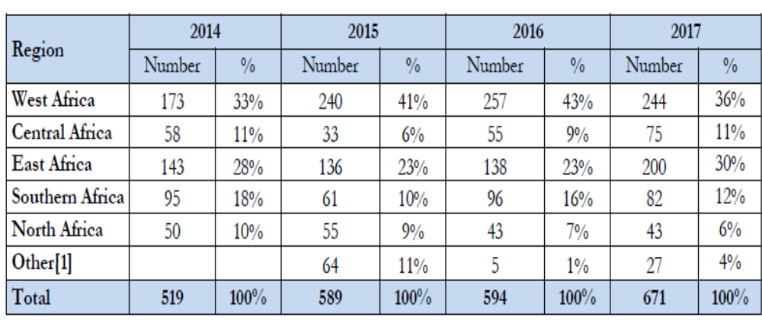
Geographical repartition

Slide 9
Research and technical assistance
9
Research areas
Agenda post-Quito and the urbanisation challenges for Africa
Data for Africa
Gender and climate change
Ownership of agendas 2030 and 2063 by African countries
Transformative agriculture for Africa’s future
Trade and industrialisation
HLPD
Is Africa ready to invest in a green industry?
Urbanisation and industrialisation
Fellowships
2 IDEP fellowship programmes, 1 ECA fellows granted

Slide 10
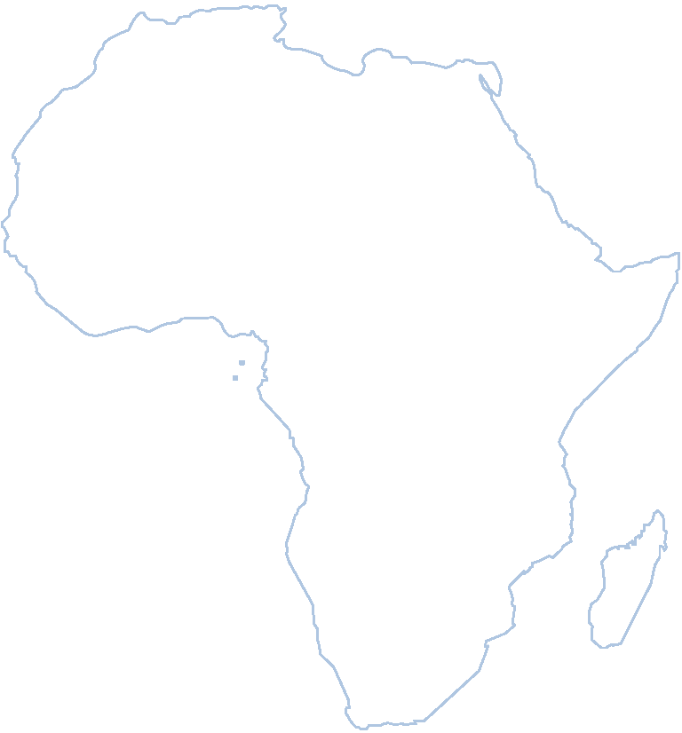
Supporting the SDG’s impolementation through E-learning activities
10
Cooperation UNITAR - ECA
1 course based on ERA 2017
6 weeks
Delivered in English and French
Internally - Pilot
1 course based on ERA 2015
To test internal capacity
4 weeks
French
Women
Men

Slide 11
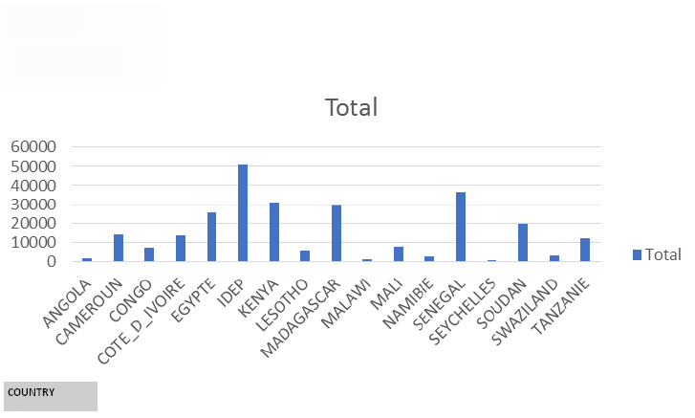
Knowledge Management
11
Library digitisation as part of IDEP KM
First phase:
262 161 pages scanned / 520 000
3323 titles / 5 800 in several file formats:
  TIFF 300 DPI for archiving
  PDF/A 300 DPI with automatic indexing by OCR
  for consulting and full text search
  TXT UTF-8 with manual indexing for further description
  and search in digital libraries and repositories
16 Countries + IDEP documents
number of pages scanned

Slide 12
Concluding remarks
12
IDEP will continue and sustain its approach to train Africans government officials especially on green industrialisation and economic transformation among others structural issues
Strategic shifts in the delivery mechanisms and orientation of the IDEP programme in immediate response to the capacity development needs expressed by Member States through both SDGs and Agenda 2063,
and the increasing requests for IDEP’s services from member States.

Slide 13


THANK YOU!
More: www.uneca.org/idep

