Slide 1

HIGH LEVEL POLICY DIALOGUE ON DEVELOPMENT PLANNING IN AFRICA
EXPERIENCES IN SDG FINANCING:
PUBLIC & PRIVATE FINANCE
(DOMESTIC AND INTERNATIONAL)
IN GHANA
BY
ADJEI-FOSU KWAKU
NATIONAL DEVELOPMENT PLANNING COMMISSION, GHANA
11 July 2018
Cairo, Egypt

Slide 2
Outline OF PRESENTATION
INTRODUCTION
NATIONAL DEVELOPMENT PLANNING SYSTEM AND PROCESS IN GHANA
LINKING PLANNING AND BUDGETING
EXPERIENCES IN SDG FINANCING: PUBLIC AND PRIVATE FINANCE (DOMESTIC AND INTERNATIONAL) IN GHANA
CONCLUSION

Slide 3
INTRODUCTION
SDG Financing, both Public & Private Finance (Domestic And International) has been integrated in the
National Development Planning System
Decentralised National Development Planning process
Budgeting system at all levels and in line with
Addis Ababa Agenda for Action (AAAA) in financing sustainable development,

Slide 4
OVERVIEW OF THE NATIONAL DEVELOPMENT PLANNING SYSTEM IN GHANA
OFFICE OF THE PRESIDENT
1
2
NATIONAL DEVELOPMENT PLANNING COMMISSION
(NDPC)
(Advice)
4
3
3
8
REGIONAL
COORDINATING
COUNCILS
(Coordination, M&E)
SECTORS (Ministries,
Departments and
Agencies (MDAs)
National Development Policy Frameworks
Planning Guidelines (format & content of District and Sector Development Plan
Harmonisation Guidelines
3
4
5
RPCU (Advice)
6
Data and Information
DISTRICT ASSEMBLIES)
Adoption
KEY
ADVICE
APPROVAL OF POLICIES
NATIONAL DEVELOPMENT POLICY FRAMEWORK AND GUIDELINES INCLUDING HARMONISATION GUIDELINES
ADVICE
DISTRICT DEVELOPMENT PLANS, HARMONISATION REPORT, M&E PLAN, ANNUAL PROGRESS REPORTS, DATA AND INFORMATION
DATA AND INFORMATION (INPUTS)
PROJECTS
SECTOR DEVELOPMENT PLANS, HARMONISATION REPORT, M&E PLAN, ANNUAL PROGRESS REPORTS, DATA AND INFORMATION
DPCU (Advice)
7
6
URBAN/TOWN,ZONAL AREA COUNCILS
6
7
UNIT COMMITTEES

Slide 5
PLANNING AUTHORITIES IN GHANA
NATIONAL DEVELOPMENT PLANNING COMMISSION (NDPC)
- Apex planning authority
Responsible for co-ordinating the national development planning system
  Ensures that budget is linked to plan reflecting SDGs
Works through Cross Sectoral Planning Groups
MINISTRIES, (MDAs) - Formulating, , monitoring and evaluating policies
    SECTOR DEPARTMENTS AND AGENCIES implementing, monitoring and evaluating policies and plans and budget reflecting SDGs respectively
  Works through Policy Planning, Monitoring and Evaluation Division (PPMED)]
REGIONAL COORDINATING COUNCILS (RCCs)
- Coordinating, harmonising, monitoring and evaluating development plans of District Assemblies in the Region
[Regional Planning Coordinating Units (RPCUs)]
DISTRICT PLANNING AUTHORITIES (DISTRICT ASSEMBLIES) - Formulating, implementing, monitoring and evaluating district development plans and budget reflecting SDGs respectively
[District Planning Coordinating Units (DPCUs)]
NDPC
MINISTRIES & SECTORS DEPARTMENTS & AGENCIES
REGIONAL CORDNATNG COUNCILS
DISTRICT ASSEMBLIES

Slide 6
DECENTRALIZED NATIONAL DEVELOPMENT PLANNING PROCESS
Implementation, monitoring and evaluation
PROGRAMME-BASED BUDGETING/N
ATIONAL MEDIUM TERM
EXPENDITURE FRAMEWORK
NATIONAL DEVELOPMENT
POLICY FRAMEWORK
NATIONAL
LEVEL
SECTOR/
DISTRICT PLANNING GUIDELINES BY NDPC
NATIONAL MEDIUM TERM DEVELOPMENT PLAN
SECTOR MEDIUM TERM DEVELOPMENT PLAN
MDAs/SECTOR
HARMONISATION GUIDELINES TO RCCs)
Analysis and synthesis of Sector Plans/Regional
Reports/district Plans into National Development Plan
254 District Plans lodged
with RCCs for harmonization
into Regional Reports. Copies
of DMTDPs sent to NDPC
REGIONAL COORDINATING COUNCIL
REGIONAL
LEVEL
DISTRICT MEDIUM-TERM DEVELOPMENT
PLANS (DMTDP) INCLUDING ANNUAL ACTION
PLANS WITH ESTIMATED COST
BY 216 DISTRICT ASSEMBLIES
Metropolitan, Municipal & District Assemblies
DISTRICT
LEVEL

Slide 7


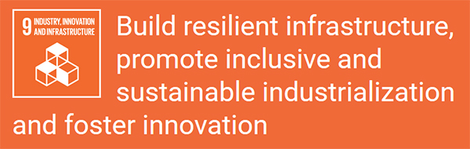













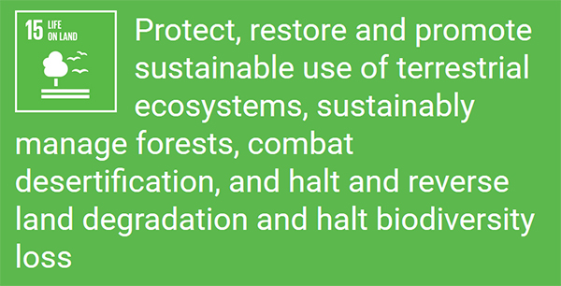
MEDIUM-TERM NATIONAL DEVELOPMENT POLICY FRAMEWORK: AGENDA FOR JOBS: CREATING PROSPERITY AND EQUAL OPPORTUNITY FOR ALL 208-2021
Economic Development
Social Development
Environmental, Infrastructure, and
Human Settlement
Governance, Corruption
Public Account.
International Affairs

Slide 8
EXTRACT FROM SOCIAL DEVELOPMENT DIMENSION
FOCUS AREA | KEY ISSUES | POLICY OBJECTIVES | STRATEGIES | SOME IMPLEMENTING AND COLLABORATING AGENCIES | GLOBAL/ REGIONAL LINKAGES
EDUCATION AND TRAINING | Poor quality of education at all levels Low participation of females in learning of science, technology, engineering and mathematics Inadequate and inequitable access to education for PWDs and people with special needs at all levels | Enhance inclusive and equitable access to, and participation in quality education at all level | Redefine basic education to include secondary education (SDG Target 4.1) Continue implementation of free SHS and TVET for all Ghanaian children (SDG Target 4.1) Popularise and demystify the teaching and learning of science, technology, engineering and mathematics (STEM) and ICT education in basic and secondary education (SDG Target 4.1) Ensure inclusive education for all boys and girls with special needs (SDG Targets 4.1, 4.2, 4.5, 4.a) | Ministry of Education, Ghana Education Service, Scholarship Secretariat, Ministry of Finance, Ghana Education Trust fund, Conference of Heads of Assisted Secondary Schools Private Sector etc. | SDG 4, 9, 13, 16, 17 AU 2, 18

Slide 9

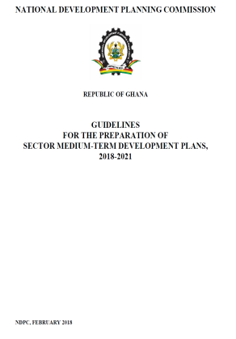

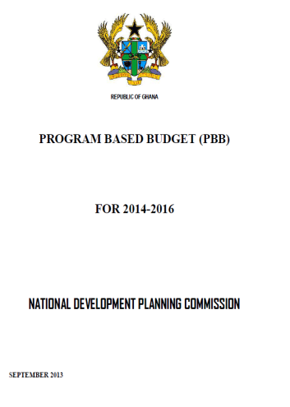
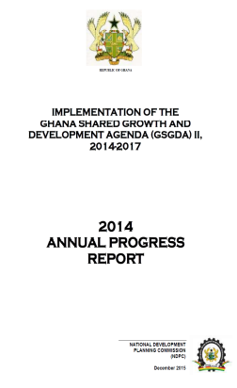
LINKING PLANNING AND BUDGETING
NATIONAL DEVELOPMENT POLICY FRAMEWORK (NDPF)
PLANNING (INCLUDING M&E GUIDELINES
FOR MDAs
MEDIUM-TERM DEVELOPMENT PLAN REFLECTING SDGs AND AGENDA 2063
PROGRAMMED BASED BUDGETING (PBB)
MONITORING & EVALUATION AT ALL LEVELS INCLUDING SDGs/AGENDA 2063
ANNUALISED AND PRIORITISED POLICY OBJECTIVES STRATEGIES PROGRAMMES, SUB-PROGRAMMES OPERATIONS WITH COST
PROCESS TO TRANSLATE NDPF INTO PROGRAMMES AND ACTIVITIES WITH COST
POLICY OBJECTIVES, STRATEGIES PROGRAMMES, SUB-PROGRAMMES AND OPERATIONS WITH COST
FOCUS AREA, ISSUES, POLICY OBJECTIVES AND STRATEGIES
REPORT ON ACHIEVEMENT OF INDICATORS AND SET TARGET

Slide 10
EXPERIENCES IN SDG FINANCING:
PUBLIC & PRIVATE FINANCE
(DOMESTIC AND INTERNATIONAL)
IN GHANA

Slide 11
TRADITIONAL FINANCING SOURCES
Taxes
Loans
Grants
Direct Investment (Foreign Direct Investment)
Philanthropic Organizations

Slide 12
  Domestic Public Resources Mobilization
Implementation of National Digital and Property Addressing System, referred to as: “ghanapostGPS” with the aim of formalising the Ghanaian economy, transform and improve the operations of business activities in the country;
Implementation of an accelerated National Identification Programme; Since November 20, 2017, the National Identification Authority (NIA) has been issuing instant smart National ID cards under a very strict multi-level verification process. The ID card, dubbed Ghana Card, is meant identify citizens
Implementation of the paperless port system; Government commenced the implementation of the paperless clearing at Ghana’s ports. The aim is to ensure faster and accurate payment of duty, Reduced human interface and paper movement among agencies, make payments electronic via mobile money, cards (visa, Gh-link), as well as online banking and promote joint inspection by sector agencies.
Implementation of the Excise Tax Stamp policy; The Excise Tax Stamp is a specially designed digital stamp with security features which will be affixed on specified excisable goods in Ghana whether locally manufactured or imported to show that taxes and duties have been paid or will be paid on them

Slide 13
  Domestic and international Private business and finance
Establishment of One District One Factory (Decentralizing industrial development)
an initiative designed to ensure an even and spatial spread of industries across the country. The state will facilitate and assist medium to large scale business to set up. This is estimated to cost GH¢ 456.3 million and create about 350,000 jobs;
Provision of US$10 Million by Government to leverage private capital to create a US$100Million fund for the National Entrepreneurship and Innovation Plan (NEIP) which focuses on providing business development services; startup incubators and funding for young innovators to enable them grow and become successful;
Implementation of Infrastructure for Poverty Eradication Programme (IPEP) an initiative to direct capital expenditure towards local, constituency-level specific infrastructure and economic development priorities with particular emphasis on rural and deprived communities. Government is committed to make the equivalent of US$1 Million annually to finance this.
Signing of “An Agreement for a Strategic Partnership”, the new initiative which is a framework for economic cooperation between countries and includes for example a commitment to develop solutions which will ensure resilience of cocoa to price volatility in the global market;

Slide 14
  International development Cooperation
Development of a Ghana Development Cooperation Policy (GDCP) to serve as the principal guide for Ghana’s engagement with its Development Partners and also promote effective development Cooperation;
Promotion of Ghana Beyond Aid Agenda that leverages on its own resources for its development.
  International trade
Signing of the Compact with G20 countries which redefines a new partnership of trade and investments to cascade resources into Ghana by crowding in private sector investment to close the large investment gap, notably in infrastructure;
Completion of the governance framework for Private Public Partnerships.
Establishment of a GH¢400 million fund to de-risk the agriculture and agribusiness sector through sustainable agriculture financing and crop insurance schemes;
Restructuring of the Ghana Infrastructure Investment Fund (GIIF) with the capability to mobilise foreign private capital for critical infrastructure development using a private sector model;
Enhancement of the capacity of Ghana Exim Bank to support agriculture and industrialization for export;

Slide 15
  International trade (cont.)
Pursuance of the use of climate financing mechanisms such as the Global Environment Facility, Green Climate Fund, Adaptation Fund and Clean Development Mechanism to finance the Transformational Agenda.
  Debt Sustainability
Implementation of the policy of re-profiling existing debts to extend the maturities, reduce the interest burden and create space for the private sector. This led to the issuance of a maiden 15-year domestic bond to lengthen maturity profile of public debt;
Issuance of an energy bond to refinance the energy sector debt to address the energy sector legacy debts and introduced the ‘Cash Waterfall Mechanism’ to prevent new debt accumulation;
Development of borrowing guidelines to outline the procedures for borrowing by Ministries, Departments and Agencies, Metropolitan, Municipal and District Assemblies and State Owned Enterprises
Issuance of guarantees and on-lending arrangements by government.

Slide 16
  Addressing systemic issues
Setting-up an Office of the special prosecutor to investigate specific cases of corruption involving public officers, and politically exposed persons in the performance of their functions as well as individuals in the private sector implicated in the commission of corruption and prosecute these offences;
Development of a National Anti-Corruption (NACAP) framework to build public capacity to condemn and fight corruption and make its practice a high risk low gain activity, to institutionalize efficiency, accountability and transparency in the public, private and not-for profit sectors, to engage individuals, media and Civil Society Organizations report and combat corruption and to conduct effective investigations and prosecution of corrupt conduct.
Improvement of transparency and accountability through the development of a Public Financial Management Act, 2016 to regulate the financial management of the public sector within a macroeconomic and fiscal framework;

Slide 17
  Science, technology, innovation and capacity building
Promotion of Science, Technology, Engineering and Mathematics (STEM) education across all levels of the education system. Government in collaboration with the Ministry of Education, the German Government, the Canadian and British Governments and the Master Card Foundation is working to build a knowledge ecosystem in Saltpond to serve as a multipurpose for training, research and capacity building to empower talented young to lead the effort in Ghana’s transformational agenda;
Development of ICT Incubator Hubs in various regional capitals to create business opportunities in the private sector, and as part of our efforts to digitize access to social and public services and to invest in technology

Slide 18
CONCLUSION
Ghana is on course in financing SDGs through its planning and budgeting system and processes with resources, mobilised, in relation to public and private financing arrangement
Hence sharing Ghanaian Experiences

Slide 19



THANK YOU VERY MUCH FOR YOUR ATTENTION

