Slide 1
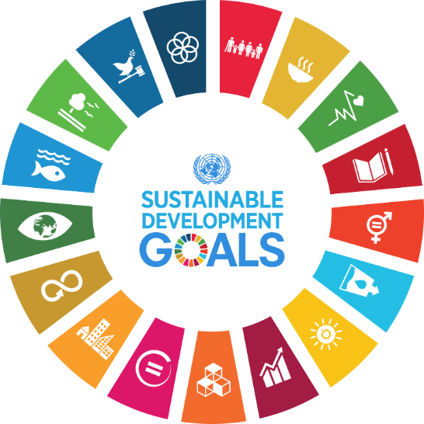

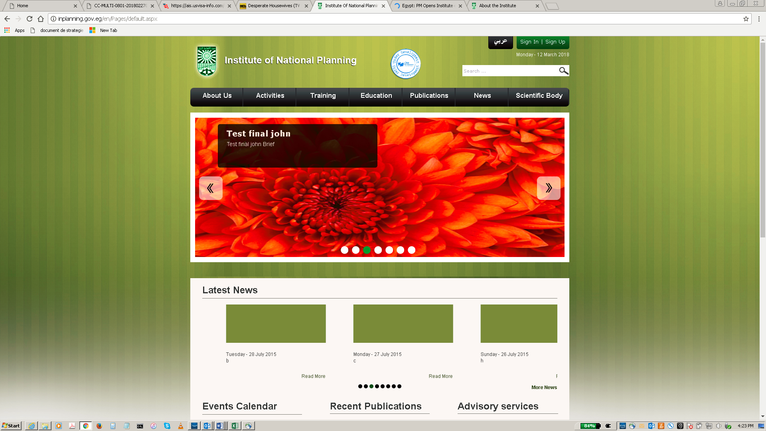
Arab Republic of Egypt Institute of National Planning
HIGH LEVEL POLICY DIALOGUE ON DEVELOPMENT PLANNING IN AFRICA
Financing the Sustainable Development Goals in Africa: Strategies for Planning and Resource Mobilization
10-12 July 2018
Cairo, Egypt

Slide 2
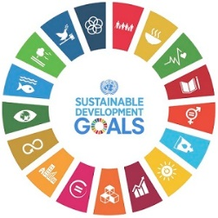
Overview
1- Introduction
2- The economic context and implications for financing the SDGs
3- Linking development planning and financing
4- Funding requirements and gaps
5- Funding sources
6- Challenges to SDGs Financing
7-Challenges to SDGs Financing: Illicit Financial Flows
8- Concluding Remarks
Status and achievement of Goal 17
www.uneca.org/arfsd2018

Slide 3
Introduction
HLPD ON DEVELOPMENT PLANNING IN AFRICA
Key recommendation of the 2017 HLPD in Abuja: Need to strengthen African countries’ capacities to develop effective resource mobilization strategies in support of integration of SDGs in National Development Plans
The AAAA of the Third International Conference on FFD of July 2015 provides a global framework for financing sustainable development
It is imperative for African countries to take stock of the financing requirements and the range of funding sources and instruments for not only the SDGs, but Agenda 2063 as well.
The mobilization of resources, their effective allocation and utilization are essential.
To this end, there is a need to design a resource mobilization framework for financing SDGs in Africa.
Status and achievement of Goal 17
www.uneca.org/arfsd2018

Slide 4
HLPD ON DEVELOPMENT PLANNING IN AFRICA
Overview of Recent Macroeconomic Developments in Africa
Status and achievement of Goal 17
www.uneca.org/arfsd2018

Slide 5
Overview of recent macroeconomic developments in Africa
Average annual GDP growth in Africa, by sub region (%)
Source: African Development Bank Group (2018) African Economic Outlook (2018)
* estimated
** projected
Status and achievement of Goal 17
www.uneca.org/arfsd2018
Notes:
The region’s aggregate GDP reveals considerable variation among its countries and sub-regions. The less resource-dependent countries in East Africa such as Djibouti and Ethiopia, as well as in West Africa, including Côte d’Ivoire, Ghana and Senegal, will continue to witness above average growth, supported by infrastructure investments, robust services sectors and a recovery in agricultural production.

Slide 6
Overview of recent macroeconomic developments in Africa
Current account balance, (%) of GDP
Source: UNCTADstat (2018)
Status and achievement of Goal 17
www.uneca.org/arfsd2018
Notes:
Maintaining macroeconomic stability is required to foster inclusive and sustainable development as espoused in Agenda 2030 and Agenda 2063.
In many African countries, current account deficits have narrowed, especially among oil and mineral exporters.
In oil-importing economies the current account deficit remains high as import growth keeps strong due to high public investment levels and rising fuel imports.
Nonetheless, global financial market conditions have been favourable and helped to finance the current account imbalances.
While foreign direct investment flows are rebounding moderately, portfolio inflows have continued at a solid pace, helped by several large sovereign-bond issuances in Angola, Côte d’Ivoire, Kenya, Nigeria and Senegal

Slide 7
Overview of recent macroeconomic developments in Africa
Fiscal deficit position in Africa, 2015 – 2018
Source: ECA calculations based on 2017 data from the Economist Intelligence Unit database,
see www.eiu.com.
Note: “e” refers to estimates; “f” refers to forecasts.
Status and achievement of Goal 17
www.uneca.org/arfsd2018
Notes:
Although Africa’s fiscal deficit is still high, a continued prudent macroeconomic management has helped the fiscal deficit narrowing and decline by 4.3 percentage points from 9.6 per cent in 2016 to 5.3 per cent in 2017, and are projected to decline further to 5.0 per cent in 2018.

Slide 8
Overview of recent macroeconomic developments in Africa
Inflation by sub-region, (%) 2015-2018
Source: Data extracted from African Development Bank Group (2018) African Economic Outlook 2018
* estimated
** projected
Status and achievement of Goal 17
www.uneca.org/arfsd2018
Notes:
High inflation still persists in Africa on average, recording 13 per cent in 2017 from 10 per cent in 2016, mainly due to the effect of rising oil prices and currency devaluations which have pushed up import costs and exacerbated inflationary pressures. However, inflation continues to be relatively low in the Central African Economic and Monetary Community, and the West African Economic and Monetary Union (WAEMU) countries

Slide 9
HLPD ON DEVELOPMENT PLANNING IN AFRICA
Development Planning and SDGs Financing
Status and achievement of Goal 17
www.uneca.org/arfsd2018

Slide 10
Development Planning and SDGs Financing
Planning is a critical exercise that helps to shape a country’s development goals and priorities.
For the SDGs, long-term planning is imperative to better understand financing requirements for sustainable development
Financing the SDGs implies need to ensure coherence and alignment between the different planning instruments internally, and with continental and global frameworks such as Agenda 2063 and Agenda 2030
However, countries must move beyond simply integrating the SDGs in national planning processes to aligning even the budgetary process to the various planning instruments.
Among the UN-recommended tools to achieve this planning and budgeting linkage are Programme-Based Budgeting and Results-Based Budgeting (RBB)
Status and achievement of Goal 17
www.uneca.org/arfsd2018

Slide 11
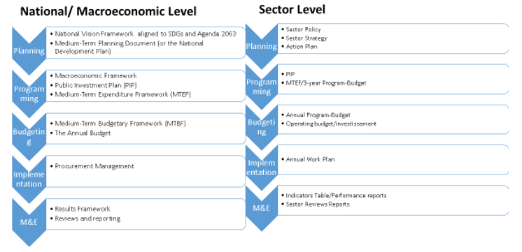
Development Planning and SDGs Financing
Planning-Programming-Budgeting-Implementation-Monitoring-Evaluation Chain
Status and achievement of Goal 17
www.uneca.org/arfsd2018
Notes:
Monitoring and evaluation (M&E) results should feed back into planning and policymaking, by refining and amending policy design, policy formulation, programming and budgeting respectively.

Slide 12
HLPD ON DEVELOPMENT PLANNING IN AFRICA
Funding Requirements and Gaps
Status and achievement of Goal 17
www.uneca.org/arfsd2018

Slide 13
Funding requirements and gaps
From “Billions” to “Trillions”
Quantifying financing needs is essential to identifying various sources of finance, mobilizing resources and establishing an accountability framework.
UNCTAD for example estimates that the incremental costs for achieving the SDGs in Africa’s low-income countries amounts to $269 billion–$279 billion per year
Overall, estimates of the additional financing needs for Africa to achieve the SDGs range from $200 billion to over $1.2 trillion annually
Status and achievement of Goal 17
www.uneca.org/arfsd2018

Slide 14
Funding requirements and gaps
HLPD ON DEVELOPMENT PLANNING IN AFRICA
Theme and Sector Specific Estimates
Growth, poverty, inequality and hunger
To end hunger and poverty by 2030, it is estimated that additional resources of an average of US$265 billion required annually.
Further, Africa needs to grow by 16.6% per annum between 2015 and 2030 to achieve a poverty headcount ratio of less than 3% in 2030 - a financing gap of 65.5 per cent of GDP/year
But, if Africa were to reduce poverty and inequality by 50% simultaneously, required growth would stand at 8.8% per annum - a financing gap of 24.4 per cent of GDP per annum
It will cost on average an extra USD1 billion per year from 2016 to 2030 to end hunger in seven African countries, namely; Ghana, Malawi, Nigeria, Senegal, Tanzania, Uganda, and Zambia.
Status and achievement of Goal 17
www.uneca.org/arfsd2018

Slide 15
HLPD ON DEVELOPMENT PLANNING IN AFRICA
Funding requirements and gaps
Health and Education
Cost of ensuring access to quality education for every child in low and lower-middle income countries projected to increase from US$149 billion to US$340 billion over the next 15 years.
Globally, estimates of $37 billion to achieve universal health care
In Africa for every US$100 that goes into state coffers in Africa, on average US$16 is allocated to health, but only US$10 is in effect spent, and less than US$4 goes to the right health services.
Nationally appropriate spending targets for investments in essential public services for all can also draw on existing benchmarks - such as the benchmark to allocate at least 4–6 per cent of GDP to education and/or at least 15–20 per cent of public expenditure to education
Status and achievement of Goal 17
www.uneca.org/arfsd2018

Slide 16
Funding requirements and gaps
Infrastructure
Overall infrastructure deficit in developing countries will cost $1-1.5 trillion - with Africa accounting for $93 billion of this gap
Estimated investment needs in the area of economic and social infrastructure sectors, amount to $135 billion per year in Africa – placing financing gap at about $60 billion per year.
A challenge for African in this area is that in 2016, the private sector contributed only 4 % of new infrastructure investments in Africa
With regard to climate change, the cost of adaptation is projected to increase fourfold to about 4% of Africa’s GDP
Status and achievement of Goal 17
www.uneca.org/arfsd2018

Slide 17
HLPD ON DEVELOPMENT PLANNING IN AFRICA
Financing Sources
Status and achievement of Goal 17
www.uneca.org/arfsd2018

Slide 18

Financing sources
Source: SustainAbility.com
    Domestic sources
    International public sources
    Domestic and international private sources
International and regional trade as sources of finance
Importance of Public Finance Management and Controls
Status and achievement of Goal 17
www.uneca.org/arfsd2018
Notes:
Domestic sources
Domestic resources have been recognized as constituting the core of SDG financing. The level of resources generated domestically is also more significant than those generated from international or foreign sources such as ODA, FDI or remittances. Thus, increasing Domestic Resource Mobilization (DRM) and managing public debt effectively can create the fiscal space for African governments to invest in the SDGs, including industrial development, social protection, health care, education, other key services and infrastructure
In general, the tax-to-GDP ratios in Africa is low - about 18 per cent, compared with countries in other regions, such as Asia, or Latin America and the Caribbean, where it is closer to 25 per cent. Hence, there is scope for increasing domestic resources by enhancing the tax base and strengthening tax administration and tax compliance. This could be done by plugging loopholes to prevent the leakage of tax revenues, including through regional tax cooperation and innovative new taxes. Non-tax revenues in the region average are even lower and have been declining.
international public sources
Considering the level of resources required to fund all the SDGs, concessional international public finance will still be vital. International public finance can support investments in services and infrastructure to reach local and isolated communities and can be a catalyst for investments that can expedite progress in achieving the SDGs. Official Development Assistance (ODA) remains a core source of international finance.
Preliminary estimates show that net bilateral ODA flows from the DAC countries to the group of least developed countries increased in 2017 by 4 per cent in real terms to about US$ 26 billion, thus reversing the declining trend noted in previous years. ODA represents about 70 per cent of least developed countries’ total external finance. 2017 OECD estimates for bilateral ODA to Africa was about US$ 29 billion, with aid to sub-Saharan Africa around US$ 25 billion, reflecting an increase of about 3 per cent in both
However, ODA accounts for only a very small proportion of the range of resources available to developing countries for investing in sustainable development. Furthermore, the decline of Foreign Direct Investments (FDI) flows to Africa, its unequal and unevenly distributed streams to the continent, have seen the emergence and expansions in recent years of activities from new development partners and innovative sources. FDI flows to Africa slumped to US$42 billion in 2017, a 21 per cent decline from 2016. However, things are looking up, as FDI inflows to Africa are estimated to grow by about 20 per cent in 2018 to US$50 billion. In 2017, FDI flows to North Africa were down 4% to $13 billion. With inflows declining by 28%, to $28.5 billion for Sub Saharan Africa
The World Bank and IMF points out that in addition to some US$ 135 billion in ODA, flows for development include philanthropy, remittances, South-South flows, other official assistance, and foreign direct investment—together these sources amount to nearly US$ 1 trillion that needs to be used just as effectively. DFI and Oxfam estimates flows from those sources as follows:
All DAC donors recommitting to reach 0.7 per cent of gross national income (GNI) in official development assistance (ODA), by 2025, which could mobilise an additional US$250 billion a year, bringing ODA to around US$400 billion;
South–South cooperation providers accelerating increases in concessional flows. These rose by 300 per cent during 2000–15, and a similar increase for the SDGs would raise them to US$80 billion.
Innovative financing of US$450–550 billion a year, including taxes on carbon, bunker fuels and air travel (US$250–300 billion), financial transactions and currency (US$100–150 billion) and issuance of IMF Special Drawing Rights (SDRs) (at least US$100 billion). Innovative sources of financing are discussed in-depth in Section 6 of the present paper.
Domestic and international private sources
While the most substantial development spending happens at the national level in the form of public resources, the largest potential is from private sector business, finance and investment. With regard to domestic private sector, new actors are increasingly involved in development finance. They include institutional investors - Pension funds, insurance companies and collective investment schemes. They have the potential to grow resources for long-term investment requirements of the SDGs. In addition, domestic capital markets (including equity, bond and insurance markets) have a growing role in mobilizing private capital to finance domestic development (i.e. issuance of public debt in domestic currencies for infrastructures development).
Multinational companies bring unique strengths: a worldwide reach, cutting-edge technologies, and massive capacity to reach large-scale solutions, which are all essential to success. The private sector can leverage non-concessional flows from IMF and multilateral development banks (MDBs) whose banking model mobilizes substantial resources from the capital markets at interest rates reflecting their strong financial structure and high ratings.
With regard to non-concessional public finance and blended and private finance, there is a need to set effectiveness indicators in order to maximise their contribution to the SDGs. Moreover, maintaining debt sustainability is crucial to the achievement of the SDGs.
International and regional trade as sources of finance
Agenda 2030 identifies international trade as an engine for inclusive economic growth and poverty reduction, and an important means to achieve the SDGs. Achieving the SDGs could open up $12 trillion of market opportunities in food and agriculture, cities, energy and materials, and health and well-being alone and create 380 million new jobs by 2030 worldwide. Regional integration has a prominent role to play in boosting intra-African trade so that member States can benefit from economies of scale and develop significant regional value chains.
This is because trade flows have assumed increasing importance for resource mobilization in many developing countries. African States trade more value-added products among themselves, than with the rest of the world, which are dominated by commodities. It is in this context that the African Continental Free Trade Area (AfCFTA) could encourage stronger FDI flows to Africa for national and regional infrastructure projects.
To improve competitiveness and production capacity, increase the creation of decent jobs, improve productivity, increase incomes and reduce economic vulnerability and risks.
The AAAA acknowledges that international trade is a catalyst for inclusive economic growth and poverty reduction. However, ongoing dynamics show that the international trade bodies and regimes, such as the World Trade Organization (WTO), or regional and bilateral trade agreements, do not often favour Africa. Nonetheless, international trade remains potentially, a considerable funding source for the SDGs in Africa; particularly since new actors are consolidating their relevance in the international trade landscape and are representing potential diversification of trade flows

Slide 19
HLPD ON DEVELOPMENT PLANNING IN AFRICA
Challenges to SDGs Financing
Status and achievement of Goal 17
www.uneca.org/arfsd2018

Slide 20
Challenges to SDG Financing include:
  Own-source revenue generation
  Access to ODAs & FDIs, and new/innovative long-term financing; and international capital markets
  Global economic downturns, natural disasters, geopolitical tensions/conflicts
  Institutional and administrative capacities
  Insufficient/inefficient intra-continental & international trade
Status and achievement of Goal 17
www.uneca.org/arfsd2018

Slide 21
Challenges to SDGs Financing: Illicit Financial Flows
  It is estimated that $100 billion a year (4% of Africa’s GDP) have been illegally earned, transferred, or used, much of it due to mis-invoicing
  Effects include: Retarding Africa’s Growth; Weakening Public Institutions and Rule of Law; Discouraging the culture of paying taxes and value-addition to natural resources; Maintaining overreliance on ODA
  Addressing IFFs will requires: Hard data on scope of IFF; Removing legal loopholes that facilitates IFFs; Designing cohesive international agreement to address IFFs; Developing local & national capacity to address IFFs, among others.
Status and achievement of Goal 17
www.uneca.org/arfsd2018

Slide 22
Concluding Remarks
African countries are committed to mobilizing adequate and predictable resources for financing the SDGs.
While national development planning processes embody resource mobilization, many countries are yet to effectively link the two.
Overall, the scale and diversity of SGDs financing available is growing across the region. This offers significant potential to drive regional progress toward realizing the SDGs.
Domestic resource mobilization improved substantially in recent decades in Africa, but tax-to-GDP ratios are still below the 25 percent threshold deemed sufficient
The challenges are many and varied, but not insurmountable. In this regard, countries must build technical, legal and administrative capacity for effective public financial management.
Finally, accurate and robust data are necessary for robust SDGs financing frameworks and monitor resource flows, including IFFs.
www.uneca.org/arfsd2018

Slide 23
Arab Republic of Egypt Institute of National Planning
THANK YOU
more info: sylvainb@un.org
www.uneca.org

