Slide 1

Welcome to the Gender Statistics Toolkit
Regional Training Workshop to Improve Use of Existing Data for Monitoring Gender Equality and Women’s Empowerment in Africa.
26-28 September 2017, Kampala, Uganda
1
Notes:
1

Slide 2
Outlines
Background
Objective of the online toolkit on gender statistics
Target audience
Structure
Next Steps
Demonstration of the Gender Statistics Online Toolkit
2
Notes:
2

Slide 3
Background
The African Group on Gender Statistics (AGGES) developed an Africa Programme on Gender Statistics (APGS), based on the requirement of pushing Gender Statistics Agenda.
The APGS has a capacity building component under which we have the Online Toolkit
The Online Toolkit was developed By ECA (ACS and ACG) in partnership with United Nations System Staff College which has the Expertise in developing online training modules
3
Notes:
3

Slide 4
Objectives of the online toolkit
on gender statistics
Support the establishment of a strong foundation of knowledgeable practitioners (users and producers of statistics) for the development of gender statistics at country level.
Improve knowledge in producing and using reliable gender statistics by promoting continued capacity building and learning by producers and users of gender statistics.
Systematize and scale up the delivery of training in gender statistics across the continent
Increase learning opportunities in the area of gender statistics, especially self-learning, not requiring organizing expensive workshops
4
Notes:
4

Slide 5
Target audience
Producers of official statistics at all levels:
  NSOs
  Line ministries, departments and agencies
  Provincial/district offices responsible for compiling statistics for dissemination and their use for programming and designing policy interventions
Users of statistics:
  Planners
  Monitoring and evaluation officials
  Civil society organizations
  Gender activists
  RECs
Trainers of statistical institutes and training centers
5
Notes:
5

Slide 6
Structure
The Toolkit is structured around four modules
  Module 1: Introduction to Gender Statistics
  Module 2: Planning for Gender Statistics
  Module 3A: Producing Gender Statistics - Engendering existing data sources (Part 1)
  Module 3B: Producing Gender Statistics - The Equitania National Time-Use Survey (Part 2)
  Module 4: Communicating and Using Gender Statistics as a Tool for Change
6
Notes:
6

Slide 7
  Describe the importance of gender statistics and its global and African context
  Provide examples of how gender statistics can inform national policy and legislation
  Define key gender terms and the minimum set of gender indicators: Difference Sex and gender, gender equality, the link between be between gender equality and pother development issues, gemder parity, gender gap, Data sources and indicators :census. Survey, administrative data, How to endenger datra sources
  The use of gender tender statistics: The importance of gender statistics in the development of gender equality
  And locate additional resources that may be helpful to you, both in the Resource Centre on the course page and online.
Module 1: Introduction to Gender Statistics
7
Notes:
7

Slide 8
Module 2: Planning for Gender Statistics
  Module 2: Planning for Gender Statistics
  Identify gender issues
  Describe the steps to initiate an engendered statistical data gathering initiative
  Explain the importance of a producer-user dialogue
  Conduct a gender-sensitive needs analysis
  Identify gaps in existing sources, and
  Communicate the need for new data collection
8
Notes:
8

Slide 9
Module 3A: Producing Gender Statistics
  Identify ways to integrate gender perspective into the data production process
  Identify key gender issues and gender-biased language in surveys and censuses
  Provide feedback to your own office on how to bring a gender perspective to their statistical activities
  An example on Aquitania is given here
  Overview of the gender statistics production process
  Gender consideration in different type of statistical instruments
  Popu and Housing Census,Agroic census and survey,labor forve survey
9
Notes:
9

Slide 10
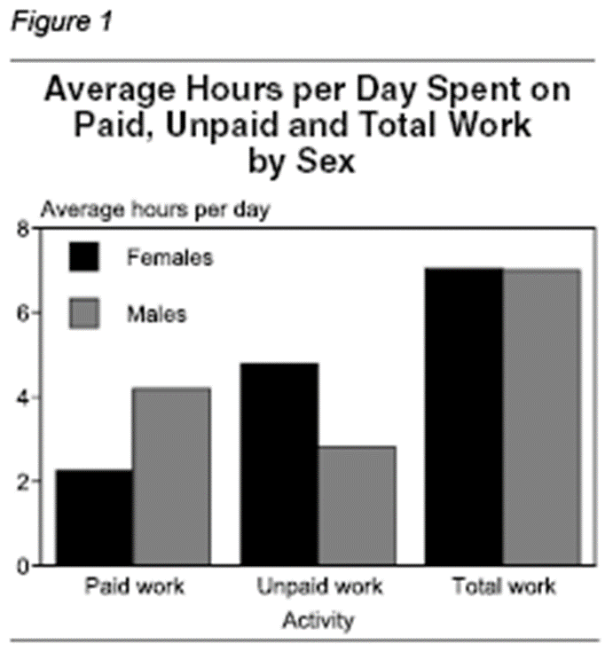
Module 3B: Producing Gender Statistics - The Equitania National Time-Use Survey (Part 2)
Unpaid work:NewZealand
Unpaid work
Men and women spend about the same amount of time working: 49 hours a week
However, females spent two hours a day more than males on unpaid work, while males spent two hours a day more than females on paid work.
While approximately 60 percent of males’ work is paid, almost 70 percent of females’ work is unpaid.
10
Notes:
10

Slide 11
Module 3B: Producing Gender Statistics - The Equitania National Time-Use Survey (Part 2)
TUS Questionnaires: Diary versus stylized questionnaire
Two main types of survey instrument to collect TUS data
Stylized questionnaire
24 hour diary

Slide 12
Module 4: Communicating and Using Gender Statistics as a Tool for Change
  Describe a few ways to disseminate gender statistics and explain how they address needs of different audiences
  Explain how to prepare reader-friendly tables highlighting meaningful differences and similarities between women and men
  Determine which charts are best suited to illustrate different types of data
  Make policy recommendations based on analysis of data
12
Notes:
12

Slide 13
Structure
Each Module includes a final quiz.
Resource Centre for further reading at the bottom of this course page
Evaluation
A Certificate of Completion will be available for download to participants who successfully complete the modules and provide feedback through the evaluation questionnaire.
13
Notes:
13

Slide 14
Next Steps
To finalize the Certificate
To provide Facility for Registration
To Finalize the French Version
To work out a Roll out Plan – in partnership with African regional Institutions such as: AfDB, AUC, RECs and training Institutions etc…
14
Notes:
14

Slide 15
Demonstration of the Gender Statistics Online Toolkit!

