Slide 1



Meeting of the Committee of Experts
All day event 9.00 - 18.45
Réunion du Comité d’experts
Journée entière 9.00 - 18.45

Slide 2

AFRICAN INSTITUTE FOR ECONOMIC DEVELOPMENT AND PLANNING INSTITUT AFRICAIN DE DEVELOPPEMENT ECONOMIQUE ET DE PLANIFICATION Progress Report Karima BOUNEMRA BEN SOLTANE Director, IDEP

Slide 3


IDEP’s Role
ECOSOC Resolution E/RES/2013/2 - July 2013
based on the recommendation of the ECA E/2013/15/Add.2
‘Refocusing and recalibrating the ECA to support Africa’s structural transformation’
IDEP = ECA training arm, in addition to its mandate
IDEP self-designed programme
Other sub-programmes
training/workshops/
seminars organized
in collaboration with IDEP
The primary purpose of IDEP shall be the specialist training of the officials of those services & institutions in Africa responsible for economic policy design & management, and development planning, monitoring and evaluation

Slide 4
IDEP’s Role
ECOSOC Resolution E/RES/2013/2 - July 2013
based on the recommendation of the ECA E/2013/15/Add.2
‘Refocusing and recalibrating the ECA to support Africa’s structural transformation’
IDEP = ECA training arm, in addition to its mandate
IDEP self-designed programme
Other sub-programmes
training/workshops/
seminars organized
in collaboration with IDEP
The primary purpose of IDEP shall be the specialist training of the officials of those services & institutions in Africa responsible for economic policy design & management, and development planning, monitoring and evaluation

Slide 5

2015
Exciting year worldwide and in Africa : a number of big ‘rendez-vous’ >> issues relevant to Africa’s development
Decisive move for Africa: SDGs + Agenda 2063
Sustainable development >> next 15 years
Financing Africa’s development
Green economy
Intra African trade
5
Migration for development

Slide 6
Other issues to be addressed
Employment
Social development, with focus on women, youth, vulnerable groups
Management of natural resources
Agriculture
Knowledge economy
. . .
IDEP programme fully consistent with Africa’s priorities /
transformative agenda
Revitalisation of the role of planning (CoM2015)
54th Meeting of the Governing Council
5 February 2016
Addis-Ababa, Ethiopia

Slide 7
IDEP in 2015
  Core / Thematic short courses
24 courses, 589 trainees, 33% women, 51 countries
New topics: transport, CFTA, negotiation, …
1 course in Arabic - 13 courses in Dakar
  Tailor made courses
  Collaborative courses
Master’s programme
University of Johannesburg: industrial policy
INP Cairo, in progress
  High level Dialogues
Strategic issues at high level: migration, fight against corruption, research-policy nexus in support of Africa's development, domestic resource mobilisation
  Monthly seminars
  Library
Revamping, as part of IDEP KM programme
e-learning programme
Gender dimension

Slide 8
IDEP in 2015
Infrastructure
ICT
Building maintenance / security
Key to measure
IDEP impact
Monitoring & Evaluation
Financial resources
Funds mobilization
Predictability
Human Capital
Main asset
To be further strengthened
UMOJA
New UN ERP
Alignment with UN processes

Slide 9
IDEP Resource Mobilisation
The implementation of IDEP activities requires a stronger resource mobilisation effort for:
The implementation of the e-learning programme and the revamping of the library
Adequate response to specific requests more and more frequently formulated at the highest level by our countries
The reorganisation of the human resources and the recruitment of staff for the newly identified functions
Member States: more regular payment of contributions and settlement of arrears (USD16,802,328)
Strategic partnerships with donors (e.g. BADEA)
Continuous support from ECA

Slide 10
 | Countries | Annual Assessed Contribution | Arrears Paid in 2015 | Prepayments | Total Amount Paid in 2015 (USD)
1 | Angola | 32,000 | 32,000 | 64,000 | 128,000
2 | Burkina Faso | 14,664 |  |  | 14,664
3 | Cameroun | 24,000 | 10,432 |  | 34,432
4 | Congo |  |  | 12,427 | 12,427
5 | Egypt | 80,000 |  |  | 80,000
6 | Guinea Bissau | 10,000 | 20,000 |  | 30,000
7 | Kenya | 17,806 |  | 23,700 | 41,506
8 | Madagascar | 16,129 |  |  | 16,129
9 | Malawi | 15,000 | 75,701 |  | 90,701
10 | Mali | 15,000 | 286,205 |  | 301,205
11 | Senegal | 24,000 |  |  | 24,000
12 | Sierra Leone | 20,000 | 170,000 |  | 190,000
13 | South Africa | 80,000 |  |  | 80,000
14 | Tanzania | 24,000 | 429,959 |  | 453,959
15 | Tunisia | 16,294 |  |  | 16,294
 | Total | 388,894 | 1,024,296 | 100,127 | 1,513,317
Member States Contributions
Breakdown of contributions
received in 2015
7-year trend in total received assessed contributions

Slide 11
Other Sources
Necessary effort to mobilise more XB
ECA regular support since 2013, in line with IDEP new mandate

Slide 12
2 0 1 6 . . .
New challenges
>> Planning will be central
>> 2016-2020 Strategic Plan
Calendar of IDEP courses
>> short courses launched
>> Joint activities: discussions with partners
MPhil Programme
KM & E-learning
Mobilization of resources
1st MDS organised on Planning for Agenda 2030, to set the scene

Slide 13
I thank you for your kind attention
AFRICAN INSTITUTE FOR ECONOMIC DEVELOPMENT AND PLANNING INSTITUT AFRICAIN DE DEVELOPPEMENT ECONOMIQUE ET DE PLANIFICATION www.uneca.org/idep

Slide 14
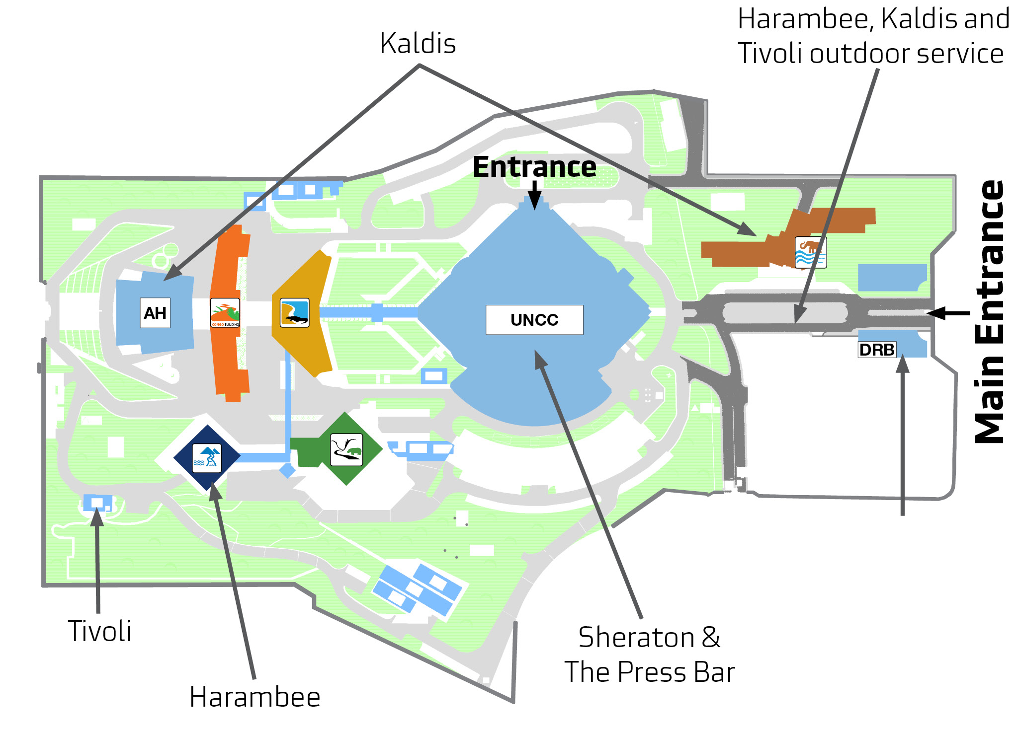
Lunch in 5 minutes/ Déjeuner dans 5 minutes
Where to eat?
Sheraton
The Press Bar
Harambee
Tivoli
Kaldis
AHCONGO
UNCC

Slide 15
Report of the ninth session of the Committee on Regional Cooperation and Integration

Slide 16
Introduction
  The Committee on Regional Cooperation and Integration is a subsidiary organ of the Conference of Ministers.
  The Committee Session takes place once in a biennium (every two years).
  The theme of the last session was « Enhancing productive integration for Africa’s transformation »
  49 member States; 6 RECs; AUC; and other partners were present.

Slide 17
Issues discussed
  Progress in the implementation of regional integration programmes
    Innovation and regional integration;
    Measuring and monitoring progress of integration;
    International and intra-African trade performance;
    Progress in the implementation of the framework and guidelines of land governance in Africa;
    Status of food security in Africa;
    Development and promotion of regional strategic food and agricultural commodity value chains;
    Implications of investment policies and bilateral investment treaties for regional integration; and
    Infrastructure development in Africa.
  Review of industrial policies and strategies in Africa

Slide 18
Highlight of recommendations
  Focus on human capital development to optimise innovation;
  Special attention towards Central Africa to strengthen mechanisms for monitoring regional integration efforts;
  To optimise outcomes for African countries, trade policy reforms need to be well sequenced;
  In order to get the most out of the large scale land based investments, African countries should consider use of the AU guiding principles;
  Efforts to be made towards target of women owning 30% of documented land by 2025;

Slide 19
Highlight of recommendations
  Balance between improving agricultural productivity and the environment;
  Establishment of food reserves as a way of dealing with poverty;
  Assessment of agricultural value chains should seek optimising job creation for youth and women;
  Member States should aim to preserve policy space in bilateral investment treaties;
  Focus on maritime transport; and
  Strengthening of capacity on projects management.

Slide 20
Presentation on the meetings of the Intergovernmental Committee of Experts (ICE) by
Antonio M. A. Pedro
Director,
Sub-regional Office for Eastern Africa

Slide 21
Summary of 2016 ICE Meetings
Sub-regional office | Venue and Date | Theme | Attendance
Eastern Africa | Nairobi, 8-11 February, 2016 | Institutions, decentralisation and structural transformation in Eastern Africa | 306 delegates from 14 MS, RECS, academia, civil society, private sector, think tanks and UN agencies
Central Africa | Doula, 24-26 February, 2016 | Harnessing the agricultural potential of central Africa for food security and the structural transformation of the sub-region | 88 delegates form MS, RECS, academia, civil society, private sector, think tanks and UN Agencies
West Africa | Dakar, 25-26 February, 2016 | The EAC Country Profiles. Tools to serve the structural transformation of West African Countries | 103 delegates from 15 MS, RECs, academia, civil society, private sector, think tanks and UN agencies

Slide 22
Summary of 2016 ICE Meetings
Sub-regional office | Venue and Date | Theme | Attendance
North Africa | Rabat, 1-4 March, 2016 | Green Economy to accelerate industrialisation in North Africa | 150 delegates from 7 MS, RECs, academia, civil society, private sector, think tanks and UN Agencies
Southern Africa | Lilongwe, 17-18 March, 2016 | Implementing the SADC Industrialisation Strategy and Roadmap: Options and Prospects | 64 delegates from 7 MS, RECs, IGOs, civil society, think tanks and UN agencies

Slide 23
Key emerging issues/messages
Eastern Africa sub-region
Decentralisation and institutions
Social cohesion and inequality
Central Africa sub-region
Harnessing the potential for an agricultural revolution for Central Africa’s transformation
Climate change and land grabbing conundrum

Slide 24
Key emerging issues/messages
West Africa sub-region
ECA country profiles
Transition from MDGs to SDGs
Innovative financing for structural transformation
Resource mobilisation for development financing
North Africa sub-region
Green economy
Industrialisation through trade in North Africa

Slide 25
Key emerging issues/messages
Southern Africa sub-region
Economic environment in Southern Africa
Industrialisation
Poverty reduction and social development

Slide 26
Key Recommendations of the ICE
The five ICE meetings issued recommendations that are summarised in three categories:
Recommendations relevant to Agenda 2063 and the SDGs.
Recommendations related to the ECA country profiles.
Recommendations on the review of the ICE and other subsidiary organs of the Commission.

Slide 27
Recommendations on Agenda 2063 and SDGs
Implementation of the SDGs to be domesticated and prioritised within the African and national contexts.
Undertake a careful selection of indicators that would be used to measure the progress of implementation of Agenda 2063 and the SDGS and provide adequate support to strengthen the capacity of national statistics systems.
African Member States to play an active role in global discussions on choice of SDG indicators.
There is need to raise awareness, improve advocacy and domesticate Agenda 2063 key tenets in national and sub-national policies and strategies.

Slide 28
Recommendations on Agenda 2063 and SDGs
Increased renewed efforts in the fight against poverty and inequalities, promoting women empowerment, improving infant and maternal health and access to sanitary infrastructure.
While acknowledging that Agenda 2063 and SDGs were aligned and complimentary there is concern over lack of clear division of roles and responsibilities of stakeholders involved in their implementation and the ICE called for action by Regional Economic Communities and the AUC.

Slide 29
Recommendations on the ECA Country Profiles
Member States welcomed the progress made by the Eastern Africa Sub-region in producing country profiles and urged the sub regional office to produce country profiles for the entire region and a sub-regional report with a focus on macroeconomic indicators.
Member States to strengthen technical collaboration with ECA and domesticate country profiles as decision making support tools for economic and social policies towards structural transformation.
ECA to coordinate and support efforts for data collection, processing and dissemination so as to reduce the burden of the work of national structures within the Central Africa subregion.

Slide 30
Recommendations on the ECA Country Profiles
ECA country profiles to serve as tools to support structural transformation in West African countries.
ECA to continue to integrate indicators on cross cutting issues such as governance, sustainable development, gender and climate change into the country profiles.
Integrate indicators on cross-cutting issues such as governance, sustainable development, gender and climate change in the North Africa sub-region.

Slide 31
Recommendations on review of the ICEs
The Conference of Ministers to mandate ECA to review the ICE and other subsidiary organs of the Commission.
The reforms to take into consideration the possibility of changing the dates of ICEs.
The selection of the topic for each ICE to be done at corporate level.

Slide 32
    Thank you for your kind attention.

