Slide 1


j
2016 UNECA Partners Survey
2016ECA Partners Opinion Survey
2016 Conference of Ministers , March 31st to April 5th, Addis Ababa, Ethiopia

Slide 2


Context
ECA strategic business priority set forth in 2013 is to transform itself into a Think Tank of reference on matters pertaining to Africa’s development through:
Policy influence for Africa’s transformation agenda
Production of high-quality, evidence-based and “good fit” policy research and knowledge delivery services
Enhancing its accountability mechanisms and deepening learning culture across all streams of its work
Timely delivery of its knowledge production and capacity- building services
2016 UNECA Partners Survey

Slide 3
Methodology
Survey conducted by an external independent contractor - Breard & Associates
Questionnaire based on ECA Key Performance Indicators
24 key survey questions and 50+ sub-questions
Survey in four languages (English, French, Arabic, Portuguese)
Convenience sampling⁽¹⁾ of ECA partners from governments, academia, NGO, UN, media and private sector
To ensure anonymity of partners, a third party administers the survey
Confidential and Independent
2016 UNECA Partners Survey
Notes:
The main objective of the Survey is to assess ECA’s partners opinion on the influence ECA is making in the area of knowledge generation and delivery and the perception on issues related to ECA’s policies and work.
The 2016 survey is the second annual survey
Results are utilized to understand the perceptions of partners and improve the work of the organization
The findings will be used for organizational learning and will be factored into reporting and performance assessments
(1) Convenience sampling: a specific type of non-probability sampling method that relies on data collection from population members who are conveniently available to participate in study. Convenience sampling is a type of sampling where the first available primary data source will be used for the research without additional requirements. In other words, this sampling method involves getting participants wherever they can be found and typically wherever is convenient. In business studies this method can be applied in order to gain initial primary data regarding specific issues such as perception of image of a particular brand or collecting opinions of perspective customers in relation to a new design of a product. However, the use of this sampling technique does not allow for a generalization of the research findings.
http://research-methodology.net/sampling/convenience-sampling/

Slide 4
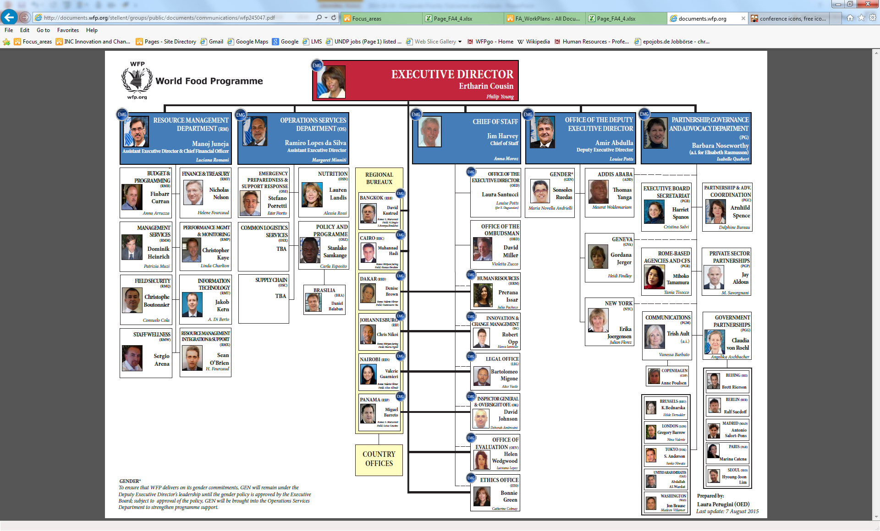
Dissemination and Validity
Overall results offer a robust number of partners
Survey opened for 3.5 weeks, from 10 February to 4 March 2016
Survey sent by email to 2,099 partners (men 73% - women 27%)
Inputs collected from 661 responding partners
Overall analysis of results based on solid number of respondents
Analysis based on conversion of Likert scales into indices from 1 (Strongly disagree/not needed/no contribution) to 5 (Strongly agree/very highly/high contribution)
2016 UNECA Partners Survey
Notes:
Comparing to last year’s survey: 900 targeted respondents and 25% response rate => efforts have been made to substantive increase the number of respondenst

Slide 5
“ECA has been playing a key role in Africa as a Think Tank and its new face will endorse and bring brand equity.
Its role and presence in Africa is sine qua none for the continents integrated development.”
2016 Partner Survey Respondent
2016 UNECA Partners Survey
Notes:
This an example of a quantitative assessment by one of the survey respondent which we though provides a good picture of the overall feedback received

Slide 6
Key Results: 2016 ECA Partners Survey
661 Partners Responded
ECA is a Think Tank of Reference
1 Close to 80% of partners state that ECA generates quality knowledge products and reliable and relevant policy ideas
2 77% believe that ECA knowledge products are of consistent high quality
3 63% believe that ECA statistics are of consistent high quality
4 70% believe that ECA’s knowledge delivery is highly sensitive to context, relevant and tailored and well attuned to policy processes
5 Over 75% of partners perceive ECA as a reliable and constructive partner
6 Close to 80% indicate that ECA makes a moderate to high contribution in improving national polices
2016 UNECA Partners Survey
Notes:
This slide provides a sample of responses to questions related to ECA’s business model. Details will be presented in the next slides

Slide 7
Response rate by region
East Africa 261
West Africa 142
North Africa 46
East Africa
Rest/unknown 81
Southern Africa 79
Central Africa 52
OVERALL
RESPONSE RATE
661
Partners responded
31.5%
of invited partners
completed the survey
5

Slide 8
Types of Organizations of Respondents
The largest cohort of respondents are based in ECA member states ministries and administrations followed by other national institutions
Types of Organizations
In which organization do you work?
2016 UNECA Partners Survey
Notes:
This year a particular effort was made to reach out to Think Thanks and members of Community of Practices

Slide 9
j
Perception of the ‘new’ ECA
2016ECA Partners Opinion Survey

Slide 10
ECA Knowledge Products
77%
74%
Products are consistent/high quality Products are cutting edge
Strongly Agree | Agree | Neutral | Disagree | Strongly disagree | DNK | Valid N
140 | 368 | 81 | 13 | 4 | 49 | 655
136 | 347 | 102 | 15 | 4 | 50 | 654
120 | 317 | 145 | 11 | 4 | 59 | 656
126 | 282 | 162 | 34 | 2 | 45 | 651
108 | 292 | 176 | 24 | 3 | 50 | 653
203 | 308 | 89 | 14 | 6 | 36 | 656
153 | 288 | 147 | 22 | 5 | 37 | 652
135 | 315 | 138 | 15 | 7 | 42 | 652
Agreement with the following statements on ECA Knowledge Products?
2016 UNECA Partners Survey
Notes:
Positive assesment (77%) with regard to the quality of our research papers that are considered effective in promoting discussion on Africa’s transformative agenda while for 74% of respondents ECA’s research apply a cutting edge understanding of African development issues
Note a relatively lower assessment ( slightly over 60%) with regard to the high quality of our statistics

Slide 11
ECA Knowledge Delivery
70%
Highly sensitive to context, relevant and tailored and well attuned to policy processes
Strongly agree | Agree | Neutral | Disagree | Strongly disagree | DNK | Valid N
85 | 250 | 209 | 39 | 11 | 58 | 652
94 | 281 | 197 | 38 | 6 | 37 | 653
108 | 286 | 175 | 39 | 6 | 37 | 651
119 | 335 | 131 | 25 | 4 | 36 | 650
114 | 340 | 137 | 21 | 5 | 37 | 654
Agreement with the following statements on ECA Knowledge Delivery?
2016 UNECA Partners Survey
Notes:
Respondents have also alerted us to ensure that our interventions have a balanced demand and supply driven approach
Other relative lower returns concern the influence that ECA is making through its knowledge delivery (59%) while 61 % think that our knowledge delivery is timely and dynamic

Slide 12
ECA Policy Work
Close to 80% find that ECA generates reliable and relevant policy ideas
Strongly agree | Agree | Neutral | Disagree | Strongly disagree | DNK | Valid N
111 | 275 | 162 | 50 | 11 | 43 | 652
144 | 268 | 150 | 39 | 10 | 43 | 654
109 | 290 | 177 | 32 | 2 | 37 | 647
98 | 326 | 159 | 30 | 4 | 36 | 653
177 | 343 | 89 | 14 | 0 | 32 | 655
Level of agreement with the following statements on ECA Policy Work?
2016 UNECA Partners Survey
Notes:
59% of the survey respondents assessed ECA’s knowledge networking and facilitation services as effective while 62% think that our policy engagement is consistently of high quality

Slide 13
ECA Interventions
63% ECA knowledge facilitation improves organizations’ skills and capacities
Strongly agree | Agree | Neutral | Disagree | Strongly disagree | DNK | Valid N
93 | 200 | 174 | 65 | 28 | 53 | 613
126 | 263 | 126 | 45 | 16 | 42 | 618
94 | 241 | 167 | 42 | 15 | 59 | 618
80 | 220 | 184 | 48 | 12 | 72 | 616
To what extent do you agree that your organization’s skills/capacities are improving due to ECA’s interventions?
?
2016 UNECA Partners Survey
Notes:
With regard to ECA’s interventions aiming at improving organization’s skills/capacities the highest response rate (63%) suggests that knowledge facilitation contributes more compared to policy advisory services (49%) and trainings (48%)

Slide 14
ECA Partnerships
Over 75% believe ECA is a constructive (78%) and reliable partner (76%)
Strongly agree | Agree | Neutral | Disagree | Strongly disagree | DNK | Valid N
122 | 246 | 155 | 40 | 19 | 30 | 612
114 | 268 | 141 | 24 | 8 | 58 | 613
96 | 265 | 163 | 26 | 8 | 57 | 615
117 | 261 | 157 | 37 | 7 | 36 | 615
86 | 263 | 179 | 35 | 15 | 39 | 617
118 | 274 | 150 | 29 | 13 | 30 | 614
173 | 310 | 84 | 15 | 7 | 26 | 615
176 | 291 | 94 | 24 | 8 | 23 | 616
96 | 306 | 134 | 30 | 15 | 37 | 618
76 | 244 | 186 | 51 | 11 | 45 | 613
Level of agreement with the following statements on ECA Partnerships?
2016 UNECA Partners Survey
Notes:
Communication, system wide coherence, effective synergies with other Pan African institutions, flexibility to adjust to evolving circumstances and coordination as well as coordination and coherence in providing support to Members States (52%) are areas that returned a relatively lower assessment

Slide 15
ECA Results Orientation
More than 60% respondents perceive ECA as a transparent and accountable partner and 2/3 find ECA business plan addresses the transformation of the continent
Strongly agree | Agree | Neutral | Disagree | Strongly disagree | DNK | Valid N
43 | 147 | 191 | 32 | 8 | 148 | 569
95 | 253 | 148 | 18 | 8 | 54 | 576
64 | 190 | 161 | 1 | 3 | 148 | 567
95 | 281 | 110 | 9 | 2 | 78 | 575
Level of agreement with the following statements on ECA Results Orientation?
2016 UNECA Partners Survey
Notes:
ECA will have to continue improving in XB resource planning, utilization rate and result oriented report as only 34% assessed the Commission favourably in this particular area

Slide 16
Mainstreaming Gender Equality
Mainstreaming gender equality is more clearly visible in ECA’s statistics, social development work, and capacity development
Very high | High | Moderate | Poor | Very poor | DNK | Valid N
83 | 185 | 159 | 27 | 10 | 108 | 572
81 | 198 | 141 | 18 | 6 | 128 | 572
89 | 180 | 154 | 27 | 8 | 113 | 571
56 | 143 | 163 | 37 | 14 | 154 | 567
45 | 154 | 171 | 32 | 8 | 157 | 567
57 | 143 | 172 | 49 | 7 | 144 | 572
59 | 163 | 168 | 32 | 4 | 147 | 573
61 | 162 | 168 | 19 | 3 | 160 | 573
How effective is ECA in mainstreaming Gender Equality and Empowerment of Women in the following area of its work?
2016 UNECA Partners Survey

Slide 17
ECA Contribution to Outcomes
Close to 80% indicate that ECA makes a moderate to high contribution in improving national policies, strategies, or legislative frameworks
High contribution | Significant contribution | Moderate contribution | Some contribution | No contribution | DNK | Valid N
71 | 162 | 138 | 66 | 34 | 80 | 551
84 | 191 | 146 | 65 | 18 | 46 | 550
84 | 201 | 151 | 49 | 14 | 54 | 553
89 | 207 | 136 | 42 | 16 | 63 | 553
How do you assess the contribution of ECA to the following outcomes?
2016 UNECA Partners Survey

Slide 18
Supporting Organizations’ Work and Results
Survey respondents perceive that the collection of data in member states should be a priority objective for the ECA
Respondents
80
183
109
157
24%
Which ones of the following ECA’s objectives would you expect to be achieved first in order to support your own activities and results?
2016 UNECA Partners Survey

Slide 19
j
Conclusions
2016ECA Partners Opinion Survey

Slide 20
Key Findings: Positive Assessment
ECA’s Business Plan addresses the transformative agenda of the continent
  In 2016, ECA continues to inform and shape policy choices and decisions of Member States and institutions for Africa’s transformation.
  ECA is effectively developing partnerships around substantive initiatives in research and knowledge delivery
  ECA knowledge delivery is highly sensitive to context, relevant/tailored
  ECA research papers apply a cutting edge understanding of African development policy issues
  ECA is a partner of choice
  ECA policy engagement is consistently of high quality
2016 UNECA Partners Survey

Slide 21
Key Findings: Areas for Improvement
  Communication and increased visibility
  Effective partnership with CSOs & Private Sector
  Improvement of skills and capacities in partners organization, particularly in the area of trainings.
  National partnerships
  Planning and reporting on extra budgetary funds
2016 UNECA Partners Survey

Slide 22
  Thank You
2016 UNECA Partners Survey

