Slide 1
Assessing Regional Integration in Africa
Next Steps for the African Continental Free Trade Area
David Luke
Coordinator, African Trade Policy Centre
20 - 26 March 2019
Marrakech, Morocco
2019 Conference of Ministers
Notes:
Indicate that slides show, necessarily, a very brief highlight of material: for considerably more detail, audience can see upcoming ARIA IX report

Slide 2
1| Status of regional integration
2
Status of regional integration in Africa
Monetary integration actively pursed in 5/8 RECs: but insufficient progress in convergence indicators
Trade: with the exception of SADC, intra-African trade remains low
Services integration important: over 53% of Africa’s GDP from services
Gradual progress in free movement: but need to ratify AU Protocol
Continuing integration challenges incl: limited energy and infrastructure development, overlapping membership of RECs; limited financial resources
Recommendations:
  Address “crisis of implementation” by translating promises made at continental and regional levels into actions
  Importance of energy and infrastructure integration, and M&E (ARII)
Assessing Regional Integration in Africa | Next Steps for the AfCFTA
UNECA.ORG

Slide 3
1| Status of regional integration
3
Intra-African trade as a share of GDP
Assessing Regional Integration in Africa | Next Steps for the AfCFTA
UNECA.ORG

Slide 4
2| State of play on the AfCFTA
4
Status update on the AfCFTA
Remarkable progress: 52/55 AU MS signed with 19 having ratified. Text concluded on all 4 Protocols and 10 of the 12 annexes: Schedules of Concessions and RoO – July 2019 deadline, specific commitments in services by end-2019 deadline
ECA AfCFTA forecast to have positive welfare benefits for all African countries without exception: boosting total GDP and exports of Africa
Recommendations:
  Remaining AU MS should promptly ratify without delay
  Rapidly conclude remaining technical work
  Follow entry into force with effective implementation
Assessing Regional Integration in Africa | Next Steps for the AfCFTA
UNECA.ORG

Slide 5
3| Maximizing the AfCFTA gains
5
Taking full advantage of the AfCFTA
Countries must buttress its implementation with complementary measures, within dedicated national AfCFTA Strategies, to support:
Investment: with, inter alia targeting AfCFTA market; “matchmaking” between international and domestic firms; and “one-stop-shops” for investment
Productive capacity: a) use industrial policy to create supportive enabling environment; b) use sector-specific strategies with regional focuses
Trade facilitation: a) AfCFTA NTB mechanism; b) standards infrastructure; c) single windows / one-stop border posts; e) AfCFTA Simplified Trade Regime
Infrastructure: implement PIDA and use strategic logistics management
Import defence: pool resources for regional trade remedy and competition institutions; ensure monitoring and evaluation of import trade flows
Assessing Regional Integration in Africa | Next Steps for the AfCFTA
UNECA.ORG

Slide 6
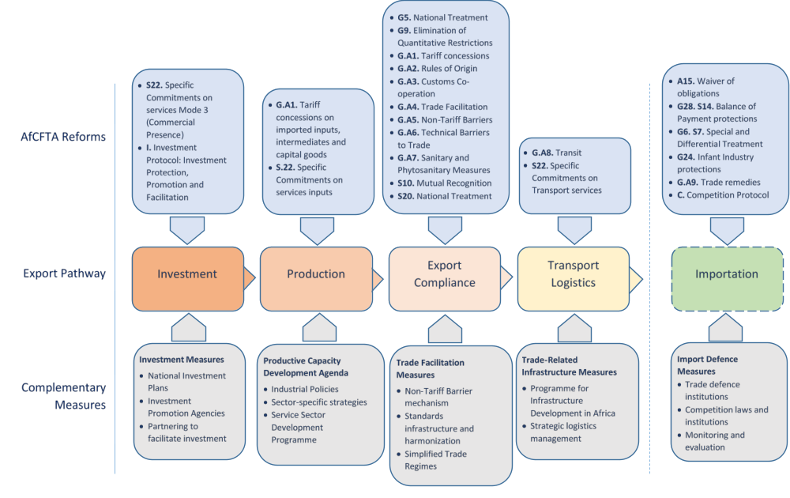
3| Maximizing the AfCFTA gains
6
Assessing Regional Integration in Africa | Next Steps for the AfCFTA
UNECA.ORG

Slide 7
4| Challenges to the AfCFTA
7
Internal and external challenges to the AfCFTA
AfCFTA explicitly aspires towards deeper integration: stated objective to “lay the foundation for the establishment of a Continental Customs Union”
Care must be taken so that AfCFTA does not add an additional strand in the African spaghetti bowel of FTAs: should cohere trade policy landscape
AfCFTA can provide a platform for a common approach to African trade relations with third countries
Recommendations:
  Strengthen the ambition of the AfCFTA over the longer term to consolidate the RECs and realize a continental customs union
  Leverage AfCFTA as platform for negotiations with rest of world: reinforce a coherent African trade policy
Assessing Regional Integration in Africa | Next Steps for the AfCFTA
UNECA.ORG

Slide 8
5| Investment in the AfCFTA
8
AfCFTA Protocol on Investment
Africa’s investment landscape is fragmented: 854 BITs (512 in force), of which 169 are intra-African (44 in force) – many overlapping and “old generation”, often with ISDS, vulnerable to treaty shopping, and policy space
AfCFTA Protocol on Investment:
  Can be informed by the Pan-African Investment Code (PAIC)
  Cohere the African investment landscape
  Provide predictable, forward-looking and transparent rules
  Substantive obligations and dispute settlement provisions need to be revisited and aligned with African developmental needs
  Emphasis on investment promotion and facilitation, and dispute prevention
Assessing Regional Integration in Africa | Next Steps for the AfCFTA
UNECA.ORG

Slide 9
6| IPR in the AfCFTA
9
AfCFTA Protocol on Intellectual Property Rights
Africa’s IPR commitments are fragmented: 44 countries member to WTO TRIPs, others in different IP international agreements and FTAs with IPR
3 models proposed for integration in IPR: a) regional cooperation and sharing of experience, b) regional filing systems, c) unification of IP laws
AfCFTA Protocol on IPR can:
  Provide guiding principles for national IP law and policy
  Develop norms to safeguard specific African interests (TK, PVP, culture)
  Provide regional IP exhaustion system to encourage RVCs
  Develop guidelines and procedures for the enforcement of IP rights
  Provide forum for cooperation between ARIPO and OAPI
Assessing Regional Integration in Africa | Next Steps for the AfCFTA
UNECA.ORG

Slide 10
7| Competition in the AfCFTA
10
AfCFTA Protocol on Competition Policy
Africa’s competition regime is patchy and incomplete: only 23 countries have competition laws enforced by competition authorities
Competition drives growth: cartels, abuse of dominance, anti-competitive practices etc cross over borders and limit development in Africa
AfCFTA framework for competition: can build on efforts undertaken at RECs, including EAC, ECOWAS, COMESA, CEMAC and WAEMU
AfCFTA Protocol on Competition can:
  Provide substantive coverage of main competition issues
  Be enforced through: a) supranational AfCFTA competition body (eg COMESA/EAC/ECOWAS), b) supranational body and cooperation network (eg EU), or c) competition cooperation framework (eg SADC)
Assessing Regional Integration in Africa | Next Steps for the AfCFTA
UNECA.ORG

Slide 11
8| E-Commerce in Africa
11
E-Commerce in a Digitalizing Africa
Assessing Regional Integration in Africa | Next Steps for the AfCFTA
UNECA.ORG

Slide 12
8| E-Commerce in Africa
12
E-Commerce in a Digitalizing Africa
E-commerce is changing African economies: worldwide e-commerce sales in 2016 reached $26tr, yet less than 5% of the population are using the internet in Niger, CAR, Guinea-Bissau, Somalia and Eritrea
E-commerce policy landscape is evolving: cooperation in Africa can prevent digital barriers and inhibit the fracturing of Africa by tech giants
Consistent digital rules in Africa: can create environment where firms (digital or not) can fairly compete and simplify the rules for e-commerce
To foster regulatory cooperation on e-commerce, 3 options identified:
  Holistic African Digital Economy Strategy
  Integrating e-commerce perspectives into existing AU instruments
  E-commerce Protocol as an instrument within the AfCFTA
Assessing Regional Integration in Africa | Next Steps for the AfCFTA
UNECA.ORG

Slide 13

For more info, see:
Upcoming ARIA IX
Follow the conversation: #COM2019
More: www.uneca.org/cfm2019

