Slide 1




Women’s Land Rights in Africa:
Does implementation match policy?
Emmanuel Sulle et al
Research Associate PLAAS
25 – 29 November 2019
Abidjan, Cote d’Ivoire

Slide 2
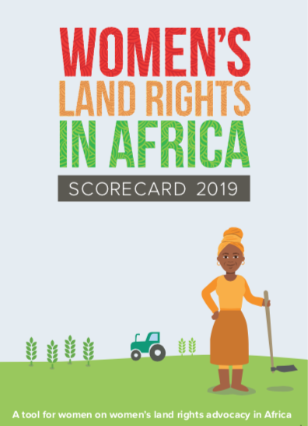

Slide 3
Key messages
Assesses the performance of selected countries in implementing the provisions of women’s land rights instruments, i.e. AU F&G; FAO VGGT
Based field research in seven African countries located in different parts
Statutory laws to protect women land rights are in place in all studied countries, with some differences and, in some cases with existing loopholes
Enforcement of laws is yet to receive sufficient political backing, due to widespread patriarchal values
Holistic implementation & reforms that address existing loopholes in land laws and regulation
  align other sectoral policies, laws and regulations
  use transformative actions to bridge the gender gap in property rights and combat corruption

Slide 4
Background and context
Women’s land rights have strongly featured in core agendas of the Africa Union (AU), United Nations Organisations, governments and non-state actors
To date virtually all African states have signed policy resolutions to ensure more equal and less discriminatory land rights for women
The AU has also embraced this aspiration and laid it down in frameworks and guidelines and other legally binding documents in relation to women's land rights
On this basis this paper examines the extent to which these policy commitments are translated into national legislation as well as practices on the ground
The paper uses scorecard developed as a quantifiable tool to measure the performance of selected countries in implementing the provisions of women’s land rights instruments.
The scorecard can be downloaded at: https://www.plaas.org.za/sue-mbaya-womens-land-rights-in-africa-2019-scorecard/

Slide 5
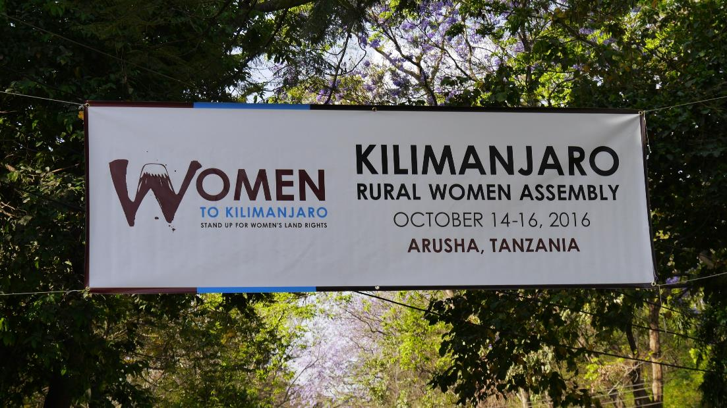

Slide 6

Women’s Land Rights in Africa Project
Women’s Land Rights for Inclusive Development and Growth in Africa is implemented by a consortium comprising Oxfam, Plateforme Régionale des Organizations Paysannes d’Afrique Centrale (PROPAC) and PLAAS
Overarching objective
  to ensure women’s access to and control over their land resources across Africa – supporting and enabling rural women’s voices

Slide 7




AU WLR selected instruments
Framework and Guidelines on Land Policy in Africa (F&G)
Voluntary Guidelines on Governance of Tenure, Fisheries and Forests in the Context of National Food Security (VGGTs)
Guiding Principles on Large Scale Land Based Investments
Protocol to the African Charter on Human and People’s Rights on the Rights of Women in Africa (the Maputo Protocol)

Slide 8

Scorecard
A quantifiable tool to measure and monitor the performance of countries in implementing the provisions of selected AU women’s land rights instruments

Slide 9



Women’s Land Rights in Africa
SCORECARD 2019

Slide 10
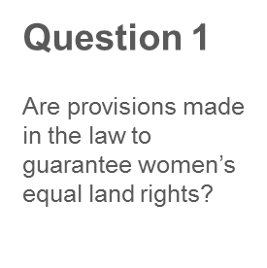
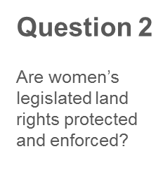
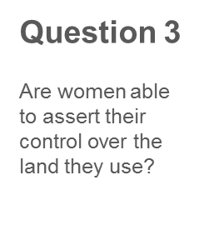
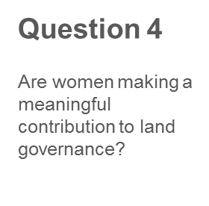
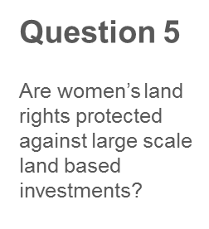





We ask 5 questions
Then we create an icon for each question

Slide 11



The scores of the 5 Questions add up to an overall country score
Is the focus country protecting women’s land rights?
YES
PARTIALLY
NO

Slide 12


Slide 13


Slide 14
Main findings
In all seven countries baseline reports show that statutory laws with provisions that safeguard women’s land rights are in place
But these laws are not well known and understood by the majority of rural women
There is poor level of understanding for policy resolutions endorsed by African states & governments to have equal land rights for women
Lack of awareness on such legislation among rural women can be attributed to high levels of illiteracy & poor dissemination of information on land rights
As a result, women in rural areas are not benefiting from the gender progressive laws that are in place

Slide 15
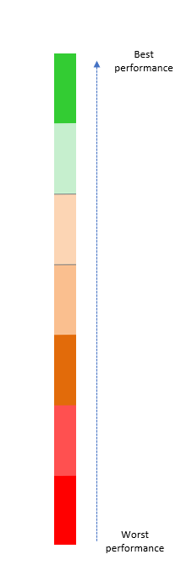
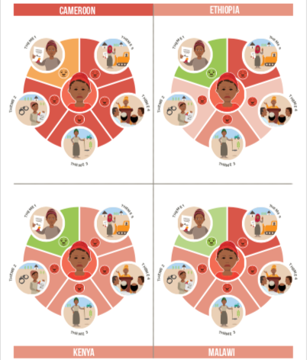

Slide 16
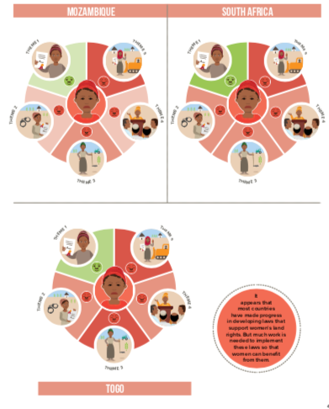

Slide 17
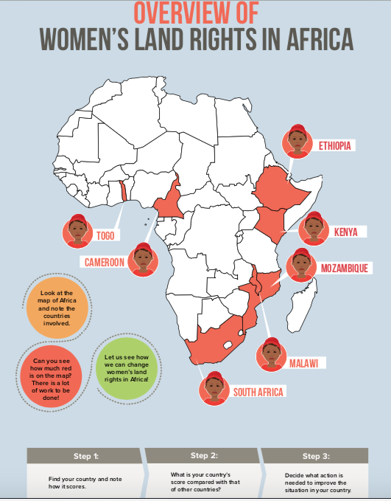

Slide 18
Conclusions
We confirm that while impressive steps to address women’s land rights issues have been made in recent African policies
Implementation is yet to receive sufficient political backing, due to widespread patriarchal values
Women’s land and property rights could greatly be improved if all AU member countries implemented the existing commitments
Formal structures can shift, but they will not bring meaningful change if they do not challenge the underlying logics of gender bias
Unequal access to formal education means that women are less likely to be able to find or access information

Slide 19
Conclusions
Women earn less and have less access to the legal system, so, even in market-based systems, women find it harder than men to buy land
These findings are corroborated by ongoing claims not only among government bureaucrats, but more importantly by policy makers in Africa.
As one of the parliamentarian (MP) from Rwanda rightly stated, the key solution is a ‘change of mindset’
As African states and government continue to commit towards equal societies where men and women equitably access land, use and control it
Building active citizenry is the key ingredient that is lacking and is where the focus in fighting corruption in land is needed
Enabling people to be active citizens increases their participation in governance issues, particularly women’s participation

Slide 20
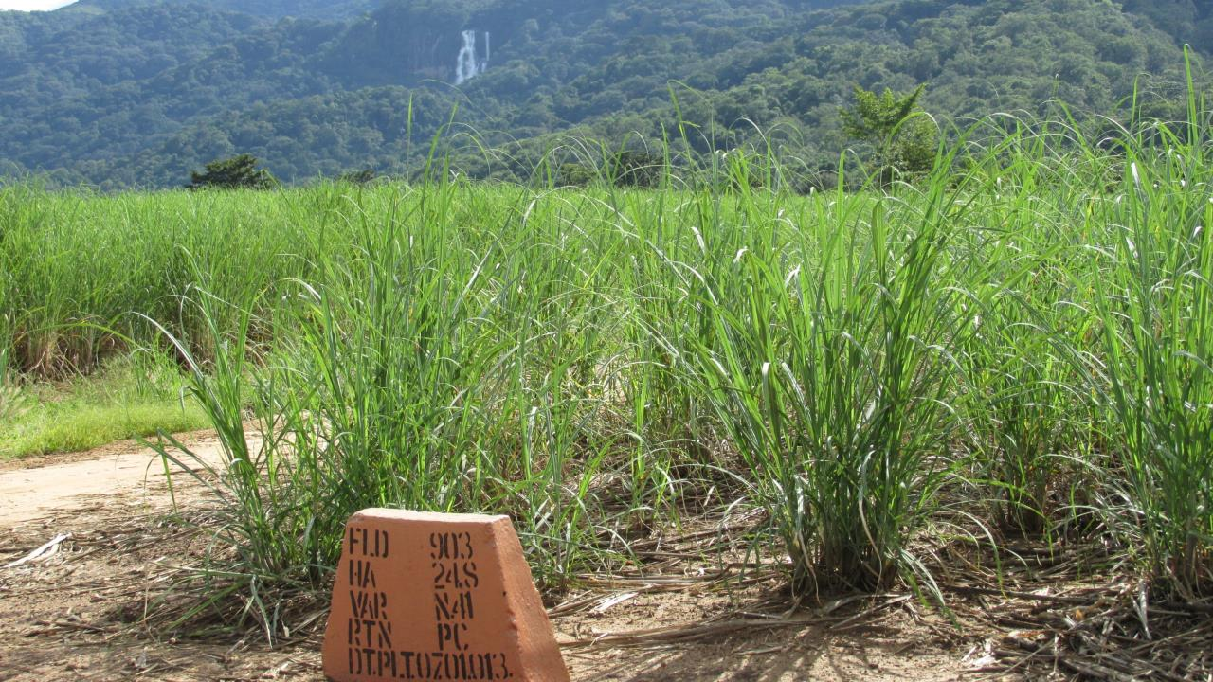



Aksanteni sana
Thank you
Project
Funders
Event’s host
African Land Policy Centre

