Slide 1
The National Land Information System (NLIS) in Uganda: Improvements in Land Governance and Transparency
Richard Oput
Ministry of Lands, Housing and Urban Development (MLHUD), Uganda
oputjr@aim.com
25 – 29 November 2019
Abidjan, Côte d’Ivoire

Slide 2
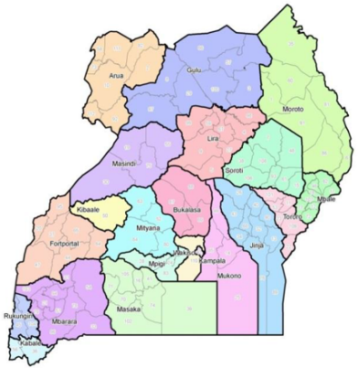
INTRODUCTION
Uganda – Approx. Area 248,000 Sq. km
Population Increase: 6 m (1962); 45.7 m (2019); 50 m (2035)
Rate of urbanization at 5.4% is among the highest in the world
1995 - A new Constitution of Uganda was promulgated.
The Constitution has a number of provisions on Land Administration and Management
10 year Land Sector Strategic Plan (LSSP) was developed and provided a framework for implementation of land sector reforms including the Land Act
One of the strategies under the LSSP was to improve Land Services delivery through Modernization of the Land Registry
One of the activities implemented under the LSSP is the Development of a National Land Information System

Slide 3
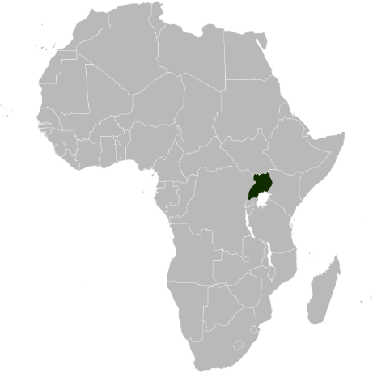
BACKGROUND
A broad range of innovative land administration and management solutions have been implemented to ensure effective and sustainable management of land and strengthen land tenure security. Uganda has embraced technology as an efficient tool in land governance and is computerizing land administration and management operations as a key component of the Competitiveness and Enterprise Development Project (CEDP) to introduce reforms aimed at improvement of the business environment in Uganda.
MLHUD engaged a Consortium led by IGN FI to implement the Design, Supply, Installation and Implementation of the National LIS Infrastructure (DeSINLISI): February 2015 to February 2020 with support of the World Bank.

Slide 4
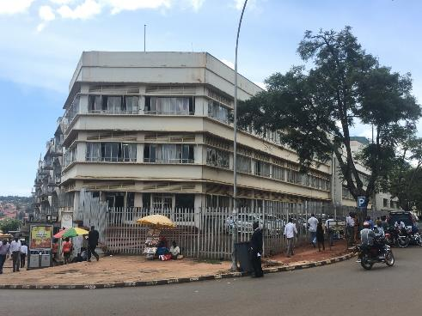
PRINCIPALS OF LAND GOVERNANCE IN UGANDA
The principles of good land governance being pursued in Uganda include:
Equitable access to land;
Security of tenure to all members of the society with specific measures to enhance security of tenure and property rights of women;
Transparent decision making regarding land and natural resources;
Decentralised land administration; and
Effective, efficient and responsive land administration services to all citizens.

Slide 5
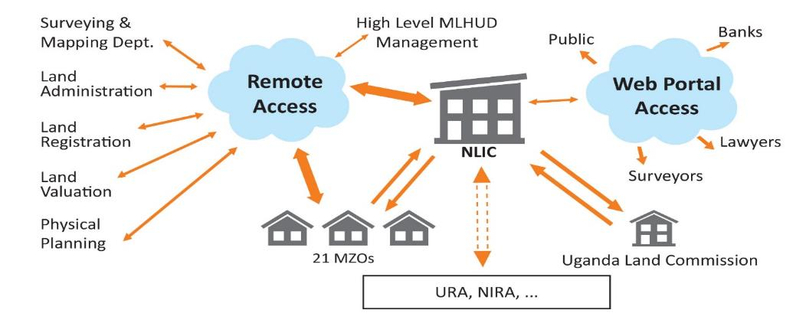
INTEGRATION OF PRIMARY STATUTORY LAND MANAGEMENT ACTORS

Slide 6
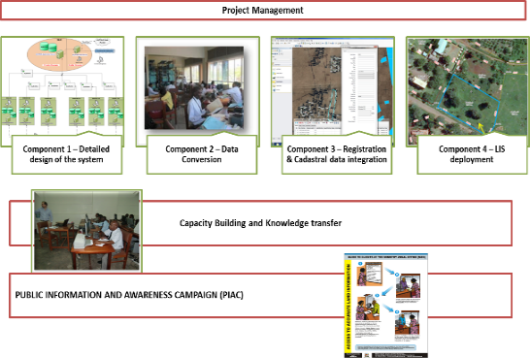
IMPLEMENTATION TO DATE
Project implementation divided into four primary components:
1) Detailed Design of the System
2) Land Records and Data Conversion
3) Registration and Cadastral Data Integration
4) NLIS Deployment
Training and Public Information and Awareness

Slide 7
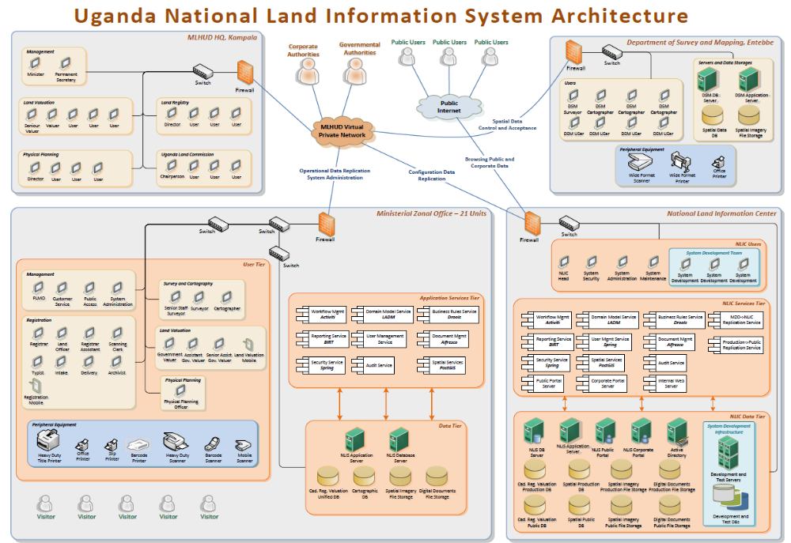
COMPONENT 1: Detailed Design of the System
New system:
Reengineered software framework to optimise performance using Open Source components
Comprises Modules from the Pilot Stage
Developed by Innola Solutions and GEOFIT
Web based application
LADM data model

Slide 8
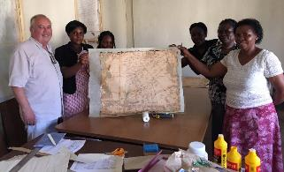
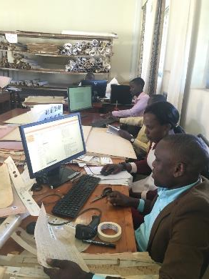
COMPONENT 2: Land Records and Data Conversion
Complete the rehabilitation, conversion and securing of land records, cadastral and other land administration data started at the first stage of the NLIS system development.
Phase 1: 500,000 Land Titles & Land Administration Files / 14,000 Maps 215,000 Parcels
Phase 2: 80,000 Land Titles / 60,000 Maps

Slide 9
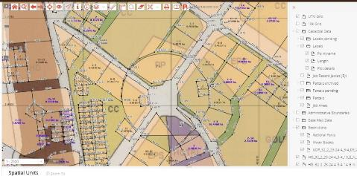
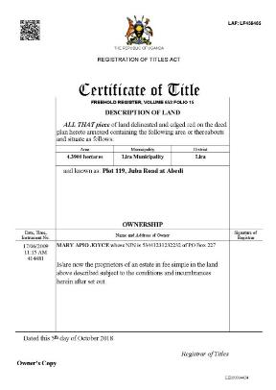
SOURCES OF INFORMATION FOR THE NLIS
Land administration and registration documents comprising mailo, freehold and leasehold titles and related cadastral data;
Historical information comprising maps and survey information
Information from Sub-Counties on customary land tenure rights
Physical Planning information

Slide 10
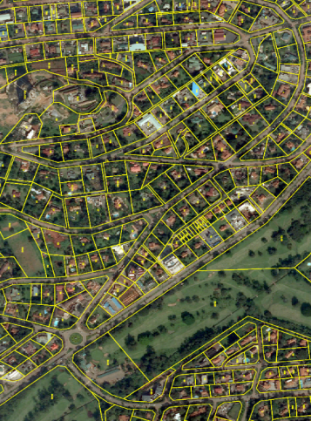
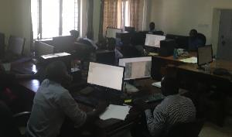
COMPONENT 3: Registration and Cadastral Data Integration
Provide each MZO with an integrated, complete and consistent dataset containing Registration, Land Administration, Cadastre, Physical Planning and Valuation data.

Slide 11
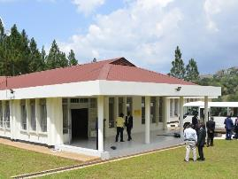
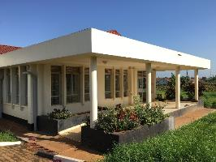
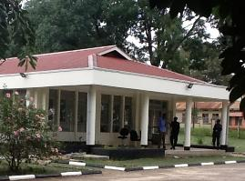
COMPONENT 4: NLIS Deployment
Roll-out the NLIS to all 21 MZOs, MLHUD HQ, Surveys and Mapping Department and the National Land Information Centre and improve security and reliability of the title registration and cadastral services.

Slide 12
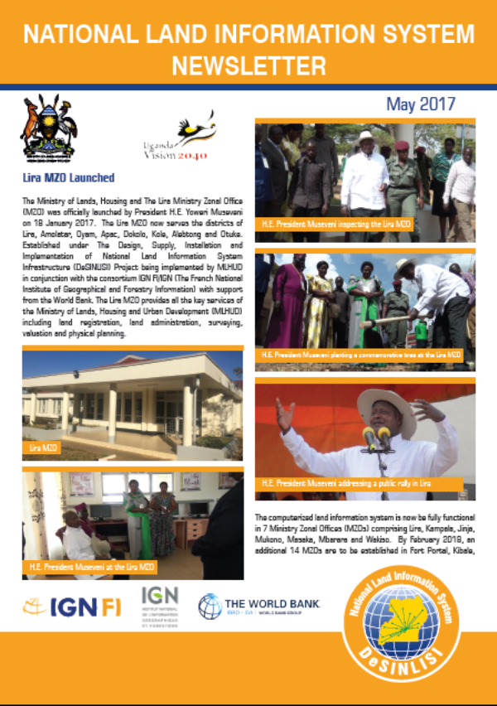
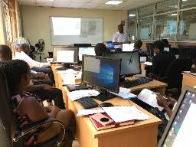
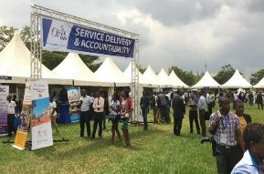
TRAINING AND PUBLIC INFORMATION AND AWARENESS
Training of staff essential to the sustainability of the NLIS
Inform the general
public and
stakeholders about
the NLIS

Slide 13
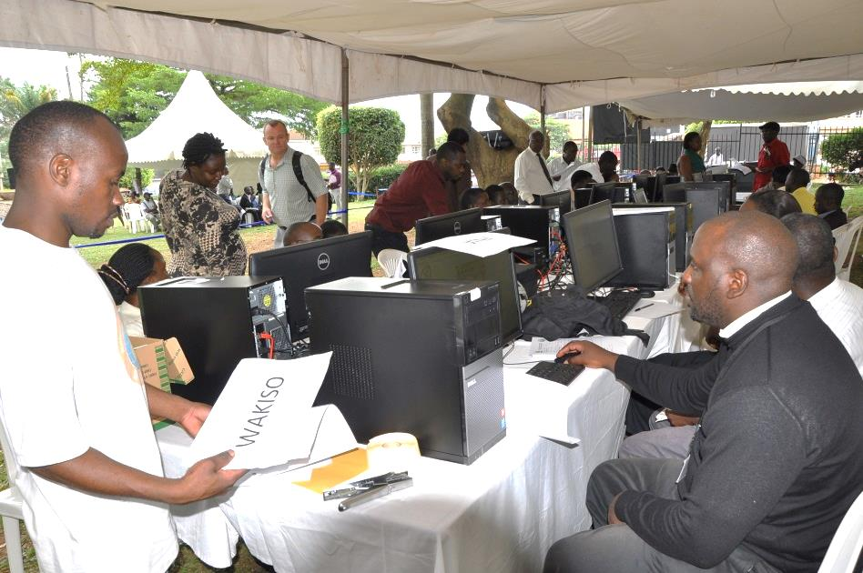
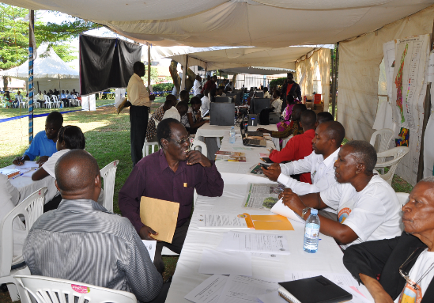
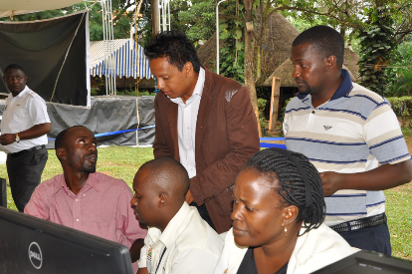
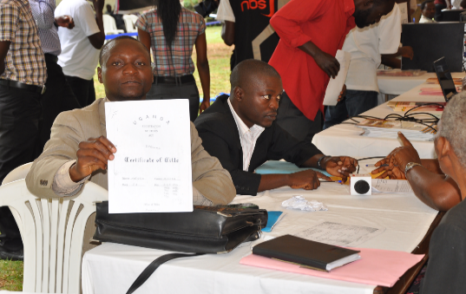
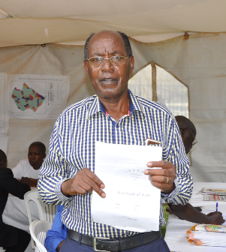
Open Registry Days
1438 people participated in the verification exercise in Kampala and Mukono districts
Aimed at enhancing Transparency of the Land Registry

Slide 14




INTEGRATED WITH OTHER NATIONAL SYSTEMS
• NLIS is designed to be integrated with national digital information systems operated by other Government agencies including the Uganda Wildlife Authority (UWA), National Forestry Authority (NFA), National Environmental Management Authority (NEMA), and Uganda National Roads Authority (UNRA), etc…

Slide 15


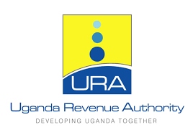
INTEROPERABILITY WITH OTHER NATIONAL SYSTEMS
• The NLIS is designed to be interoperable with other national digital information systems operated by other Government institutions comprising Ministries, Departments and Agencies including Ministry of Water and Environment, National Identification and Registration Authority (NIRA), Uganda Revenue Authority (URA), Uganda Registration Services Bureau (URSB), etc…

Slide 16
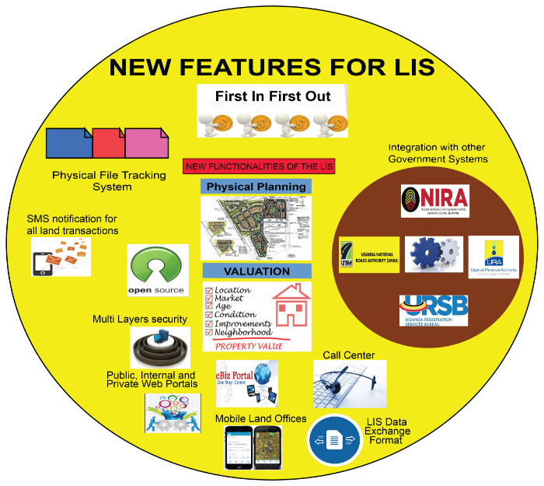
NEW FEATURES FOR THE NLIS

Slide 17
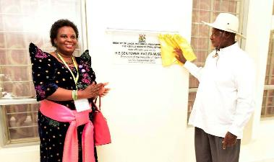
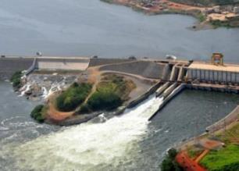
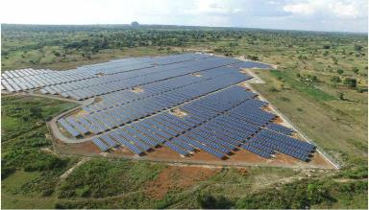
CHALLENGES TO IMPLEMENTATION
Paucity of infrastructure including power supply and internet connectivity: addressed with massive Government focus on infrastructural development
Human resources: Addressed with recruitment campaign
Political will: Addressed following early demonstration of successful
implementation

Slide 18
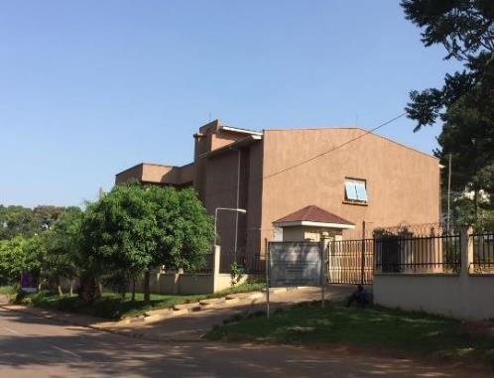
IMPACT TO DATE
Increase in the number of land transactions.
Decentralization of the cadastral and registration services,
Securing of land records and maps,
Establishment of audit trail of land transactions,
Improvement in the quality of records and their management,
Instant retrieval of land related information,
Better service delivery to the stakeholders,
Improvement in public perceptions of land service delivery,
Increased sustainability of land governance.

Slide 19
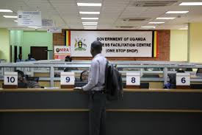
SYNERGIES BETWEEN NLIS, NDSI AND OTHER NATIONAL PROGRAMMES
With support of the World Bank the NLIS has:
Received necessary funding
Demonstrated success in improving service delivery
Over 260 MLHUD staff trained under the NLIS
MLHUD engaged in eBiz (Investor platform) and Digital One Stop Centre
Been a catalyst for greater integration of spatial data in Uganda

Slide 20
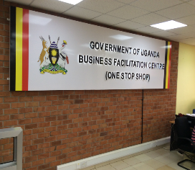
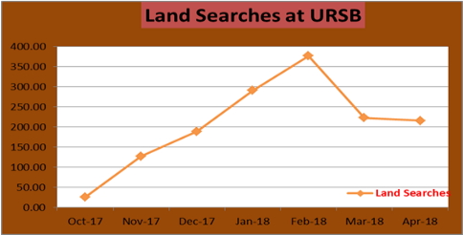
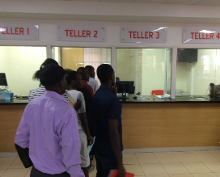


ONE STOP SHOP - URSB
The creation of a Land Registration Land Verification point at the One Stop Shop has reduced the number of days of obtaining a search letter to a few hours. All the Land Title verification for all MZOs can be done within the One Stop Shop at the URSB
Months | Land Verification Searches
Oct-17 | 25
Nov-17 | 127
Dec-17 | 189
Jan-18 | 291
Feb-18 | 377
Mar-18 | 223
Apr-18 | 216
Ministry of Lands, Housing and Urban Development

Slide 21
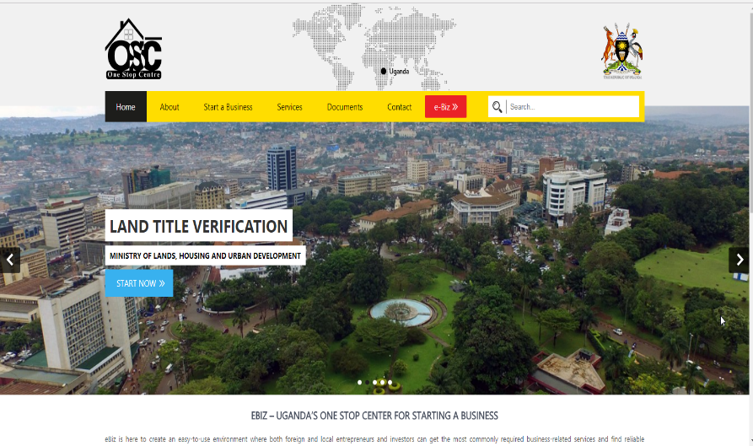
ONE STOP CENTER(e-Biz)

Slide 22
INCREASE IN LAND TRANSACTIONS
Slight reduction in the transfer of mailo and leasehold titles reflects the dampening effect of the 2016 election period on the national economy and the general economic slowdown experienced in Uganda over the period 2016/2017

Slide 23
INCREASED REVENUE GENERATION
Revenue generated from US$100,000 a month in 2012 to approximately US$3 million a month in 2016/2017 with a total cumulative generation since the inception of the NLIS of US$113.5 million by June 2017
Cumulative generation of US$113.5 million in revenue before completion of the project represents a 172 percent return on the US$66 million investment
Financial Year | Total Revenue
FY 2012/13 (4 months) | $2,560,000
FY 2013/14 | $31,381,000
FY2014/15 | $30,141,000
FY2015/16 | $13,535,000
FY2016/17 | $35,910,928
Total Revenue | $113,527,928

Slide 24
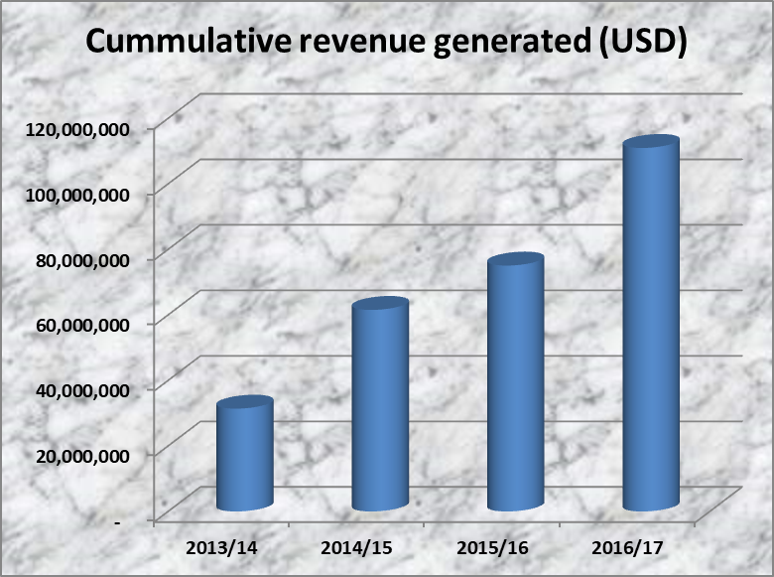
LIS Revenue Generation 2013 - 2017
Steady increment from one Financial Year to another
Average annual revenue of USD 28 Million

Slide 25
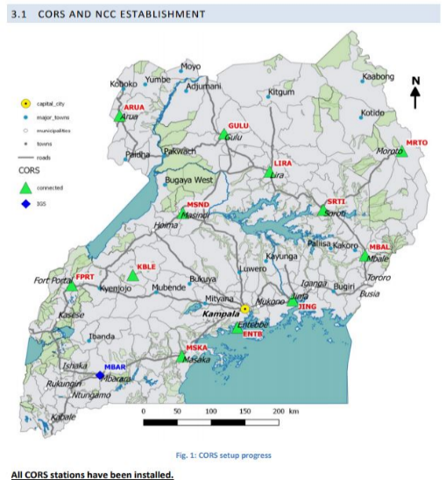
Support Activities: UGRF – CORS and NCC

Slide 26
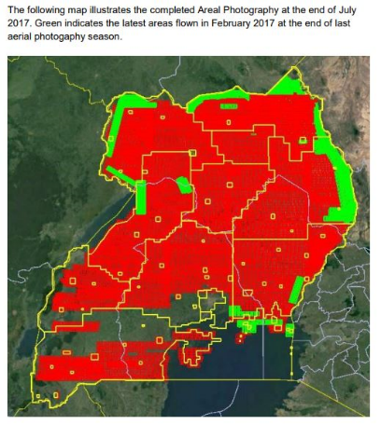
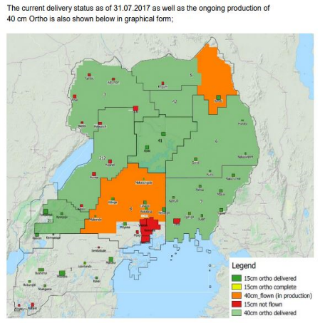
Support Activities: Base Mapping

Slide 27
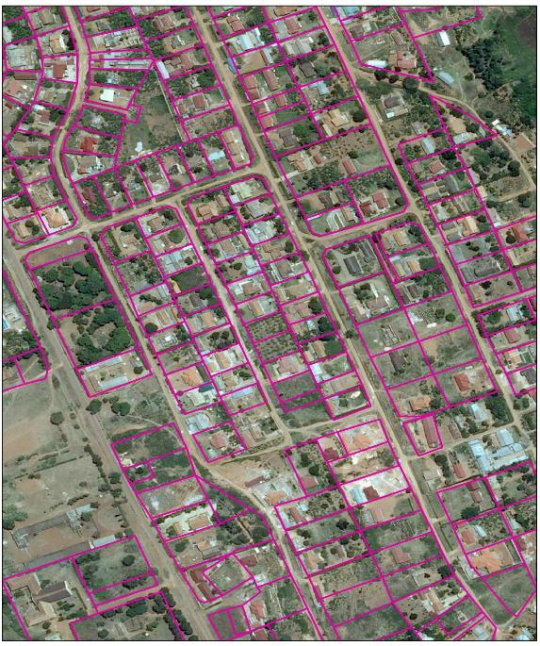
Significance of the BMP Reference layer for the LIS Database

Slide 28
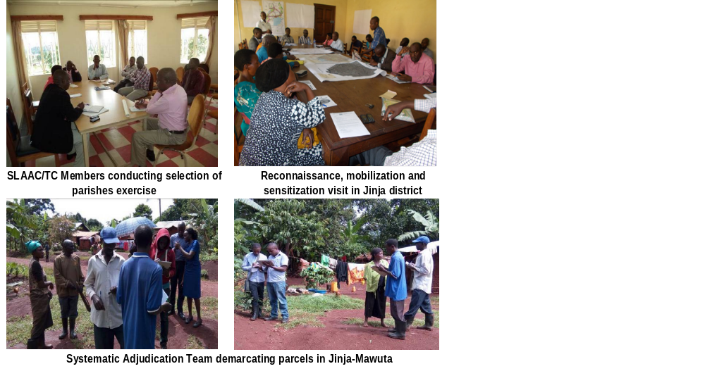
Support Activity: Systematic Certification/Registration

Slide 29
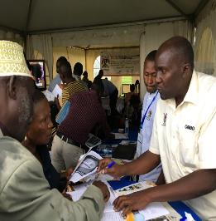
IMPROVED SERVICE DELIVERY
World Bank Cost of Doing Business Report reports the number of days to complete a transaction reduced from 77 days in 2010 to 42 days in 2019.
Prevention, reduction or elimination of:
  Backdoor transactions
  Forgeries and graft, and
  Challenges associated with missing land records.
Transparency International reported the pprobability of paying a bribe for land services plummeted from 46.5 percent in 2014 to 19.2 percent in 2017.
Transparency International also reported value of bribes dropped by 76 percent in 3 years

Slide 30
THANK YOU FOR YOUR ATTENTION
RICHARD OPUT
Ministry of Lands, Housing and Urban Development (MLHUD), Uganda
oputjr@aim.com

