Slide 1





Building Harmonized Private and State Land Holding Data and Information Systems in Ethiopia
Yohannes Redda, Tommi Tenno, Oliver Schoenweger, Mulugeta Tadesse, Zerfu Hailu
Conference on Land Policy in Africa, CLPA-2019
“Winning the fight against Corruption in the Land Sector:
Sustainable Pathway for Africa’s Transformation”
November 25 - 29, 2019
Abidjan, Cote d’Ivoire

Slide 2

Outline
Introduction
National Rural Land Administration Information System (NRLAIS)
  NRLAIS Development and Functional Components
  Conceptual Design Framework
  Core Architecture of NRLAIS
Commercial Agriculture Management Information System (CAMIS)
  Core Functional Components
  Architecture of CAMIS
Integration of NRLAIS and CAMIS
Benefits of Integrating NRLAIS and CAMIS
Conclusion

Slide 3
Introduction
Challenges
Until recently, systematically organized IT based land information system was non-existent
Land Records on land holding and use rights are not properly organized – manually maintained
Institutions involved in land related issues act independently – poor communication and coordination among institutions
Land data and information sharing among institutions have been major challenge

Slide 4
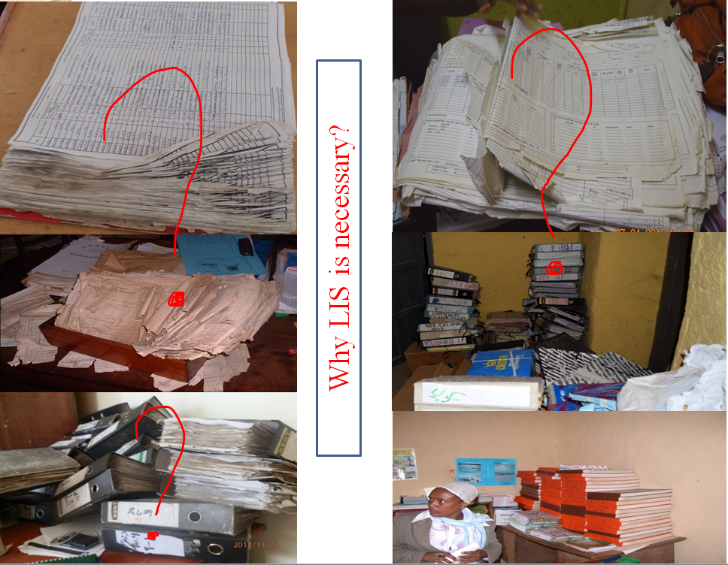

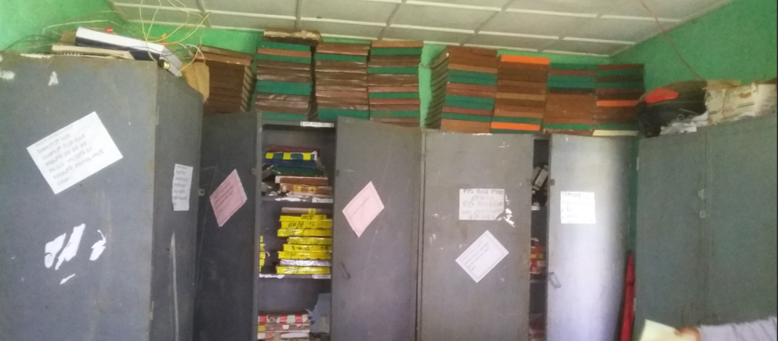
Risk due to fire

Slide 5
Introduction
Initiatives for Solution
MoA supported by Finish Government financed project (REILA) developed NRLAIS
  Designed and built using Open Source Technology
  Key strategy in the development of integrated land administration sector
  Provides required functionalities to manage land datasets and administrative services
Former EHAIA supported by EU/German co-financed project (S2RAI) implementing CAMIS
  System for handling state land transferred to investors for commercial agriculture
  Built using similar open source technologies as NRLAIS and depends on service transactions of NRLAIS

Slide 6
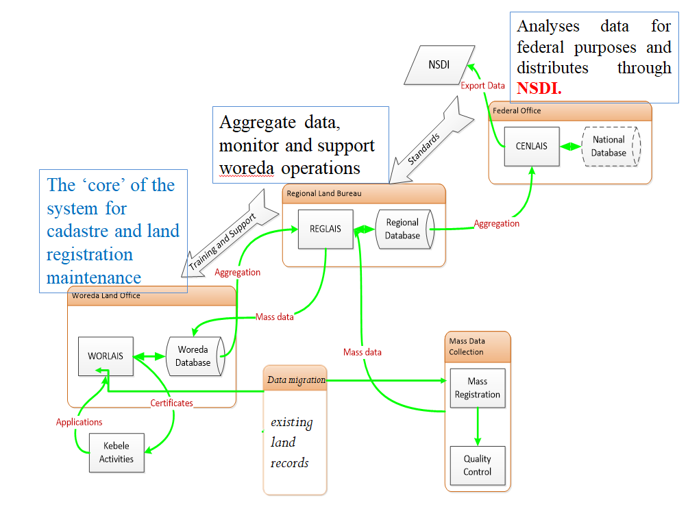
NRLAIS – Development & Functional Features
Functional features of NRLAIS at administrative levels
Web Application System
Support systematic and sporadic land registration
Maintains rural land records
Cadastre is the basis of NSDI and faster updating of land records.

Slide 7
NRLAIS – Functional Components & Subsystems
Physically independent but logically dependent
Independent GUI and handles different data
NRLAIS
Web Information Provision Sub-System (WIPSS)
Property Registration Sub-System (PRSS)
Cadastre Maintenance Sub-System (CMSS)
With User Interface
Process Sub-System (PSS)
Document Management Sub-System (DMSS)
Database (DB)
Service Level
Services
In the Background

Slide 8
NRLAIS – Conceptual Design Framework
Based on LADM, ISO standard 19152, adapted to the requirements of Ethiopian rural land administration
NRLAIS LADM adopted 4 main packages and 1 auxiliary class package:
  Party – for modeling natural and non-natural persons
  Administration – implements Right, Restriction and Responsibility
  Source – models source/evidence documents
  Spatial – models spatial aspects and represents cadaster
  Auxiliary Class – models common structures

Slide 9
NRLAIS – Open Source Software Systems Used
Name | Usage
PostgreSQL | Database management system - used on all levels of the NRLAIS for storage of structured and semi-structured data
PostGIS | PostgreSQL extension handles spatial data
QGIS | Desktop GIS used for editing, visualization and analysis of geospatial data
GDAL/OGR | Converting different GIS formats
Geoserver | Geoserver used on all levels of the NRLAIS for OGC compliant services such as WMS or WFS
MapProxy | MapProxy used as proxy to encapsulate WMS requests for performance and security reasons
ExperMaps | Basis for web based geospatial clients in the NRLAIS
node.js | Application environment
Python | Used for Customization of QGIS

Slide 10
NRLAIS Development Process
Concept Development
NRLAIS Software Concept Validation Version
Operational Acceptance Testing (OAT)
OAT Reports and Recommendations
NRLAIS Software Production Version

Slide 11
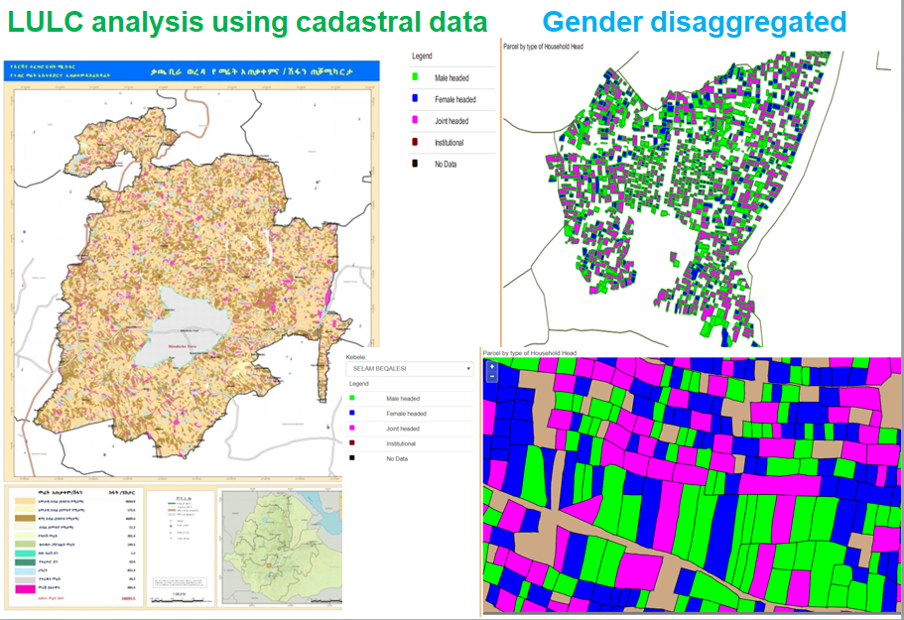
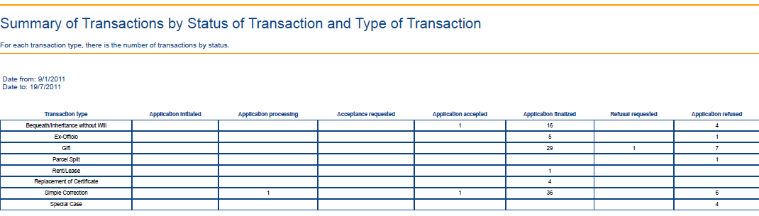
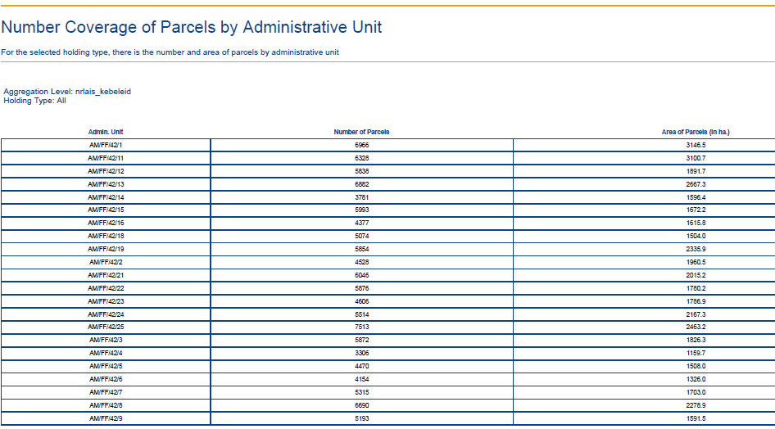
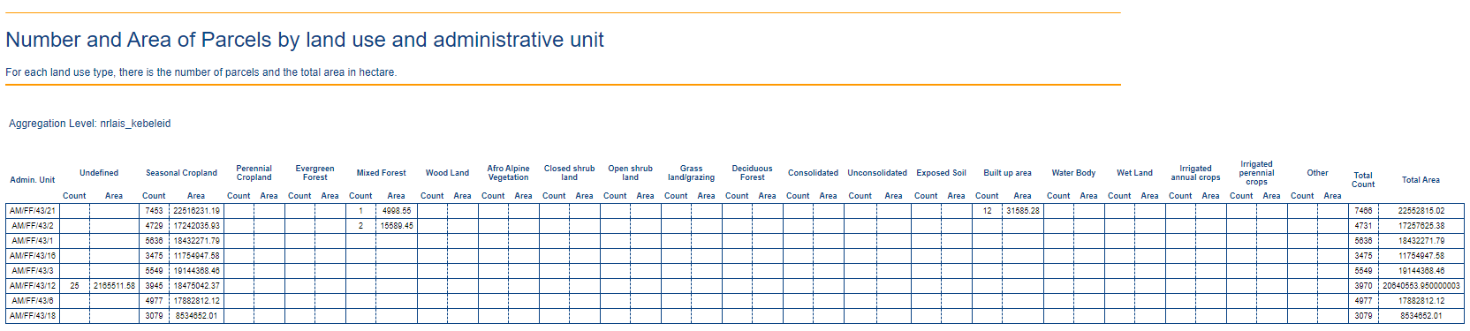
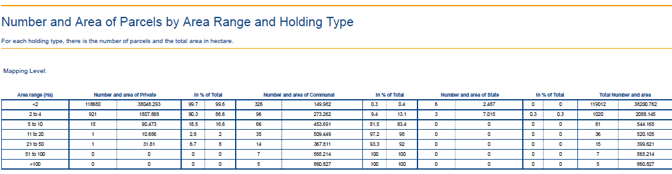
Sample of reports in NRLAIS
Gender disaggregation based on the subsequent registrations
 | Woreda | Female | Male | Joint | Total | Others | Total | total transaction
1 | Asagirt | 4 | 2 | 16 | 22 | 21 | 43 | 43
2 | Awabel | 125 | 159 | 87 | 371 | 82 | 453 | 453
3 | Basoliben | 6 | 7 | 7 | 20 | 19 | 39 | 39
4 | Basona worana | 9 | 10 | 17 | 36 | 19 | 55 | 55
5 | Burie | 22 | 25 | 27 | 74 | 12 | 86 | 86
6 | Dangila | 71 | 68 | 110 | 249 | 47 | 296 | 296
7 | Debrelias | 6 | 1 | 10 | 17 | 4 | 21 | 21
8 | Enarjinawuga | 218 | 227 | 468 | 913 | 107 | 1,020 | 1020
9 | Enemay | 3 | 4 | 9 | 16 | 90 | 106 | 106
10 | Ensaro | 4 | 2 | 6 | 12 | 14 | 26 | 26
11 | Gozamin | 7 | 9 | 7 | 23 | 9 | 32 | 32
12 | Kewet | 8 | 0 | 14 | 22 | 25 | 47 | 47
13 | Machakel | 11 | 24 | 41 | 76 | 34 | 110 | 110
14 | Menzmama | 6 | 7 | 9 | 22 | 8 | 30 | 30
15 | Mojanawodera | 16 | 13 | 8 | 37 | 60 | 97 | 97
16 | Siyadeberwayu | 1 | 5 | 4 | 10 | 16 | 26 | 26
17 | Tarmaber/Debresina | 10 | 5 | 8 | 23 | 23 | 46 | 46
18 | Yilmanadensa | 2 | 7 | 42 | 51 | 19 | 70 | 70
No. | Woreda name | Landholders |  |  | Number of parcels |  | Area (Ha)
 |  | Total HHs per woreda | Total Youth (15 to 29) | Below 15 age group | Total parcel per woreda | Parcels own by Youth | Total area (Ha) per woreda | Area (ha) per wored for youth (15 to 29)
1 | Asagirt | 1020 | 188 | 7 | 3004 | 97 | 3558.9 | 112.216
2 | Awabel | 22778 | 965 | 21 | 56835 | 282 | 26710.7 | 97.32
3 | Basoliben | 12625 | 581 | 85 | 31353 | 389 | 16653.4 | 96.85
4 | Basona worana | 29987 | 4418 | 259 | 121704 | 2506 | 52202.6 | 1011.035
5 | Burie | 19777 | 2011 | 52 | 57131 | 752 | 20396.3 | 199.521
6 | Dangila | 32364 | 4823 | 206 | 74013 | 1539 | 38955.4 | 575.132
7 | Debrelias | 12763 | 627 | 91 | 33224 | 709 | 15168.6 | 226.633
8 | Enarjinawuga | 49036 | 5803 | 329 | 125647 | 2690 | 45117 | 597.788
9 | Enemay | 15905 | 1759 | 68 | 38883 | 480 | 13620 | 119.139
10 | Ensaro | 1238 | 5 | 0 | 4174 | 3 | 1421.3 | 1.307
11 | Gozamin | 22508 | 2195 | 55 | 54716 | 498 | 22741.5 | 139.336
12 | Kewet | 8310 | 276 | 7 | 48428 | 38 | 11278.5 | 18.729
13 | Machakel | 15084 | 2044 | 147 | 40814 | 985 | 17691.5 | 292.016
14 | Menzmama | 6122 | 244 | 13 | 29902 | 241 | 9922.3 | 70.732
15 | Mojanawodera | 2818 | 321 | 39 | 10887 | 369 | 4126.1 | 99.134
16 | Siyadeberwayu | 1016 | 122 | 32 | 3947 | 166 | 1499.4 | 45.956
17 | Tarmaber/Debresina | 2214 | 370 | 28 | 4359 | 161 | 3256.9 | 80.697
18 | Yilmanadensa | 36768 | 3732 | 266 | 112708 | 2220 | 36871.6 | 438.758

Slide 12
CAMIS – Core Functional Components
Distributed web application system
Supports inventory of commercial farms and contract farming model
Has strong component for performance monitoring of lease-based agricultural investment projects
Supports LSAI, Horticulture, Livestock, Forest and Forest product business function
Functional components
  Land Management
  Bid workflow management
  Performance monitoring and evaluation
  Mobile app for field level farm monitoring
  Contract farming

Slide 13
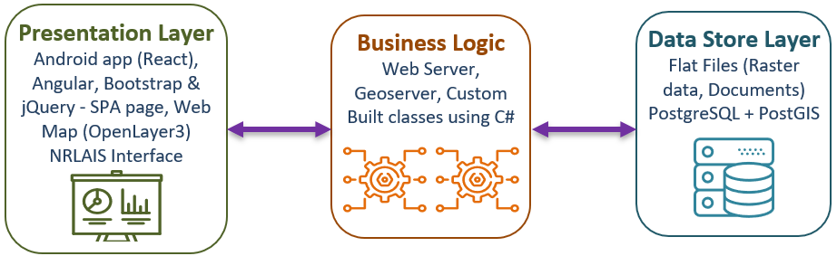
CAMIS – Architecture
CAMIS nodes are implemented based on three-tier client-server architecture

Slide 14
CAMIS Workflow and Interaction with NRLAIS
Land Identification
Register Land
Land Bank
Request Parcel ID
NRLAIS
Get Parcel ID
Request geometry change
Existing
New
Bid Work Flow CAMIS Portal
Sign Contract
Request Parcel ID
Get Parcel ID
Investor Registration
Send notification to change use right
Land Transfer/Farm Registration
Request use right registration
Get registration confirmation
End/ Terminate/ Amend Contract
Digitize Existing Farm Information
Performance Monitoring
Contract Farming
Investment Projects Evaluation
Warning
Award

Slide 15







CAMIS – Deployment
CAMIS will be deployed at different regional nodes and one national node
Region Node
Region Node
Web Portal
NRLAIS
Internet
VPN
Region Node
Region Node
National Node
Region Node
Region Node

Slide 16
Integration of NRLAIS and CAMIS
NRLAIS is built on a toolkit concept and customizable to support functionalities at different administrative levels
NRLAIS services can be consumed by different applications, like CAMIS
NRLAIS implements 21 system use cases
CAMIS request services from NRLAIS which are related to change in the Geometry of parcel and use right

Slide 17
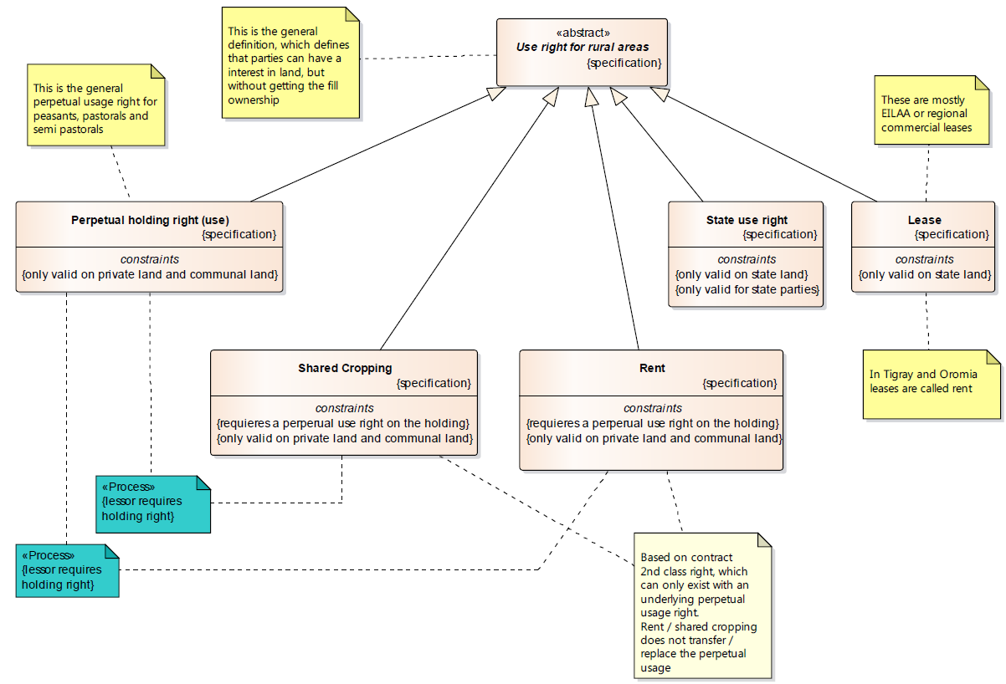
Integration of NRLAIS and CAMIS Contd’

Slide 18
Benefits of Integrating NRLAIS and CAMIS
Minimized cost in the development of CAMIS
Use of common software architectures increase productivity and reduce learning curve
Better coordination of data and information at different administrative levels
Easy deployment with docker container
Better utilization of resources
Excellent capability for data migration

Slide 19
Conclusion
Coordinating land related issues across institutions dealing with land and developing information systems based on common software architecture facilitates easy data and information sharing at different administrative levels

Slide 20
Thanks for your Attention!!!

