Slide 1





On Climate Change: Inequalities and Gender Vulnerability in Benin
F´ebronie AKIMABERA & S`edjro C. R. DOSSOU-CADJA
MedA Conseils (Benin), Sapienza University of Rome (Italy)
November 25–29, 2019
Conference on Land Policy in Africa, CLPA-2019 Abidjan, Cˆote d’Ivoire
CLPA-2019

Slide 2
Outline
Introduction
Motivation
Index of Inequality of Gender Vulnerability to Climate Change (IIVGCC)
Application to Benin Agricultural Sector Concluding Remarks
CLPA-2019
2 / 18

Slide 3
Introduction
In face of climate shocks, responses varie from one society/community to another, from one individual to another depending on the individual and collective capacities to deal with disasters.
CLPA-2019
3 / 18

Slide 4
Introduction
In face of climate shocks, responses varie from one society/community to another, from one individual to another depending on the individual and collective capacities to deal with disasters.
Gender analysis in vulnerability to CC therefore integrates, inequalities in men and women adaptation capacities in face of climate shocks, that could degrade their living conditions.
CLPA-2019
3 / 18

Slide 5
Motivation
Men and women contribute differently to adaptation and mitigation of climate change impacts since there are some difference in their social roles.
CLPA-2019

Slide 6
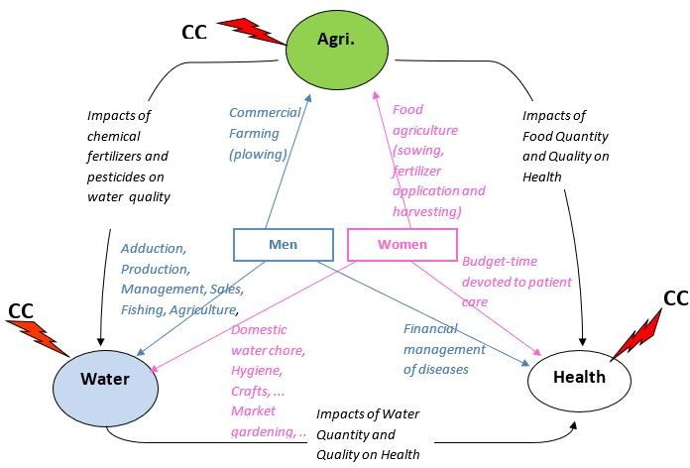
Motivation
Figure:Distribution of men and women’ social roles in 3 strategical development sectors (Source: MedA Conseils)
CLPA-2019

Slide 7
Motivation
DSAAT in Agricultural Sector, BenHydro for water demand, and so on, include no input or output data for the differentiated impacts of climate change on men and women.
CLPA-2019
6 / 18

Slide 8
Motivation
DSAAT in Agricultural Sector, BenHydro for water demand, and so on, include no input or output data for the differentiated impacts of climate change on men and women.
It thus appears that existing simulation models at sectoral level do not integrate social variables and are not revisable by users.
CLPA-2019
6 / 18

Slide 9
Question
How to measure gender inequalities in a given development sector in face of climate change occurrence?
CLPA-2019

Slide 10
Index of Inequality of Gender Vulnerability to climate change (IIVGCC)
The proposed methodology IIVGcc is basically inspired by:
CLPA-2019
8 / 18

Slide 11
Index of Inequality of Gender Vulnerability to climate change (IIVGCC)
The proposed methodology IIVGcc is basically inspired by:
UNDP Vulnerability Index to Poverty (2011);
CLPA-2019
8 / 18

Slide 12
Index of Inequality of Gender Vulnerability to climate change (IIVGCC)
The proposed methodology IIVGcc is basically inspired by:
UNDP Vulnerability Index to Poverty (2011); Guillaumont economic vulnerability index (2008,2009);
CLPA-2019
8 / 18

Slide 13
Index of Inequality of Gender Vulnerability to climate change (IIVGCC)
The proposed methodology IIVGcc is basically inspired by:
UNDP Vulnerability Index to Poverty (2011); Guillaumont economic vulnerability index (2008,2009);
Guillaumont and Simonet physical vulnerability index to climate change (2012)
CLPA-2019
8 / 18

Slide 14
Index of Inequality of Gender Vulnerability to climate change (IIVGCC)
The proposed methodology IIVGcc is basically inspired by:
UNDP Vulnerability Index to Poverty (2011); Guillaumont economic vulnerability index (2008,2009);
Guillaumont and Simonet physical vulnerability index to climate change (2012)
Overall, as a baseline, we have (Rousseau, 2001):
risks
vulnerability =
capacities
CLPA-2019
8 / 18

Slide 15
Index of Inequality of Gender Vulnerability to Climate Change (IIVGCC)
The Climate Change Sectorial Vulnerability Index (CCSVI) for the development sector named ‘S’, is defined as the simple arithmetic mean of S risk exposure index (IERs), and the potential CC shock index on S rated by IYs:
CLPA-2019
9 / 18

Slide 16
Index of Inequality of Gender Vulnerability to Climate Change (IIVGCC)
The Climate Change Sectorial Vulnerability Index (CCSVI) for the development sector named ‘S’, is defined as the simple arithmetic mean of S risk exposure index (IERs), and the potential CC shock index on S rated by IYs:
CCSVIs = 0.5 IERs + 0.5 Iys ,
where Ys is the combination of the ‘climatic proxy’ variables identified for sector S.
CLPA-2019
9 / 18

Slide 17
Index of Inequality of Gender Vulnerability to Climate Change (IIVGCC)
In fact, we have:
The sub-index of risk exposure before climate change (IERs)
defined as:
n
Σ
IERs = α RX
i i
i=1
with α_{i} the weight of X_{i} in the development of sector S, and RX_{i} the vulnerability ratio of the variable X_{i}. Each X_{i} is set as a critical identifiable emergence variable/indicator for sector S.
CLPA-2019
November 25–29, 2019
10 / 18

Slide 18
Index of Inequality of Gender Vulnerability to Climate Change (IIVGCC)
The sub-index of Climate Change shock (IYs) for a given development sector is a simple arithmetic mean of climatic indicators calculated from the potentials climatic variables (which we call the climate proxies) that can influence the considered sector. It is above all the variables such as temperature, rainfall, sea level, the level of rivers, the extent of drought, which participate in the calculation of the sub-index of CC shock.
CLPA-2019
November 25–29, 2019
11 / 18

Slide 19
Index of Inequality of Gender Vulnerability to Climate Change (IIVGCC)
The sub-index of Climate Change shock (IYs) for a given development sector is a simple arithmetic mean of climatic indicators calculated from the potentials climatic variables (which we call the climate proxies) that can influence the considered sector. It is above all the variables such as temperature, rainfall, sea level, the level of rivers, the extent of drought, which participate in the calculation of the sub-index of CC shock.
Consequently, the IIVGCC for sector S is defined as
CCSV I men
IIVGCCs =
.
CCSV I women
It therefore measures by development sector, the relative vulnerability of men to climate change compared with that of women.
CLPA-2019
November 25–29, 2019
11 / 18

Slide 20
Index of Inequality of Gender Vulnerability to Climate Change (IIVGCC)
In practice, variables primary data must be standardized for the index calculation, using the min-max standardization procedure as follows:
Value − Min
I = × 100 .
Max − Min
CLPA-2019
November 25–29, 2019
12 / 18

Slide 21
Index of Inequality of Gender Vulnerability to Climate Change (IIVGCC)
In practice, variables primary data must be standardized for the index calculation, using the min-max standardization procedure as follows:
Value − Min
I = × 100 .
Max − Min
In the case where a variable is negatively related to the vulnerability, the formula for calculating the index changes. It becomes:
Max − Value
II = × 100 or II = 100 − I .
Max − Min
NB: The different weights to be used throughout the IIVGCC calculation are not chosen at random. They must be chosen on the basis of a factorial data analysis (PCA, MCA,..).
CLPA-2019
November 25–29, 2019
12 / 18

Slide 22
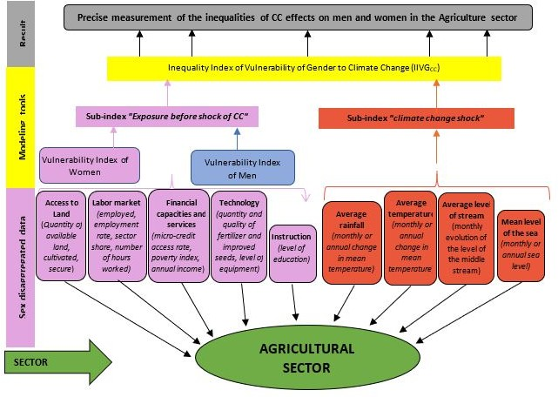
Application to Benin Agricultural Sector
Figure:Architecture of the Gender Vulnerability Index to Climate Change (IIVGCC) for the Agricultural Sector (Source: Authors)
CLPA-2019
November 25–29, 2019
13 / 18

Slide 23
Application to Benin Agricultural Sector
Components | CC Vulnerability Index (CCSVI)
Risk exposure before the shock of CC | 71.60 81.50
Shock of CC | 28.63
CC Vulnerability Index (CCSVI) | Men 50.115 Women 55.115
Gender Vulnerability Inequality Index to CC ( IIVGcc ) = 0.90
Men ^{Σ}_{i} p_{i}v_{i}
Women ^{Σ}_{i} p_{i}v_{i}
Source: Authors calculations based on EMICoV2011 data
CCSVI men = 50.115; CCSVI women = 55.115; IIVGCCA = 0.90.
CLPA-2019
November 25–29, 2019
14 / 18

Slide 24
Application Findings
Women are 1.10 times (inverse ratio of IIVGCCA) more vulnerable to Climate Change than men in the Beninese agricultural sector.
CLPA-2019
November 25–29, 2019
15 / 18

Slide 25
Application Findings
Women are 1.10 times (inverse ratio of IIVGCCA) more vulnerable to Climate Change than men in the Beninese agricultural sector.
The ‘access to land’ parameter contributes to 50% of the inequalities of vulnerability, whilst the “instruction” parameter accounts for 37%.
CLPA-2019
November 25–29, 2019
15 / 18

Slide 26
Application Findings: Policy Implications
This result suggests the implementation of social policies in favor of women in the agricultural sector in Benin such as:
CLPA-2019
November 25–29, 2019
16 / 18

Slide 27
Application Findings: Policy Implications
This result suggests the implementation of social policies in favor of women in the agricultural sector in Benin such as:
Promotion of women’s access to land and tenure security,
CLPA-2019
November 25–29, 2019
16 / 18

Slide 28
Application Findings: Policy Implications
This result suggests the implementation of social policies in favor of women in the agricultural sector in Benin such as:
Promotion of women’s access to land and tenure security, Promotion of literacy and education of girls and women.
CLPA-2019
November 25–29, 2019
16 / 18

Slide 29
Concluding Remarks
The issue gender mainstreaming in modeling the impacts of climate change by development sector is actual, since existing models lack of consistency in terms of taking into account difference of gender social roles.
CLPA-2019
November 25–29, 2019
17 / 18

Slide 30
Concluding Remarks
The issue gender mainstreaming in modeling the impacts of climate change by development sector is actual, since existing models lack of consistency in terms of taking into account difference of gender social roles.
The proposed methodology of ‘Index of Inequality of Gender Vulnerability to Climate Change (IIGVCC)’ is overall, a modeling by development sector, of gender vulnerability inequalities to climate change.
CLPA-2019
November 25–29, 2019
17 / 18

Slide 31
Concluding Remarks
The issue gender mainstreaming in modeling the impacts of climate change by development sector is actual, since existing models lack of consistency in terms of taking into account difference of gender social roles.
The proposed methodology of ‘Index of Inequality of Gender Vulnerability to Climate Change (IIGVCC)’ is overall, a modeling by development sector, of gender vulnerability inequalities to climate change.
In line with building sustainable resilience against climate change, National Adaptation Programs (NAP), future studies and projects may consider collecting data, and monitoring the IIVGCC calculation for all key development sectors in Benin, ECOWAS, and Africa at large.
CLPA-2019
November 25–29, 2019
17 / 18

Slide 32
THE END!!
Thanks to
Contacts:
febronie.codja@meda-conseils.com;
rdoscadj202@gmail.com, dossoucadja.1889522@studenti.uniroma1.it
CLPA-2019
November 25–29, 2019
18 / 18

