Slide 1






Nuancing narratives on Large Scale Agriculture Investments labor market effects in Sub-Saharan Africa
P. Burnod, S. Mercandalli, A. Reys, W. Anseeuw, M. Giger, B. Kiteme and T. Ralandison

Slide 2
Context:
Employment in Sub-Saharan Africa => 375 million young actives will enter the labor market in the next 15 years.
Debate on Large Scale Agricultural Investment (LAI) & jobs creation
Need of information based on several cases
Need to overcome simplistic narratives on LAI labor and other socioeconomic impacts

Slide 3
Research question
What are the direct impacts of LAIs in terms of jobs creation ?
Who get the jobs?
Originality of the research : to analyze labor impact both on the supply and demand sides

Slide 4
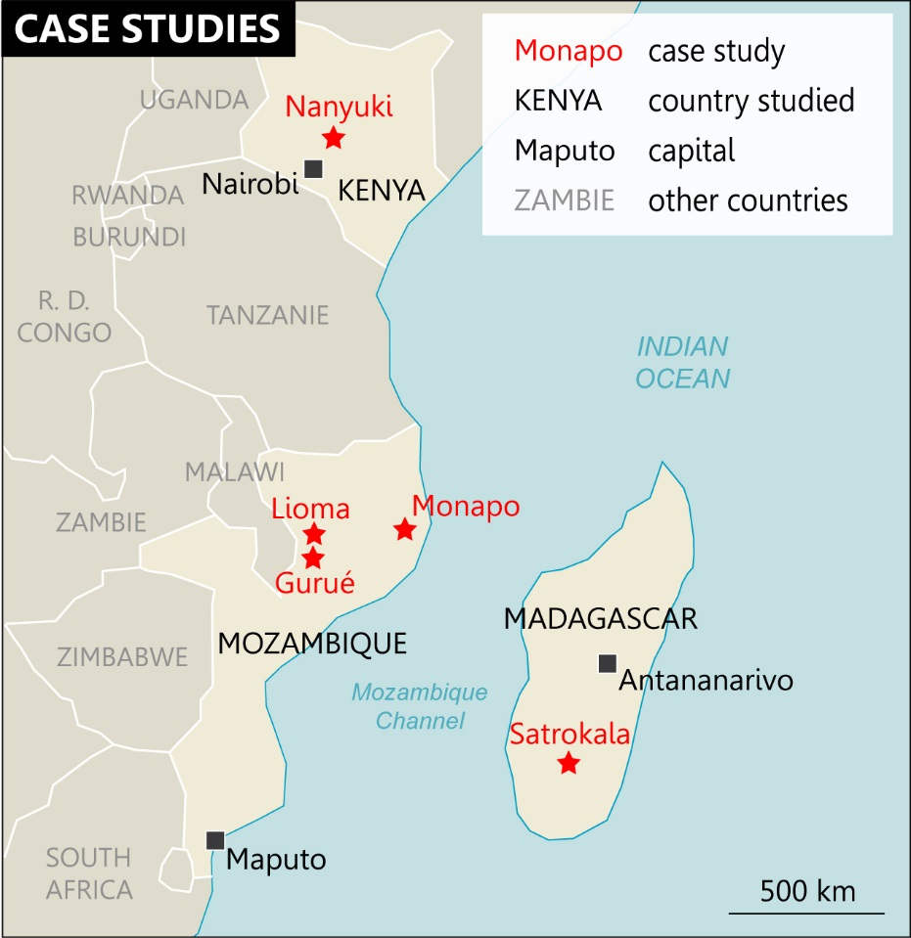
3 countries: 3 contrasting contexts, with different levels of agricultural investments
Kenya: Nanyuki area =many longstanding investments, notably in the horticultural sector
Mozambique: Nacala corridor = high number of new investors present thanks to pro-investment policies
Madagascar: lots of projects announced, 95% collapsed and only few companies have continued : [2000-2017 period]

Slide 5
Quantity and quality of jobs created?
Production models and contexts matter
impacts on labor supply

Slide 6
Step 1 : LAI companies level : Inventory & Qualitative assessment of business models => qualitative interviews with Cies
Data Collection
Agricultural farms | MOZAMBIQUE study area | KENYA study area | MADAGASCAR study area
# Companies (inventory) | 25 | 64 | 95
# interviewed companies | 14 | 34 | 20
# Still active / Retained for assessment | 13 | 33 | 1
Table 1 : companies’ census in study areas according to country. sources Cetrad and CDE, ILC and Cirad, Malgasy Land Observatory

Slide 7
Quantity of created jobs per company (2016)
 | MOZAMBIQUE | KENYA | MADAGASCAR
Nb of companies assessed | 13 | 33 | 1
Permanent jobs (PJ)
Average PJ /company | 94 | 165 | 95
Temporary jobs (TJ)
Average TJ / company | 456 | 71 | 200
Households
Nb of HH in the study area | 162 000 | 200 000 | 1 000
% potentially impacted HH | 5% | 3,5% | 30%

Slide 8
Quantity of created jobs depend on production model
 |  | Area cultivated /farm | Mechani zation | Proces sing | Nb of Perm/ 100 ha | Nb of Temp/ 100 ha
Vegetables /mixed |  | 21 – 33 | Partial | yes | 210 | 225
Roses |  |  | no |  | 1740 | 220
Cereal |  | 950 – 3 500 | yes | no | 6 | 1
Maize Soybean (moz) |  |  |  |  | 6 | 22
Maize Soybean (mada) |  |  |  |  | 3 | 4
Sisal |  | 1500 - 2000 | no | yes | 1 | 40
Tea |  |  |  |  | 9 | 71
Meringa,macadamia. |  |  |  |  | 12 | 4

Slide 9
Quality of jobs depends on company and local context
89%
80%
65%
42%
36%
24%
Moz.
Ken.
Mad.
Moz.
Ken.
Mad.
% of permanent workers
% with formal contract

Slide 10
Attractiveness of jobs depends on local context
 | MOZ – 3 cases | KENYA - Nanyuki | MADA - Satrokala
Level of remuneration per day (local unit) | MNZ | KS | MGA
Agribusiness jobs | 80 to 120 | 320 | 7 500
Non-agriculture employment* | 80 to 220 | 420 | 3 500
Self employment | 90 to 100 | 250 | 2 900

Slide 11
LAIs vs family farming : job created per 100 cultivated hectare
Commercial farms Kenya |  |  |  | Family farms Kenya
Area cultivated /farm | crop | Nb of PJ/ 100 ha | Nb of TJ/ 100 ha | Area cultivated /farm | crop | Nb of PJ/ 100 ha
31 | Veg | 210 | 225 | 1,02 | Mixed - veg | 212
23 | Roses | 1740 | 220 | 1,07 | Mixed | 160
952 | Cereal | 6 | 1 | 1,07 | mixed | 160

Slide 12
Who benefit from the jobs?
Differentiated workers and household profiles
LAI labor impacts on the demand side

Slide 13
Data Collection
Households livelihoods survey
500 to 600 HH per study area
in factual and counterfactual zones
Households were randomly selected

Slide 14
Jobs opportunities for women ? Yes.
% of female workers
% of female permanent workers
54%
56%
45%
23%
15%
-
Moz.
Ken.
Mad.
Moz.
Ken.
Mad.
In large most cases, only 1 member in the household is working for an agribusiness.
Kenya: women represent half of the (permanent) workers ;
Madagascar: women represent half of the workers but only 23% of the permanent;
Mozambique: women are seldom employed as workers.

Slide 15
Jobs opportunities for migrants ?
Yes but specially far migrants
Majority of workers are migrants : 80% (Kenya & Mada); 50% (Moz)
Coming from neighboring localities (Kenya), from remote localities (Moz & Mada)

Slide 16
Jobs opportunities for the ones who lost land?
In Kenya: no HH lost land in the studied area – roses and vegetable farms used former private land already allocated to commercial farms
In Mozambique: 22 to 45% of the HH lost land (farmers used to occupy former state farm or customary land)
In Madagascar: 8% of HH lost land – mainly large grazing land for cattle
  In Madagascar and Mozambique: HH who lost land benefit less from jobs than other HH

Slide 17
To conclude….on agricultural models and pubic policy
policy orientations toward:
  labour intensive business model choices ;
  imposition of minimum labor conditions/ wage ;
  Quantity and quality of LAI jobs do not justify displacement of farmers

