Slide 1
Analysis of Factors influencing Vulnerability of Fishing Systems to Climate Change among Artisanal Fisher-folks in Coastal area of Lagos, Nigeria
By
Abdulrazaq Kamal DAUDU, Ph.D.
Department of Agricultural Extension and Rural Development,
Faculty of Agriculture,
University of Ilorin, Ilorin, Nigeria

Slide 2
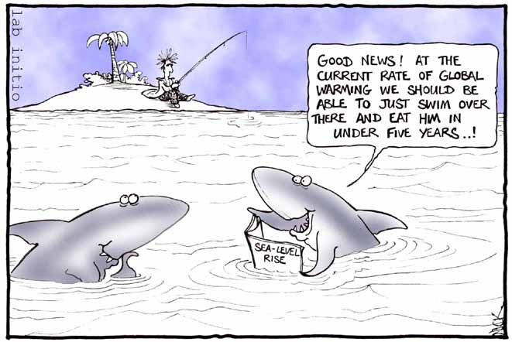
Introduction
Agriculture is at the core of environmental vulnerability and concerns the management of natural resources, such as
  land degradation,
  water scarcity,
  deforestation, and
  the threat to biodiversity.
Climate change could cause irreversible damage to land and water ecosystems, and lead to loss of production potential.
Stresses as a result of climate change will compound existing pressure on fisheries and aquaculture and threaten their capacity to provide food and livelihoods.

Slide 3
Introduction continue….
Climate change not only influence the fishing directly by affecting various
  physiological process,
  developmental rates,
  reproduction,
  behavior and
  survival of individual
  but also affects indirectly by altering ecosystem,
  food availability,
  prey-predator relationship (Brander, 2010)
Recent studies have been forecasted about the imminent future where the capture fisheries will get severely affected by climate change and thus affecting the national economics (Allison et al., 2009).
These findings provide insightful perceptive for vulnerability assessment of fisheries ecosystem which supports livelihood of over a half a billion people (Allison et al., 2009 and FAO, 2010).

Slide 4
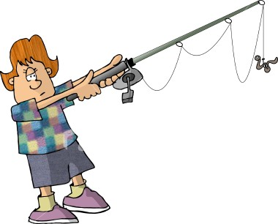
Introduction continue…
The vulnerability of fishery- and aquaculture dependent communities and regions to climate change is complex, reﬂecting a combination of three key factors:
  exposure of a particular system to climate change,
  degree of sensitivity to climate impacts, and
  the adaptive capacity of the group or society experiencing those impacts.
Over the years, several studies conducted indicate that Nigeria’s is very vulnerable to climate change impacts and particularly sea level rise, flooding, inundation and coastal erosion.

Slide 5
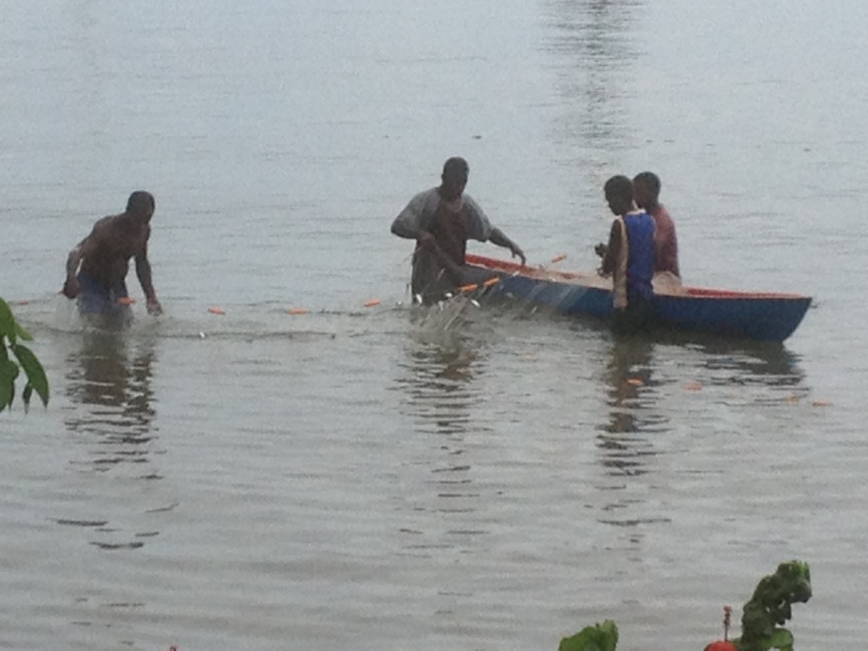
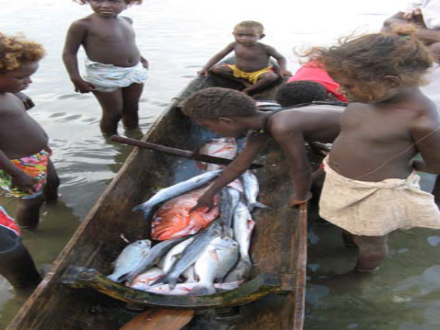
Introduction continue….
Many of the settlements are exposed to shoreline dynamics owing to distance from the shoreline.
The artisanal fishers cover the operations of
  small-scale canoes,
  fisheries operating in the coastal areas,
  creeks, and lagoons,
  inshore water and the inland rivers and
  characterized by low capital outlay, low operational costs, low technology application and it is labor intensive (Bolarinwa, 2014).
Several policy measures have been put in place by successful government in the Nigeria to stimulate local fish farming.
Till date, the results from the colossal investment and policy have not yielded the desired results.

Slide 6
Objectives of the study
The general objective of the study was to investigates factors influencing the vulnerability of fishing activities to climate change among artisanal fisher-folks in coastal area of Lagos, Nigeria
1. describe the socioeconomic profile of the artisanal fishers in the study area;
3. ascertain the adaptive capacity employed by artisanal fishers to ameliorate their vulnerability to climate change; and
2. investigate the vulnerability of the artisanal fishers to climate change;
4. determine the factors associated with their vulnerability to climate change in the study area.

Slide 7
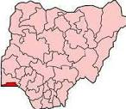
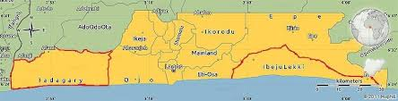
Methodology
Study Area: The study was carried out in coastal areas of Lagos State, Nigeria
Feature | Lagos State
Land Area | 3,577 sq. km
Population (projected) | Approx. 20.2m by 2016
Coastal lines | 786.94 sq. km.
Coordinates | 6⁰ 23′N and 6⁰ 41′N , 2⁰ 42′E and 3⁰ 42′E
Av. rainfall | 1,500-2,000mm
Temperature | 26⁰ C - 34⁰ C
Occupation of coastal communities | Fishing and farming
Type of fish catches | Tilapia, Catfish, Crayfish, Mollusks, Mackerel, Barramundi etc
Map of Nigeria
Table 1: Geographical features of Lagos state, Nigeria
Population of the study: The study population comprised of all artisanal fisher-folks in Lagos State, Nigeria
Map of Lagos State

Slide 8
Sampling procedure and sample size
A two-stage sampling technique was used to select respondents for the study.
In the first stage purposive sampling was used to select four Local Government areas from the coastal axis of the study area
The second stage involved the selection of the respondents from the sample frame (2,349) of artisanal fishers obtained from Lagos State Agricultural Development Programme
And finally, using sample size calculation formula based on Fisher et al. (2007) , a total number of 342 artisanal fishers were eventually selected for the study.

Slide 9
Methodology continue….
The collected data were subjected to both descriptive and inferential statistics such as frequency counts, percentages, charts and mean, vulnerability and factor analyses.
The adaptive capacity employed used by artisanal fishers were measured on a 5-point Likert scale involving statement relating to possible adaptation strategies.
The values on the scale were summed together and divided by 5 to obtain the cut-off mean value of 3. Variables with a mean score value ≥ 3 are considered to be as high, while variables with a mean score below 3 were regarded as low.
Data were collected with the aid of structured questionnaire on socioeconomic characteristics of artisanal fishers, respondents’ vulnerability to climate change and factors associated with vulnerability

Slide 10
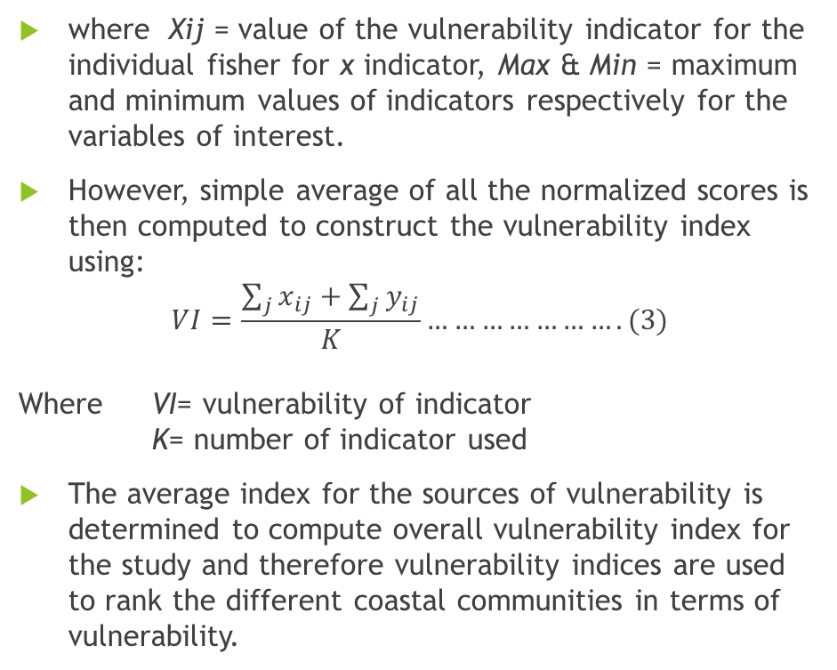
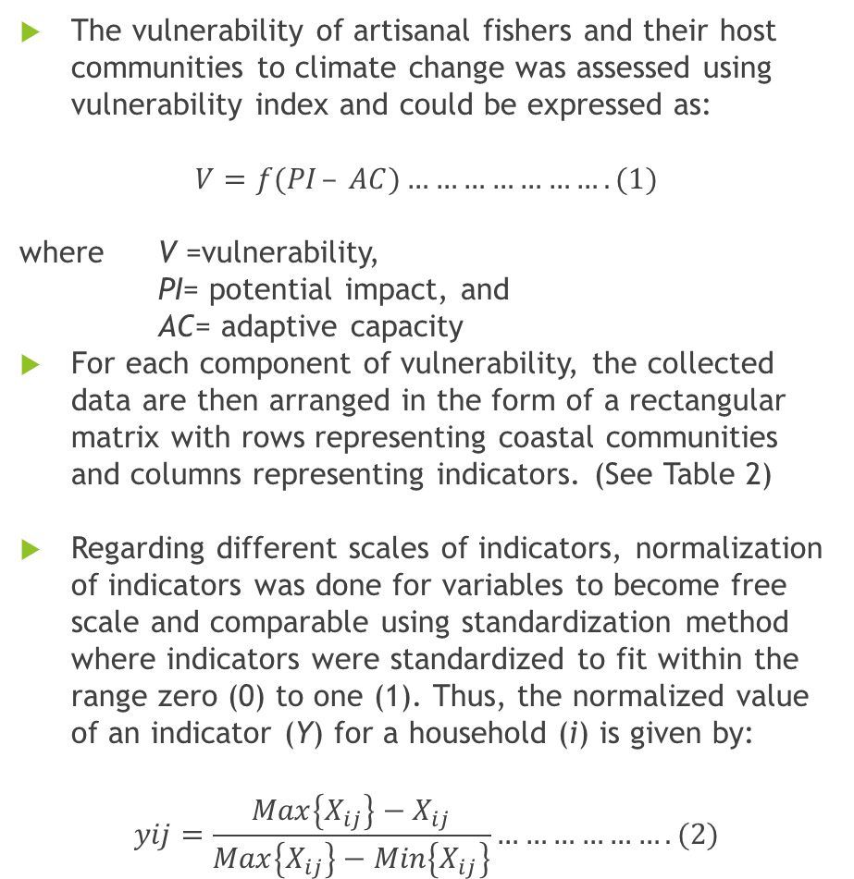
Calculation of vulnerability index
Table 2: Illustration of arrangement of data in statistical analysis
The vulnerability of artisanal fishers and their host communities to climate change was assessed using vulnerability index and could be expressed as:
$${V=f(PI}_{ }– AC)………………….(1)$$
where V =vulnerability,
PI= potential impact, and
AC= adaptive capacity
For each component of vulnerability, the collected data are then arranged in the form of a rectangular matrix with rows representing coastal communities and columns representing indicators. (See Table 2)
Regarding different scales of indicators, normalization of indicators was done for variables to become free scale and comparable using standardization method where indicators were standardized to fit within the range zero (0) to one (1). Thus, the normalized value of an indicator (Y) for a household (i) is given by:
$$yij=\frac{Max\left\{X_{ij}\right\}−X_{ij}}{Max\left\{X_{ij}\right\}−Min\left\{X_{ij}\right\}}……………….(2)$$
Coastal communities | Vulnerability Indicators
 | 1 | 2 | - | - | K
Eti-osa | X_{1j} | X_{2j} | - | - | X_{ijk}
Ibeju-Lekki | X_{ij1} | X_{ij2} | - | - | X_{ijk}
Epe | X_{ij1} | X_{ij2} | - | - | X_{ijk}
Badagry | X_{ij1} | X_{ij2} | - | - | X_{ijk}
where Xij = value of the vulnerability indicator for the individual fisher for x indicator, Max & Min = maximum and minimum values of indicators respectively for the variables of interest.
However, simple average of all the normalized scores is then computed to construct the vulnerability index using:
$$VI=\frac{\sum_{j}{x_{ij}}+\sum_{j}{y_{ij}}}{K}………………….(3)$$
Where VI= vulnerability of indicator
K= number of indicator used
The average index for the sources of vulnerability is determined to compute overall vulnerability index for the study and therefore vulnerability indices are used to rank the different coastal communities in terms of vulnerability.

Slide 11
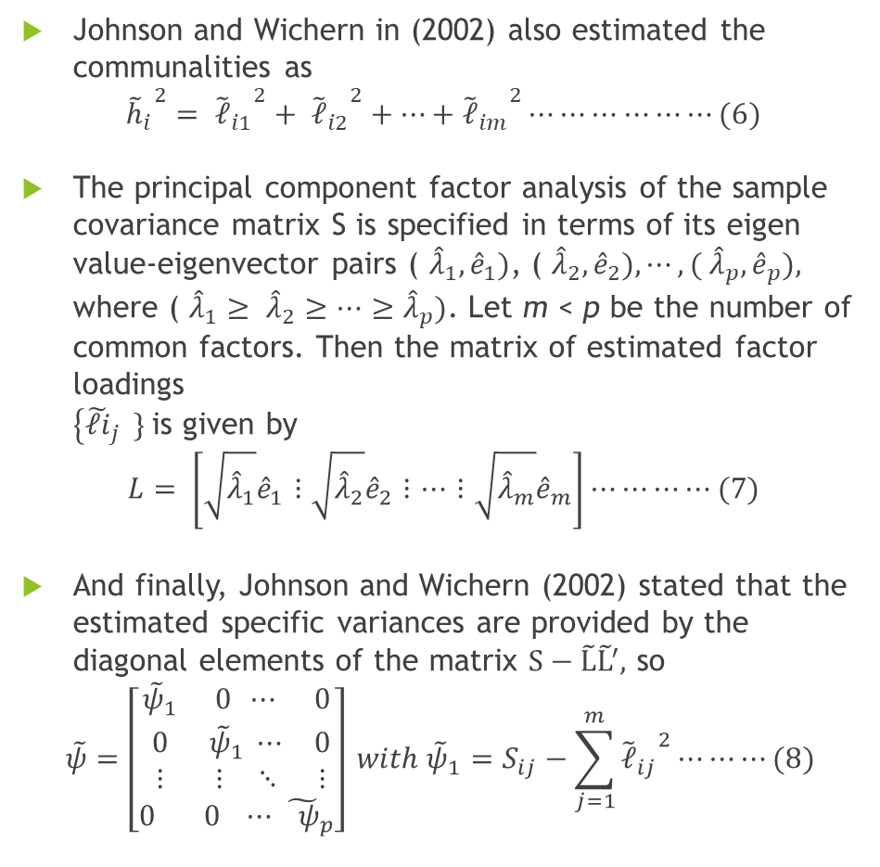
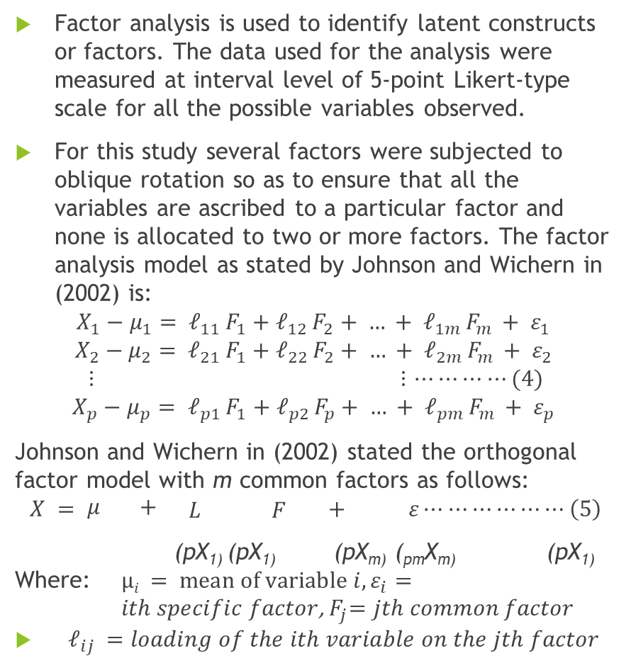
Use of Factor Analysis
Factor analysis is used to identify latent constructs or factors. The data used for the analysis were measured at interval level of 5-point Likert-type scale for all the possible variables observed.
For this study several factors were subjected to oblique rotation so as to ensure that all the variables are ascribed to a particular factor and none is allocated to two or more factors. The factor analysis model as stated by Johnson and Wichern in (2002) is:
$$X_{1}−μ_{1}= 𝓁_{11 }F_{1}+𝓁_{12 }F_{2}+ … + 𝓁_{1m }F_{m }+ ε_{1 }$$
$$X_{2}−μ_{2}= 𝓁_{21 }F_{1}+𝓁_{22 }F_{2}+ … + 𝓁_{2m }F_{m }+ ε_{2 }$$
$$⋮ ⋮…⋯⋯⋯(4)$$
$$X_{p}−μ_{p}= 𝓁_{p1 }F_{1}+𝓁_{p2 }F_{p}+ … + 𝓁_{pm }F_{m }+ ε_{p }$$
Johnson and Wichern in (2002) stated the orthogonal factor model with m common factors as follows:
$$X = \begin{matrix}μ & +\end{matrix} \begin{matrix}L & F\end{matrix} + ε⋯⋯⋯⋯⋯⋯\left(5\right)$$
(pX₁₎ (pX₁₎ (pX_{m)} (_{pm}X_{m)} (pX₁₎
Where: $µi = mean of variable i, ε_{i}=$
$ith specific factor$,${ F}_{j}=jth common factor$
$𝓁_{ij }=loading of the ith variable on the jth factor$
Johnson and Wichern in (2002) also estimated the communalities as
$${{\tilde{h}}_{i}}^{2}= {{\tilde{𝓁}}_{i1}}^{2}+ {{\tilde{𝓁}}_{i2}}^{2}+⋯+{{\tilde{𝓁}}_{im}}^{2}⋯⋯⋯⋯⋯⋯(6)$$
The principal component factor analysis of the sample covariance matrix S is specified in terms of its eigen value-eigenvector pairs ( ${\hat{λ}}_{1}, {\hat{e}}_{1})$, ( ${\hat{λ}}_{2}, {\hat{e}}_{2}), ⋯, ( {\hat{λ}}_{p}, {\hat{e}}_{p}),$ where ( ${\hat{λ}}_{1}≥ {\hat{λ}}_{2}≥⋯≥{\hat{λ}}_{p})$. Let m < p be the number of common factors. Then the matrix of estimated factor loadings
$\left\{{\tilde{𝓁i}}_{j } \} \right.$is given by
$$L= \left[\sqrt{{\hat{λ}}_{1}}{\hat{e}}_{1}⋮\sqrt{{\hat{λ}}_{2}}{\hat{e}}_{2}⋮⋯⋮\sqrt{{\hat{λ}}_{m}}{\hat{e}}_{m}\right]⋯⋯⋯⋯(7)$$
And finally, Johnson and Wichern (2002) stated that the estimated specific variances are provided by the diagonal elements of the matrix $S−\tilde{L}{\tilde{L}}^{′},$ so
$$\tilde{ψ}=\left[\begin{aligned}\begin{matrix}{\tilde{ψ}}_{1} & 0 ⋯ & 0 \\ 0 & {\tilde{ψ}}_{1} ⋯ & 0 \\ ⋮ & ⋮ ⋱ & ⋮\end{matrix} \\ 0 0 ⋯ {\tilde{ ψ}}_{p}\end{aligned}\right] with {\tilde{ψ}}_{1}=S_{ij}−\sum_{j=1}^{m}{{{\tilde{𝓁}}_{ij}}^{2}⋯⋯⋯(8)}$$

Slide 12
Socioeconomic characteristics of respondents
Results
Table 3: Distribution of respondents by age, household size and fishing experience and monthly income (N=342)
Variable | Group | Frequency | Percentage | Explanation
Age (Years) | ≤30 | 35 | 10.3 | Max: 67 Min: 18 Average: 45.4 SD: 25.6
 | 31-40 | 83 | 24.2
 | 41-50 | 125 | 36.6
 | 51-60 | 70 | 20.4
 | >60 | 29 | 8.5
Sex | Male | 267 | 78.3 | Mode: Male
 | Female | 75 | 21.7
Marital status | Single | 89 | 26.1 | Mode: Married
 | Married | 246 | 71.6
 | Widowed | 7 | 2.3
Fishing experience (Years) | 1-10 | 63 | 18.3 | Max: 46 Min: 7 Average: 23.7 SD: 28.1
 | 11-20 | 124 | 36.4
 | 21-30 | 135 | 39.5
 | >30 | 20 | 5.8
SD: Standard Deviation, Max: Maximum, Min: Minimum
Source: Field survey, 2018

Slide 13
Vulnerability of the artisanal fishers to climate change
Table 4: Vulnerability analysis of respondents to climate change in coastal communities
Coastal communities | Vulnerability Indicators |  |  |  |  |  |  |  |  |  | Sum of the Scores | Average Vulnerability Index (AVI) | Ranking
 | Level of Education | Ownership of boats | Monthly income | Household size | Fishing experience | Access to labour | Access to fishing gears | Catches/day | Extension visit | Membership of coop. society
Eti-Osa | 1.001 | 0.521 | 0.452 | 0.572 | 0.448 | 0.620 | 0.601 | 0.058 | 0.622 | 0.575 | 5.470 | 0.547 | 2nd
Ibeju-Lekki | 0.168 | 0.563 | 0.634 | 0.626 | 0.601 | 0.551 | 0.422 | 0.387 | 0.696 | 0.036 | 4.684 | 0.468 | 3rd
Epe | 0.203 | 0.384 | 0.156 | 0.690 | 0.704 | 0.439 | 0.780 | 0.000 | 0.122 | 0.214 | 3.692 | 0.369 | 4th
Badagry | 0.139 | 0.676 | 0.349 | 0.900 | 0.000 | 1.000 | 0.560 | 0.274 | 0.610 | 1.000 | 5.508 | 0.551 | 1st
Source: Analyzed from Field survey, 2018

Slide 14
Adaptive capacity employed by artisanal fishers to ameliorate their vulnerability to climate change
Table 5: Adaptive capacity to climate change among artisanal fishers
Communities have different levels of coping strategies that allow them either respond to climate change or to prevent potential hazard.
Communities with greater adaptive capacity face a lower risk of disaster.
Using mean score and rank, the results showed that occupational mobility with mean score 3.812 was highly used adaptation strategy among the respondents and ranked 1st followed fishing gear diversity (mean=3.673)
Adaptive capacity | Mean score | Rank | Remark
Gear diversity | 3.673 | 2nd | High
Occupational mobility (Diversification) | 3.812 | 1st | High
Access to credit | 3.477 | 3rd | High
Access to information | 3.331 | 5th | High
Organize fishers association | 3.012 | 6th | High
Community infrastructure | 2.869 | 8th | Low
Access to fishing technology | 2.993 | 7th | Low
Environmental conservation | 3.449 | 4th | High
Source: Field survey, 2018

Slide 15
Factors associated with artisanal fishers’ vulnerability to climate change
Table 6: Extraction of component factors
Table 7: Oblique rotated factor matrix component correlation (factor loading)
Factors | Eigen values | Percentage (%) of variance | Cumulative percentage (%) of variance
Socioeconomic | 2.2532 | 39.4 | 39.4
Occupational activities | 1.5713 | 26.1 | 65.5
Social cohesion/ organization | 1.3314 | 14.9 | 80.4
Market opportunities | 1.1024 | 11.7 | 92.1
Biodiversity conservation | 0.5991 | 5.4 | 97.5
Government policies | 0.4635 | 2.5 | 100
Variables | Socioeconomic factors | Occupational diversification factors | Social cohesion /organization factors | Market opportunity factors
Age | 0.092 | 0.008 | 0.106 | 0.063
Sex | -0.067 | 0.024 | 0.004 | 0.108
Level of education | 0.611 | 0.212 | 0.031 | 0.002
Household size | 0.518 | 0.241 | 0.048 | 4.22E-01
Fishing experience | 0.568 | 0.024 | 0.092 | 0.142
Income | 0.019 | 2.46E-02 | 0.002 | 0.811
Consumer’ preference of fish caught | 0.047 | 0.062 | 0.026 | 0.639
Ownership of boats/canoes | 0.002 | 0.535 | 0.226 | -0.052
Catches per day | 0.068 | 0.669 | 0.039 | 0.027
Fishing gears | -0.210 | 0.684 | 0.044 | 0.093
Membership of cooperative | 0.036 | 0.031 | 0.743 | 0.213
Extension contact | 1.33E-01 | 0.262 | 0.559 | 0.208
Knowledge of fishing | 0.003 | -0.164 | 0.001 | 0.056
Government policy | 0.041 | -0.051 | 0.496 | 0.017
Market information | 0.001 | 0.034 | -0.036 | 0.555
Source: Computed from field survey, 2018
Source: Computed from field survey, 2018

Slide 16
Discussion
Six factors were extracted but only four of them were considered for further analysis because their eigen values greater than 1.
When six factors were extracted, then 100 percent of the variance would be explained.
These factors are:
  Socioeconomic;
  occupational activities;
  social cohesion/organization; and
  market opportunities were considered and all the four factors representing 92.1 percent of the variance in the data.
Factors 5 and 6 which are biodiversity conservation and government policies with eigen values of 0.991 and 0.4635 respectively and representing 7.9 percent of variance are eventually excluded for further investigations.
Because their eigen values were relatively lesser than 1.
This suggests that biodiversity conservation and government policies were not significant variables among the artisanal fishers in their vulnerability to climate change.

Slide 17
Conclusion
Based on this study, six factors were successfully constructed using factor analysis and considered as major factors influencing the vulnerability of artisanal fishers to climate change; which are socioeconomic, occupational activities, social cohesion/organization and market opportunity factors.
Using to adaptive capacity strategy, vulnerability analysis showed that all coastal communities in the study area are vulnerable to climate change.
The vulnerability was high in Badagry followed by Eti-Osa, Ibeju-Lekki and Epe.
Occupational mobility or diversification of livelihood was the most adaptive capacity strategy used by artisanal fishers to ameliorate or cope with climate change.

Slide 18
Recommendations
The study recommends proper sensitization and capacity building among the coastal fishers on the threats of climate change to their fishing activities.
Access to technology that helps artisanal fishers receive timely information on climate and innovative ways to improve agriculture would help improve adaptive capacity and reduce vulnerability.
Also, improving the vulnerability indicators identified in this research could help reduce the vulnerability of these four coastal communities, and possibly other coastal communities in the study area.

Slide 19

&
Stay Blessed!

