Slide 1

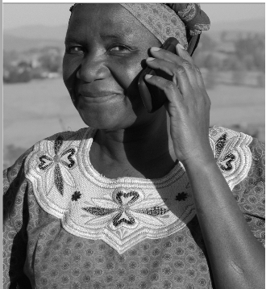
Reviewing the role of women pastoralist in conflicts in the
Horn of Africa
Kenneth Odary
Everlyne Komba
Walter Nyamato

Slide 2
Outline
Context.
Methodology & Rationale.
Findings.
Conclusions.
Recommendations.

Slide 3
Context
Occupy arid and semi arid region of the Horn of Africa.
Populated by nomadic pastoralists communities.
Except two, most are minorities within the national boundaries.
Case of triple marginalization.
Share similar values such as patriarchy, traditional practices.
NR conflicts over pasture, water and land.
Proximity to failed or formerly failed states.

Slide 4
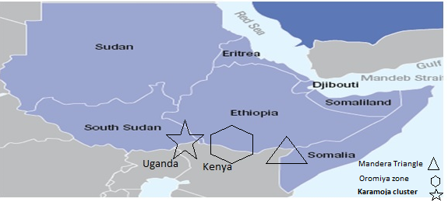
Context

Slide 5
Methodology & Rationale
Methods;
  Existing Data Approach.
  Open ended interviews of knowledgeable persons.
Rationale;
  Resolution 1325 & SDG 16.
  Personal experience.

Slide 6
Findings
“Mothers of war and Mothers of Peace.”
Various roles;
  Combat .
  Cultural.
  Reproductive.
  Confict/Peace.

Slide 7
Findings
Prestige of Marriage- Women can and do demand higher bride price / custodians of sons inheritance.
Oral folklore – combination of poems, sonnets and songs that appeal to male ego.
Blood oath – Quid pro quo/ “A knife for a life.”
Hero worship – idolization and symbolism.
Cultural;
  Karamoja Cluster
  Oromiya Zone
  Mandera Triangle
Notes:
Women praise raiders bringing large herds of cattle, burden of unsuccessful son

Slide 8
Findings
Reproductive role;
  Karamoja Cluster
  Oromiya Zone
  Mandera Triangle
Prestige of bearing sons- Women bearing sons do get a higher social ranking.
Gender shaming - mockery of male folk/ shame of not raiding.
Feminineness – ability to birth future generation.

Slide 9
Findings
Conflict resolution/peace;
  Karamoja Cluster
  Oromiya Zone
  Mandera Triangle
Symbols of peace and new beginning -Dual loyalty of women , Grassroot mobilization by Dekha Ibrahim in Wajir.
Notes:
Only one case that is well documented

Slide 10
Findings
Political – Expansionist.
Economic – Commercialization of cattle raiding.

Slide 11
Conclusion
Women;
  Engage actively in conflicts.
  Assumed vulnerability obfuscates reality.
  Inadequate conflict analysis.
  Not goal oriented in pursuit of conflict or peace – opportunistic and not strategic.

Slide 12
Recommendation
Build women’s mediation capacity – make it more strategic.
Engender the peace and mediation processes.
Adopt and institutionalize preventive approaches that target women.
Build knowledgebase of women’s role in conflicts.
Bring in more women into the mediation spaces occurring at different levels.

Slide 13
END.

