Slide 1
Heterogeneous Effects of Land Acquisitions on
Conflict in Africa
Prof. Jann Lay, Prof. Alexander de Juan,
Daniel Geissel and Rebecca Lohmann
GIGA German Institute for Global and Area Studies
Monrovia, November 2019

Slide 2
Previous research on LSLA violent conflict
Competing expectations on LSLA effects
Negative income effects, displacement, land scarcity vs. employment creation, infrastructure development (Jiao et al. 2015; Schoneveld et al. 2011; Nolte et al., 2016; World Bank, 2011).
Mainly single case studies on LSLA and conflict
LSLAs can increase competition over land and job opportunities, raise horizontal inequality among groups and thereby create state-society and communal tensions (Jensen/Søensen, 2012; Deininger et al. 2011; De Schutter 2009).
Aggregate quantitative analyses
Only few cross-case studies; analyses are spatially and conceptually aggregated – country-level, no differentiation of types of violence (Balestri/Maggioni 2019; Krieger/Meierrieks 2016).
➔ Little systematic evidence on specific effects of LSLA on conflict

Slide 3
How can LSLA increase the risk of violent conflict?
- Potential differential effects of LSLA on different types of violence
LSLA
State repression
Violent mobilization
Communal violence
The state may apply (preventive) violent repression in order to prevent any local resistance that may jeopardize the LSLA
(Expected) Negative repercussions of LSLA may motivate local mobilization against investors and/or the state
LSLA increase land scarcity and provide new job opportunities; both processes may instill distributional conflicts

Slide 4
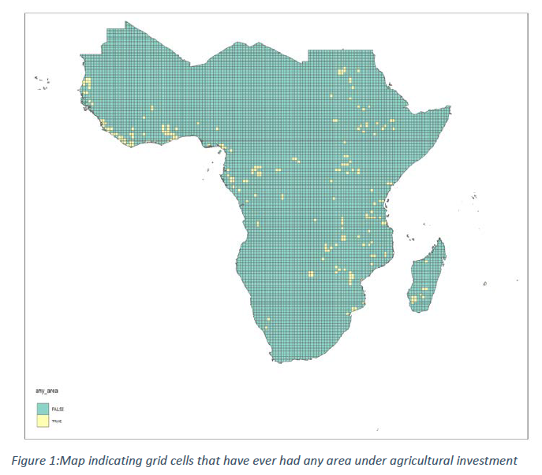
Data
Land Matrix: 1500 investments since 2000
Armed Conflict Location & Event Data Project (ACLED), 1997 – 2019
observational unit: grid-cells from the PRIO-grid database with
0.5°x0.5°, translating into 2500-3000km² (variation due to projection)
location information only in form of point data
with information about the size we create circular buffers
used to create a dummy variable for the presence of an LSLA
Notes:
The extensive Land Matrix dataset is filtered to contain only deals with a size greater than 200 ha, to exclude oil or gas extraction, to exclude pure contract farming, to be transnational, to deals after the year 2000, and to exclude mining and forest concessions. Based on this we obtain information
by year on the operational size of the plantations and on the size of the area under contract (typically leased).

Slide 5
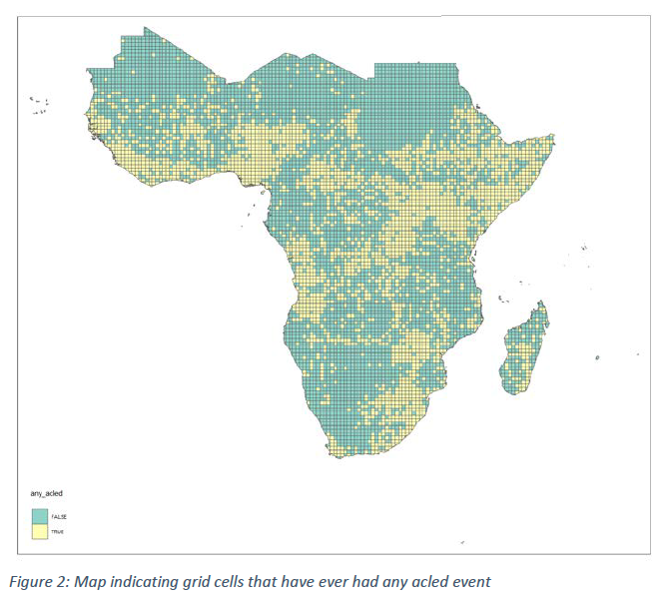
Data on violent conflict
- The Armed Conflict Location & Event Data Project (ACLED)
Academic/non-governmental initiative; collates georeferenced data on political violence and protest around the world
Includes events that occur within civil wars and periods of instability, public demonstrations, and regime breakdown.
ACLED’s aim is to capture the forms, actors, dates, and locations of political violence

Slide 6
Data on violent conflict
- Measurement of outcome variables
Actor-based differentiation of three type of violence in ACLED data:
LSLA
State repression
Violent mobilization
Communal violence
State security agencies or political militias
vs.
Civilians
State security agencies or political militias
vs.
Protesters, rioters, communal militias
Communal militias, protesters, rioters
vs.
Communal militias, protesters, rioters, civilians

Slide 7
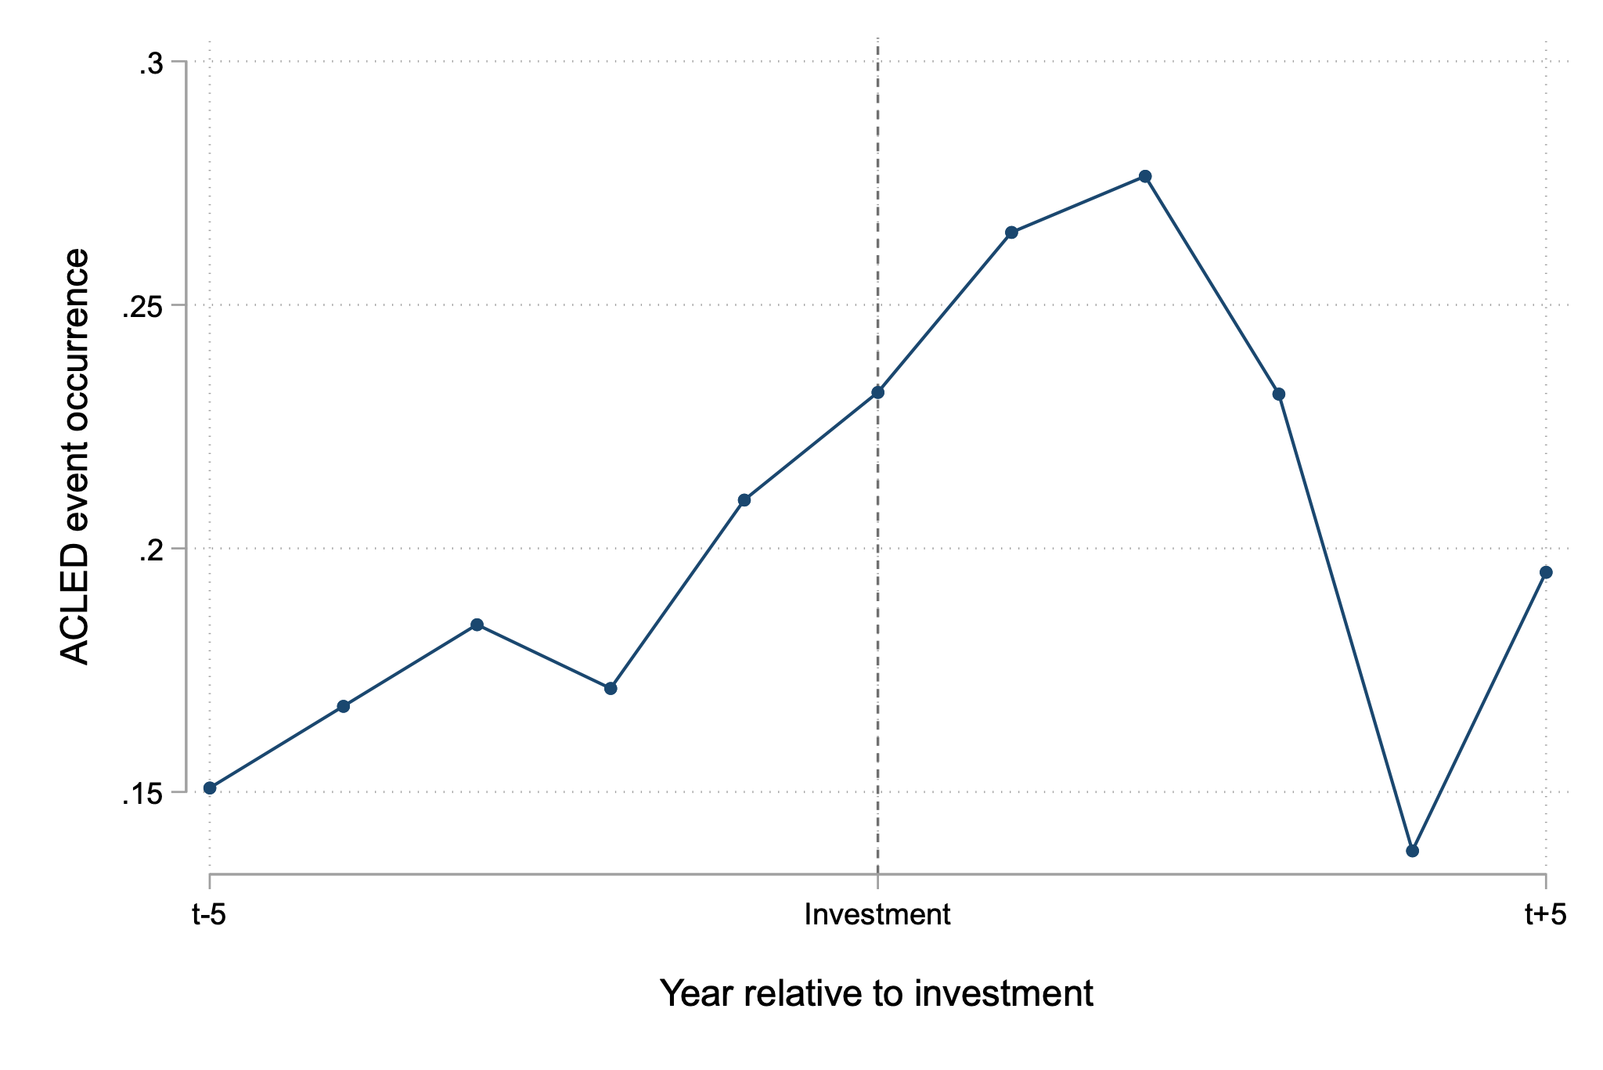
Descriptive analyses
- temporal development of violence relative to LSLA onset
Average event incidence (y/n) over time; sample of grid cells that have experienced at least one LSLA
Notes:
investment = conclusion of contract

Slide 8
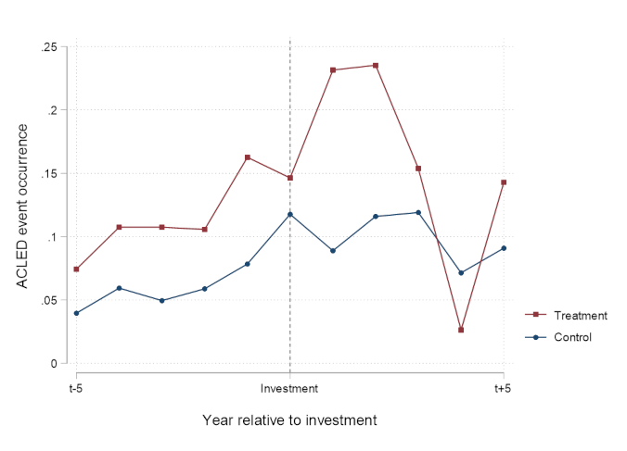
Descriptive analyses
- effects of LSLA on conflict over time – relative to other areas
Average event incidence (y/n) over time; sample of grid cells that have experienced at least one LSLA compared to matched control group (coarsened exact matching based on pre-treatment covariates; LSLA dates of matched treated unit)

Slide 9
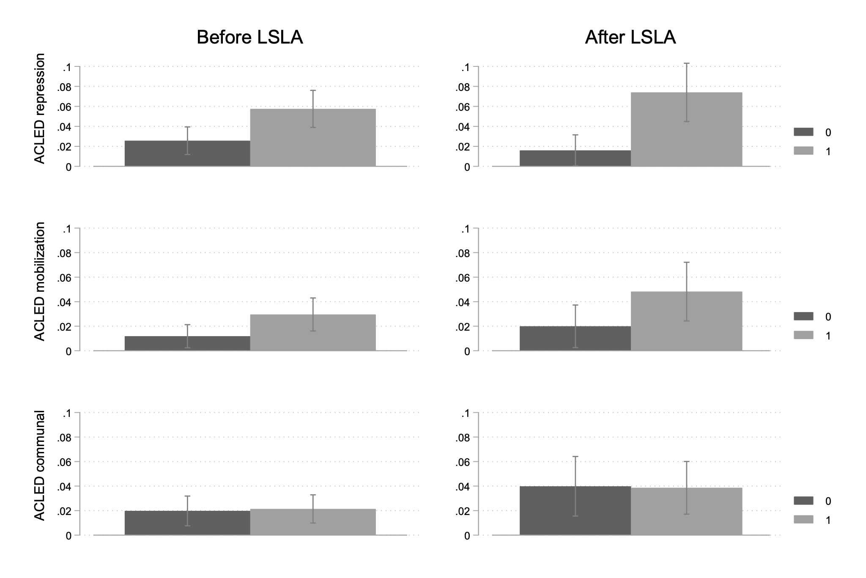
Descriptive analyses
- effects of LSLA across types of violence
Average event incidence (y/n) before and after LSLA; sample of grid cells that have experienced at least one LSLA (1) compared to matched control group (0)

Slide 10
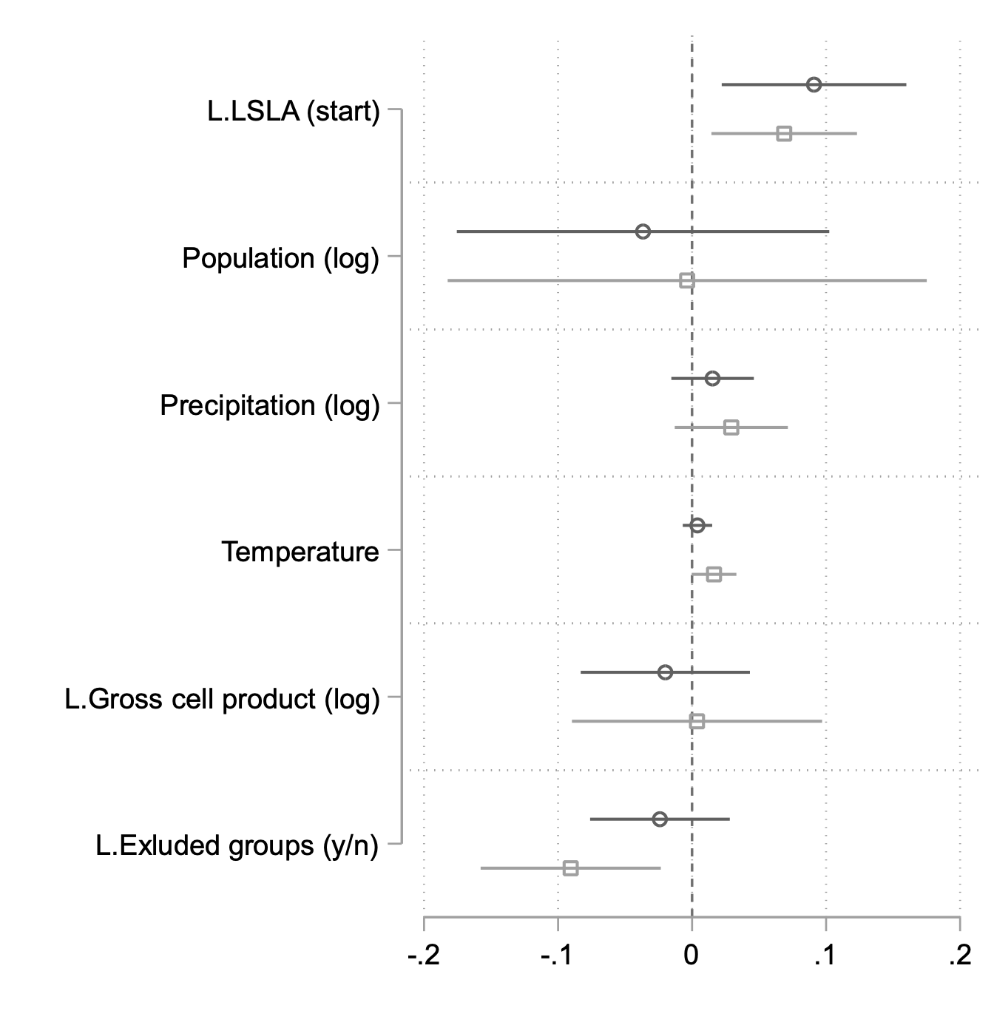
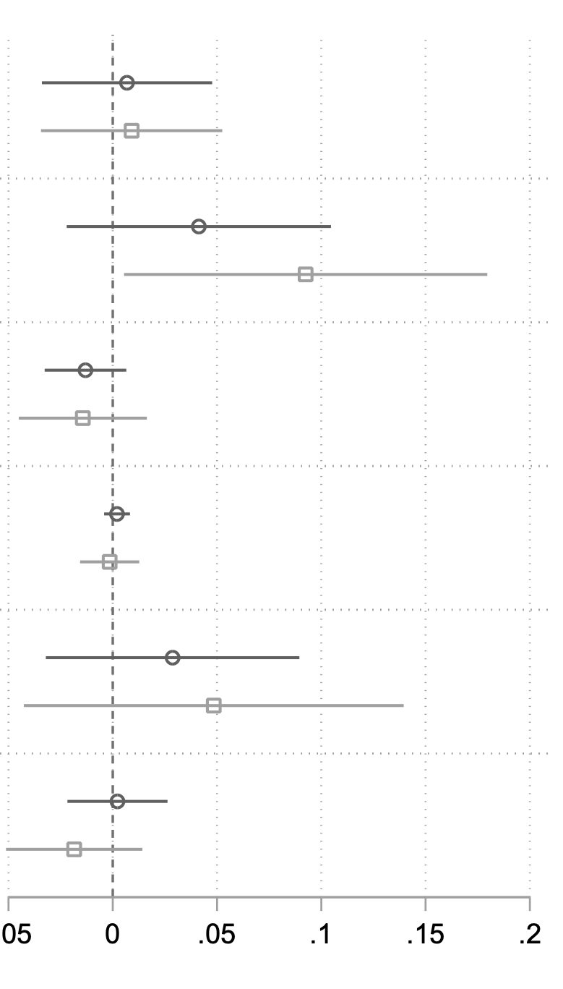
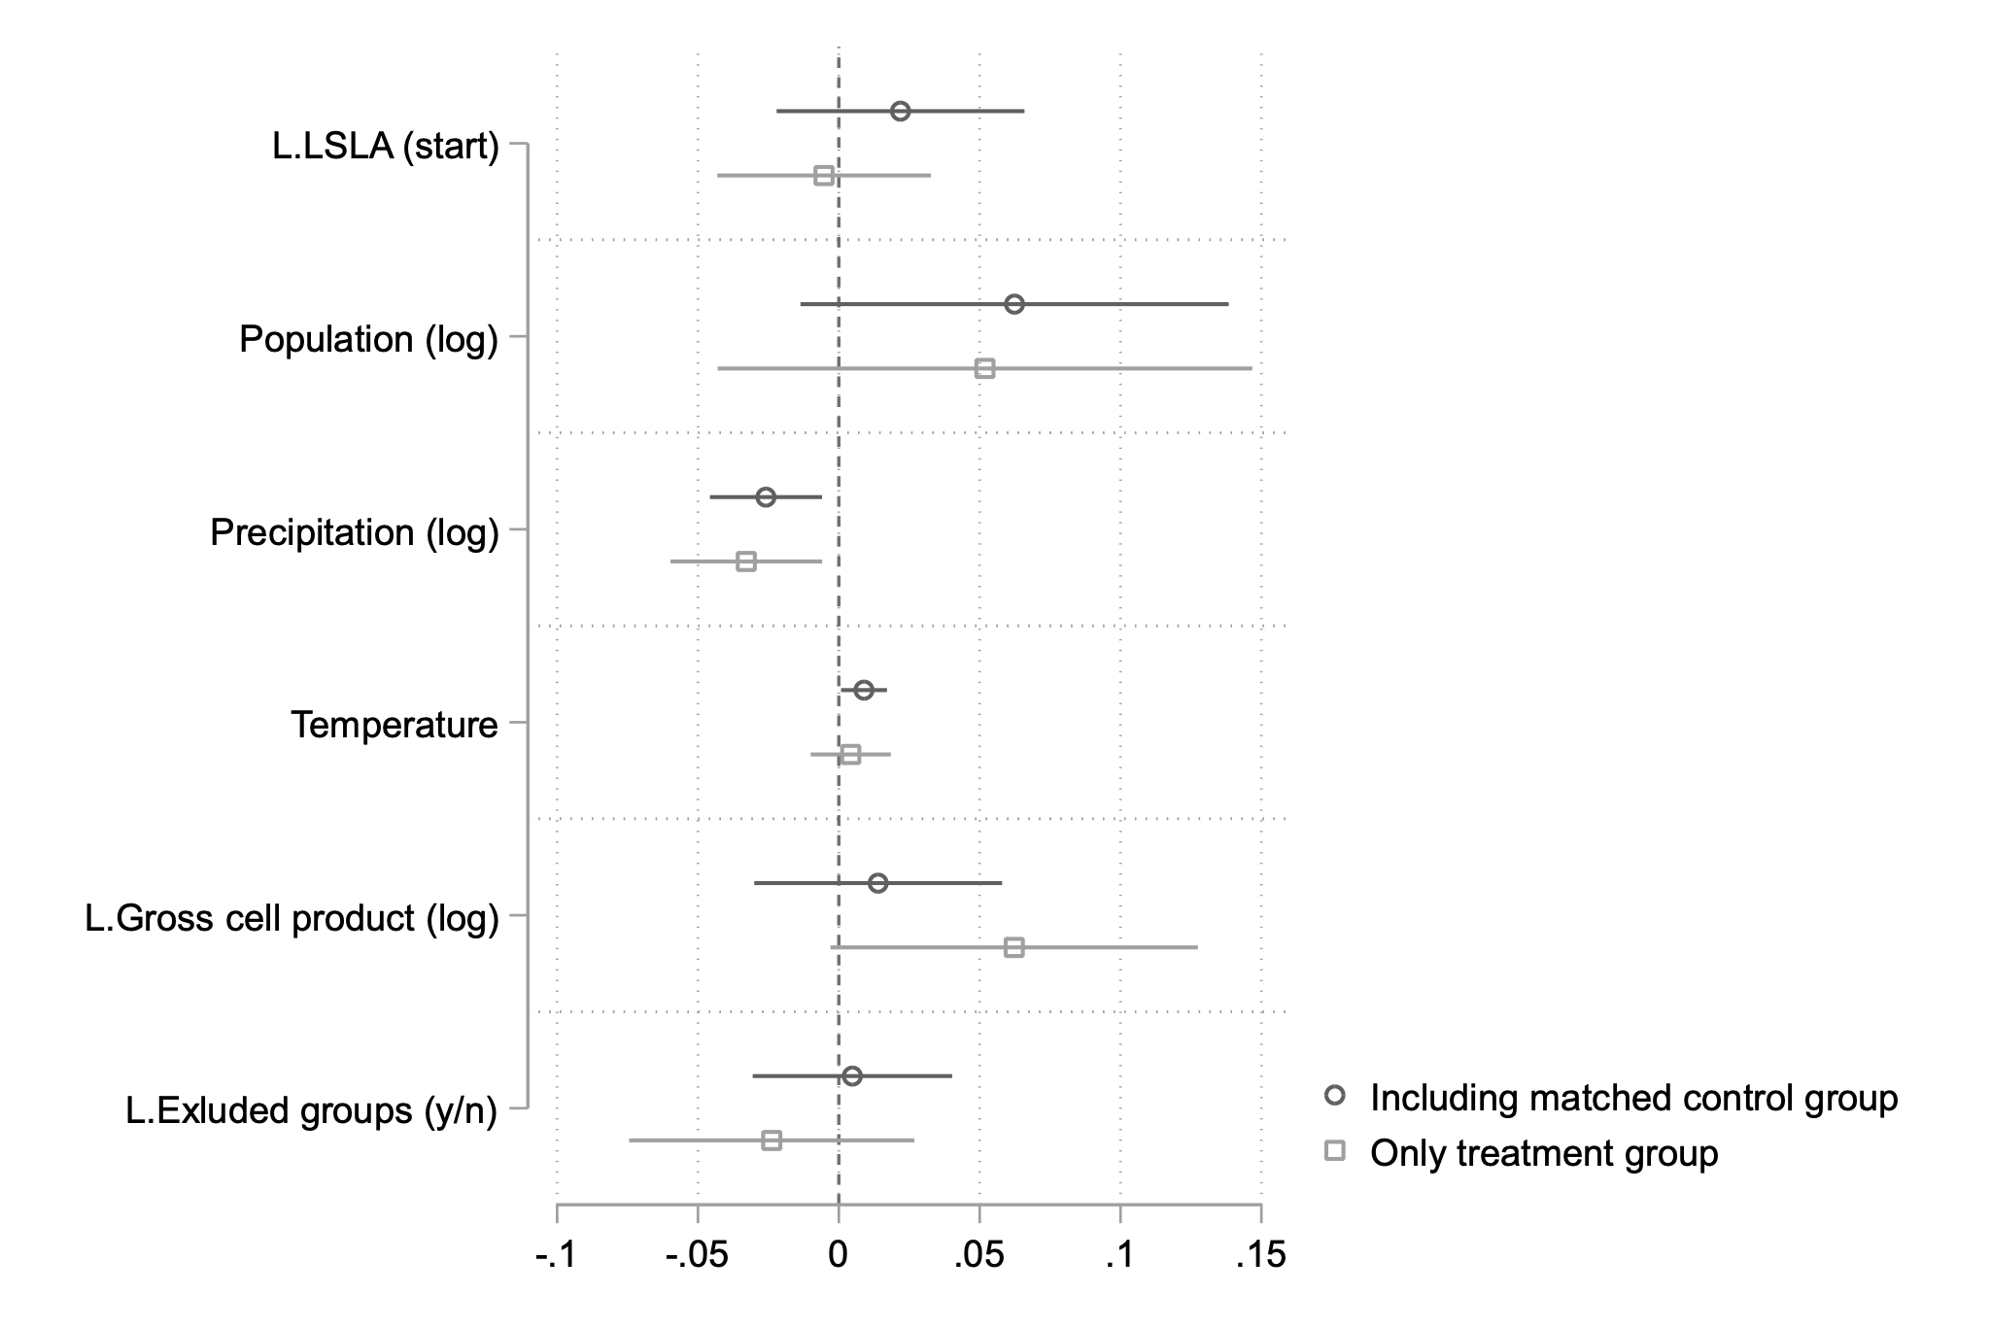
Regression analyses
- effects of LSLA across types of violence
Repression
Mobilization
Communal
LPM, unit fixed effects, standard errors clustered per unit, all models include cubic polynomials to account for time dependencies

Slide 11
Heterogeneities
forms of violence are affected differently, strong effects on repression and mobilization
important dynamics in relation to conflicts, e.g. conflicts rise in anticipation of large-scale land deals
important transmission channels
  (expectations on) land loss and distribution
  (expectations on) employment effects
investigated via a survey in Liberia in the proximity of two large plantations
  so far first insights and anecdoctal evidence, the survey is so far partly implemented

Slide 12
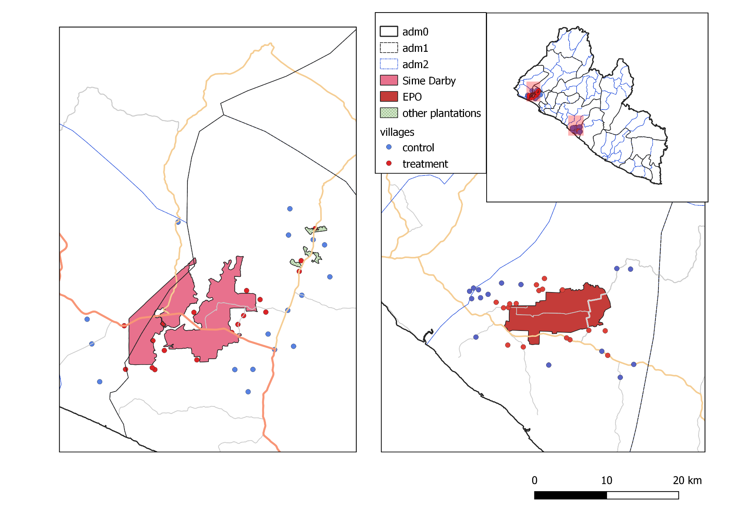
Study Regions in Liberia

Slide 13
Case Study: Liberia
Sime Darby and Equatorial Palm Oil (EPO)
  investors took over old plantations and partly expanded
  Sime Darby transformed rubber into oil palm plantations
  EPO replanted oil palm
  new investors displaced few people
land rights
  EPO is indemnifying communities that have been affected 50 years before from the prior investor
  now people are mobilizing against new intentions of plantation expansions

Slide 14
Case Study: Liberia
employment:
  people have high expectations towards employment possibilities on the plantations
  in the Sime Darby region labour-intensive rubber plantations were replaced with oil palm – expectations on employment possibilities are hard to meet
  precarious working conditions
    irregular and unreliabe salary payments
    particular forms of employment via sub-contractors, i.e. many workers do not have direct contracts with the plantation company
  Sime Darby has been laying off many workers recently and it said to abandon the investment

Slide 15
Outlook
completion of data collection and systematic analysis of the effects of employment and land loss on household welfare and conflict implications
  Who gets the jobs?
  Which households are particularly affected by land investments?
Beyond the Liberian case:
  further investigation of the dynamics including of the implementation status of projects, e.g. project failure
  systematic investigation of the context factors, e.g. conflict history, quality of institutions and ethnic composition

Slide 16
Merci beaucoup
Thank you

