Slide 1
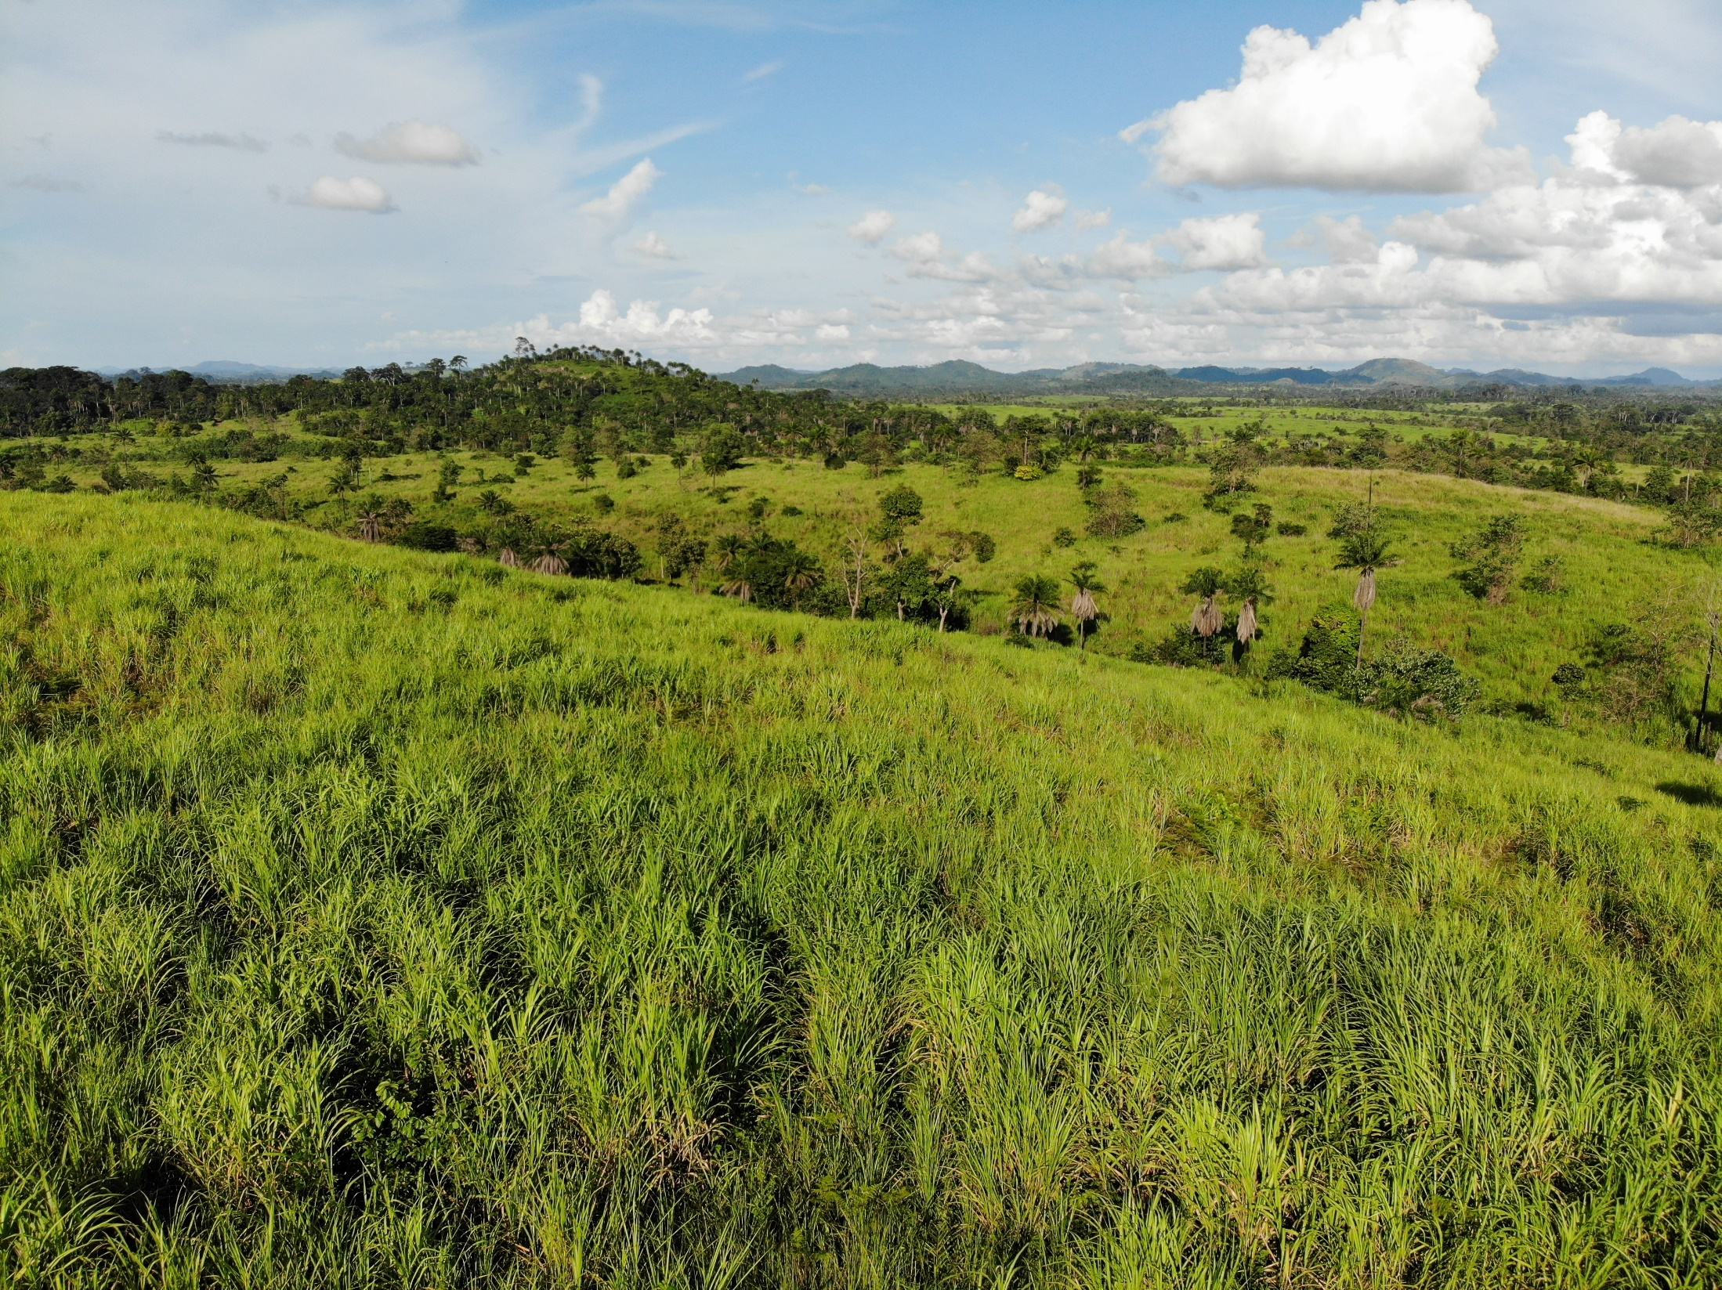

Participatory Land Use Planning for Equitable and Inclusive Development in Rural Customary Communities
Case STUDY FROM LIBERIA
Hon. Ellen O. Pratt
Commissioner of Land Use and Management Liberia Land Authority
Uriah Garsinii, Liberia Land Authority

Slide 2
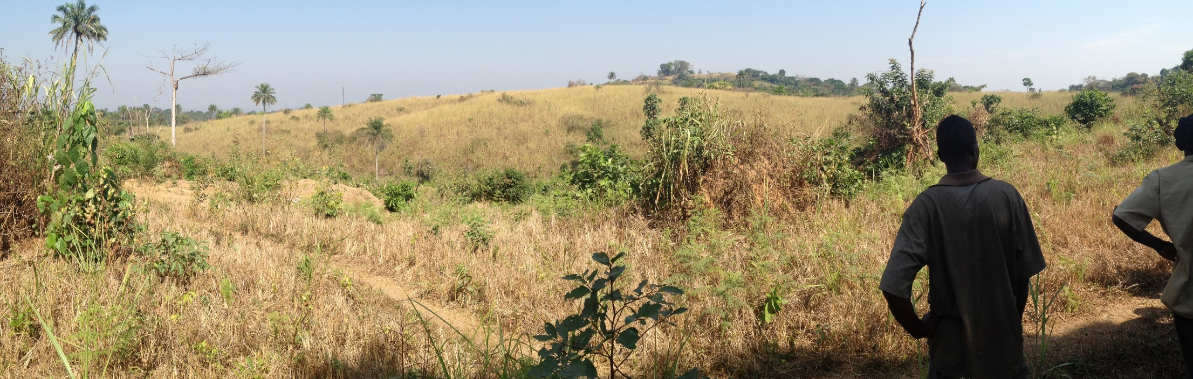
What are the challenges and opportunities of bottom-up land use planning as part of tenure reform?
Distill lessons that can inform tenure reform processes and land use planning processes in other communities in Liberia
Develop a Land Use Planning Guide

Slide 3
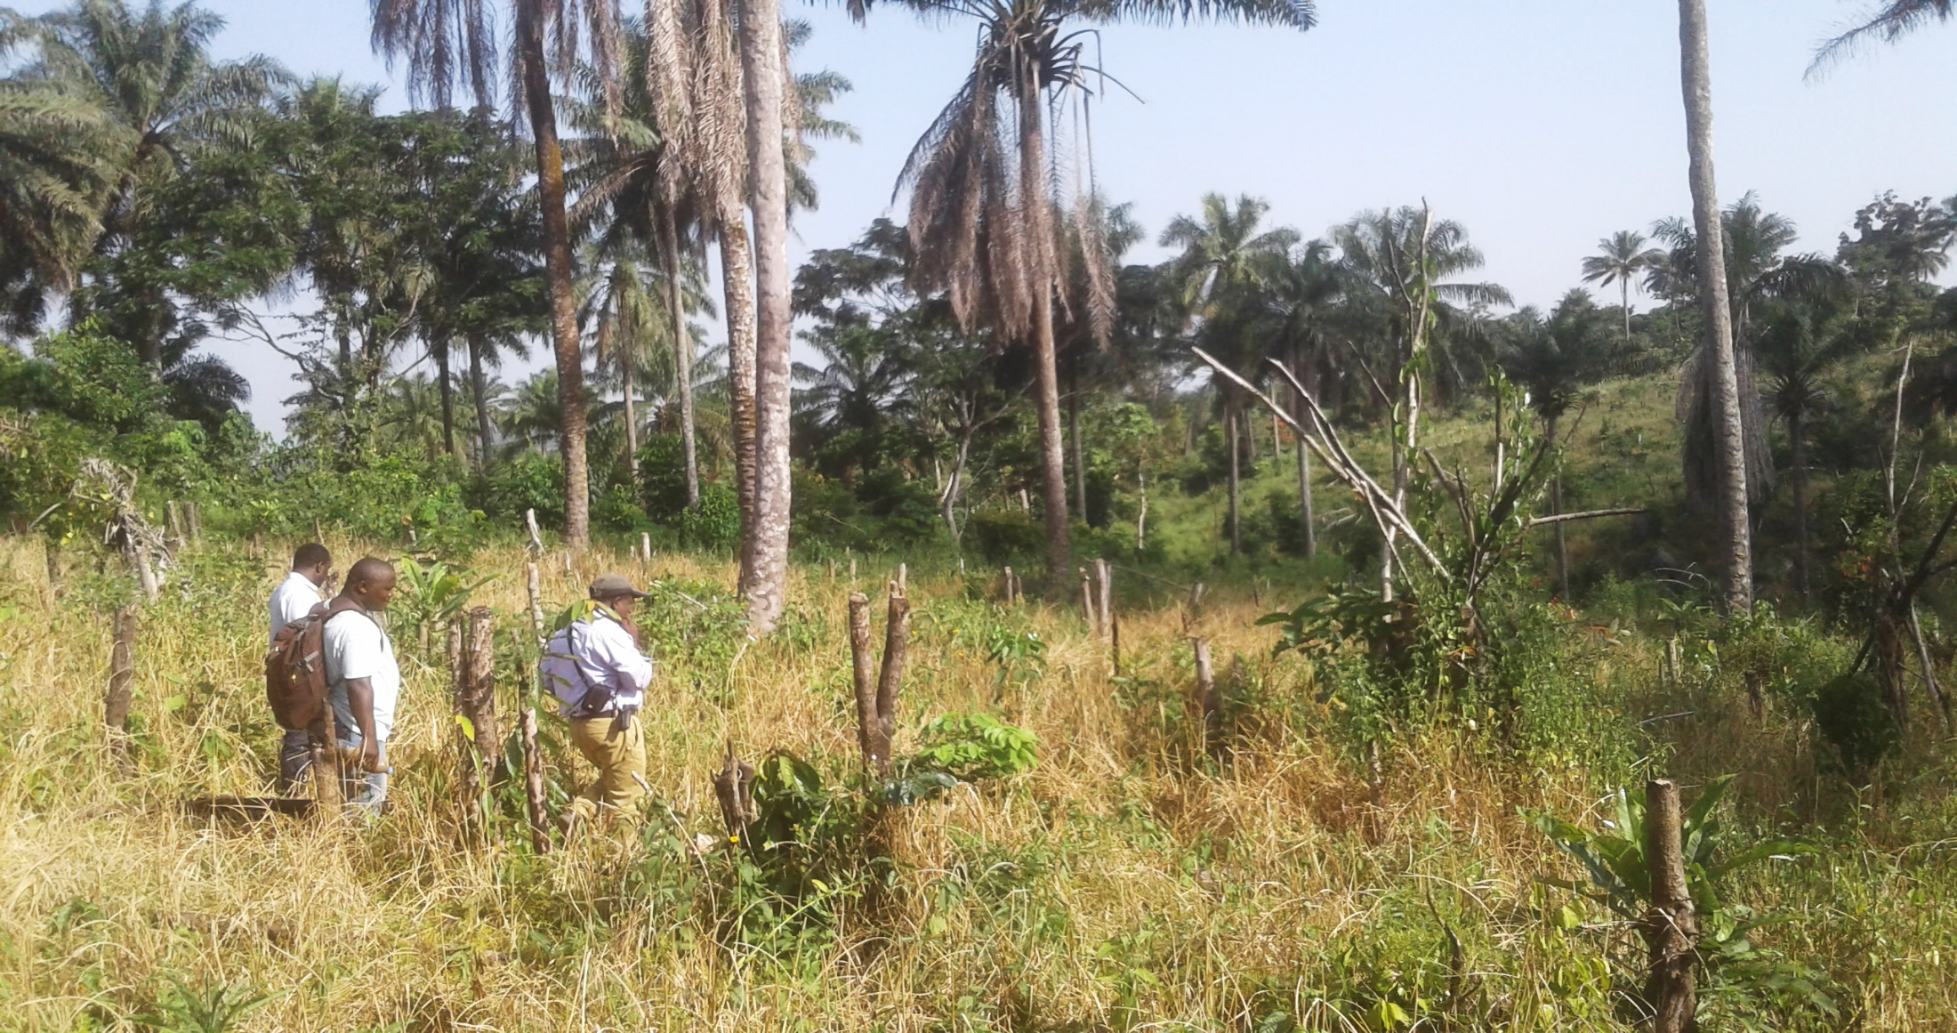
Thematic Focus
Rapid urbanization, sustainable land use and spatial planning, taxation and development control theme
Specific focus on inclusive land use and management planning.

Slide 4

Policy Implications
“The origins of the conflict can be traced to two broad factors. First, significant portions of society were systematically excluded and marginalized from institutions of political governance and access to key economic assets… In the early days, land and property rights of most Liberians were severely limited.”
Liberia Poverty Reduction Strategy 2008
“The Government recognizes and protects the land rights of communities, groups, families, and individuals who own, use, and manage their land in accordance with customary practices and norms, equal to Private Land Rights.”
Liberia Land Rights Policy 2013

Slide 5
Legal Context
2013 Land Rights Policy
Liberia’s first Land Rights Policy (Land Commission, 2013)established four land rights categories including Government Land, Public Land, Private Land and Customary Land.
2016 Legislation to Establish the Liberia Land Authority
Liberia Land Authority was legislated to consolidate land administration functions at the National, regional and local levels and charged with a comprehensive reform of the land sector.
2018 Land Rights Law
Legal framework established to implement the Policy. “Requires every customary community to “develop a land use management plan”, as a component of the formalization process of securing customary land rights. –Article 35 Section 1.e

Slide 6
Land Administration Context
Scattered, Uncoordinated and Duplicated
“One Stop Shop” for Land Administration
LLA-LRA Implementation Strategy
Pilot projects to inform policy decisions
80% of Land is Customary

Slide 7
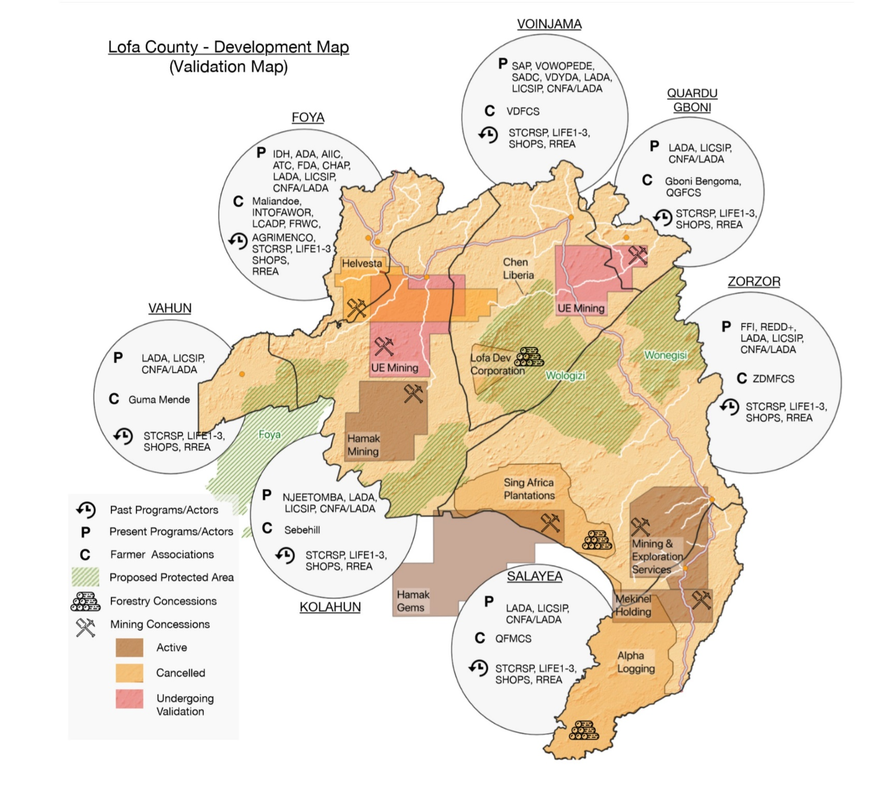
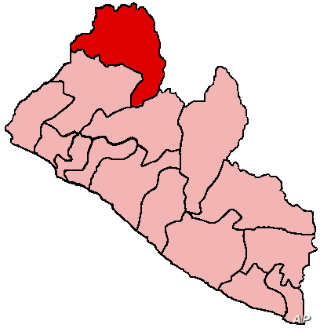
Development + Land Use

Slide 8
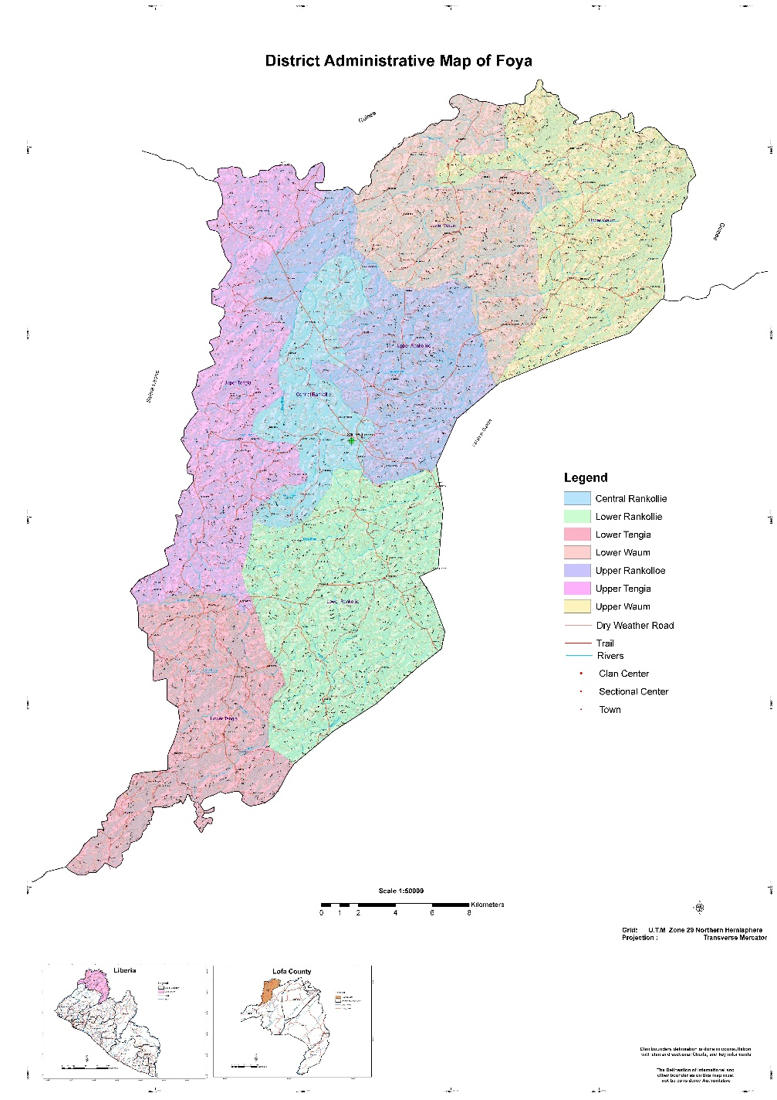
Guinea
Foya is in the Northwest corner of the Liberia, bordering Sierra Leone and Guinea.
Customary land tenure
Comprised of a mosaic of grasslands, secondary seasonal tropical forest, and agriculture land
Shifting cultivation
71,364 people (as of 2008)
Primary thoroughfare for trade and movement between the three countries.
Sierra
Leone
“Breast Basket” of Liberia
(prior to the civil crisis)

Slide 9
Participatory Planning Methodology
The land use planning process followed a participatory approach, incorporating top-down perspectives into a largely bottom-up process.
Consultancy
Project was implemented by Meta Meta Research, a consultant firm. Data collection and analysis was performed by IDH and LLA staff.
Timing
The process took place between November 2018 and July 2019.

Slide 10
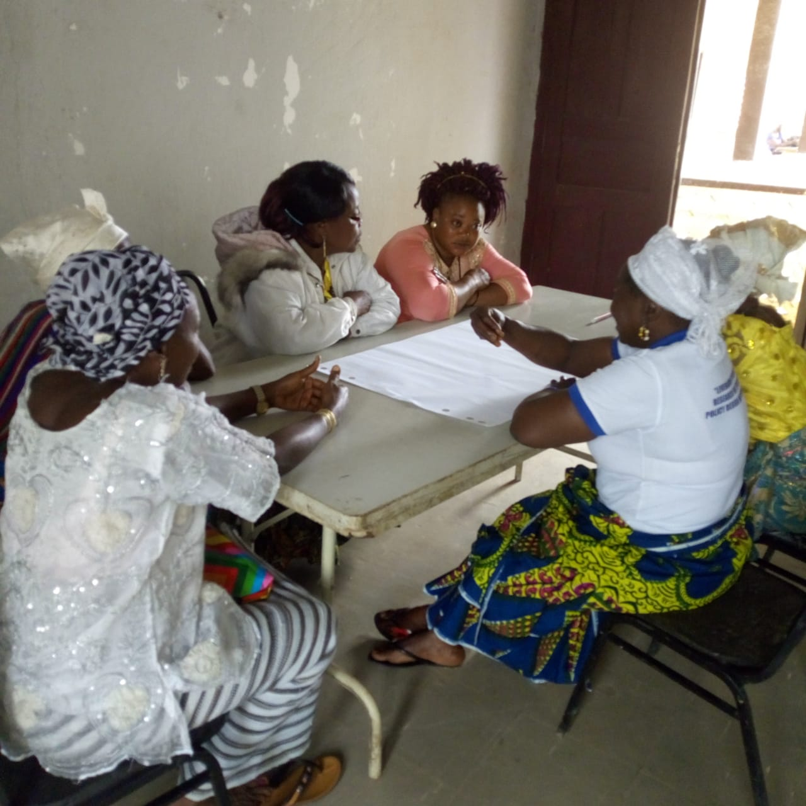
National and District Level Planning
National workshop: Government, civil society, local representatives map and vision future development efforts
Hackathon: Technical session on land cover mapping with GOL technicians
District workshop: Local government and civil society developed hand-drawn maps of district indicating current and proposed land uses

Slide 11
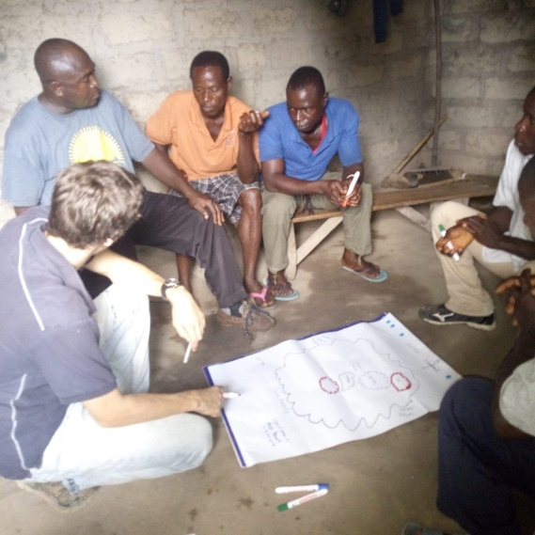
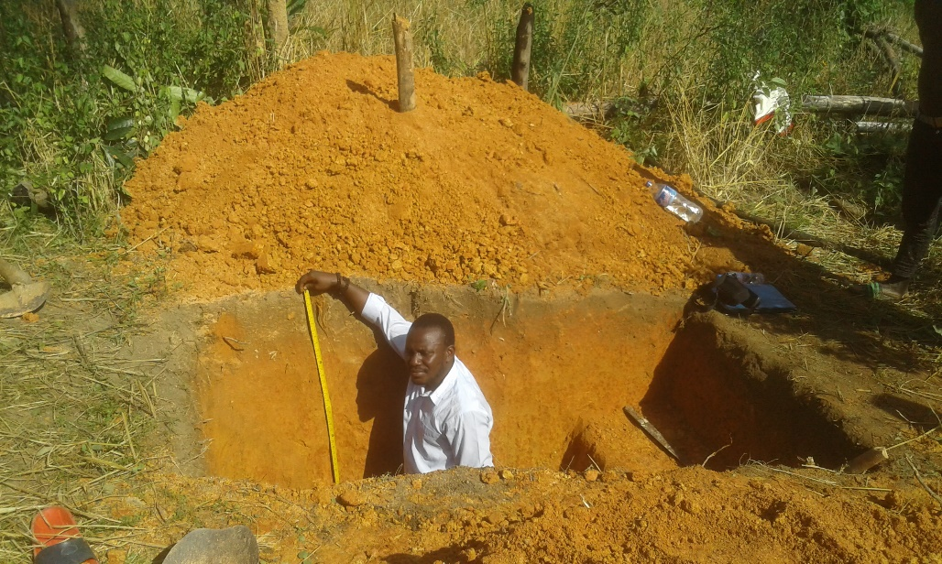
Clan Level Planning
Consultations in all (7) clans in Foya district
Participatory resource mapping, problem analysis, future land use visioning, analysis of land use conflicts
Inclusive, bottom-up approach and participatory rural appraisal
Clan-level biophysical observations: soil, water, vegetation

Slide 12
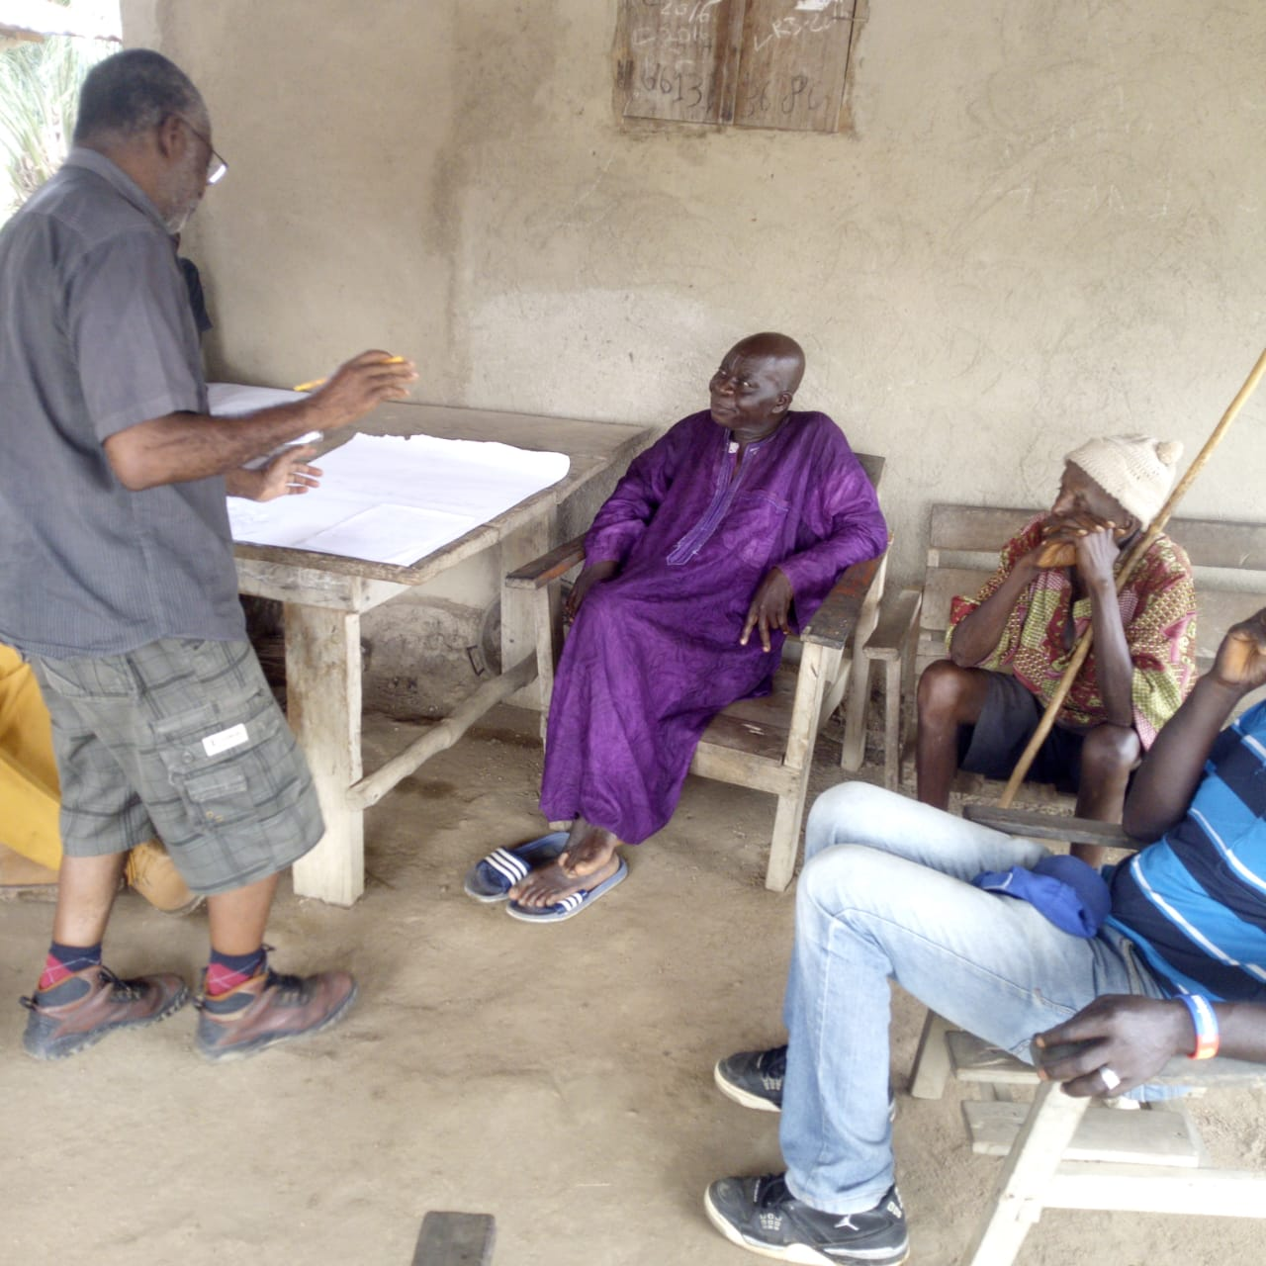
Data Collection
Goal: understand the challenges and opportunities of the process
Participant observation
Key informant interviews

Slide 13

Data Analysis
Structural Theme
Procedural Theme
Lessons about framework and institutional structure
Lessons about implementation and land use planning process

Slide 14
Structural Themes
Building inter-governmental and inter-agency support is crucial in settings that are more familiar with sectoral planning. Comprehensive (multi-sectoral) planning requires significant culture change
Need to clarify the connection between land rights reform and land use planning on the ground. Awareness raising is cardinal
Build capacity of implementing partners to support communities
Mobilize cross-sectoral group of technicians who will support land use planning processes

Slide 15
Procedural Themes
Disaggregate planning decisions by gender and age
Facilitate interactions between local and national representatives
Scale of land use planning is a critical
Strong facilitators are key to empowering local knowledge
For rural context, biophysical soil analysis and land suitability are critical components, especially for investments
Customary land formalization should be a separate process
Land-use planning on customary land needs to allow for short-term land use decisions by communities

Slide 16
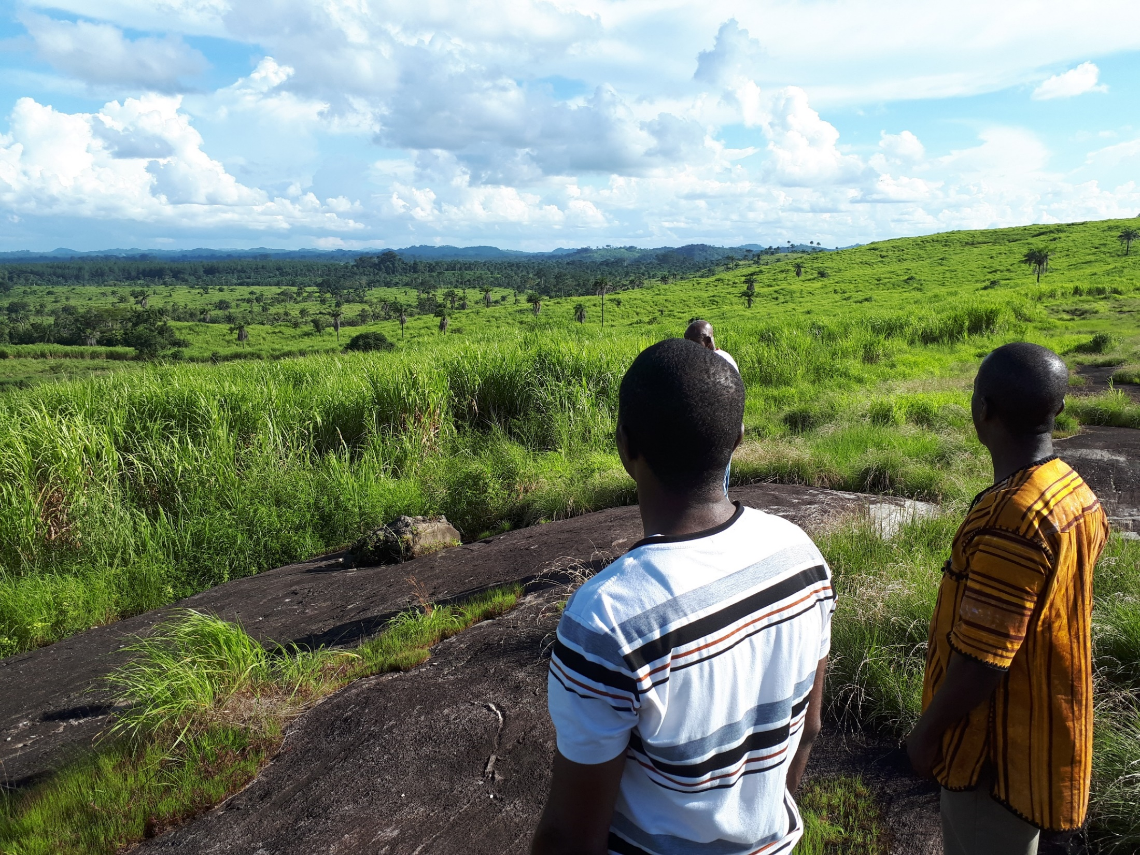
Land Use Planning Template
PREPARING FOR PLUP | 1 week
Define the scale of ‘community’ and the unit for planning
Constitute a representative PLUP group at the community level
Establish common objectives for the PLUP process
Review studies or projects that have happened in the area
COMMUNITY CONSULTATION | 2-3 days
Participatory mapping of current land uses and borders
Situation and problem analysis
Identify and agree on solutions
Prepare future land use map and plan
FINALZING THE PLAN | 3 days
Compile decisions and maps into a final plan
VALIDATING THE PLAN | 3 days
Present and validate

Slide 17
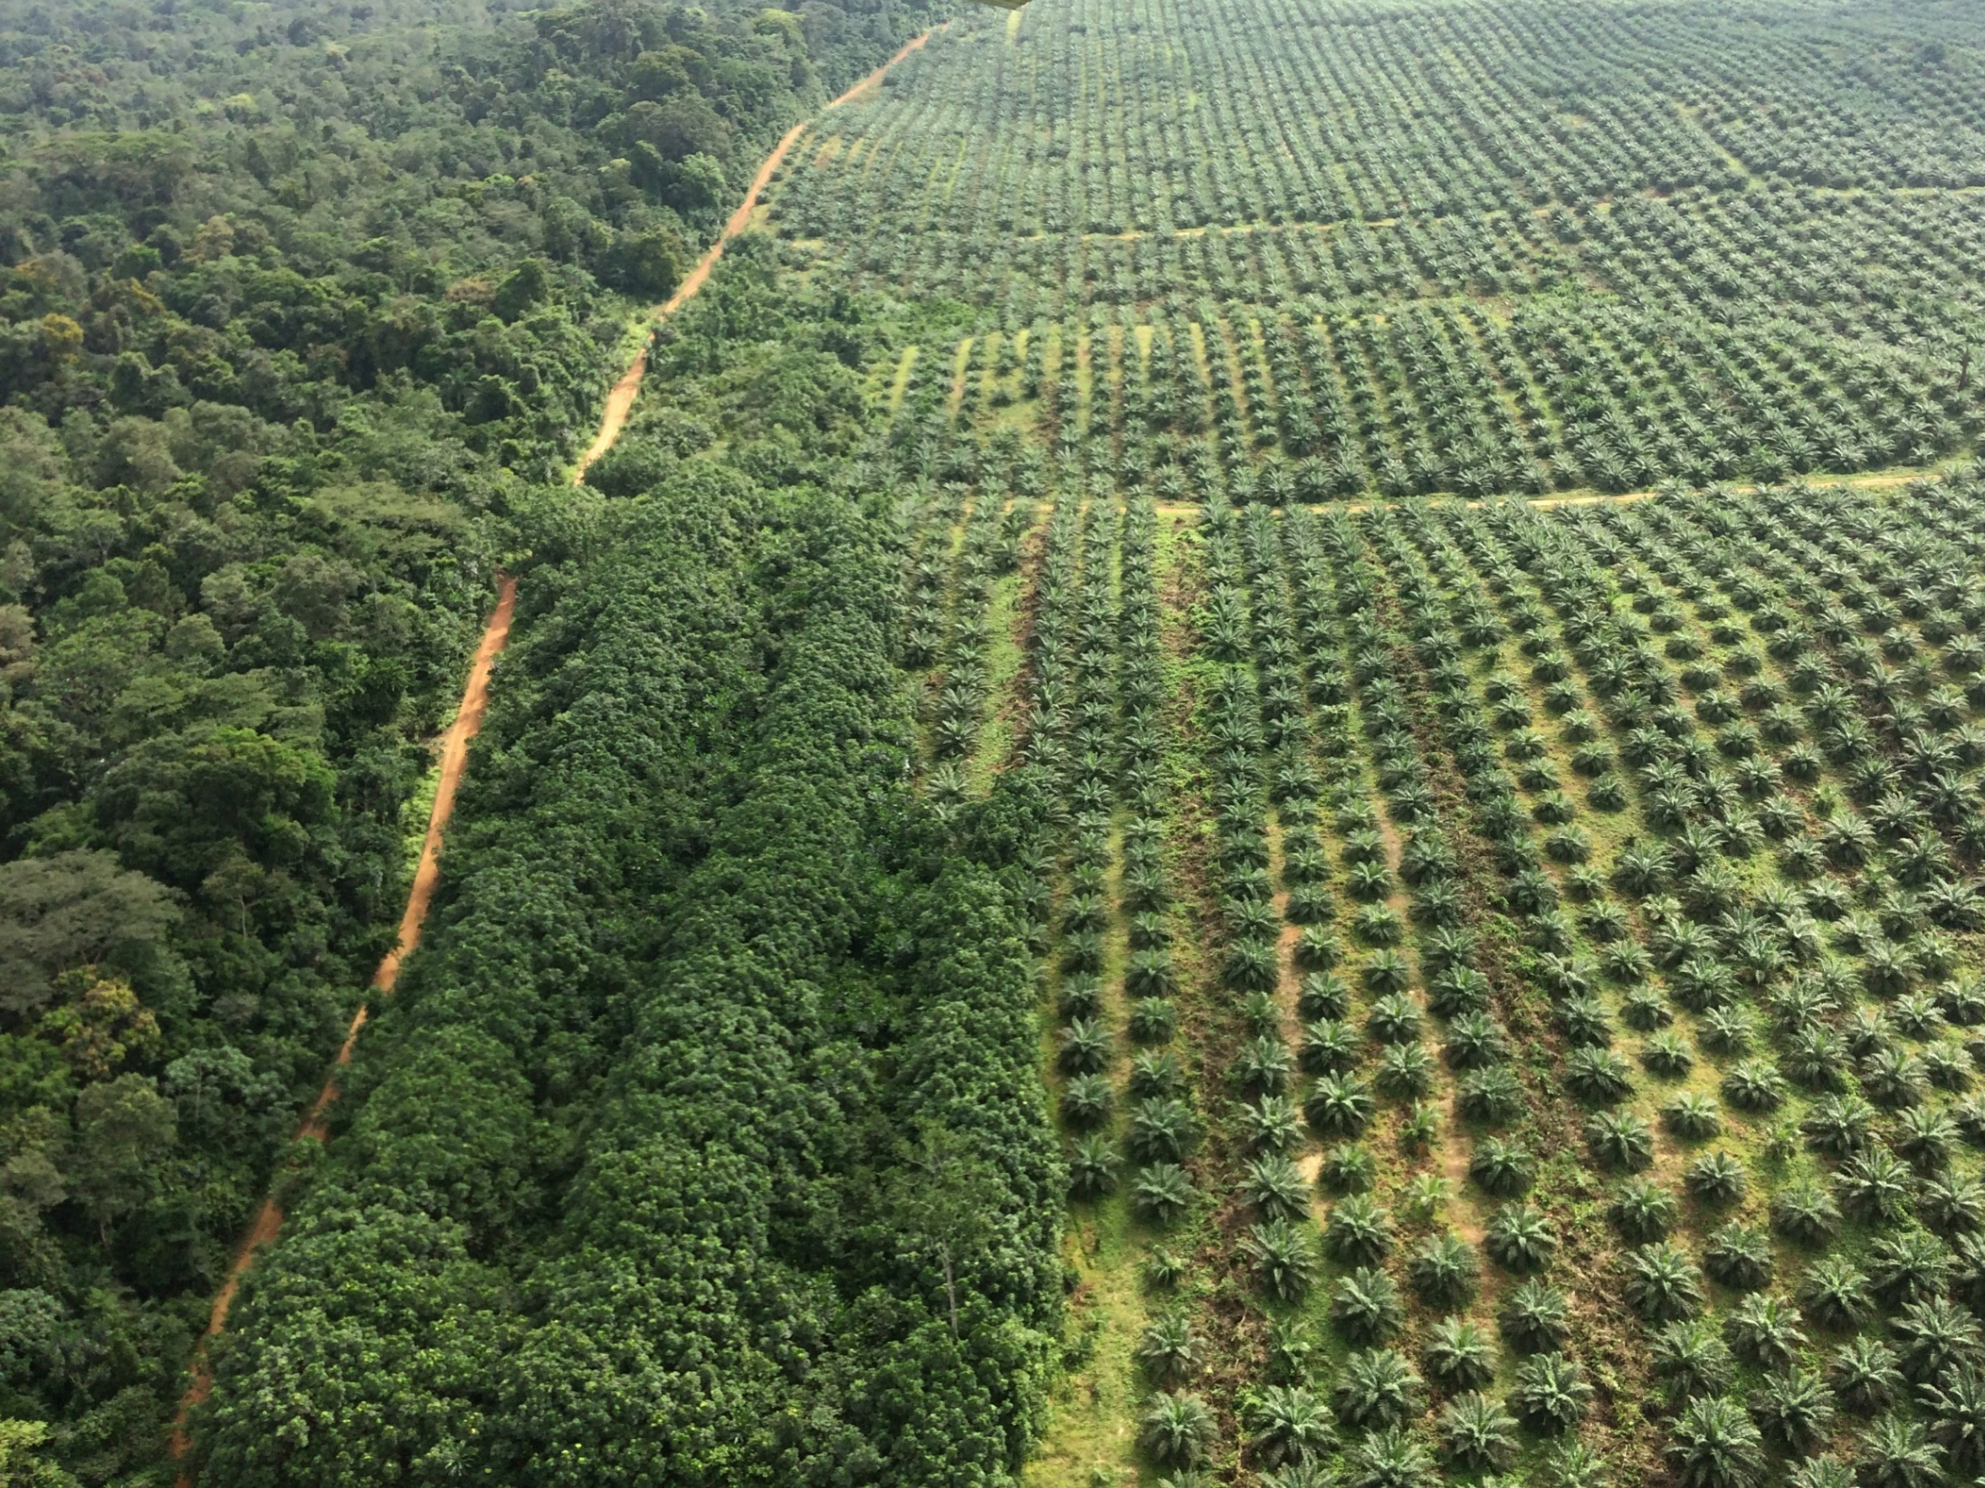
Conclusions
Land use planning tied to agricultural investments should be prioritized in Liberia
Participatory land use planning can enable transparent development
Need for regulations to systematize processes
Land use planning processes must adapt to different settings and scales

Slide 18
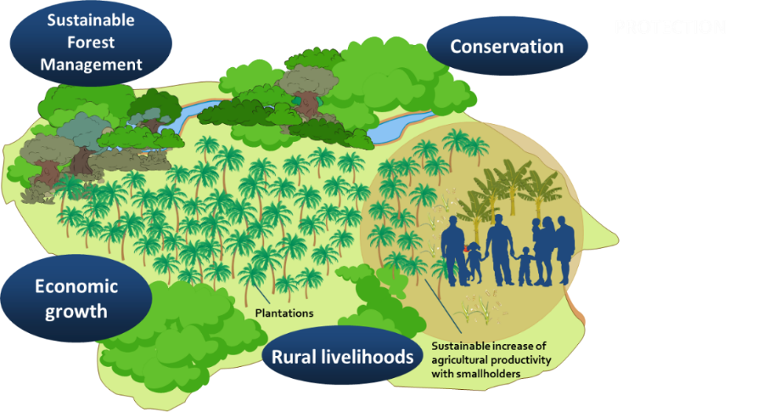
THANK YOU !!

