Slide 1



Means of implementation: bridging the gap
Perspective from the Science and Technology Community
Ministerial policy dialogue: 25 October 2011

Slide 2
BACKGROUND
Agenda 21 set the scene for economic growth that is socially equitable and environmentally responsible.
However, the means of implementation available to the continent and their utilisation, will be the main determinant of the level of success for the region on its commitments post Rio+20.
We have heard from the report and are fully aware of some of Africa’s advantages and limitations that drive her performance, or lack thereof, towards full attainment of sustainable development.

Slide 3
We are also aware of the good practices and quick wins, albeit in pockets, that can be leveraged to speed up progress in the delivery on Africa’s commitments for the achievement of sustainable development, and we need to take more advantage of these.
The report highlights NEPAD’s Plan of Action, which was one of the biggest achievements towards sustainable development. What has not been covered adequately, however, is the level of implementation of this Plan of Action, which is either not materialising as desirable or no progress reporting is happening.

Slide 4
We fully agree with the need for capacity building, but unless initiatives in this regard are targeted and harmonised for the continent to build core skills needed for sustainable development, we will continue to miss the target.
Science and Technology has been cited in a number of interventions. This increased awareness of the role of S&T is appreciated. However, we are all too familiar with the mismatch between awareness and real investments or utilisation of the benefits of S&T to achieve set objectives.

Slide 5
Identifying AFRICA’S Challenges

Slide 6
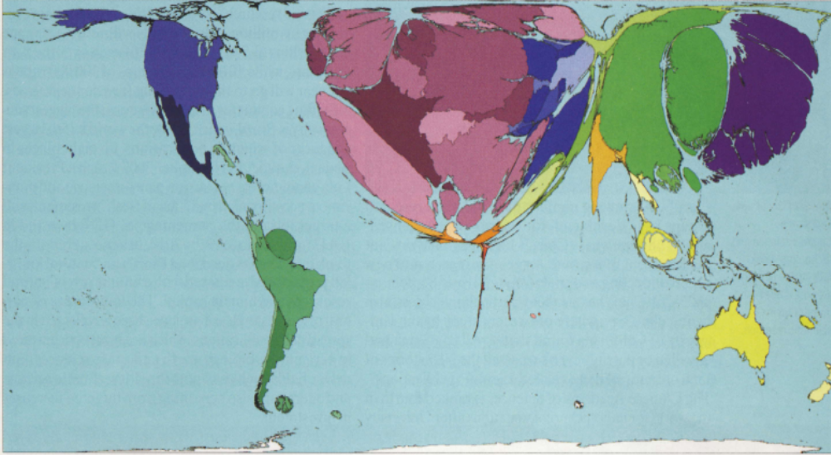
Scientific Research in Africa
Identifying AFRICA’S Challenges
A map of the world with the areas of countries reshaped in proportion to their scientific growth
Courtesy : James Wilsdon – Physics World October 2008

Slide 7
What the report has not highlighted in detail are the roles of Regional Economic Commissions in each of the areas of delivery. We know fully well that these Commissions have an important role to play in providing guidance to countries of the Region on delivering on their commitments. In this regard, the work of REC’s can provide the foundation needed by countries to build on. Rationalisation of the REC’s has a potential to make them more effective and eliminate fragmentation.

Slide 8


It is noted with concern that even though civil society is cited in a lot of these initiatives, in some cases the actions never go beyond lip-service.
Some gaps worth highlighting in the engagement of civil society are those around vulnerable groups, i.e. women and the disabled. Conscious efforts are needed in this regard.

Slide 9
Indigenous knowledge systems are another gap that needs to be bridged. Indigenous people is a stakeholder group need protection of its intellectual property rights, documentation of its natural and intellectual resources, as well as provision of formal platforms for knowledge sharing to enable it to share and bring IKS into mainstream science, to produce greater benefits to society. Green economy can benefit a great deal from this science.
We as the Science and Technology major group believe that so much can be achieved through innovative ways of doing what we do everyday, with rationale use of little resources, and a little external help.

Slide 10
Recommend of key policy messages to be taken into account in drawing up the consensus statement
Increased and concerted efforts by countries towards the full implementation, monitoring and evaluation of NEPAD’s Science and Technology Consolidated Plan of Action, which promises to be an effective vehicle for the attainment of sustainable development.
Use of Science, Engineering,Technology and Innovation (SETI) and the results thereof, including technology transfer, as pillars for sustainable development. We need to utilise research data to generate evidence-based policies for implementation, and also invest in and advance SETI to find sustainable solutions to Africa’s development problems.

Slide 11
3. Still on SETI, African states also need to safeguard against potentially unsafe technologies with negative impacts on already vulnerable populations, and do technology assessments as a norm to ensure that what they are investing in is indeed beneficial, sustainable technology.
4. Waking up to the reality that with the Western World budgets consistently suffering such pressures like the Eurozone economic crisis and overindebtedness, and other big economies targeting areas that may not be priority for Africa, development aid is fast drying up. African countries need to be more innovative in mobilising their own resources and using them effectively. Establishment of an African Development Fund is needs to be explored.

Slide 12
5. Employing robust monitoring and evaluation strategies that will continually inform countries on the level of achievement of targeted results on the performance indicators. This includes countries subjecting themselves to the APRM process and adaptation of the APRM to cover elements of post-Rio+20 evaluation programmes for various countries.
6. Engaging all stakeholders (in particular, major groups and vulnerable groups) in seeking solutions that advance the implementation process of the Rio+20 commitments, and building their capacities to facilitate their meaningful engagement.
7. Investing in capacity building and skills development for sustainable development through harmonised strategies.

Slide 13
8. Reinforcement of legal, political and diplomatic frameworks to ensure the accountability and enforcement of the implementation of internationally and nationally agreed commitments (for example, the commitment of African countries to devote 1% of GDP to SETI); and monitoring of the progress on these commitments in each African country.

Slide 14
9. Using synergies that some effective strategies potentially have in addressing more than one challenge, e.g
African women are one of the major players in utilization of the forest product fuelwood, in that they use it to cook meals and heat water for their families. This means that most of the fuelwood consumed in Africa is consumed by households, and collected by women and girls. Fuelwood collection and charcoal production contribute to desertification. If we want to reduce desertification, we must disseminate improved cookstoves (efficient fuelwood and charcoal stoves) in African countries. Good practices on these exist in Kenya, amongst others. Ripple effects of efficient wood and charcoal stoves are: reduced burden on women, women's health improves as they don’t spend long hours around open woodfires, they collect fuelwood fewer times as the stoves use minimal fuelwood and charcoal, forests have time to be regenerated, and there is less carbon emission by fuelstoves as a result of using few pieces of fuelwood and charcoal'.

Slide 15
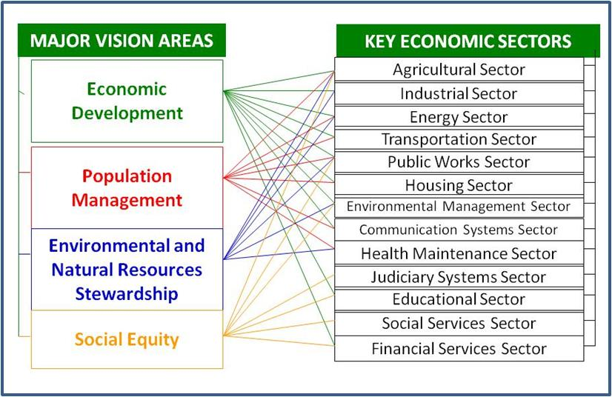
LINKAGES BETWEEN THE FOUR CARDINAL SUSTAINABLE DEVELOPMENT VISION AREAS AND ECONOMIC SECTORS

Slide 16
Thank you
Merci

