Slide 1

AGENDA 2063 FIRST TEN YEAR IMPLEMENTATION PLAN
By
Admore Chakadenga M&E Expert on
30-10- 2017
(M & E UPDATE….)

Slide 2
PRESENTATION OUTLINE
 | What is it? The AU A2063 M&E Framework: What is already done Indicator Handbook: Major components of indicator Profiles M&E Framework Snapshot Regional Value in the M&E of Agenda 2063 Outlook

Slide 3
The AU A2063 M&E Framework: What is it.
Is a guiding document on monitoring, evaluation, accountability and reporting
‘Guiding book’
Overarching Principles
  Implementation and Monitoring is primarily national responsibility
  Leverage Regional and Continental Value for enhanced action

Slide 4
Purpose
Common M&E Framework for MS, RECs and AU Organs
Reinforcing culture of accountability at all levels
Measuring regional and continental value addition to national action
Fostering convergence in M&E of the FTYIP and SDGs
Encouraging evidence based learning
Encouraging participation and ownership

Slide 5
Origins
Adoption of FTYIP by AU Summit in June 2015
Summit directives on M&E
Technical Committee (AUC/NEPAD, RECs, ECA, AfDB, ACBF, APRM
Validation Process

Slide 6

The AU A2063 M&E Framework: What is already done
Draft M&E Framework & Indicator Handbook developed (May 2017)
63 Core Indicators Agreed to
[Dec 2016]
Validated by National Planning Experts
Awaiting Approval by Policy Organs
Widespread roll out is the next step
Technical working formed
First Ten-year A2063 Implementation Plan (Results Framework)
[Jan 2015]
Widespread consultation
Mapping of Agenda 2063 and SDGs
AU Summit Commitment Decision on the A2063 vision in 2013
AUC, NEPAD, JSSO, AfDB, UNECA, ACBF, PAP, 8 RECs, ASSD,
Measurable goals and targets (desired change/ impact; outcomes, outputs)
Political agenda

Slide 7
Convergence reminder…
AGENDA 2063 FTYIP
7 Aspirations ; 20 Goals, 39 Priority Areas, 256 Targets, 242 (63 Core) Indicators Social Sustainability Cultural Economic Political Others
17 SDGs
Social - 169 Targets
Economic - 231 Indicators
Sustainability etc

Slide 8
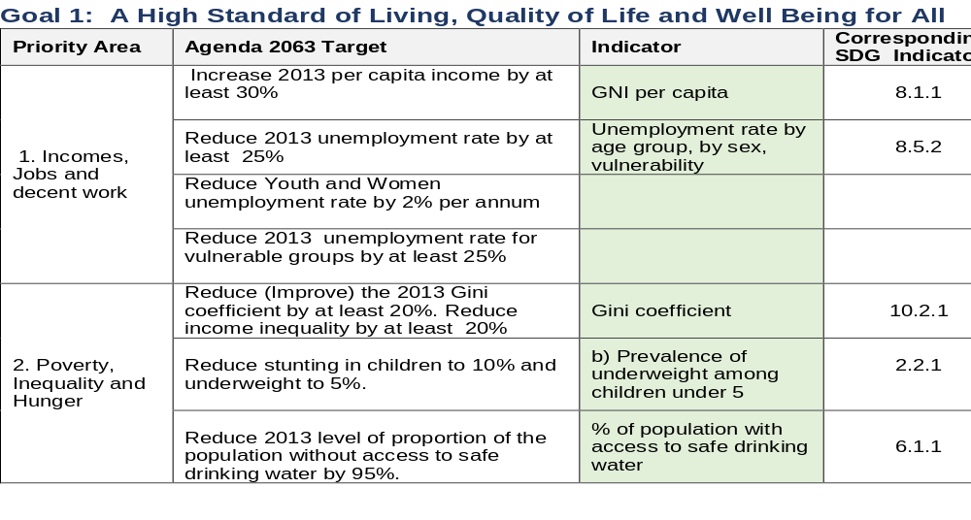
Mapping of the final list of indicators

Slide 9
Indicator Handbook: Major Components of Indicator Profiles
4. Data Collection Methods, Data Sources, Data Analysis & Reporting Methods and Frequencies
3. Unit of Measurement and Disaggregation
2. Indicator Computation Formula
WHEN, WHERE & how: Defines freq. of data collection, analysis and reporting, incl. data limitations
1. Indicator description, relevance and definition of key terms
Specifies unit by which magnitude is accounted for. Also allows for breakdown of data values into constituent parts
HOW: standardising the computation of indicator values
Focus is on WHAT & WHY

Slide 10
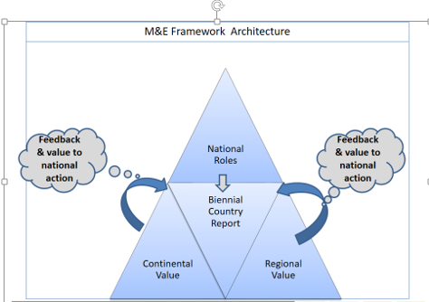
M&E Framework snapshot

Slide 11
Role of RECs in M&E of Agenda 2063
Organize annual forum for member states to review regional monitoring and evaluation performance on FTYIP
Facilitate/coordinate the preparation of an integrated regional M&E report on the implementation of the FTYIP by member states and regional programmes
Strengthening national capacities for the monitoring and evaluation of FTYIP
Facilitate/coordinate the assessment of the implementation effectiveness of the resource mobilization plans of member states on FTYIP execution

Slide 12

OUTLOOK | WAYFORWARD
Implementations of the FTYIP M&E Framework | RECS to play the lead roles in the domestication the M&E Framework Strengthened Partnership between AUC/NEPAD/RECs and the UN System Consideration of additional SDG indicators and adoption by the EC Widespread role out including Working with RECs and MS to domesticate M&E Framework.

Slide 13
Thank You

