Slide 1

Ethiopia’s STI Policy, Strategy and Updates
Prof. Afework Kassu Gizaw
State Minister
Ministry of Science and Higher Education, Ethiopia

Slide 2
National Innovation System of Ethiopia
The Prime Minister
S&T Council
TOP LEADERSHIP
MOST
S&T Related Ministries
Execution
NationaI
IP&STI System
National Quality System
GRI
Financial Support
Universities
S&T
University
LI
Innovation Support & Research System
SMME
Tech Parks,Incubation Centre
TVET
Quality General Education
The Base
People and Culture
Notes:
Innovation is the implementation of creative inspiration. The National
Innovation Initiative (NII) defines innovation as “the inter-section of invention and
insight, leading to the creative of social and economic value” Innovation is “value” – the
creation of value adding value to customer’s satisfaction- “delighting the customers”.
Innovation is the basis of all competition advantages, the means of anticipating and
meeting customer’s needs and the method of utilization of technology.

Slide 3







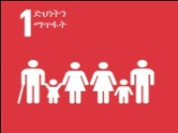














National Development Priorities and Their Alignment with SDGs
 | National Development Priority Areas in GTP II | Sustainable Development Goals
1 | The Agriculture Sector remains the Source of the rapid Economic growth.
2 | Expediting transformation of the economic infrastructure by enabling the manufacturing industry grow by leaps and bounds.
3 | Prioritizing Productivity, Quality and Competitiveness by increasing Efficiency in order to reach the Full Production Capacity of the Economy
4 | Correcting the Imbalance between the Gross Demand Level and the Gross Supply Level
5 | Building/Reinforcing capacities in the Construction Industry Development and Project Management

Slide 4
























National Development Priorities and Their Alignment with SDGs
 | National Development Priority Areas in GTP II | Sustainable Development Goals
6 | Adopting Urban Administration and Management comparable with the Rapid Urbanization, Industrialization and Structural Changes
7 | According due precedence to transform Domestic Investors
8 | Supporting the Human Resources Development Efforts with Technology
9 | Building Climate Resilient Green Economy
10 | Upholding Developmental Perspectives by eliminating Rent-Seeking Attitudes

Slide 5
STI Priorities
Agriculture
Health
ICT
Energy
Manufacturing
Water/Irrigation
Mining
Agro-Processing
Leather/Textile
Foods/Beverages
Metals
Pharmaceuticals
Chemicals
Construction Inputs

Slide 6
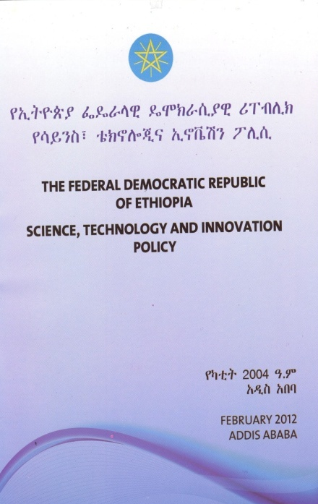

1. The FDRE STI Policy
The STIP of the FDRE was issued in 2012 replacing the National Science and Technology Policy that was adopted in 1993.
This policy primarily comprises general directions and major implementation strategies identified upon series of consultative discussions held with stakeholders.

Slide 7
2. Vision, mission and objectives of the STI policy

Slide 8
2.1 Vision
The vision of the STI Policy is based on the national vision: “to see Ethiopia become a country where a democratic rule, good governance and social justice reigns upon the involvement and free-will of its peoples, and once extricating itself from poverty becomes a middle-income economy as of 2020-2023.”
Accordingly, the STI vision of the country is:
“To see Ethiopia entrench the capabilities which enable rapid learning, adaptation and utilization of effective foreign technologies by the year 2022/23”

Slide 9

2.2. Mission
To create a technology transfer framework that enables the building of national capabilities in technological learning, adaptation and utilization through searching, selecting and importing effective foreign technologies in manufacturing and service providing enterprises.

Slide 10
2.3. Major objectives of the policy are:
1. Establish and implement a coordinated and integrated general governance framework for building STI capacity;
2. Establish and implement an appropriate national Technology Capability Accumulation and Transfer (TeCAT) system;
3. Promote research that is geared towards technology learning and adaptation;
4. Develop, promote and commercialize useful indigenous knowledge and technologies;
5. Define the national science and technology landscape and strengthen linkages among the different actors in the national innovation system;
6. Ensure implementation of STI activities in coordination with other economic and social development programs and plans;
7. Create conducive environment to strengthen the role of the private sector in technology transfer activities sustainably.

Slide 11
3. Policy directions and strategies

Slide 12
3. Policy directions and strategies
Based on the national STI problem analysis and assessment of the characteristics of countries selected as benchmarks for their best practices, eleven critical policy issues are identified.
Technology Transfer,
Human resource development,
Manufacturing and service providing enterprises,
Research,
Financing and incentive schemes
National quality infrastructure development,
Universities, research institutes, TVET institutions and industries linkage,
Intellectual property system,
Science and technology information,
Environmental development and protection, and
International cooperation.

Slide 13
3.1. Technology transfer
The issue of technology transfer should primarily focus on devising a system of learning, adapting and utilizing as well as disposing of imported technologies in order to meet national demand.
The national capability to learn, adapt and utilize foreign technology is still at a very low stage.
Hence, appropriate support will be given to create capabilities which enable to search, select, adapt, and utilize effective foreign technologies that support development needs.

Slide 14
Technology Transfer Strategies
1. Import effective and appropriate foreign technologies and create capabilities of adaptation and utilization of these technologies in manufacturing and service providing enterprises;
2. A system to search, select, adapt, utilize as well as dispose imported technologies should be established and implemented;
3. Establish and implement a system to use foreign direct investment (FDI) and other ways of supporting technology transfer;
4. Strengthen technology transfer among and between various manufacturing and service providing enterprises;
5. Strengthen wide use of intellectual propriety, standards and other related information in support of technology transfer.

Slide 15
Examples
Ministry of Foreign Affairs:
- National Business and Economic Diplomacy Forum
- Infrastructure and Engineering Technology Transfer Committee – solutions to challenges of technology transfer issues
Ministry of Innovation and Technology:
- Technology Roadmaps development – identifying required technologies in 24 priority sectors for middle income Ethiopia
Ministry of Science and Higher Education
Linkage forums
Sector specific TT activities
Universities (50 public and 174 private HEIs
TVET (1547 TVET Colleges)
Research Institutes/Centers of Excellence in Universities)

Slide 16
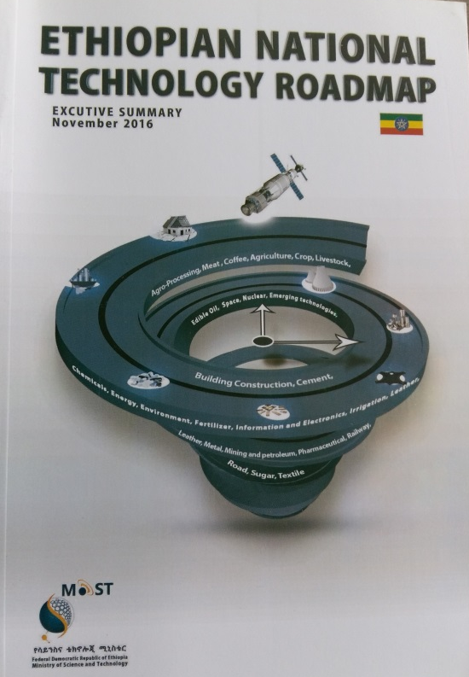
National STI Road Maps Implementation
Tech-Roadmap in 24 Sectors
Agriculture (crop & livestock), agro-processing (meat & coffee), sugar, irrigation, cement, mining & petroleum, energy, railway, road construction, building construction, information and electronics, metal, chemical, textile,leather, pharmaceutical, environmental, fertilizer, edible-oil, space, nuclear, and bio & emerging technology roadmap

Slide 17
3.2. Human resource development
To search for, select, diffuse, adapt and use technologies from other countries competent local technicians, engineers and scientists are needed.
In Ethiopia the level of qualified manpower capable of transferring foreign technology is low, certainly inadequate to facilitate the effective transfer of technology.
Hence, the national education and training system will need to place emphasis on producing engineers and natural scientists in manufacturing and service providing enterprises; qualified in understanding and utilizing appropriate technologies.

Slide 18
Human resource development Strategies
Develop science and technology institutions that focus on producing highly qualified technicians, engineers and scientists in line with the demand of the national economy;
Focus on modifying the balance of the enrollment numbers of higher education students in favor of the science and technology human resource development need of the country and conduct practical training in cooperation with industry;
Increase the number of females enrolling in engineering, science and TVET institutions;
Enable the establishment of workforce in manufacturing and service providing enterprises with the knowledge and skills necessary to learn, adapt and utilize technology.

Slide 19
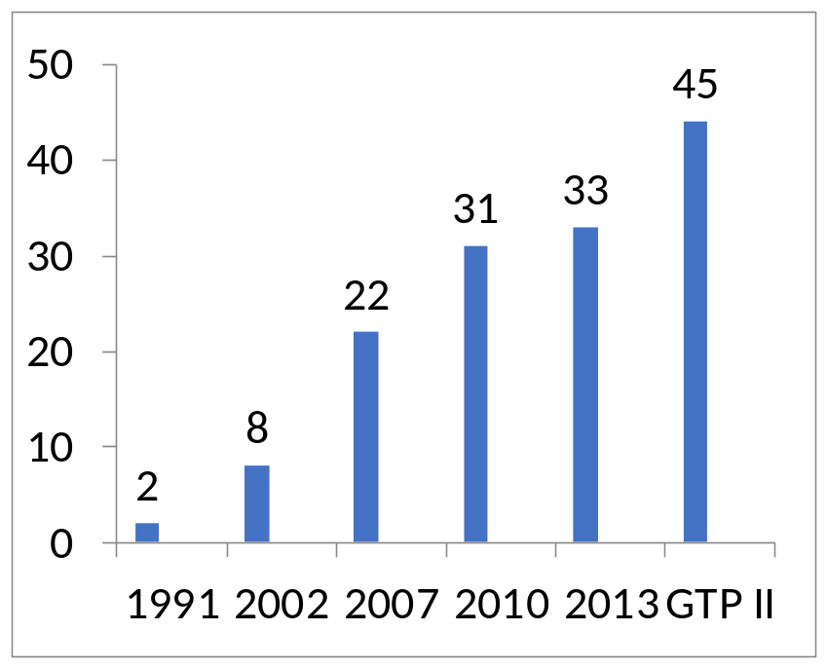
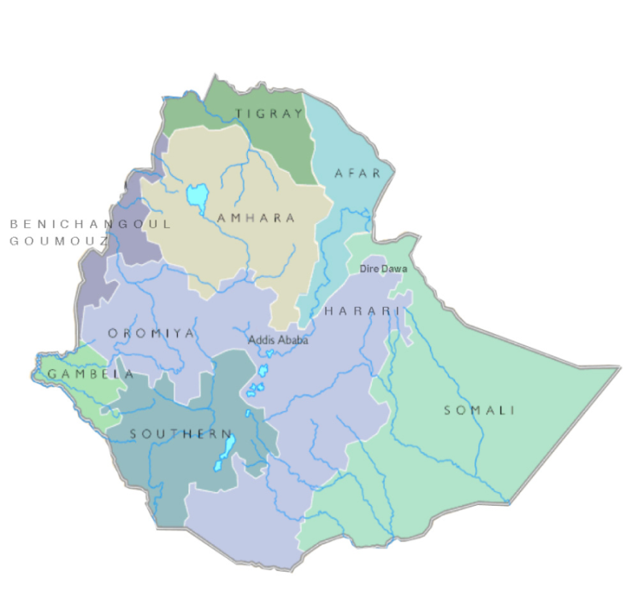
Ethiopian HEIs Landscape
2 Universities up to 1991
1. Addis Ababa University
2. Haramaya University
21 Universities 1992 - 2009
Adama University
Aksum University
Ambo University
Arba-Minch University
Bahir Dar University
Debre Birhan University
Debre Markos University
Dilla University
Dire Dawa University
Gonder University
Hawassa University
jigjiga University
Jimma University
Mekelle University
Mizan Tepi University
Semera University
Sodo university
Wollega University
Wollo University
33 Universities 2010 - 2013
AASTU
Asosa University
Bule Hora University
MadaWalabu University
Metu University
Wachamo University
Welkite University
Debre Tabor University
Woldiya University
Adigrat University
. Arsi University
. Gambella University
Private HEIs : N=174
4 Universities
1 Institute
4 University Colleges
165 Colleges

Slide 20
Examples of studies on HR
MoST and Ethiopian Academy of Sciences
Science and technology human resource demand and supply: published in 2015
HR demand and supply in health and agriculture: published 2016

Slide 21
HE Student gender aggregated Data

Slide 22
Higher Education Teachers Data (gender aggregated with academic rank)
.

Slide 23
TVET Trainees Enrollment Trend

Slide 24
Current unemployment rate among university graduates is extremely high ( 50%)
Strengthening career services at selected universities. Career services is new to intervention among Ethiopian universities and capacity development intervention would be relevant
Strengthening entrepreneurship education and training. Main streaming entrepreneurship in HE curricula and introducing extracurricular entrepreneurship trainings
Strengthening technology business incubation(TBIS) services and developing science and technology parks (STP).
  TBIC/STPs have been established at some of the universities but they are at a very infant stage and twining with international universities for capacity development helps
Higher education leadership development system
  Developing higher education leaders and managers is critical and especially developing female leaders is a huge challenge and intervention in this topic is vital for overall development of the higher education system
  Employment facilitating interventions are required!!!

Slide 25
Ethiopian Education Development Roadmap
Higher Education
Access in Higher Education
Equity in Higher Education
Unity in Diversity in Higher Education
Quality in Higher Education
Relevance of Higher Education
Efficiency of Higher Education
Research, Technology Transfer and Community Services
Financing of Higher Education
MoSHE
Higher
Education

Slide 26
Ethiopian Education Development Roadmap
Vocational Education
Recommended Reform Issues for TVET System
Policy Reform Issues
TVET Strategy Reform Issues
TVET System Governance Reform Issues
TVET Qualification Framework (TQF)
Occupational standards and curriculum
TVET Trainers and Leaders
TVET Delivery Reform Agenda
Occupational Competency Assessment
Building the Image of TVET
TVET Financing Reform Agenda
Cross cutting issues
MoSHE

Slide 27
Employability Challenges
2,2 million new job seekers per year in Ethiopia for the next 3 decades
However, around 2 million young people each year enter the world of work without or with minimal qualifications or skills
Young people with formal qualifications also often don’t meet the requirements of employers due to skill mismatch. Firms in Ethiopia struggle to recruit candidates with appropriate hard (technical) and soft skills.

Slide 28
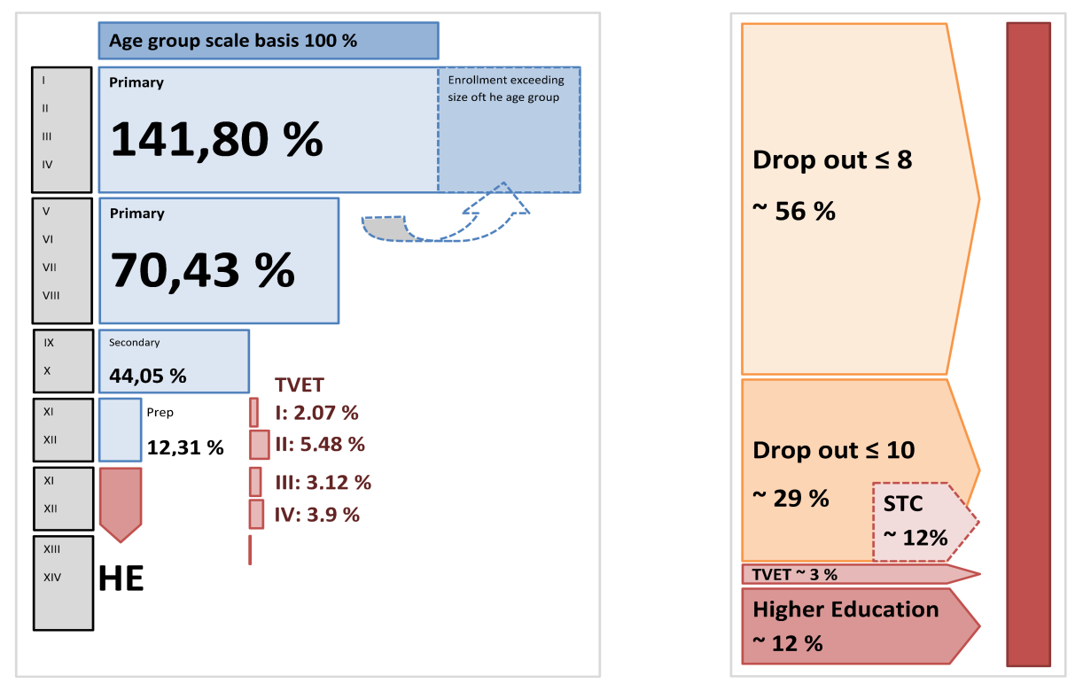
Enrollment vs Drop-Out Rates
1,1 million school leavers from primary education (grade 1-4)
250.000 drop out with grade 8
700.000 with a maximum of grade 10
Around 2 million un- or under-skilled workforce
Source: ELMA 2018

Slide 29
Reform agenda and most important priority areas for MoSHE in the coming years
  Alignment of TVET and HE programs with the industry: MoSHE to intensify the cooperation with the private sector; first pilot / model approaches tested by GIZ show that there is also a great willingness on the side of the private sector to support the skill development agenda – e.g. the Graduate Anchoring Program (GAP) in the construction sector – 7 large Ethiopian construction companies act as trainers and they will train more than 100 graduates to improve their skills. This can be scaled up to more companies and other sectors all over the country)
  Diversification of TVET and HE system to increase access and provide longer training for a better skilled workforce (focus on access for more young people – strengthen the informal TVET sector for short-term solutions and – at the same time – make like long learning possible by making the education system more permeable to keep young people longer in school and training to elevate their skills level)
  Foster women in education to ensure equitable access for women (with the aim to include women in all sectors and also to raise the educational level of women that usually has an effect on reduction of birth rates and demographic change)
  Adequate Infrastructure
  Financing TVET

Slide 30

Higher Education System Transformation Agenda
Alignment with the Economy
Accountability
Financing
Diversification
Transition into the World of Work
Women in Education
Enabling Infrastructure
Modern Educational Standards
Research Quality & Relevance
Teacher Training
4/17/2019

Slide 31
3.3. Manufacturing and service providing enterprises
The role of manufacturing and service providing enterprises in the STI sector ranges from conducting and supporting research and technology transfer activities to contributing to and implementing the policy framework.
However, such enterprises have no clear value-adding linkages between them and their role in advancing the STI is not well defined in Ethiopia.
Hence, assistance will be provided to strengthen micro and small enterprises development to serve as basis for the expansion of medium and large enterprises.
Beside this, emphasis will be placed on the provision of support to medium and large enterprises in order to allow them to play a vital role in technology transfer.

Slide 32
Manufacturing and service providing enterprises Strategies
Support medium and large enterprises to become focal points for searching, learning, transferring, and adapting foreign technologies;
2. Strengthen linkages between value chains within and between industries;
3. Strengthen TVET institutions’ contribution in building the capacity of micro and small enterprises.

Slide 33
3.4. Research
In order for a country to have effective learning, transfer, adaptation and utilization of technology, having an effective national research system typically becomes of significant strategic importance.
In Ethiopia research is needed to address the resolution of major social and economical problems; contribute to the achievement of national development objectives; and to meet technology demand.
However, it is learnt that there is a gap between the research activities and focuses in higher education and research institutions and the national development need.
Hence, the national research system should be strengthened and orientated to focus on the national technological demands for searching for, learning about, adapting and utilizing effective foreign technologies.

Slide 34
Research Strategies
1. Support research institutes to develop their capacity to search, learning, adapting and utilizing effective foreign technologies;
2. Ensure research work in higher education and research institutions is in line with the technological needs of national development programs;
3. Support joint research activities among universities, research institutes and industries;
4. Support medium and large industries to establish research centers on technology adaptation.

Slide 35
Challenges of research in Ethiopia
  Shortage of qualified human power/Lack of research experience.
  Poor mentoring of young researchers.
  Limited capacity for management of research projects.
  Increasing brain drain.
  Limited/poor collaboration within and among researchers/research groups (Lack of effective platform that facilitates interaction and collaboration of different stakeholders: sector ministries, research institutions, universities, NGOs, etc)
  Fragmented research endeavors (project-based, non-thematic, mono-disciplinary and not need based).
  Problem of quality and relevance
  Lack of adequate research infrastructure
  Funding scarcity
  Weak dissemination and use of research evidence for policy

Slide 36
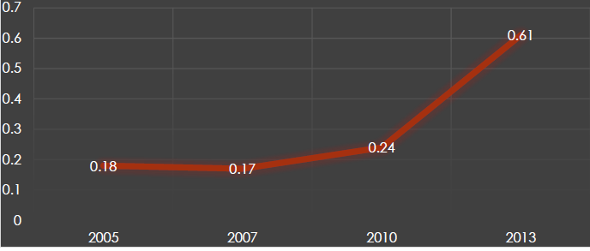
Expenditure on R&D: Growth in GERD as % of GDP in Ethiopia

Slide 37
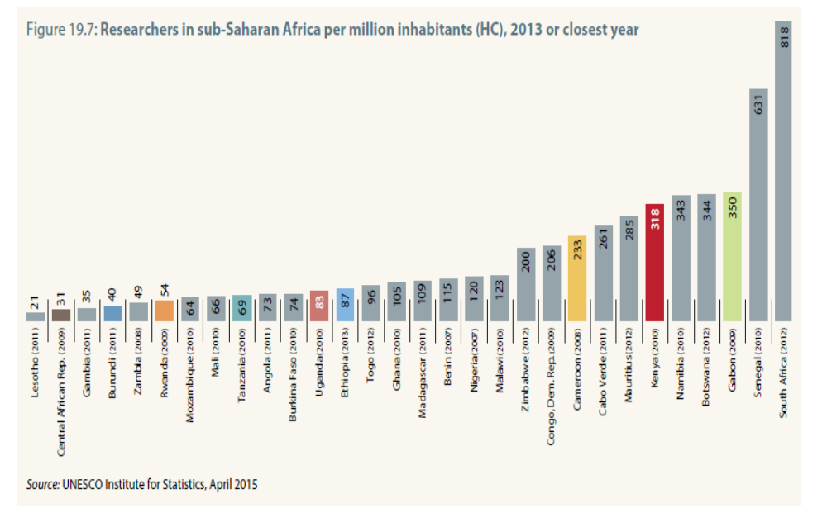
Researchers number per million population is also low in Ethiopia

Slide 38
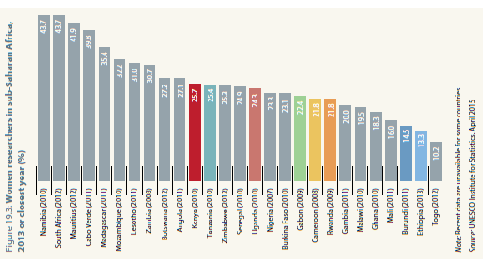
Women Researchers number is low in Ethiopia

Slide 39
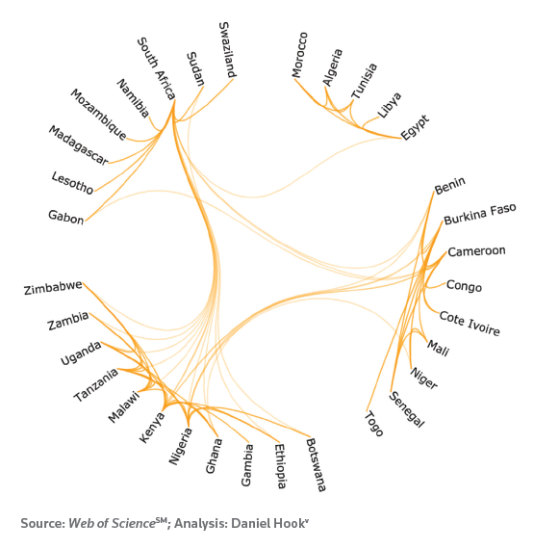
Ethiopia is not well integrated into major research collaboration network in Africa
Research in Ethiopia – Networks

Slide 40
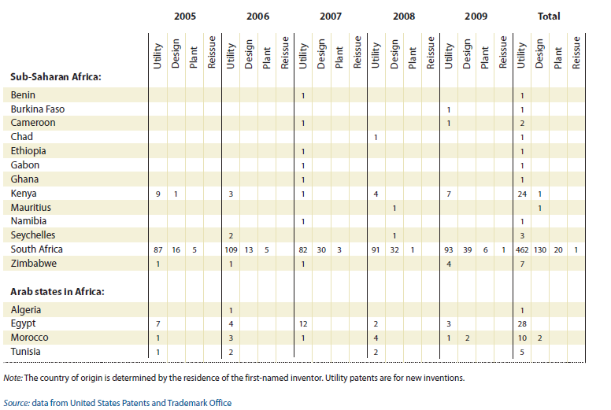
Ethiopia rarely show up in the list of countries receiving patent from USPTO
Research in Ethiopia – Patents

Slide 41
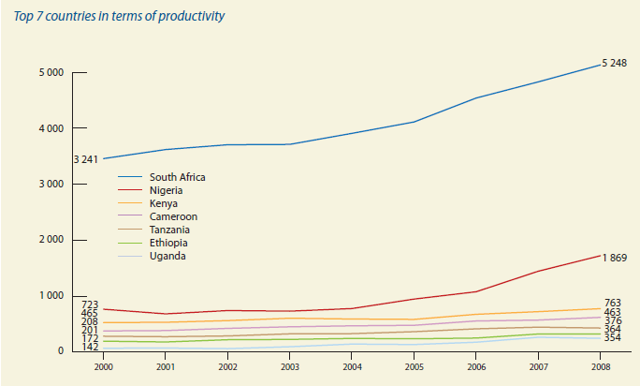
Research in Ethiopia – Publications
Ethiopia is one of African countries that produce low scientific output in terms of publications.
UNESCO Science Report, 2010

Slide 42
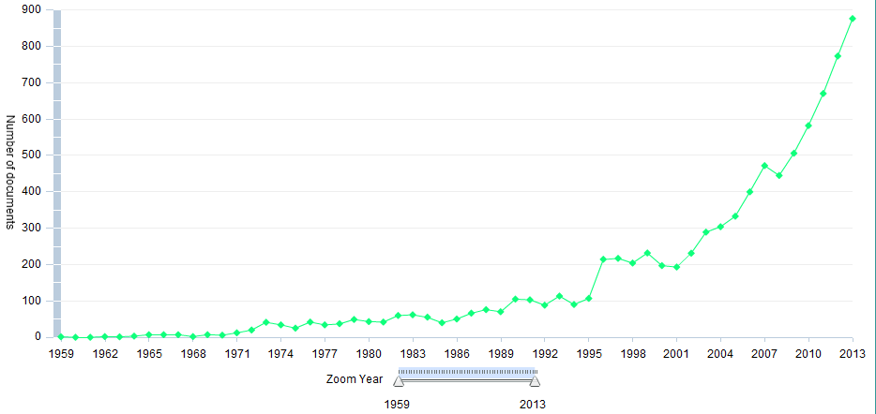
Research in Ethiopia – Ethiopian Publication Productivity
(Source: Elsevier, 2013)
Number of publications per year increased by 9 times from 1991 to 2013: Sign for improvement

Slide 43
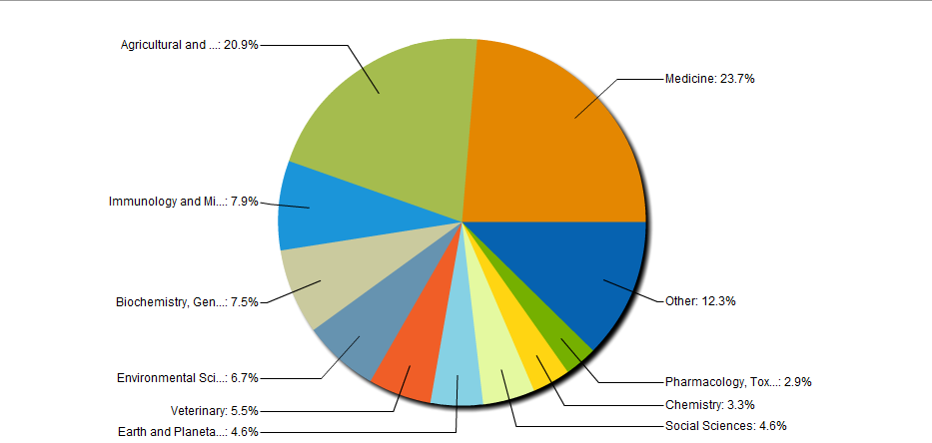
Research in Ethiopia – Subject Area Split for the Ethiopian Publications (1959-2013)

Slide 44

Opportunities to strengthen research in Ethiopia
National STI Council and National Research Council: Ex. competitive research funding.
Sectoral Research Councils: Ex. Ethiopian Agricultural Research Council; Ethiopian Health Research Council.
Research becoming visible part in federal institutions organogram.
Professional associations supporting research and engaging in dissemination.
Ethiopian Academy of Sciences, SEWiST, promoting research culture.
Etc…
Research

Slide 45
3.5. Financing and incentive schemes
An effective transfer of foreign technologies requires the availability of sufficient finance.
In Ethiopia there is not yet a well developed and systematized finance and incentive mechanism to support technology transfer in manufacturing and service providing enterprises.
Therefore, financing and incentive schemes need to be established to support activities on searching for, learning about, adapting and utilizing of effective foreign technologies in line with national development needs.

Slide 46
Financing and incentive schemes Strategies
1. Offer various incentives to medium and large enterprises that will be involving in searching for, learning about, adapting and utilizing foreign technologies in line with the national investment policy;
2. Establish incentive schemes to award those manufacturing and service providing enterprises which show high performance gains through technology transfer;
3. Allocate resources for higher education and research institutes in line with the economical development for their contribution to technology transfer.

Slide 47
5.6. National quality infrastructure
A national quality infrastructure landscape contributes significantly to deliver quality and standardized products and services to local and international markets.
Failure to meet the quality standards is one of the major problems prevailing in most of local manufacturing and service providing enterprises in Ethiopia.
This is mainly due to lack of implementing standards in the national collection.
In order to solve problems related to productivity and quality thereby creating competitive manufacturing and service providing enterprises, capacitating the standardization, metrology, conformity assessment service providers and accreditation bodies would of paramount importance.

Slide 48
NQI Strategies
1. Ensure the adoption of best practices on productivity, quality and safety management systems in all manufacturing and service providing enterprises;
2. Incorporate issues of national quality infrastructure in the curricula of higher education and TVET colleges;
3. Establish a credible and internationally recognized metrology system;
4. Promote and strengthen the use of standards and technical information as a tool to facilitate technology transfer;
5. Establish an effective and credible national conformity assessment system having the capacity to demonstrate the effective implementation of standards for products and services;
6. Establish a national accreditation system with international recognition as a means to demonstrate the credibility of the Ethiopian NQI;
7. Issue additional mandatory standards to conduct proper technical regulation on various products and production processes;
8. Ensure creation of strong regulatory capacities which make use of the services provided by the national quality infrastructure institutes.

Slide 49




NQI institutions

Slide 50
NQI Strategy and Capacity Building Needs
Prime Minister
NSTIC
NQI strategy
NUILF
NQI- TC
ENQF
Private sector
Other Ministries/ Agencies with NQI and regulatory functions
Ministry of Trade
Ministry of Science and Technology
Accreditation Body
Private Conformity Assessment bodies
Regulation Enforcement Authority/ Agency
Standards
Conformity Assessment
National Metrology Institute

Slide 51
3.7. Universities, research institutes, TVET-institutions and industry linkage
Universities, research institutes, TVET institutions and industry can be demonstrated to be core actors in the national innovation system.
The strength as well as effectiveness of the established linkages among these institutions largely depends on their tendency and capability to be involved in activities dealing with technology transfer.
As far as technology learning is concerned, the current situation of our country confirms that universities are not taking the leading role and are lagging behind the industries.
Therefore, the linkages that exist among these actors should focus on contributing to capacitating the productivity of manufacturing and service providing enterprises.
The shared effort should also focus on identifying appropriate technologies and their sources, understanding the technologies through learning-by-doing and adaptation as well as effective utilization.
Thus, joint cooperation and support system among the actors will be established with the aim to support and facilitate the search, selection, importation, adaptation and utilization of effective foreign technologies.

Slide 52
URITVETI Linkage Strategies
1. Establish a system that integrates and synergizes technology transfer issues among Universities, research institutes, TVET-institutions and industry;
2. Create a conducive environment for university academia and students to engage in technology transfer activities in industry;
3. Create strong linkages among universities, research institutes and industry addressing technology adaptation;
4. Establish a system that enables universities to provide an advisory role to industry in relation to technology transfer activities

Slide 53
URITVETI Linkage
Research
Institutes
Industries
Universities
& TVET
Government

Slide 54
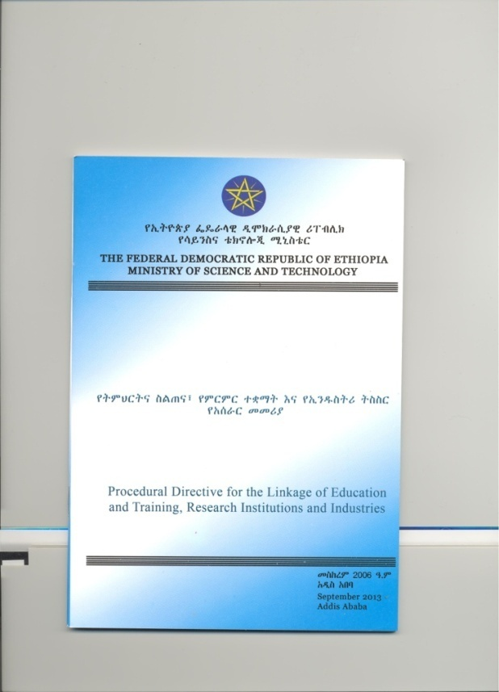
Directive for URITVETI Linkage

Slide 55
3.8. Intellectual Property System
Intellectual Property system is said to play a valuable role if it contributes to technology transfer as well as to technology capability building through FDI and technology licensing.
Nevertheless, intellectual property system as a whole in Ethiopia is not playing a substantial role in accelerating technology transfer and expansion of local innovation activities.
Hence, the Ethiopian IP system needs to be designed in such a way as to support the endeavor of technology learning and adaptation as well as to protect the rights of inventors and creators and support the augmentation and application of indigenous knowledge.

Slide 56
IP System Strategies
1. Make use of IP information at large in support of the efforts to build national technology capability;
2. Establish and implement a system that ensures effective protection of indigenous genetic resources and IP assets of the nation besides bringing benefit out of them.
3. Develop and implement the application of IPR systems at national and institutional level;
4. Strengthen and implement copyright protection in such a way to encourage and promote creative works;
5. Strengthen trademark protection to create a healthy and competitive environment among manufacturing and service providing enterprises

Slide 57

Ethiopian Intellectual Property Office
IP right , copy right protection and trade mark protection

Slide 58
3.9. Science and technology information
Collecting, organizing, analyzing, disseminating, and using information related to science and technology is of significant importance for successful technology transfer.
In Ethiopia there is no well organized science and technology information source or system as required by manufacturing and service providing enterprises, higher education, researcher institutes and other entities.
Despite the fact that there are certain types of information which are prepared and kept in the form of statistics, databases, indicators and bibliography, there are no mechanisms to publish and update them regularly.
Therefore, it is imperative to develop and establish a national science and technology information system to fill the gaps and bring expected results, including the acceleration of technology transfer.
Establishing and strengthen such a system will create a capacity that accelerates technology transfer through identifying, gathering, organizing, analyzing, disseminating and proper utilization of science and technology information.

Slide 59
ST Information System Strategies
Establish a National Science and Technology Information Centre;
2. Support technology transfer through gathering, organizing, analyzing, and disseminating of Science and technology information;
3. Establish and implement up-to-date systems to link and exchange science and technology information among national, regional and international information centers;
4. Support research activities with respect to strategies and methodologies of gathering, analyzing, management and dissemination of Science and technology information.

Slide 60

Science & Technology Information Center

Slide 61




STIC: Surveys and Publications

Slide 62

STIC: TechScience Booklet

Slide 63

STIC: TechScience TV Program

Slide 64
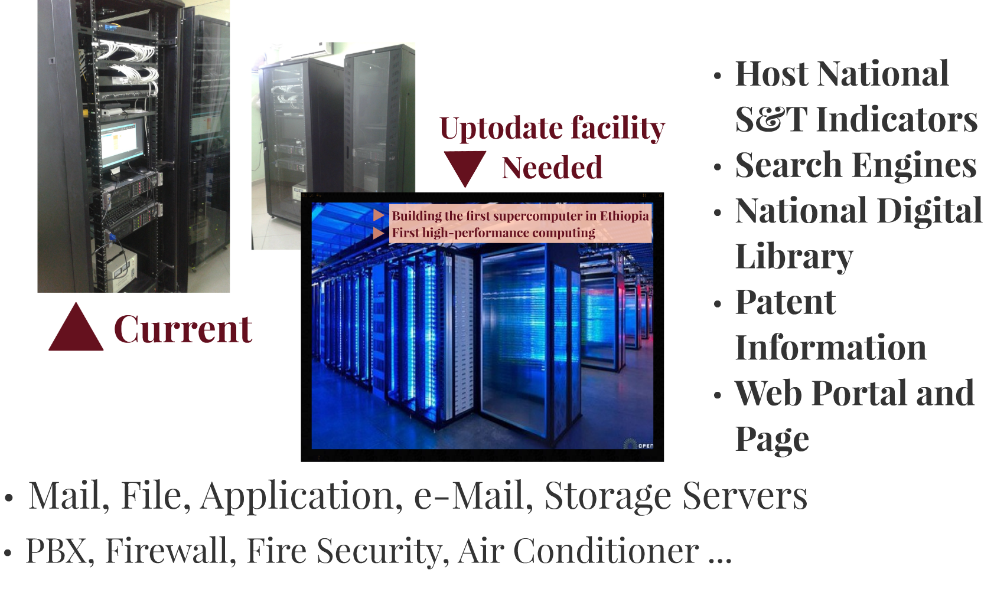
STIC: Data center

Slide 65


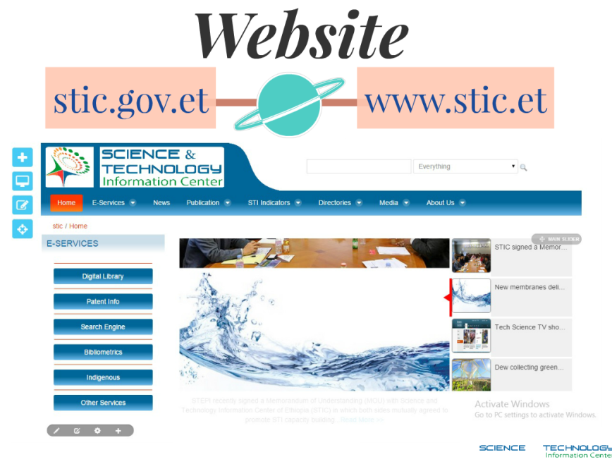
STIC: E-Services

Slide 66
3.10. Environmental protection and development
Environmental protection and development is crucial to maintain continual and sustainable economic growth.
The major issues of the environment in Ethiopia are desertification, deforestation and soil erosion.
In big cities lack of solid waste disposal and sewerage system are critical environmental challenges.
Therefore, to address these and other environmental problems prevailing in the country, appropriate technologies will be applied in the course of natural resource utilization and implementation of various development activities.

Slide 67
Environmental protection and development Strategies
Establish a system that allows technology importation, adaptation, utilization, and disposal activities without polluting the environment;
2. Create local capabilities to learn about, adapt and adopt green technologies;
3. Establish and implement a system that addresses the safety of the environment and of society in relation to the use of equipment emitting radiation, the use of actually or potentially non ecologically-friendly chemicals and other industrial inputs actually or potentially threatening to the environment.

Slide 68
3. 11. International cooperation
International cooperation in the areas of science and technology is crucial for information sourcing, manpower training, expert assistance, scientific visits, collaborative research, joint ventures in technology transfer and funding of scientific and technological projects.
However, the current cooperation practice of our country lacks focus, particularly on STI information sourcing, and exchange of scientists and engineers, thereby highlighting certain particular needs for cooperation to strengthen national technology capabilities.
Therefore, the prime focus of international relations should be to encourage cooperation with developed and developing countries as well as with various international and regional organizations with the objective of building national technological capabilities.

Slide 69
International cooperation Strategies
1. Ensure incorporation of STI capacity building elements in bilateral and multilateral agreements;
2. Strengthen exchange of professionals and scientists through South-South and North- South cooperation initiatives;
3. Initiate joint research programs with international partners, within Ethiopia, that have direct contribution to the national development agenda.

Slide 70
4. Policy Implementation and Principles

Slide 71
4. Policy Implementation and Principles
This policy is an enabling framework for the establishment of a national innovation system as well as to bring in stakeholders as core actors contributing to its implementation.
The primary focuses in the implementation of the policy should be the establishment of a clear and effective STI governance structure, building technological capacity in learning about, adapting, and utilizing effective foreign technologies, as well as producing well trained technicians, engineers and scientists.
The policy will be led by the national STI council and the respective ministries will be responsible for its implementation.

Slide 72
The major policy Implementation Principles are:
a) The government will lead the national STI capacity building process;
b) STI activities will be performed in an integrated manner with other social and economical activities;
c) Increase the inclusion and participation of the private sector in innovation activities by providing support which leads to competitiveness in learning about and utilization of technology;
d) Establish an effective, accountable and transparent system of allocation and utilization of resources for STI programs, projects and activities;
e) Promotion and encouragement of strong integration and cooperation among national and international stakeholders to utilize science and technology infrastructure as well as to use resources effectively and efficiently;
f) Compilation of other countries’ relevant best practices and adapting them as appropriate to be compatible with the Ethiopian context.

Slide 73
5. Governance of the National Innovation System

Slide 74
5. Governance of the National Innovation System
The governance structure of the national innovation system will be implemented in a way to lead, support and monitor the implementation of the policy.
The main actors of innovation system are:
National Science, Technology and Innovation Council;
Ministry of Science and Technology (MoST); and
Other related ministries and
Innovation Support and Research System.

Slide 75
5.1. Roles and responsibilities of the council
Based on consultation present recommendations on the selection and prioritization of national technology capacity building programs; Monitor and evaluate technology adaptation and utilization activities in all national priority programs;
b) Present recommendations for resource allocation for technology capacity building out of the gross domestic product (GDP); Monitor and evaluate its implementation
c) Recommend national priority areas where support should be provided in the creation of competent human resource in science and technology, and to subsequently monitor and evaluate the implementation of such recommendations;
d) Create and promote an environment of integration and synergy among all actors of innovation system.

Slide 76
5. 2. The national innovation support and research system
This comprises:
universities,
government research institutions,
national laboratories,
TVET institutions,
financial support service providers,
science and technology parks,
intellectual property office,
manufacturing and service providing enterprises and
the agencies of the national quality infrastructure.
As the aforementioned bodies are main actors in technology transfer, dissemination and research activities, they will be expected to provide financial, technical, legal and infrastructure development support for the national innovation system.

Slide 77
5.3 MOST and other innovation system actors
The STI policy and recommendations of the council will be implemented by the MoST and other respective government bodies.
Effort will be exerted to ensure clarity of roles and activities, thereby preventing unnecessary task overlapping, redundant responsibilities and resource wastage.
The MOST serves as secretariat of the council.
MoST will provide and ensure the functions of coordination, monitoring and support to STI development activities based on the strategic direction of the council.

Slide 78
6. Monitoring and Evaluation
Monitoring and evaluation systems will be implemented at each level.
M & E will ensure the effectiveness of the policy implementation, efficient resource utilization and taking of corrective measure on weaknesses, with a specific responsibility resting with the council.

Slide 79
Summary
Our STI policy has:
clear vision, mission and objectives
Eleven policy issues and strategies
Clear implementation principles
Governance structure
The STI policy is meant to:
build strong STI capabilities,
access foreign technologies and
build strong national systems of innovation which are important for economic growth, social welfare and addressing environmental challenges.
Although achievements are being enjoyed in some areas of the policy issues, much is yet to be done in the future. This requires concerted efforts from all stakeholders.

Slide 80
Thank you!! www.moshe.ethernet.et

