Slide 1

Linking the National Programme of Action (NPoA) to the Medium Term Expenditure Framework (MTEF)
Osten Chulu
Regional MDG Policy Advisor
UNDP Regional Service Centre for Africa
Taj Pamodzi Hotel, Lusaka,
28-29 October, 2014

Slide 2
Starting Point – Plans and Budgets
All countries develop NDPs/PRSs/Growth Strategies (some brilliantly)
Most countries are resource constrained
But most plans start off as unconstrained wish lists
Few are costed – No NAs undertaken
Challenge is to unite the two – Plans and resources (through the budget)
In many countries, the two are unfortunately mutually independent processes

Slide 3
Plans and Budgets
Almost all national programmes and strategies are important to governments
The challenge is prioritization
Methodologies for prioritization are few (e.g., the MAF approach)
There are also challenges in sequencing – which intervention takes precedence?
How do we resource priority interventions? has a Needs Assessment been undertaken?
What about recurrent cost implications?

Slide 4
Many Plans running concurrently
National Strategic Development Plan
Sectoral Strategic Plans
MDG Acceleration Framework
  National Plan of Action
    Democratic/political governance, economic governance, management and social economic development
Donor-driven initiatives (implemented by line ministries)
“Pet” projects and initiatives

Slide 5
Challenge….
Programmes not matched by resources
Usually the same Govt. Ministry/department responsible for many of these concurrent programmes
Financing arrangements are weak – not taking advantage of synegies
Resource scarcity leads to “programme greed” – bring anything on as long as there are resources coming – spreading ourselves to thin

Slide 6
Challenge…
Different plans may have overlapping life cycles – How do we synchronize these?
NSDP – MDGs – NPoA?
How do we align expenditure cycles of the NPoA and the MTEF? Annual Budgets can be used.
NPoA and MTEF level of aggregation – are they the same?
What about financial cycles of donors (many countries are dependent on these)?

Slide 7
The Medium Term Expenditure Framework (MTEF)
MTEF – Came about through the need to have a more predictable resource envelope
There is a need to know the amount of resources required to implement interventions
The MTEF facilitates this! MTEF is a potential solution in countries where policy making, planning, and budgeting are in disarray or not property linked with one another. For this reason, MTEF has recently become a central element of many of the public expenditure reform (PEM) programs

Slide 8
What is a MTEF
A tool for linking policy, planning & budgeting over the medium term (3-5 years)
Characteristics
  Medium term Fiscal Framework
  Estimates of the future costs of existing policies
  Sector strategies setting out priorities for future spending
  Can also be used for estimates of resource requirements for emerging initiatives such as the NPoAs

Slide 9
Why an MTEF?
Strong linkages between policy, planning and budgeting are necessary for the efficient and effective use of limited resources
  PRSPs → Identify the medium-long term objectives and priorities for poverty reduction
  MTEF provides a framework for allocating resources
  The annual budget serves as the instrument for implementing the national aspirations
  MTEF provides the ‘linking framework’ which allows expenditures to be driven by policy priorities and disciplined by budget realities (constraints).

Slide 10
Elements of an MTEF
A top-down resource envelope consistent with macroeconomic stability and policy priorities
A bottom-up estimate of the current and medium term cost of existing national programmes and activities
How far down to the bottom do we go? – cost considerations?
Cost estimation methodologies exist – data challenges are numerous (target populations, coverage, etc.)
An iterative process of decision-making, matching costs and new policy ideas with available resources over a rolling 3-5 year period

Slide 11
Elements of the MTEF
Stages of formulating a comprehensive MTEF include:
  (a) developing a macro/fiscal framework which projects revenues & expenditure in the medium-term;
  (b) developing sectoral programs with cost estimates of activities, their objectives, and outputs;
  (c) defining a sector-resource allocation strategy based on medium-term sector budget ceilings;
  (d) preparing sectoral budgets; and
  (e) political approval.
In sum, MTEF will include three pillars: (i) Projection of aggregate resource envelop, (ii) cost estimates of sectoral programs, and (iii) the political-administrative-institutional process which integrates the two

Slide 12
What an MTEF can do
If successfully applied, it can
Improve macroeconomic balances by developing a multi-year resource framework (expenditure and revenue)
Assist in improving resource allocation between and across sectors
Improve predictability of funding for line ministries

Slide 13
Requirements for an MTEF
A clear framework of national objectives, policies and priorities
Realistic medium-term resource projections
Comprehensive budget that enables the budget system to relate results and accountabilities to resource inputs
A budget and programme classification that can be linked to national and sectoral objectives
Monitoring indicators of inputs, final and intermediate outputs and outcomes

Slide 14
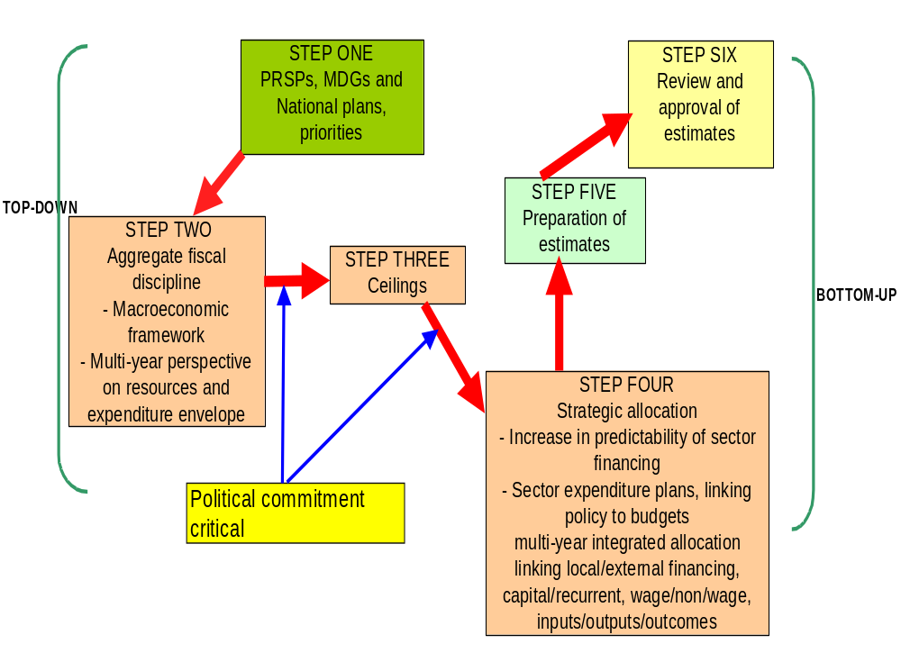

Slide 15
The NPoA and the MTEF
NPoA Structure
Democracy and Political Governance
Economic Governance and Management
Corporate Governance
Socio Economic Development

Slide 16
Costing Frameworks
PRSP or NDP, inclusive of NPoA, provides the roadmap for policy priorities
Based on the objectives laid out for each NPoA thematic area
Sector Working Group mechanism (e.g., Sector Investment Plans)
Institutional Mandates and Objectives (Vote Functions)

Slide 17
Costing Frameworks
Sectoral and institutional objectives
Expected Outcomes, Outputs and indicators
Review of existing initiatives and financing plans

Slide 18
From the NPoA to the Budget
NPoA Plan
  Thematic Paper on Governance
Plan MTEF
  Sector Budget Framework Papers
MTEF Budget
  Budget Call Circulars, Setting of ceilings etc.

Slide 19
Enhancing MTEF-NPoA Links
NPoA should be incorporated/absorbed into the NSDP
Same macro-framework used for MTEF and NSDP
MTEF process should cover all sectors
Budget comprehensiveness is key
Opening up the budget making process to stakeholders as part of the development of the MTEF
Improved costing and target-setting – Prioritization and hard decisions on what to do first

Slide 20
Benefits of MTEF
More realistic budget framework and better alignment with policy priorities such as PRSP
Greater opportunities to fund highest priorities
More accurate reporting requirements such as reporting expenditures
Greater transparency and ownership due to the involvement of and consultation with line ministries, local/regional government units.
Setting up ‘Hard budget constraints’ and tighter sectoral ceilings
Building ‘institutional’ (rules/procedures, etc.) and organizational (agency) capacities at all key levels of budget formation.

Slide 21
Challenges of MTEF
Creating an effective expenditure monitoring/tracking system at all levels of the government and especially at sub-national levels governments.
Implementation challenges due to lack of organizational and human resource capacity at all levels of government.
Inability to prioritize sectoral/regional policies due to lack of political will.
Lack of proper coordination within key policy-making & budgetary units in the government.
Lack of ‘institutional capacity’ – i. e., lack of appropriate laws, rules, and regulatory and monitoring procedures in place.

Slide 22
International Commitments
MDGs. HIPC, WSSD, NPoA
Advocacy
Consensus building
Consistency of economic and social objectives
Setting national targets
National Policy
Macroeconomic Policy
SNDP
SWAPs etc.
Setting priorities
Setting sectoral targets
Estimating costs
Budgeting
Mobilization of resources
Policy coordination
Sectoral Policy
Education Rural Development
Health etc.
Housing
Industrial Policy
Labour,
Translate targets into project objectives
Select monitoring indicators
Result oriented management
Policy Implementation
Specific Policies, programmes and projects
Monitoring and Evaluation
Participatory monitoring
Monitor process
Linking Outputs with Outcome and Impact
Outputs
Outcomes
Flexible, Result Oriented, Participatory Management
Impact

Slide 23
Conclusion
Integrate NPoA into the National Plan/Strategy
Identify gaps and assess the magnitude of difference
Accurate costing, prioritization in the face of limited resources
Capacity development
Implementation, implementation, implementation
What is lagging behind and what can be done about it? MAF methodology customised to local context
Follow-through and feedback mechanisms developed and adhered to
Leadership and political commitment

Slide 24
Thank you.

