Slide 1


Long-Term Trends in Food Security:
Africa’s Turnaround
William A. Masters
Professor and Chair, Department of Food and Nutrition Policy, Tufts University
www.nutrition.tufts.edu · sites.tufts.edu/willmasters
UNECA/AfDB/UNDP African Economic Conference
Addis Ababa, 28 October 2011

Slide 2
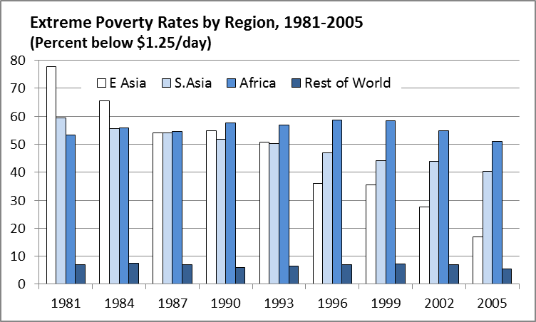
Africa’s poverty rates rose only recently, and turned down over the past decade
Source: Author’s calculation from World Bank (2011), PovcalNet (http://iresearch.worldbank.org/PovcalNet/), updated 11 April 2011. Estimates are based on over 700 household surveys from more than 120 countries, and refer to per-capita expenditure at purchasing-power parity prices for 2005.

Slide 3
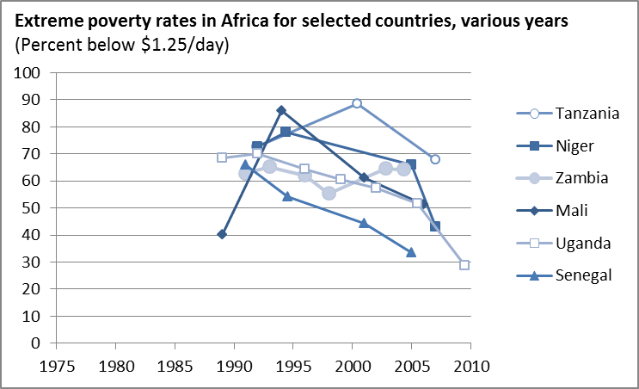
There are limited data and wide variation but many signs of improvement
Source: Author’s calculation from World Bank (2011), PovcalNet (http://iresearch.worldbank.org/PovcalNet/), updated 11 April 2011. Estimates are based on over 700 household surveys from more than 120 countries, and refer to per-capita expenditure at purchasing-power parity prices for 2005.

Slide 4
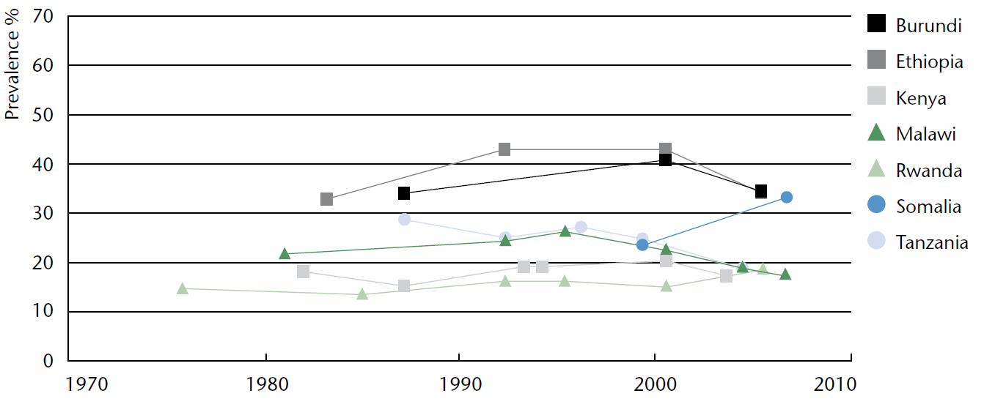
Undernutrition has also begun to improve in some African countries
National trends in prevalence of underweight children (0-5 years)
Selected countries with repeated national surveys
Source: UN SCN. Sixth Report on the World Nutrition Situation. Released October 2010, at http://www.unscn.org.

Slide 5
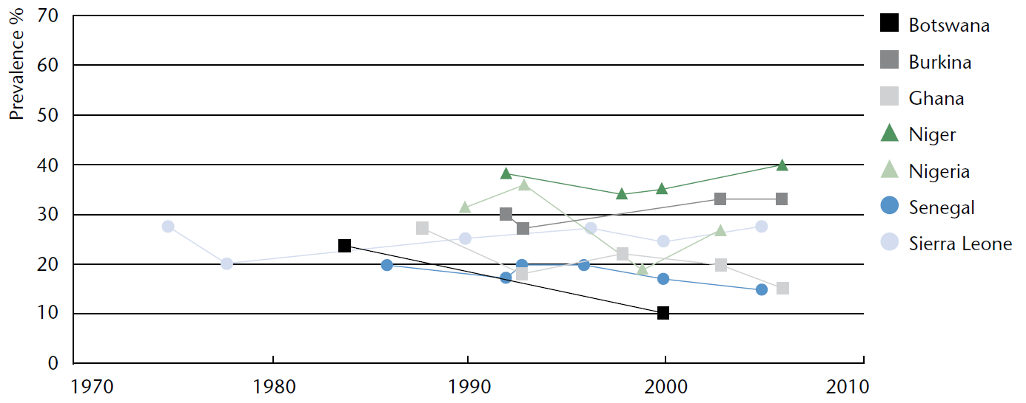
...although undernutrition levels and trends still vary widely across Africa
National trends in prevalence of underweight children (0-5 years)
Selected countries with repeated national surveys
Source: UN SCN. Sixth Report on the World Nutrition Situation. Released October 2010, at http://www.unscn.org.

Slide 6
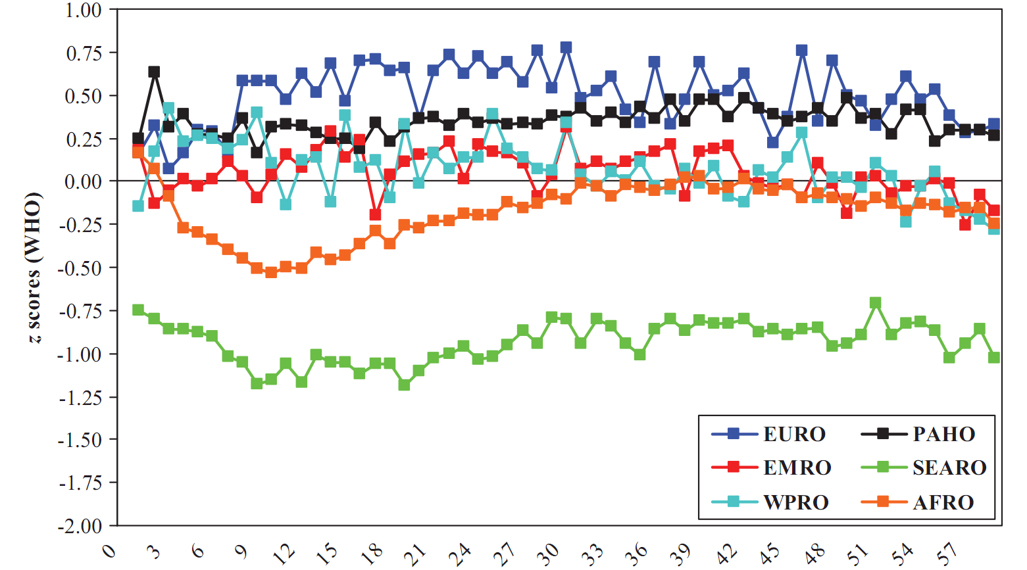
Extreme under-nutrition occurs in infancy
and is less bad in Africa than in Asia
Mean weight-for-height z-scores in 54 countries, 1994-2007, by region (1-59 mo.)
African infants are much
less severely affected than Asia’s
The shortfall is worst
at 3-24 months of age
Source: CG Victora, M de Onis, PC Hallal, M Blössner and R Shrimpton, “Worldwide timing of growth faltering: revisiting implications for interventions.” Pediatrics, 125(3, Mar. 2010):e473-80.

Slide 7
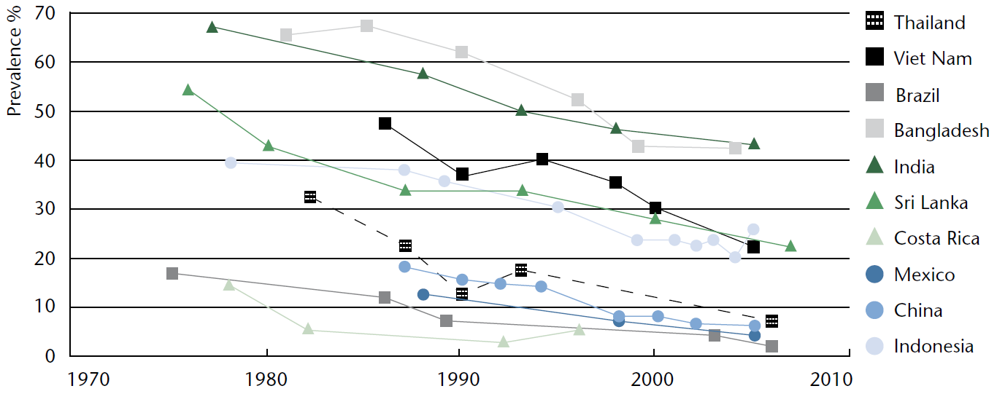
In Asia, where undernutrition was worst, we’ve seen >20 years of improvement
National trends in prevalence of underweight children (0-5 years)
Selected countries with repeated national surveys
Source: UN SCN. Sixth Report on the World Nutrition Situation. Released October 2010, at http://www.unscn.org.

Slide 8
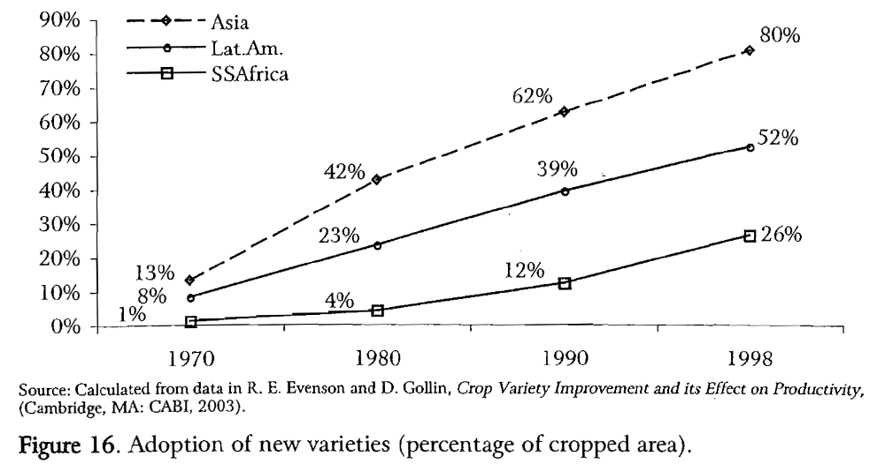
Africa’s green revolution is
at least 20 years behind Asia’s
Source: Reprinted from W.A. Masters, “Paying for Prosperity: How and Why to Invest in Agricultural Research and Development in Africa” (2005), Journal of International Affairs, 58(2): 35-64.

Slide 9
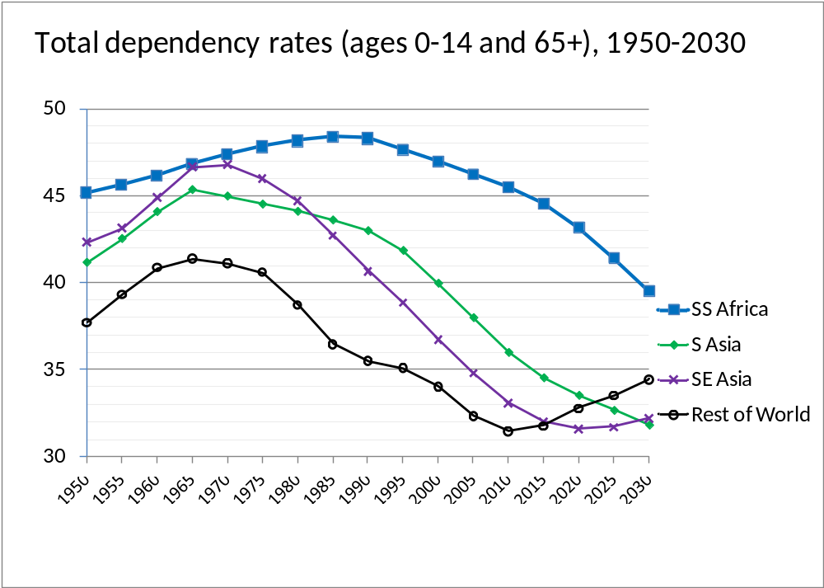
The rise then fall in Africa’s child-survival baby boom is also 20 years behind Asia’s
Child and elderly dependency rates by region (0-15 and 65+), 1950-2030
Africa had the world’s most severe demographic burden (>45% )
now a demographic gift
Source: Calculated from UN Population Projections, 2008 revision (March 2009), at http://esa.un.org/unpp.

Slide 10
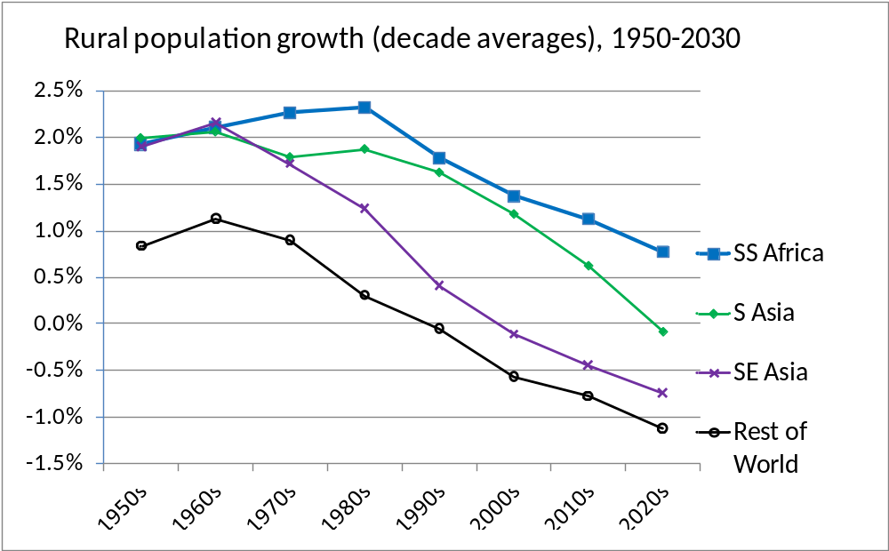
The rise then fall in Africa’s rural
population growth is also 20 years later
Rural population growth rates by region, 1950-2030
Over 2% annual growth for 30 years!
Under 1.3% annually, and falling
Below zero = more land/farmer
Source: Calculated from FAOStat (downloaded 17 March 2009). Rural population estimates and projections
are based on UN Population Projections (2006 revision) and UN Urbanization Prospects (2001 revision).

Slide 11
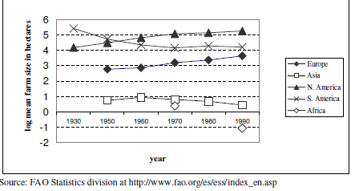
An underlying cause of Africa’s impoverishment in the 1970s-1990s was a sharp fall in land area per farmer
Land available per farm household (hectares)
Reprinted from Robert Eastwood, Michael Lipton and Andrew Newell (2010), “Farm Size”, chapter 65 in Prabhu Pingali and Robert Evenson, eds., Handbook of Agricultural Economics, Volume 4, Pages 3323-3397. Elsevier.

Slide 12
Urbanization eventually employs all new workers so land per farmer can rise
…in Africa that won’t happen until the 2050s
Population by principal residence, 1950-2050
World (total)
Sub-Saharan Africa
2010
2010
Source: Calculated from UN World Urbanization Prospects, 2009 Revision , released April 2010 at http://esa.un.org/unpd/wup. Downloaded 7 Nov. 2010.

Slide 13
Africa’s green revolution has just begun
USDA estimates of average cereal grain yields (mt/ha), 1960-2010
Source: Calculated from USDA , PS&D data (www.fas.usda.gov/psdonline), downloaded 7 Nov 2010. Results shown are each region’s total production per harvested area in barley, corn, millet, mixed grains, oats, rice, rye, sorghum and wheat.

Slide 14
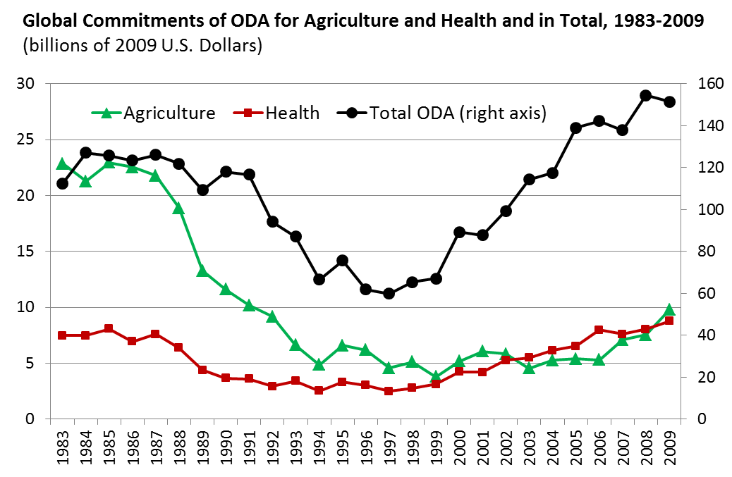
Foreign aid for agriculture has just begun to recover after being sharply cut in 1985-99
Source: Author's calculations from OECD (2011), Official Bilateral Commitments by Sector, updated 6 April 2011 (http://stats.oecd.org/qwids).

Slide 15
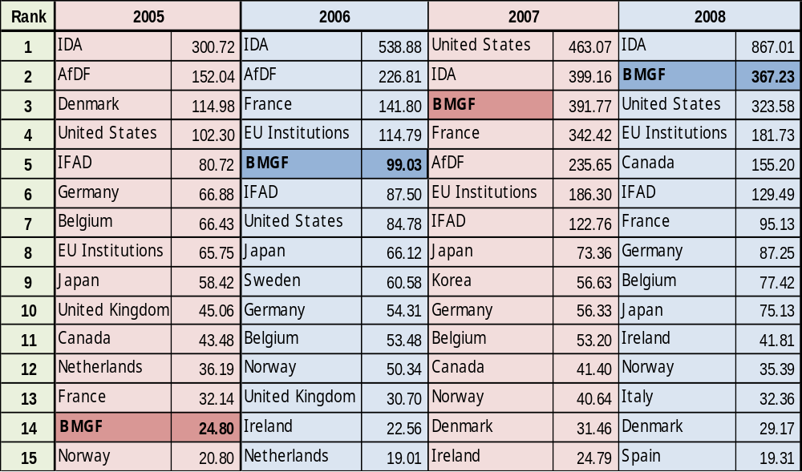
The wake-up of external aid for agriculture has been led by the Gates Foundation
Top 15 donors’ foreign aid commitments to African agriculture, 2005-2008
Note: Exact amounts for BMGF have been obscured because methodology differs from that used by the DAC. Source: P. Pingali, G. Traxler and T. Nguyen (2011), “Changing Trends in the Demand and Supply of Aid for Agriculture Development and the Quest for Coordination.” Annual Meetings of the AAEA, July 24–26, 2011.

Slide 16
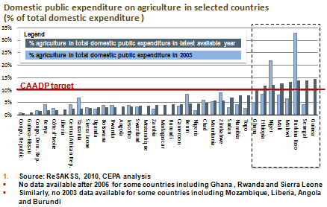
Many African governments are now focusing more on agriculture
Slide is courtesy of Prabhu Pingali, Greg Traxler and Tuu-Van Nguyen (2011), “Changing Trends in the Demand and Supply of Aid for Agriculture Development and the Quest for Coordination,” at the AAEA, July 24–26, 2011.
Notes:
Slide is courtesy of Prabhu Pingali, Greg Traxler and Tuu-Van Nguyen (2011), “Changing Trends in the Demand and Supply of Aid for Agriculture Development and the Quest for Coordination.” Presentation at the Annual Meetings of the AAEA, July 24–26, 2011.

Slide 17
Conclusions:
Africa’s Coming Turnaround in
Agriculture and Food Security
African poverty worsened from 1980 through 2000, but is now improving
  A major underlying cause is change in land available per farmer, driven down by rural population growth which is now slowing
  Appropriate new farm technologies are finally arriving, so crop yields, output and input use are now rising
Investment in agriculture, food and nutrition security had shrunk to near zero, but is now being restored
  Investment in agriculture was key to cutting Asian poverty, then seen as no longer needed for Africa in the 1980s and 1990s;
  Africa is now poised for rapid uptake of new technologies, with many opportunities for sustained improvements

