Slide 1

Sixth African Economic Conference – Addis-Ababa, Ethiopia, October 25-28, 2011
EXTENSIFICATION versus INTENSIFICATION:
Revisiting the Role of Land in African Agricultural Growth
Guy Blaise NKAMLEU
African Development Bank
1

Slide 2
Main Messages from this Study
The African agricultural sector still follows an extensive and unsustainable production pathway
In particular, the contribution of land increase on agricultural production is still important.
Consequently, agricultural land expansion is increasing at an increasing rate…. And the system is getting closer to the limit

Slide 3
Main Messages from this Study
Though land productivity has increased over the years, its level and its growth rate is still small compared to what is needed to cope with population growth…. Agricultural land expansion will continue.
Two solutions to the problem:
  Boost Agricultural productivity through substantial support to technological progress
  Put more effort to control exogenous factors such as political instability, conflicts and climate change.

Slide 4
African Growth Tragedy
Africa’s growth performance continues to challenge our understanding. But everybody seems to agree that growth in agriculture is strongly tied to the overall economic growth and poverty reduction.
  Recent studies show that for African countries, a 10% increase in agricultural yield leads to a 9% decrease in the percentage of those living on less than US $1.00 a day.

Slide 5
Key components of Agricultural Growth
Agricultural growth
Unaccounted
factors
Physical
factors
Productivity
Land,
Labor,
Fertilizer,
Tractors,
….
Conflict,
Climate,
Natural
disaster
……
Technical
efficiency
(extension)
Technological
change
(research)

Slide 6
What do we know about Land use in Africa
At present over 1.1 billion ha of the Africa’s land surface (2.9 billion ha) is used for agriculture.
- Agricultural land is the sum of the areas under arable land (land under temporary crops, temporary meadows for mowing or pasture, land under market and kitchen gardens and land temporarily fallow), permanent crops and permanent pastures.

Slide 7
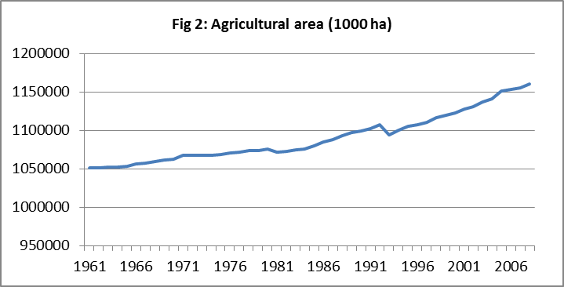
African agricultural land has been constantly increasing since 1961 and has increased by more than 10% between 1961 to 2008

Slide 8
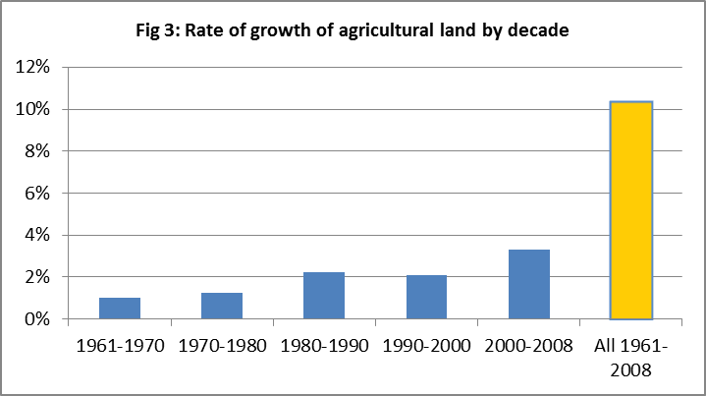
Remarkably, since 1980 the rate of growth of agricultural land use is higher and seems to accelerating

Slide 9
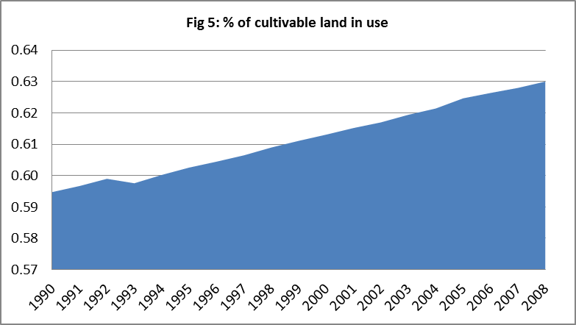
If we consider that total cultivable land is the sum of Agricultural land and forest land, agricultural production is presently using 63% of the potential cultivable land
from 1990 to 2008, the proportion of use of cultivable land has increase by nearly 4 points. If this trend continues, the vacant lands for agriculture will be exhausted in less than 2 centuries.

Slide 10
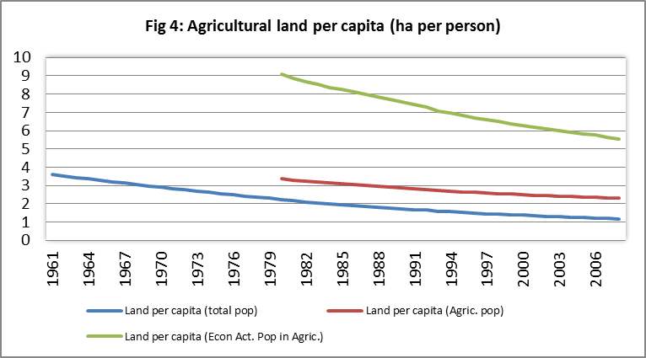
The Malthusian Specter
The reality is that African farmers might in the not too distant future no longer be able to find land for food production. Such fears are not illusive.
Figure 8: Agricultural production index – PIN - (base 1999-2001)
120
Agriculture and food crop production are not increasing at a rate necessary to meet African population growth.
100
80
%
60
PIN - all Africa
PIN - 26 sampled
40
countries
Per-capita PIN
20
0
1970
1972
1974
1976
1978
1980
1982
1984
1986
1988
1990
1992
1994
1996
1998
2000
Year

Slide 11
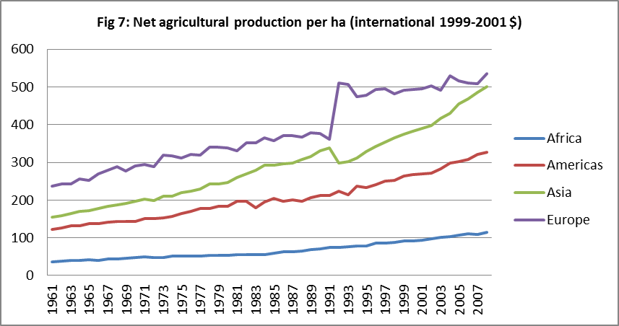
In all continent, agricultural land productivity has increased considerably except Africa

Slide 12
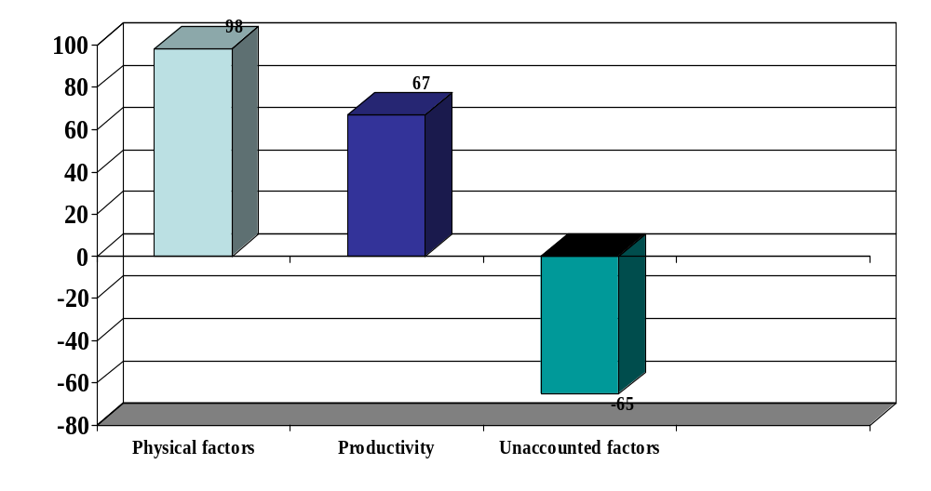
Agricultural growth contributors, 1971-00 (%) – Analysis base on 26 sample countries
factor accumulation globally provided the most important component of output growth during the last three decades.
Some productivity growth is happening, unfortunately this productivity growth is almost totally eaten by exogenous factor (drough, disasters, conflicts…)

Slide 13
Disentangling the Sources of Growth of African Agriculture
Source of growth (annual growth rate in percentage)
 | 1971-80 | 1981-90 | 1991-00 |  | All (1971-2000)
Total output growth per year (a) | 100% | 100% |  | 100% | 100%
Total growth due to factor inputs (b) | 113.88% | 48.33% |  | 92.04% | 98.41%
Yearly growth due to Land (c) | -13.51% | 5.39% |  | 3.06% | 4.14%
Yearly growth due to Labor (d) | -14.77% | -34.76% |  | 30.06% | 21.04%
Yearly growth due to Tractor (e) | 88.10% | 13.12% |  | 14.79% | 25.44%
Yearly growth due to Fertilizer (f) | 57.40% | 67.82% |  | 44.90% | 51.31%
Yearly growth due to Livestock (g) | -3.34% | -3.23% |  | -0.77% | -3.54%
Yearly growth due to unaccounted factors (h) | 31.23% | -34.47% |  | -83.39% | -65.35%
Yearly growth due to Total factor productivity change (i) | -45.11% | 86.14% |  | 91.36% | 66.95%
= (b)+(h)+(i) ; (b) = (c)+(d)+(e)+(f)+(g)
Sample of 26 countries

Slide 14
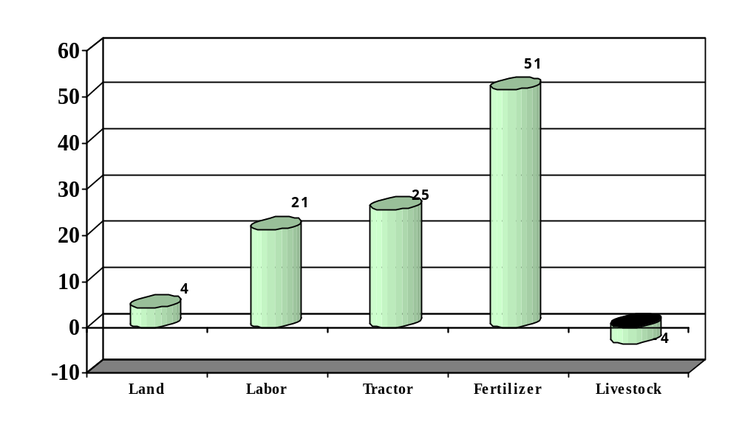
Disentangling the Sources of Growth:
Between 1971-00, Fertilizer Tractors and were the main contributors of Agricultural growth in Africa; The contribution of Land is getting close to zero

Slide 15
Summing-up: Implications
In a context of need of a more greening agriculture, the present situation of land use and land productivity in African agriculture is a cause for deep concern, and need prompt reaction.
This paper suggests two possible ways out of this dead-end:
  Boost Agricultural productivity through substantial support to technological progress
  Predicting the “hand of god”; Turn some uncontrollable factors into controllable variables.

Slide 16
END
Guy Blaise NKAMLEU
b.nkamleu@afdb.org
16

