Slide 1
The Implications of HO and IRS Theories for Bilateral Trade Flows within
Sub-Saharan Africa
Julie Lohi
West Virginia University
Julie.lohi@mail.wvu.edu

Slide 2
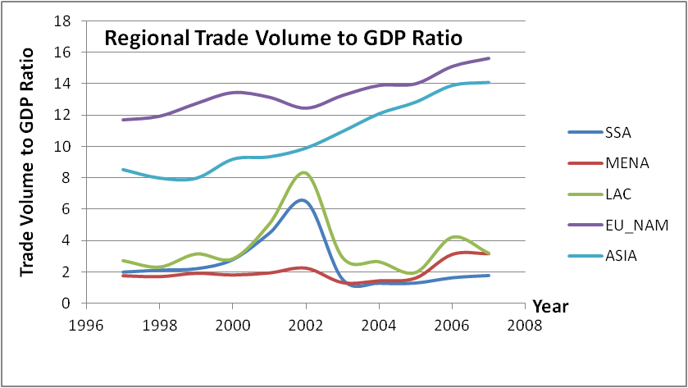
Motivation
Why Bilateral trade Flows are Low within Sub-Saharan Africa (SSA)?

Slide 3
Literature
Hanink and Owusu (1998)
Used trade intensity index (TII)
Find that ECOWAS has failed to promote trade
Alemayehu and Haile (2008)
Regional grouping has insignificant effects on bilateral trade flows in SSA.
Reasons: poor private participation, compensation issue.
Faezeh and Pritchett (2009)
Trade flows are low within SSA
Gravity prediction similar to actual trade
Piet and Wheeler (2010)
Transport infrastructure and border restrictions are main reasons for lower trade rate in SSA

Slide 4
Contributions
Trade evaluation based on imperfect specialization in production
Show that comparative advantages matter in stimulating trade
SSA countries exhibit similar endowments
Products are not differentiated in the region

Slide 5
Underlying trade Theories
Heckscher-Ohlin Theory: Heckscher (1919) and Ohlin (1933)
Predicts high trade for large differences in factor endowment ratios.
Increasing return to scale theory: Krugman (1979, 1980)
Predicts intensive trade between industries producing different varieties of a product.
The love of varieties creates demand across countries.

Slide 6
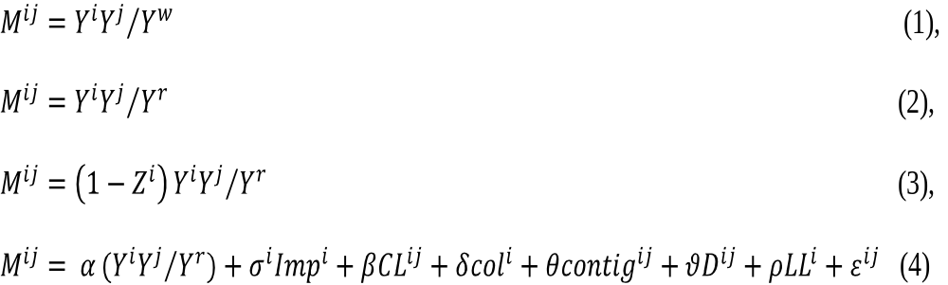
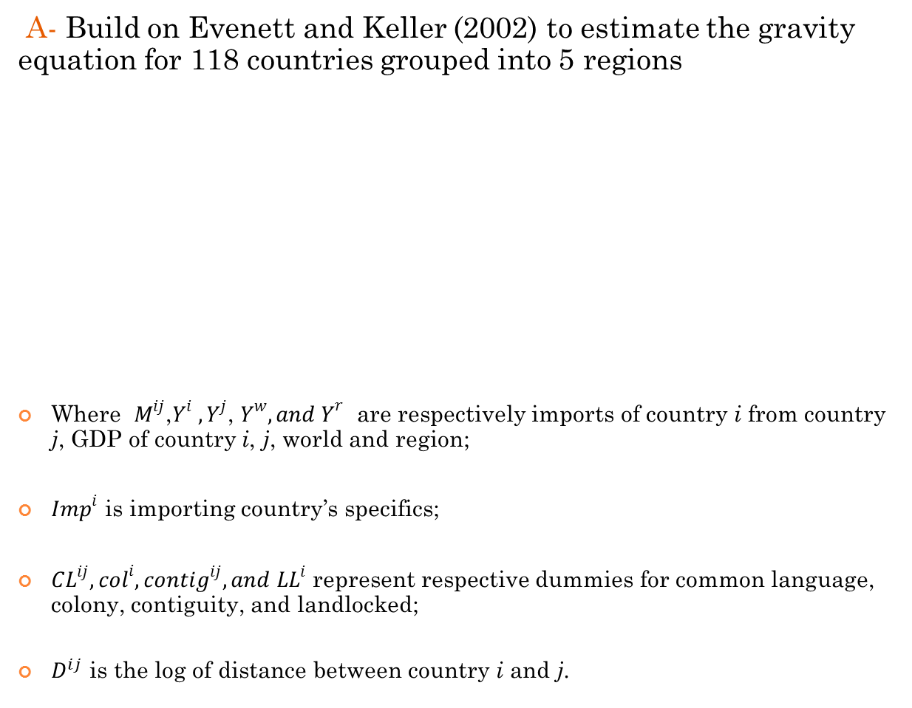
Methodologies
A- Build on Evenett and Keller (2002) to estimate the gravity equation for 118 countries grouped into 5 regions
Where $M^{ij}$,$Y^{i}$ ${, Y}^{j}$, $Y^{w}, {and Y}^{r}$ are respectively imports of country i from country j, GDP of country i, j, world and region;
${Imp}^{i}$ is importing country’s specifics;
${CL}^{ij}, {col}^{i}, {contig}^{ij}, and {LL}^{i}$represent respective dummies for common language, colony, contiguity, and landlocked;
$D^{ij}$ is the log of distance between country i and j.

Slide 7
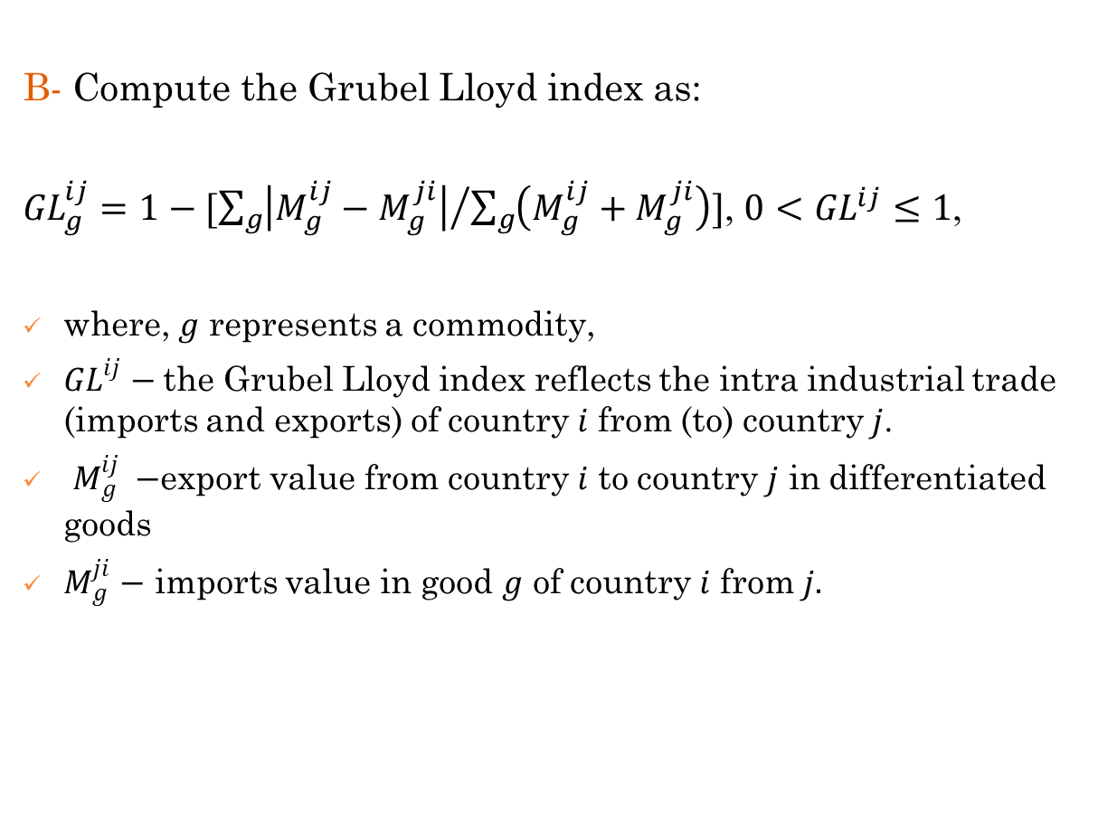
Methodologies
B- Compute the Grubel Lloyd index as:
${GL}_{g}^{ij}=1−[{\sum_{g}{\left|M_{g}^{ij}−M_{g}^{ji}\right|}}/{\sum_{g}{\left(M_{g}^{ij}+M_{g}^{ji}\right)]}}$, $0<{GL}^{ij}≤1$,
where, $g$ represents a commodity,
${GL}^{ij}$ $−$the Grubel Lloyd index reflects the intra industrial trade (imports and exports) of country $i$ from (to) country$j$.
$M_{g}^{ij} −$export value from country $i$ to country $j$ in differentiated goods
$M_{g}^{ji}$ $−$ imports value in good $g$ of country $i$ from $j.$

Slide 8
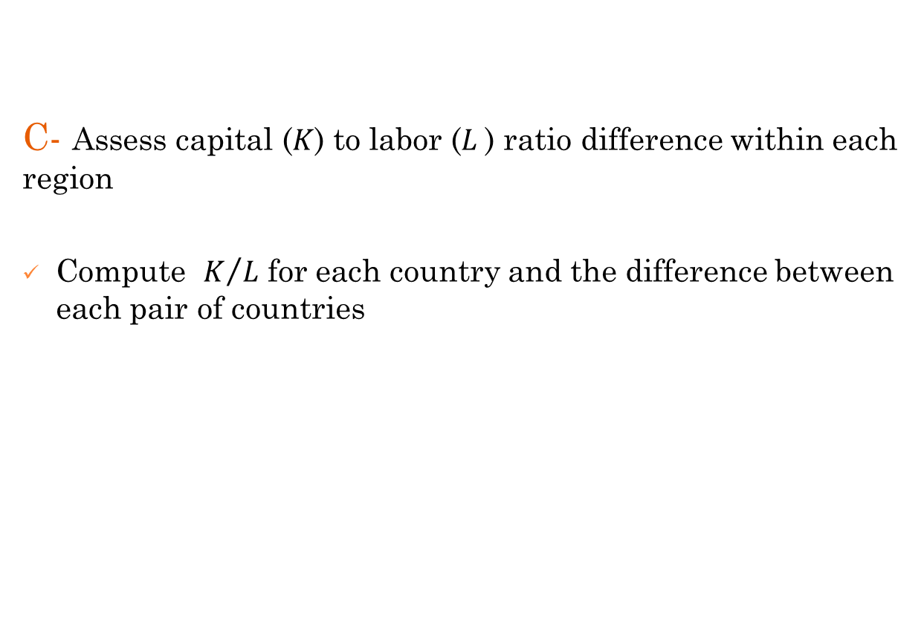
Methodologies
C- Assess capital ($K$) to labor ($L$) ratio difference within each region
Compute $K/L$ for each country and the difference between each pair of countries

Slide 9
Data
118 countries across the world grouped into 5 regions: Asia, Europe and North America, Latin America and Caribbean, Middle East and North Africa, and Sub-Saharan Africa.
Panel from 1997 to 2007
Data on bilateral imports is extracted from the IMF-DOT
Data on Real GDP, Investment Share, Real GDP per worker, and population are taken from the Penn World Tables (last version- 6.3)
Data on trade factor dummies can be found at http://www.cepii.fr/anglaisgraph/bdd/distances.htm
Capital stock and labor force data are from the World Bank’s World Development indicator (WDI) database
The Grubel Llyod is calculated using Uncomtrade data at 3-digit.

Slide 10
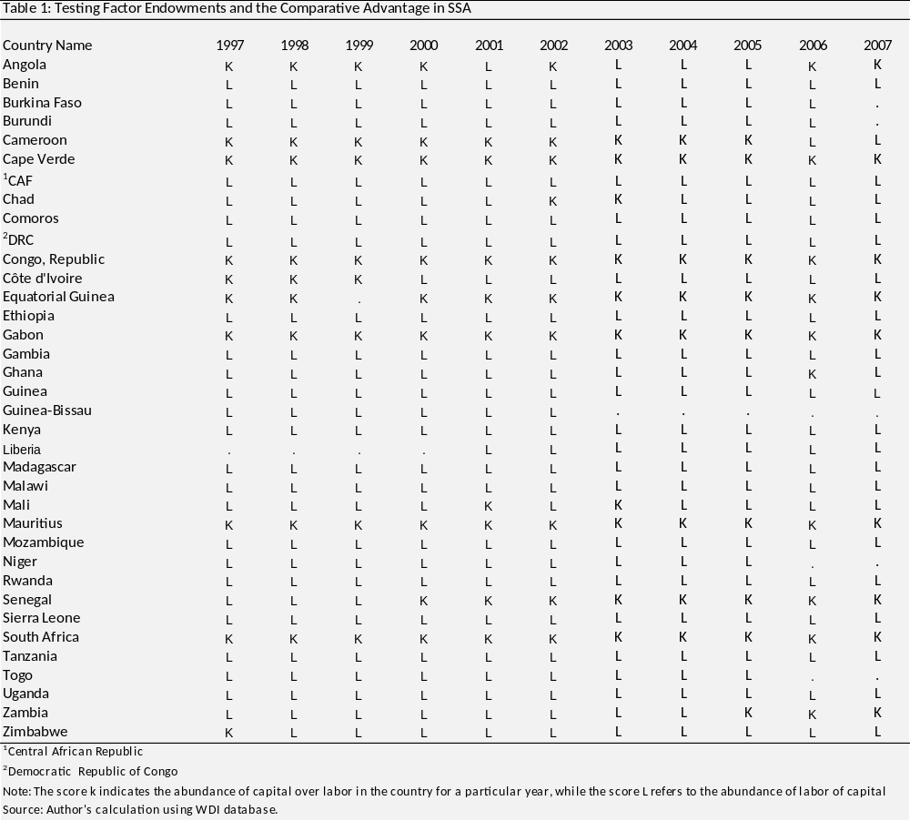
Results

Slide 11
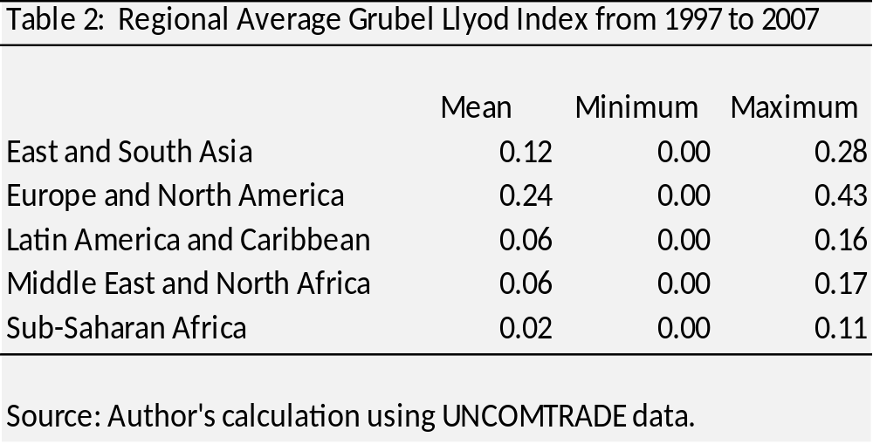
Results

Slide 12
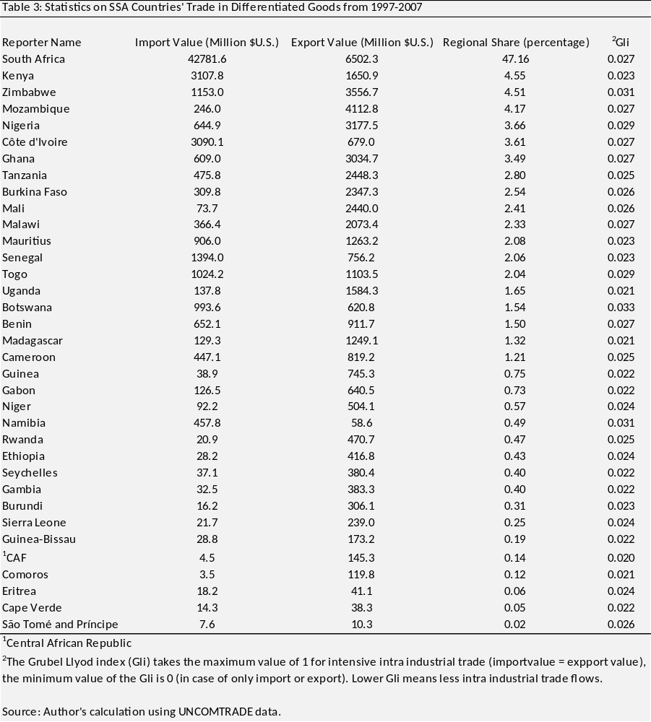
Results

Slide 13
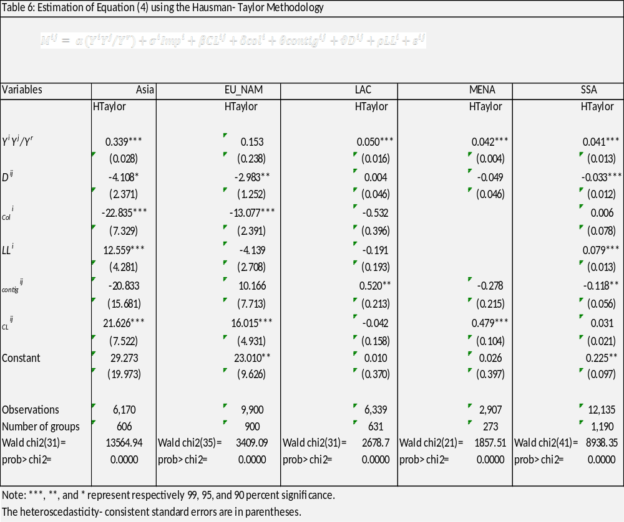
Results

Slide 14
Concluding remarks
Bilateral trade flows are low within SSA compare to that of other regions due to:
Lack of comparative advantage in production across countries in SSA
Similar endowments in factors of production across countries within SSA
Homogeneity of traded goods
Less product differentiation

Slide 15
Suggestions
SSA countries might want to increase efforts towards accessing developed markets
Gain the “know-how” from interacting with mature markets
Benefit from their comparative advantage over industrialized countries
Use new technologies for industrialization and differentiate their products in many varieties.

Slide 16
Thank you for your attention
Your comments are very welcome!

