Slide 1
Transitioning in and out of Formal Status: Evidence from 4 African Countries
Ousman Gajigo*
And
Mary Hallward-Driemeier
2011 AEC – Addis Ababa

Slide 2
Research Question
What determines formality/registration of firms?
To what extent are government policies or regulations or actions of public officials affecting rate of formality?

Slide 3
Importance of Formal Status
Effect on firm performance.
  Access to Infrastructure and access to finance.
Effect on government
  Broadening the tax base, and therefore tax revenue.
Effect on welfare of workers
  Worker rights more likely to be enforced.

Slide 4
Data
Four African countries in 2009/10: Ivory Cost, Kenya, Nigeria and Senegal.
Mixture of formal and informal firms across different sectors and ownership structures
Information on transitioning between formal and informal sectors.

Slide 5
Size distribution

Slide 6
Ownership types

Slide 7
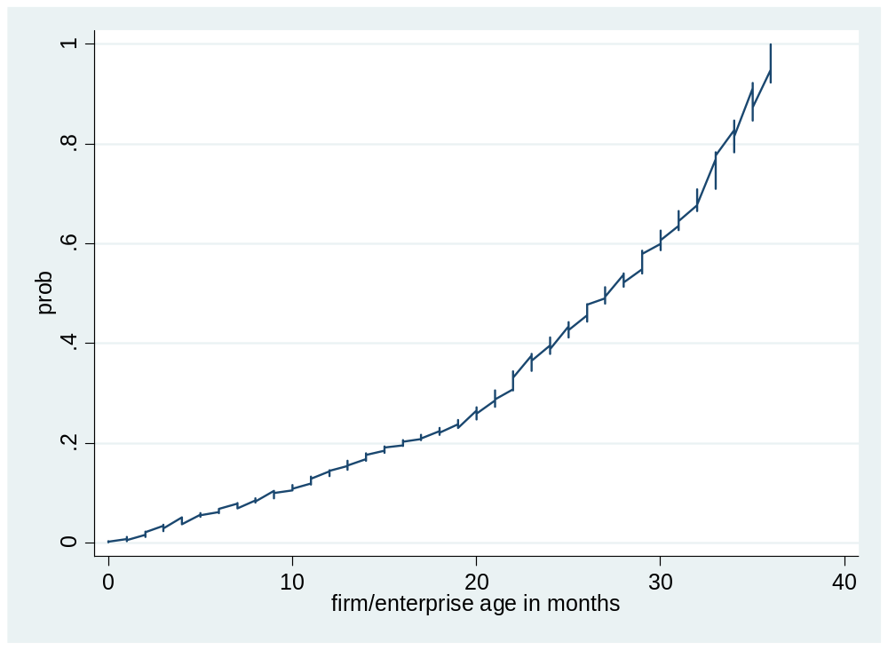
Age distribution

Slide 8
What is new in this paper?
Analyzing the determinants of exiting the formal sector for the informal sector.
    5% of initially formal firms became informal within 3 years.
    23% of initially informal firms became formal within 3 years.

Slide 9
Median Start-up Capital
Formal>>Informal: started as formal but currently informal
Informal>>Formal: started as informal but currently formal

Slide 10
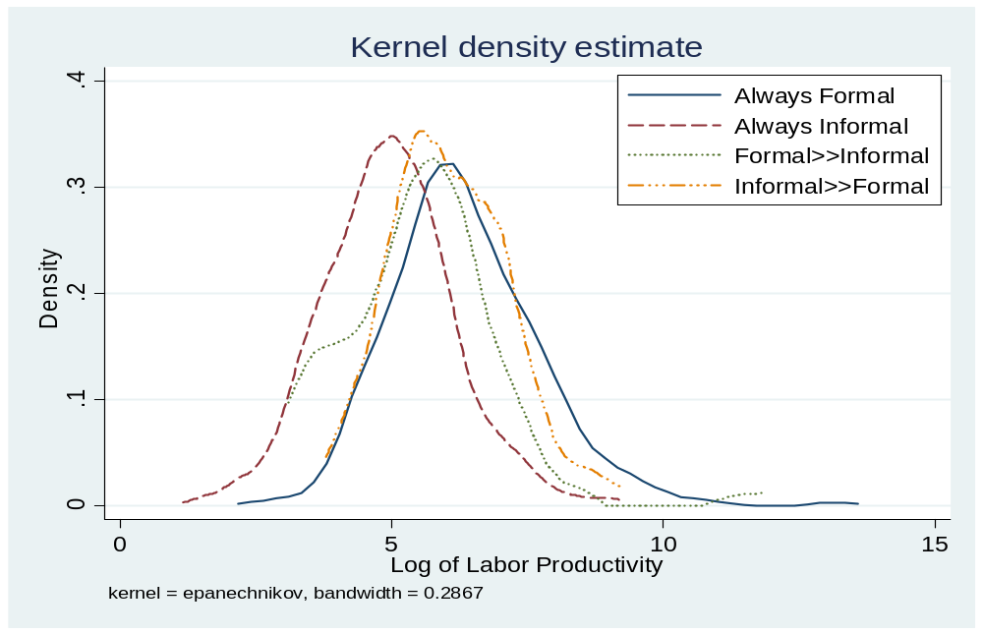
Distributions of Start-up Capital

Slide 11
Labor Productivity (revenue per worker)
Formal>>Informal: started as formal but currently informal
Informal>>Formal: started as informal but currently formal

Slide 12
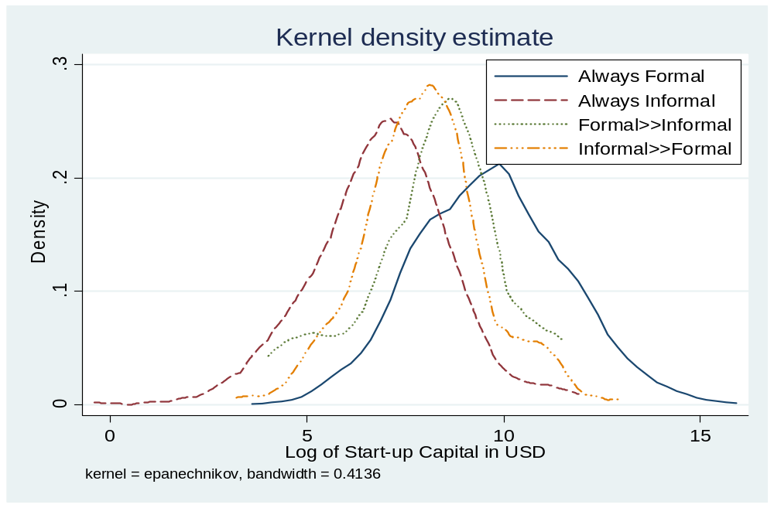
Distribution of Labor Productivity

Slide 13
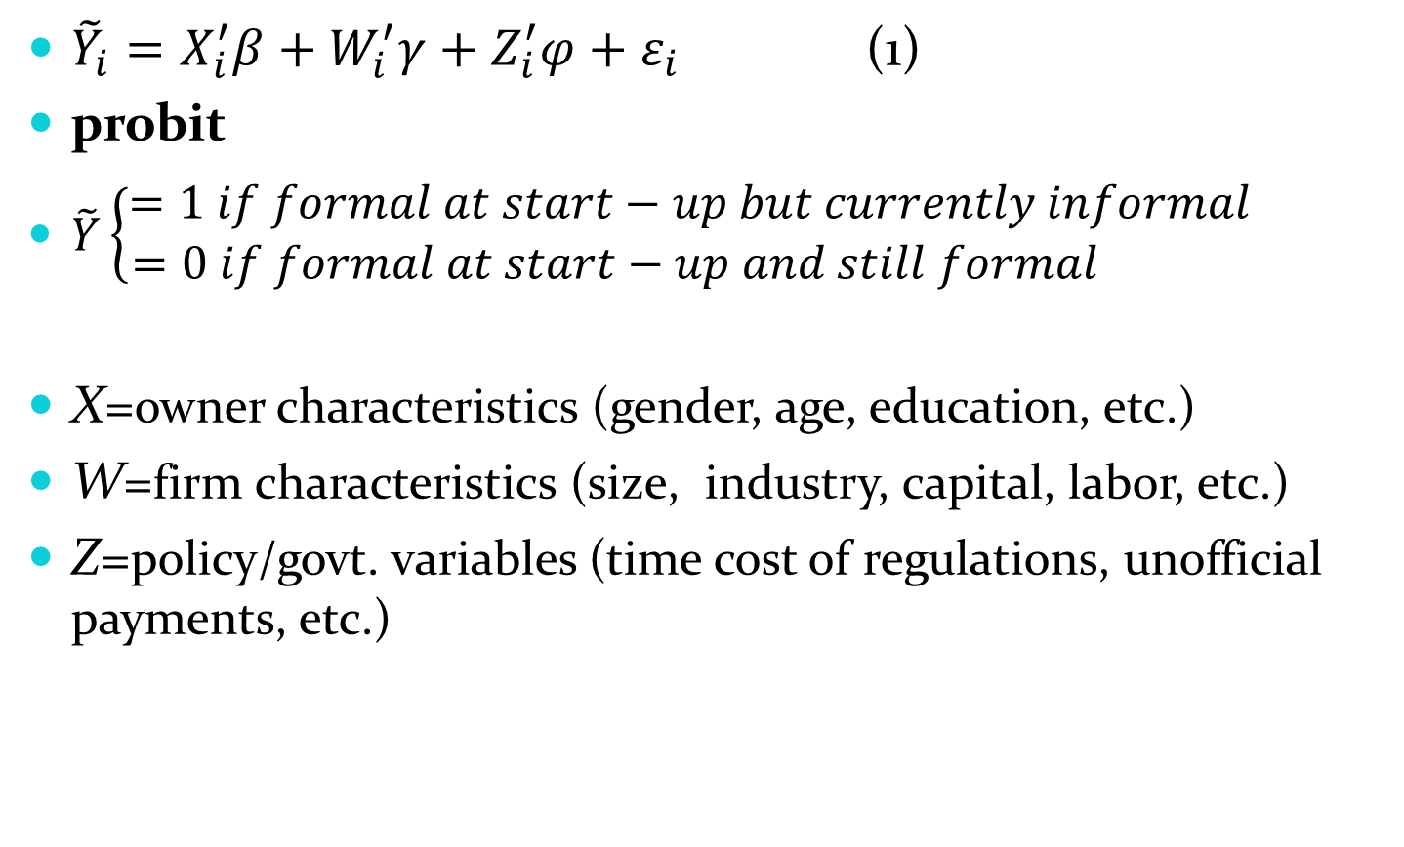
Estimations
${\tilde{Y}}_{i}=X_{i}^{′}β+W_{i}^{′}γ+Z_{i}^{′}φ+ε_{i}$ (1)
probit
$\tilde{Y}\left\{\begin{aligned}=1 if formal at start−up but currently informal \\ =0 if formal at start−up and still formal \end{aligned}\right.$
X=owner characteristics (gender, age, education, etc.)
W=firm characteristics (size, industry, capital, labor, etc.)
Z=policy/govt. variables (time cost of regulations, unofficial payments, etc.)

Slide 14
Regression Results (Probit)
Marginal Effects

Slide 15
 | Coef. | z-stat
Female owner | -0.002 | -1.07
Enterprise age in months | -0.0002** | -2.36
Owner age | -0.0001 | -0.46
Total # workers at start-up | -0.0004** | -1.95
log of labor productivity (revenue per worker) | -0.003*** | -3.38
log of start-up capital -USD | -0.002** | -2.16
Largest source of finance at start-up was Trade Credit | -0.002 | -0.86
Largest source of finance at start-up was Money Lenders | -0.001 | -0.38
Largest source of finance at start-up was MFI | -0.002 | -0.59
Largest source of finance at start-up was Bank | -0.003 | -1.13
Largest source of finance at start-up was Friends/Relatives | -0.001 | -0.52
management spent time dealing with govt. regulations | -0.003 | -1.25
% of management's time spent dealing with govt. regulations | 0.000 | -0.88
spent some money on gifts/informal payments to govt. officials | -0.009** | -2.19
% of annual sales spent on gifts/informal payments to govt. officials | 0.0002* | 1.92

Slide 16
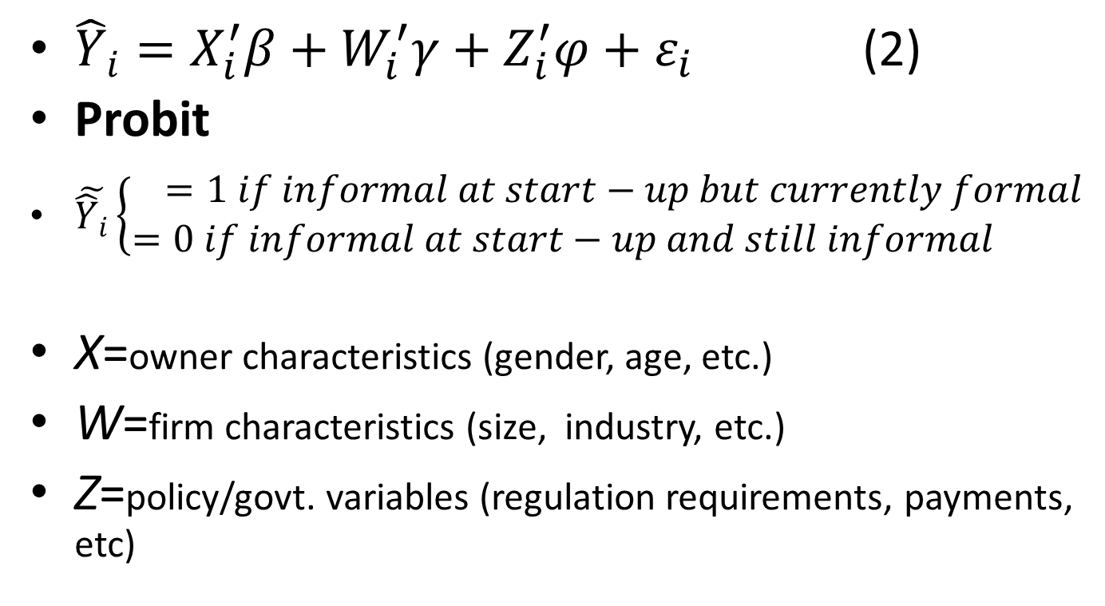
Estimation Contd.
${\hat{Y}}_{i}=X_{i}^{′}β+W_{i}^{′}γ+Z_{i}^{′}φ+ε_{i}$ (2)
Probit
$\tilde{{\hat{Y}}_{i}}\left\{\begin{aligned}=1 if informal at start−up but currently formal \\ =0 if informal at start−up and still informal \end{aligned}\right.$
X=owner characteristics (gender, age, etc.)
W=firm characteristics (size, industry, etc.)
Z=policy/govt. variables (regulation requirements, payments, etc)

Slide 17
 | Coef. | z-stat
Female owner | -0.012* | -1.73
Owner age | -0.003*** | -3.65
Attended some university | 0.213** | 1.98
Attended some graduate school | 0.087 | 1.28
# years served as an employee of a formal enterprise | 0.003*** | 2.83
Total # workers at start-up | -0.0004 | -0.6
log of labor productivity (revenue per worker) | 0.019*** | 4.91
log of start-up capital -USD | 0.006** | 1.97
Largest source of finance at start-up was Bank | 0.079** | 2.63
management spent time dealing with govt. regulations | 0.005 | 0.5
% of management's time spent dealing with govt. regulations | -0.0002 | -0.84
spent some money on gifts/informal payments to govt. officials | 0.046** | 2.85
% of annual sales spent on gifts/informal payments to govt. officials | -0.005** | -2.84

Slide 18
% of firms that made informal payments or gifts to “get things done”.

Slide 19
Management/owners spent substantial amount of time meeting govt. regulations.

Slide 20
Conclusion
Productivity is a determinant to being in the formal sector.
  Consistent with findings that formality increases with productivity.
Bribe payments limits firm registration by increasing cost.
    It also shrinks the formal sector.
Policy Implication:
  Streamline registration requirements to reduce both the direct and opportunity cost, as well as bribe payments.

