Slide 1
The Food Price Spikes of 2008/09 and 2010/11:
Country-Level Impacts and Policy Responses in Africa
Pedro Conceição, Sebastian Levine
and Zuzana Brixiova
African Economic Conference
Addis Ababa, October 2011

Slide 2
Overview
Background
Conceptual framework
Impacts and vulnerabilities
Policy responses
Conclusions

Slide 3
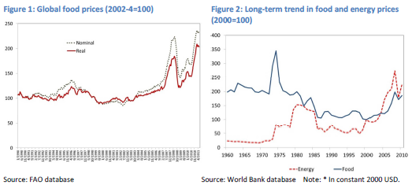
Background – some stylized facts
Notes:
International food prices have spiked dramatically on two occasions in the past few years. In the year to June 2008 prices surged 36 percent in real terms after two decades of relative stability. After receding, prices surged again in mid-2010 (Figure 1). Although the recent spikes in food prices have been significant they are not without precedent over a longer period (Figure 2).
Increasing food prices are particularly challenging for sub-Saharan Africa:
- the region is a net importer of food,
- it has the highest share of poor and hungry people in the world, and
- agricultural productivity remains far below that of other regions.
The (short-term) increase in global food prices and increased volatility in recent years, reflects the tightening of stocks in cereal markets and adverse weather conditions (supply – side bottlenecks/shocks). According to Food and Agriculture Organization (2011), cereal stocks have fallen by one-third since 2000 and are expected to fall even further in 2011. With thinner stocks, the adjustments to supply shocks need to be accommodated through price changes.
The longer term food price increase trend is driven by demand growth outpacing gains in yields (i.e. low agricultural productivity is an important factor especially in Africa). Sources of increased demand include population growth, shifting tastes in emerging and frontier markets, including in Africa as well as the climate change and the rise of the bio-fuel industry.
Food markets in 2010/11 have been affected by the confluence of many of the same factors as in 2007/08: adverse weather and poor harvests affecting some of the main exporters, dollar depreciation, rising oil prices and short-sighted policy responses (e.g., export bans).

Slide 4
Differences between the two price spikes
Type and number of commodities affected
2. Limited pass-through of global to local prices in 2010/11 relative to 2007/08
Varied policy responses
  Reduced fiscal space after the global financial crisis limited macro policy responses in 2010/11
Notes:
The first notable difference is in the type and number of commodities that have been affected. The increases in global food prices in 2010/11 were led by maize, wheat, oil and sugar. Rice, which saw significant price rises in 2007/08, and on which many especially West African countries are import dependant, has been largely unaffected this time around due to good harvests in Asia – the main source of global supply.
The second difference is that the pass-through of global prices on to local African markets, which was very strong in 2007/08, has been limited in 2010/11. This is in large part due to a strong performance of agriculture sectors in many countries. Overall, cereal production in Africa was up by 11.5 percent between 2009 and 2010, according to FAO. Cereal production increased by 23 percent in East Africa and by 12 percent in West Africa, especially in Chad, Niger and Mauritania as these countries recovered from the 2009 drought. Over the period, among the 39 Low-Income Food Deficit Countries in Africa, cereal production increased by more than double the average for the 70 country-group as a whole (FAO 2010).
Changes in international food prices may not pass through, or do so with delay, to local food markets in Africa for a number of reasons. Transportation costs are high especially among the many landlocked countries on the continent and among those with inadequate infrastructure. Policy barriers such as export bans or restricted access to foreign exchange also disrupt price transmissions. Concentration of market power and asymmetrical information among traders can further prevent arbitrage and the transmission of price changes.
The third difference relates to policy responses. The more restrained approach in the latter period was attributable to the more limited policy space as a result of interventions in the former period and the growing impact of the global financial crisis over both periods. Specifically, responses that had less negative implications on the budget (e.g., price controls) tended to be more used in 2009/10 than in 2007/08. Conversely,
measures that would lead to immediate deterioration of the budget (e.g. increased infrastructure outlays, cuts in tariff imports) were used less. In several countries, monetary policy also adopted different priorities with regards to growth-inflation trade-offs. For example, while central banks
reduced policy rates to stimulate growth in Kenya and Uganda in 2007/08, they have subsequently raised rates to bring down the double-digit inflation in 2009/10, with less concern of the negative impacts such measure can have on economic activity.

Slide 5
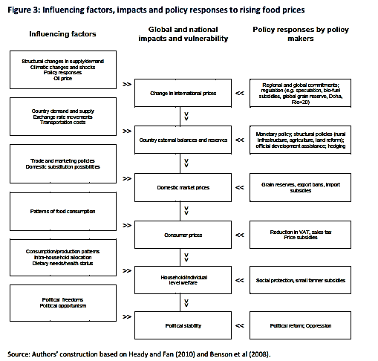
Conceptual framework

Slide 6
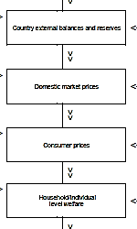
Conceptual framework (cont.)

Slide 7
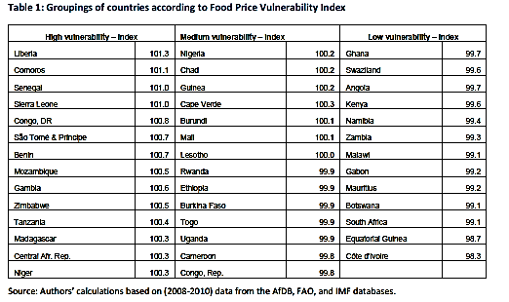
Impact: Food price vulnerability
Notes:
Vulnerability of the continent to rising and more volatile international food prices can be assessed with the food price vulnerability index (FVI) developed by Nomura (2010) for selected emerging market economies. Here we apply it to all African countries:
FVI = 100 - {0.25 *GDPpc - 0.25 * food / consumptio n + 0.5 * net _ trade _ balance /GDP }
Where GDP pc is GDP per capita, food/consumption is the share of food in household expenditures and net trade balance/GDP is the net food exports as a share of GDP. The index puts high weight on net food trade balance since on the macro level, high food prices impact in particular food importers. The higher value of the index indicates greater vulnerability to price rises.
Results in Table 1 show that five countries most vulnerable to food prices increases were Liberia, Comoros, Senegal, Sierra Leone, and Congo Dem. Rep. Their vulnerability stemmed from the high share of food in household consumption and high food import dependency. Often, these are also the countries with particularly limited policy space to counter shocks.
Five least vulnerable countries are either oil exporters (e.g. Equatorial Guinea and Côte d'Ivoire) or middle income countries (MICs) in Southern Africa (e.g., Botswana, Mauritius and Southern Africa). The lower vulnerability of MICs, as measured by this index, stems from their relatively low share of food in household expenditures and high income.

Slide 8
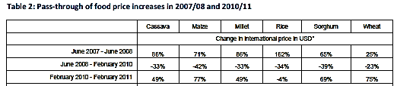

Impact: Price pass through
Notes:
Minot (2011) offers several possible explanations for why the pass through in 2007/08 was particularly strong including: the extraordinary large size of the price shock, which was accompanied by sharply higher transportation costs due to oil price increases, and adverse policy responses,
including export taxes or bans on grains, which exacerbated the impact on prices in neighboring countries.

Slide 9
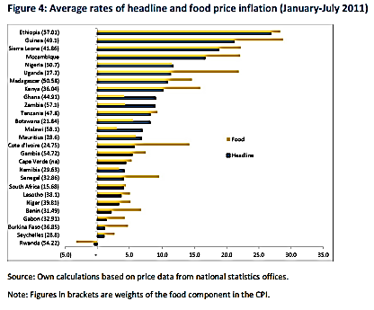
Impact: Consumer prices
Notes:
In 19 of the 27 African countries for which we have recent price data, food price inflation has been rising faster than headline inflation in the first half of 2011 while food price inflation was actually tempering overall price changes in the remaining eight countries (Figure 4). In six countries is the food price increase more than twice as high as for the CPI as a whole. The food component of consumer price indices in African countries is by far the largest typically weighing 40 percent but can be as high as 58 percent (in Malawi). Hence food inflation is a critical determinant of overall consumer price inflation in most African countries.

Slide 10
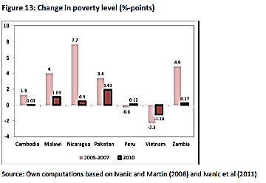
Impact: Household welfare
Notes:
The poverty impacts of the 2010/11 price spikes appear more limited than in 2007/08.
The World Bank estimated though that rising prices had led to a short-term surge of 105 million more extreme poor (living on less than $1.25 a day PPP terms) in the developing world (Ivanic and Martin, 2008). The updated analysis released earlier this year suggested that the comparable rise in prices in the second half of 2010 led to 44 million more poor (Ivanic et al., 2010), total in to about 150 million additional people.
These estimates do not represent the actual number of people that have been pushed into poverty as a result of the food price changes. Rather they are a result of simulations on micro-economic models that use historical household data and a number of assumptions, and hence rather give estimate of vulnerability. The estimates only consider the impact from changes in food prices, not other commodities such as oil. Finally, the second and third round impacts need to be further researched, i.e. the substitution for other commodities etc. Moreover, the impact of higher growth was not taken into account – in sum the micro-simulations exhibited limitations of partial equilibrium analysis.

Slide 11
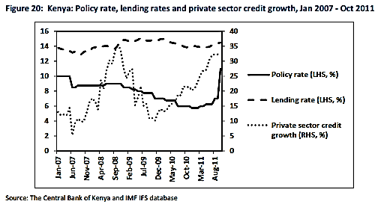
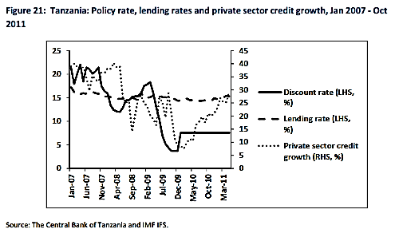
Policy responses – Monetary policy
Notes:
In low income countries with the high share of food in the CPI basket, the negative impact of rising food prices is even more acute if these raise inflationary expectations and thus contribute to acceleration of the underlying inflation. Monetary policy can help in these circumstances, but in
African countries its effectiveness is often undermined by weak transmission mechanisms and numerous policy objectives (growth-inflation trade-off), besides the imperfect information and structural rigidities.
This point is illustrated by an example of Kenya, which is one of the East African countries most affected by food (and fuel) driven inflation. In Kenya, even though inflation accelerated to double digits in 2008, the monetary policy rate increased only marginally, from 8.75 in early 2008 to 9 percent in mid-2008. Since the end of 2008 the Central Bank started to lower its rate again (it reached 5.75 percent in January 2011) to stimulate growth during the global financial crisis and its aftermath. In July 2011 annual inflation reached again almost 16 percent, while food inflation amounted to 24 percent. To reduce inflation and anchor the expectations, the central bank raised the rate to 6 percent in March and to 6.25 percent in May 2011, and again to 7 percent in August 2011. Subsequently, the Central Bank raised the policy rate markedly (by 400 bps) in October 2011 with a view to contain inflation and stabilize the exchange rate, bringing the rate to the highest level in the past 5 years. Effectiveness is yet to be seen.
In Tanzania, private sector credit has declined for most of 2009, even though the Bank of Tanzania markedly reduced its rate in 2009 (from 18.3 percent in February to 3.7 percent in December), again in part due to stickiness of the commercial banks’ lending rates, which have hardly moved throughout the crisis period. Credit to the private sector has been finally reviving in 2010. With inflation reaching double digits in mid-2011, attention of policymakers shifted to prices. Unlike Kenya (and Uganda) who have tightened their monetary policies in the third quarter of 2011 to curb of inflationary pressures and strengthen currencies, the Bank of Tanzania has kept its rate unchanged. Nevertheless, call for coordinating EAC responses to the rising food prices has recently emerged, suggesting that Tanzania may follow Uganda’s and Kenya’s policy rate increased.

Slide 12
Policy responses – Survey of RMCs
In 2011, UNDP RBA conducted a survey of national policy responses through its country offices;
Total of 33 countries included in responses
Policy responses adopted by SSA countries in 2007/08 and 2010/2011 are classified according to:
  overall type (macro, micro/social at the household, level and structural/sectoral)
  channels by which they operate (supply/demand),
  likely timing of their impact (short vs. long term).
Notes:
Examples of macro/market measures include: (i) trade measaures (e.g. exports bans, trade tariffs); (ii) fiscal measures (VAT rate changes) and (iii) monetary policy (changes in policy rates).
Examples of direct support to households (social safety measures) include cash transfers; transport vouchers; food distribution.
Examples of structural/sectoral measures include raising budget allocations to agriculture (also a fiscal measure); land lease changes; infrastructure investment (details on the next slide).

Slide 13
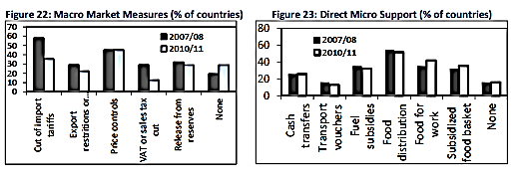
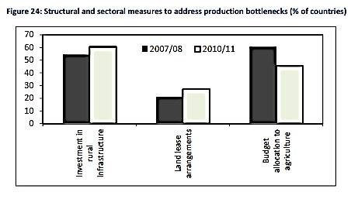
Policy responses – 2007/08 vs. 2010/11
Notes:
Governments in 31 of 33 countries surveyed intervened to contain food price surges in both (2007/08 and 2010/11) episodes.
Regarding timing of their impact, cuts of import tariffs on food items and food aid distribution were most common among the short-term policy responses e.g., market economy-wide interventions and direct support to consumers and vulnerable groups) in 2007/08 and were
adopted in more than half of the countries surveyed. They were followed by price controls, which were used in almost half (45 percent) of the countries.
In 2010/11, still more than half of the countries surveyed relied on food aid distribution as a way to reach vulnerable groups, which became the most common short term policy response. Among the economy-wide market interventions, with the marked decline in use of tariff cuts to only 1/3 of countries due to less fiscal space, direct price controls became the most frequent policy tool.
Within the micro/direct support measures, food aid distribution, food-for-work programs and general fuel subsidies, subsidized food baskets and cash transfer programs were commonly used in SSA countries surveyed. Specifically, the applications ranged between one quarter of
countries adopting cash transfer programs in both 2007/08 and 2010/11 spikes and more than half of them distributing food again in both 2007/08 and 2010/11.
More than half of the countries increased investment in rural infrastructure during at least one of the episodes, while more than quarter altered land lease arrangements in 2010/11.

Slide 14
Policy responses (% of SSA sub-groups)
Market (macro) interventions, by SSA sub-groups (% of countries)
Structural and sectoral measures, by SSA sub-groups (% of countries)
Notes:
The aggregate figures hide differences in policy responses among sub-groups and individual countries. Here countries are grouped as: (i) oil-rich countries; (ii) non-oil middle income countries and (iii) non-oil LICs.
Oil exporters intervened heavily at macro level, their direct interventions at the household level were limited, reflecting in part absence of permanent safety nets. They also implemented structural reforms (increased rural infrastructure) to diversify their production and export bases.
Non-oil middle income countries have refrained from macro level interventions during both food price spikes, consistently with their relatively low macro/national vulnerability to price shocks (the earlier FVI). Their policy responses have focused on direct interventions for targeted groups, with a view to address local food market failures and reduce inequalities.
Governments in non-oil low income countries continued to utilize all groups of interventions during both food price increases, reflecting their high macro vulnerability as well as imperfections in functioning of local food markets.
No fragile LIC other than Eritrea distributed cash transfers in 2007/08 or 2010/11; instead most have implemented food aid distribution and food-for-work programs. About half of the fragile LICs have increased outlays on rural infrastructure; some resorted to measures such as rapidly
increased access to credit or land.

Slide 15
Conclusions
Similarities between the two price spikes in 2007/08 and 2010/11.
Key differences: Different commodities affected, limited pass-through, different policy responses.
Between African countries also significant heterogeneity reflecting differences in exposure, vulnerability, policy space and coping strategies.

Slide 16
Conclusions (cont.)
Invest in agriculture, raise productivity and mitigate impacts of climate change
Facilitate supply responses, deepen markets (cross-border trade, RD, infrastructure)
National and regional policy coordination (both on structural – reserves – and macro policies)
Social protection to build resilience and raise productivity
Reduce domestic market volatility (credit, storage, insurance, commodity exchanges)

