Slide 1

Statistical Data and Metadata eXchange (SDMX)
Dany Ghafari/ 19-21 September 2018 / Kigali, Rwanda
Notes:
Statistical Data and Metadata Exchange (SDMX) is an iso standard for the data and metadata exchange between organizations and between countries and the international agencies.

Slide 2

Statistical Data and Metadata eXchange
What’s SDMX?
SDMX is a standard to describe statistical data and metadata
Normalize their exchange
What is SDMX?
Improve their efficient sharing across statistical and similar organizations
It consists of:
technical standards (including the Information Model)
statistical guidelines
an IT architecture and tools
2
For more information: SDMX.org
Cela consiste en:
Notes:
SDMX is a standard that describe data and metadata and provides an integrated approach for their sharing across organizations, during my presentation I will cover the IT architecture and the existing tools of SDMX

Slide 3
Statistical Data and Metadata eXchange
IT architecture and tools
IT architecture differ from one institution to another and the implementation of SDMX will vary as well.
What is SDMX?
SDMX Implementation models
Institutions with existing databases for the collection and dissemination of statistical data
Institutions with no existing databases
3
For more information: SDMX.org
Cela consiste en:
Notes:
Many colleagues have spoken about data collection and data sharing and for me today I will focus more on the technical implementation of SDMX especially SDMX_RI in UN Environment.

Slide 4
Statistical Data and Metadata eXchange
SDMX Implementation model with Existing database
Institutions has the required IT infrastructure (hosting servers, cloud hosting services, network infrastructure, Windows hosting servers, Linux, etc…)
What is SDMX?
Institutions has existing databases (MS Access, MySQL, MS SQL, Oracle, etc…)
Institutions pick the right SDMX tool that is compatible with their existing infrastructure
4
For more information: SDMX.org
Cela consiste en:
Notes:
The implementation of SDMX can be selected based on existing IT infrastructure in your organization

Slide 5
Statistical Data and Metadata eXchange
SDMX Implementation at UN Environment
UN Environment had MySQL database where all the statistical data are stored.
The database has more than a 1000 indicators (Social, Economic and Environmental data, including the SDGs Indicators data where UN Environment is the custodian agency)
What is SDMX?
The data in this database is not SDMX compliant and can be downloaded in Excel, csv and in regular JSON format
It was easy for us to identify an existing tool and to implement SDMX_RI on top of our existing database
5
For more information: SDMX.org
Cela consiste en:
Notes:
First step in implementing SDMX for us was the SDGs reporting to UNSD Global Database and where UNEP is a custodian agency for 26 indicators

Slide 6
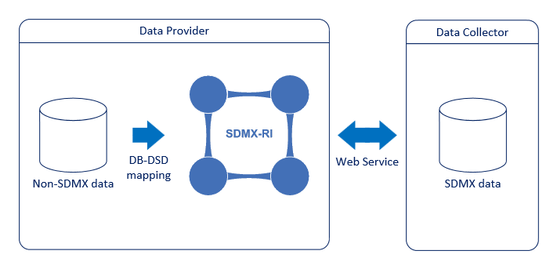
Statistical Data and Metadata eXchange
SDMX_RI Implementation at UN Environment
The SDMX-Reference Infrastructure (SDMX-RI) is a set of pick-and-choose building blocks and tools that allow data to be exposed to the external world
SDMX-RI enables the production and dissemination of SDMX data from existing reference/dissemination databases. It is composed of reusable building blocks that are designed to provide data and structural metadata based on mappings to each organization's dissemination data warehouse
6
For more information: SDMX.org
Cela consiste en:
Notes:
The SDMX-Reference Infrastructure (SDMX-RI) is a set of pick-and-choose building blocks and tools that allow data to be exposed to the external world
SDMX-RI enables the production and dissemination of SDMX data from existing reference/dissemination databases.

Slide 7
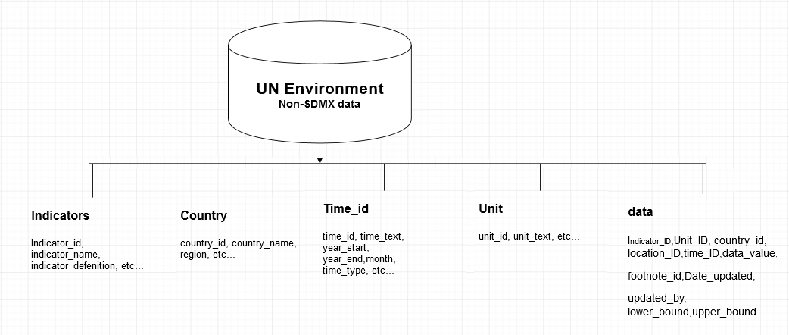
Statistical Data and Metadata eXchange
UN Environment Global Database structure
7
For more information: SDMX.org
Notes:
This is the structure of UN Environment existing database with the following table (Indicators, Country, Time_id, Unit, data, etc…)
`Indicator_ID`, Used to identify the Indicator ID
`Unit_ID`, Used for the unit of measure
`country_id`, Used for the country id (m49)
`location_ID`, The location field is not used
`time_ID`, Used for the Year or Year_start-Year_end
`data_value`, Used for the value reported
`footnote_id`, Used to reference to the footnote
`Date_updated`, Used for the date when was last updated
`updated_by`, the name of the person who last updated
`lower_bound`, used for the lower bound of the data_value
`upper_bound`, used for the upper bound of the data_value

Slide 8
Statistical Data and Metadata eXchange
SDMX Data Structure Definition (DSD for SDGs)
The DSD define the data model for the SDMX data dissemination and it is composed of Dimensions and Attributes as showing below:
Dimensions:
FREQ, DATASET_TYPE, SERIES, REF_AREA, SEX, AGE, URBANISATION, INCOME_WEALTH_QUANTILE, EDUCATION_LEV, OCCUPATION,CUST_BREAKDOWN
COMPOSITE_BREAKDOWN, DISABILITY_STATUS, TIME_PERIOD, OBS_VALUE
Attributes:
UNIT_MULT, UNIT_MEASURE, OBS_STATUS, NATURE, TIME_DETAIL, COMMENT_OBS, TIME_COVERAGE, UPPER_BOUND, LOWER_BOUND, BASE_PER
Missing Dimensions and attribute from UN Environment database
FREQ, DATASET_TYPE, SERIES, COMPOSITE_BREAKDOWN, TIME_DETAIL, BASE_PER
8
For more information: SDMX.org
Notes:
The most difficult part and the most time consuming is to map fields in our existing database to the Dimensions and Attribute of the DSD. Abdula mentioned yesterday that DSD is used to design and fill in data in your database. If you already have a database structured you need to map your existing structure and the DSD
During this process we have identified some missing fields and for sure some missing information, the missing fields were FREQ, DATASET_TYPE, SERIES, COMPOSITE_BREAKDOWN, TIME_DETAIL, BASE_PER and these were added to the existing structure of our database in order for the mapping to work.

Slide 9
Statistical Data and Metadata eXchange
Mapping before
Mapping after
ELGDB |  | SDMX DSD
 |  | FREQ
 |  | DATASET_TYPE
 |  | SERIES
country_id |  | REF_AREA
_T |  | SEX
_T |  | AGE
_T |  | URBANISATION
_T |  | INCOME_WEALTH_QUANTILE
_T |  | EDUCATION_LEV
_T |  | OCCUPATION
_T |  | CUST_BREAKDOWN
 |  | COMPOSITE_BREAKDOWN
_T |  | DISABILITY_STATUS
time_id |  | TIME_PERIOD
data_value |  | OBS_VALUE
 |  | UNIT_MULT
unit_text |  | UNIT_MEASURE
 |  | OBS_STATUS
nature |  | NATURE
 |  | TIME_DETAIL
 |  | COMMENT_OBS
 |  | TIME_COVERAGE
upper_bound |  | UPPER_BOUND
lower_bound |  | LOWER_BOUND
 |  | BASE_PER
ELGDB | SDMX DSD
update_frequency | FREQ
rep_type | REPORTING_TYPE
Series_Name | SERIES
country_id | REF_AREA
_T | SEX
_T | AGE
_T | URBANISATION
_T | INCOME_WEALTH_QUANTILE
_T | EDUCATION_LEV
_T | OCCUPATION
_T | CUST_BREAKDOWN
comp_breakdown | COMPOSITE_BREAKDOWN
_T | DISABILITY_STATUS
time_id | TIME_PERIOD
data_value | OBS_VALUE
Zero | UNIT_MULT
unit_text | UNIT_MEASURE
 | OBS_STATUS
 | NATURE
time_detail | TIME_DETAIL
 | COMMENT_OBS
 | TIME_COVERAGE
upper_bound | UPPER_BOUND
lower_bound | LOWER_BOUND
base_year | BASE_PER
source_id | SOURCE_DETAIL
9
For more information: SDMX.org
Cela consiste en:
Notes:
In this slide, we did the one to one mapping and we came up with the missing fields in our database.
FREQ: is used for the frequency of the update of this indicator or series. Our indicators are updated Annual and some every 2, 3 and 5 years.
DATASET_TYPE: is used for the type of reporting and in our case we do global reporting
SERIES: is used for Serie name
We have added to our database all missing fields and use the appropriate code in the DSD
FREQ, DATASET_TYPE, SERIES, COMPOSITE_BREAKDOWN were added to the Indicators table
TIME_DETAILS was added to the data table

Slide 10
Statistical Data and Metadata eXchange
SDMX_RI Modules
01-Web services (.Net and Java)
This component is part of the SDMX RI and is responsible for exposing the data and structural metadata using a Web Service interface that provides SDMX-ML messages. The interface follows the guidelines of the SDMX v2.0 standard for Web Services and the web service guidelines for SDMX v2.1 standard
What is SDMX?
02- Web Client (.Net and Java)
This component is part of the SDMX RI and provides a Web graphical user interface that helps users to formulate queries to the SDMX dissemination environment.
03- Mapping Assistant (Installation package)
Mapping Assistant is a desktop graphical application. This component is part of the SDMX RI and is responsible for initializing and configuring a Mapping Store Database. It is used for creating/maintaining the mappings between an SDMX Data Structure Definition (DSD) and a "Dissemination Database".
10
For more information: SDMX.org
Notes:
When we download the SDMX_RI package from sdmx.org we can find 10 modules in that package. UN Environment we have installed the first 3 modules, the web services, web client and the mapping assistant

Slide 11
Statistical Data and Metadata eXchange
Web services and Web client
UN Environment implemented the .Net web services because of the following:
Existing .Net infrastructure
Knowledgeable staff of the .Net and MS Windows
What is SDMX?
Mapping assistant
This module is installed as an application
11
For more information: SDMX.org
Notes:
This is the interface of Mapping assistant of the SDMX_RI

Slide 12
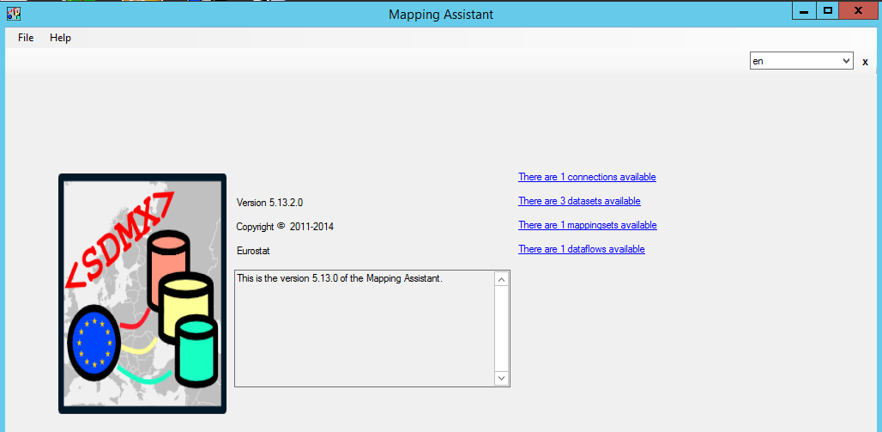
Statistical Data and Metadata eXchange
Mapping Assistant
What is SDMX?
12
For more information: SDMX.org
Notes:
I will start with mapping assistant as the settings in the mapping assistant is the foundation for providing the data for web services and web client. Once the mapping assistant is installed an icon is added to the desktop and once clicked the will looks like this screenshot.
This screen provides a summary and direct access to the total number of connections available to databases, the number of datasets, the number of mapping sets and dataflows from the DSD available.
In Mapping Assistant we can
Add Dissemination Database
Adding Mapping Store database
Adding DSD Structure
Adding Categories
Adding Dataflows
Adding datasets
Building the mapping between the datasets and the DSD
Adding content constraint

Slide 13
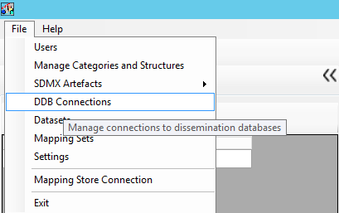
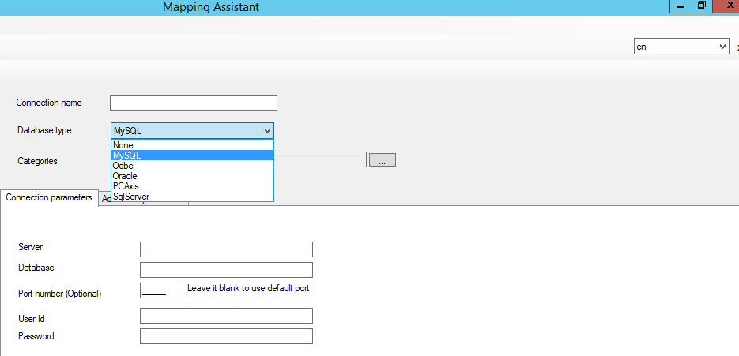
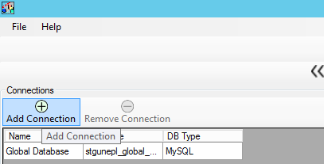
Statistical Data and Metadata eXchange
Dissemination Database
What is SDMX?
13
For more information: SDMX.org
Notes:
The forst step was to create a connection to dissemination database (DDB), fill in all the required fields and add connection.

Slide 14
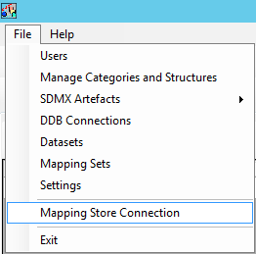
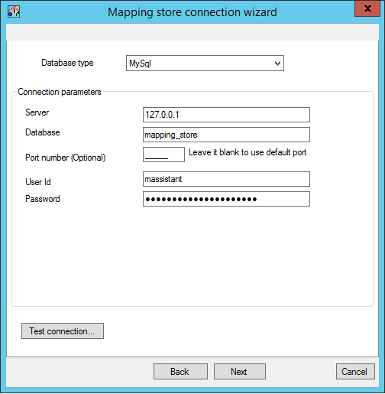
Statistical Data and Metadata eXchange
Mapping Store Database
What is SDMX?
14
For more information: SDMX.org
Notes:
The second is to create the mapping store database, entering all the required information.

Slide 15
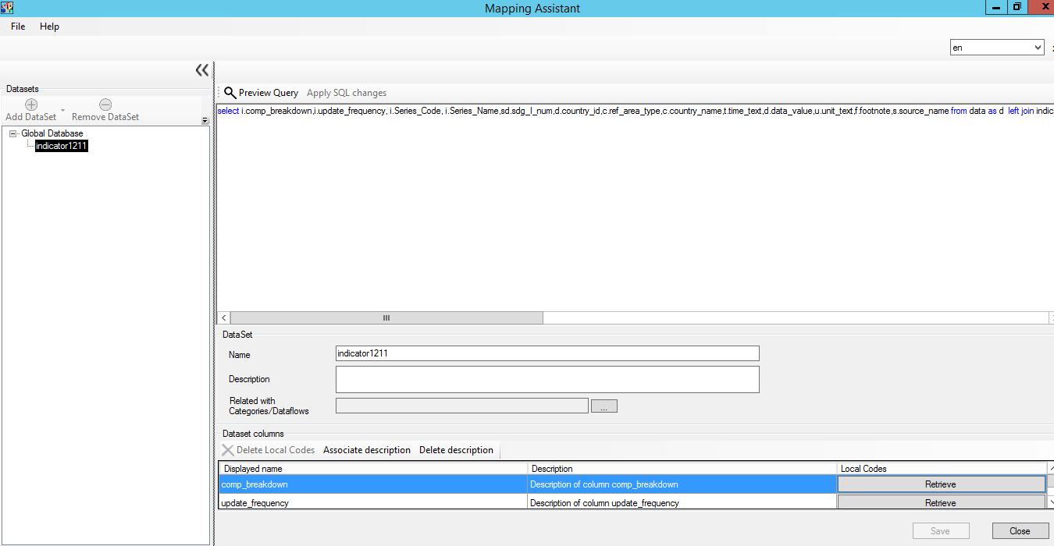
Statistical Data and Metadata eXchange
Datasets
What is SDMX?
15
For more information: SDMX.org
Notes:
Creating the datasets from the DDB
Content Constraint that Abdula Spoke about can also be defined here

Slide 16
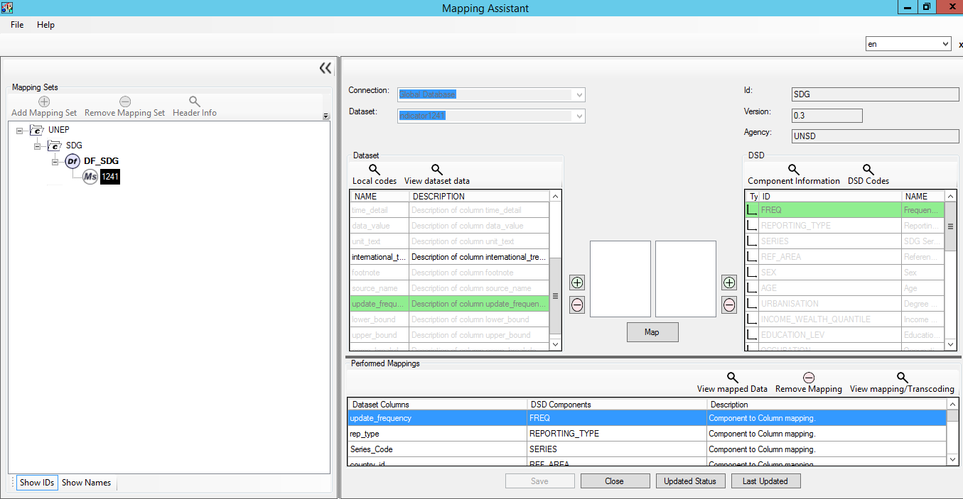
Statistical Data and Metadata eXchange
Mapping Sets
What is SDMX?
16
For more information: SDMX.org
Notes:
Importing the SDG DSD can be done here, the file structure (XML) was send to us from Abdula
After import is done, we need to map the DSD to the dataset.

Slide 17
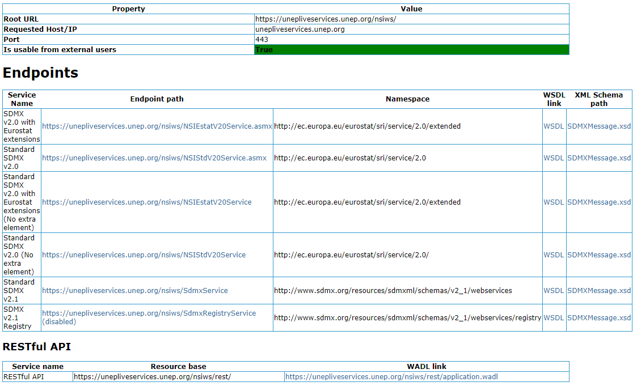
Statistical Data and Metadata eXchange
Web services
What is SDMX?
17
For more information: SDMX.org
Notes:
After a successful implementation of SDMX_RI, this is how the web services looks like, the restful API can be shared with institutions or organization interested in your data in SDMX format

Slide 18
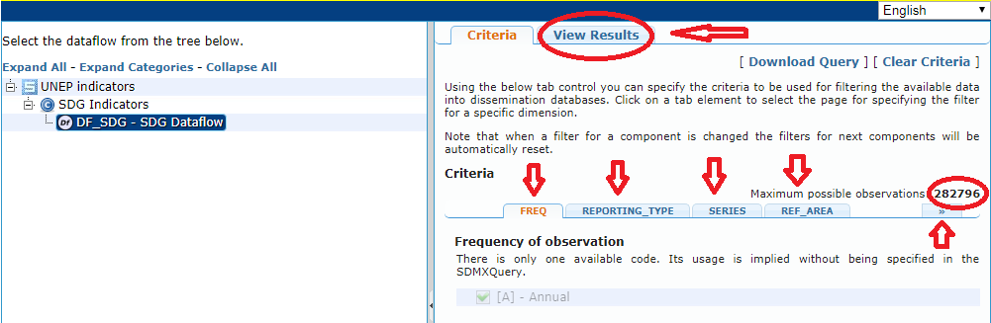
Statistical Data and Metadata eXchange
Web Clients
What is SDMX?
18
For more information: SDMX.org
Notes:
Web client module allow data users to extract data by selecting Criteria of the data they want to extract (FREQ, Reporting type, Series, Refrence Areas, sex, etc… and time period). Once all the criteria are filled user can click view results

Slide 19
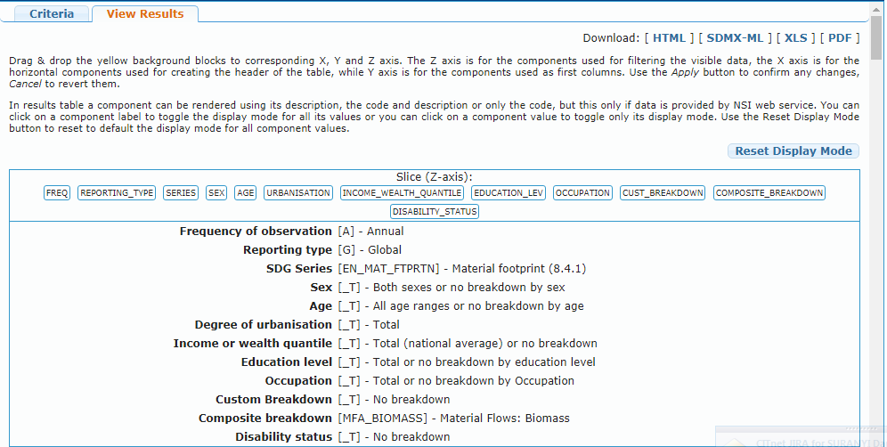
Statistical Data and Metadata eXchange
Web Clients
What is SDMX?
19
For more information: SDMX.org
Notes:
This is the top part of the returned results

Slide 20
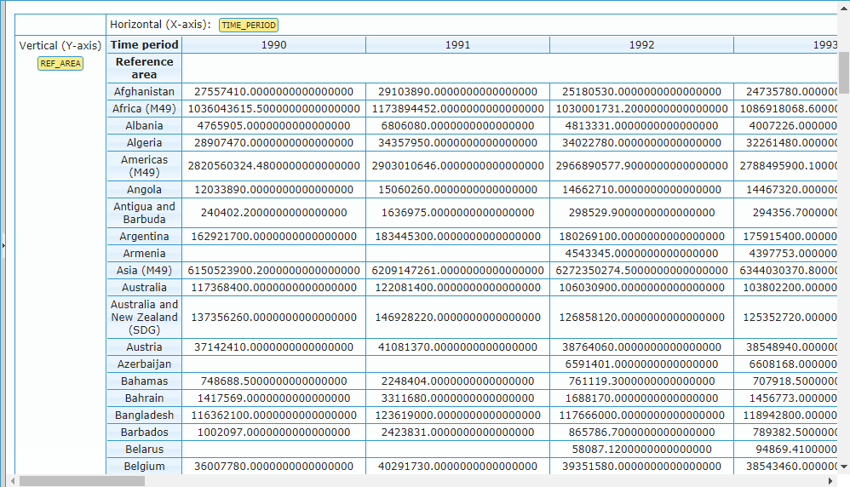
Statistical Data and Metadata eXchange
Web Clients
What is SDMX?
20
For more information: SDMX.org
Notes:
This is the second part of the returned results for the data matrix X and Y

Slide 21
Statistical Data and Metadata eXchange
Pilot testing
At this stage, we are in the process of uploading the data directly from UN Environment SDMX web services to UNSD SDGLAB with some errors. We are working with UNSD to fix these errors.
What is SDMX?
Adding missing series to the SDG DSD
Adding missing unit of measures to the SDG DSD
By 31 December 2018, the data to UNSD can be sent using SDMX web services
21
For more information: SDMX.org
Notes:
At this stage we are working with UNSD on fixing the errors when uploading SDG Indicators data to UNSD SDGLAB and adding the missing series and unit of measures from the SDG DSD. Our aim is to be able by February 2019 to share our data with UNSD for the 2019 Secretary General Report using the SDMX web services.

Slide 22
Thank you!
Dany Ghafari/ Science Division / SDG and environment statistics Unit
dany.ghafari@un.org
www.unenvironment.org
Notes:
Thank you!

