Slide 1


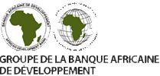
Collaboration case:
ASYB
Sharing SDMX skills
Pilot Data Hub
Communication
STAGE 3

Slide 2
African Statistical Yearbook
The African Statistical Yearbook (ASYB) is the fruitful collaboration that exists among the three pan-African organizations:
  African Development Bank (AfDB);
  African Union Commission (AUC), and
  United Nations Economic Commission for Africa (ECA).
The objectives of this synergistic collaboration are:
  to minimize the risk of inconsistent information being produced by the three organizations,
  to reduce the reporting burden on member states, who might otherwise submit data separately to each institution.

Slide 3

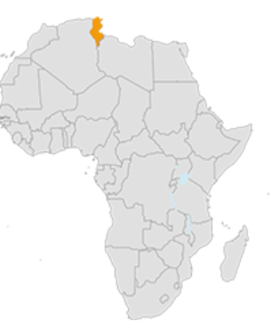

African Statistical Yearbook
SDMX
tools
ASYB
PULL
SDMX
tools
SDMX tools
PUSH
Structure
Data
SDMX
tools

Slide 4
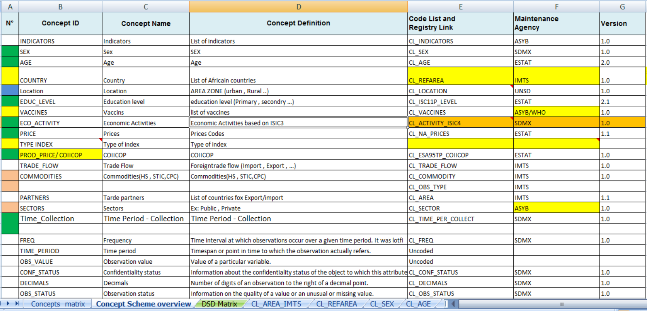
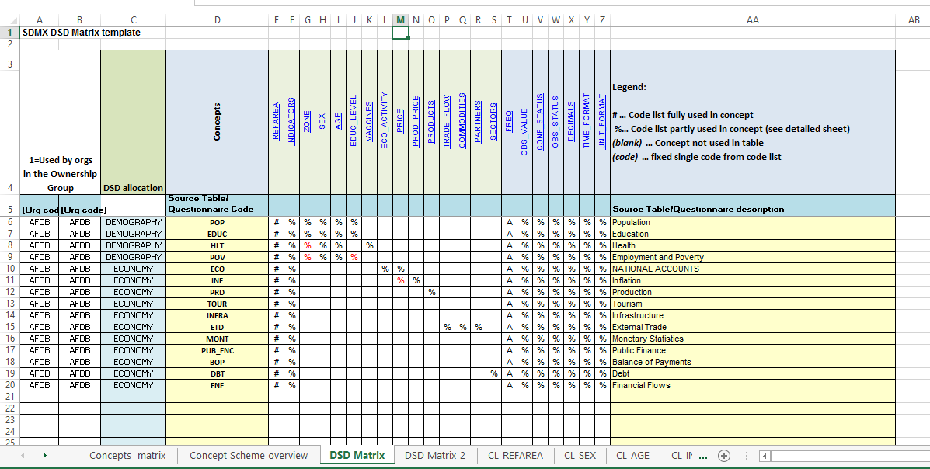
Design phase of pilot project

