Slide 1

May 2017
Kigali Sept, 2018
SDMX in Statistical Information System, INS TUNISIA
Mr. Kamel Abdellaoui
Dissemination Information System & Coordination
NIS Tunisia
Abdellaoui.kamel @ins.tn
kamelabdellaouister@gmail.com
Notes:
this project aims to modernize our statistical system

Slide 2



Why SDMX ?
Reporting issues
Code | Label
X | Import
M | Export
Code ID | Label
E | Domestic Exports
R | Re-exports
I | Imports
ID | Name
I | Import
E | Export
Out_1 | Out_2
Var1 | Import
Var2 | Export

Slide 3




Why SDMX ?
Reporting issues
FLOW | HS6 | PARTNER | CValue
E | 190540 | BE | 84993
I | 680911 | CN | 45217
TRADE DB
TYPE | PRD_CODE | PAYS | VAL
E | 010110 | 0056 | 1435
I | 310110 | 0250 | 3422
Notes:
- Get data in different format
- Loose of time to harmonize structure and codes

Slide 4

Why SDMX ?
Reporting issues
ZM1
REF | T_FLOW | .. | OBS_VALUE
ZM1 | E |  | 1435
ZM1 | I |  | 3422
Mapping
TRADE DB
TN1
REF | T_FLOW | .. | OBS_VALUE
TN1 | E |  | 4325
TN1 | I |  | 3426
Mapping
REF | T_FLOW | .. | OBS_VALUE
ZM1 | E |  | 1435
ZM1 | I |  | 3422
TN1 | E |  | 4325
TN1 | I |  | 3426
XX1 | E |  | 6542
XX1 | I |  | 5423
… | …. | … | …..
REF | T_FLOW | .. | OBS_VALUE
XX1 | E |  | 6542
XX1 | I |  | 5423
XX1
Mapping

Slide 5
Why SDMX ?
Data management enhancements
Harmonize Data Design
Service Oriented Architecture
Interoperability between used tools
Free and open sources tools
Open format : XML , JSON , CSV

Slide 6
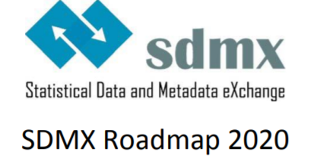
So ,why SDMX ?
Strengthening the implementation of SDMX
Making data usage easier via SDMX
SDMX to modernize statistical processes and to improve the standards and IT infrastructure
Improving communication and including a better interaction between international partners

Slide 7
SDMX Action Plan
Capacity building
Tools implementation
Test
PHASE 1
Data modeling
Test/validate
SDMX outputs
PAHSE 2
Sharing SDMX skills
Pilot Data Hub
Communication
STAGE 3

Slide 8
SDMX Action Plan
PHASE 1
Capacity building
Tools implementation
Test
Training on :
  - SDMX Data Modeling
  - SDMX for Data reporting and dissemination
  - SDMX IT tools implementation
Mixed group :
- Internal( IT , Statisticians, Dissemination, classification )
- External(National partners , Ministries …)

Slide 9


SDMX Action Plan
PHASE 1
Capacity building
Tools implementation
Test
Internal Capacity building
Tools implementation
Data Structure Wizard
SDMX-RI Mapping Store
SDMX-RI NSI WS
SDMX-RI Web Client
SDMX-RI Mapping Assistant
Test Client
SDMX Registry, Metadata Manager
SDMX Data Manager (Builder/Loader)
EXCEL2CSV

Slide 10
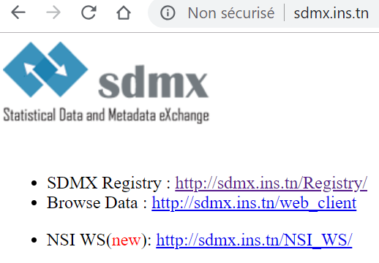
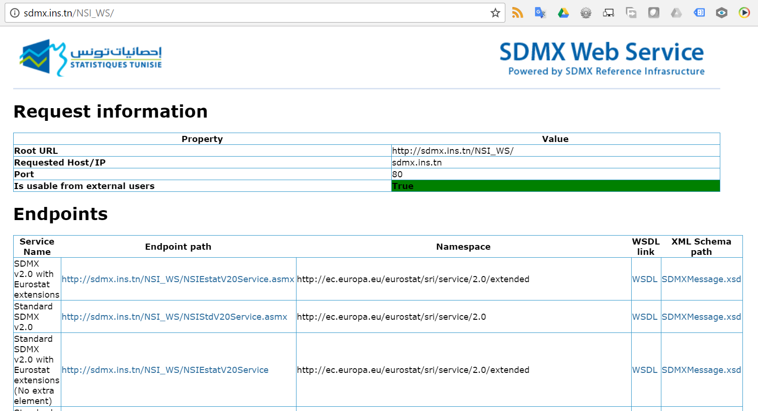
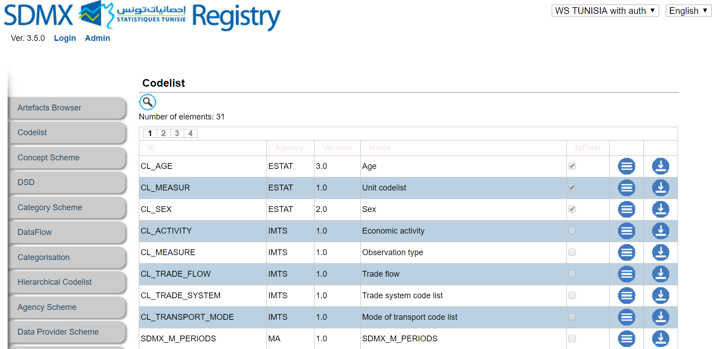
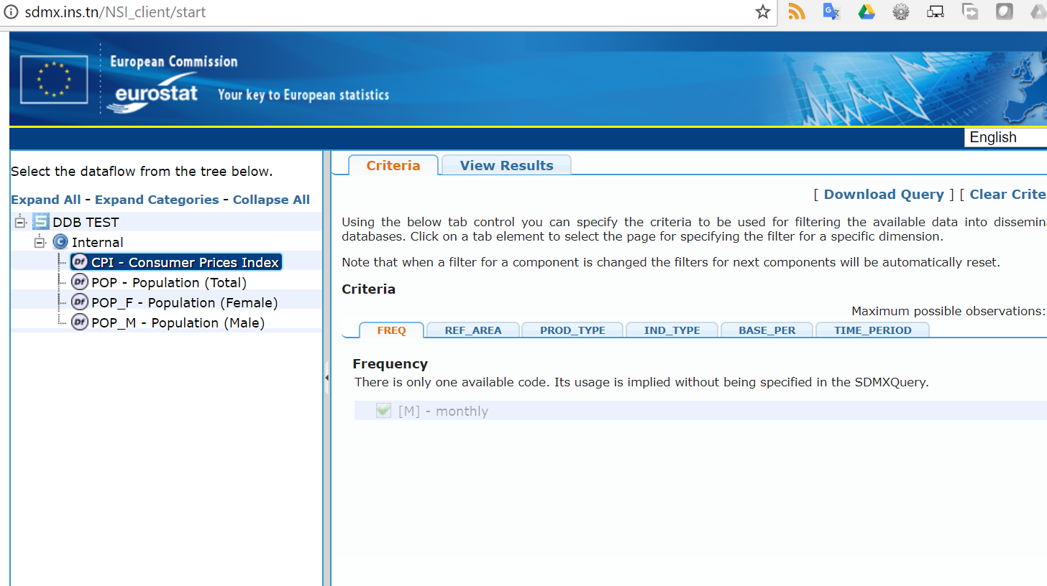
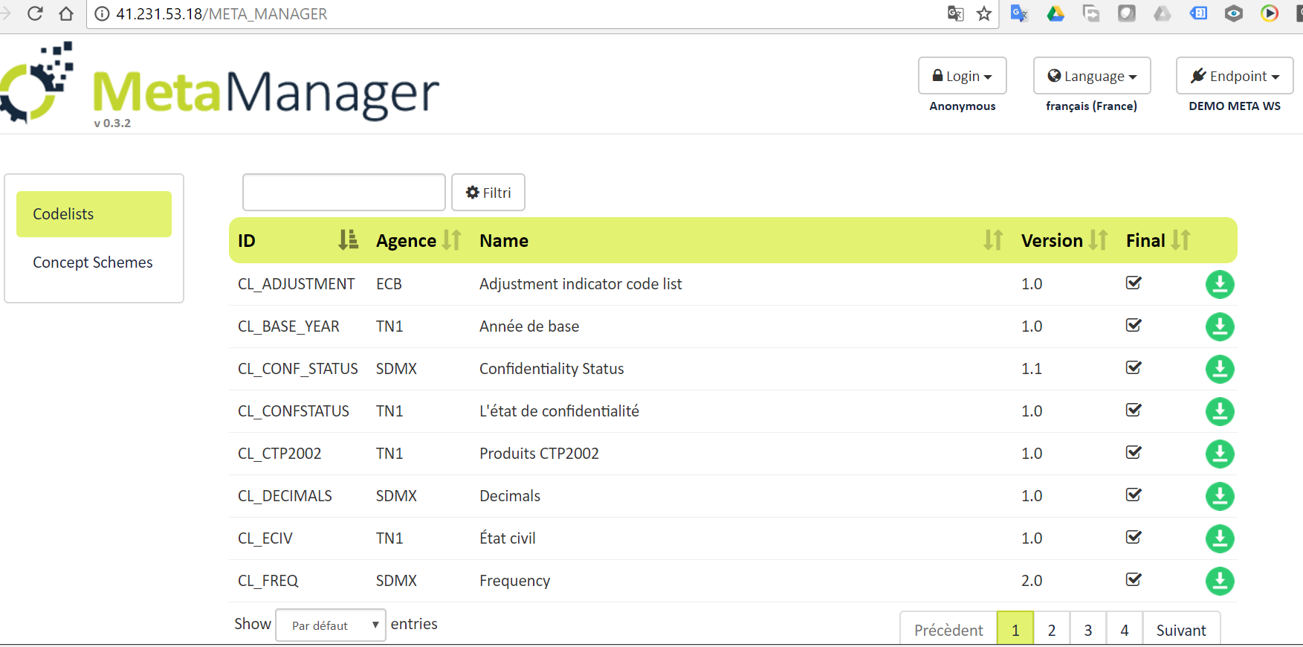
SDMX Action Plan
PHASE 1
Capacity building
Tools implementation
Test
http://sdmx.ins.tn/

Slide 11







SDMX REGISTRY

Slide 12
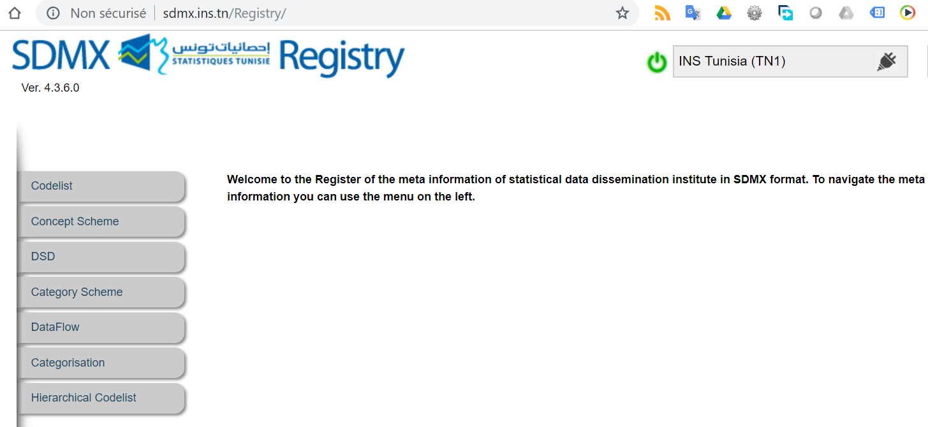
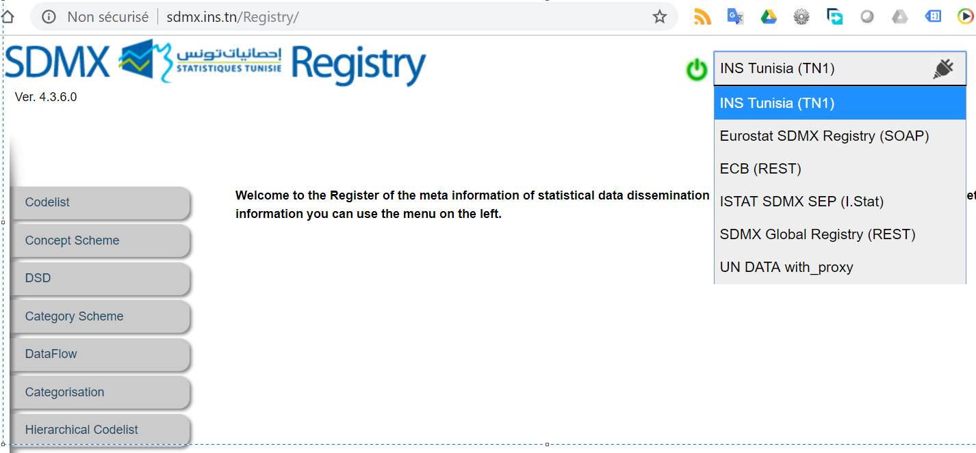
SDMX REGISTRY

Slide 13




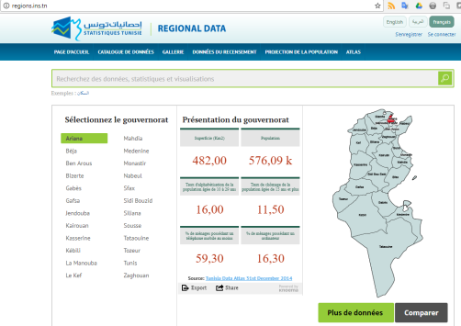

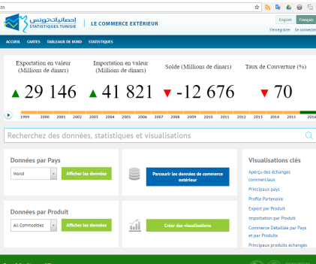


INS Architecture
Survey database
External for dissemination
External processable
Survey file
Collect
Primary Data Storage
External Data Storage
Process
Metadata Manegemnt
Working Data
Micro
Final
Macro
Data
Dissemination
Dissemination
Data

Slide 14
SDMX integration scenarios
DB exists
YES
SDMX mapping
with exiting DB
Case 1
NO
Agree to use ready DW
YES
Building SDMX
DW
Case 2
NO
Convert to csv (friendly structure for SDMX)
Case 3

Slide 15
INS Architecture
Survey database
External for dissemination
External processable
Survey file
Collect
Primary Data Storage
External Data Storage
Process
Metadata Manegemnt
Working Data
Micro
Final
Macro
Data
Dissemination
Dissemination
Data

Slide 16


SDMX vision: integrated system
Dissemination Space
Process Space
DB
NSIWS
DB
MSBD
REGISTRY
NSIWS
Reporting Space
MASTORE
DB
NSIWS
MSDB
REGISTRY

Slide 17

Modeling Statistical domain
Data modeling
Test/validate
SDMX outputs
PAHSE 2
In progress
Foreign Trade
Business
Prices
Done
Population
Business
Planned
Education
National account
Next
The rest !!

Slide 18
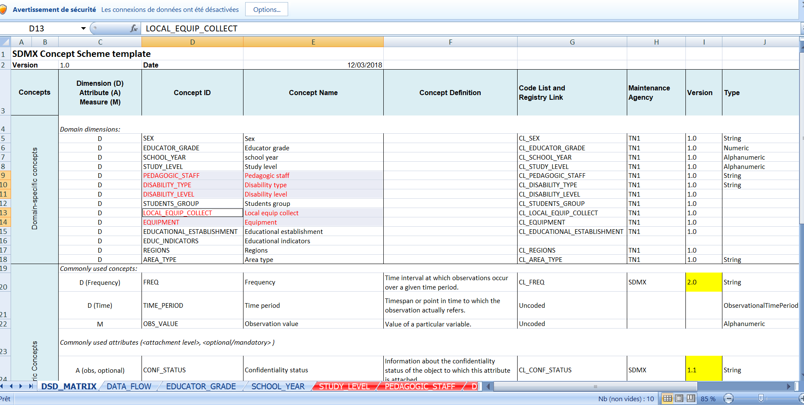
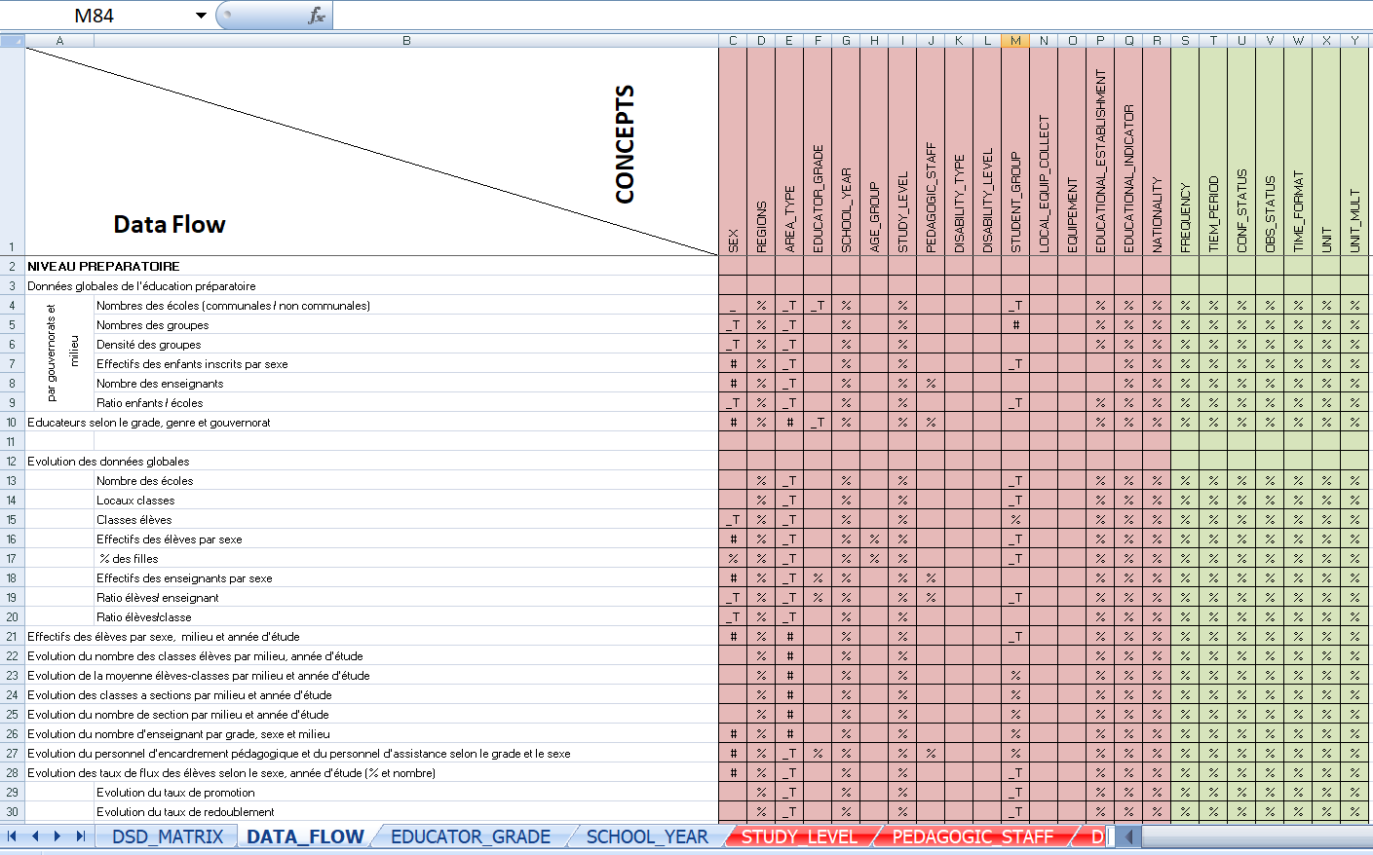
Modeling Statistical domain
We ‘re using DSD Generic Matrix
We try to reuse SDMX artifact as possible as you can from SDMX Global registries
Most working time dedicated to check cross SDMX concepts between domains and departments

Slide 19



Collaboration case:
ASYB
Sharing SDMX skills
Pilot Data Hub
Communication
STAGE 3

Slide 20
African Statistical Yearbook
The African Statistical Yearbook (ASYB) is the fruitful collaboration that exists among the three pan-African organizations:
  African Development Bank (AfDB);
  African Union Commission (AUC), and
  United Nations Economic Commission for Africa (ECA).
The objectives of this synergistic collaboration are:
  to minimize the risk of inconsistent information being produced by the three organizations,
  to reduce the reporting burden on member states, who might otherwise submit data separately to each institution.

Slide 21

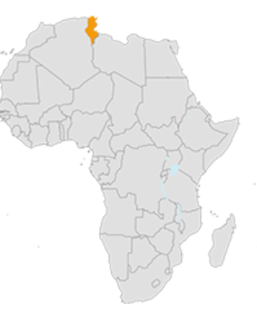
African Statistical Yearbook
SDMX
tools
ASYB
PULL
SDMX
tools
SDMX tools
PUSH
Structure
Data
SDMX
tools

Slide 22
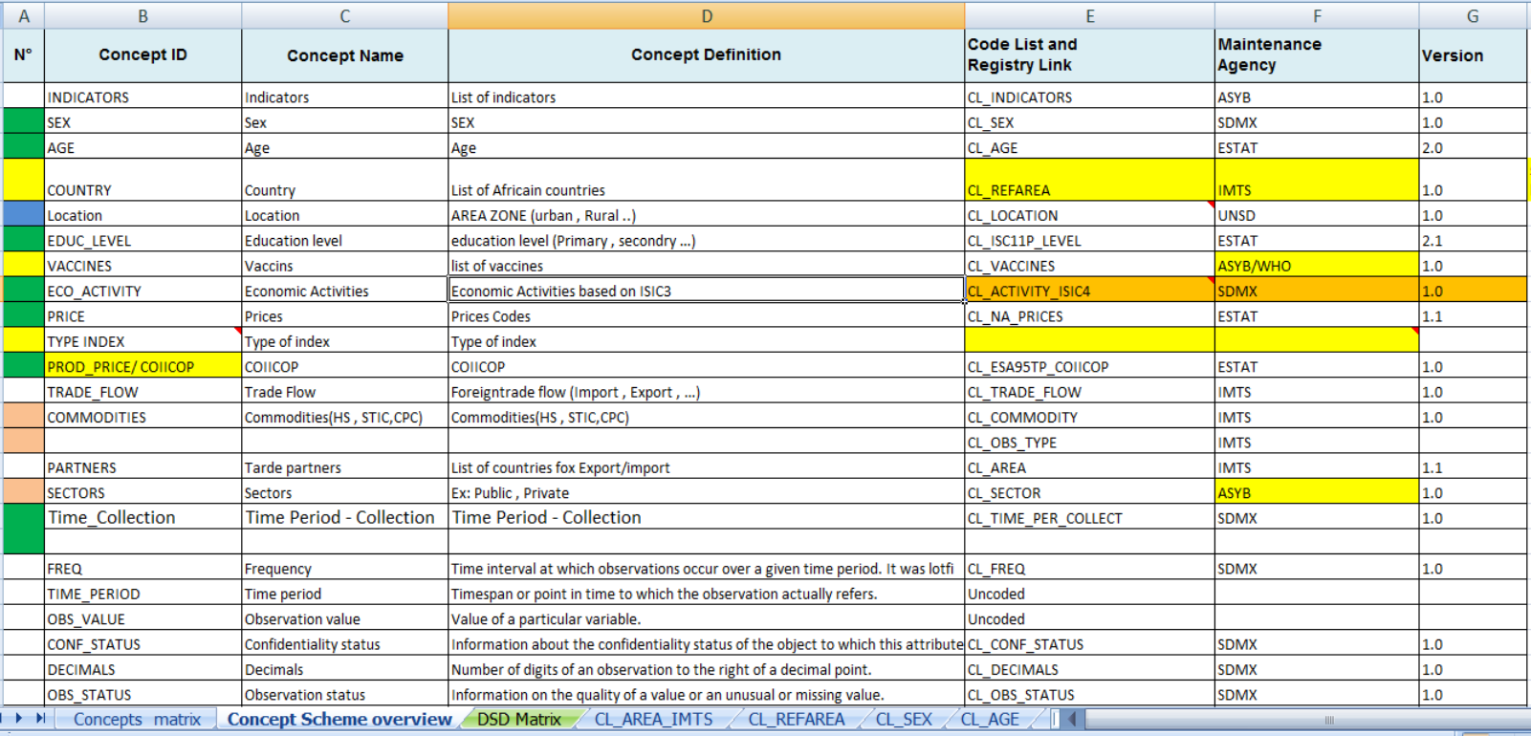
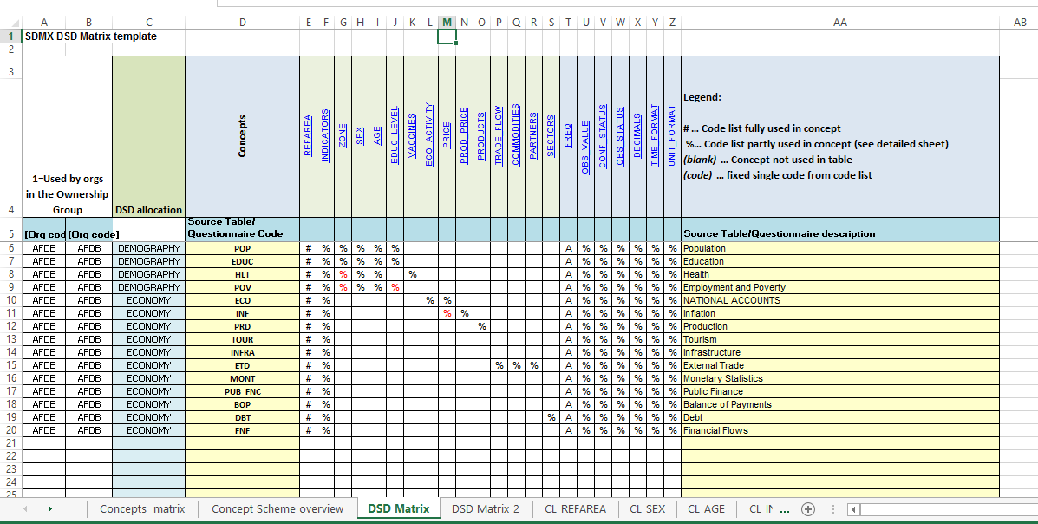
Design phase of pilot project

Slide 23



Collaboration case:
COMESA , CSO ZAMBIA
Sharing SDMX skills
Pilot Data Hub
Communication
STAGE 3

Slide 24

COMESA , CSO ZAMBIA Case
  Objective was to improve the statistical process of data collection, sharing, processing and reporting
Pilot domain :
Decided to start with data on Trade Statistics to test and evaluate SDMX implementation.

Slide 25
COMESA , CSO ZAMBIA Case
Inception phase:
Training session was organised to develop capacity of COMESA staff and Zambia CSO staff (as a pilot data provider)
Implementation phase:
Second training session around SDMX tools (SDMX RI) : MappingStore DB , NSI WS , Mapping Assistant , NSI web Client

Slide 26
COMESA , CSO ZAMBIA Case
Testing phase:
Pratical pilot case (trade Statistics flows) : Identification of SDMX concepts , Designing SDMX artefacts , Mapping , Testing reporting cases,...
Production phase:
- Setup SDMX infrastructure
- Pilot Trade DSD ( for dissemination)
- SDMX data flows

Slide 27

Sharing SDMX skills
Pilot Data Hub
Communication
STAGE 3
Not only IT project
Not only for reporting
Rethinking your IT strategies
Improve applications interoperability
Data producer as stakeholder
Clear vision , realistic road map
Learn from guidelines and NSO experiences
Very open SDMX community

Slide 28
Start Kit tools
Sharing SDMX skills
Pilot Data Hub
Communication
STAGE 3
Data collection : Excel2CSV
Data storage : Data Manager (Builder&Loader)
Data visualization : NSI web client / Data browser
Data reporting : NSI WS ,Registry , Mapping Assistant
Metadata management : Data Structure Wizard , SDMX Registry , ISTAT Metadata Manager

Slide 29



Enhance capacity building , Data modeler profile
Establish SDMX working groups
Common SDMX road map

Slide 30
