Slide 1
Standards for Data and Metadata eXchange in Rwanda
RUBEN MUHAYITETO
National Institute of Statistics of Rwanda
September 2018

Slide 2
Outline
Background
SDMX CURRENT STATUS
APIs
WAY AHEAD

Slide 3

DIGITAL DATA DISSEMINATION
SDMX Registry
Website
statistics.gov.rw/publications
Website
http://geodata-nisr-rwanda.opendata.arcgis.com/
NADA (Public)
Microdata.statistics.gov.rw
Highway Rwanda
EGDDS/SDDS NSDP
Internal NADA
DevInfo
Devinfo.statistics.gov.rw
Publications (PDFs &
Data in MS Excel)
GeoData
Microdata &
Metadata
Indicators
(Time-series)
Source of Data: Surveys and censuses conducted by NISR

Slide 4
Looking back:
Issues in Data Dissemination
Going digital
Multiplicity of data dissemination portals/channels (NADA, IMIS, Website, Information highway, Devinfo, Countrystat, social media)
  Non-comprehensive data
  Lack of consistency
  Issue of harminization and standardization practices of data reporting
Delivery
Centralized
Distributed
Digital
Form
Non-digital
Notes:
11 Years

Slide 5
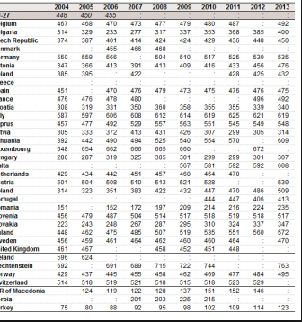
Tradititional way of data reporting
Burden for NSO in reporting development indicators using excel questionnaires
Errors
Time consuming
Missing data
No harmonization and standardization

Slide 6
SDMX Project*
*
Improving the Availability, Collation and Dissemination of
National Development Indicators, including Millennium
Development Goals Data: UNSD+DFID (January 2010 to March 2015)
Notes:
11 Years

Slide 7
SDMX Project*
Objectives:
Improve the coherence and clarity of development indicators
  Improve coordination in the NSS
  Collate development data in 1 place/database
  Explain differences between intl. & nat. data
Improve accessibility and visibility
  Make access to national data easier
  Draw attention to wider set of indicators
  Reduce data request burden
Enhance knowledge
  Strengthen IT support
  Use of latest IT software & practices
  Training & skills development
*
Improving the Availability, Collation and Dissemination of
National Development Indicators, including Millennium
Development Goals Data: UNSD+DFID (January 2010 to March 2015)
Notes:
11 Years

Slide 8
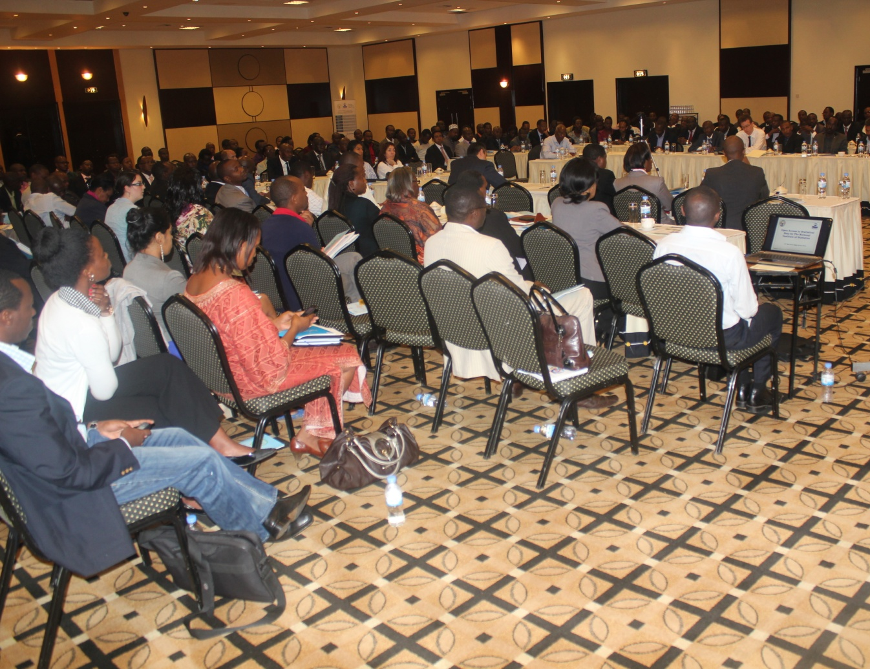
Capacity
2012
  Trainings on Metadata by UNSD
  Identification of IT and methodological requirements
  SDMX Registry installation at NISR
2013
  Official launch of SDMX in Rwanda
  SDMX international workshops and trainings for two NISR staff
2014
  UNSD consultant: Training on Devinfo database management, and metadata compilation
  SDMX international workshops and trainings for two NISR staff
Notes:
11 Years

Slide 9
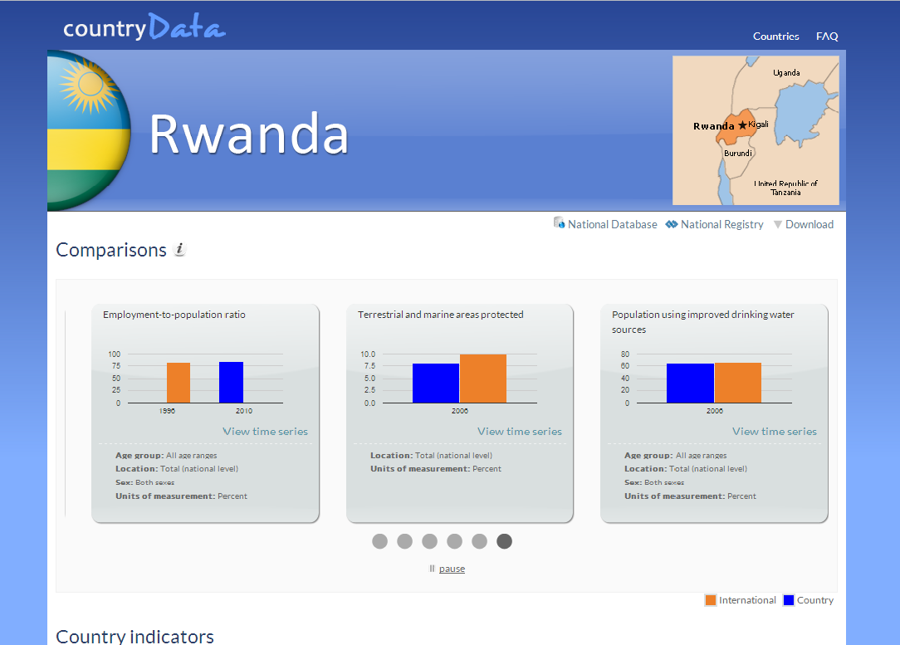
SDMX exchange established
With UNSD-DFID project , Rwanda has made substantial progress in using SDMX in reporting development indicators
Capacity building
Clean national repository, containing development indicator dataset online;
Full metadata associated with reported indicators;
Discrepancies between explained in the CountryData website
http://data.un.org/countryData/showdetail/RWA
Notes:
11 Years

Slide 10
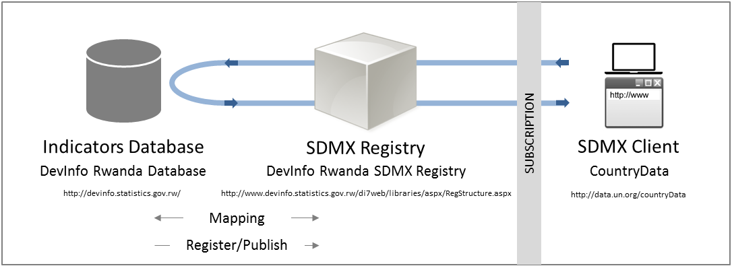
SDMX Set-up
National repository ( Devinfo Database)
SDMX Registry
SDMX Client
Notes:
11 Years

Slide 11
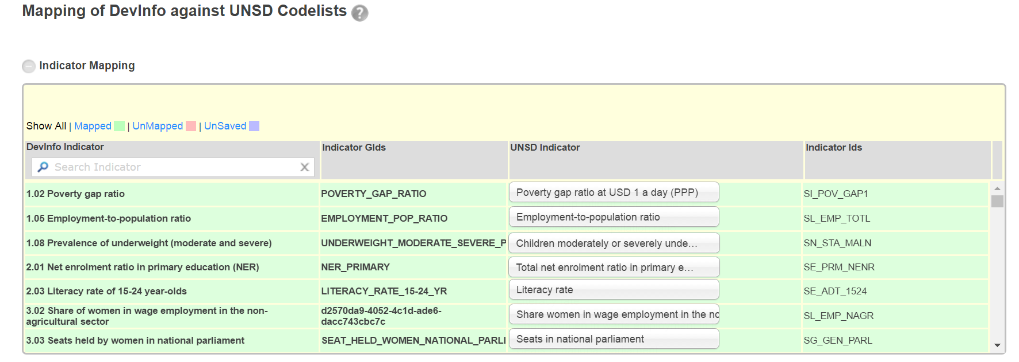
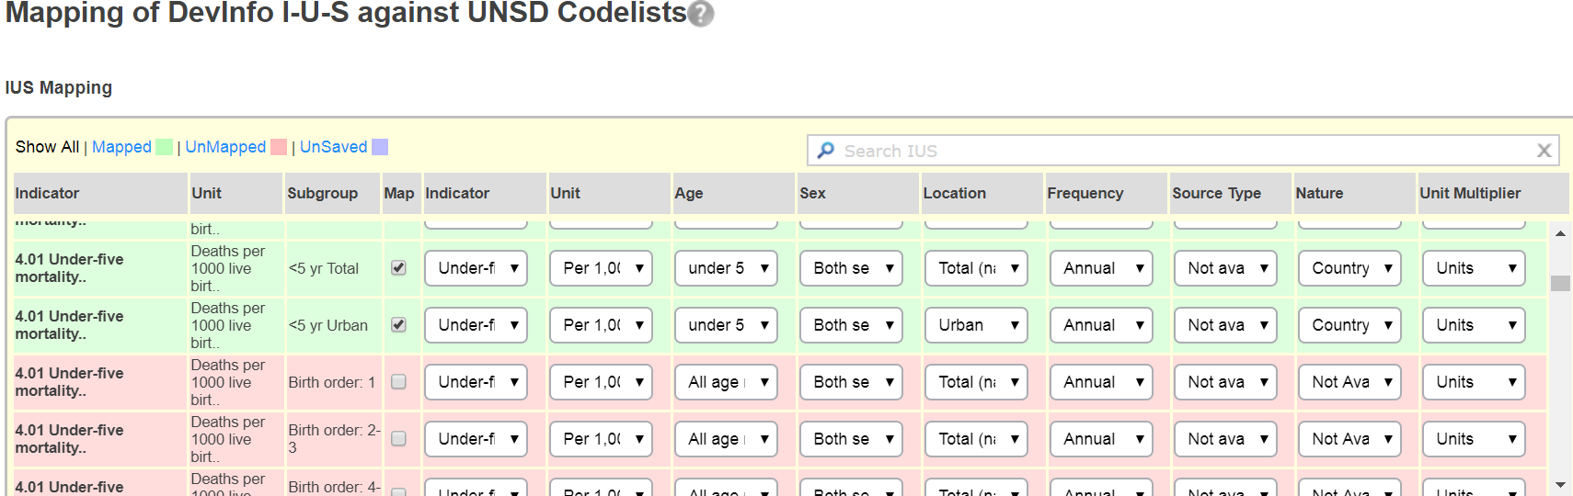
IUS mappings against UNSD code lists
IUS mappings against UNSD code lists

Slide 12
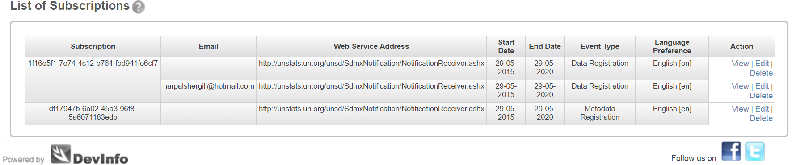
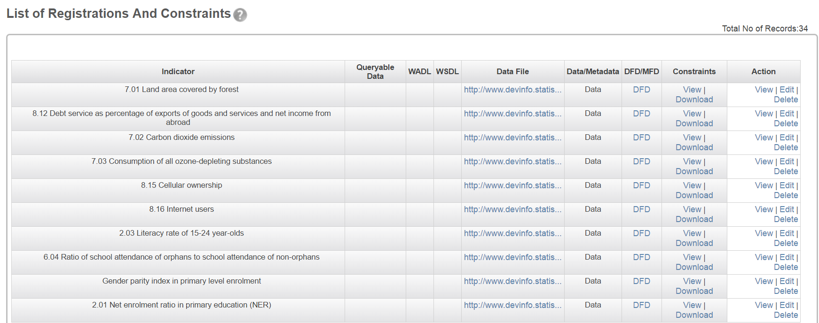
SDMX clients updated

Slide 13
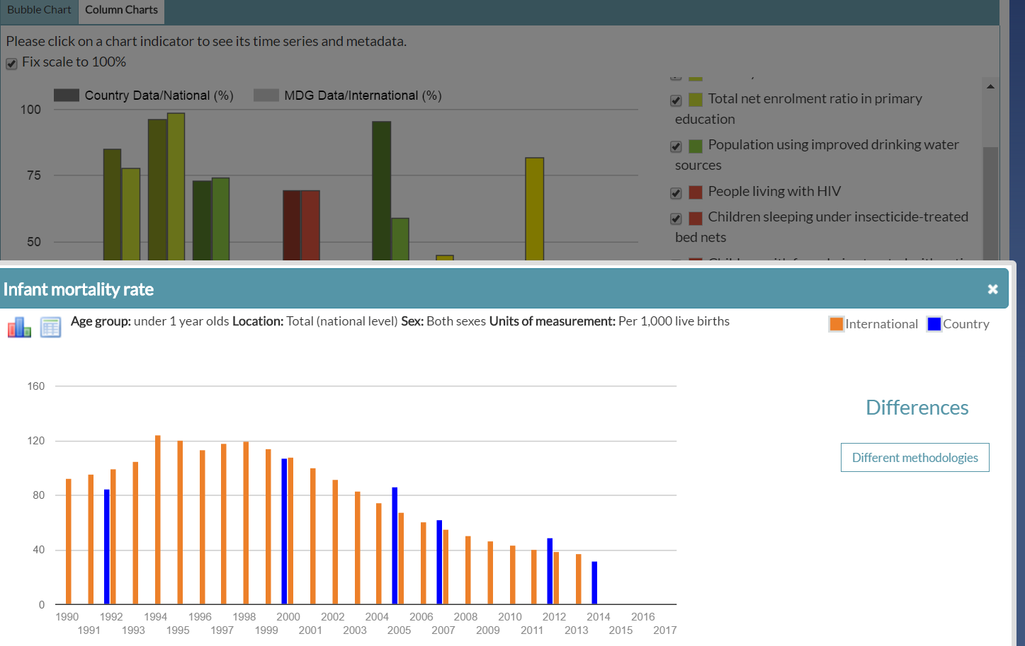
UNSD CountryData website gets updated

Slide 14
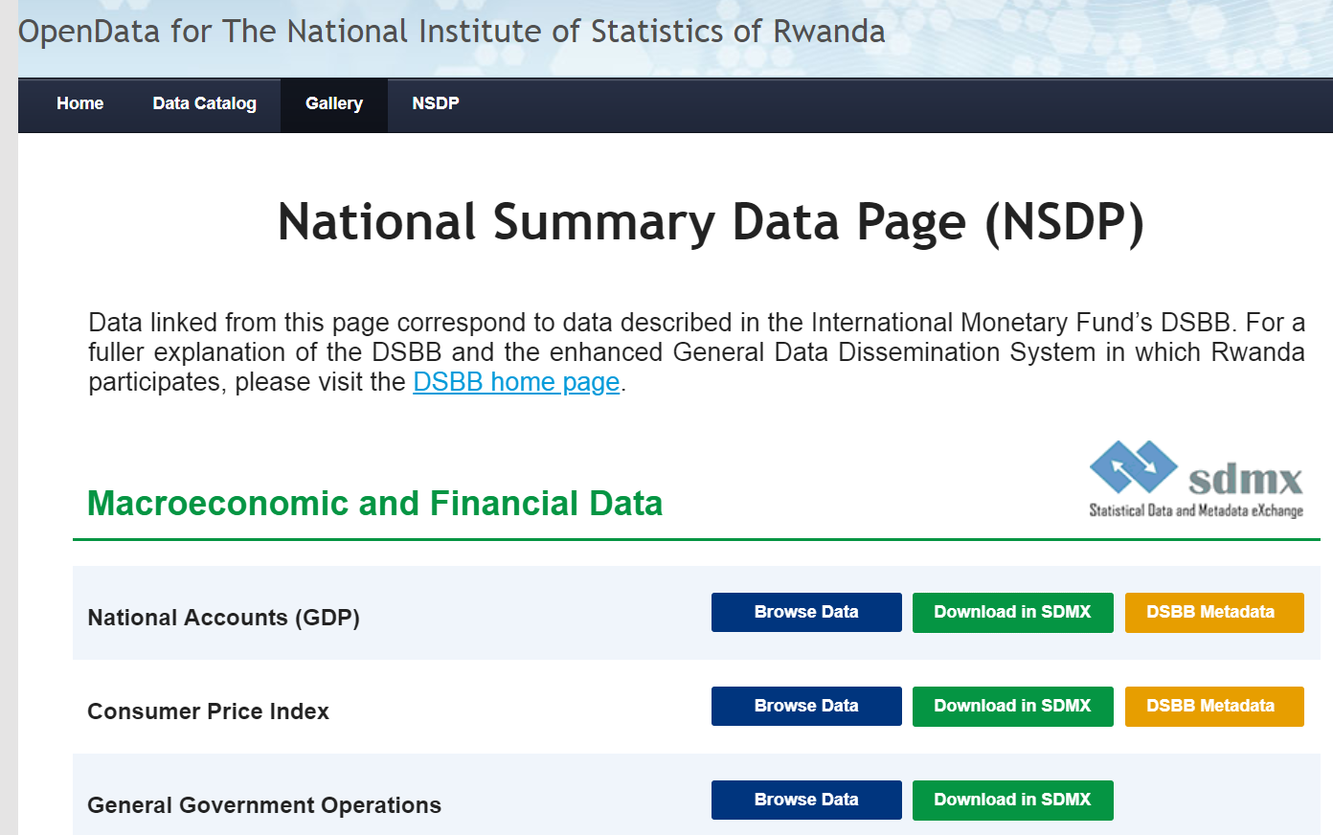
National Summary data page

Slide 15
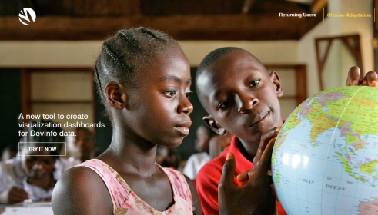
Better data: So, APIs
Better data
  DevInfo Dashboard
  Government Command Center (GCC)
Using DevInfo API for dataviz
http://dashboards.devinfo.org/
Notes:
11 Years

Slide 16
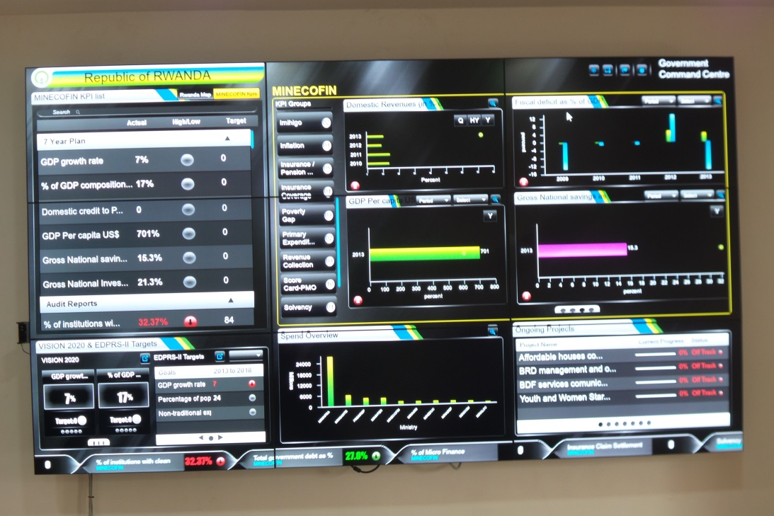
APIs(cont.)
Institutionalised Data Curation Process
Updated SDMX Clients
Better data
  DevInfo Dashboard
  Government Command Center (GCC)
Notes:
11 Years

Slide 17
Getting ready for SDGs reporting
New national repository being prepared
Working on SDGs to be reported on
Counting on:
- GoR Good will & commitment
- Good collaboration: UNSD, UNECA,
AfDB, IMF….
Notes:
11 Years

Slide 18
Thank you!
Ruben.muhayiteto@statistics.gov.rw

