Slide 1
Modernization of Statistical data processes
African Centre for Statistics,
Economic Commission for Africa

Slide 2
Outline
Background
What is modernization
Quality assurance
Metadata
Technology and Innovation
Standards

Slide 3
Background
Increased demands to produce statistics in quantity and quality
  New development agendas
Data revolution
  New data sources for statistics
  Use of new technology
Advancement in technology
Emphasis on data analytics
Notes:
Often with fewer resources. At the same time there is a strong pressure to increase understanding among stakeholders of how we deliver our output in an efficient and structured manner.

Slide 4
Modernization
“…the process of adapting something to modern needs or habits.”
Transforming the way we manage statistical processes
Reengineering the processes
Increased flexibility to adapt
“Doing more with less”
Notes:
Common generic processes
– Common tools
– Common methodologies
•Recognizing all statistics are produced in a similar way

Slide 5
Quality assurance
Data quality refers to the condition of a set of values of qualitative or quantitative variables. There are many definitions of data quality but data is generally considered high quality if it is "fit for its intended uses in operations, decision making and planning".
Wikipedia

Slide 6
Quality assurance
Data quality dimension:
  Relevance: degree to which statistics meet users’ needs
  Timeliness: time elapsed between release of data and reference period
  Accessibility: ease with which statistical data can be obtained by users
  Interpretability: the ease with which the user may understand and properly use and analyse the data or information
  Accuracy: distance between the estimated value and the true value
  Coherence: logically connected and complete
  Punctuality: distance between actual and planned release dates
Notes:
Accuracy of data or statistical information is the degree to which those data correctly estimate or describe the quantities or characteristics that the statistical activity was designed to measure. Accuracy has many attributes, and in practical terms there is no single aggregate or overall measure of it. Of necessity these attributes are typically measured or described in terms of the error, or the potential significance of error, 4 In addition, several international quality conferences have been held over the last couple of years. See e.g. http://www.nso.go.kr/eindex.html, www.statcan.ca/english/conferences/symposium2001, www.q2001.scb.se. 5 For a more detailed comparison, a paper by Alberto Signora and Michael Colledge of the OECD is worth reading (see References). Parts of this paper draw on the Signora/Colledge paper. 6 Statistics Canada (1998) Quality Guidelines, third edition, October 1998, available at www.statcan.ca. 3 introduced through individual major sources of error - e.g., coverage, sampling, non response, response, processing and dissemination. Timeliness of information reflects the length of time between its availability and the event or phenomenon it describes, but considered in the context of the time period that permits the information to be of value and still acted upon. It is typically involved in a trade-off with accuracy. Accessibility reflects the availability of information from the holdings of the agency, also taking into account the suitability of the form in which the information is available, the media of dissemination, the availability of meta-data, and whether the user has reasonable opportunity to know it is available and how to access it. The affordability of that information to users in relation to its value to them is also an aspect of this characteristic. Interpretability of data and information reflects the ease with which the user may understand and properly use and analyse the data or information. The adequacy of the definitions of concepts, target populations, variables and terminology underlying the data and information on any limitations of the data largely determines their degree of interpretability. Coherence of data and information reflects the degree to which the data and information from a single statistical program, and data brought together across data sets or statistical programs, are logically connected and complete. Fully coherent data are logically consistent - internally, over time, and across products and programs. Where applicable, the concepts and target populations used or presented are logically distinguishable from similar, but not identical, concepts and target populations of other statistical programs, or from commonly used notions or terminology.

Slide 7
Quality assurance
At the agency level
At the programme design stage
At the Implementation stage
At the post-collection evaluation stage

Slide 8
Metadata
Metadata is “data that defines and describes other data.” OECD Metadata is "data [information] that provides information about other data". Wikipedia

Slide 9
Metadata
Structural metadata needed to identify, use, and process statistical data Reference metadata describe the content and the quality of the statistical data Source: “Management of Statistical Metadata at the OECD”, OECD, 2006
Notes:
Accordingly, structural metadata will have to be present together with the statistical data, otherwise it becomes impossible to identify, retrieve and navigate the data. Structural metadata should preferably include all of the following:
• Variable name(s) and acronym(s), which should be unique (e.g. Financial Intermediation Services Indirectly Measured, FISIM). It is an advantage if these names and acronyms correspond as far as possible to entries in the OECD Glossary of Statistical Terms; terms from the Glossary will be clickable from MetaStore/OECD.Stat.
• Discovery metadata, allowing users to search for statistics corresponding to their needs. Such metadata must be easily searchable and are typically at a high conceptual level, allowing users unfamiliar with OECD data structures and terminology to learn if the Organisation holds some statistics that might suit their needs (e.g. users searching for some statistics related to “inflation” should be given some indication on where to go for a closer look); • Technical metadata, making it possible to retrieve the data, once users have found out that they exist. An example are the coordinates (combinations of dimension members of the dimensions in the data cube), as kept in MetaStore.
On the other hand, reference metadata describe the content and the quality of the statistical data. Reference metadata are the focal point of the common metadata items outlined below in this paper3 . Preferably, reference metadata should include all of the following: • Conceptual metadata, describing the concepts used and their practical implementation, allowing users to understand what the statistics are measuring and, thus, their fitness for use; • Methodological metadata, describing methods used for the generation of the data (e.g. sampling, collection methods, editing processes, transformations); • Quality metadata, describing the different quality dimensions of the resulting statistics (e.g. timeliness, accuracy); These types of metadata are included in the list of common metadata items provided in Annex 1 below.

Slide 10
Standards and architecture
GSBPM
GSIM
CSPA
SDMX
DDI
Notes:
To promote harmonization of the business and information systems architectures;
To support collaboration for the development of statistical software
The Generic Statistical Business Process Model (GSBPM) is a means to describe statistics production in a general and process-oriented way.
GSIM is a reference framework of internationally agreed. definitions, attributes and relationships that describe the pieces of information that are used in the production of official statistics (information objects).
The Common Statistical Production Architecture (CSPA) is a reference architecture for the official statistics industry, providing the blueprint for designing and building statistical services in a way that facilitates sharing and easy integration into statistical production processes within or between statistical organisations

Slide 11
Business architecture
Generic Statistical Business Process Model (GSBPM)
  To define and describe statistical processes in a coherent way
  To standardize process terminology
  To compare and benchmark processes within and between organisations
  To identify synergies between processes
  To inform decisions on systems architectures and organisation of resources

Slide 12
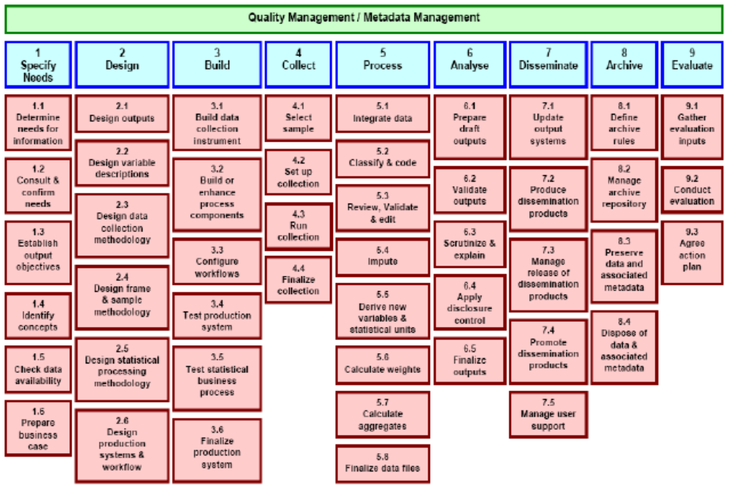
Business architecture

Slide 13
Information architecture
  Generic Statistical Information Model (GSIM) describes the information objects and flows within the statistical business process
    GSIM is not a software tool: It is a new way of thinking!
  Common Statistical Production Architecture: An statistical industry architecture will make it easier for each organization to standardize and combine the components of statistical production, regardless of where the statistical services are built

Slide 14
Application architecture
Standard Data and Metadata eXchange (SDMX)
  Common data transmission format for statistical data and metadata
Data Documentation Initiatives (DDI)
  Standard dedicated to microdata documentation; enables documentation of complex microdata files

Slide 15
Technology and innovation
The Internet
Web services/API
Web 2.0
Open data/standard/sources
New data sources
Data analytics

