Slide 1
Localizing SDG indicators and building national capacity to measure violence, crime, access to justice, and corruption
Angela Me Chief Research and Trend Analysis Branch
UNODC

Slide 2
Localizing SDG indicators
At national and regional level, the principle of ‘leave no one behind’ should be given priority, as it is at this level that minority groups, vulnerable communities can be ‘given a name’ (i.e. clearly identified) and the monitoring of SDG targets among them become fully meaningful.
The process of establishing national and regional framework is absolutely key and, similarly to what was done at global level, a clear distinction should be maintained between the policy process (deciding on the ‘what’) and the technical one (deciding on the ‘how’)

Slide 3
Criteria to localize indicators
Is the global indicator relevant at national or sub-national level?
Policy makers
Is it a priority for national policy?
Statisticians
Is the phenomenon currently measured?
Does it required additional resources?
What is the most pressing element to consider at national/local level?
Start a new data collection, modify existing data collection or find a proxy?
Trade off between relevance, feasibility, cost decided in partnership

Slide 4
SDG global indicators | Level of relevance | Possible new/alternative national indicators
3.5.1 Coverage of treatment interventions for substance use disorders by type | National and local Sub-populations (youth and adults) | Prevalence of drug use among youth Prevalence of drug use among 15-64 years old Prevalence of drug addiction
5.2.1 Proportion of ever-partnered women and girls aged 15 years and over subjected to physical, sexual or psychological violence by intimate partner in the previous 12 months | National and local | Number of femicide Women reporting their violent experience to authorities
5.2.2 Proportion of women and girls aged 15 years and over subjected to sexual violence by persons other than an intimate partner in the previous 12 months
11.7.2 Proportion of persons victim of physical or sexual harassment, by sex, age, disability status and place of occurrence in the previous 12 months | National and Local, but more relevant at local level | Feeling safe walking alone in the dark

Slide 5
SDG global indicators | Level of relevance | Possible new/alternative national indicators
Percentage of seized wildlife as compared to legal trade | Mainly national, but also local (national parks) | Number of living elephants/rhinos Forest area with protected species
Number of victims of intentional homicide per 100,000 population by sex and age | National and local | By type of perpetrator Injuries caused by violence Important to identify specific drivers and forms of violence and focus on relevant metrics
Conflict-related deaths per 100,000 population by sex, age and cause | National | Relevant? Important to distinguish it from homicide
Proportion of population subjected to physical, psychological or sexual violence in the previous 12 months | National and local | Only physical and sexual violence? What is the most relevant type of violence?
Proportion of population that feel safe walking alone around the area they live | Local

Slide 6
An alternative and under-utilized source at local level: emergency rooms
Did health services report the asaults to the Police Department?
Ministry of Health. Data base of injuries with violence in Mexico “The health in numbers”. Total of records between 2010 -2014.

Slide 7
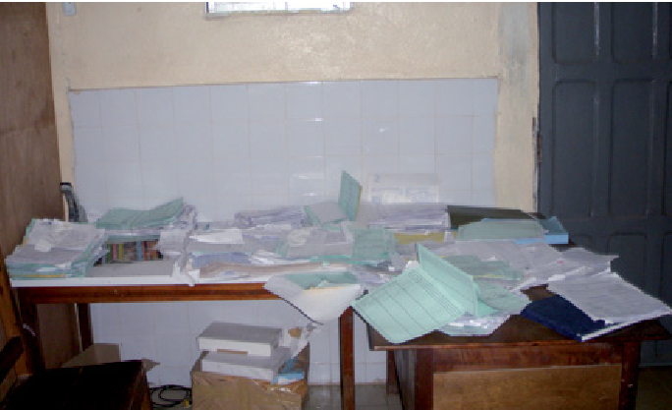
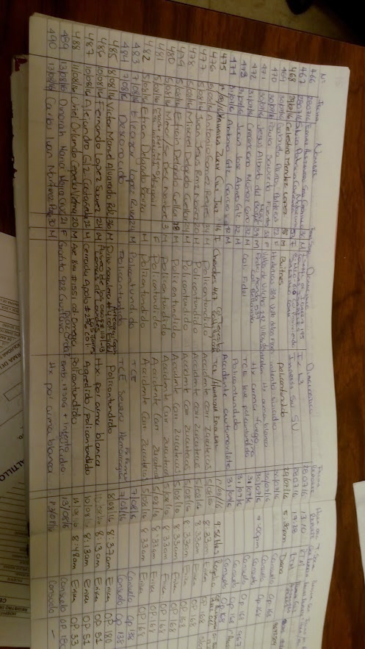
Value of Emergency Rooms data
What we can get
Periodical information (weekly/monthly)
Information that is not captured by traditional sources
Detailed data on sensitive crimes
Causes and consequences of injuries
Data at the local level
Specific geographic location

Slide 8
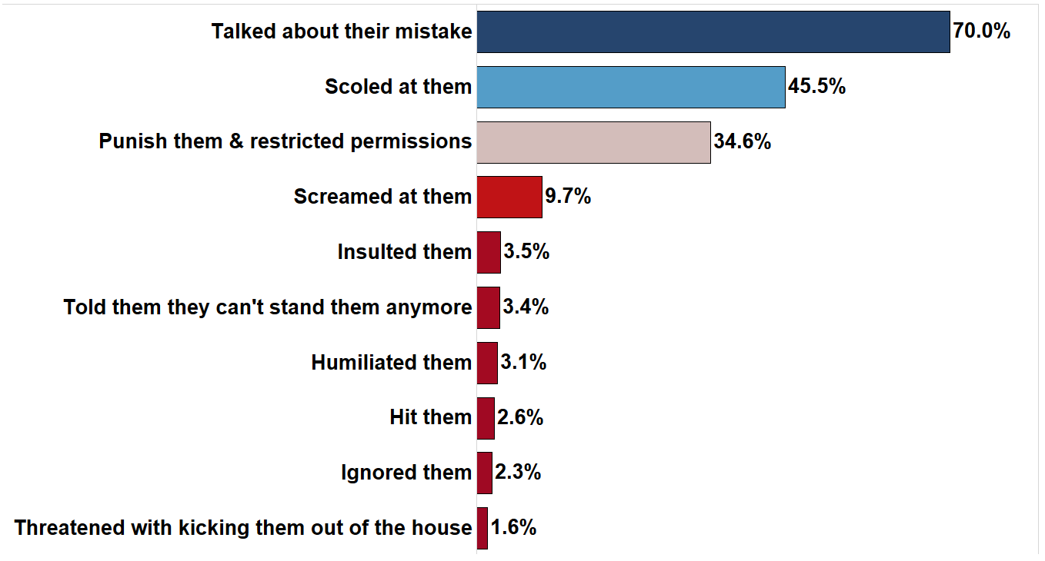
16.2.1 Proportion of children aged 1-17 years who experienced any physical punishment and/or psychological aggression by caregivers in the past month
Proxy
Percentage of children aged 12-17 whose parents or tutors have…
16.5%
INEGI. National Survey on Social Cohesion & Crime Prevention (ECOPRED) 2014

Slide 9
16.2.3 Proportion of young women and men aged 18-29 years who experienced sexual violence by age 18
Men
Women
Proxy
Age
INEGI. National Survey on Social Cohesion & Crime Prevention (ECOPRED) 2014

Slide 10
SDG global indicators | Level of relevance | Possible new/alternative national indicators
Proportion of victims of violence in the previous 12 months who reported their victimization to competent authorities or other officially recognized conflict resolution mechanism | National | The role of informal justice? Legal aid What are the major hiccups in the justice system? Civil justice?
Unsentenced detainees as a proportion of overall prison population | National | By length of detention

Slide 11
Pillars of capacity building
Surveys
Victimization surveys
Administrative records
Coordination
ICCS
Corruption surveys
Quality process

Slide 12

Administrative data
Surveys

Slide 13

Regional capacity building
Regional victimization and corruption survey module (SaSha)
E-training module (English and Spanish)

Slide 14
Administrative records
Regional training on the ICCS
Africa champions which successful implement the classification
Bi-annual international conference

Slide 15

Thank you for your attention

