Slide 1
African regional or sub-regional action plans related to violence, crime, access to justice, and corruption and UNODC support to African national statistical systems
Angela Me Chief Research and Trend Analysis Branch
UNODC

Slide 2
RoL and access to justice
Violence and violent deaths
Affordable, timely access to independent court/unbiased justice
Peaceful resolutions of conflict, culture of peace, security, safety
Prevention and treatment of drug abuse
Drug free
Violence against women and girls
SDG
Gender based violence
A2063

Slide 3
Corruption
Human trafficking
Organized crime
Firearms trafficking

Slide 4
Illicit Financial Flows
Violence against children
Wildlife trafficking
Piracy
Urban safety
Terrorism, extremism

Slide 5
Effective criminal justice systems to combat organized crime, drug trafficking and drug use
Effective suppression and international cooperation against organizations involved in organized crime, drug trafficking and consumption
ESCWA and AU Plan of Action
Access to controlled drugs for medical purposes
Drug use and prevention, services to address health and social impact of drug use
Sustainable, valid and reliable data on drug consumption, drug trafficking and organized rime
Reduction od drug trafficking

Slide 6
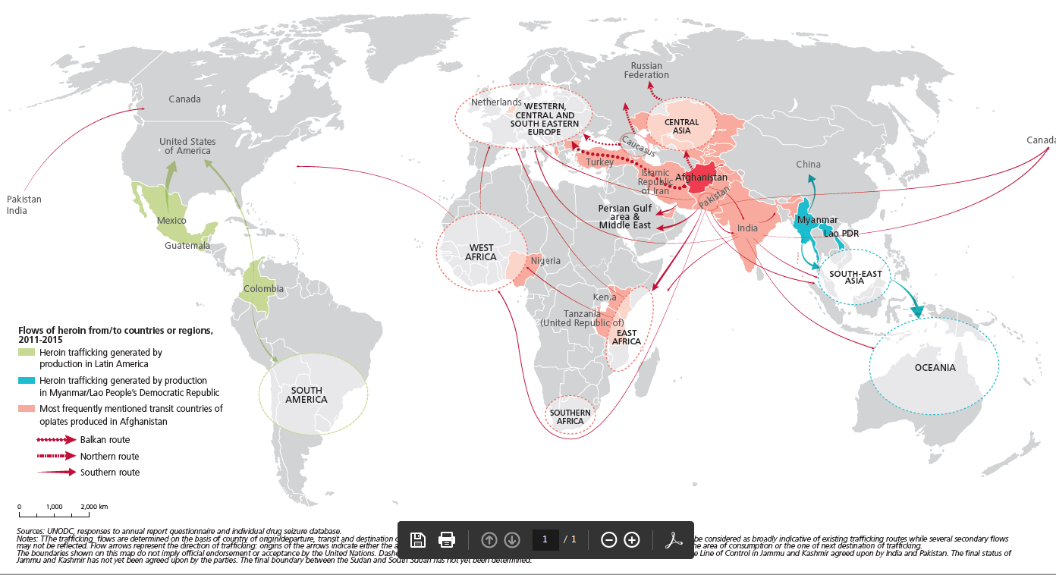
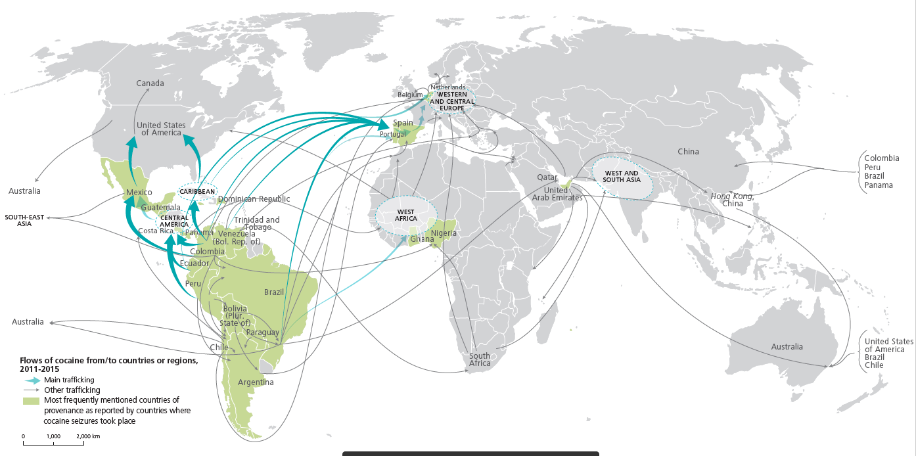
Spill over effect of drug trafficking is a major concern in Africa

Slide 7
Recorded violent crime (homicide)
Unreported violence, corruption, safety perception (victimization surveys)
Seizures, detected victims
Drug use surveys, drug treatment information system
Records in criminal justice institutions
Exposure to justice systems (surveys among general population, in prison)
The data needed

Slide 8
Police
Ministry of Justice
Prison administration
Drug control agencies
Ministry of health
NSO
The actors
Coordinating role of the NSO

Slide 9
Typical UNODC Support
Assessment of crime and criminal justice statistics
National Coordination
  International Classification of Crime for Statistical Purposes (ICCS)
National surveys
  Example of Nigeria
  Standards to undertake victimization surveys
Improvement of accessibility to and public dissemination of available data on crime and criminal justice

Slide 10
Challenges in using crime statistics
Three main factors affect interpretability of crime statistics (i.e. what to account for when making sense of figures on crimes):
Proportion of crime that is reported/detected
The way crime is defined and classified
The way crime is recorded and counted
What is addressed by the ICCS?

Slide 11
Improve measurability and analysis of crime
The ICCS: a hierarchical framework that groups and organizes criminal offences meaningfully and systematically.
It allows to:
Build a comprehensive stat. framework on all criminal offences to facilitate analysis of crime
Improve comparability across countries and through time
Improve data consistency within countries:
  across entities in federal states
  across data produced by successive stages of criminal justice process
  across sources (admin. data and surveys)

Slide 12
Principles
  Object of the classification: the primary unit of classification is the act or event which constitutes a criminal offence
  The description of criminal acts is based on behaviours/events, not on legal provisions or terms
  Statistical Principles:
    Exhaustiveness – events generally known to constitute offences in a significant number of countries
    Structure – organised hierarchically, with manageable and balanced numbers of categories at successive levels
    Mutual exclusivity – any crime assigned to one and only one category
    Description – as precise as possible description of each criminal act and category

Slide 13
Additional attributes
Disaggregating variables:
Event descriptions: Use of weapon, location, organised crime, attempted/completed
Victim descriptions: natural person (age, sex, age status, citizenship), legal entity/business (economic sector), public entity
Perpetrator descriptions: ages, sex, age status, citizenship, victim-perpetrator relationship
Data descriptions (Metadata):
Inclusion of threats, aiding, accomplice, conspiracy, incitament

Slide 14
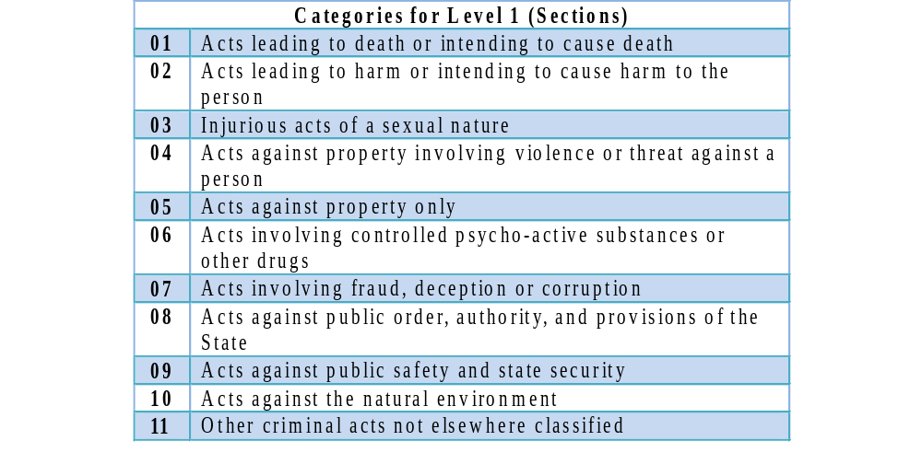
The current structure of the ICCS
11 Top-level categories:

Slide 15
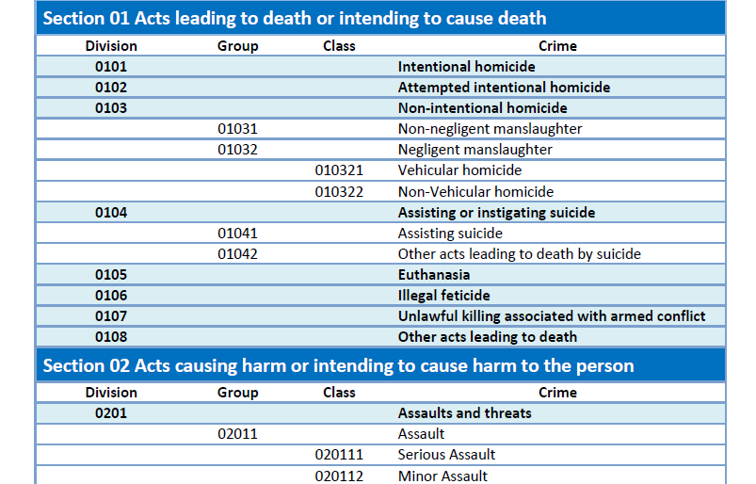
The ICCS – broad structure

Slide 16
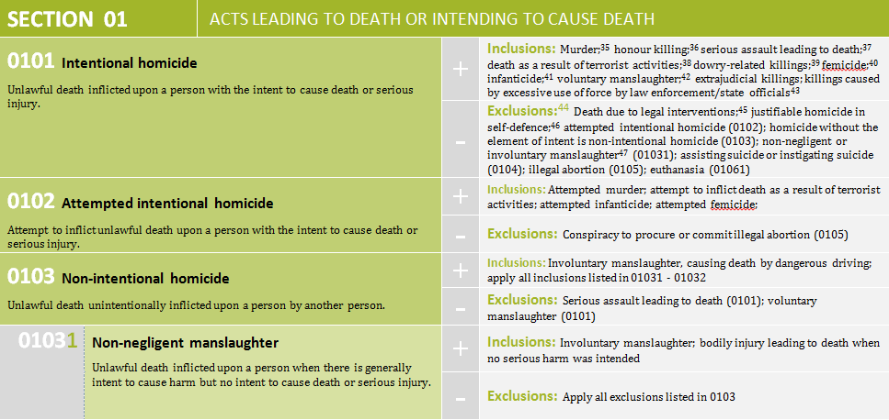
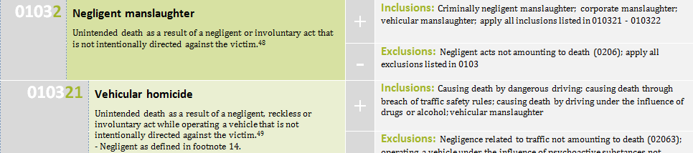
The ICCS – detailed structure

Slide 17
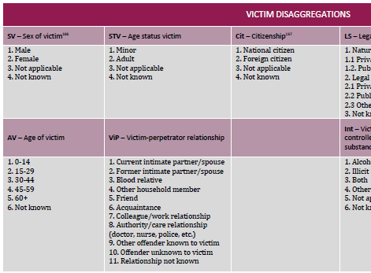
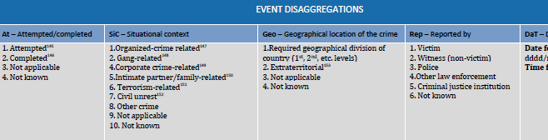
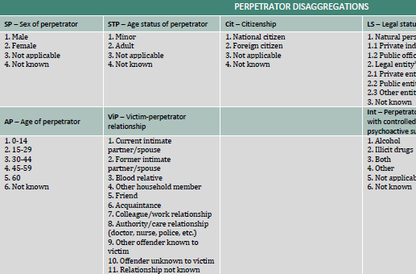
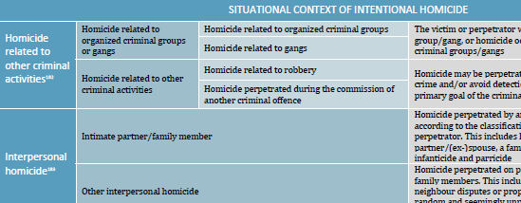
Additional disaggregations

Slide 18
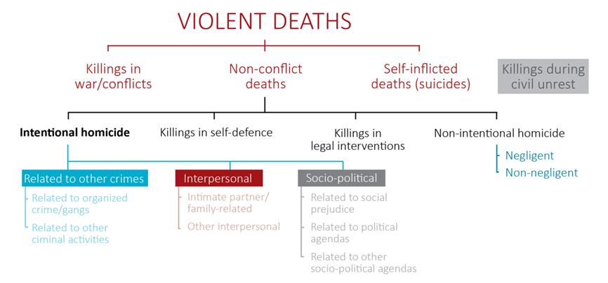
Clarifying intentional homicide

Slide 19
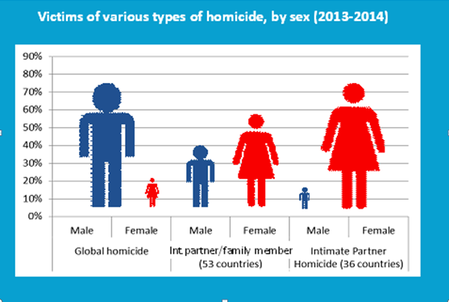
An example of the impact of the ICCS

Slide 20
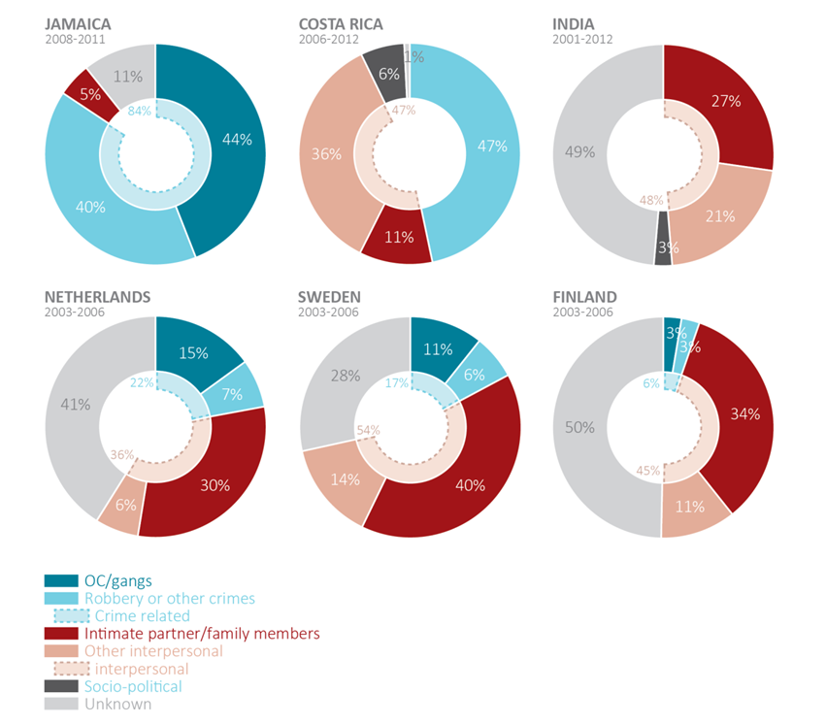
An example of the impact of the ICCS

Slide 21

Thank you for your attention

