Slide 1


Developing a National SDG Indicator Framework – Issues and challenges
Case for Uganda
The Republic of Uganda
Ben Paul Mungyereza
Executive Director,
Uganda Bureau of Statistics

Slide 2
Contents
  Coordination Framework
  National Monitoring Mechanism
  The Indicator Framework
  Baseline for SDG Monitoring
  Challenges

Slide 3
The Coordination Framework
Government under Cabinet Minute No. (CT 2003) 257 in an endeavour to adress the coordination challenge, approved the Institutional Framework for Coordination of Policy and Programme Implementation in Government.
This is under the Mandate of the Office of the Prime Minister as leader of Government business

Slide 4
National Monitoring Mechanisms…
Uganda recognizes the power of evidence-based decision making across all the levels of the public and private sector.
To this effect, the NDP II is fully cognizant of Uganda’s development obligations as enshrined in the Constitution, the East African Community Integration Protocols, the Africa Agenda 2063, Vision 2040 and the Agenda 2030 for Sustainable Development.
In this context, the Sustainable Development Agenda has been integrated into the NDPII and therefore, monitoring and reporting mechanisms of SDGs implementation will follow the existing arrangements under the NDP II.

Slide 5
National Monitoring Mechanisms
Currently Uganda is implementing its second National Strategy for the Development of Statistics (NSDS 2) that is aligned to NDP II.
NSDS 2 provides an integrated programme for censuses and surveys, and articulates mechanisms for strengthening administrative data and civil registration systems.
It is envisaged that the information needs for monitoring Agenda 2030 will be delivered through implementation of NSDS2 that recognizes the emergence of non-conventional data sources.

Slide 6
The National Indicator Framework…
Uganda Bureau of Statistics (UBOS) in collaboration with the Ministry of Finance, Planning and Economic Development (MoFPED), Office of the Prime Minister (OPM), and National Planning Authority (NPA) developed a National Standard Indicator (NSI) framework.
The NSI framework is a four level hierarchical indicator framework; the national, sector, service and routine government function level indicators for monitoring government operations.
The Framework has helped identify the data gaps.

Slide 7
The National Indicator Framework…
Not all SDG indicators will be monitored through the NSI framework.
The NSI framework has given priority to indicators that will be required for monitoring the NDPII.
Under the government reporting mechanism through the Office of the Prime Minister, every institution is required to report on its performance in the Government Annual Performance Review.
The NSI indicators have been agreed on as the indicators to report on in the next cycle.

Slide 8
The National Indicator Framework
Uganda government has adopted a Programme based budgeting system. We have been using the Output based budgeting.
Effective FY 2016/17 as a pilot, the NSI framework has been adopted as a tool in the budgeting process.
Starting FY 2017/18, the NSI framework will be fully integrated with the budgeting process and each institution will be required to report on the NSI indicators as part of budget reporting.

Slide 9
Baseline for SDG Monitoring
The fiscal year 2014/15 is considered the most appropriate baseline year for measuring progress of implementation of Agenda 2030 in Uganda because it is the baseline for NDP II.
In addition, wealth of data/information was made available during the course of the fiscal year 2014/15. Such information is available from the 2014 National Population and Housing Census, 2014 Rebased GDP series and routine administrative data from Central Government Ministries, Departments and Agencies.
For indicators where no data series are available for 2014/15, data from the most recent surveys will provide the baselines as well as data from upcoming surveys.

Slide 10
Challenges in monitoring and reporting SDGs
  Limited user appreciation of statistics and its role in economic and social development,
  Inadequate appropriation of resources for statistical activities
  Lack of baseline data on various SDG indicators
  Limited disaggregation on available data.
  Absence of appropriate methodologies and technologies for measuring some indicators
  Underdeveloped administrative data and Civil Registration System

Slide 11
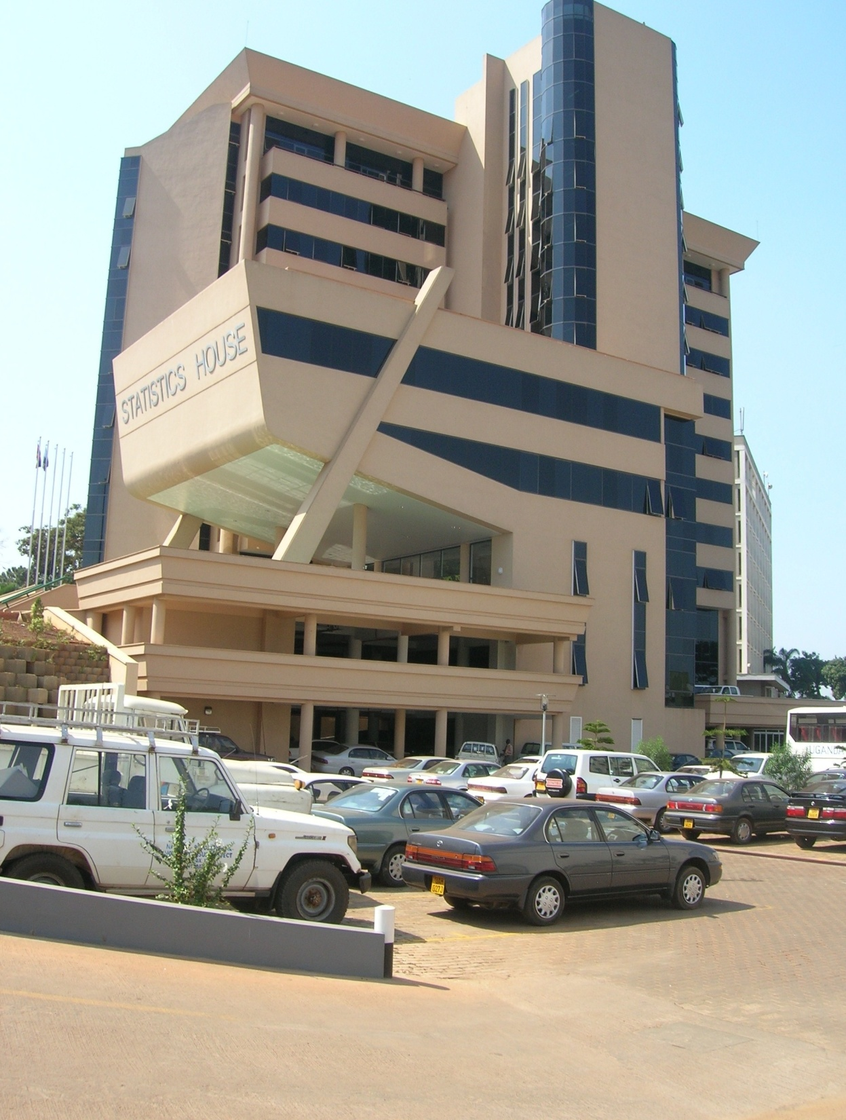
PLOT 9
COLVILLE STREET
P.O BOX 7186
KAMPALA
TEL.
0414-706000
FAX
0414-237553
E-MAIL
ubos@ubos.org
Website
www.ubos.org
My Contacts
ben.mungyereza@ubos.org
THANK YOU !!

