Slide 1




  Unpacking the challenges of urban SDG target and human settlements indicators monitoring
Robert P Ndugwa, PhD
Head Global Urban Observatory Unit
UN-Habitat, Nairobi, Kenya
Email: robert.ndugwa@unhabitat.org

Slide 2


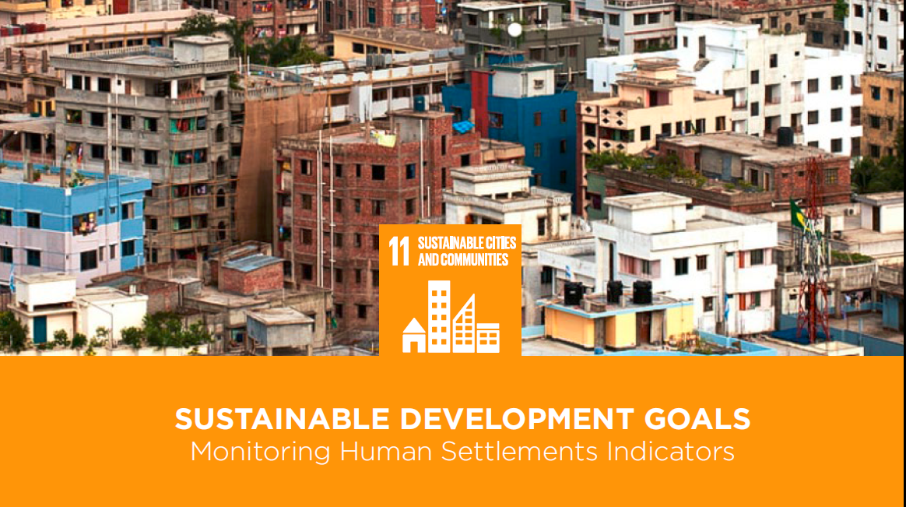
Africa
Agenda 2063
Paris climate aggreement

Slide 3

The Sustainable Development Goals
SDG – Goal 11 +
Make cities and human settlements inclusive, safe, resilient and sustainable
11 Targets
11.1 Housing and Slums
11.2 Sustainable Transport
11.3 Participatory Planning
11.4 Cultural Heritage
11.5 Disaster risk Reduction
11.6 Air Quality and Waste Management
11.7 Public spaces
11.a Rural-urban and regional planning
11.b Mitigation of Climate Change, Resilience
11.c LDCs support – buildings
1.4.1 Basic services
1.4.2 Secure land rights

Slide 4
The Sustainable Development Goals
SDG – Goal 11 +
Targets/ indicators for human settlements with spatial analysis needs
11.1 Housing and Slums
11.2 Sustainable Transport
11.3 Participatory Planning
11.4 Cultural Heritage
11.5 Disaster Reduction
11.6 Air Quality and Waste Management
11.7 Public spaces
11.a Rural-urban and regional planning
11.b Mitigation of Climate Change, Resilience
11.c LDCs support – buildings
1.4.1 Basic services
1.4.2 Secure land rights

Slide 5

Goal 11 - Indicators
Goal 11: Make cities and human settlements inclusive, safe, resilient and sustainable
Targets |  | Indicator
11.1 | By 2030, ensure access for all to adequate, safe and affordable housing and basic services and upgrade slums | Proportion of urban population living in slums, informal settlements, or inadequate housing
11.2 | By 2030, provide access to safe, affordable, accessible and sustainable transport systems for all, improving road safety, notably by expanding public transport, with special attention to the needs of those in vulnerable situations, women, children, persons with disabilities and older persons. | Proportion of the population that has convenient access to public transport disaggregated by age group, sex and persons with disabilities
11.3 | By 2030, enhance inclusive and sustainable urbanization and capacity for participatory, integrated and sustainable human settlement planning and management in all countries. | Ratio of land consumption rate to population growth rate
 |  | Percentage of cities with a direct participation structure of civil society in urban planning and management which operate regularly and democratically
Connecting the New Urban Agenda and the SDGs: (re)thinking UN-Habitat’s role

Slide 6


Goal 11 - Indicators
Goal 11: Make cities and human settlements inclusive, safe, resilient and sustainable
Targets |  | Indicator
11.4 | Strengthen efforts to protect and safeguard the world's cultural and natural heritage. | Total expenditure (public and private) per capita spent on the preservation, protection and conservation of all cultural and natural heritage, by type of heritage (cultural, natural, mixed, World Heritage Centre designation), level of government (national, regional, and local/municipal), type of expenditure (operating expenditure/investment) and type of private funding (donations in kind, private non-profit sector, sponsorship)
11.5 | By 2030, significantly reduce the number of deaths and the number of people affected and substantially decrease the direct economic losses relative to global gross domestic product caused by disasters, including water-related disasters, with a focus on protecting the poor and people in vulnerable situations. | Number of deaths, missing people, injured, relocated or evacuated due to disasters per 100,000 people.
 |  | Direct disaster economic loss in relation to global GDP, including disaster damage to critical infrastructure and disruption of basic services
Connecting the New Urban Agenda and the SDGs: (re)thinking UN-Habitat’s role

Slide 7


Goal 11 - Indicators
Goal 11: Make cities and human settlements inclusive, safe, resilient and sustainable
Targets |  | Indicator
11.6 | By 2030, reduce the adverse per capita environmental impact of cities, including by paying special attention to air quality and municipal and other waste management. | Percentage of urban solid waste regularly collected and with adequate final discharge with regards to the total waste generated by the city
 |  | Annual mean levels of fine particulate matter (i.e. PM2.5 and PM10) in cities (population weighted)
11.7 | By 2030, provide universal access to safe, inclusive and accessible, green and public spaces, in particular for women and children, older persons and persons with disabilities. | Average share of the built-up area of cities that is open space for public use for all, by sex, age and persons with disabilities
 |  | Proportion of persons victim of physical or sexual harassment, by sex, age, disability status and place of occurrence, in the previous 12 months
Connecting the New Urban Agenda and the SDGs: (re)thinking UN-Habitat’s role

Slide 8
Goal 11 - Indicators
Goal 11: Make cities and human settlements inclusive, safe, resilient and sustainable
Targets |  | Indicator
11.a | Support positive economic, social and environmental links between urban, peri-urban and rural areas by strengthening national and regional development planning. | Number of countries that are developing and implementing a National Urban Policy or Regional Development Plans that (a) respond to population dynamics, (b) ensure balanced territorial development, and (c) increase local fiscal space
11.b | By 2020, substantially increase the number of cities and human settlements adopting and implementing integrated policies and plans towards inclusion, resource efficiency, mitigation and adaptation to climate change, resilience to disasters, and develop and implement, in line with the Sendai Framework for Disaster Risk Reduction 2015-2030, holistic disaster risk management at all levels. | Proportion of local governments that adopt and implement local disaster risk reduction strategies in line with the Sendai Framework for Disaster Risk Reduction 2015-2030
 |  | Number of countries with national and local disaster risk reduction strategies
Connecting the New Urban Agenda and the SDGs: (re)thinking UN-Habitat’s role

Slide 9
Goal 11 - Indicators
Goal 11: Make cities and human settlements inclusive, safe, resilient and sustainable
Targets |  | Indicator
11.c | Support least developed countries, including through financial and technical assistance, in building sustainable and resilient buildings utilizing local materials. | The proportion of financial support to the less developed countries (LDCs) that is allocated to the construction and retroffiting of sustainable, resilient and resource efficient buildings, utilizing local material (*)
Connecting the New Urban Agenda and the SDGs: (re)thinking UN-Habitat’s role

Slide 10
APPROVED INDICATORS
PROGRESS MADE AT INDICATOR LEVEL
 | Target 1 Housing & slums | 11.1 Proportion of urban population living in slums or informal settlements and inadequate housing
 |  | Consultation with partners on-going Working with partners to prepare EGMs 2017
 | Target 2 Transport | 11.2 Proportion of the population that has a public transit stop (within 0.5 km ….)
 |  | Consultation with partners on-going (WB) Working with partners to organise EGM 2017
 | Target 3 Planning | 11.3 Ratio of land consumption rate to population growth rate – Efficient land use
 |  | Partnership with several teams EGM organized in NY June 2016 Finalizing 1st draft of a unified methodology
 | Target 3 Planning | Percentage of cities with a direct participation structure of civil society in urban planning and management which operate regularly and democratically

Slide 11
APPROVED INDICATORS
PROGRESS MADE AT INDICATOR LEVEL
 | Target 3 Planning | Percentage of cities with a direct participation structure of civil society in urban planning and management which operate regularly and democratically
 |  | Metadata prepared and submitted No specific partnership EGM 2016/17
 | Target 6 Environment | 11.6.1 Percentage of (urban) solid waste regularly collected and with adequate final discharge with regards to the total waste generated by the city
 |  | Working with partners to organise EGM 2017

Slide 12
APPROVED INDICATORS
PROGRESS MADE AT INDICATOR LEVEL
 | Target 7 Public space | 11.7.1 The average share of the (total) built-up area of cities that is open space in public use for all
 |  | Consultation with partnership Working with Urban Planning team EGM to be organized late 2017 Preparing a unified methodology

Slide 13
APPROVED INDICATORS
PROGRESS MADE AT INDICATOR LEVEL
 | Target 11.a Rural-urban and regional planning | 11.a.1 The number of countries that are developing and implementing national urban policy that (a) responds to population dynamics, (b) ensures balanced regional and territorial development, (c) prepares for infrastructure and service development, (d) promotes urban land-use efficiency, (e) enhances resilience to climate change, (f) protects public space and (g) develops effective urban governance systems; (h) increases local fiscal space.
 |  | Consultation with partners Working with Regional/Metro Planning Unit EGM to be organized 2017 Agreeing on a unified methodology

Slide 14
APPROVED INDICATORS
PROGRESS MADE AT INDICATOR LEVEL
 | Target 11.c LDCs support – buildings | 11.c.1 The proportion of financial support to the less developed countries (LDCs) that is allocated to the construction and retroffiting of sustainable, resilient and resource efficient buildings, utilizing local material
 |  | Partnership with OECD and WB EGM to be organized 2017 Preparing a unified methodology

Slide 15

Coordination issues
Technical meetings- Global/Regional
Indicator based EGMs (14x2 minimum)
Definitions (cities, human settlements, public spaces, etc? )
Measurement challenges– city as unit of analysis
Spatial vs non-spatial data & - diversity/complexity of data sources
Disaggregation at what levels and detail
Capacity development challenges/strategies
Funding

Slide 16
What have we done so far?
Funding
Mapping the opportunities
Sharpening the measurement tools
Coordination

Slide 17
What have we done so far?
Funding
  Dev Account support
  Norway funding

Slide 18
Mapping the opportunities
Launched 2005
Linked to MDG (has yet to be updated for SDGs)
20+ indicators
Uses GIS technology
Produces Global Urban Indicator Database
Online database system/software tool ‘UrbanInfo’
Initiative also has Network component
17 Themes
100 Indicators: CORE + SUPPORTING
20 cities piloted – 40 members
Data is third-party verified
Excellent coverage, Comparability
High cost, High capacity needed
Global Urban Observatory
(UN-Habitat)
Global Cities Registry
(World Council on City Data)
Global Partnerships for Sustainable Development Data
(UN World Data Forum)
150+ partners
(Governments, NGOs, Businesses)
Data production and use oriented
SDG as focal point
50+ settlements
Collected data on slums/informal settlements
Data used as form of advocacy for resource and service distribution
Mobilizes communities
Know your City Community
(UCLG/SDI)
Global Geospatial Information Management
(UN GGIM)
194 partner countries, 14 International organization, 17 UN Agencies
Geospatial information supporting Sustainable Development and post 2015 Development agenda
Platform for cooperation
First forum 16-18 January 2017 (Cape Town, SA)
Global Action Plan for modernization + strengthening of statistical system for SDG Data
High-level Group for partnership, coordination + Capacity Building for post-2015 monitoring
UN World Data Forum
(UN Statistical Commission)
What Works Cities
(Bloomberg Philanthropies)
Launched 2015
Open data with robust citizen engagement
39 Cities
US Cities only (with size specification)
111 Cities
Addresses urban governance ‘data challenge’
Platform for exchange and good practice
New/innovative ways communicating and mapping urban governance for dissemination
Three thematic areas (legal, finance, governance)
Trust Fund for Statistical Capacity Building
(World Bank Group)
Trust Fund for Innovations in Development Data
(World Bank Group)
Launched 2015
Funding in support of data processing
Data to support post-2015/SDG Development
Urban Governance Survey
(LSE Cities, UNH, UCLG, Mac Arthur Foundation)
Global Platform for Sustainable Cities (GPSC)
(WB with other Dev. Banks, UNEP, UNDP, UNJDO)
11 Countries
23 Cities
Knowledge sharing and management program – collaborative engagement
Products: studies, workshops, online data
Works with existing cities networks
Launched 2012
400 cities in 20 countries
Comparability framework for cities and countries
Framework on Urban SDGs
Metric and policy dialogue
Integrates various indicators (from official SDG Indicator data set)
Cities Prosperity Initiative
Global Indicator
(UN-H)
SDG Goal 11 Monitoring Framework
(based on CPJ in coop. with WHO, UNISDR, etc.)
Linked to CPI
SDG indicators
6 dimensions, 18 sub-dimensions
Avoid excessively sectorial approach
Sub-divides by goal 11 targets
Launched 2013 (since, 2 revisions)
What regions: Africa
Indicators cover 5 areas + 10 criteria
Promotes integrated and multilevel urban strategies
Cities Enabling Environment Rating
(CA + UCLG)
NUP Programme
(UN-H, OECD, CA incl. NUP database)
Monitoring on of main phases
10 focus areas
Monitoring developed in context of NUP not separately
Database on Urban Law – planning, management, financing
7 main categories
Not complete (work in progress)
Not all National Urban Plans available
Urban Lex
(UNH with partner Universities)
Public expenditure + financial accountability
7 pillars, 31 indicators, 94 dimensions
Review key systems, processes and institutions
Strictly financial
PEFA (Improving Public Financial Management )
(EU, IMF, WB, SECO, France, Norway, Ukraine
Flagship report 2016
Closely linked to development of NUA and H§ process
World Cities Report
(UN-Habitat)
International Multistakeholder Panel on Sustainable Urbanization (GAP)
Future?
Two year reports (2015 & 2016) +
Aimed at strengthening science-policy interface
Global Sustainable Development Report
(GA)
Notes:
Enabling Consitions/Drivers of Change (NUA) – Blue
SDGs – Green
Localising SDGs – Light Blue
Voluntary Commitments – Orange
Transformative Change/urban Transformation - Red
Other - Purple

Slide 19
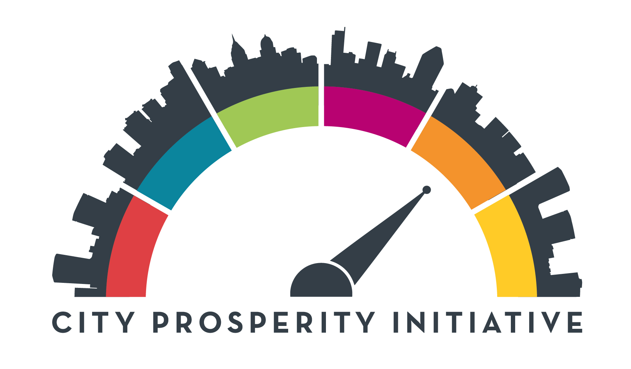
Sharpening the tools ---The City Prosperity Initiative
Measuring city performance goes beyond Goal 11 or the Urban SDGs. Other urban issues are in different global frameworks e.g NUA, Paris Agreement, etc.
UN-Habitat developed a tool to measure the prosperity and sustainability of cities. The City Prosperity Initiative (CPI) is a global initiative meant to assist decision makers to design effective policy interventions.
THE 6 DIMENSIONS OF URBAN PROSPERITY
Urban Governance and Legislation
Urban Planning and Design
Urban Economy and Municipal Finance
Infrastructure Development
Social Cohesion and Equity
Urban Ecology and Environment
http://cpi.unhabitat.org/

Slide 20
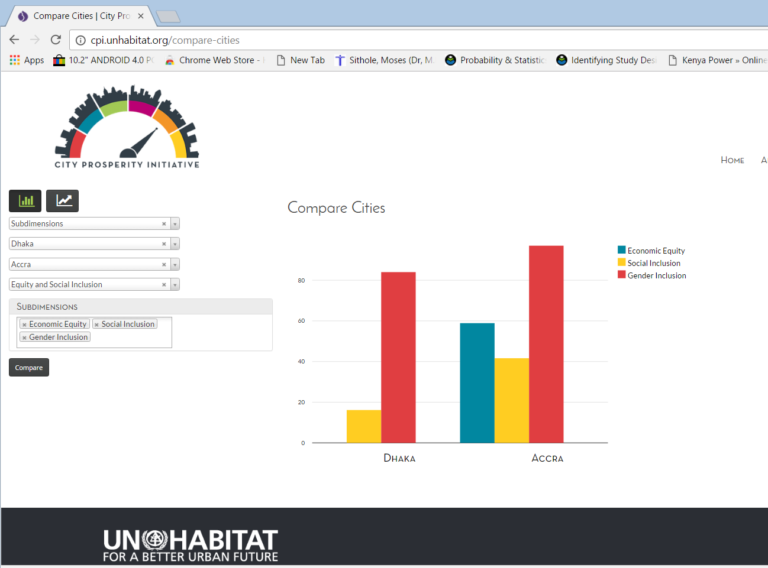

Slide 21
The CPI and the SDGs
Urban Economy and Municipal Finance | Local Economic Development | 8.1.1 City Product (GDP) per Capita (PPP)
 |  | 8.2.1 Growth rate per employment
 | Employment | Employment to Population Ratio
 |  | 8.5.2 Unemployment rate
 |  | 8.3.1 Infomal employment
 |  | 9.2.2 Manufacturing employment
 |  | 11.c.1 Jobs in the Manufacturing of Local Building Materials
 | Municipal Finance | Capital expenditure per capita (ppp)
 |  | Own revenue collection
Infrastructure Development | Adequate Housing | 11.1.1 Slum households
 |  | 11.1.2 Housing Affordability
 | Energy and ICT | 7.1.1 Access to electricity
 |  | 7.1.2 Population with primary reliance on clean fuels
 |  | 17.8.1 Internet Use
 | Urban Mobility | 11.2.1 Public Transit Stop Coverage
 |  | 3.6.1 Traffic Fatalities
Urban Planning and Design | Urban Form | Intersection density
 |  | Land allocated to street
 |  | Street density
 |  | Land Use Mix
 | Urban Land | 11.3.1 Efficient land use
 |  | Population Density
 | Public Space | 11.7.1 Proportion of Open Space in Public Use
 |  | Accessibility to open public space
Equity and Social Cohesion | Social Development | Life Expectancy at Birth
 | Economic Inclusion | Literacy Rate
 |  | Under five Mortality
 |  | 1.1.1 Poverty rate
 |  | 10.1.1 Growth rate of bottom 40%
 |  | GINI coefficient
 | Gender and Youth Inclusion | 8.6.1 Youth not in education, employment or training (NEET)
 |  | 5.5.1 Women in local government
 |  | 5.5.2 Women in managerial positions
 |  | Proportion of women in the workforce
 | Safety and Security | 16.1.1 Homicide rate
 |  | Theft Rate
 |  | 11.7.2 People subjected to harassment in Public Areas
Urban Ecology and Environment | Resilience | 11.5.1 Population affected by hazardous events
 |  | 11.b.1 Disaster Risk Reduction Strategies
 | Environmental Sustainability | 11.6.2 Air Quality - PM2.5 concentration
 |  | New registered Cars
 |  | 11.6.1 Solid waste collection and disposal
 |  | 6.3.1 Waste water treatment
 | Climate Change | CO2 emissions per capita
Urban Governance and Legislation | Urban rules and regulations | 11.a.1 Regional development plans
 |  | Principles of Planning TBD
 | Urban Governance | 11.4.1 Cultural Heritage Budget
 |  | 11.3.2 Participatory Planning
People Planet Prosperity Peace Partnership

Slide 22




The City Prosperity Initiative
1. A flexible monitoring framework that takes into account the contextual needs and particularities of cities and countries
2. The CPI promotes integration in the implementation of a more sustainable urbanization model
3. An innovative tool based on spatial analysis that integrates indicators such as street connectivity, public space, urban expansion
4. As a multi-scale tool the
CPI supports decision-making from national urban policies
to regional to city-wide interventions
CITY PROSPERITY INITIATIVE (CPI), September 2015

Slide 23
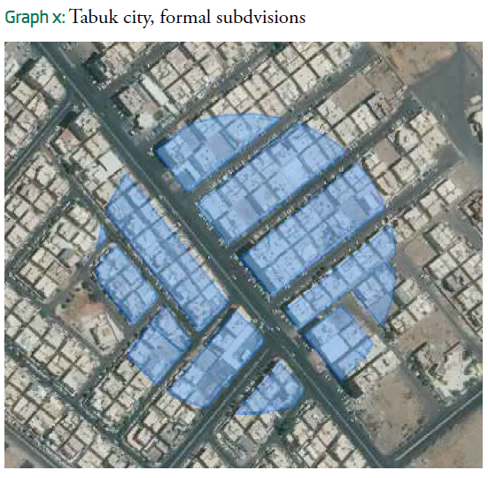
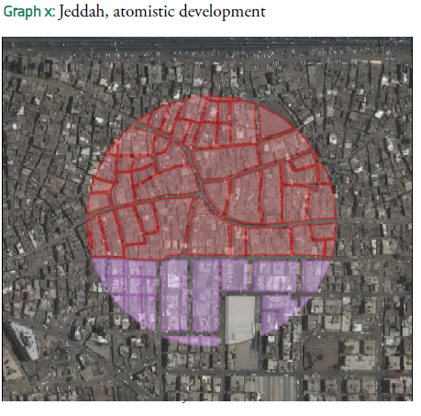
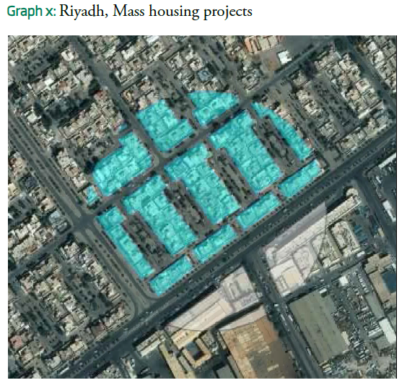
The City Prosperity Initiative
e.g As an Innovative Tool based on Spatial Analysis
STREET CONNECTIVITY AND SPATIAL INDICATORS

Slide 24

The City Prosperity Initiative
Why the CPI is proposed as the ideal Global Monitoring Framework for the New Urban Agenda and SDGs and is compliant with Africa Agenda 2063
Cities and countries that join the CPI are able to identify, quantify, and evaluate the progress on these agendas, avoiding duplication and systematizing the monitoring and reporting process
The CPI is a tool for coordination, implementation and monitoring of Sustainable Development Goals and New Urban Agenda at local level
The CPI integrates most of the urban Sustainable Development Goals (SDGs) indicators

Slide 25
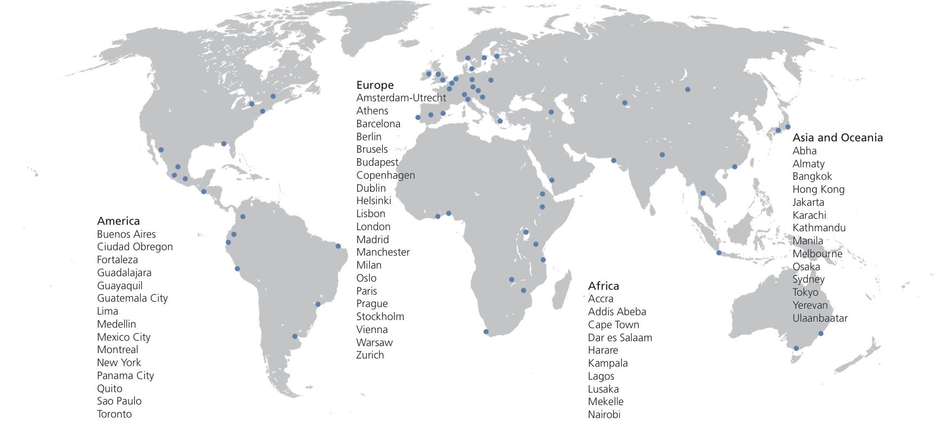
A Global Initiative
Already more than 300 cities around the world joined the CPI

Slide 26
Going forward
 | Timelines
Advocacy work for urban related SDGs including a possible side event in 2017 UNSC meeting | 2017-2019
Finalizing the guidance on the National Sample of cities | March/April 2017
Organize the first technical meeting on human settlements indicator | Feb 2017
Regional workshops on human settlements indicator | June 2017, Oct 2017, Jan 2018
Consultations and refinements of definitions | By August 2017

Slide 27


For more information contact
Robert Ndugwa
robert.ndugwa@unhabitat.org

