Slide 1

Status of Implementation of SDG Indicator Framework in Ghana
By
Baah Wadieh,
Deputy Government Statistician, Ghana
At the
Cape Town International Convention Centre
January 19, 2017

Slide 2
This presentation talks about…
Legal framework
SDG implementation plan
Long Term National Development Plan
Linking the data needs
Data availability
Activities to ensure increased data production
Way forward

Slide 3
Existing legal framework
Statistical activities of the National Statistical System in Ghana is governed by
  the Statistical Service Law, PNDC Law 135, enacted in 1985 and
  the 1993 Civil Service Law, PNDC Law 327, which requires each Ministry to establish a Research, Information, Statistics and Public Relations Directorate

Slide 4
Ghana’s Long Term National Development Plan (LTNDP)
Ghana is preparing a Long Term National Development Plan (2018 - 2057)
The LTNDP overlaps with AU Agenda 2063 (2014 – 2063) and UN Agenda 2030 (2016 – 2030)
To avoid the proliferation of national plans in response to the global, regional and national agenda, the National Development Planning Commission (NDPC) leading the developing a national development framework which will incorporate Agenda 2030 and Agenda 2063
As part of the process, the SDGs Implementation Coordination Committee comprising representatives from selected Ministries, Agencies and Departments (MDAs) has been formed to provide strategic direction for the SDGs related activities
The committee will also provide technical support to the High Level Inter-Ministerial Committee on the SDGs, chaired by HE the President
Technical Committee currently mapping all three agenda and identifying specific MDAs/CSOs/NGOs to lead implementation of specific SDG targets

Slide 5
The Five Goals of the LTNDP
Build an industrialised, inclusive and resilient economy
Create an equitable, healthy and disciplined society
Build safe, well-planned and sustainable communities
Build effective, efficient and dynamic institutions
Strengthen Ghana’s role in international affairs

Slide 6
Linking the data needs
SDGs
Agenda 2063
LTNDP

Slide 7
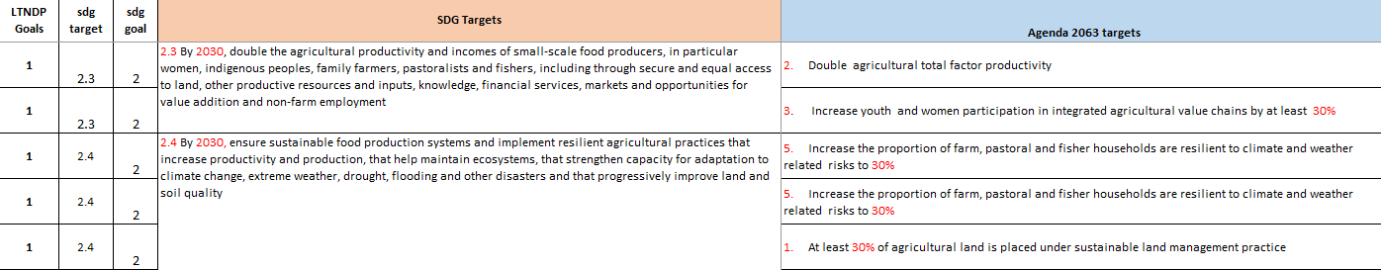
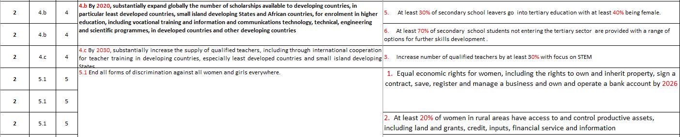
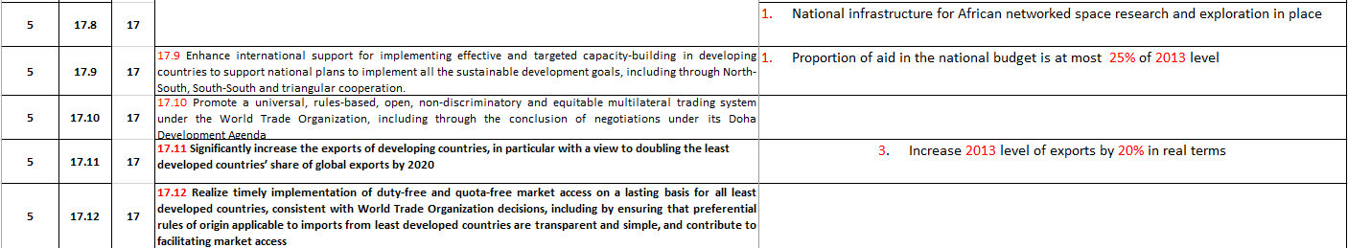

Slide 8
Data Determination Process
Given Ghana’s decision to incorporate the SDGs into the LTNDP and the fact that most of the Goals of Agenda 2063 are aligned with the SDGs:
GSS initiated a process since April 2016 to review the global set of SDG indicators to determine data availability within the NSS
The review generally focused on:
  data availability for each indicator (classified as tier I or II)
  data sources
  Institution producing the data
  most recent year data is available
  frequency of compilation
  levels of disaggregation
  Other possible data sources

Slide 9
Outcome of the review (1/2)
 | All sources | Administrative data sources
 |  | Number | Percent
Indicator already produced | 63 | 30 | 47.6
indicator not produced but data exist (with limitations) | 61 | 43 | 70.5
Total | 124 | 73 | 58.9

Slide 10
Outcome of the review (2/2)
The process has enabled the GSS to identify the indicators that can be monitored with its current survey and future survey programmes
Example: GLSS7, currently underway, will collect data for monitoring 36 SDG indicators
46 MDAs and other institutions identified for data production – mostly administrative data
Programmed activities to review administrative data and data collection templates of the MDAs in quarter one of 2017

Slide 11
Activities to ensure increased data production (1/5)
The National Strategy for the Development of Statistics (NSDS) has over the years provided a strategy for the National Statistical System (NSS)
NSDS I (2009-2013) elapsed, but relevant activities still being implemented in the 10 MDAs until Mid 2018
NSDS II document (2017-2021) – launched in Accra on November 25, 2016
NSDS II expected to have increased funding for MDAs statistics production

Slide 12
Activities to ensure increased data production (2/5)
 | Core | Associated
1 | Ghana Statistical Service | Ministry of Trade and Industry
2 | Ministry of Lands and Natural Resources | Ministry of Communications
3 | Ministry of Employment and Labour Relations | Office of the Head of Civil Service
4 | Ministry of Health/ Ghana Health Service | Judicial Service
5 | Ministry of Education | Energy Commission
6 | Births and Deaths Registry
7 | Registrar General
8 | National Communication Authority
9 | Ministry of Water Resources, Works and Housing
10 | Ghana Police Service
11 | National Road Safety Commission
12 | Environmental Protection Agency
13 | Ghana Immigration Service
14 | Ministry of Tourism, Culture, and Creative Arts
15 | Ministry of Food and Agriculture
16 | Ministry of Gender, Children and Social Protection
NSDS II has six strategic goals
  Improve the policy, regulatory and institutional framework
  Improve human resource development and management
  Modernise physical infrastructure
  Update statistical infrastructure
  Enhance data production, quality, dissemination and use
  Develop sustainable funding arrangements and establish collaborations with national and international institutions
**New MDAs included based on SDG data required

Slide 13
Activities to ensure increased data production (3/5)
Improving policy, institutional and regulatory framework – New Decentralization Bill
  The bill has a provision for the establishment of Statistics Department in each of the 216 MMDAs
Collaborating with the Local Government Service Secretariat to establish a Statistics Department in each of the MMDAs
Restructuring the Service – operating up to the regional level and to give technical backstopping services to the MMDAs
Human resource capacity building – providing advanced training (MSc) in priority subject areas for GSS and MDAs staff
Collaborating with research and other institutions to build capacity in data analysis – poverty analysis

Slide 14
Activities to ensure increased data production (4/5)
Formation of statistics and development team - NDPC & GSS
  Assessment for strengthening statistics in national development planning underway
    To assess the state of statistical development, the availability of quality data within the decentralized planning system (MDAs & MMDAs)
Statistical Service Law being revised and strengthened – first reading in Parliament in October 2016
  New Law expected to strengthen the role of GSS in coordinating the NSS
Moving from PAPI to CAPI to reduce the time lag between completion of data collection and publication of results
Collaborating with PARIS21 to develop data dashboard for monitoring NSDS II & SDG implementation – ADAPT
Efforts underway to open all data (microdata and metadata)
Discussions underway to develop Data Quality Assurance Framework

Slide 15
Activities to ensure increased data production (5/5)
information
Policy/
decision-
maker
Policy-related Analysis
Basic Analysis
End point of most existing data
Tables
Raw Data

Slide 16
Way Forward
Refine and localise indicators for Ghana
Regular and improved use and dissemination of statistical products – open data platform/data dashboard
Build partnerships for increased statistics production
Align Agenda
2030 & 2063
with LTNDP
Review national statistical
capacity gaps

Slide 17
Thank you

