Slide 1
UN Support to SDG implementation in Seychelles.
Savoy Hotel 25-27 October 2017
Roland Alcindor
Programme Manager – UNDP Seychelles

Slide 2
Contents
    SDG Awareness
    Prioritization workshop
    VRCP / Baseline Study
    Domestication of SDG in local language
    SDG Monitoring Mechanism (NOSCIS)
    Integration of SDG in National Development
    UNDP Country Programming
    Data in support of SDGs (Various interventions)

Slide 3
UNDP Support to SDG in Seychelles
SDG Symposium – September 2015 to coincide with adoption of Agenda 2030 at UNGA
  Awareness of Agenda 2030 (ensure it does not remains an MFA issue but that all line ministries discuss the implications of SDG for Seychelles.
  Focus on each of the Goals and relevance to Seychelles
…

Slide 4
UNDP Support to SDG in Seychelles
SDG Prioritization workshop (May 2016)
  Support from UNDP/ Kazakhstan partnership
  Online Survey to determine priority goals
  Priority Goals – HEALTH & EDUCATION considered top priority.
  Why Education and Health? (2 areas where data is more readily available)

Slide 5
UNDP Support to SDG in Seychelles - VRCP
VRCP Workshop (March 2017
-
help small island developing States (SIDS) track their progress in the implementation of the Samoa Pathway.
-VRCP provides guidance for monitoring progress in each of the thematic areas of the Samoa Pathway. (Thematic areas of Samoa Pathway linked to the 17 goals).
-complement ongoing national planning processes and facilitate future review of the implementation of the Samoa Pathway.

Slide 6
UNDP Support to SDG in Seychelles - VRCP
The VRCP could also be used as an analytical tool for identifying key issues and indicators for other international initiatives relevant to SIDS, such as the SDGs.
Technical Assistance Programme (SDG Baseline Study?). (e.g Nigeria and S. Africa
Exploring how to use the UNDESA funds to engage the Government in commissioning such a report.

Slide 7
UNDP Support to SDG in Seychelles
SDG Creole Booklet launching (June 2017)
  Awareness and inclusiveness/Domestication of SDG concepts at national level
  Bringing the SDG to grass roots level.

Slide 8
UNDP Support to SDG in Seychelles – Advocacy for SDG Monitoring Mechanism
  Advocacy for institutionalization of SDG Monitoring Mechanism
  Cabinet Paper (July 2017)
    (The Institutional Framework for the Implementation of the 2030 Agenda and Seychelles’ Global Commitments approved in July 2017)
  UNDP member of the NOSCIS (National Oversight Strategic Committee for Implementation of Seychelles Regional and Global Commitments.

Slide 9
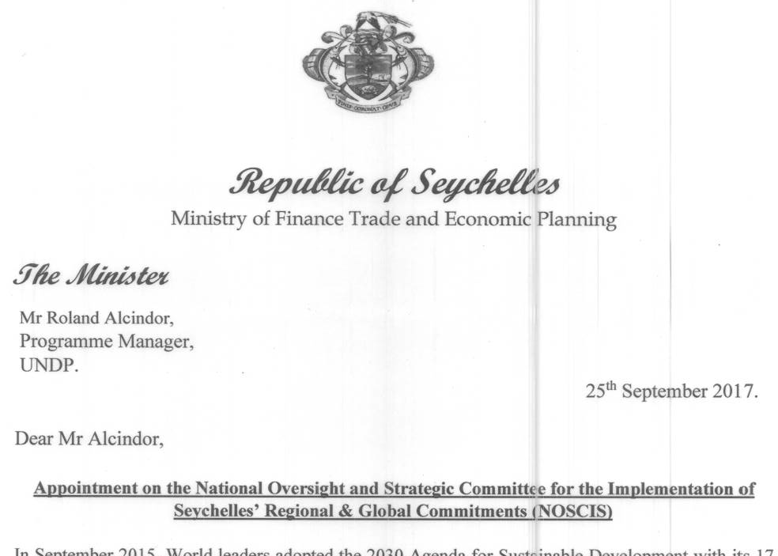
UNDP Support to SDG in Seychelles – UNDP observer status on NOSCIS

Slide 10
  National Oversight Strategic Committee for Implementation of Seychelles Regional and Global Commitments .
To ensure that Agenda 2030 and global agreements and sustainable development are implemented in an integrated and balanced manner; in doing so it will promote a “whole of government” approach;
To strengthen the knowledge and competencies of national institutions, public policy officials and other key stakeholders on developing integrated policies to advance the SDGs and Seychelles’ Global Commitments;
To address the major weakness of national capacity for data collection and make recommendations on how to improve and strengthen same;

Slide 11
Dialogue for Integrating SDG and Agenda 2063 into National development Planning Processes.
UNDP-Kazak Partnership – July 2017
      Workshop on Integrating SDG into National development planning process
Purpose
      Assess the linkages between the National Development Strategy and the SDGs
      Identify existing Data Gaps and Challenges
      Disseminate Results from the Rapid Integrated Assessment (Gaps in National Strategies both policy/data
      Come up with key recommendations to harmonize SDGs (as well as Africa Vision 2063 and the Samoa Pathway) into planning processes
      Initial recommendations on indicator harmonization / alignment to add in reporting
      Create Knowledge Sharing of Best Practice and Lessons Learnt (eg: Education integration of SDG into PPBB)

Slide 12
Dialogue for Integrating SDG and Agenda 2063 into National development Planning Processes
Output National Dialogue on Integrating SDGs into National Plans and Budget with the aim to strengthen capacities of relevant ministries and agencies to mainstream and accelerate, implement, monitor and report on the SDGs
Vision 2032
Sector Strategies
National Development Strategy 20198-2022

Slide 13
Converting Vision 2032 into a reality
Seychelles’ vision
National Development Plan
Sector Strategies
MTFF
Annual Action Plan
Annual Budget
Monitoring and Evaluation

Slide 14
UNDP COUNTRY PROGRAMME AND SUPPORT TO INSTITUTIONS
Poverty and Environment Focus.
M & E of 2017-2020 CPD
UNDP will ensure that project monitoring and evaluation frameworks are in place and aligned with programme priorities, including strengthening the capacities of implementing partners in data collection and usage. UNDP will establish and manage a cost-shared project monitoring and evaluation function supporting the baseline, project and impact evaluations. The emphasis will be on data disaggregation to allow better monitoring and targeting. Partners will be involved in joint monitoring visits and mid-year reviews, as well as assurance activities to promote understanding of the relevance of monitoring and evaluation activities and to improve results-based management

Slide 15
ADHOC Support on Data for Sustainable Development/SDG
Big Data using satellite (UK Space Agency/Institute of Environmental Analytics )
Anti- Corruption Survey
Marine Spatial Planning –
Environmental Information System (Database)

Slide 16

Trust no other source ..except your own reliable disaggregated data)

Slide 17
Thank you for your attention

