Slide 1
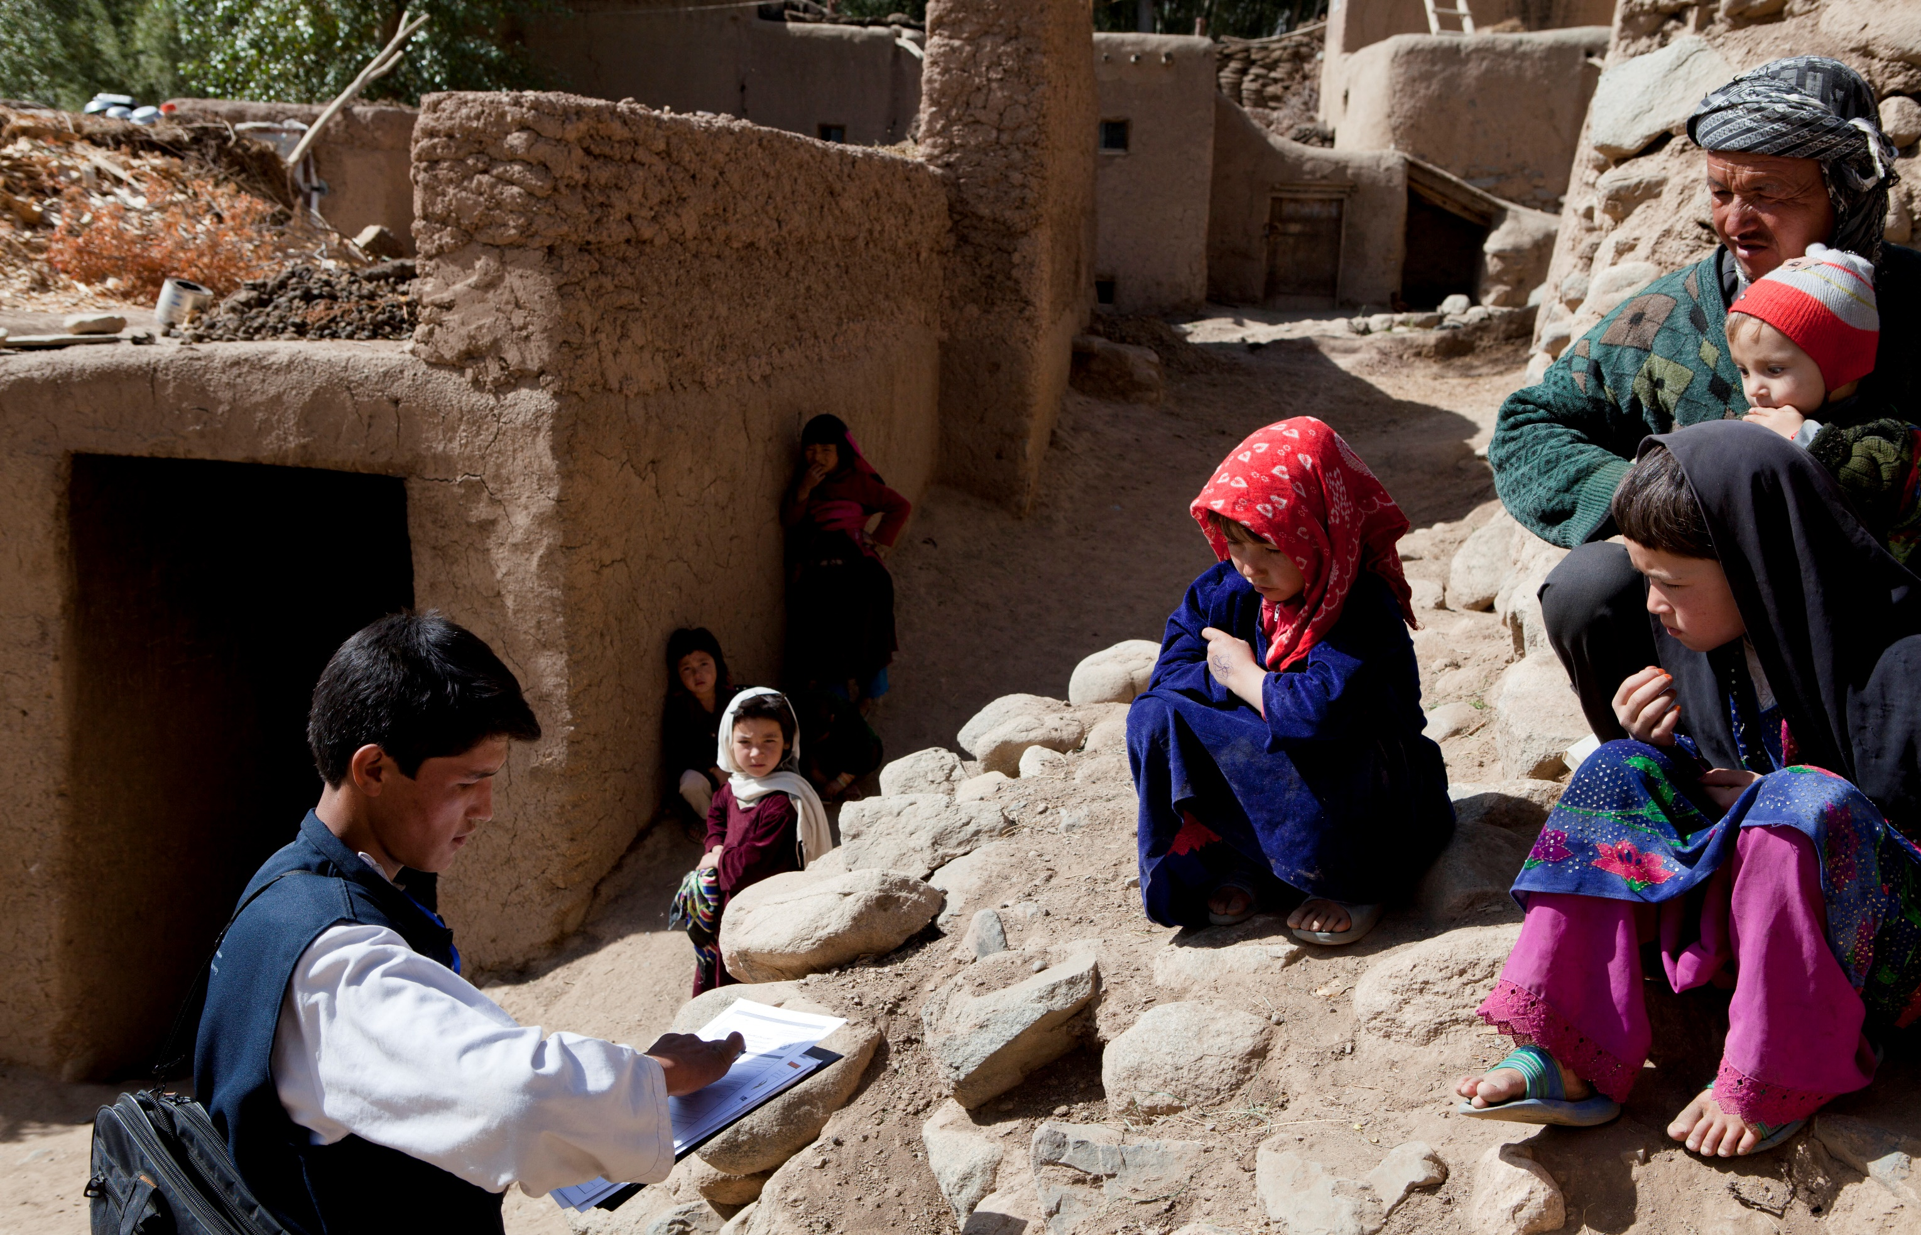

BECAUSE
EVERYONE
COUNTS
EMERGING METHODOLOGIES FOR PHCs:
Insights into Hybrid Census Methodology & UNFPA Population Data Platform
13th ASSD | Addis Ababa | 1-2 October 2018

Slide 2
Hybrid Census

Slide 3
Outline
Why / What Census Hybrids?
Hybrid Census - Population estimation from microcensus and satellite imagery!
Hybrid Census – Use Cases
GRID³ Partnerships
Focus countries

Slide 4
1.1. Census Hybrids / Alternatives to the traditional census – What / Why?
More countries are adopting alternative methodologies.
Why alternatives to traditional census:
  Need to produce more frequent and timely statistics;
  Budgetary limitations for census taking;
  Increasing reluctance to participate in censuses (e.g. due to privacy concerns)
  Increased technical capacities to manipulate data sources

Slide 5
1.2. The Alternatives
  Traditional census
  Combined census methodology / Hybrids
    Field enumeration and registers
    Registers and sample surveys – (short form- register-based; long form sample survey)
    Field enumeration and rolling surveys
    Registers and existing sample surveys
  Fully register-based- a new method developed in the 2000 round of censuses. Produces statistics by using administrative data which is related to population, household and housing, such as resident registers and building registers, without a field survey.”

Slide 6
1.3. Census methodologies

Slide 7
1.4. Other “Hybrids”
  1. Mixed data collection methods
    Paper based and CAPI
    Internet and CAPI
  2. Population estimation from micro-census / sample surveys data and satellite imagery- the “Hybrid Census methodology”
g
administrative data which is related to

Slide 8
2. Population estimation from microcensus and satellite imagery- What is it?”
An innovative methodology to estimate population counts for a country where a full census is not feasible.
Statistical modelling method which requires some data from surveys, GIS data and satellite imagery.

Slide 9
2.1. How does it work?
Core Steps:
Enumeration of population with ground-based surveys (micro-census/ sample surveys)
Prediction of EA population in un-surveyed areas using statistical models integrating population survey data and ancillary datasets (e.g. GIS and satellite imagery, topographical slope, night time lights; vegetation index)
Spatial disaggregation of population estimates
Output dataset includes:
  Population counts at EA level;
  100mx100m gridded population estimates;
  Population estimates disaggregated by sex and large age groupings
  Confidence intervals for modelled estimates

Slide 10
2.2. When is “Hybrid Census” approach appropriate?
For countries where a traditional census is not possible e.g. due to insecurity;
For countries where a traditional census enumeration is possible only for parts of the country;
To generate inter-censal estimates;
May also be useful to inform census cartography planning.

Slide 11






2.3. Hybrid Census is supported by GRID³ Project

Slide 12
2.3.1. Goal of GRID³ Project
“
Enable all governments to collect, use, and share geospatial data on population, settlement, and infrastructure

Slide 13
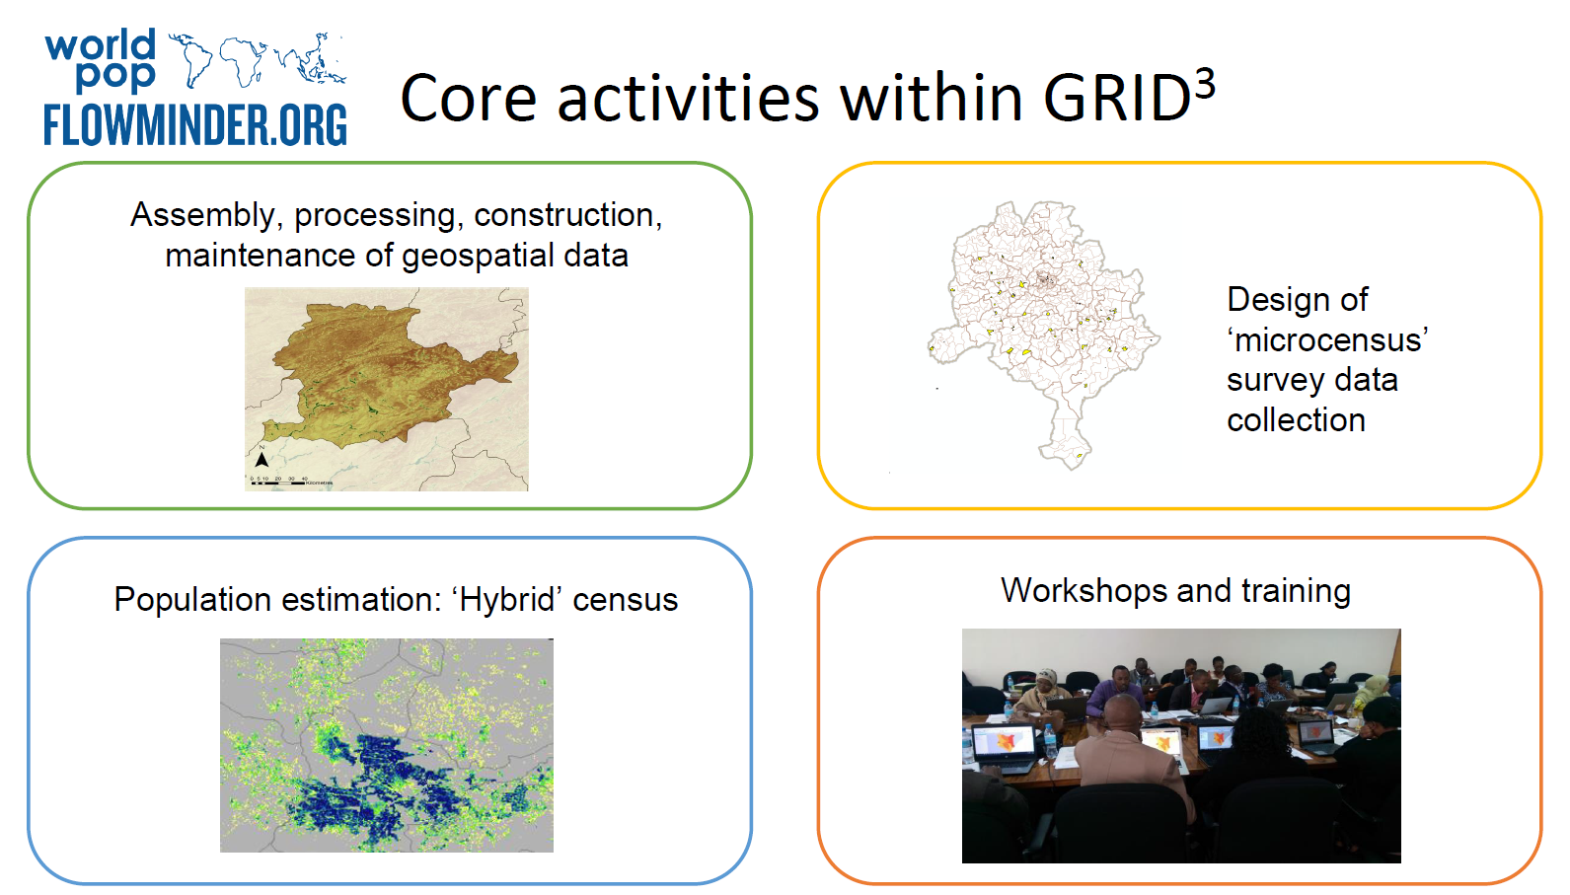

Slide 14
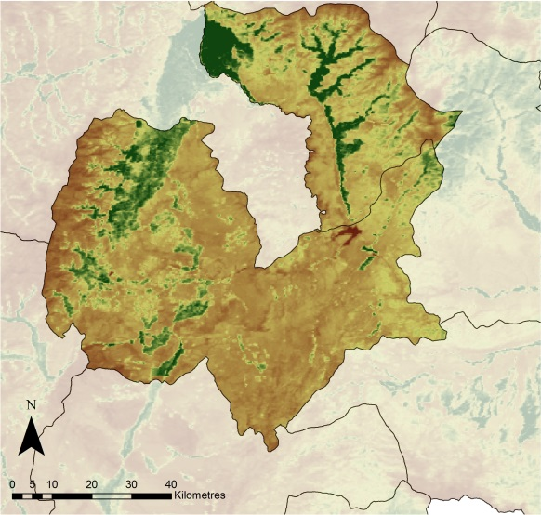
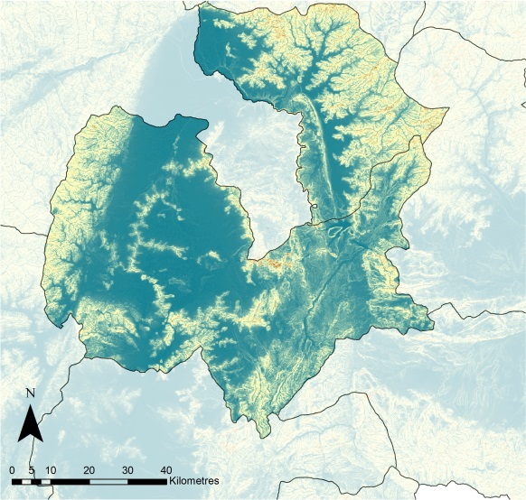
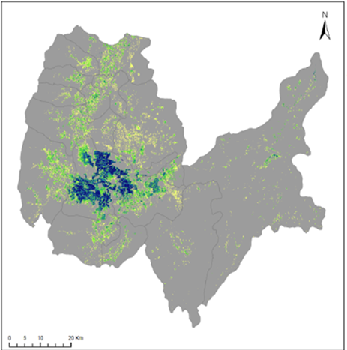

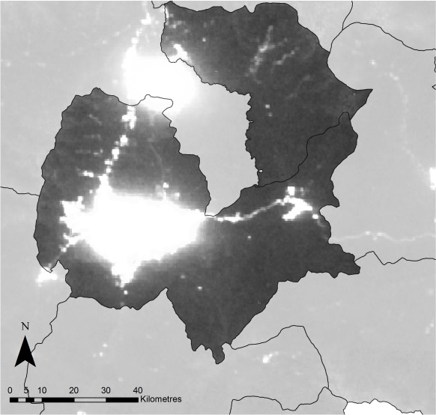
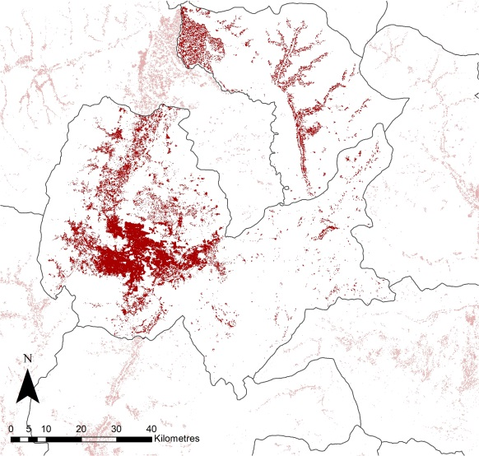
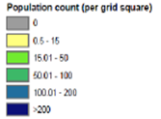
  2.3.3. Focus on supporting Hybrid Census, where full enumeration is not possible
Ancillary geospatial data
Output
•100mx100m grid population estimates
Slope
Vegetation index
Slope
Night-time lights
Settlements
Partnership of UNFPA, WorldPop/Flowminder, and Afghanistan National Statistics Office..
Notes:
This is an example of a hybrid census in Afghanistan.
UNFPA was spearheading efforts in generating population estimates from satellite imagery where a traditional census has not been possible.
In 2015, at the request of the Afghanistan Government, UNFPA and Worldpop/Flowminder generated sub-national population estimates from localized micro-census surveys and satellite imagery to inform planning processes. The estimates provide current data to inform development-planning processes at national and sub-national level, as the last census was conducted in 1979 as well as election planning for Afghanistan’s upcoming presidential election.

Slide 15
  3.1. Case Study 1: Afghanistan

Slide 16
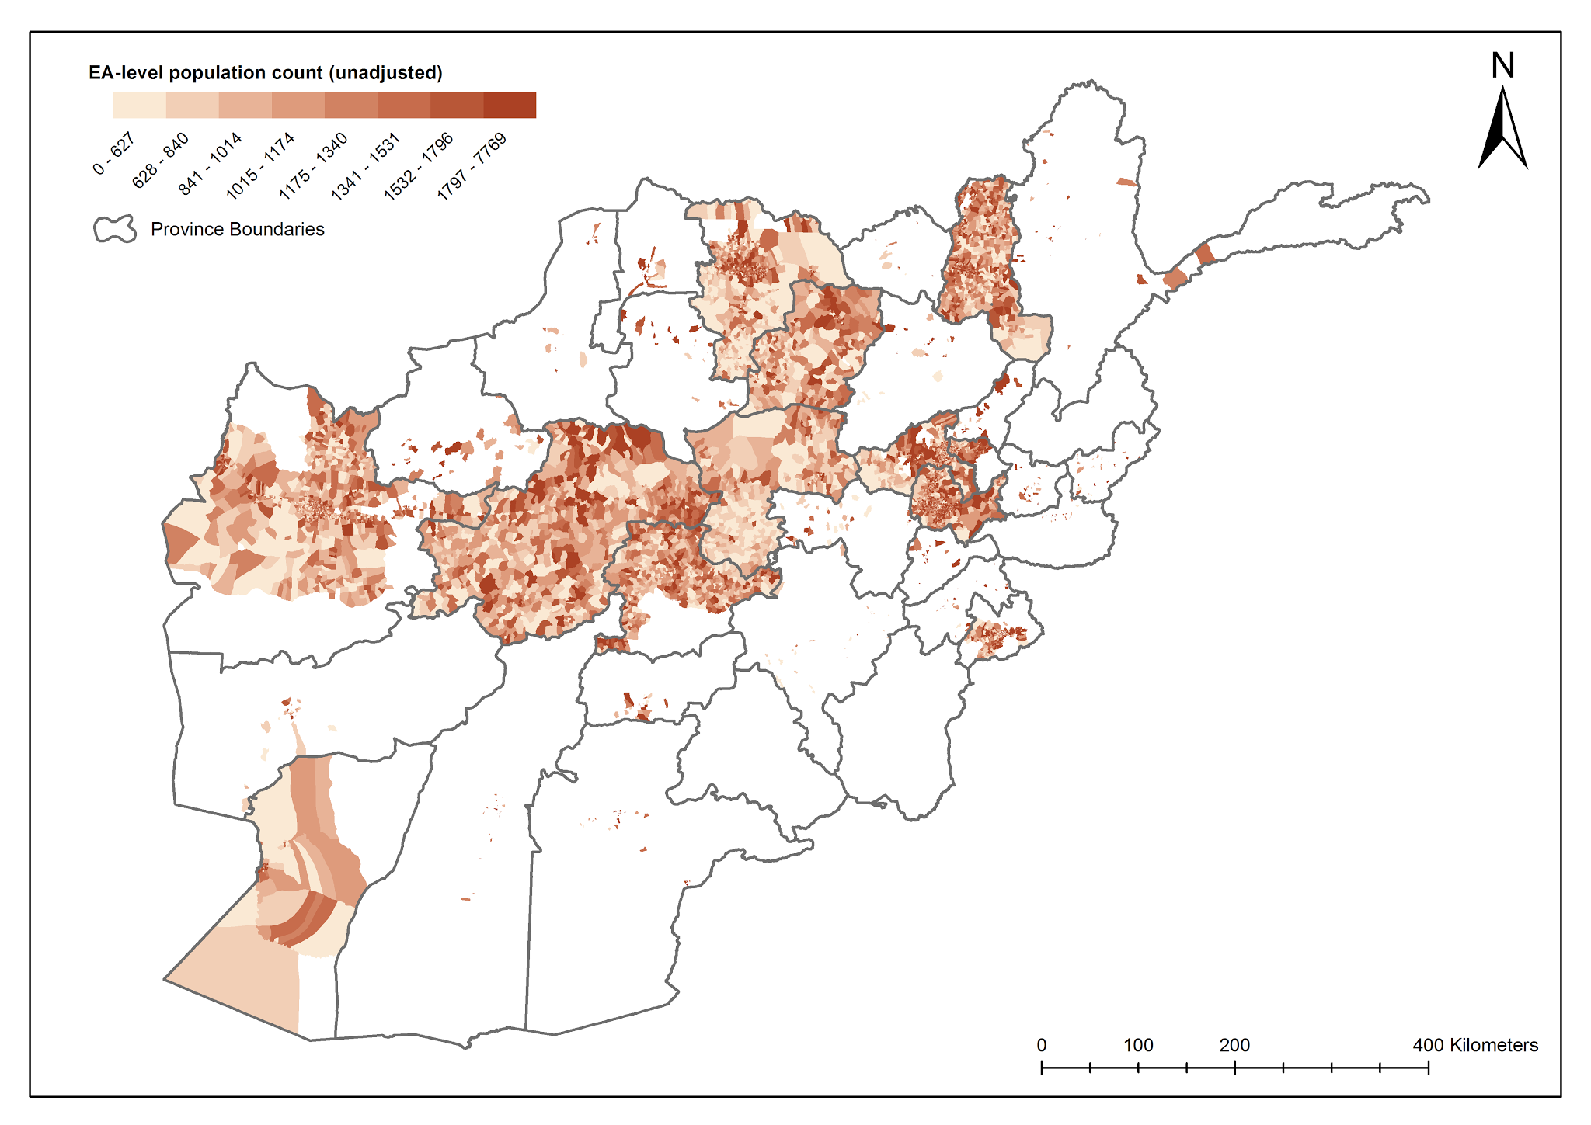

3.1. Case study: Afghanistan
Last national census 1979
1/3 country covered by a rolling census, but insecurity prevented full coverage
President Ghani requested new methods for population estimates

Slide 17
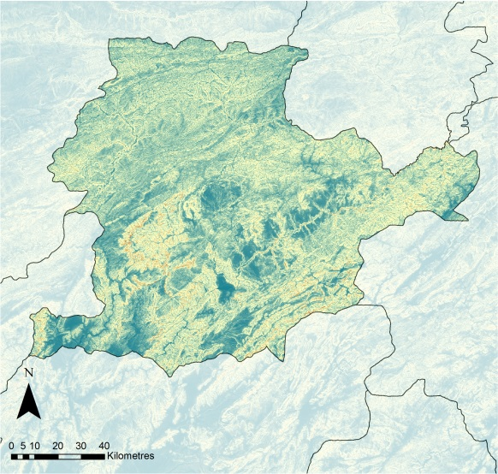
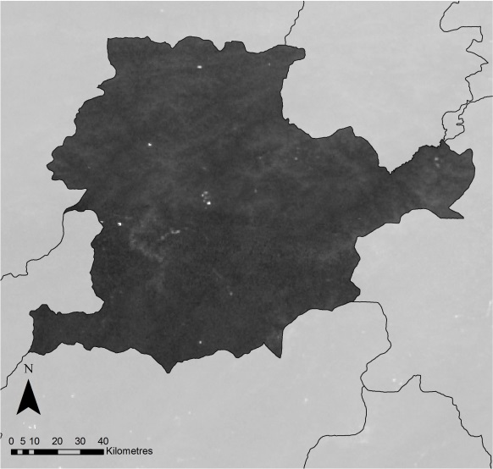
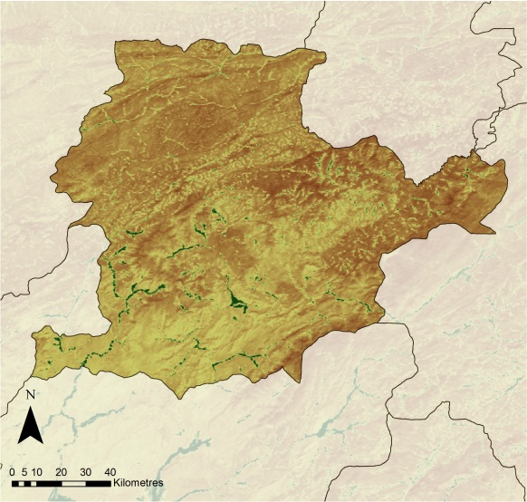
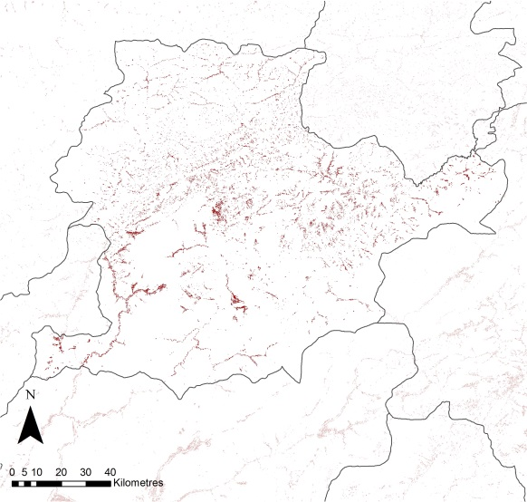
4.1. Inputs: Example – ancillary geospatial datasets
Slope
Night-time lights
Vegetation index
Number of compounds & area settled
>100 geospatial layers
Notes:
Population predictions makes use of a range of ancillary datasets which have a statistical relationship with population counts.
For example: 1. the number of individual compounds, the area of each EA which is “settled” (i.e. has buildings); 2. satellite derived enhanced vegetation index: a measure of the amount of green vegetation; 3. satellite derived night-time lights, which captures lights from settlements; and 4. slope, which is a measure of the steepness of the land.

Slide 18
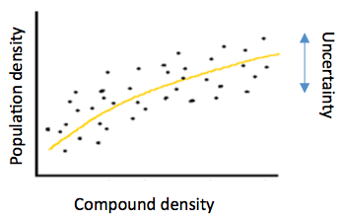
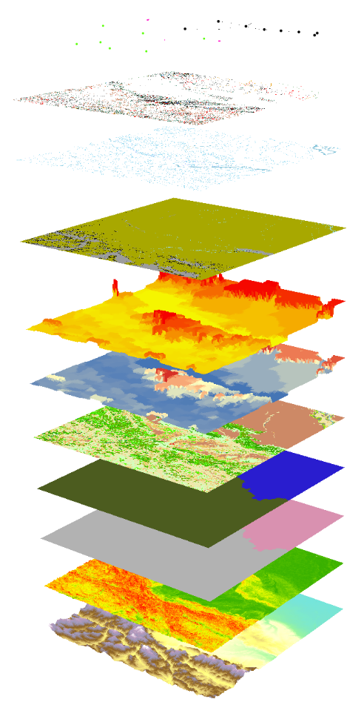
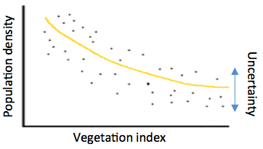

Slide 19
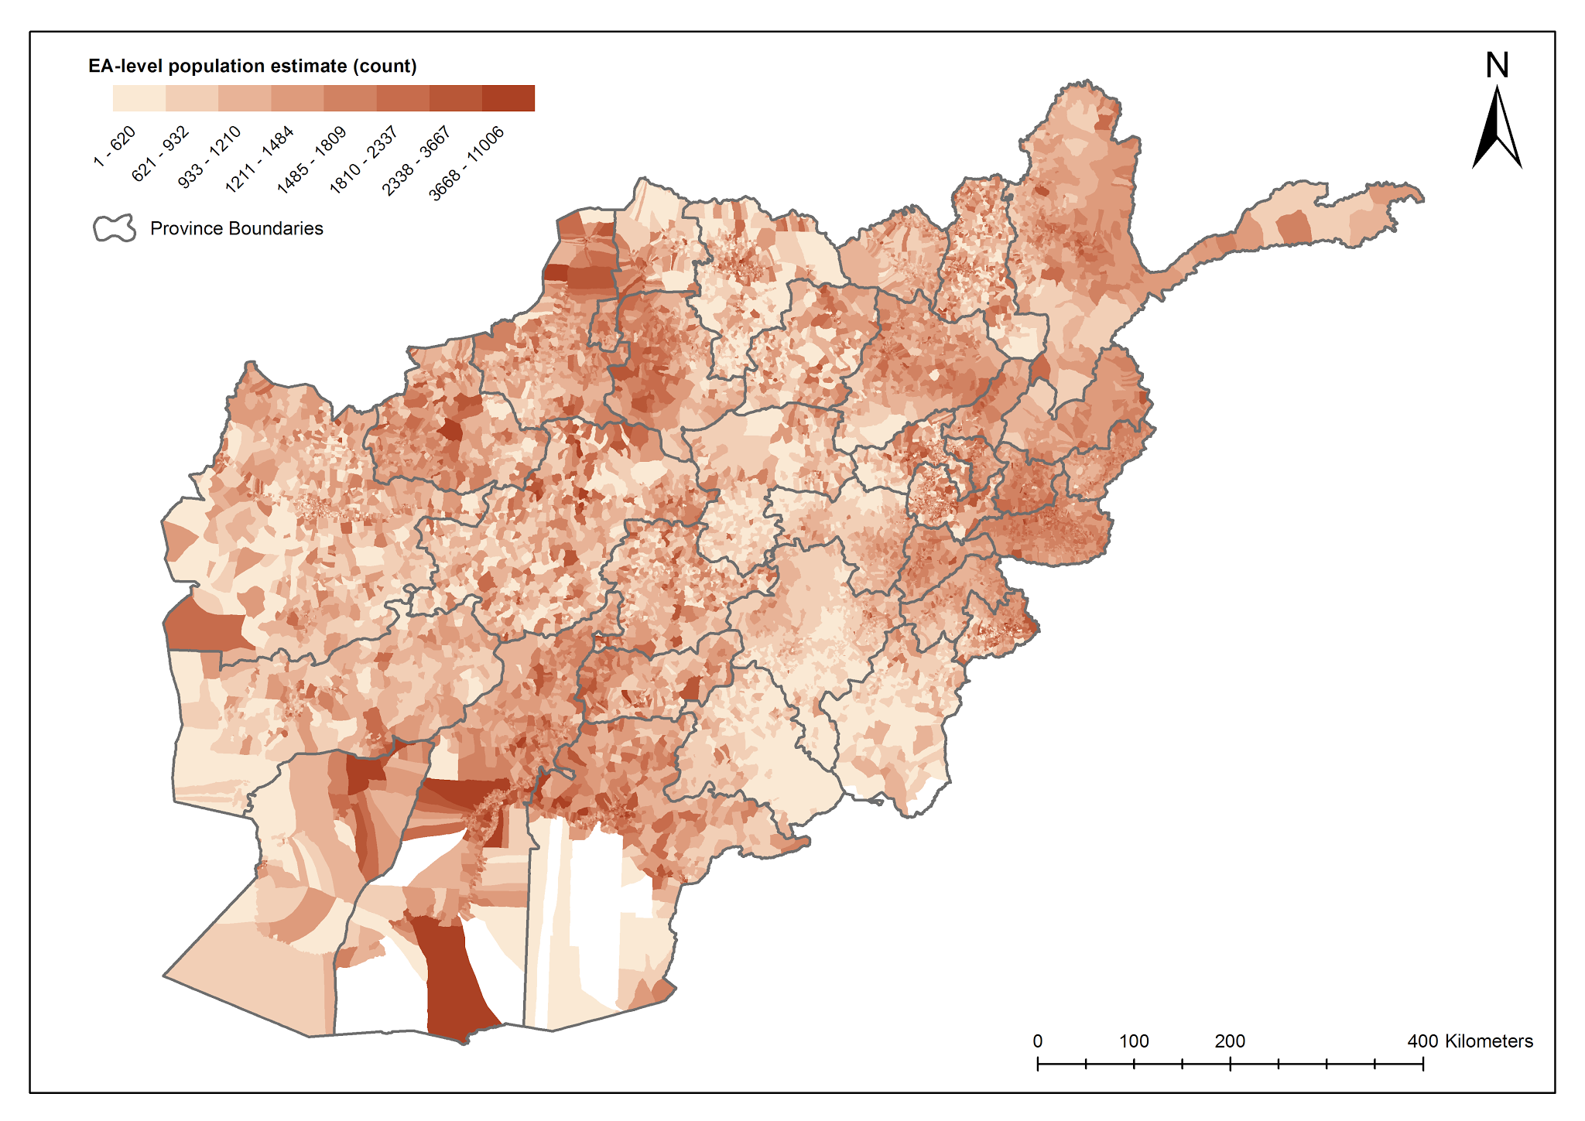

Slide 20
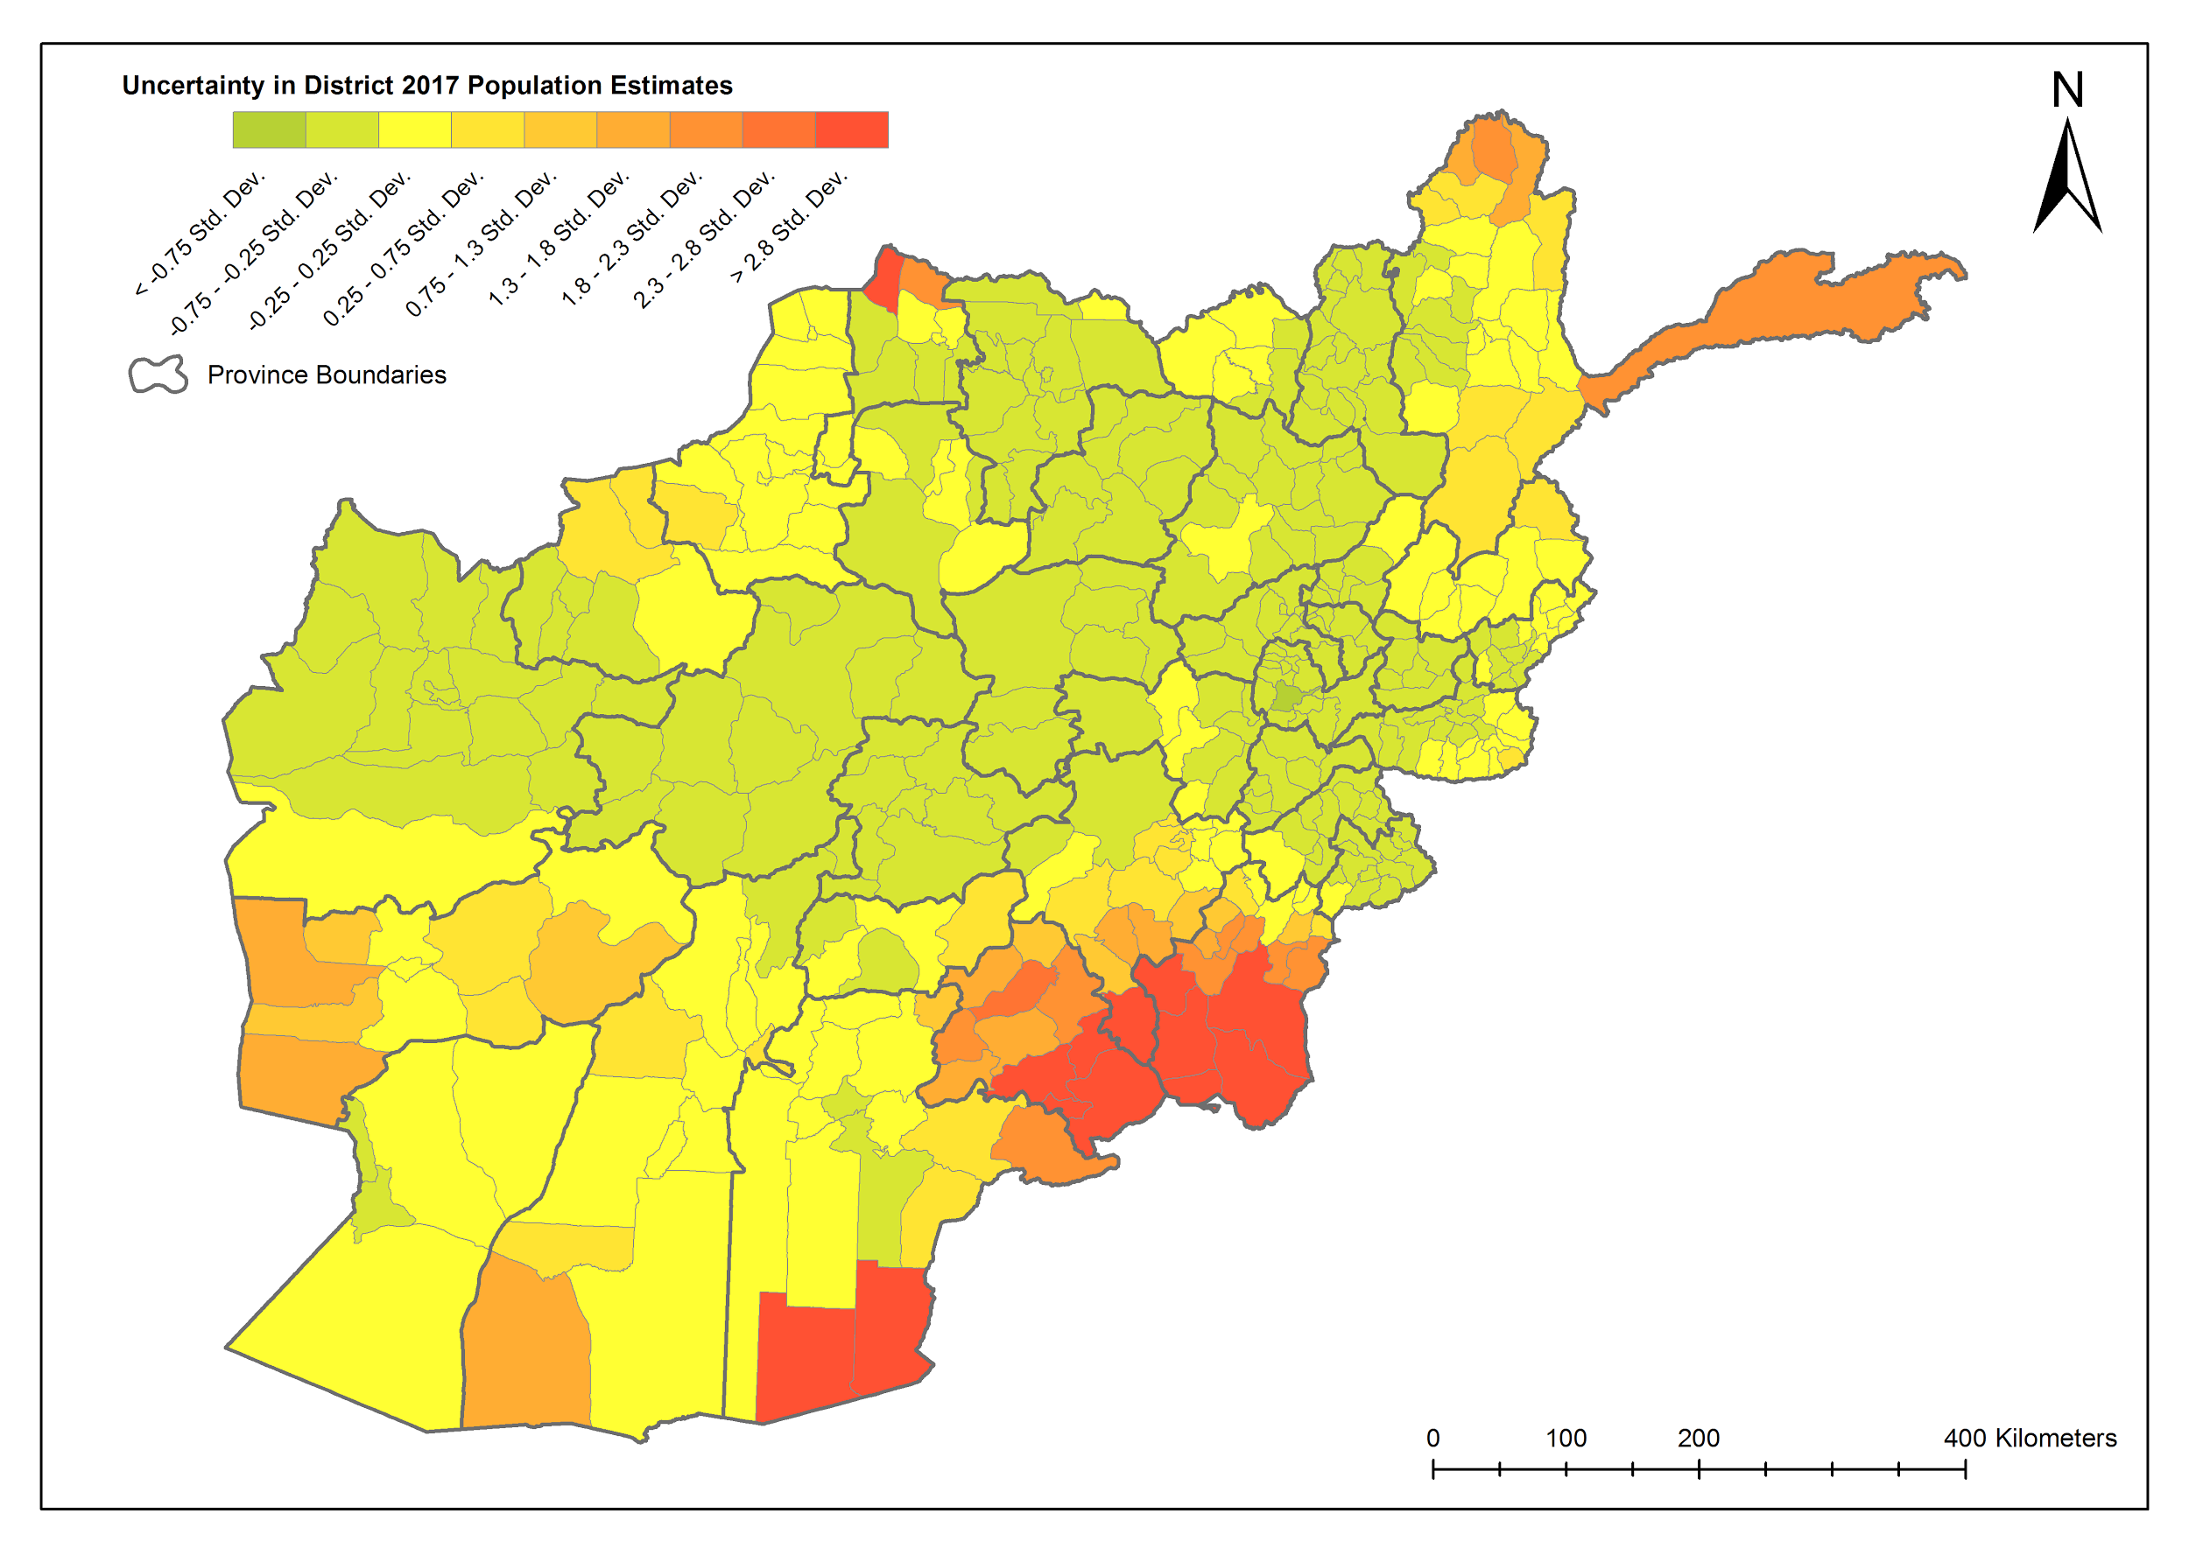

Slide 21
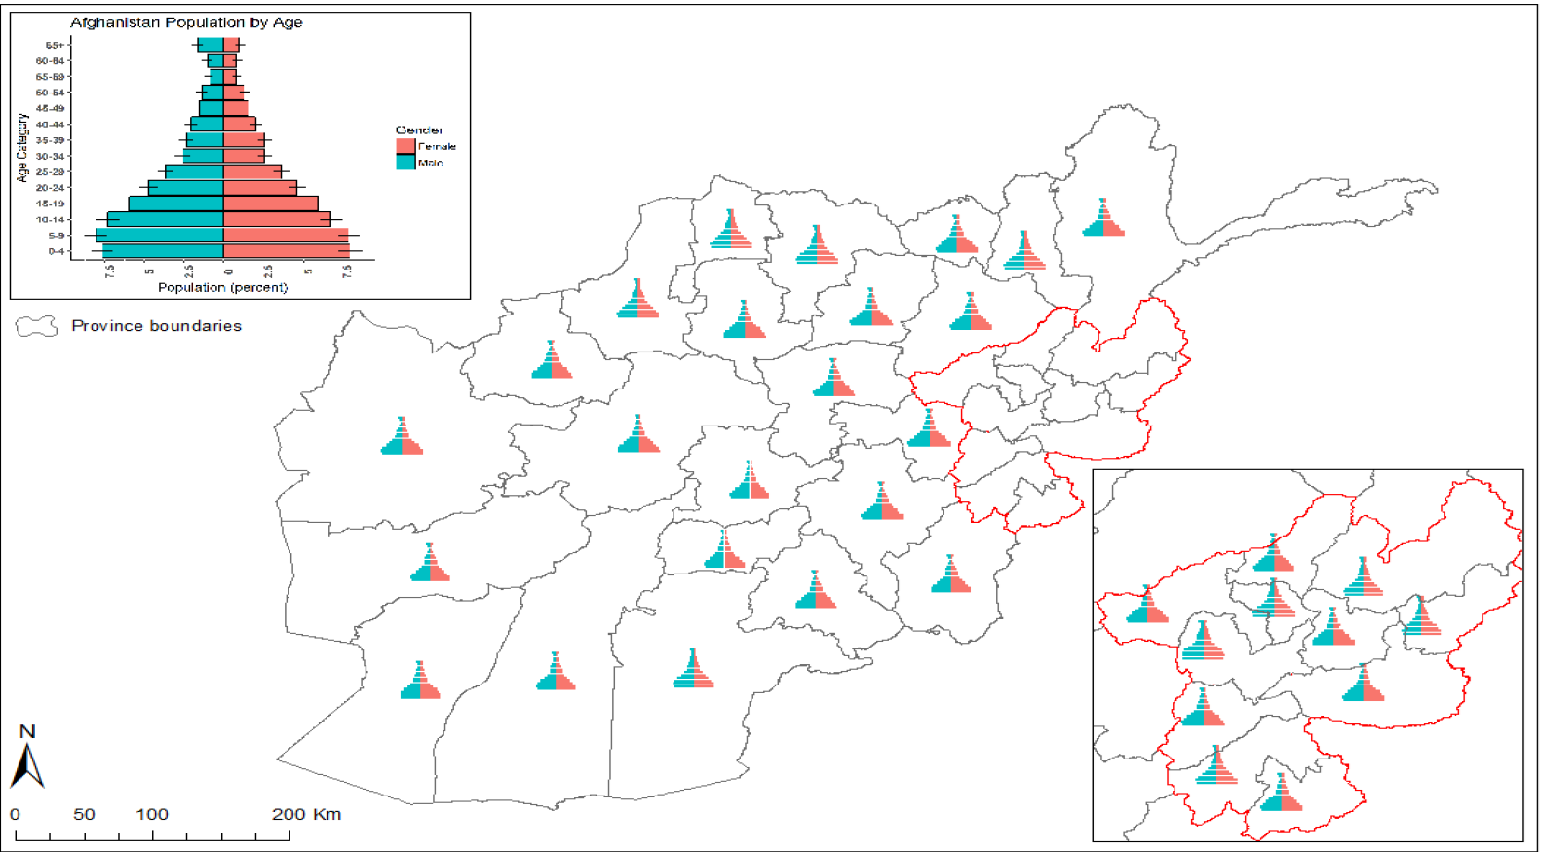

Slide 22
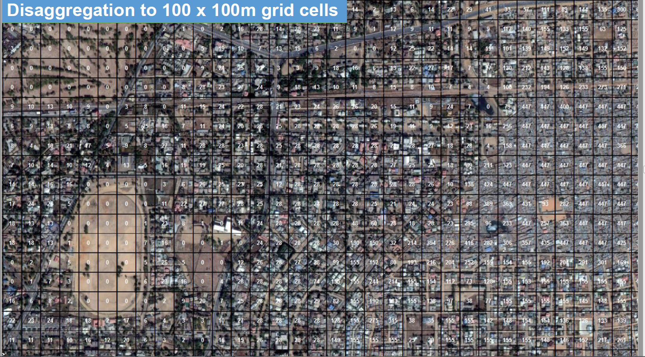

Slide 23
  3.2. Case Study 2: Nigeria Polio Project

Slide 24
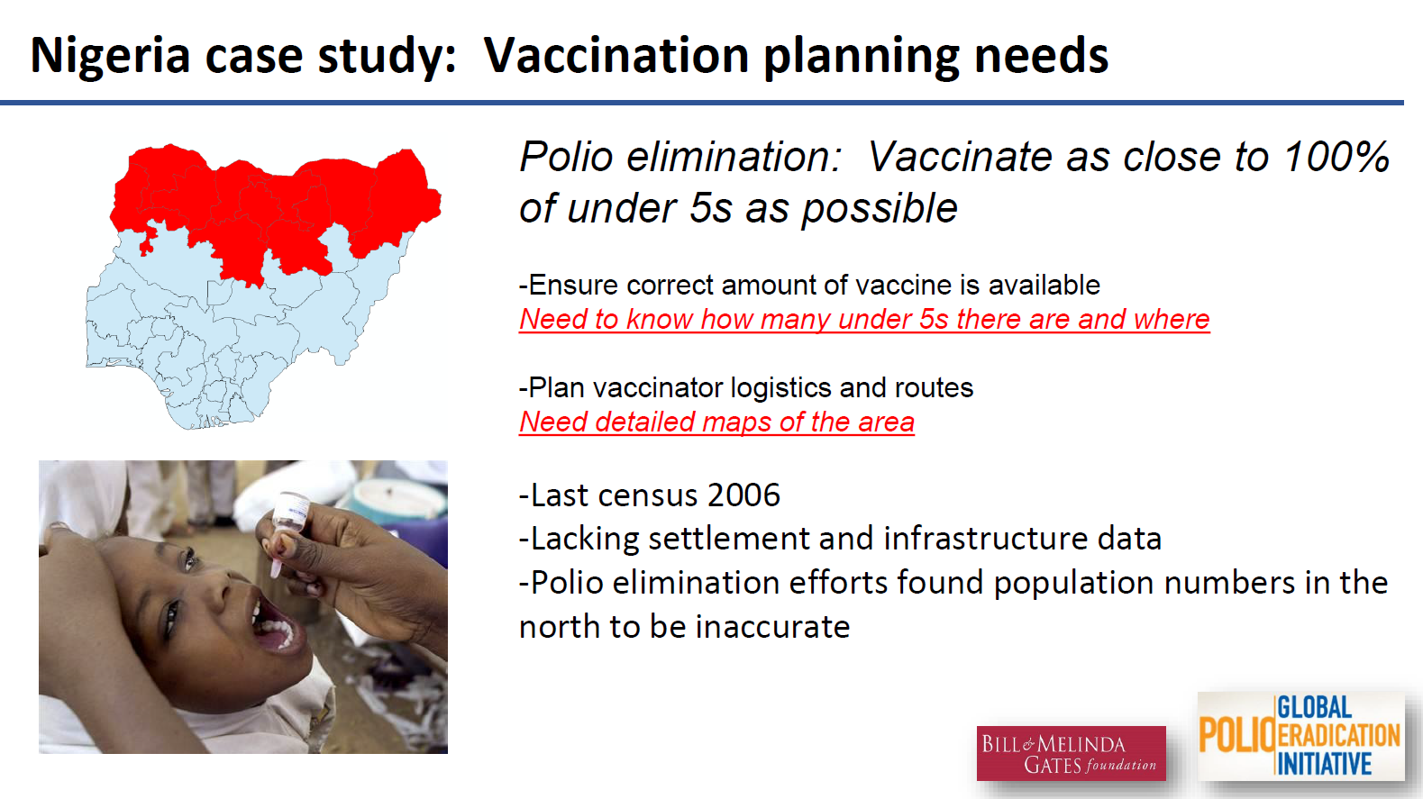

Slide 25
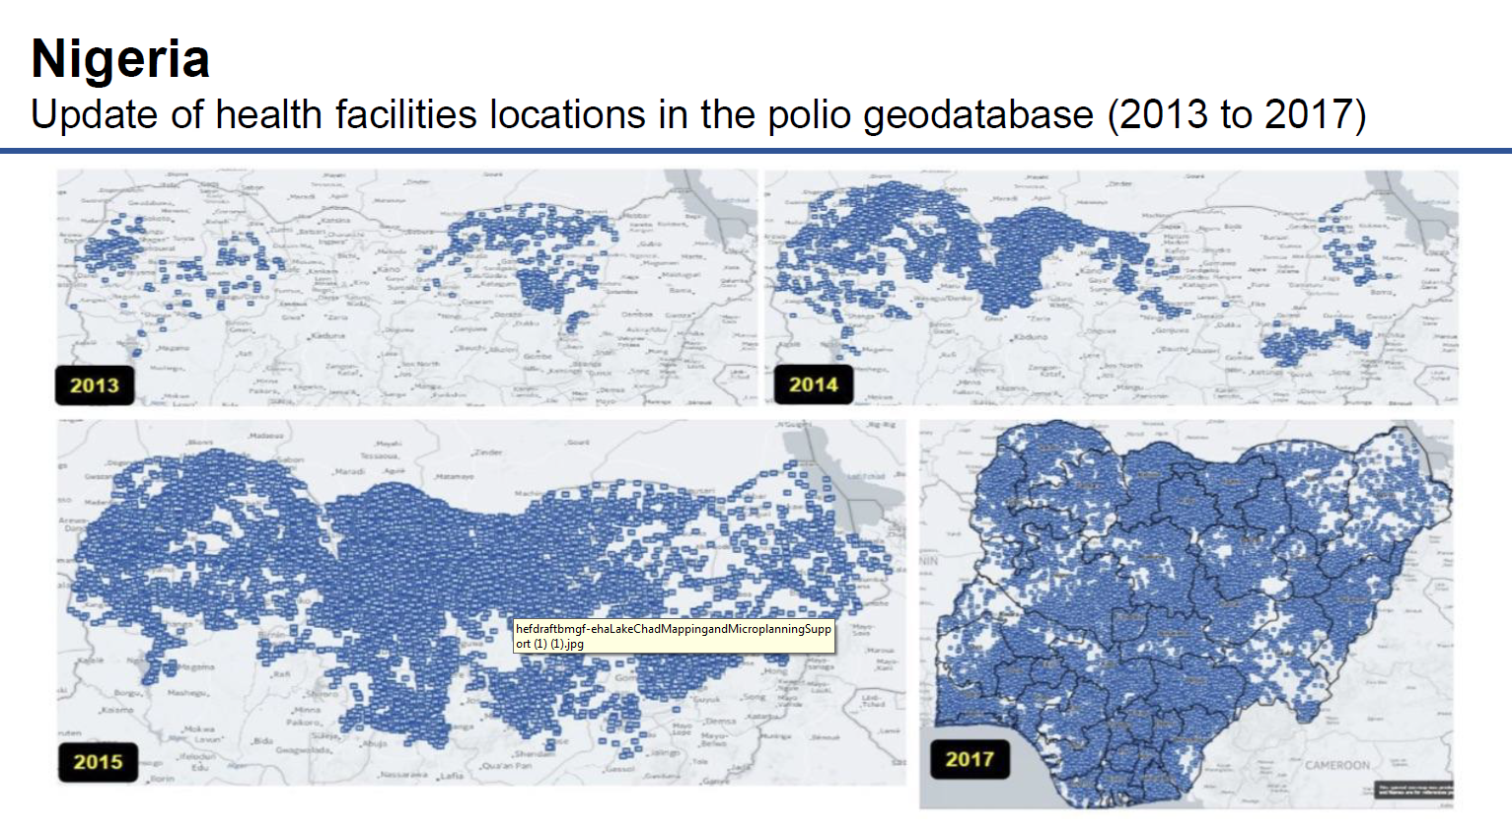

Slide 26
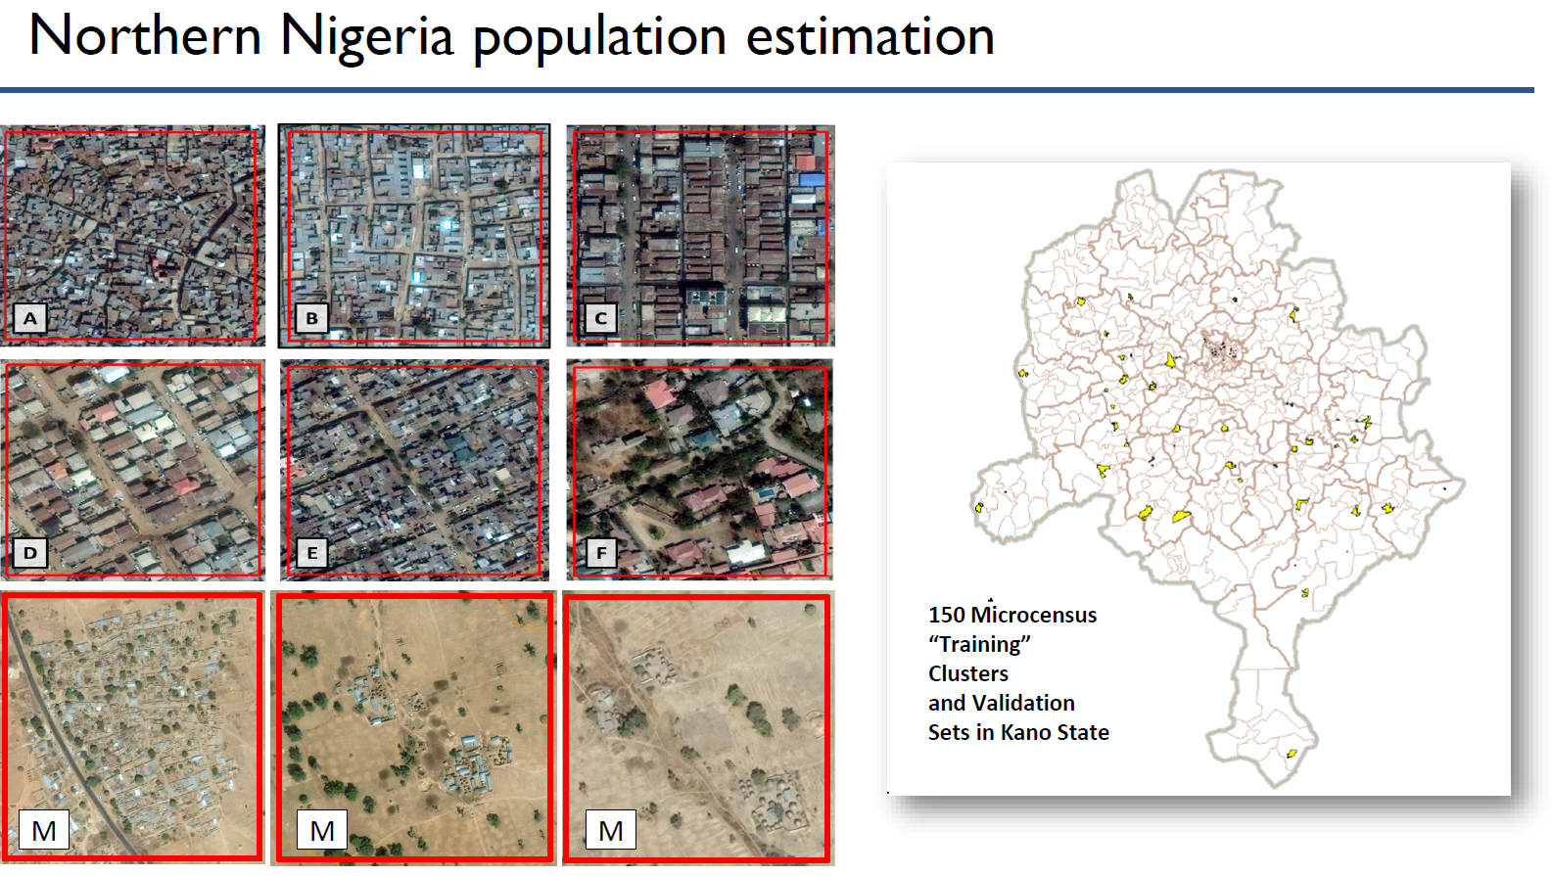

Slide 27
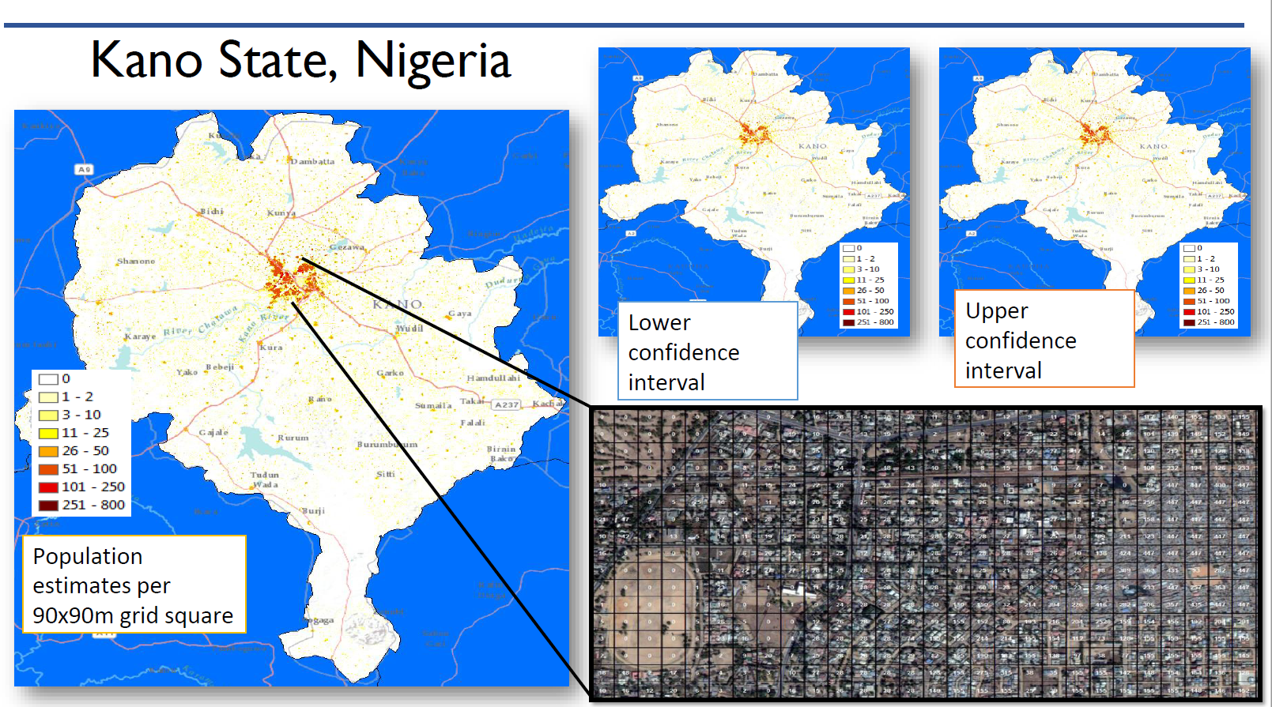

Slide 28
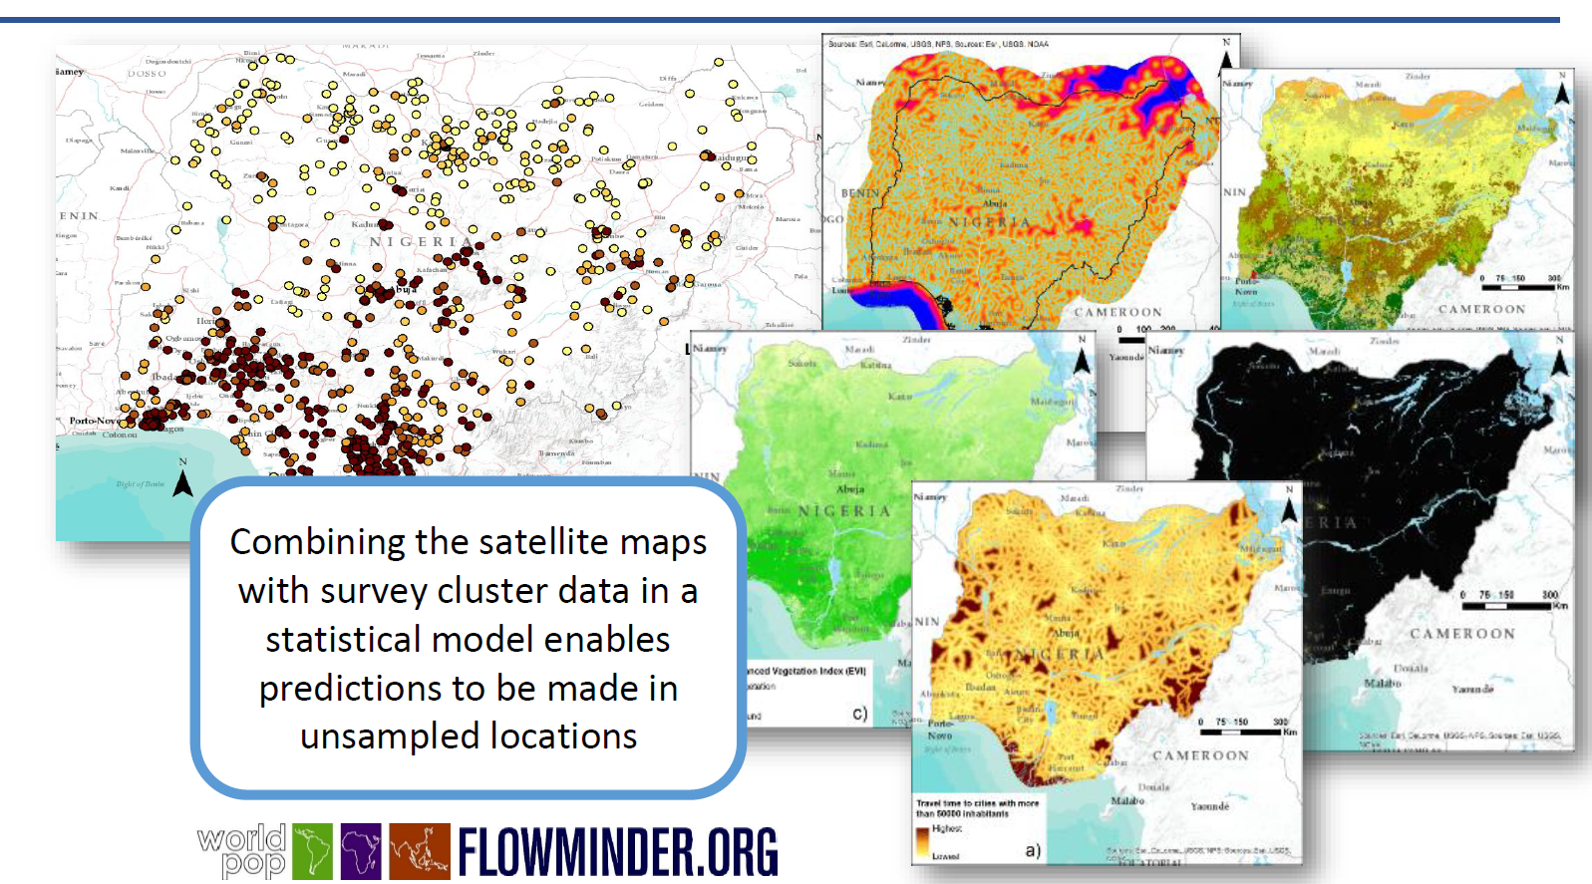

Slide 29
4. GRID³ Project – Partnerships!

Slide 30
4.1. GRID³ is A Global Partnership
Implementing Partners
Coordinating Partner
Funding Partners
Oversight and Decision Making
Technical Implementation, Capacity Strengthening
Management, Networking, Advocacy, Communication

Slide 31
4.2. GRID³ Implementation Structure
Global Advisory Group
Global Level
Funders
National Level
BMGF
UK DFID
National Steering Committee
Coordinating Partner
CIESIN
Implementing Partners
Technical Support Team
Flowminder/
WorldPop
UNFPA
Project Management Team
Sub-committees
Country implementation Teams
GRID National Coordinator

Slide 32
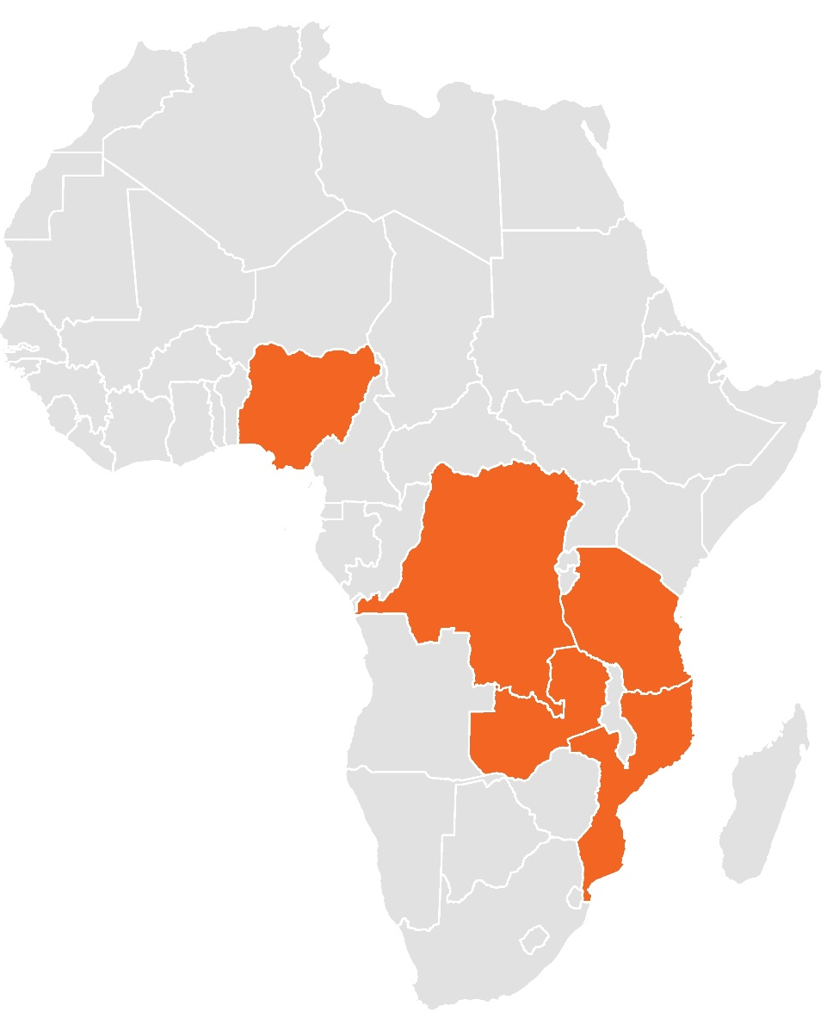
5. GRID³ Current Focus Countries
GRID³ is underway in 3 African countries,
Actively exploring 3 more:
Nigeria
Zambia
Democratic Republic of the Congo
South Sudan
Mozambique
Tanzania
Notes:
Data source: Global Administrative Areas ( 2012). GADM database of Global Administrative Areas, version 2.0. [online] URL: www.gadm.org.

Slide 33
For more information, contact us: info@grid3.org
For project updates and announcements, follow the partners on Twitter or #GRID³
@Flowminder, @WorldPopProject, @PopDevUNFPA, and @CIESIN

Slide 34
UNFPA Population Data Platform

Slide 35
UNFPA Population Data Platform (PDP):
General Description

Slide 36
Outline
Introduction – why dissemination platforms?
PDP Overview
PDP Ecosystem, Building Blocks & Functions
PDP Architecture
User Experience
Expected Functions – Examples
Partnerships
Concluding remarks

Slide 37

1.1. SDGs Agenda 2030 & Agenda 2063
230 Indicators to monitor 17 Goals and 169 Targets of the Sustainable Development Goals (SDGs)

Slide 38
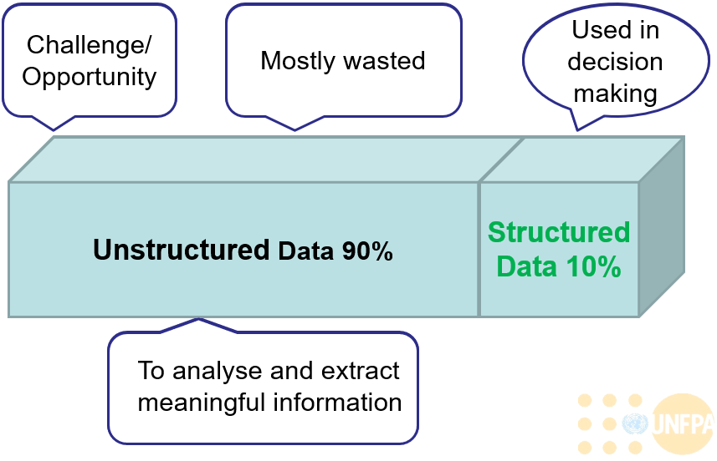
1.2. Explosion of Data

Slide 39
1.3. Availability of, Access to, and Use of Quality Data – Lessons Learned
But…
Little evidence of data and information use
Little focus on the information needs of the very sub-national level
Little access and utilization of credible data for informed decision making at all levels
Little focus on P,M&E
Weak coordination between data producers
There is/are:
Increased availability of plenty of data (in any form, of any quality, or in any frequency)
“Data Led” systems in place producing numerous data sets from various sources of data for development
More focus on M&E
Many data producers

Slide 40
1.4. Data Sources for Development
Agricultural Censuses
Living Standard Measurement Study Surveys
Employment Surveys
Income and Expenditure Surveys (IES)
Civil Registration / Vital Statistics
Health Information System (HIS)
Demographic and Health Surveys (DHS)
Core Welfare Indicator Questionnaire (CWIC)
Multiple Indicator Cluster Surveys (MICS)
Education / School Information Systems
Sentinel Surveillance Systems
Other Routine Service-Based Data
Migration Surveys
Behavioural Surveillance System
Population and Housing Censuses

Slide 41
1.5. Challenges & Opportunities for Quality
Data for Development
Increased demand for quality data at all levels especially in response to accurate and timely information for programme planning, implementation and monitoring and evaluation, including preparedness and response to humanitarian and emergency situations, and as a result of greater accountability for development outcomes;
Time to move the region into a data revolution - Use of new technologies to improve the quality and reduce the cost of the production, availability, dissemination, access and utilization of credible data for informed decision making at all levels.

Slide 42
2. PDP Overview
Capitalizes on increased availability of geo-spatial database
New web-based, integrated, interoperable data platform for access to population, development, SRH, gender and related data for knowledge management, standardized reporting, analysis, applied research and informed decision making
Integrate multiple source data – census microdata, survey, Humanitarian, geospatial, and other ICPD, UNFPA SP, SDG
Reliance on third-party microdata (i.e., cleaned and normalized): e.g., IPUMS; and indicators (e.g., UNESCO, UNPD, WPP, DHS, MICS)
Provide current, verified standard data for all UNFPA, external partners and experts, and general public

Slide 43
3.1. PDP Data Ecosystem
Inputs
Processed data (platform)
Products
Population base layer based on Census
Traditional Data
Census, administrative boundaries/EAs/settlements
Tracking SDG, ICPD, Demographic Dividend, National Development Plans
Integrating population with other geospatial data
Preparedness & Reponse
Programme Outcomes and Outputs
Estimated Population
Development Indicators
CRVS
Other Geospatial Data
Sample surveys (e.g. DHS, MICS)
Research
Non-traditional data
SDG, ICPD, DD Indicators
Humanitarian
Satellite imagery
Humanitarian etc. Indicators
Other Geospatial Data
Strategic Plan
Special programme indicators
Roads, elevation, land use, settlement, hospitals, schools, environment, etc.

Slide 44
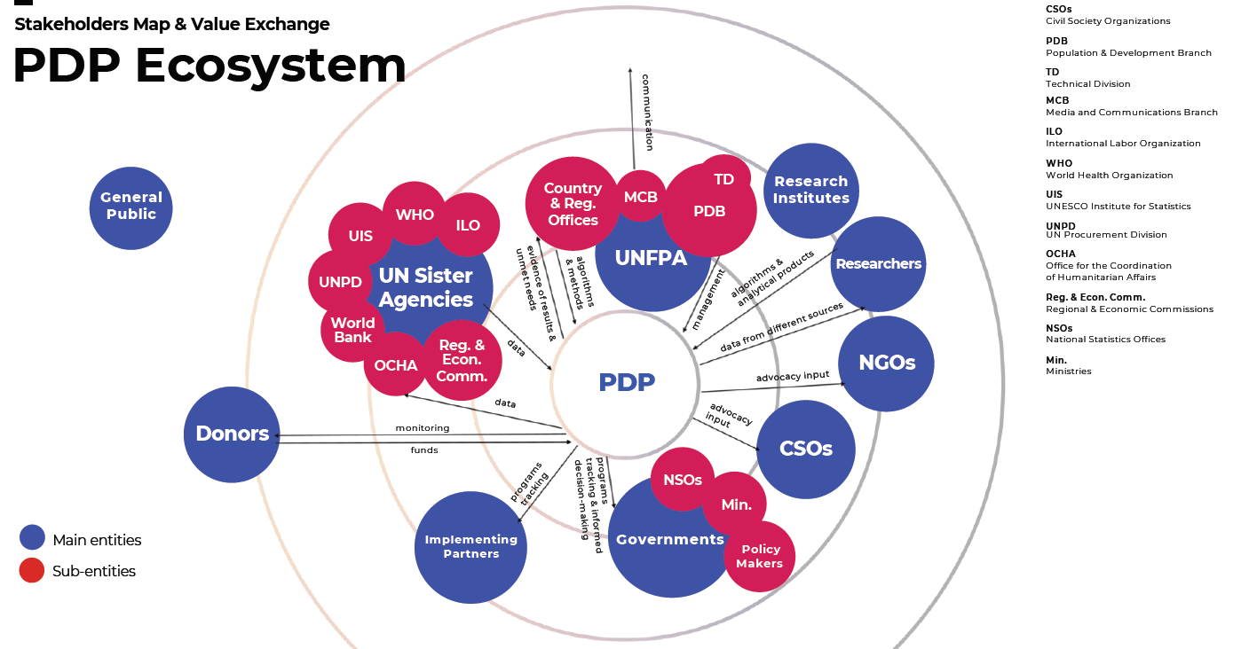

Slide 45
3.2. The Functional Building Blocks of the PDP
Data Sources
GIS Services
Census
Household Surveys
Manage Geospatial Data
Integrate “Value” Data
Analytic Tools/Services
Programmes
Humanitarian
Data Governance and Access Services
UN Partners
Others TBD
Core User Functions
Unified Data Storage and Management
Data Search and Retrieval
Data Acquisition
Microdata
Static and Interactive Maps
Indicator Data
Charting and Visualizations
Other TBD
Templated Outputs/Reports
Use Data
Create Data
Data Processing and Management
Statistical Analysis
Output Products & Services Framework
Demographic Dividend Profiles
Source Data Archiving
Code Repository and
Version Control
DECA
Family Planning Profiles
UNFPA Website Profiles
Manage Archive
“Model” Development Lifecycle
Others TBD

Slide 46
3.3. Geospatial Data for PDP - The Platform
Indicator data
  Indicator data (e.g. based on census, surveys) aggregated to boundaries
  Gridded indicator data
Human settlement
Boundaries
Infrastructure data, e.g. hospital, clinic, road, water system
High resolution population base layers
  Number of population by age and sex at EA level
  Gridded population data by age and sex
Location data, e.g. census with HH-level GPS, survey cluster locations
Other geospatial data
  Topology data, e.g. land use/cover, elevation
  Environmental data, e.g. vegetation index, surface temperature, precipitation
  Risk boundary, e.g. natural disaster exposure areas, conflict zones
Basemaps, e.g. Open Street Map

Slide 47
3.4. Expected Geospatial Functions of a Public Interface
The platform will have a user-friendly public interface, with the abilities to:
Visualize, including overlay various geospatial data (e.g. vector, raster)
Customize the maps (e.g. title, legend, scale bar, north arrow, color categories, transparency)
Adjust the interface (e.g. zoom in/out/ to full extent, pan)
Interactively show correspondent values for selected area
Has a “query” function to target priority areas
Conduct simple pre-designed statistical and geospatial analysis (e.g. statistical summary, buffer, zonal statistics)
Export maps, data and tables

Slide 48
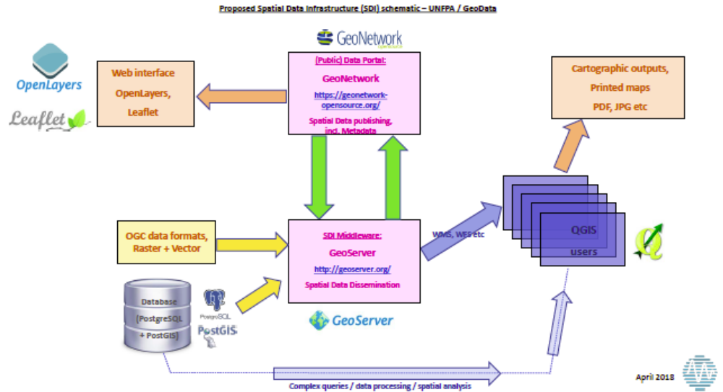
4.1. Building the Architecture – III

Slide 49
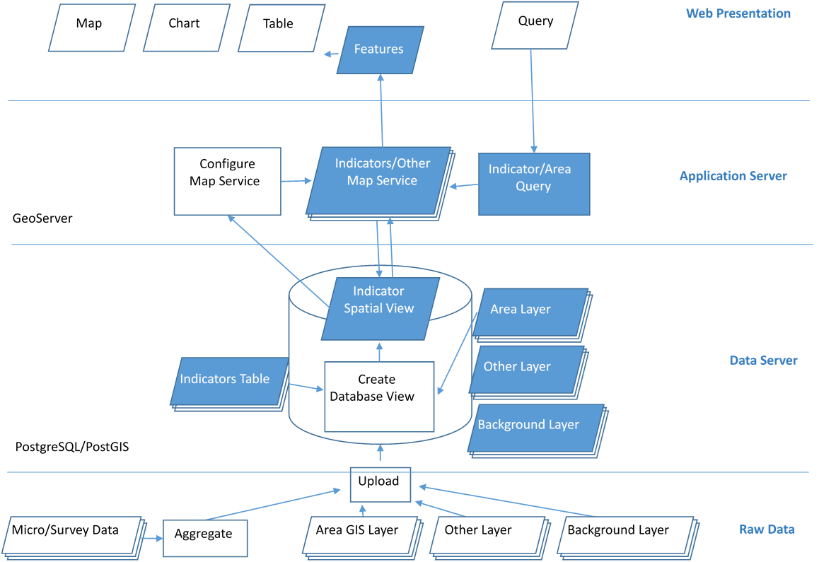
4.2. Building the Architecture – IV

Slide 50
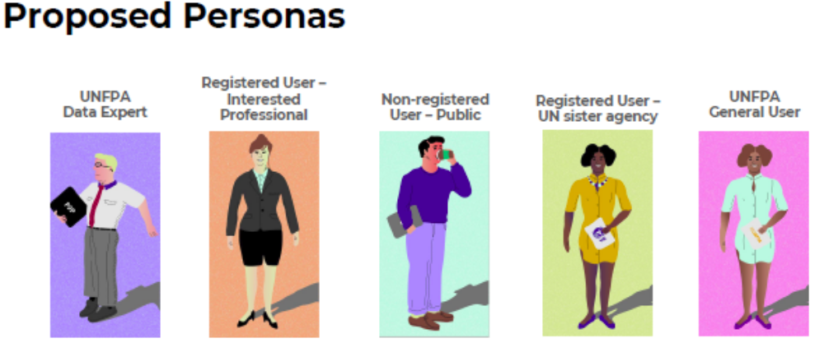
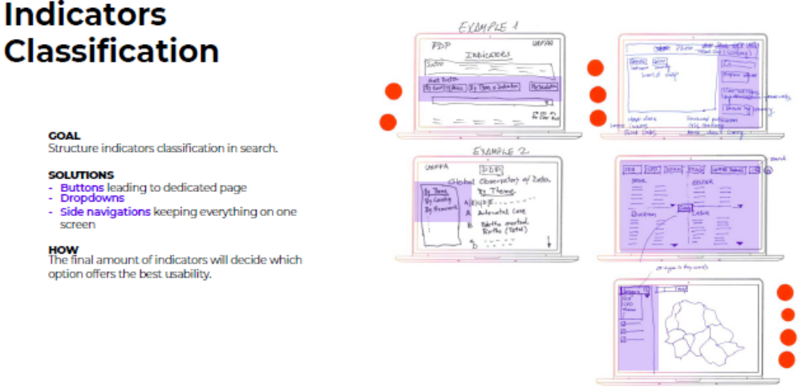
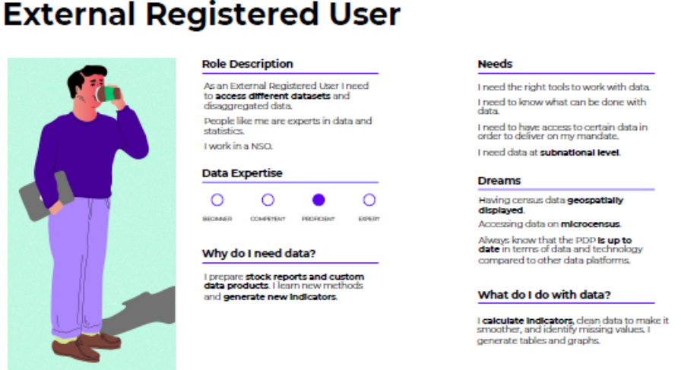
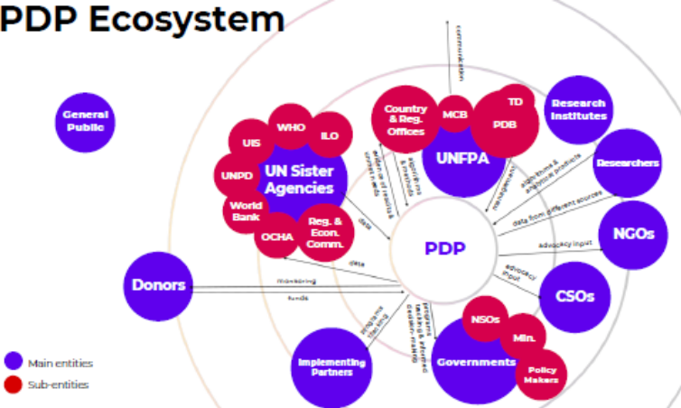
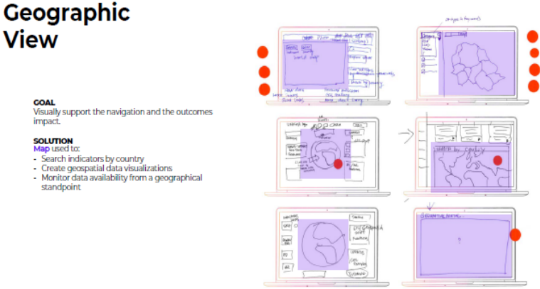
5.1. User Experience workshops – I (Users, Data classification, journeys, landing page)

Slide 51
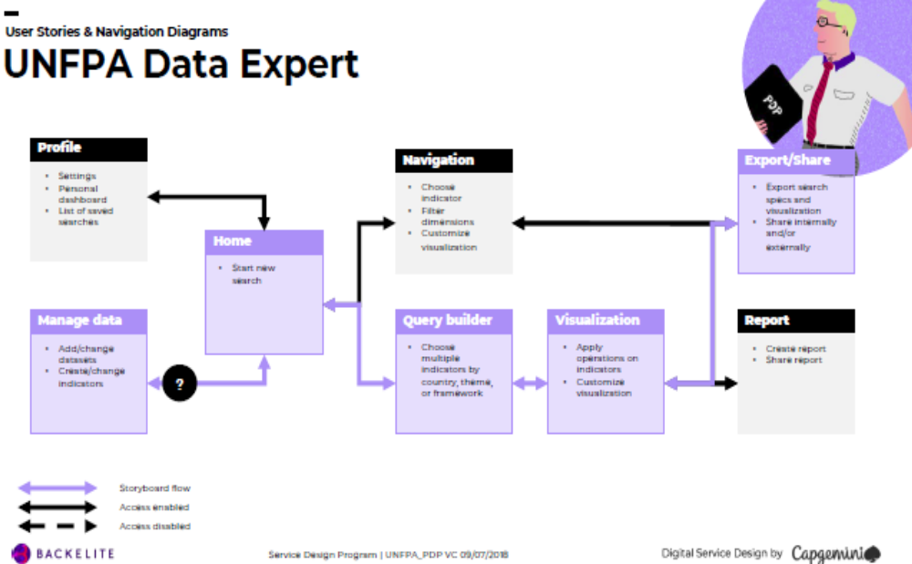
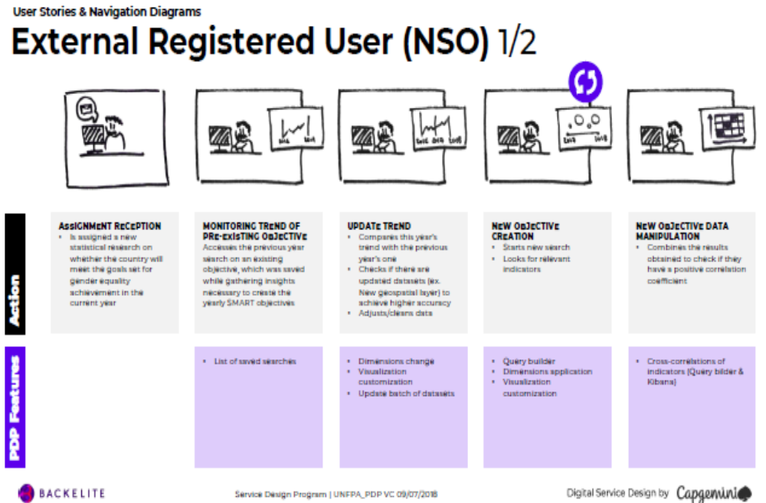
5.2. User Experience workshops – II (Stories & Navigation)

Slide 52
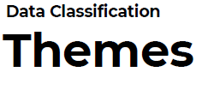
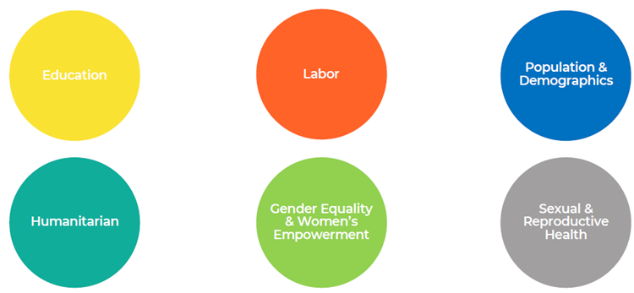
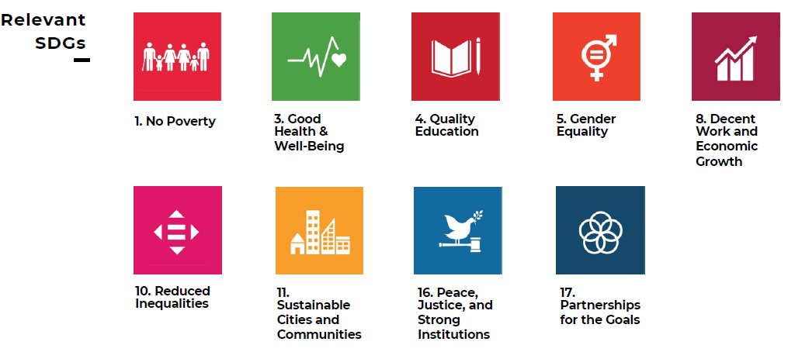
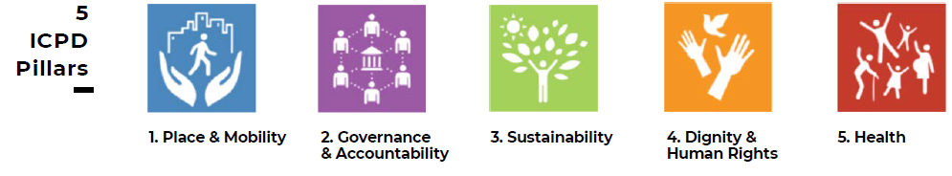
5.3. User Experience Workshops – IV (Data structures)

Slide 53
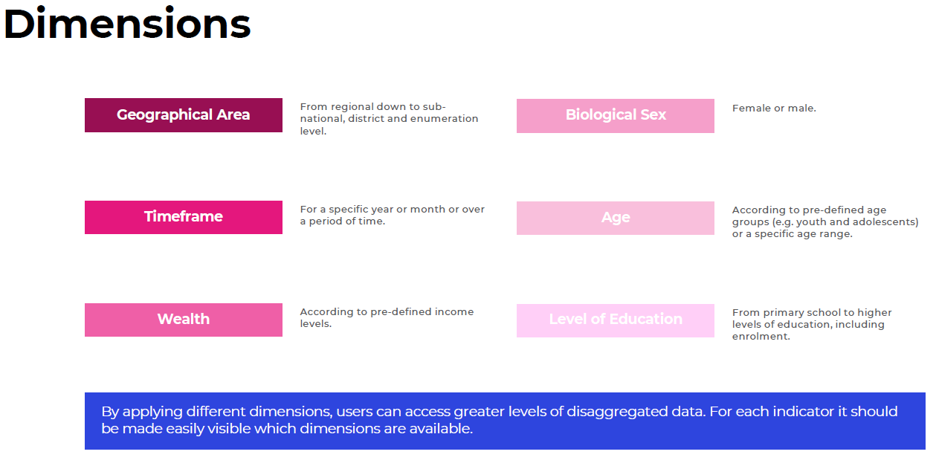
5.4. User Experience Workshops – V (Data dimensions)

Slide 54
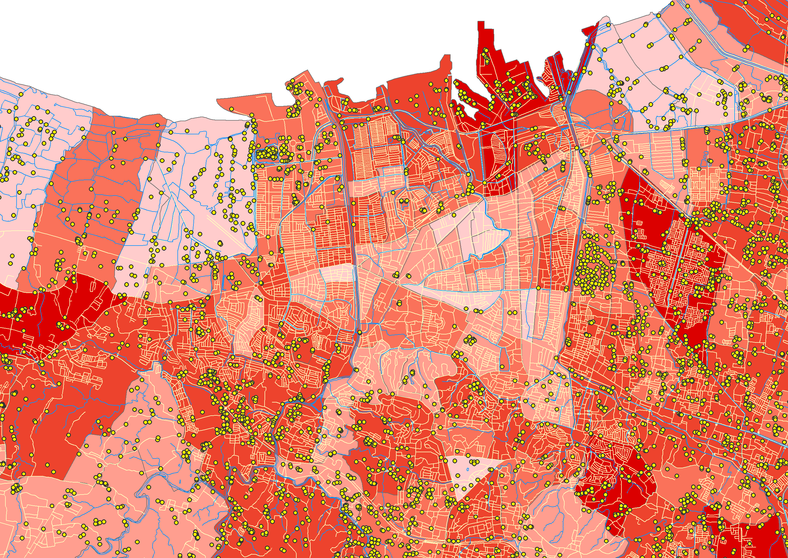
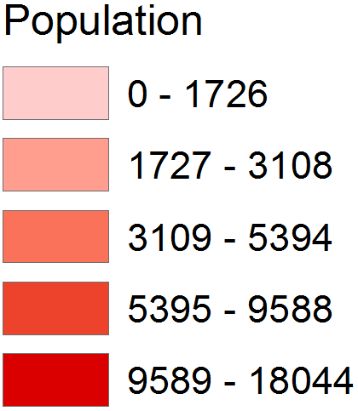
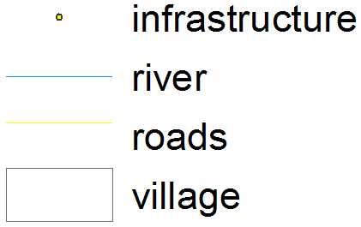
6.1. Example of Expected Functions - I: Overlaying Geospatial Data
Data shown in this map:
- Indicator data
- Boundaries (village)
- Infrastructure (hospitals, schools…)
- Road system, Water system
Source: UNFPA Indonesia country project

Slide 55
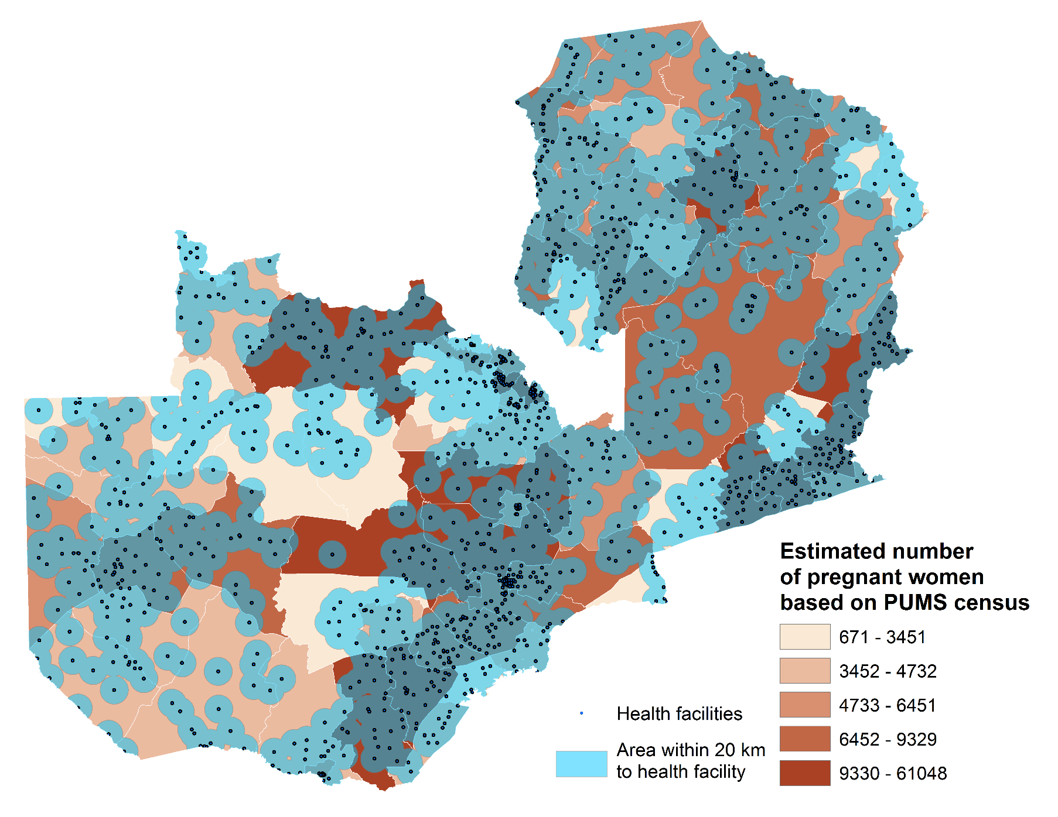
6.2. Example of Expected Functions - II: Analyzing Geospatial Data
Data shown in this map:
- Indicator data (estimated number of pregnant women)
- Administrative boundaries (districts)
- Hospitals
- Areas with 20km to health facilities
Source: UNFPA Zambia country project

Slide 56

7.1. Partnership – IPUMS
Standardization & dissemination data for 85 countries, 301 Censuses
Typical 5% data from Censuses
Use: mostly students (60%) - US; 50% Economic analysis; ~14,000 approved users
Each year: additional 20-25 censuses
Harmonization of maps with census coding.
Future: more censuses from round 2020; also, labor force surveys; aggregate climate, agricultural information into Raster format
Partnership with UNFPA: expand users, diversify funding; partnership on data acquisition & utilization

Slide 57
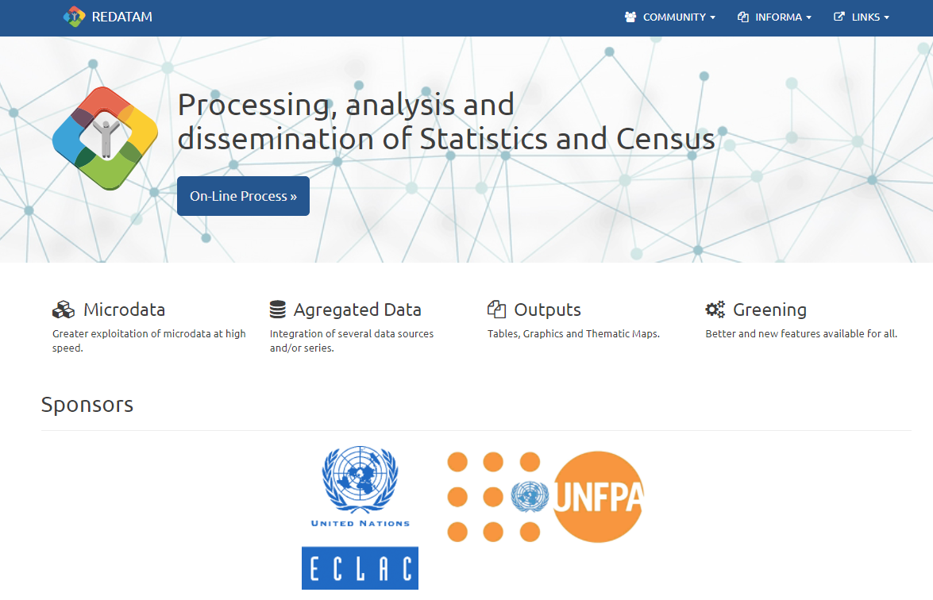
7.2. Partnership – REDATAM / IMIS
Solution from past 30 years for data input and primary analysis, indicator production and reporting; widespread in LAC & some countries in Africa and Asia
Each microdata stored in customized database (issues of comparability, harmonization across dates within countries, countries, regions?)
Limited GIS capabilities but linkage possibilities
“Redatam 7”: improve processing engine, “centralize” services, add more web interfaces and functionalities, charting, GIS
Potential approach: main source for micro census data and service for country census data dissemination

Slide 58
7.2.1. What REDATAM Can Do with Any Dataset
Country
County
District
Agricultural Segment
Area
Etc.
REtrieval of DATa for Small Areas by Microcomputer (REDATAM)
REDATAM helps you handle
large volumes of microdata in a hierarchical structure…
…making it easy
to process data for
specific geographical units.
Maximum disaggregation
No need to process the whole database

Slide 59


7.2.2. What You Can Do with REDATAM…
PROCESS
ANALYZE
TABULATE
MAP
DISSEMINATE

Slide 60

7.2.3. REDATAM WebServer
Online processing
Easy and friendly interface
No programming skills required
Customized parameters
Predefined indicators for quick results
Graph and Theme mapping
Multipurpose: census, survey etc.
Data remains safe and confidential

Slide 61
7.3. Partnership – National Statistical Offices
Country able to analyze and disseminate census and survey results to the public in a secure, accurate matter
Country specific website
Willingness to share microdata – legal, political and cultural
  Country Has Laws/Policies Restricting Sharing Microdata?
  Level of Aggregation/Processing Required to Share Microdata outside of country borders (if applicable)
  Country Willingness to Share Microdata with ECLAC and/or UNFPA
  NSO Internet Access Availability & Quality
  Census Data Collection Mechanism
  Census Data Consolidation Mechanism
  Historic REDATAM/IMIS User?
  REDATAM Already Planned for Next Census?
  If historic REDATAM/IMIS User, last census year used
  If NOT historic REDATAM/IMIS User, Software Used for Tabulation, Indicator generation, dissemination
  If NOT historic REDATAM/IMIS User, REDATAM Candidate?
  NSO willing to share what other survey/vital statistics microdata?

Slide 62
8.1. Core functionalities
Data search and retrieval (supporting multiple modes, e.g., HTML, XML (SDMX standards), JSON, CSV/Excel downloadable)
Interactive visualization
Report generation
Model construction, estimation, evaluation (retrospectively and prospectively; e.g., linking datasets, generating estimates)
App destinations
Geospatial mapping and analysis

Slide 63
8.2. Core geospatial functionalities
Provide online and/or offline analytic tools/software for contributor users
  - for generation of UNFPA geodatabase, e.g. base population data, core indicator data, other geospatial data
  - for analysis and utilization of geodatabase, e.g. mapping hotspots or core indicators, integrating population and health facility data and other geo-spatial data
Provide an online “geospatial repository” to disseminate geospatial data and analytical results
  - Disseminate geodatabase, medadata, methodology
  - A simple online interface to visualization geospatial data and analytical results
Provide the capability to create specialized interactive mapping "apps“, e.g. cell phone apps

Slide 64
8.3. Ideal scenarios for PDP
Data capture would use some standard and uniform code (e.g., IPUMS)
Other platforms collecting Census /survey microdata (e.g., REDATAM/IMIS) would be able to transfer them to uniform codes -> new data cleaned and harmonized
Countries would allow full use of Census data to UNFPA (MoU), transfer/convert them using such uniform codes
PDP uses this process as source of harmonized Census and Survey microdata
PDP creates different types of users (registration) and access to data (full, sample), plus analytical capabilities
PDP data, as much as possible, is standard and interoperable, allowing & facilitating ample cross country/regional comparisons, including combination of survey - census data with geocodes for small area estimation (SAE).

Slide 65
THANK YOU
QUESTIONS AND COMMENTS

