Slide 1

The 4th UN-GGIM: Africa meeting
1-4 October. 2018, in AA, Ethiopia
JEMAL ALI BESHIR
3C PLC
Geospatial Product & Service Provider
OFFICE LOCATIONS
ADDIS ABABA, Meskel Square, Lion Building, 6th F, H No. 6B, Kirkos Sub-city Kebele 20
  :+251 11 552 11433, :+251 911 210472, Fax: +251 11 552 1434
E-mail: JemalAliBeshir@gmail.com

Slide 2
BIRD'S-EYE VIEW OF
AFRICAN LOCAL GEOSPATIAL PRIVATE SECTOR CHALLENGES & OPPORTUNITIES
Presentation Content:
  1. Introducing 3C PLC
  2. Pros & Cons of African Local Geospatial Private Sector
My Definition: ALGPS = Geospatial private companies owned by Africans & working in Africa
Notes:
BIRD'S-EYE VIEW OF AFRICAN LOCAL GEOSPATIAL PRIVATE SECTOR CHALLENGE
Presentation Content:
1. Introducing 3C PLC
2. Pros & Cons of African Local Geospatial Private Sector
My Definition: AFRICAN LOCAL GEOSPATIAL PRIVATE SECTOR (ALGPS) = Geospatial private companies owned by Africans and working in Africa
Draft Abstract
It is inevitable that ALGPS have or will have enormous prospects and advantages in the New Emerging Africa. But the question needs to be address is, do ALGPS really have got the chance to catch the prospects and grow their companies, countries and Africa in large?
Participation and involvement of ALGPS in the government, Regional/International organizations and donors geospatial programs is very crucial to successfully turn Geospatial Information Technology into a real Sustainable Development Enabler in Africa. However, the ALGPS have facing many challenges hindering their growth and active participation in the geospatial industry and activities in Africa.
Since 3C PLC is one of the ALGPS actively working for about 20 Years in the geospatial industry, we would like to share our birds'-eye view of the challenges we facing or observed for discussion and also discus on other ALGPS challenges and recommend the UN-GGIM:Africa to conduct professional studies in member states and outline the way forward in solving our CONS.
THANK YOU FOR THE OPPORTUNITY! and apologize for my late request..
Jemal Ali Beshir /Manager
Corporate Computer Center (3C) PLC
Meskel Square, Lion Building, 6th Floor, House No. 6B,
Kirkos Sub-city Kebele 20, Addis Ababa, Ethiopia
Tel: +251 11 552 11433, Fax: +251 11 552 1434
Mobile No: +251 911 210472
E-mail: Jemalalibeshir@gmail.com or 3cbdr@ethionet.et

Slide 3
INTRODUCING 3C PLC
Established in 1998
Leading provider of geospatial products & services in Ethiopia
Realize the ideal combination of HW, SW & Prol. skills to meet client requirements
Takes a lion market share in Ethiopia & has progressed to emerge as one of the most trusted names in the market.

Slide 4
VISION, MISSION & VALUES
VISION:
  To have a leading presence in the geospatial market & establish proper, effective & efficient utilization of GP&S in all sectors of the economy to the benefit of decision-makers, professionals & citizens at large.

Slide 5
VISION, MISSION & VALUES (Cond.)
MISSION:
  To provide quality, most usable & reliable GP&S on the latest technologies.
  Promote /establish effective & efficient use of GP&S by using a variety of methodologies customized to the needs of the client.
  To earn long term loyalty of our stakeholders, customers and employees through continued satisfaction.
  To grow our business in a sustainable way and actively contributes to fast economic development in Ethiopia and Africa at large.

Slide 6
VISION, MISSION & VALUES (Cond.)
VALUES:
  We value trust/respect each other & work together as a team
  We value innovation and discovery
  We are committed to achieving outstanding results.

Slide 7

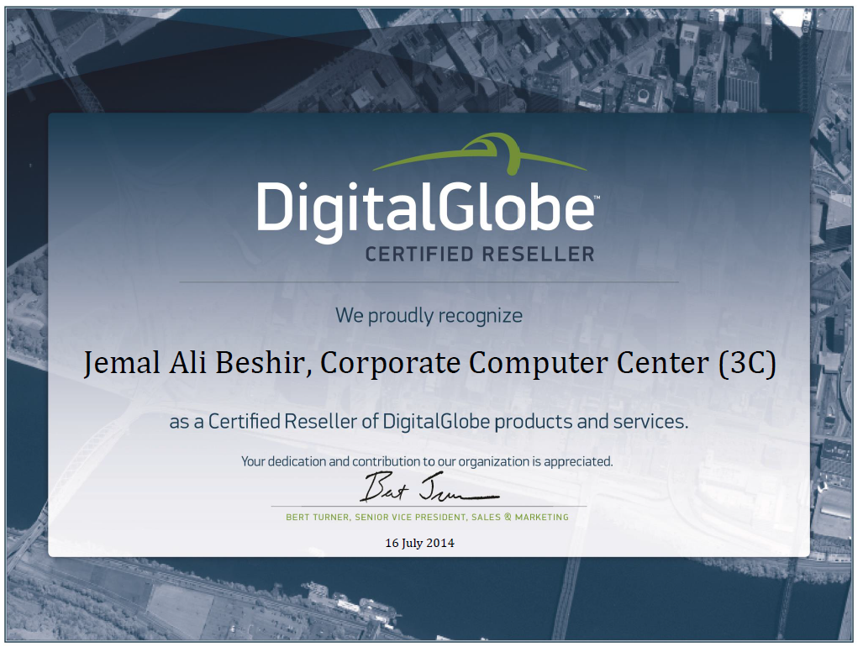
INTERNATIONAL BUSINESS PARTNERS
An Authorized Certified DigitalGlobe Reseller
http://www.digitalglobe.com/partners/global-resellers#country-ethiopia

Slide 8


INTERNATIONAL BUSINESS PARTNERS
An Authorized Reseller of Trimble Geospatial and Surveying product and services
http://dealerlocator.trimble.com/locator.aspx

Slide 9







INTERNATIONAL BUSINESS PARTNERS
An authorized distributor for Vexcel Imaging
http://www.microsoft.com/ultracam/en-us/Partners.aspx

Slide 10


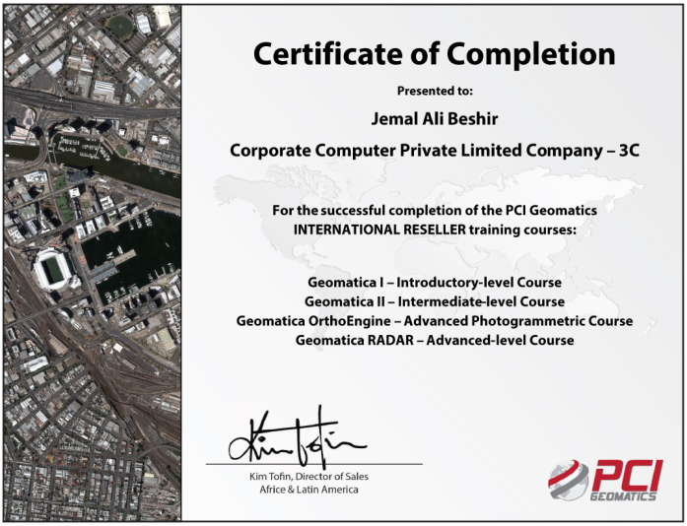
INTERNATIONAL BUSINESS PARTNERS
An Authorized Reseller of PCI Geomatics Enterprises Inc. product for Ethiopia.
http://www.pcigeomatics.com

Slide 11
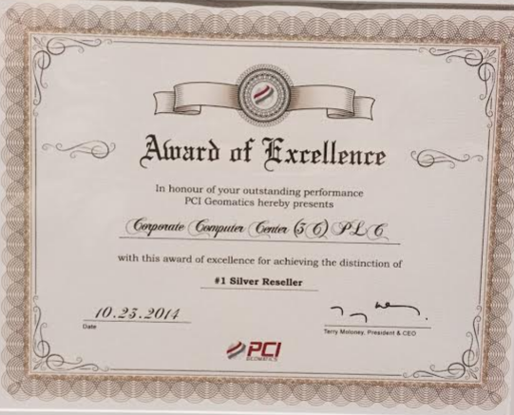
INTERNATIONAL BUSINESS PARTNERS
An Authorized Reseller of PCI Geomatics Enterprises Inc. product for Ethiopia.
http://www.pcigeomatics.com

Slide 12


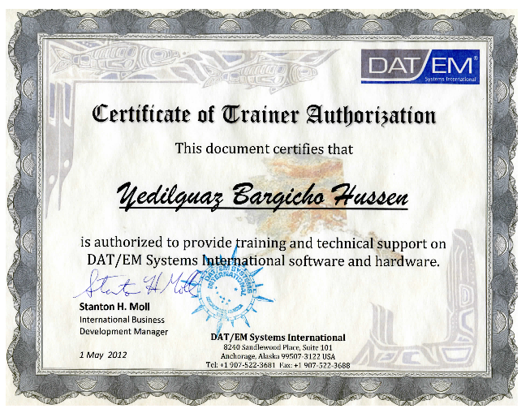
INTERNATIONAL BUSINESS PARTNERS
An authorized distributor for
DAT/EM Systems International
DAT/EM is one of the world robust photogrammetric software
& hardware provider.
www.datem.com

Slide 13

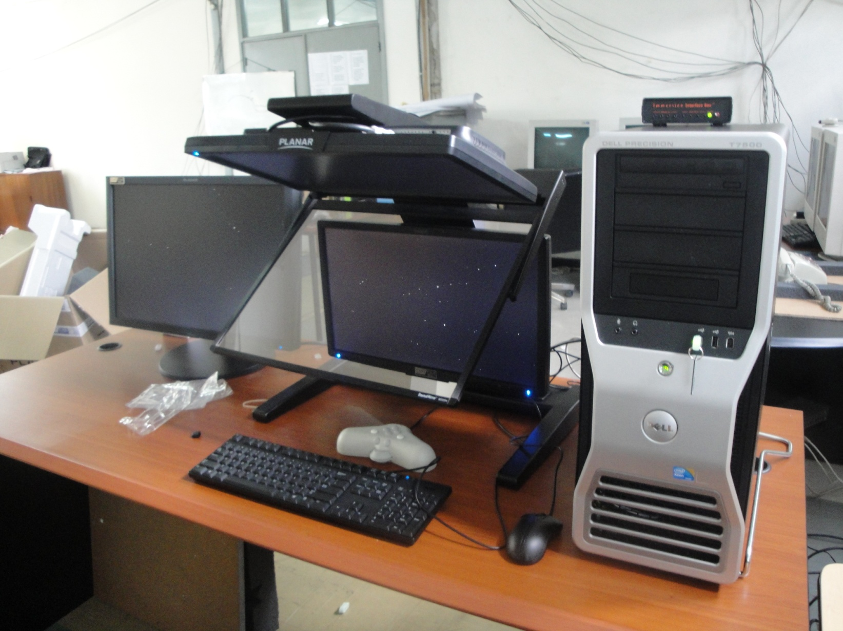
INTERNATIONAL BUSINESS PARTNERS
Dell Side
Monitor
Planar ‘SD2220’
3D Mouse
DIGITAL PHOTOGRAMMETRY SYSTEM
Dell Precision
T7400
An authorized DELL Reseller in Ethiopia.
http://www1.euro.dell.com/content/topics/topic.aspx/emea/contact/edb/ethiopia?c=ed&l=en&s=bsd

Slide 14
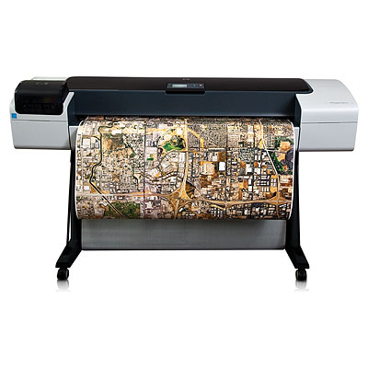
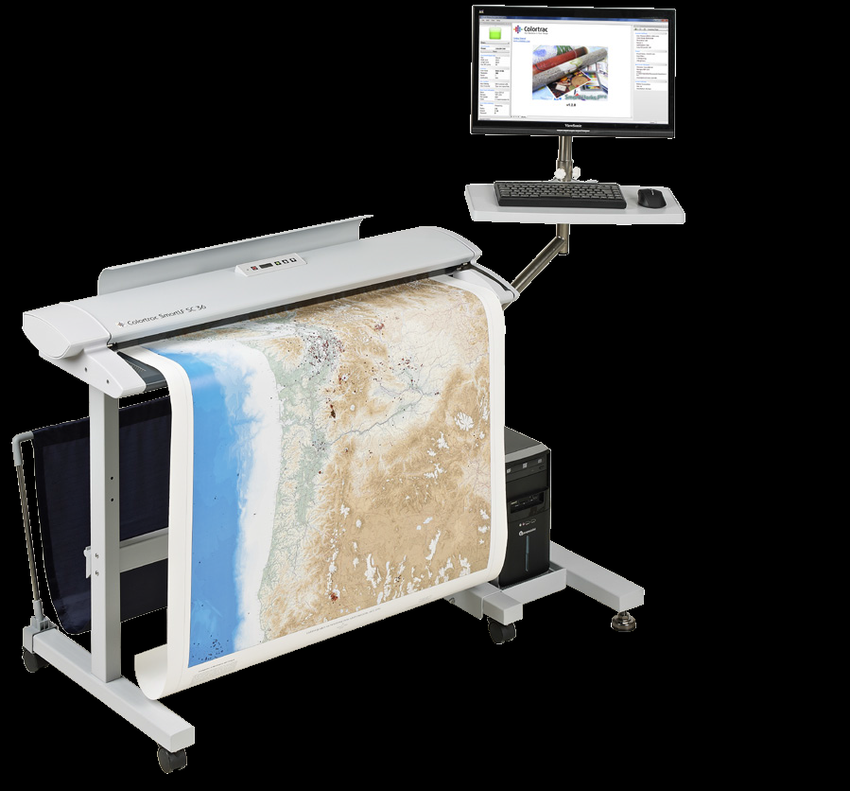
INTERNATIONAL BUSINESS PARTNERS
DIGITAL PHOTOGRAMMETRY SYSTEM

Slide 15
MAINSTREAM OF OUR POTENTIAL & PROVISIONS
GEOSPATIAL PRODUCT :
HR SATELLITE IMAGERY
GEOSPATIAL & SURVEYING PRODUCT & SERVICES
PHOTOGRAMMETRIC SOFTWARE & HARDWARE
DIGITAL AERIAL CAMERA SYSTEMS
GEOSPATIAL SERVICES :
SATELLITE & AERIAL IMAGERY ACQUISITION
DIGITAL PHOTOGRAMMETRY
GEOSPATIAL CONSULTANCY
GEOSPATIAL TRAINING
Notes:
MAINSTREAM OF OUR POTENTIAL & PROVISIONS:--  GEOSPATIAL PRODUCT • SATELLITE IMAGERY • PHOTOGRAMMETRIC SOFTWARE & HARDWARE • ULTRACAM DIGITAL AERIAL CAMERA SYSTEMS  GEOSPATIAL SERVICES • DIGITAL AERIAL ACQUISITION • DIGITAL PHOTOGRAMMETRY • GEOSPATIAL CONSULTANCY • GEOSPATIAL TRAINING

Slide 16
WORK EXPERIANCE
Successful contract Detail.pdf
  Major Awards/ contracts and successfully accomplished by 3C PLC & 3C PLC together with its International partners.
Company Profile 3C PLC.pdf
  3C PLC Company Profile

Slide 17
Pros & Cons of African Local Geospatial Private Sector
Institutional & Legal Challenges
  Government Monopoly on Geospatial Information Production
  un-ggim_-_geospatial_information_for_sustainable_development_in_africa-Page 24
No - Govt. Incentive for the Geospatial Sector
Geospatial products & Services Abuse
Bid Regulations
  Technical Specifications & TOR
  Least bidder policy
  Evaluation time
  Bid cancelation & Re-bid
  Expected Bid bonds
  etc
Lack of Budget Allocation for Support & Update
Internet Connectivity & Speed
etc

Slide 18
RECOMMENDATION
UN-GGIM:Africa to conduct professional studies in member states and outline the way forward in solving our CONS.

Slide 19
THANK YOU
FOR THE OPPORTUNITY!
Jemal Ali Beshir /Manager
Mobile No: +251 911 210472
E-mail: Jemalalibeshir@gmail.com

