Slide 1

UN-GGIM:Africa –
Report on Invitations
United Nations Economic Commission for Africa
___________________
UN-GGIM: Africa
___________________
Andre Nonguierma
UN-GGIM:Africa 2018
Addis Ababa, Ethiopia
03 October 2018

Slide 2
Report on Invitations….
2018
Member States Attendance
Algeria, Botswana, Burkina Faso, Cameroon, Côte d'Ivoire, Ethiopia, eSwatini, Kenya, Madagascar, Mali, Niger, Nigeria, Senegal, South Africa, South Sudan, Togo, Uganda
Thu 23/08/2018 12:11
Individual Invitations
30 Countries
10 Non-Government Entities
10 Partners
Presences
17 Countries
9 Non-Government Entities
5 Partners
Wed 08/08/2018 18:07
Announcement
Message sent via e-mail include:
Announcement Letter
Concept Note
Work Programme
Responses
Uganda [Comments on Work Programme]
Niger
South Sudan
Thu 19/07/2018 16:00
Executive Board
Message Sent via E-mail include:
Concept Note
Work Programme
Annotaed Agenda
Responses
Cameroon

Slide 3
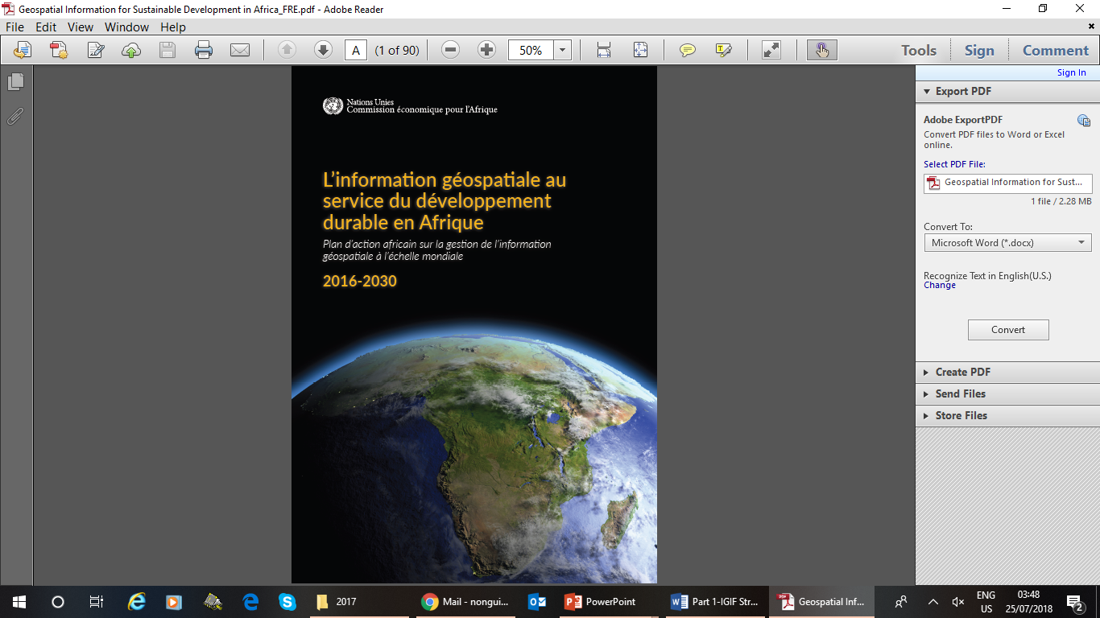
Thank You [www.un-ggim-Africa.org]
UN-GGIM:Africa Action Plan :
English : www.uneca.org/sites/default/files/PublicationFiles/un-ggim_-_geospatial_information_for_sustainable_development_in_africa-20171115.pdf
French : www.uneca.org/sites/default/files/PublicationFiles/geospatial_information_for_sustainable_development_in_africa_fre-20171115.pdf

