Slide 1


Integration of Geospatial and Statistical Information
The African Spatial Statistical Framework
Sultan Mohammed Alya
___________________
UN-GGIM: Africa
___________________
StatCom-Africa 2018
Integration of Statistics and Geospatial
04 October 2018 – Addis Abeba, Ethiopia

Slide 2
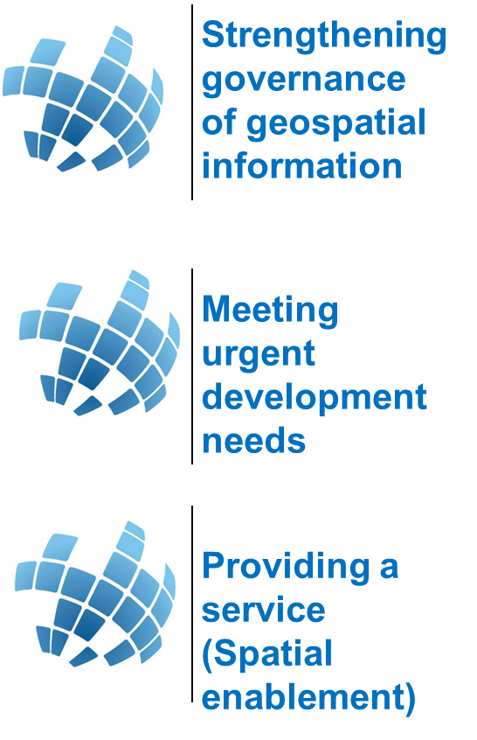
Outlines – Spatially-Enabled Statistics
A right decision making requires the gathering and reviewing of up-to-date, and accurate data.
For the data to be interpreted, understood, and linked to our goals and to our decisions, it needs to be linked with the one thing they have in common: Location (Where?)
Overview
Everything that happens, happens somewhere over space and time
Most decisions need to be anchored to geography
Where is “it”?
How far is A from B?
What is the extent/territory of some phenomenon?
How do I get from A to B?
What areas are suitable for certain activities?
Purpose
Expanding the locational management of information" refers to the idea of integrating spatial information with other data products to enable decision makers and general users to exploit the locational attributes for better targeting of interventions and more efficient service delivery.
This will require leadership, combined collaborative global leadership, with appropriate frameworks and methods and close collaboration between national statistical and geospatial and earth observation communities to deliver seamless data for national to regional to global objectives and aspirations.
Issues and Challenges
Availability
Finding the appropriate information at the required time and at the relevant scale of aggregation.
Accessibility
Even where information is available, it may not be easily accessible, either because of the lack of technology for effective access or because of associated costs
Transformability
There is a general lack of infrastructure capacities for the collection and assessment of data, for their transformation into useful information and for their dissemination.
Governance
There is also need for improved coordination among environmental, demographic, social and developmental data information, applications and services.
Integration Dimensions
Scale : The scope of the geographic space in which the integration is due to take place.
Policy : The policy dimension necessary at all levels on the Scale axis to initiate and harmonize the strategies and related regulations in order to smoothly achieve full integration
Institutional : The institutional arrangements necessary to achieve real integration, in accordance with the orientation of the two compatible policies.
Modelling : The component of the integration process dealing with the technical, technological, scientific abstraction and their related functional and procedural interactions : ) GSGF
Way Forward
..
Policy : Institutional mechanisms aligned with national efforts, while taking into account international perspectives
Data democracy : Ubiquitous availability of relevant spatial data/information as common goods. Adhering to agreed standards : metadata, data models, encoding, interoperability
People : High Level Education to empower African youth in geospatial science and technology culture at all education levels (schools, universities)

Slide 3
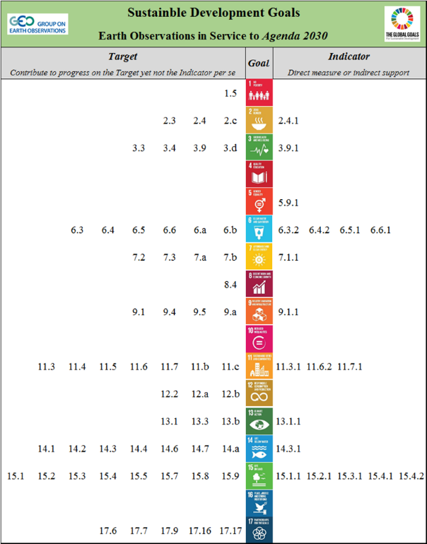


Why We Need Geospatial Information for Sustainable Development (GI4SD)
Targets and Indicators that Geospatial can contribute to (directly or indirectly)
Alignments of the Goals with specific types of geospatial information
Sample indices related to Earth Observations.
More indicators are under discussion.

Slide 4
Assessment of the Status of Mainstreaming Geospatial into Statistical Processes in Africa
The question is no longer about the ingestion of geospatial technology, but what are some of challenges and commonalities in Africa.
Adoption and sound application of GIS, Remote Sensing and other geospatial solutions, tools and techniques (including standard and interoperability) in the creation, analysis and presentation of statistical data.
GPS
Degree of ingestion
GIS
Enable tabulations and spatial aggregations to be referenced to any small geographic or administrative subdivisions and, if possible, population grids.
Fundamental role in the creation of Enumeration Area (EA) maps for a seamless collection of census data
Satellite
Imagery
For most census applications, 5m or better spatial resolution is needed to identify housing units.
Aerial
Photograph
Seamless mosaic coverage of very large part of a territory that can be used for census cartography and other analytical processes.
Time

Slide 5


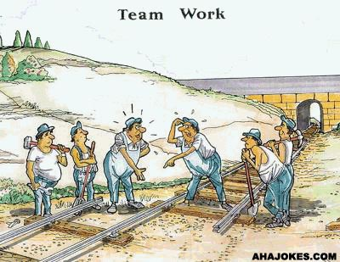


Nexus Issues in Linking Geography and Statistics
Lack of suitable base maps in scale and currency
Lack of coordination: there is no linkages between the statistical systems and the geospatial systems and infrastructures
Duplication of Effort: the statistical offices create their own data on administrative boundaries and topographic maps
Counting and Locating
Counting in Real Time
Cooperation
institutional arrangements for operationalizing an integrated and coherent approach with other information infrastructures
Leadership
Leadership: Establishment of effective national leadership
Resources
Mobilization of resources needed to effectively produce development information
Capabilities
Member States capabilities to ensure geospatial data, products and services are readily available

Slide 6
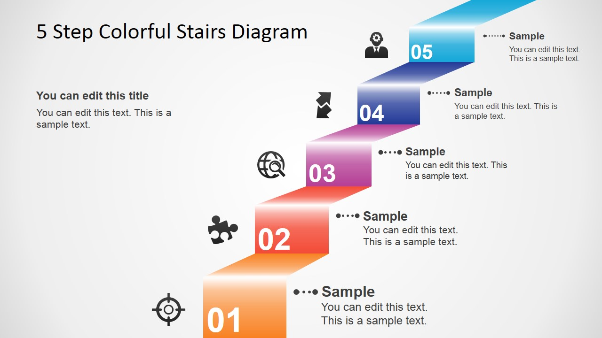
The African Statistical Spatial Framework: Overarching Principles (From the GSGF)
Integration of Statistical and Geospatial Information : Overarching Principles
Mainstreaming the enabling capabilities of geospatial technology into National Statistics Offices activities (all the way through training, data and processes)
Linking NSDs and NSDI: National statistical, planning and geospatial authorities have effective collaboration between them in the development of respective data infrastructures
Support the publication, access, analysis and visualization of geospatial information
The user can easily draw conclusions and make full use of the data available for local action
Principlee 5: Accessible and usable geospatial statistics - Analyse
Overcoming structural, syntactic and semantic barriers between statistical and geospatial data and metadata
ISO Standards - OGC Standards - Statistics Principles
Principle 4: Statistical and Geospatial Interoperability
Standards techniques
Make use of authoritative geographies to disseminate all statistical results
Principle 3: Common geographies for the dissemination of statistics
(Geographic Areas)
Establish persistent storage of geocoded statistical microdata in a relational database management system
Principle 2: Geocoded unit record data in a data management environment
Unique identifiers
Assign each statistical unit precise and unambiguous location information from authoritative, relevant and nationally agreed basic data sources
Principle 1: Policies - More institutional
Political leadership and support
(NSDI, integration)

Slide 7

The African Statistical Spatial Framework : Dimensions
A successful integration of geospatial information and Statistical Information requires to look at the following dimensions: (1) Scale; (2) Policy; (3) Institutional; (4) Modelling.
  Scale: The scope of the geographic space in which the integration is due to take place.
  Policy: The policy dimension necessary at all levels on the Scale axis to initiate and harmonize the strategies and related regulations in order to smoothly achieve full integration
  Institutional: The institutional arrangements necessary to achieve real integration, in accordance with the orientation of the two compatible policies [Custodianship Principles].
  Modelling: The component of the integration process dealing with the technical, technological, scientific abstraction and their related functional and procedural interactions
Institutional
Policy
Modelling
Scale

Slide 8
The African Statistical Spatial Framework: Strategic Objectives
The integration process will be based on the following strategic objectives (SO) and expected results (R)
SO.5
Knowledge Management
Spatially-Enabled Statistical applications, standards, methods and tools development
SO.4
Effective implementation
Knowledge generation and dissemination
Capacity and skills development
SO.3
Linkages with Global Frameworks
Mainstreaming of NSSFs into Africa’s agenda
Synergies and coordination are enhanced, and resources mobilized
SO.2
Advocacy for Policy Level Engagement
Adoption at National Level
Appropriation by the RECs
SO.1
Design of Both ASSF and NSSFs
Validated by the African geospatial and statistical communities

Slide 9
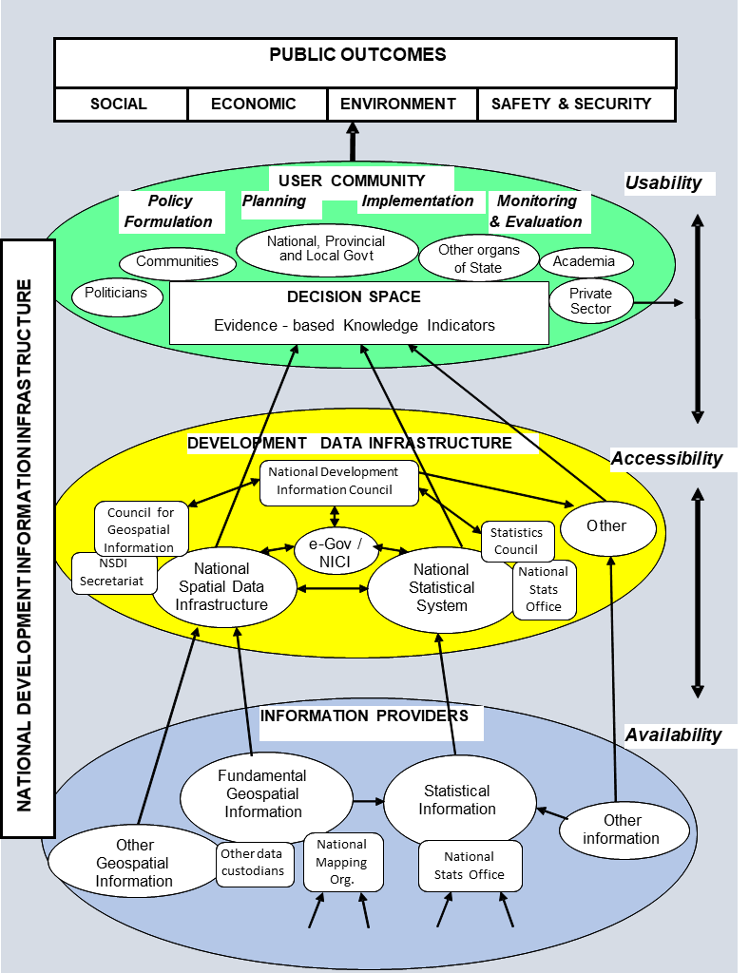
Next Step: From Global to Local - Downscaling into NSSF
The strategy includes a deconvolution mechanism to downscale the framework at national level
Member States can adopt, adapt and apply their own National Statistical Spatial Framework (NSSF)
Building the National Development Information Infrastructure (NDII)
  The foundational, authoritative and up-to-date spatially-enabled statistical information that are consistently available and accessible over time for informed decision-making at the local, national, regional, and global levels.

Slide 10





Next Step: Leveraging the Spatially-enabled Statistics Dimensions
Leveraging the enabling capabilities of geospatial information technologies in statistical data collection, processing, analysis and dissemination. While ensuring that spatial information infrastructures are harmonized with national statistical development strategies.
Policy and Governance
Data, Common Tools
Geo-enabling NSDS
[Before NSDS, NSDI was]
Ensuring effective collaboration between statistical and geospatial community
Building on Basic Data Themes
Use of common specifications and standards
Partnership
Capacities
Ensuring linkages and cooperation with various initiatives
Making geospatial analysis a core competency in any Census Office

Slide 11
Next Steps: Implementing Quick Wins
SALB Project:
  Building, updating and sharing common administrative boundaries.
GeoNyms Project:
  Standard web-based application to record and edit geographic names in a harmonized manner.
2020 Round of Censuses:
  Fostering geospatially-enabled censuses.
  Building geo-referenced dwelling frames
Sample
survey data
Census data
Statistical-Geospatial Integration
Admin. Registers
People
Businesses
Primary statistical registers
Geo-coding
Statistical Indicators
Maps
Geo-Visualizations
Common
geographies
Location
Standard
classifications
Fundamental
Geospatial Themes
EO
Other sources of data
Adapted from G. Luis Morales 2018

Slide 12
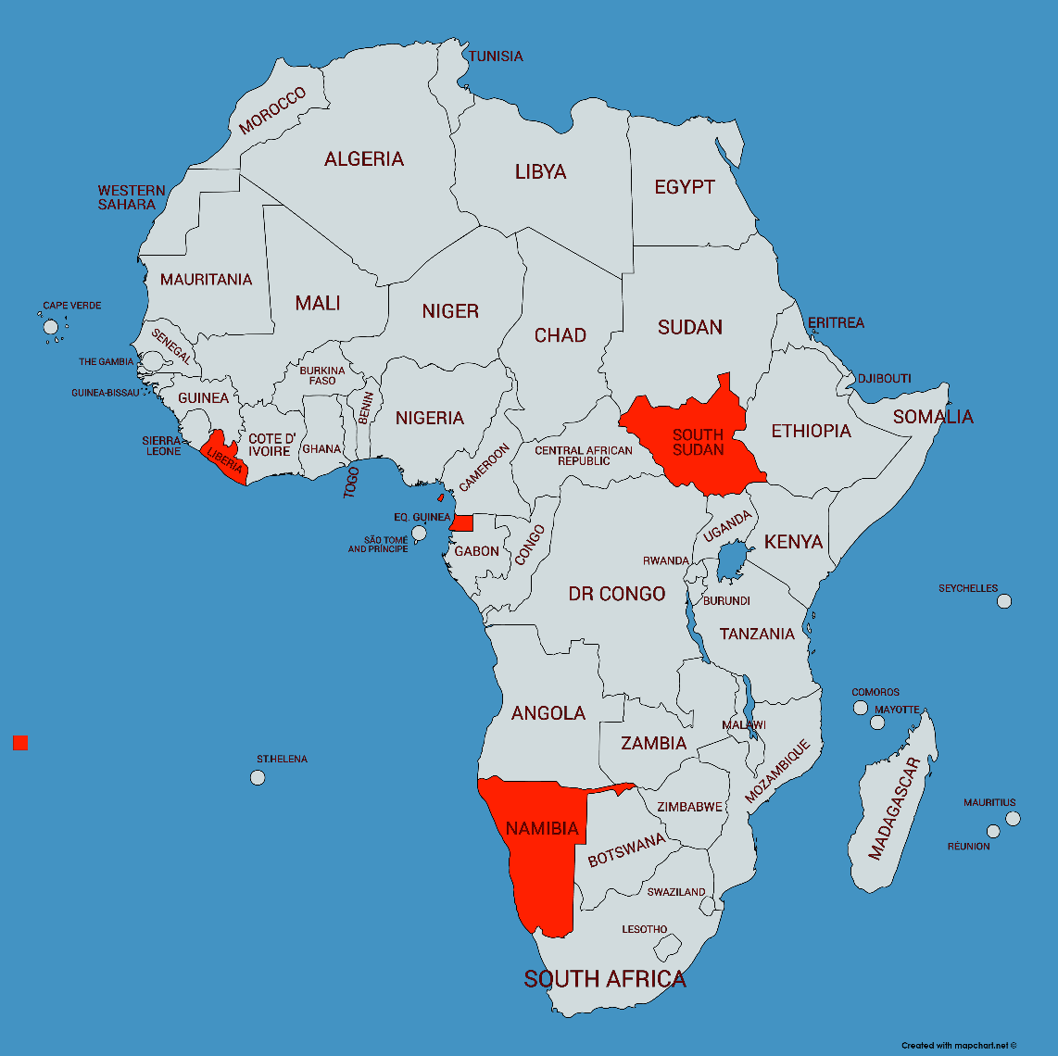
Concluding Remarks
Invariably, GIS have modified the way in which data from national statistics offices are collected and stored and are produced.
In Africa more and more countries are integrating GIS into their census mapping processes and household listings in some regard.
Many now have developed a solid geo-referenced (GPS) database of dwelling locations, clearly delineated enumeration area boundaries and a complimentary set of high-resolution satellite imagery.

Slide 13
Recommendations
We, the representatives of National Geospatial Information/Mapping Authorities (NMAs) of African States, supported by the African Union Commission (AUC), the United Nations Economic Commission for Africa (ECA), the United Nations Geospatial Information Management (UN-GGIM) Secretariat, and other partners, gathered in Addis Abeba, Ethiopia from 1-4 October 2018, for the Fourth meeting of the United Nations Global Geospatial Information Management for Africa (UN-GGIM:Africa)
  Acknowledging that geospatial information science and technology and related disciplines are now commonly found as the driving force of many applications and services in industrial and socio-economic development, offering a radically different way in which we produce and use information required to manage our communities and economic activities,

Slide 14
Recommendations
Request the ECA and the AUC to work collaboratively in the furtherance of advocating the importance of geospatial information in the achievement of the sustainable development goals at national, regional and global levels among Member States, NGOs, academia, private sector and other stakeholders.
Request StatCom-Africa convey to the consideration of the African Conference of Ministers responsible for Finance, Economic and Social Development and Planning, the formal endorsement of the Regional Committee of the United Nations Geospatial Information Management for Africa (UN-GGIM: Africa), as an overarching governance framework in the field of geospatial information management, science and technology, in order to ensure that UN-GGIM: Africa is able to mould policy and strategic actions, suited to African issues and ensure that national bodies are capable of addressing their unique concerns.

Slide 15
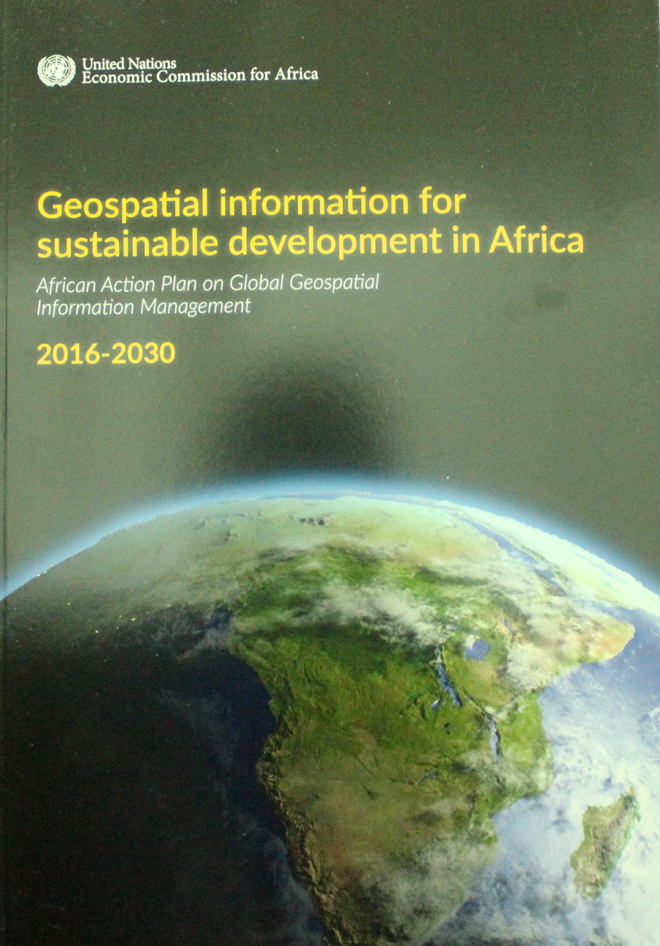
Thank You [www.un-ggim-Africa.org]
A framework for Action: the UN-GGIM:Africa Action Plan
English: www.uneca.org/sites/default/files/PublicationFiles/un-ggim_-_geospatial_information_for_sustainable_development_in_africa-20171115.pdf
French: www.uneca.org/sites/default/files/PublicationFiles/geospatial_information_for_sustainable_development_in_africa_fre-20171115.pdf
Nonguierma@un.org

