Slide 1

UN-GGIM:Africa –
Activities Report
United Nations Economic Commission for Africa
___________________
UN-GGIM: Africa
___________________
Andre Nonguierma
UN-GGIM:Africa 2018
Addis Ababa, Ethiopia
03 October 2018

Slide 2
The Journey So Far….
2018
Addis Ababa
Review of Management and Governance
2017
African Action Plan
Implementation activities
2016
Addis
2nd Meeting
HLF.4
African Action Plan
2015
Nairobi
First Meeting
Endorsement by Member States
5 Working Groups
2015
New York
Formal endorsement by the UNCE
2014
Tunis
Inaugural Meeting
Transitional Bureau Working Groups
2011
Addis
Preparatory Meeting

Slide 3
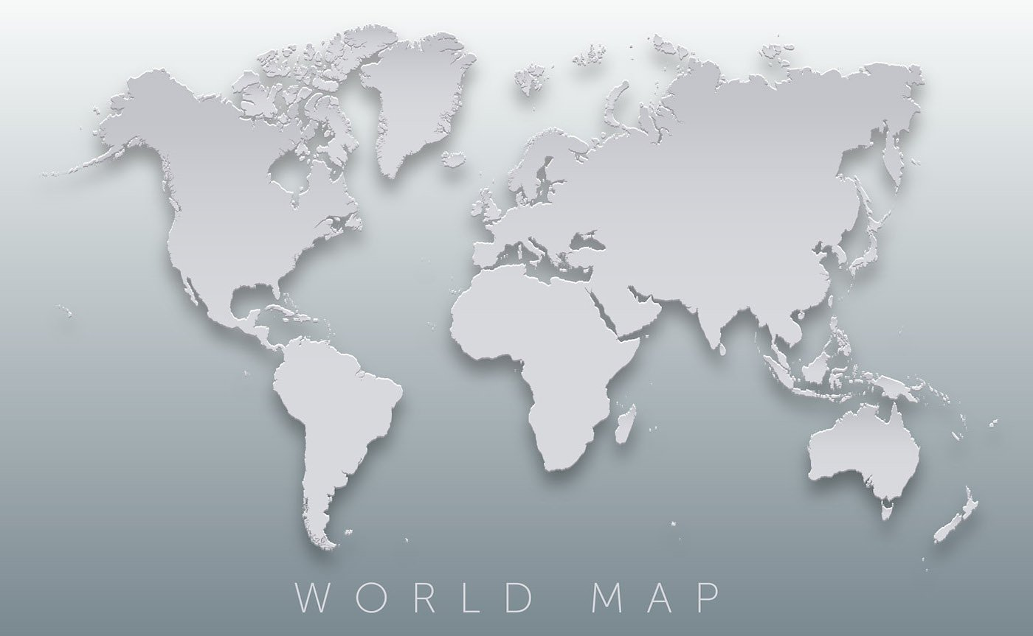

Governance & Administrative Arrangement
Executive Board
Chair: Ethiopia
1st Vice-Chair: Burkina Faso
2nd Vice-Chair: South Africa
1st Rapporteur: Morocco
2nd Rapporteur: Cameroon
Secretariat: Economic Commission for Africa
Morocco
Cameroon
Burkina
Ethiopia
S.Africa

Slide 4
The Working Groups
UN-GGIM:Africa Pillars
SDI : Frameworks with related policies & structures
FDS : Fundamental Geospatial Datasets
AFREF : African Geodetic Reference Frame
SALB : Second Administrative Level Boundaries
GeoNyms : Geographic Names
Geo-Stats : Locate - Count
UN-GGIM Asia-Pacific
(2012)
UN-GGIM Africa
(2015)
UN-GGIM
Arab States
(2014)
UN-GGIM Americas
(2013)
UN-GGIM Europe
(2014)
Working Group | Chair | Members | Non Voting Member
WG1: African Geodetic Reference Frame | 1. Kenya | Nigeria Morocco Botswana Gabon | RECTAS RCMRD UNECA
WG2: Fundamental Geo spatial datasets and Standards | 1. South Africa | Cameroon Burundi Burkina Faso North Africa [TBD] | Niger UNECA
WG3: Institutional arrangements and Legal frameworks | 1. Nigeria | Algeria [TBC] Madagascar Ethiopia Central Africa [TBD] | UNECA
WG4: Capacity and capability development | 1. Morocco | Kenya Zimbabwe Côte d’Ivoire Central Africa [TBD] | South Africa RECTAS RCMRD AARSE UNECA
WG5: Integration of Geospatial and Statistical Information for Sectoral Applications | 1. Namibia | South Sudan Liberia Cameroon Morocco | Zambia Gabon UNECA
Japan
ROK/Mongolia
China
ETH,
BFA, ZAR, MAR, CMN, ECA
Saudi Arabia
Algeria
Jordan
Mexico
Chile
Mexico
Sweden
Netherlands/
EuroGeographics
WG 1
Geodetic Reference Frame for SD
WG 1 Geodetic infrastructure Standards
WG
Institutional, Legal, Policy
WG
NSDI
European Commission
+ Eurostat
WG 2
Data Sharing & Integration for Disaster Mgt
WG 2
Fundamental Datasets and Standards
WG
Fundamental Data & Geo Standards
WG
Integration
Stat & Geo
Euro
Geographics
WG 3
Place-Based Information for Economic Growth
WG 3
Institutional
& Legal
WG
Geodetic Reference
WG
Regional Coordination & Cooperation
WG A
Core Data
WG 4
Capacity Building
WG
Integration Stat&Geo
WG
GI in DDR
WG B
Data Integration
WG 5
Integration of Geospatial & Stats
Courtesy Ayako Kagawa, © 2015

Slide 5
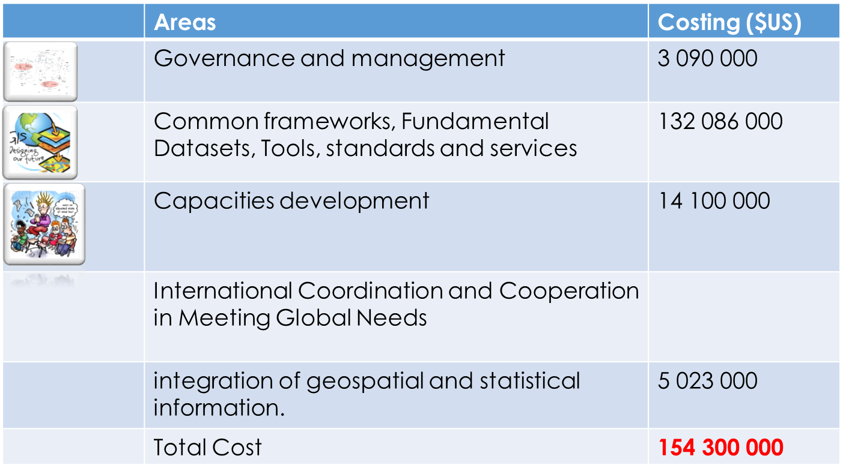
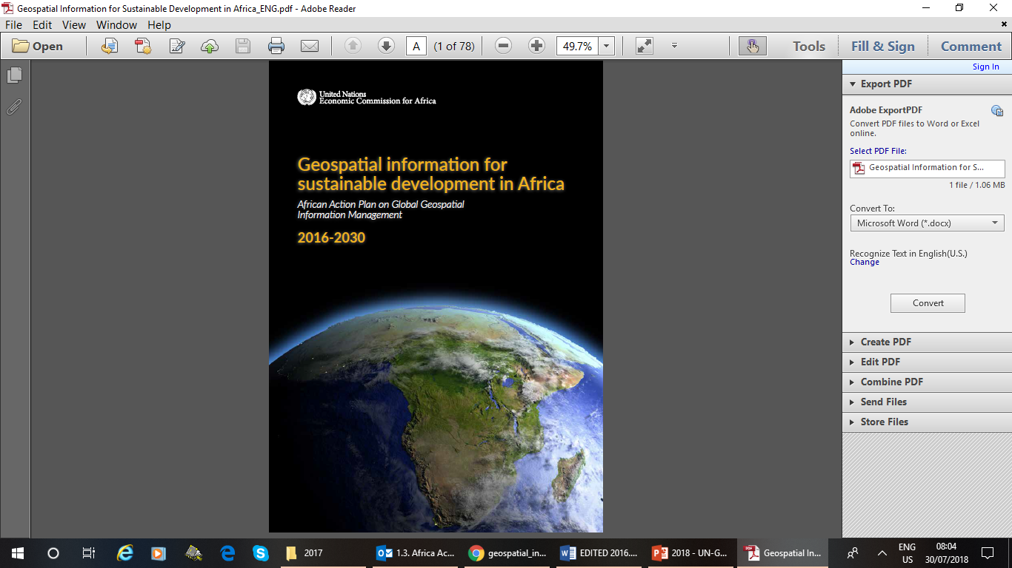
UN-GGIM: Africa : Action Plan
The Vision of GI4SD for the 2030 horizon on the African continent is "Advancing Africa’s Sustainable Development Agenda through sound Geospatial Information Management".
The Mission Statement of GI4SD in Africa is as follows: Africa Produces and Uses Authoritative and Evidence-Based Geospatial Information for the Attainment of its Sustainable Development Goals and Agenda 2063 objectives.

Slide 6
Activities Highlight : Institutional
Organization of the Third meeting : 17-20 November 2017 in Addis Ababa
Over 50 Participants from 14 African countries, international organizations, ECA, UN Secretariat, Academia, Industry and Private Sector.
Organisation of the AfricaGIS 2017 Conference.
Organisations of Working Group Meetings : AFREF and Standard.
Organisation of Workshops : Enabling Legal and Regulatory

Slide 7
Activities Highlight : Technicalities
Pillars | Objectives | Progress
SDI | Frameworks with related policies & structures | African action Plan : Published. African Geospatial Policies: dimensions of geospatial overarching policies for Africa – Editing underway
Standards | Standardization and Interoperbaility | Development of a guiding document on key geospatial standards for Africa – Editing underway
FDS | Fundamental Geospatial Datasets | Contribution to UN-GGIM Working Group on FDS Development of Policies Guidelines on Standards for Africa Organization of the Workshop on Fundamental Geospatial Data Themes
AFREF | African Geodetic Reference Frame | Organization of the 2nd Meeting of the AFRFE Working Group Strategy for revamping the programme – Editing underway
SALB | Second Administrative Level Boundaries | Data received from only 4 countries.
GeoNyms | Geographic Names | Revamped Standard Web-based application
ASSF | Locate & Count | Strategy for the integration of geospatial and statistical information

Slide 8
Activities Highlight : Global UN-GGIM
(a). Participation and contribution to the Eightieth Session of the Committee of Experts of UN-GGIM and its side events, held in New York in 30th July – 3rd August 2018. The session offered good opportunity for many formal and informal contacts and discussions with various government/private sector partners on issues of common interest in order to continue strengthening UN-GGIM: Africa interaction with public/private organizations, institutions and individuals that are involved in the development of geospatial information to effectively support the African geospatial community by raising awareness, funds and learning from the experience of other regions.
(b). Contribution to the work of the United Nations Expert Group on the Integration of Statistical and Geospatial Information (UN EG-ISGI).
(c). Participation and contribution to the Fifth High Level Forum on UN-GGIM in Mexico City, Mexico, 28 – 30 November 2017.
(d). Participation and contribution to the Expanded UN-GGIM Bureau Meeting that was held on 01 December 2017 in Mexico City, Mexico.
(e). Participation in the international workshop on Legal & Policy Frameworks for Geospatial Information Management in Tianjin, China, 7-9 November 2017.
(f). Participation and contribution to the inaugural meeting of the Advisory Committee for the first United Nations World Geospatial Information Congress (UNWGIC) in Deqing, China on 11-12 April 2018.

Slide 9
Status of implementation of Recommendations
Actions | Activities Carried Out
Fundamental geospatial datasets and geospatial information standards | SA: Several actions were undertaken including : Contribution to ISO/TC.211; Establishment of the Committee for Spatial Information (CSI); Continuous collection and updating of geospatial information
 | WG: Participation in the work of the UN-GGIM WG on Fundamental Data Themes
 | ECA : Assessment of the Readiness of African Countries in utilizing Fundamental Geospatial Data for the SDGs Organization of the Workshop on Fundamental Geospatial Data Themes
African Geodetic Reference Frame (AFREF) | SA: Reinforcement of GNSS Network (68 ORS. Streaming of GNSS data to IGS)
 | UN-GGIM:Africa - Adopt the proposed objectives, structure and recommendations of the meeting
 | ECA: Organization of the 2nd Meeting of the AFRFE Working Group Strategy for revamping the programme – Editing underway
Participation in UN-GGIM:Afica | SA: Active contribution to UN-GGIM: Africa
 | ECA: Initiated the process of building of the UN-GGIM: Africa Website. Expected completion by the end of the year.
Participation of academia and the private sector | Executive Board: Work in Progress
Overarching policy on geospatial information | ECA: Review and editing of the draft document underway

Slide 10

Upcoming Events
United Nations World Geospatial Information Congress (UNWGIC)
Deqing, Zhejiang Province, China
19-21 November 2018

Slide 11
Perspectives - Outlook
African Spatial and Statistical Framework: Finalization of the strategy for the integration of geospatial and statistical information
FDGT : Identification of geospatial datasets for SDG indicators
Standards. Poor participation of Africa to in ISO/TC211. Mechanisms to disseminate the relevant standards to the African geospatial community.
Resources mobilization: Advocacy towards donors and partners
Communication is key to a successful implementation of the UN-GGIM: Africa’s activities. Development of a dedicated Website

Slide 12
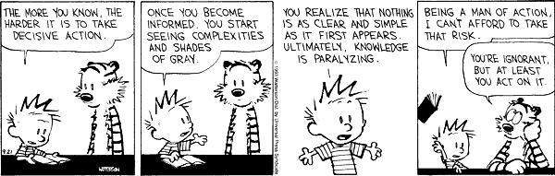
Getting There… Without Getting Lost…
More active participation of Member States and Executive Board Members
More Proactivity in participation and contribution to the global UN-GGIM
Strategy for resources mobilization.
Involvement of the Private Sector
Translation of the Action Plan into concrete projects. More expected from Working Groups.

Slide 13
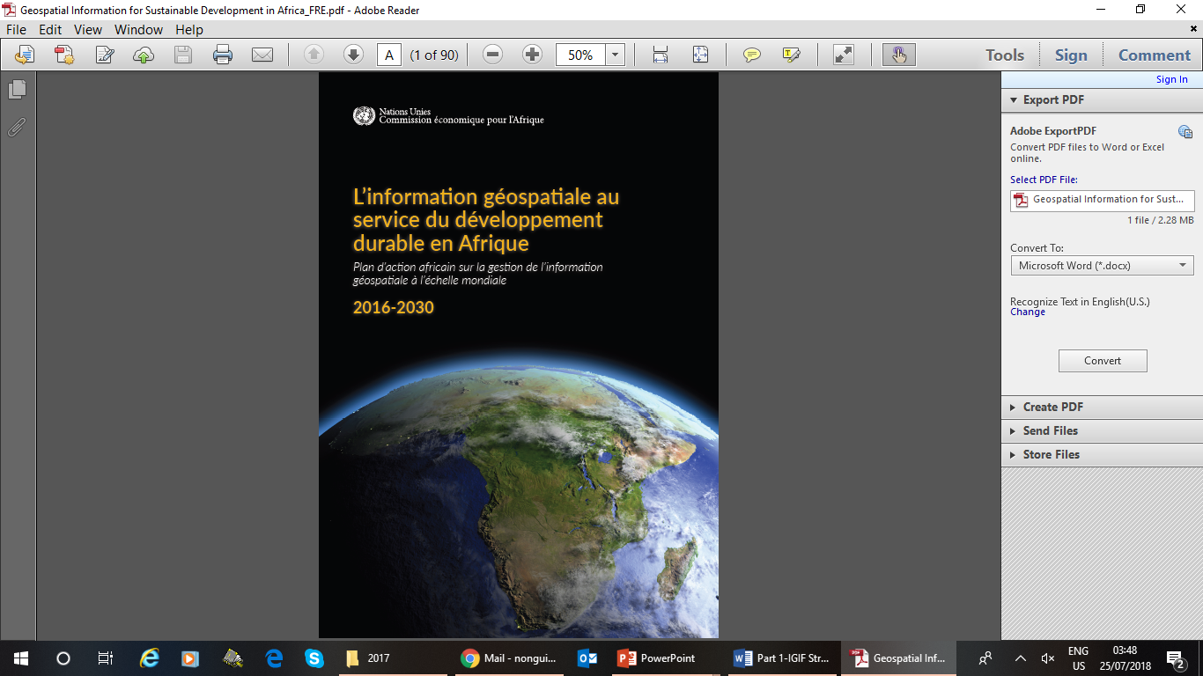
Thank You [www.un-ggim-Africa.org]
UN-GGIM:Africa Action Plan :
English : www.uneca.org/sites/default/files/PublicationFiles/un-ggim_-_geospatial_information_for_sustainable_development_in_africa-20171115.pdf
French : www.uneca.org/sites/default/files/PublicationFiles/geospatial_information_for_sustainable_development_in_africa_fre-20171115.pdf

