Slide 1

Presentation of the new statistical measure
Total Official Support for Sustainable Development (TOSSD)
Addis Ababa, 4 October 2018
Pali Lehohla
Expert and member of the TOSSD Task Force

Slide 2
Outline
What is TOSSD?
Work of the International Task Force
Timeline of TOSSD development
Potential of TOSSD to fill statistical data gaps
TOSSD and global SDG monitoring framework

Slide 3
1. What is TOSSD?
TOSSD is a statistical measure that includes all officially-supported resource flows to promote sustainable development in developing countries, to support development enablers and to address global challenges at regional or global levels.
  Official bilateral and multilateral institutions.
  Traditional donors and emerging economies, including through south-south co-operation and triangular co-operation.
  All instruments (concessional and non concessional).
  Also captures private resources that are mobilised through official means .
TOSSD is complementary to ODA. It covers a broader range of flows is focused on sustainable development.
  Need to move “from billions to trillions” of financing to achieve the SDGs.

Slide 4
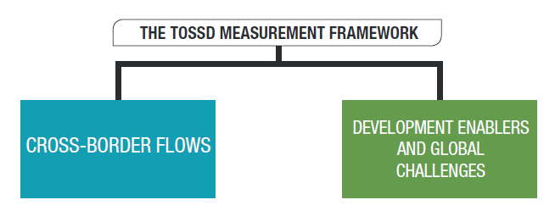
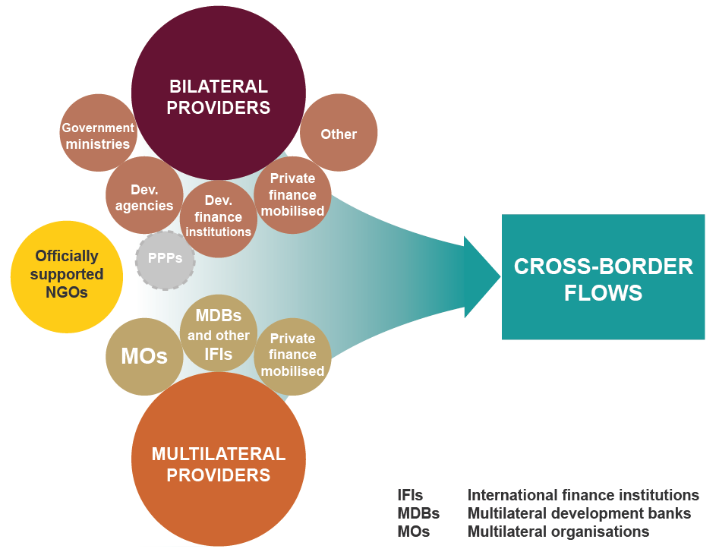
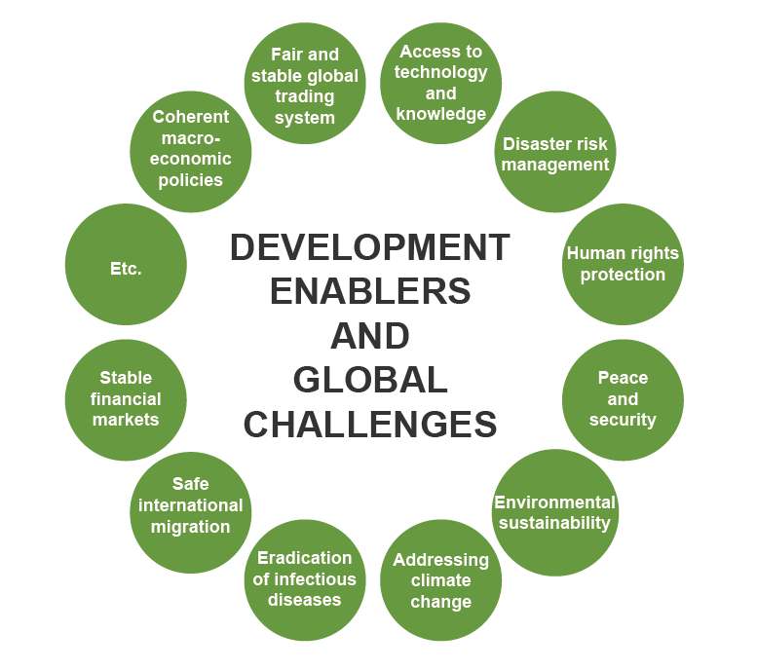
1. What is TOSSD?
Resources to developing countries
Global level expenditures

Slide 5
2. Work of the International TOSSD Task Force
Established in 2017 following the call at the 3rd International Conference on Financing for Development to develop the TOSSD framework in an open, inclusive and transparent manner.
Co-chairs: Mr Risenga Maluleke (South Africa) and Mr Laurent Sarazin (EU).
Members: 25 experts from traditional and emerging provider and partner countries as well as international organisations (8 experts from NSOs).
Mandate: develop the TOSSD statistical framework (definitions, measurement parameters and methodologies, eligibility criteria).
Task Force website: all documents are posted there to allow for “open, inclusive and transparent” discussions.
Consultations: country pilots (e.g. Senegal, Nigeria), outreach events (e.g. UN StatCom, FFD Forum)

Slide 6
3. Timeline of TOSSD development
By the end of 2018: finalise the methodology for the TOSSD “cross-border resource flows” pillar.
Early 2019: conclude work on the TOSSD methodology including on “development enablers/global challenges” pillar.
Throughout 2019: TOSSD data collection from provider countries and institutions. Regional consultations in Africa, Latin America, Asia.
From 2020: TOSSD data available for possible use in monitoring SDG finance.

Slide 7
4. Potential of TOSSD to fill statistical data gaps
Access to comprehensive data on all sources of development finance, reported by both traditional donors and emerging economies.
TOSSD is also specifically designed to look at the sustainability aspects of development co operation.
Potential confirmed by a recent pilot study in Nigeria: TOSSD would fill a critical information gap related to SDG finance.

Slide 8
5. TOSSD and global SDG monitoring framework
TOSSD could supplement or update existing SDG financing indicators where scope broader than ODA (e.g. 9.a.1 “total official international support to infrastructure”).
  Reporting by provider countries and institutions.
  No additional reporting burden for developing countries.
Next steps:
  TOSSD Task Force interaction with Inter Agency Expert Group on SDG Indicators (November, Stockholm).
  Present TOSSD data and metadata to IAEG-SDGs.

Slide 9
Thank you!
http://www.oecd.org/dac/financing-sustainable-development/development-finance-standards/tossd-task-force.htm

