Slide 1



Analytically ready Satellite data across decades to support delivery of Sustainable Development in Africa
Davis Adieno, Regional Director for Africa
Global Partnership for Sustainable Development Data (GPSDD)

Slide 2
About the GPSDD
The Global Partnership for Sustainable Development Data (GPSDD) is a multi-stakeholder partnership consisting of over 330-member organizations across sectors focused on leveraging data and technology to support achievement against the Sustainable Development Goals (SDGs) and other regional and national development frameworks.
Within the context of the data revolution, the GPSDD is working to develop an ecosystem approach where governments, private sector and civil society are working together to achieve the SDGs inclusive of the political, technical, institutional and capacity and resource issues.
GPSDD was launched during the United Nations General Assembly in September, 2015 to support countries around the world and stakeholders across sectors to better harness the data revolution to achieve the SDGs.

Slide 3
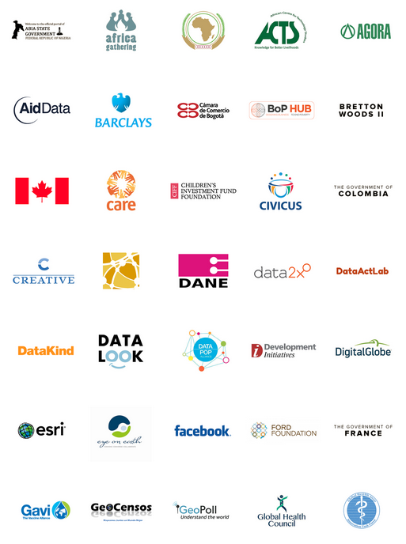
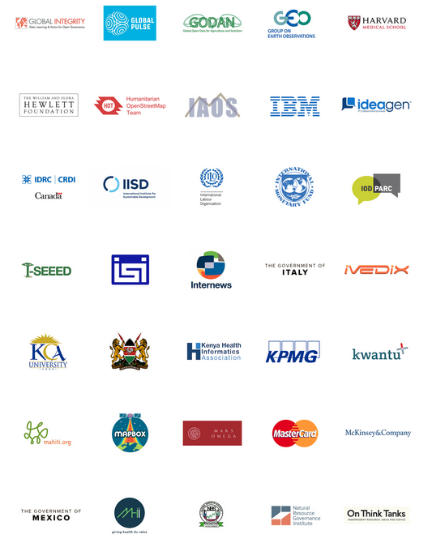
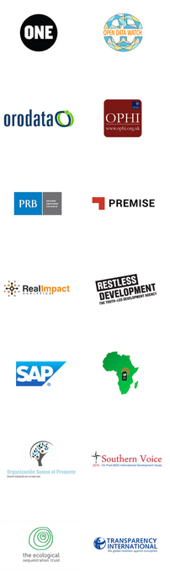
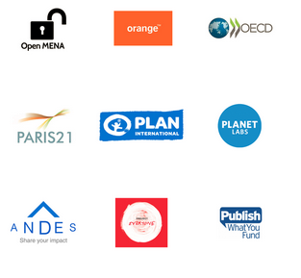
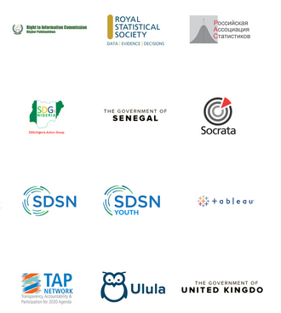




Slide 4
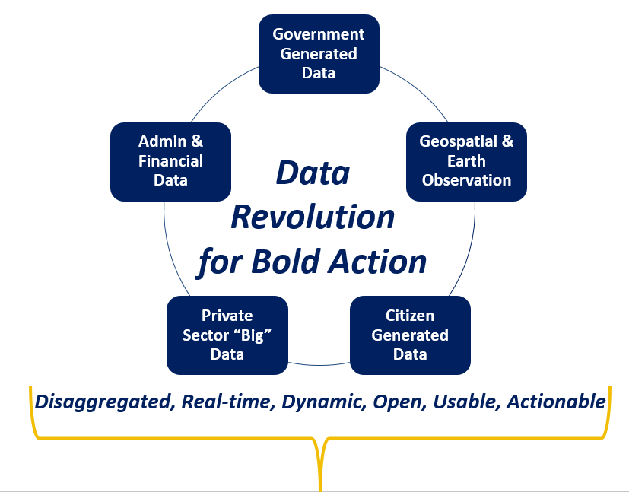
  Harnessing the Data Revolution
Supporting and complementing government and civil society efforts to generate data for statistics for the formal SDG monitoring framework
Unleashing innovation in production, accessibility and use of real-time, dynamic, disaggregated data from multiple sources
4

Slide 5
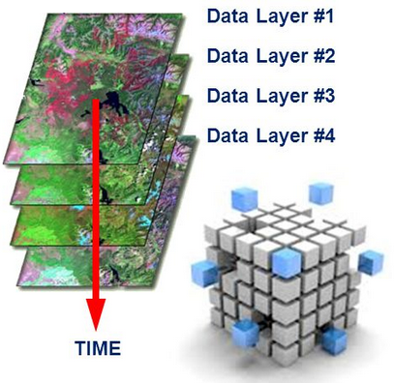
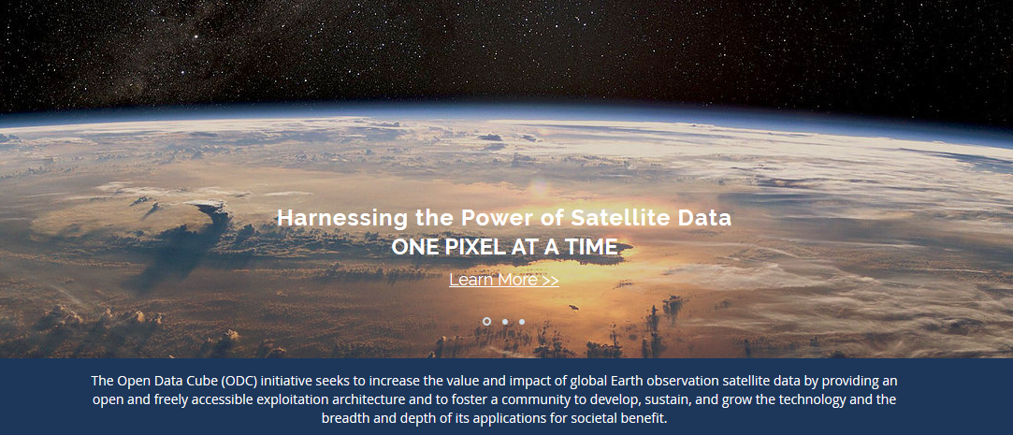






Africa Regional Data Cube
The data cube provides analytically ready data across decades allowing for easily accessible geospatial analysis on priority thematic sectors. Initial focus for the data cube will be on algorithms to address priorities identified by GPSDD partners across 5 countries:
Ghana | Kenya | Senegal l Sierra Leone | Tanzania
Kenya Government

Slide 6
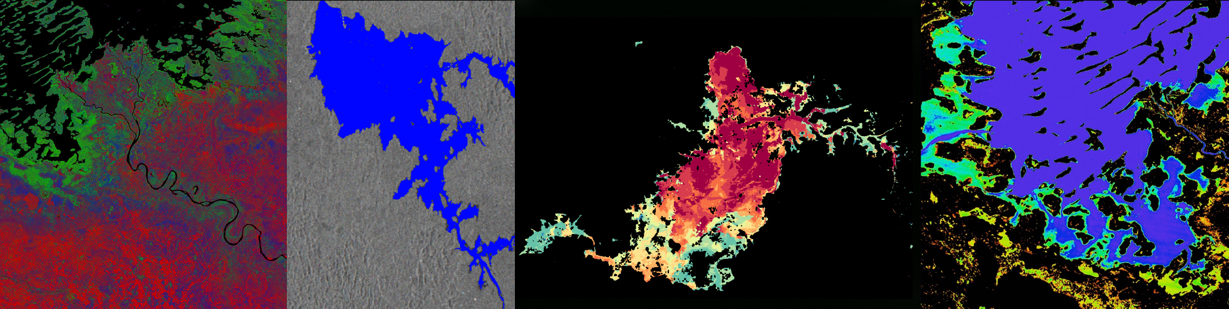
Breaking New Barriers
A regional, demand-driven data solution
Availing satellite data free and open source to countries
Implementation is in the cloud with a wide-range of applications
Facilitating data and analytics (algorithms)-sharing among users
Increasing regional and global capacity to use satellite data
Supporting the delivery of the SDGs & other development goals

Slide 7

African Regional Data Cube (ARDC) Operational Model
Strathmore University
(Host in Nairobi, Kenya)
Amazon Web Services (AWS) Cloud (Simple Storage)
S3 Data Storage
(13 to 23 TB)
Elastic Compute Cloud (EC2) Computing
* Data Cube management, new data ingestion, web-based user interface
* Managed by Strathmore University with support
from NASA-SEO
Landsat 7/8
Sentinel-1
Sentinel-2 (year 2)
Kenya
Sierra Leone
Senegal
Ghana
Tanzania
Each country has its own EC2 Computing “instance” for analysis purposes (User Interface
and Jupyter Notebooks), but S3 data storage is shared among countries in the AWS cloud

Slide 8
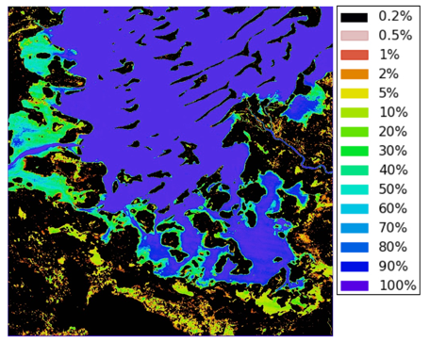
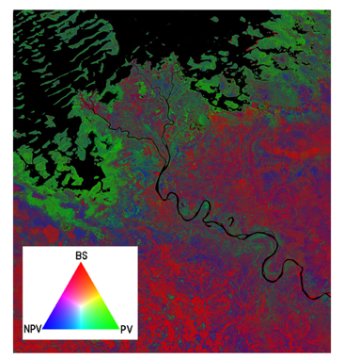
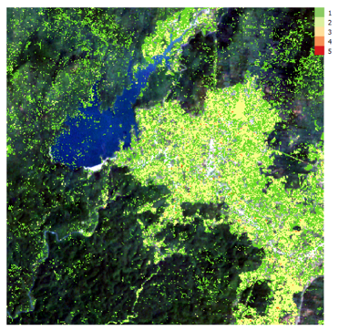
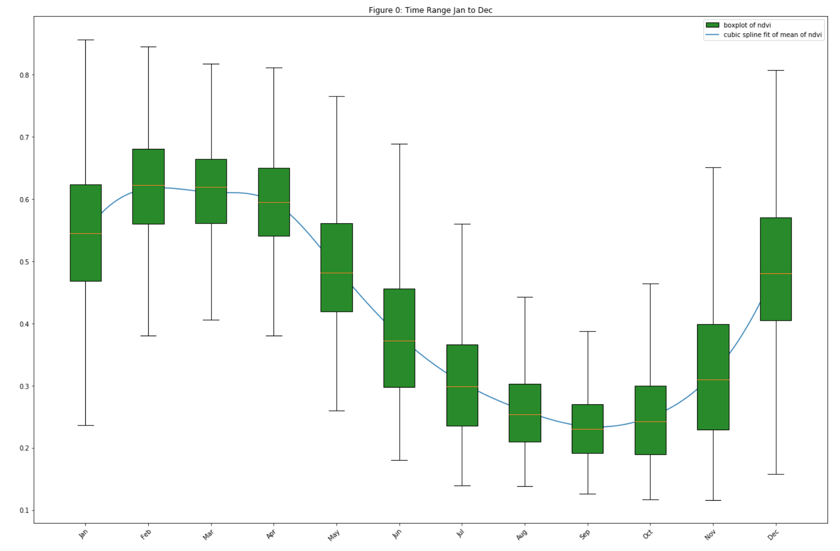
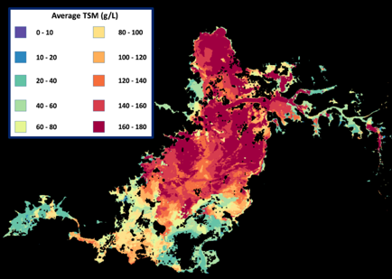
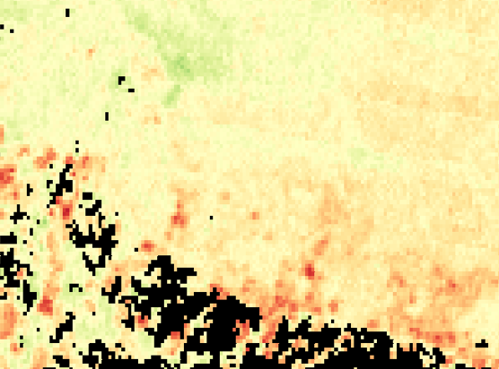
  Application Products
20+ algorithms & 17+ years of data
Cloud-free Mosaics: Recent Pixel, Median, Geomedian, Max-NDVI
Spectral Indices: NDVI, EVI, NDBI, NDSI, NDWI, FC, TCT
Land Classification: K-Means, Random Forest, Snow (from Swiss)
Water: WOFS (from Australia), WASARD (radar), Total Suspended Matter (TSM)
Land Change: PyCCD (from USGS),
PCA (from Colombia), NDVI Trend (Vogelmann), NDVI Anomaly, S1 Radar (Deutscher), Coastal Change,
SLIP-Landslides (NASA GSFC)
8

Slide 9
ARDC timelines
May
Training + Launch
Countries + Strathmore
June - July
Country engagement
Buy-in + coordination
Partnerships
Fundraising
July - Sep
Country use-cases
Scope + development
Innovation
Sharing
Learning
Online Forum
Showcase products
Sept - Oct
UNGA/WDF
Hiring GIS
Technical
Manager
Oct - Dec
Products + users
Regional + In-country
2019 +
Scale-up model
Digital Earth Africa
Strategies
Operational Communications Country engagement

Slide 10
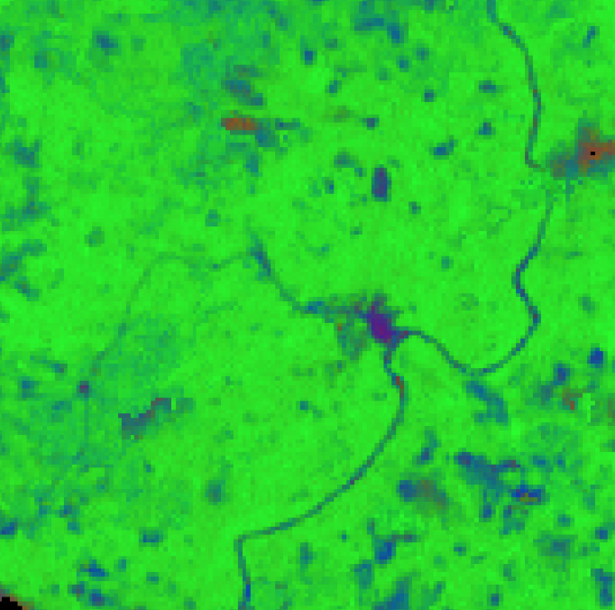
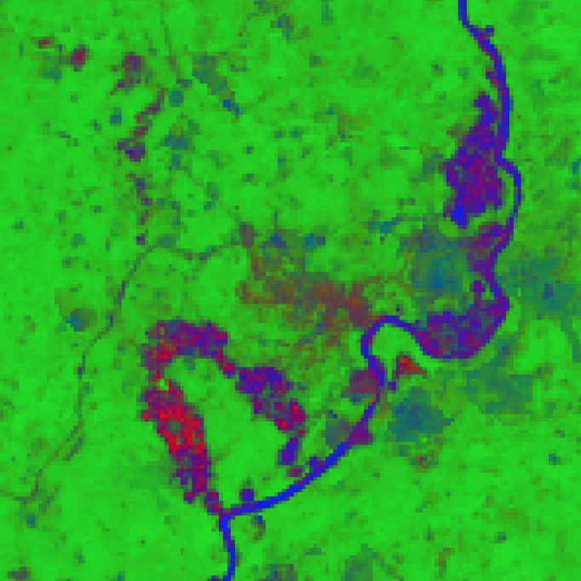
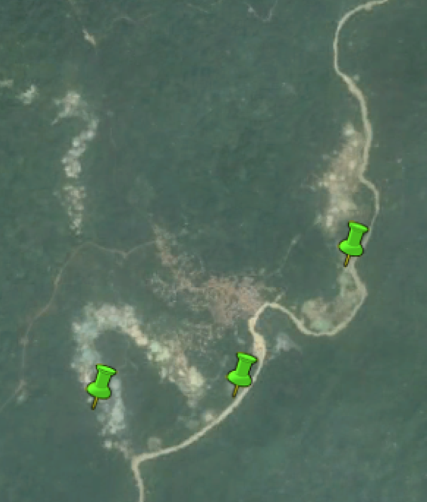
Illegal Mining on the Ankobra River in Ghana
Year 2000
Year 2017
Google Earth 2017
  A Fractional Cover (FC) analysis (GREEN images) showed a 13% loss in dense vegetation along the river & when it started
  A Google Earth image in 2017 (far right) shows the known locations of illegal mining, provided by the Ghana Government
  Pin-pointing potential hotspots to warrant further investigations saves both time and money - and enhances efficiency

Slide 11
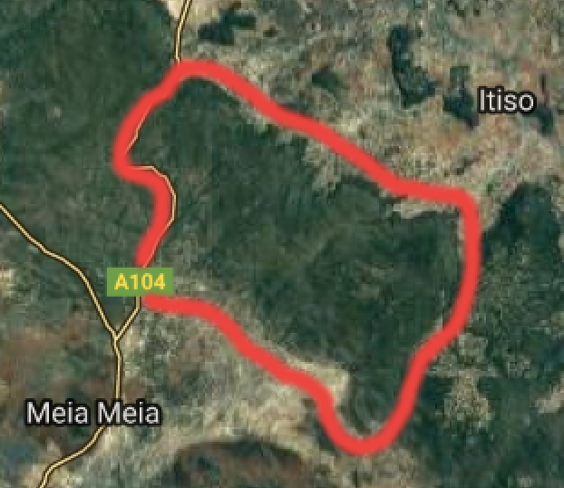
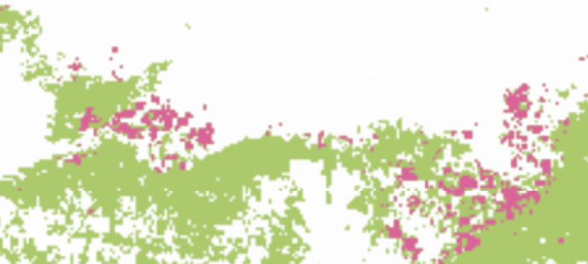
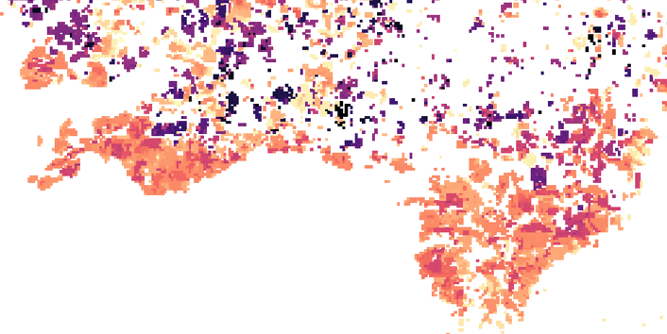
Deforestation and Settlements along the East Chenene Forest Reserve in Tanzania
Africa Regional Data Cube
Land Change 2012-2016
(orange and red)
The PyCCD Land Change Algorithm (orange/red – bottom figure) compares well with the Global Forest Watch results (pink – top figure) for deforestation detection

Slide 12
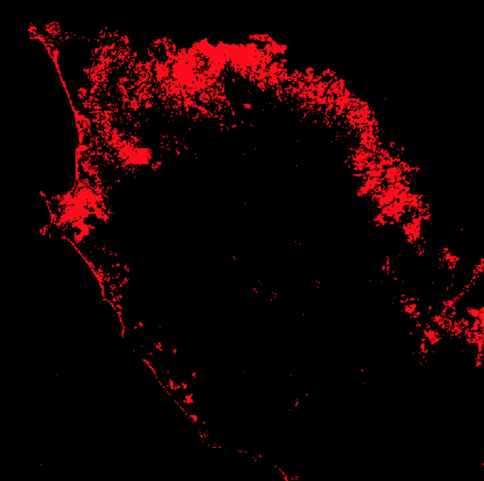
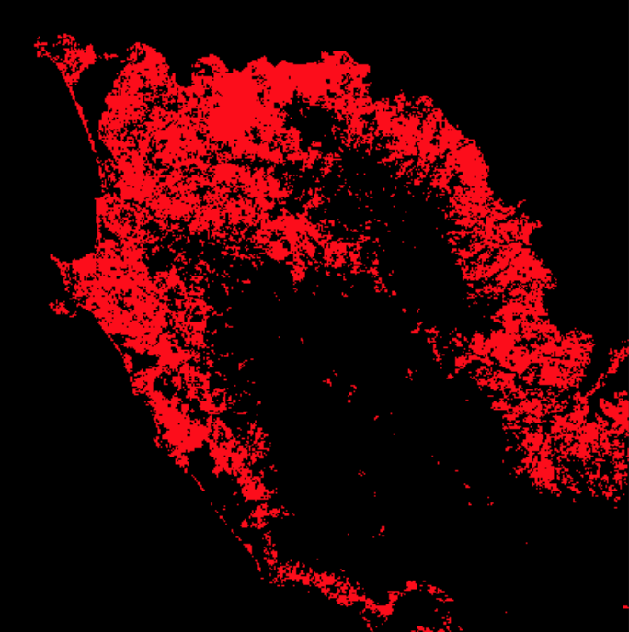
Urbanization in Freetown, Sierra Leone
Year 2000
Year 2017
Urban extent has grown 11.4% over 10 years
* Analyses based on the NDBI index using the Africa Regional Data Cube

Slide 13
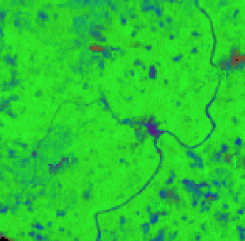
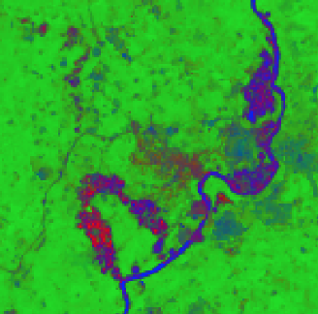
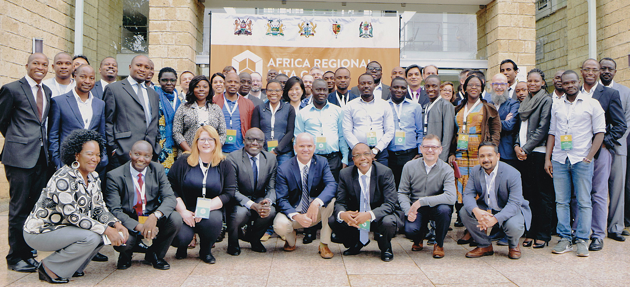
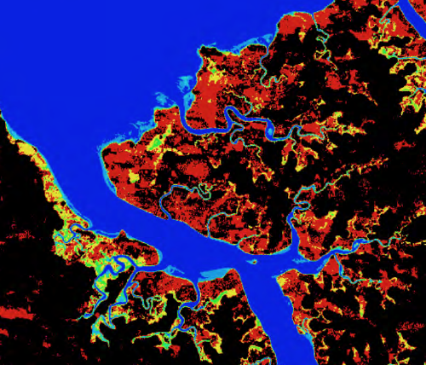
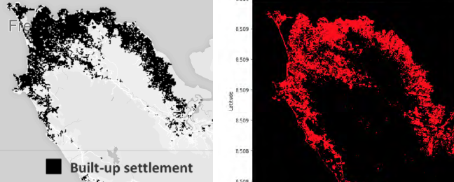
Progress
  National coordinating mechanisms established in 4 out of 5 countries
  Recent web-based remote training for Ghana (July 31), Tanzania (August 16), and Sierra Leone (Aug 24). More training planned for late 2018
  Enhancements to the infrastructure based on user experience
  Initial support has been focused on algorithms to support desired use-cases in:
  Kenya: Dadaab Refugee Camp expansion, deforestation and vegetation extent, livestock rangelands
  Tanzania: Chenene Forest Reserve deforestation and agriculture phenology
  Ghana: Illegal mining (on right)
  Sierra Leone: Flooding and urbanization (below)

Slide 14
Challenges
Since the initial training in May 2018, there has been little progress in expanding the satellite data in the ARDC. We are recruiting a GIS Technical Manager and finalising institutional hosting (took longer than expected) to strengthen technical support and add new datasets
From May to July 2018 there was limited interaction with country users. July to August 2018 showed a significant increase in interactions with several remote training sessions and identification of use-cases
Limited capacity of partners means much training is needed to impart skills – especially face-face
Whereas remote training is possible, internet connectivity has hampered this in some instances – effective use hinged on good internet connectivity
Analytical products can be technical and need packaging to better communicate to broader audiences

Slide 15
Learning
The infrastructure, data, and tools are great, but; leadership, coordination mechanisms, country buy-in and ownership are critical
Significant and sustained capacity development is needed to impart skills
EO and satellite data are great but depending on what you have available it may not be applicable across the board – define what’s useful for the type of data you have
Combining satellite data and other data sources yields optimum results
It takes time, you need patience and resources. More sustained training is needed to impart skills – especially face-face
It can’t work without solid partnerships with National Statistical Offices (NSOs), National Space Agencies, key Ministries and government agencies
Demand exists. Other data communities are needed to foster innovation and effectively respond to demand

Slide 16

www.data4sdgs.org
Contact: Davis Adieno
Email: dadieno@data4sdgs.org

Slide 17
TOPICS FOR PLENARY DISCUSSIONS
Topic 1: Tackling policy and legal barriers - what are the challenges, priorities and solutions?
Topic 2: What are the key capacity gaps or needs – how can these be met?
Topic 3: Governments sustainable investments in Earth Observations and satellite data - what approaches should be adopted and by who?
Topic 4: Exploring practical use and innovation around Earth Observations and satellite data - what are the priority sectors?
Topic 5: Government coordinating mechanisms and building data communities around Earth Observations and satellite data - how can this be effectively achieved and communicated?

