Slide 1






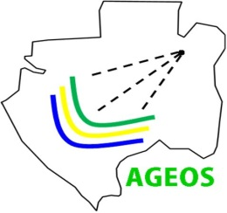
AfriGEOSS Data and Infrastructure

Slide 2

GEO Strategic Plan 2016 – 2025: Implementing GEOSS core function:
Cultivating awareness, building capacity and promoting innovation
Building capacity, as well as sustaining and enhancing existing capacity, is essential for developing competencies in the effective use of Earth observations for responding to societal challenges and addressing sustainable development issues.
promote the engagement of institutional users worldwide;
assist countries to acquire, share, store, maintain, and utilize;
engage with the international development and donor organizations;
work with the appropriate national entities to develop activities; and
promote cooperation through national and regional GEO mechanisms.
Notes:
Ministers will reconvene in 2019 to review and reaffirm GEOs progress

Slide 3
AfriGEOSS Implementation
2013
Launch
2015
AMCOMET-3
AU STC-EST
+3 Members
DICT
2016
26th AU Summit
1st Steering Committee Meeting
1st AfriGEOSS Symposium
AfriGAM
SFS CT
2017-2019 WP
+1 EXCOM
+1 PO
EO in ADIRC
2014
SADC Ministers STI & ET
EU-Africa Summit
Implementation Plan
Steering Committee
+2 Member & PO
2017
WRM CT
SUD CT
2nd AfriGEOSS Symposium
1st Training Programme
+2 PO
2012
Endorsed by GEO-Plenary

Slide 4
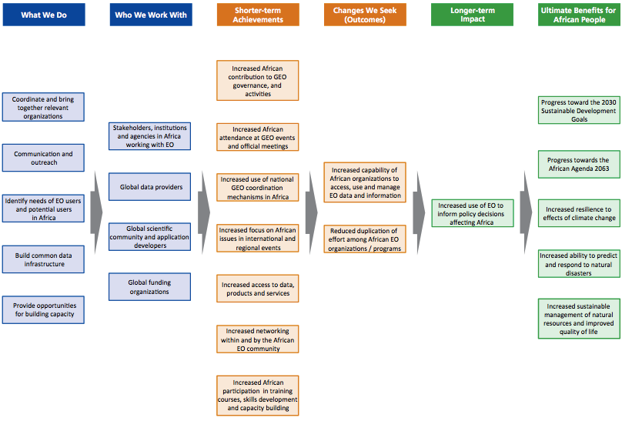
AfriGEOSS Initiative
  Who is doing What Where

Slide 5
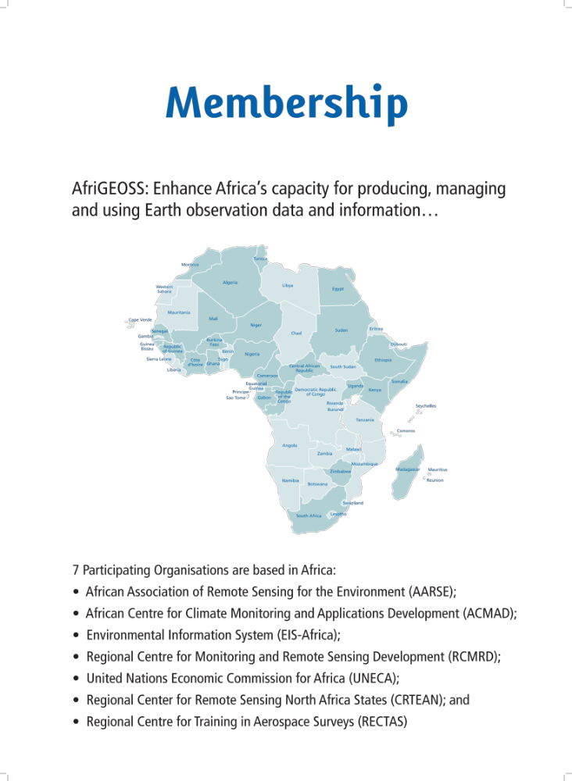
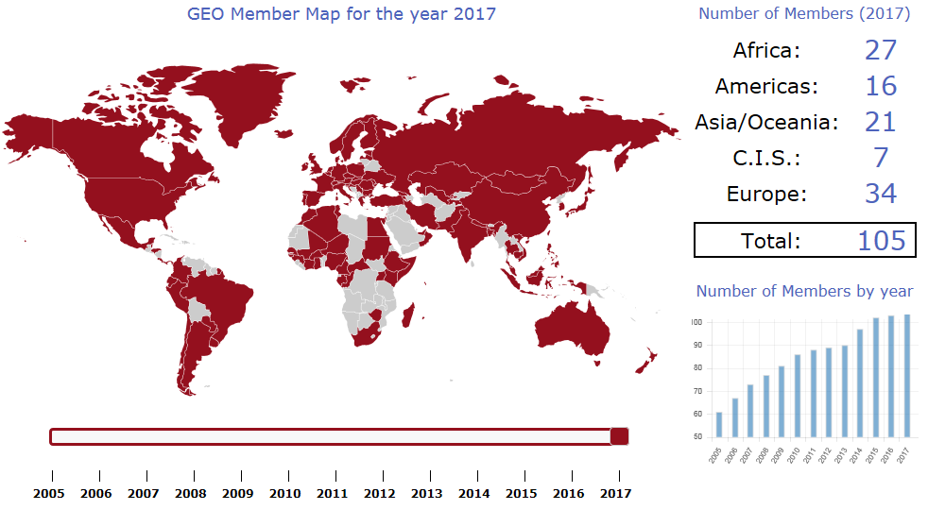




GEO Partnership 105 Members

Slide 6
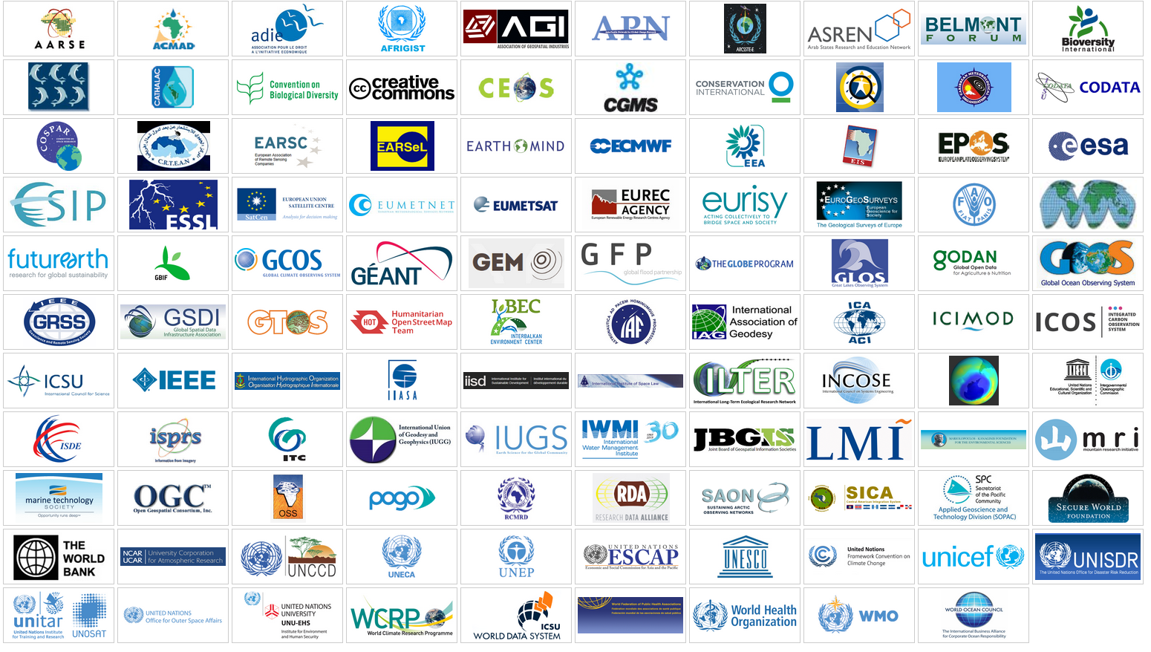
GEO partnership 109 Participating Organizations

Slide 7
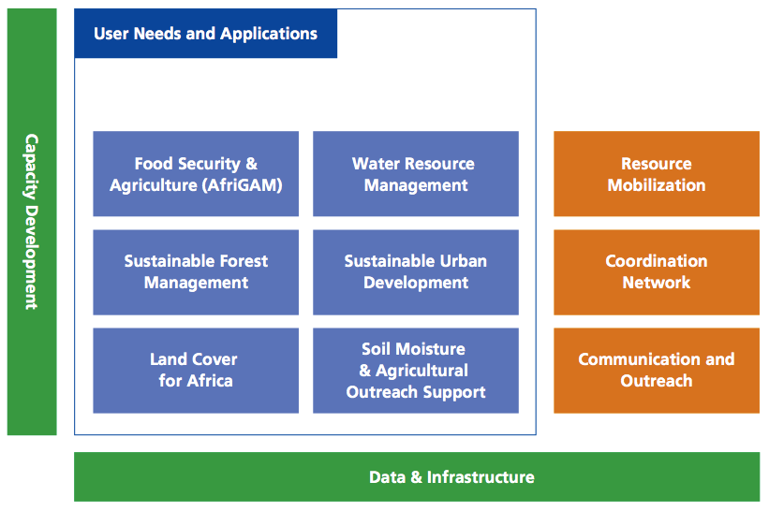





AfriGEOSS Action Areas
Notes:
The AfriGEOSS Implementation Plan identified 6 Action Areas, namely ….

Slide 8

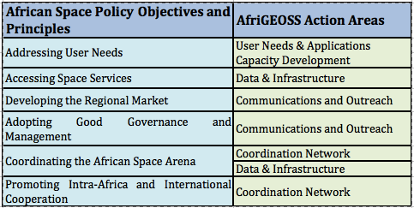

Engagement with Continental Programmes
African Action Plan on Geospatial Information for Sustainable Development in Africa (GI4SD), which focuses on five key areas, namely:
  Geospatial Information Policy and Governance;
  Common Framework and Tools;
  Capacity Building and Knowledge Transfer;
  International Coordination and Cooperation in Meeting Global Needs;
  Integration of Geospatial Information and Statistics.
African Space Policy &
Strategy

Slide 9
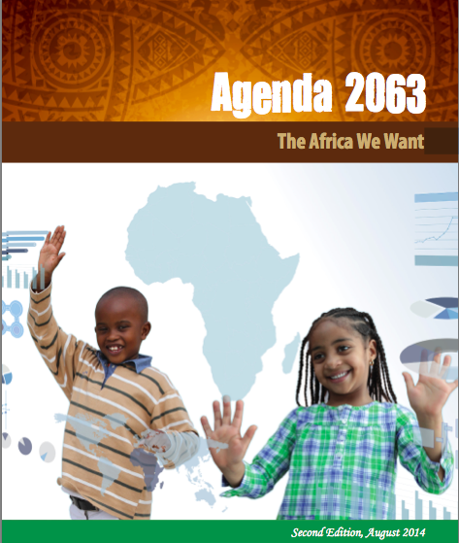
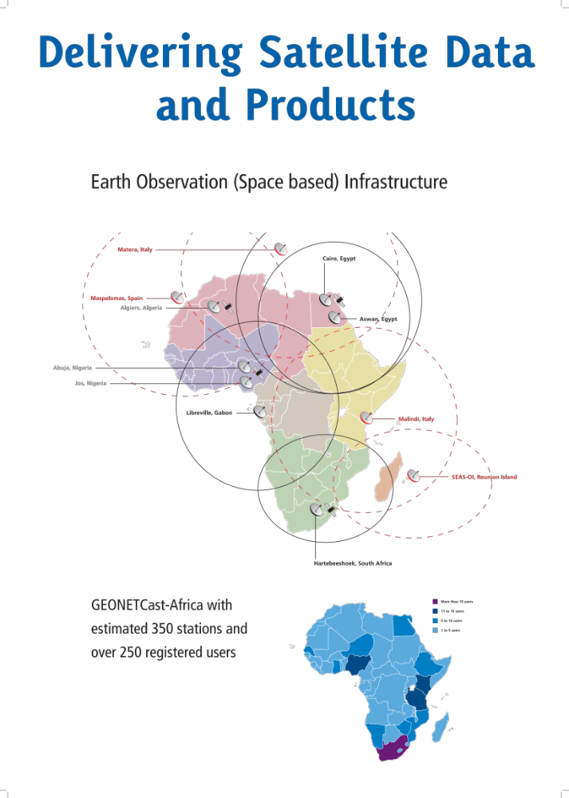

Observations and Opportunities
Data is critical for informed decisions and improved livelihoods;
Growing free and open data;
Increased uptake of Earth observations in the continent;
Africa has capacity incl. infrastructure;
Increase in data initiatives; and
Leveraging opportunities and building collaborations;

Slide 10
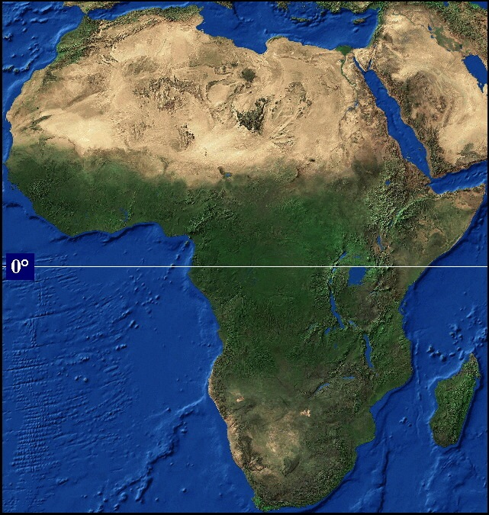
… Earth Observations for complex issues
  world’s second largest continent (30.2 m km2) including islands
  second most populous continent (about 15% of the world’s population)
  has a vast land area with difficult terrain (deserts, rainforest, inland water bodies, complex and inhomogeneous topography, the Great Rift Valley
  30% of oil resources
  Earth observations are critical to support environment and natural resources management for protection of life and property and sustainable socio-economic development of Africa.
United States of America
India
Argentina
Europe
New Zealand
China

Slide 11

… data revolution calls for a holistic approach
Data
Enables effective decisions
Policy
Allow free access, use and re-use
Infrastructure and Technical capability
Enable discovery, access, product development and dissemination
Local Context
Provide needs, build partnerships and design own innovative solutions

Slide 12

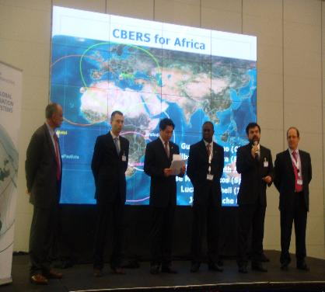
Open access policies and Earth Observation data
GEO Data Sharing Principles
Full and Open Exchange of Data
Data and Products at Minimum Time Delay and at Minimum Cost
Free of Charge or Cost of Reproduction
Global “Free data access” Announcements / Releases
Sentinels, 2014 (EC)
SPOT World Heritage Programme, 2014 (France)
Shuttle Radar Topography Mission-30m, 2014 (US)
Landsat family, 2008 (US)
CBERS, 2007 (Brazil & China)
GEO Cape Town Ministerial Summit, 2007
Notes:
Shuttle Radar Topography Mission

Slide 13
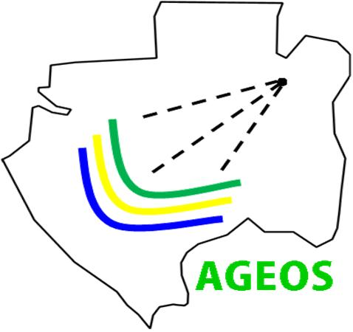
AfriGEOSS: Data & Infrastructure
Support EO data (satellite & in-situ) access and dissemination in Africa by identification existing infrastructure, gaps and recommend actions for the community to implement.
Undertook a SWOT analysis of African EO infrastructure (data receiving, data processing, data archiving, and data distribution)
Resource optimization of existing EO infrastructure
Identify and exploit other continental infrastructure that enable EO data access and dissemination
  Africa Data Intensive Research Cloud (ADIRC)
  GEANT – African National Research and Education Networks
  Digital Earth Africa (only engaged end of 2017)
Develop action plan towards building EO infrastructures that respond to gaps
Advocate for free and open access of African owned data
Notes:
The work required in this task is big, hence we have decided to start with access to satellite data, to ensure the released free and open satellite data becomes accessible to Africa – beyond the policy level.
This work will contribute to the implementation of the African Space Policy and Strategy under approval.

Slide 14
What users want …
Users to free and open source solutions
Users want minimum time and capacity required to obtain and prepare satellite data
Users want to perform time series analyses
Users want to use multiple datasets together
Users want to use their common GIS tools
Users want data sovereignty
Users want customer service and help

Slide 15
1st AfriGEOSS Symposium Outcomes (2016)
  Bring AfriGEOSS into political discussions to inform and influence policy formulation
  Promote and Ensure the use of EO Data and Information in decision-making
  Confirm the mandate of the Data & Infrastructure Coordination Team and consolidate its working plans (Develop the framework for a Coordinated Data Acquisition Strategy)
  Establishment of thematic coordination mechanisms within AfriGEOSS
  AfriGEOSS Agriculture Monitoring (AfriGAM)
  AfriGEOSS Sustainable Forest Management
  Continue engagements with the private sector and industry (AARSC)
  Contribution to the GEO Work Programme

Slide 16
Steering Committee & Caucus Recommendations
Investigating the requirements of the African Renaissance Fund to support AfriGEOSS activities (South Africa)
Prepare AUC-AfriGEOSS partnership framework document - value proposition for unlocking resources (AUC-AfriGEOSS Partnership Task Force)
and n) Adopted text changes in the AfriGEOSS Management Arrangement
DICT to develop a “coordinated data acquisition strategy for Africa” – SC approved this strategy will be implemented through the EO in ADIRC platform.
  Partnership with SKA on Africa Data Intensive Research Cloud (ADIRC)
Establishing national coordination and undertake regional representation of AfriGEOSS

Slide 17



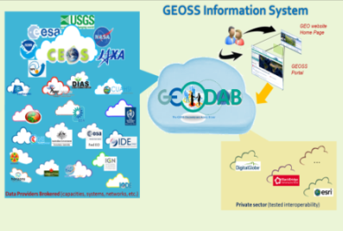
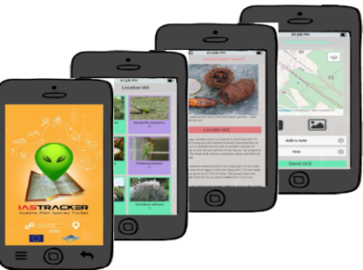
Promote broad and open sharing of Earth observation data globally,
Coordinate strategies and investments in observing capabilities;
Develop an information architecture to enable sharing of data and information,
Develop new integrative initiatives to deliver services tailored to specific end-user needs, creating and fostering the connection between data providers and users.

Slide 18
African Space Policy - Access to Space
Data Sharing Protocols
Regional/Sub-Regional Centers
Upgrades
New builds
Existing Infrastructure
Notes:
To use existing space infrastructure.
To coherently develop, upgrade and operate cutting-edge African space infrastructure
To promote capacity-building for the development of space services
To develop and increase our space asset base
To establish regional and sub-regional centres
To adopt data-sharing protocols

Slide 19
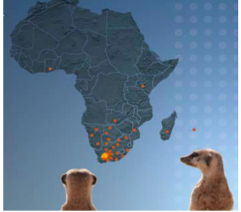
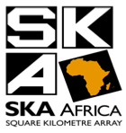
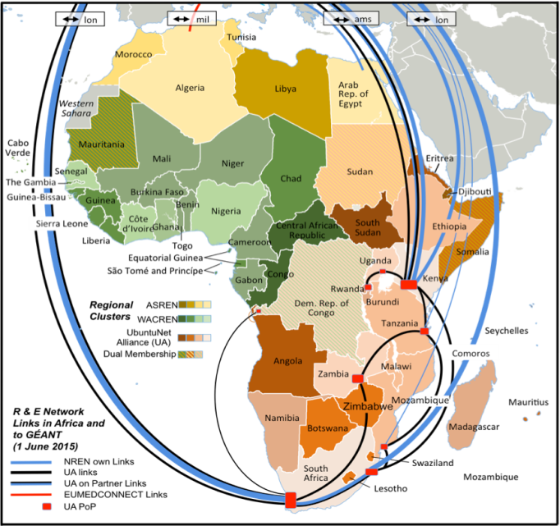




Building collaborations and leveraging opportunities
Square Kilometre Array
Co-location of observation systems
Archiving, computing and dissemination infrastructure
Research Networks
Dissemination infrastructure

Slide 20
Outcomes from the session
Develop a common understanding of the African Data Intensive Research Cloud;
Review of existing and planned data and infrastructure efforts on the continent;
Identify potential nodes/contributions to ADIRC
Outline elements of a roadmap towards an EO platform in the ADIRC;
Establish a task team to develop a roadmap towards an EO platform in the ADIRC;

Slide 21
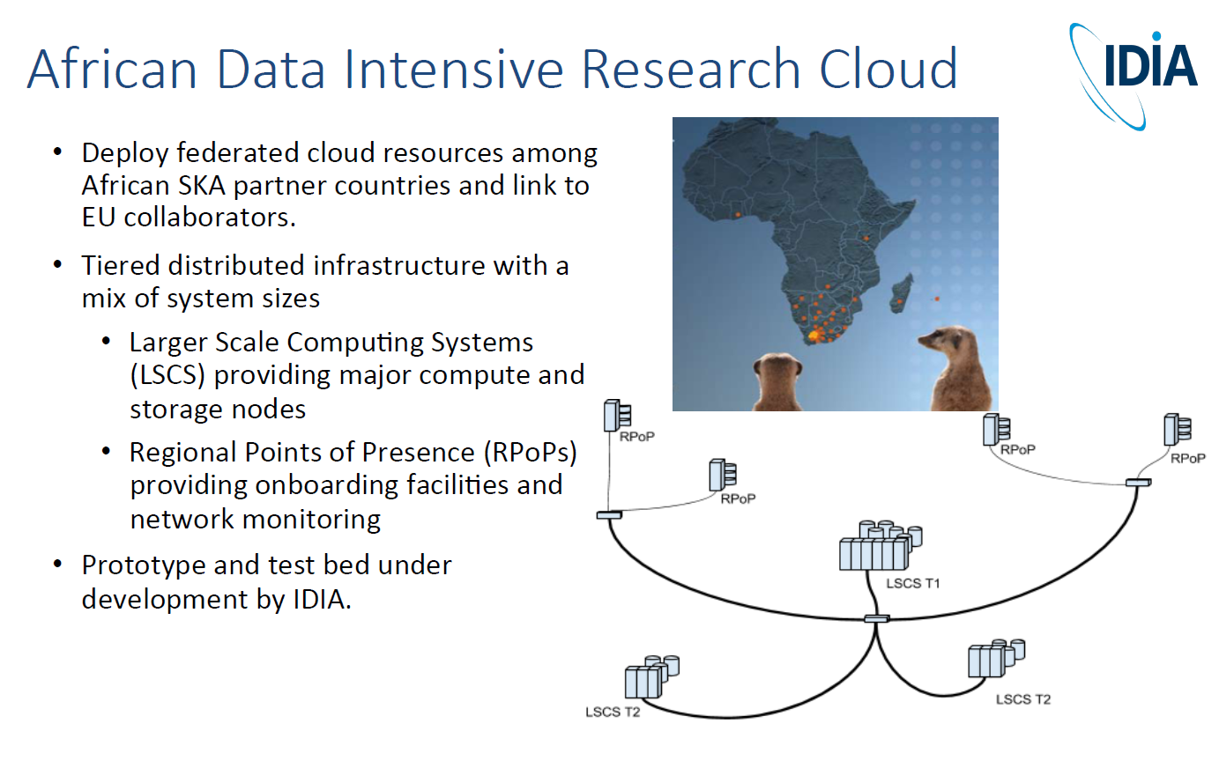

Slide 22
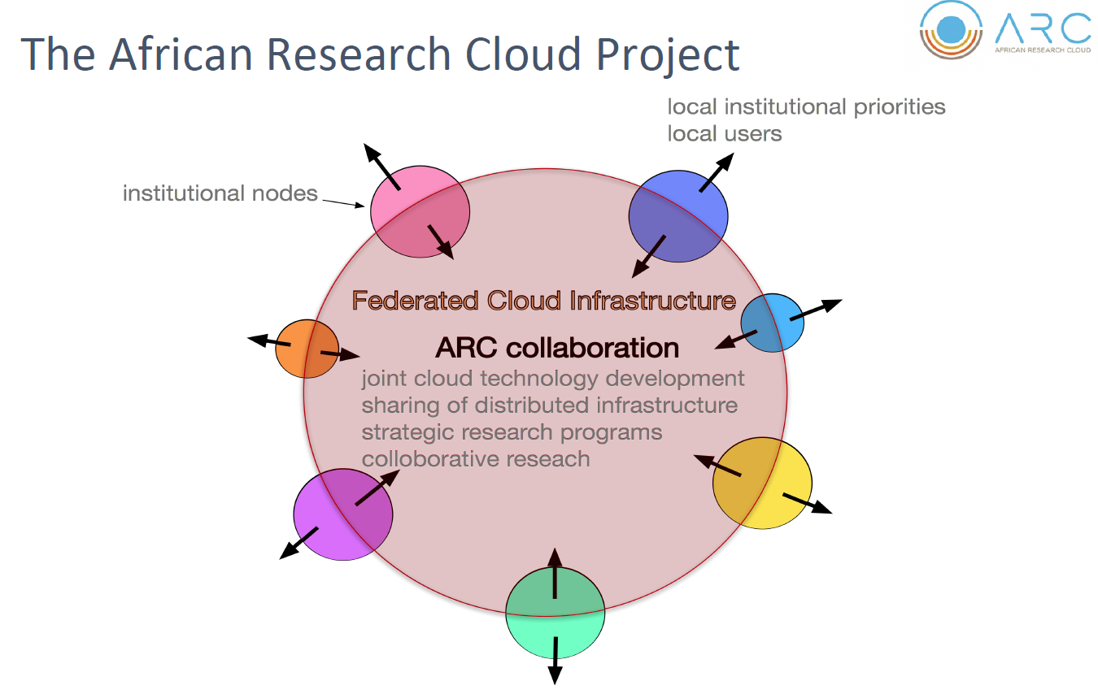
Astronomy
Bioinformatics
Earth Observation

Slide 23
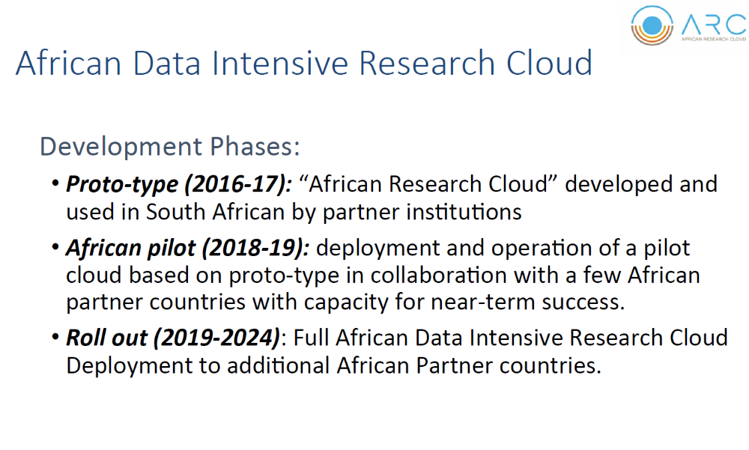

Slide 24
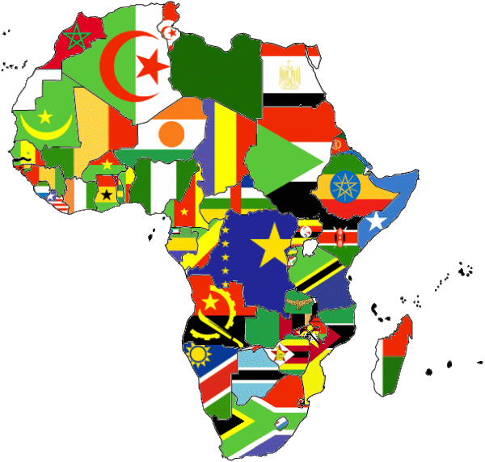
EO &
The African Data Intensive Research Cloud
??GMES & Africa
SERVIR
WASCAL
SASCAL
UNGGIM –Africa ??
AfriGEOSS
AstroHPC
HPC
Bio info HPC
EO HPC Node(s)
HPC
African Space Programme
HPC

Slide 25
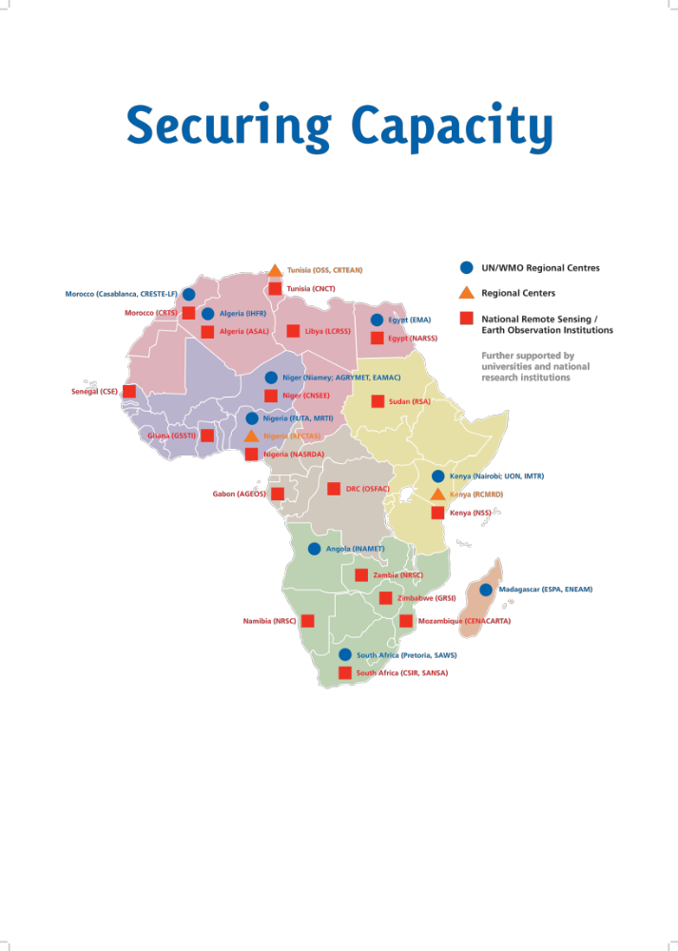
Staging engagement with other African countries
Map national and regional institutions
Develop proto-type data cubes – partnership with CEOS
Training on computing and cloud processing platforms
Then…

Slide 26
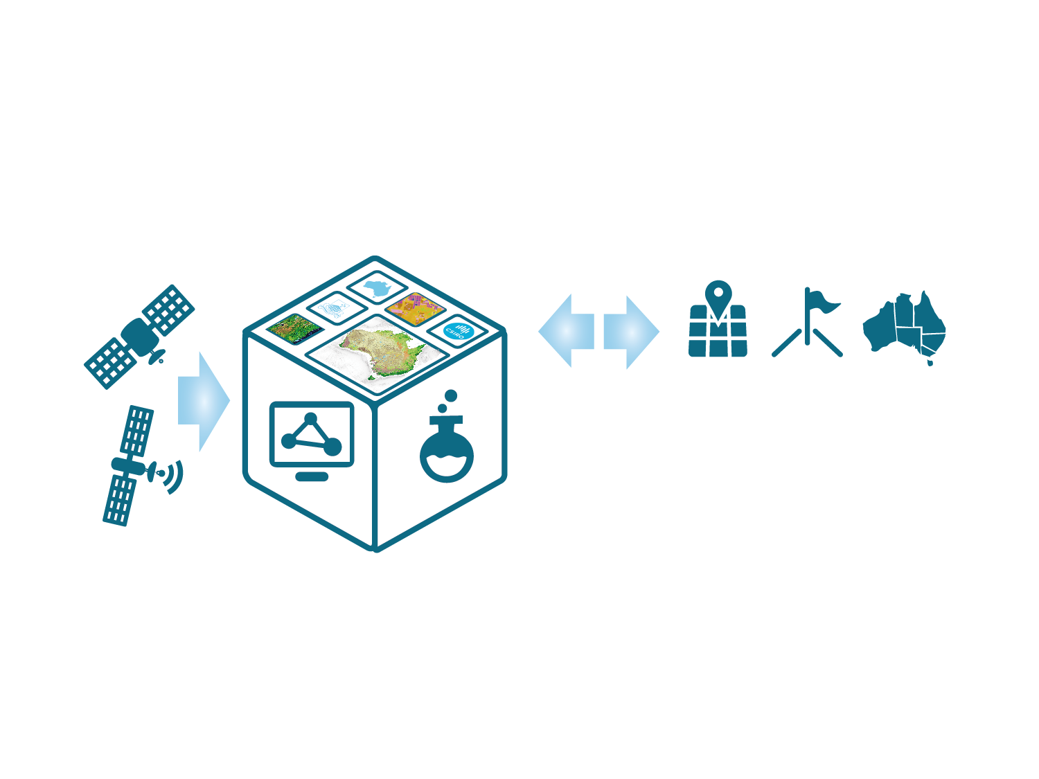

New Data Cube remote sensing paradigm
Open, Cloud based, Free, spatio-temporal analytics, analysis ready datasets.
Demonstrable ROI (political and bugetary buy-in)
Data cube technology is also being implemented in many other countries including Colombia, Switzerland, Vietnam and the United Kingdom.
ACQUIRE and PROCESS
Notes:
As a service through the Data Cube, on to which industry, governments and reesearchers through which users can interact, e.g. as new data becomes available, or as they seek to refine their product or their research
The Data Cube makes comprehensive information about our Earth available as information infrastructure, supporting the digital economy, enabling downstream users, such as industry, to leverage it to create economic activity and employment
In this model, new data is proactively acquired and processed to further enhance the data cube, and users and the applications they develop can interact with the cube, rather than being passive recipients of ‘one off’ products … this type of interaction enables the answer to one question provided by EOS to trigger the next inquiry and so forth ...

Slide 27
AfriGEOSS principles are to the provide member states (27 countries) with access to decision ready EO data at low to no cost..
ADIRN strategy: link with existing IT infrastructure such as SKA is to leverage economies of scale and technical infrastructure and expertise built.
AfriGEOSS must meet users needs.
AfriGEOSS recognizes the Australian and African Regional Data cubes and the benefits to Africa’s EO community.
AfriGEOSS is keen to support these Data Cube initiatives and ensure that African countries are partners, and that long term sustainable capacity building (individual and institutional) is achieved.
Technical issues largely addressed.
Political buy-in at regional, sub-regional and national level is essential. (engagement with SANSA, CSIR, ECA, AU & NEPAD

Slide 28
What users want …
Users to free and open source solutions
Users want minimum time and capacity required to obtain and prepare satellite data
Users want to perform time series analyses
Users want to use multiple datasets together
Users want to use their common GIS tools
Users want data sovereignty
Users want customer service and help

Slide 29


