Slide 1
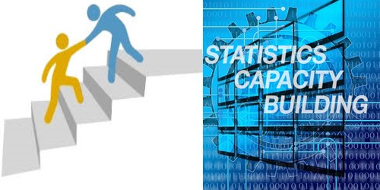

AfDB Statistical Capacity Building
Statistics Department

Slide 2

Content
Introduction
Statistical Capacity Building Activities
Challenges

Slide 3
Introduction
The Statistics Department is responsible for the Bank’s statistical activities that focus on two main components
Providing support for effective development of statistical capacity and systems in African countries
Mainstreaming results measurement in Bank operations to ensure their operational effectiveness as well as meeting the data needs for the Bank’s research, policy and financial services

Slide 4
Statistical Capacity Building Activities
The Bank provides technical assistance and financial support for regional public goods (RPGs) activities
Statcom
ISI
Workshops in general
Training of RMC and SRO officials to strengthen statistical capacity
Organizational and methodological work to promote statistical infrastructure development using an approach that fits the African environment
Development of manuals, Guidelines : National Account Manual, NSDS Sector Guidelines, Statistical Business Register Guidelines
Support events such as :
ASSD

Slide 5
Statistical Capacity Building- Ongoing Activities (1)
Cross Cutting Areas
Strategy for the Harmonization of Statistics in Africa (SHaSA). The Bank successfully led the preparation of SHaSA-2 which was endorsed by the African Heads of State and Government Summit in January 2018. Preparations for the launching of SHaSA-2 in Abidjan (date to be determined in tandem with AUC, ACBF, and ECA)
National Strategies for the Development of Statistics (NSDS). The Bank is the lead agency in providing technical and financial assistance to RMCs for NSDS design and implementation.
Africa Information Highway (AIH) (Data Management and Dissemination)
African Economic Outlook

Slide 6
Statistical Capacity Building- Ongoing Activities (2)
Power and Light up Africa and Infrastructure Statistics
The Bank has been assigned the lead role in Africa in the area of infrastructure statistics and infrastructure knowledge products. The objective of this initiative is to achieve a major improvement in the country-level knowledge base of the infrastructure sector.
Feed Africa (Agriculture Statistics) - Action Plan to Improve Statistics for Food Security, Sustainable Agriculture and Rural Development in Africa
Development of Strategic Plans for Agricultural and Rural Statistics (SPARS). 14 countries covered.
Construction of master sampling frames - So far, ECST has been supported four countries: Benin, Kenya, Niger, and Senegal…
Development of Food Balance Sheets (FBS)- So far, four countries are being supported on FBS: Cote d’Ivoire, Kenya, Tanzania, and Togo
Use of Computer-Assisted Personal Interview (CAPI) technology for agricultural data collection - Five countries are receiving technical assistance in this area: Ghana, Malawi, Mozambique, Tunisia, and Zanzibar
updated Agricultural Minimum Sets of Core Data (MSCD). ECST has supported 48 RMCs to regularly generate the minimum sets of core agricultural data – the first time Africa had such a large number of countries accomplishing this important milestone
Areas covered : (i) Transport; (ii) Electricity; (iii) ICT; and (iv) Water and Sanitation
Need for countries to integrate infrastructure statistics in their National Statistical systems
Reporting on Agricultural Statistics Capacity Indicators (ASCI)

Slide 7

3. AIKP Country Teams
Composition of Country Teams:
  1 Focal person (based in NSO) coordinating data collection;
  1 Fiscal Expert responsible for Fiscal data collection;
  1 Expert responsible for Power sector
  1 Expert in charge of ICT sector
  1 Expert in charge of Water and Sanitation sector
  1 Transport Expert responsible for Road, Air, Rail and Ports data collection;

Slide 8
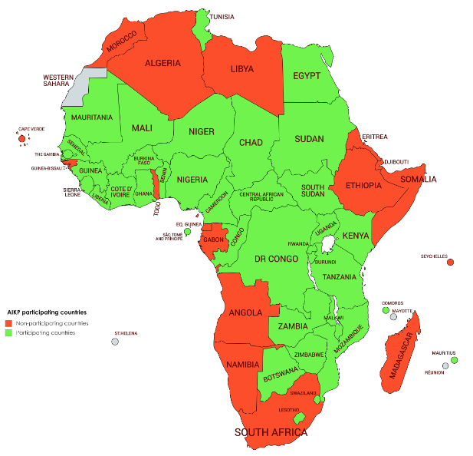
2. AIKP Participating countries
17 non-participating countries:
Morocco, Algeria, Libya, Cabo Verde, Guinea-Bissau, Togo, Equatorial Guinea, Gabon, Angola, Namibia, South Africa, Madagascar, Seychelles, Djibouti, Ethiopia, Somalia, Eritrea
37 participating countries:
Countries with established and nominated teams

Slide 9
Statistical Capacity Building- Ongoing Activities (3)
Integrate-Industrialize Africa
Strategy for the Harmonization of Statistics in Africa (SHaSA-2)- The Bank successfully led the preparation of SHaSA-2 which was endorsed by the African Heads of State and Government Summit in January 2018. Preparations for the launching of SHaSA-2 in Abidjan (date to be determined in tandem with AUC, ACBF, and ECA)
International Comparison Program for Africa (ICP-Africa)- The Bank coordinates ICP-Africa activities across 50 participating RMCs. Finalization of the collection and validation of their price data for some 560 products and services by end December 2018

Slide 10
Statistical Capacity Building- Ongoing Activities (4)
Integrate-Industrialize Africa
National Accounts (NA)- The Bank provides support to RMCs on improving their NA, including assisting them in the process of rebasing their GDPs. In Q4 2018, the Bank will assist Zambia in conducting some economic surveys and support the process of GDP rebasing
Harmonized Consumer Price Index (HCPI)- The Bank provides Technical and financial support to COMESA & SADC RMCs for the monthly production and dissemination of the HCPI, to inform the regional macroeconomic convergence agenda. This assistance is being extended to AMU, CEMAC & ECOWAS countries
Statistical Business Register (SBR). SBRs are critical tools that provides the source data for designing the frames for all economic surveys

Slide 11
Statistical Capacity Building- Ongoing Activities (5)
Improve the Quality of Lives of Africans
2020 Round of Population & Housing Censuses- The Bank helped countries prepare for the 2010 Round of Population and Housing Census (RPHC), & assisted them to process the data and analyze the results.
SDGs Data & Monitoring: The Bank assists RMCs to improve the quality of their data for monitoring progress toward the SDGs. The Bank has developed and installed SDG Data Hubs in all the RMCs.
Civil Registration and Vital Statistics. The Bank provides methodological support to improve the collection of Civil Registration and Vital Statistics (CRVS) in RMCs.
Household Surveys and Poverty Work: The Bank provides technical & financial support to RMCs for household survey fieldwork leading to the generation of country poverty statistics.
Labour Statistics (with ILO). The Bank is assisting RMCs to improve their labor statistics through: (i) preparing operational and methodological guidebooks to help in the conduct of labor force surveys and household expenditure surveys (ii) assisting with labor surveys; (iii) providing technical and operational support to countries to undertake labor statistics classifications and to develop business registers; and (iv) providing training for African sampling statisticians.
Gender Statistics. The Bank activities in this area include: (i) developing gender indicators; (ii) launching a process addressing challenges related to the development of gender statistics in Bank documents.

Slide 12
Challenges
Advocacy at country level
Budgetary allocations
Audit Report
Justifications to Sub Regional Organizations

Slide 13
AfDB Key Contact Information(Statistics)
Ben Paul MUNGYEREZA
Manager, Statistical Capacity Building Division
Louis Koua KOUAKOU
Manager, Economic & Social Statistics Division
Charles Leyeka LUFUMPA
Director, Statistics Department
Email: C.LUFUMPA@AFDB.ORG
Email: B.MUNGYEREZA@AFDB.ORG
Tel: +225-2026-4592 (Landline); +225-7575-0781 (Mobile)
Email: K.L.KOUAKOU@AFDB.ORG
Tel: +225-2026-3058 (Landline); +225-7575-0685 (Mobile)
Tel: +225-2026-2175 (Landline); +225-7575-0185 (Mobile)

Slide 14

Thank you

