Slide 1


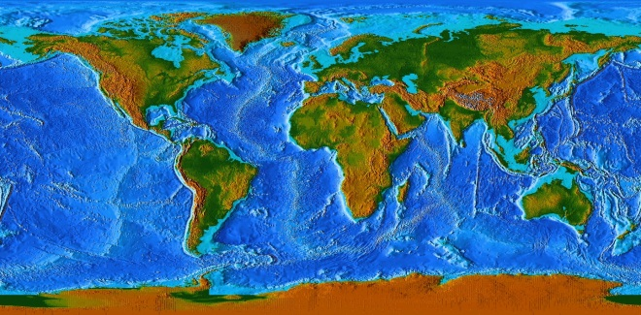


International Workshop on Global Fundamental
Geospatial Data Themes for Africa
The Fundamental Geospatial Data Journey
Greg Scott, UN-GGIM Secretariat
United Nations Statistics Division
Department of Economic and Social Affairs
United Nations, New York
Positioning geospatial information to address global challenges

Slide 2
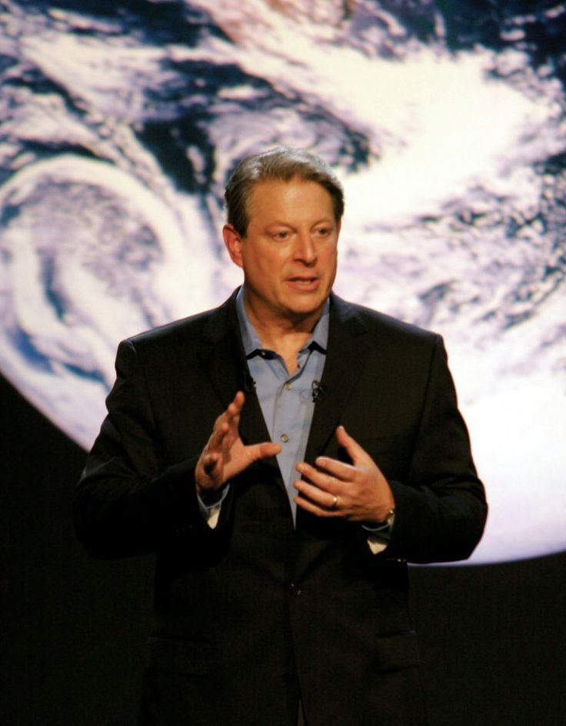
A bit of history…and a lot of vision…
“I believe we need a ‘Digital Earth’ – a multi-resolution three-dimensional representation of the planet, into which we can embed vast quantities of geo-referenced data.
We have an unparalleled opportunity to turn a flood of raw data into understandable information about our society and our planet. This data will include high-resolution satellite imagery of the planet, digital maps, and economic, social, and demographic information.
If we are successful, it will have broad societal and commercial benefits in areas such as education, decision-making for a sustainable future, land-use planning, agricultural, and crisis management; and to collaborate on the long-term environmental challenges we face.”
Al Gore, 1998: The Digital Earth: Understanding our planet in the 21st Century
Positioning geospatial information to address global challenges
Notes:
In an effort to take advantage of the new wave of technological innovation leading into the 21st century, in January 1998 Al Gore, Vice President of the United States, proposed the need for a ‘Digital Earth’ – a multi-resolution three-dimensional representation of the planet……..
In my view this in stark contrast to the Millennium Summit in New York in September 2000, where the MDGs failed to recognize the need for data and geography at all.
However, 2 years later at the World Summit on Sustainable Development held in Johannesburg in September 2002, the need for geographic data was first captured in a global sustainable development dialogue.

Slide 3
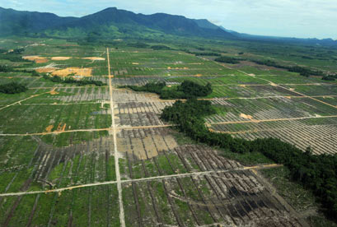
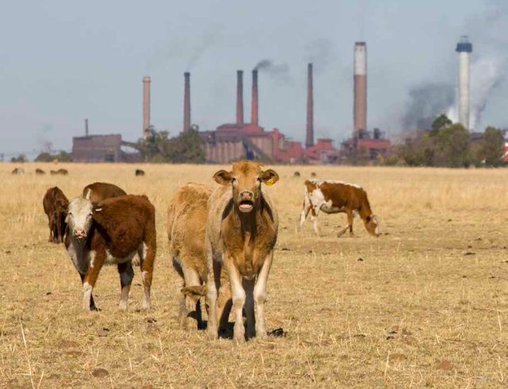
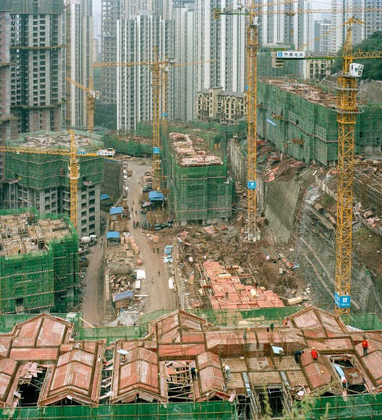
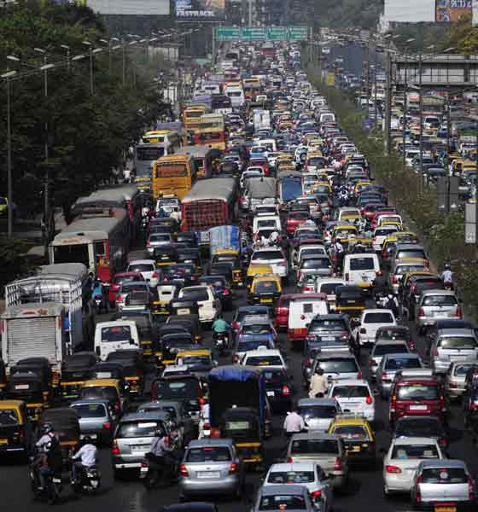
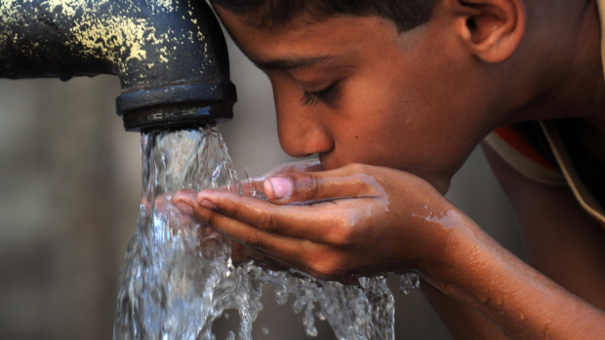
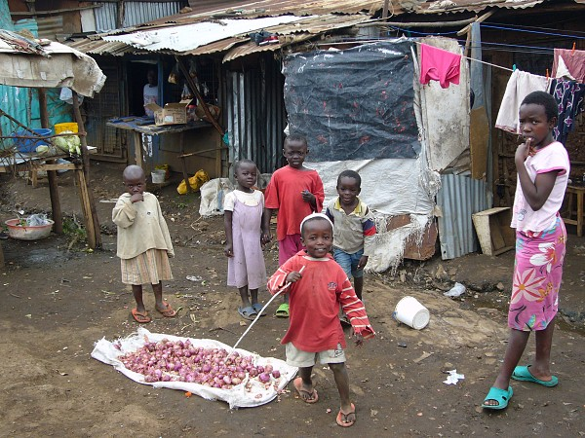
“Everything happens somewhere…”
Nancy Tosta, June 2001
We can measure and monitor what happens where…
Positioning geospatial information to address global challenges

Slide 4
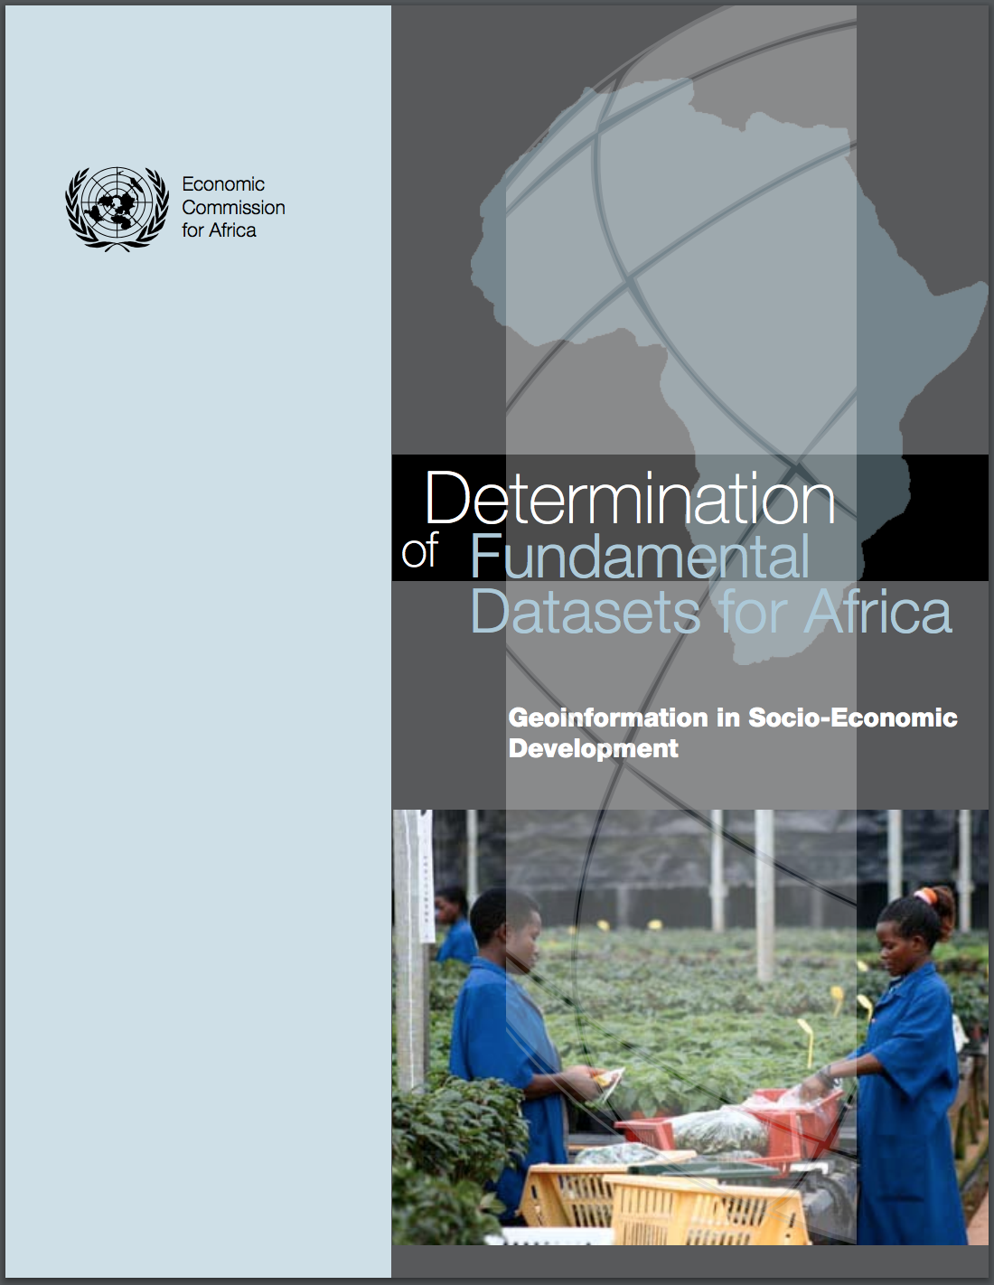
Fundamental Datasets for Africa, 2007
As geospatial information becomes widely accepted….a pan-continental and common definition of what constitutes a minimally necessary core of geospatial data and information products is required.
Objective: Identify and enumerate these core, or fundamental, geospatial datasets to support Africa’s development agenda.
A key aspect of fundamental datasets is that they should be a reference frame, foundation, or base for the development and integration of geospatial datasets at a national, sub-regional and regional level.
To be accomplished, it is necessary for the data to be available and widely accessible so that new geospatial data can be developed through the cooperation of users.
Positioning geospatial information to address global challenges

Slide 5
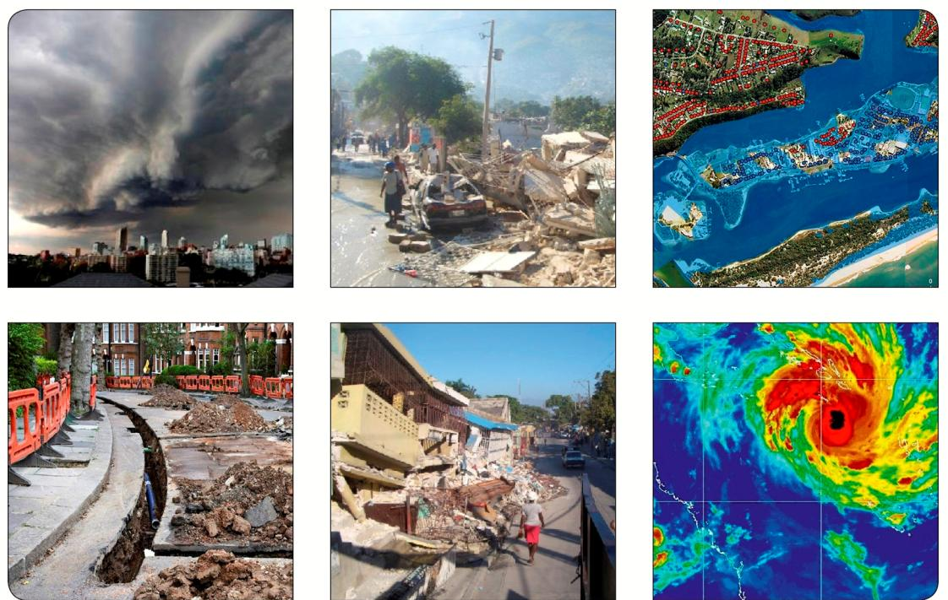
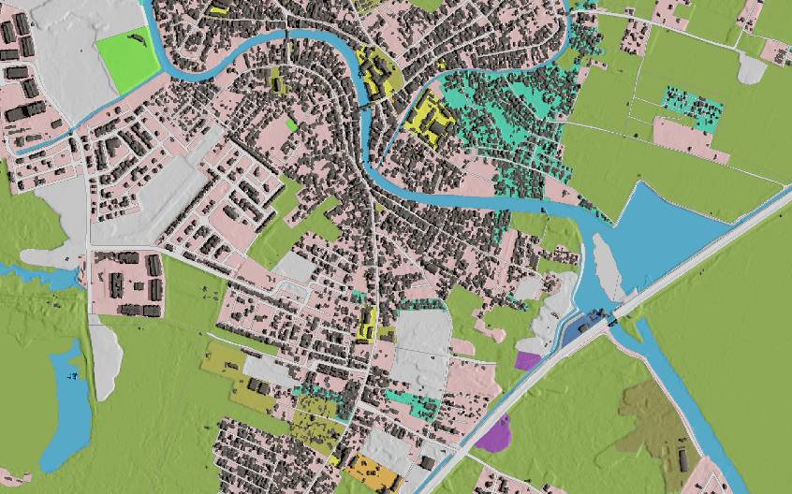

How can you measure and monitor sustainable development…
…without geography, place, and location
Positioning geospatial information to address global challenges

Slide 6







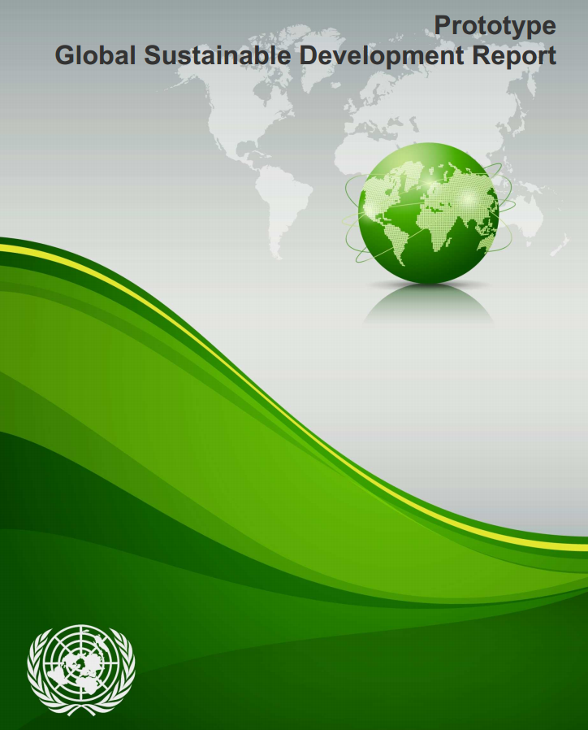


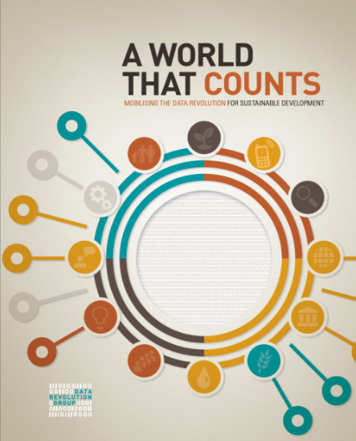

Need for geospatial data captured in Sustainable Development
Positioning geospatial information to address global challenges

Slide 7

Pillar 2: Science, technology and innovation:
(d) ) Optimal utilization of space and geospatial technologies: “This will require increasing investments and promoting human resources development in the
management and deployment of space and geospatial technologies”
Enabling Implementation:
“INVEST IN and STRENGTHEN national statistical capacities and geospatial information systems for the collection, analysis, production and dissemination of disaggregated data to measure and evaluate policy effectiveness; and PROMOTE a culture of evidence-based decision making”
Positioning geospatial information to address global challenges

Slide 8
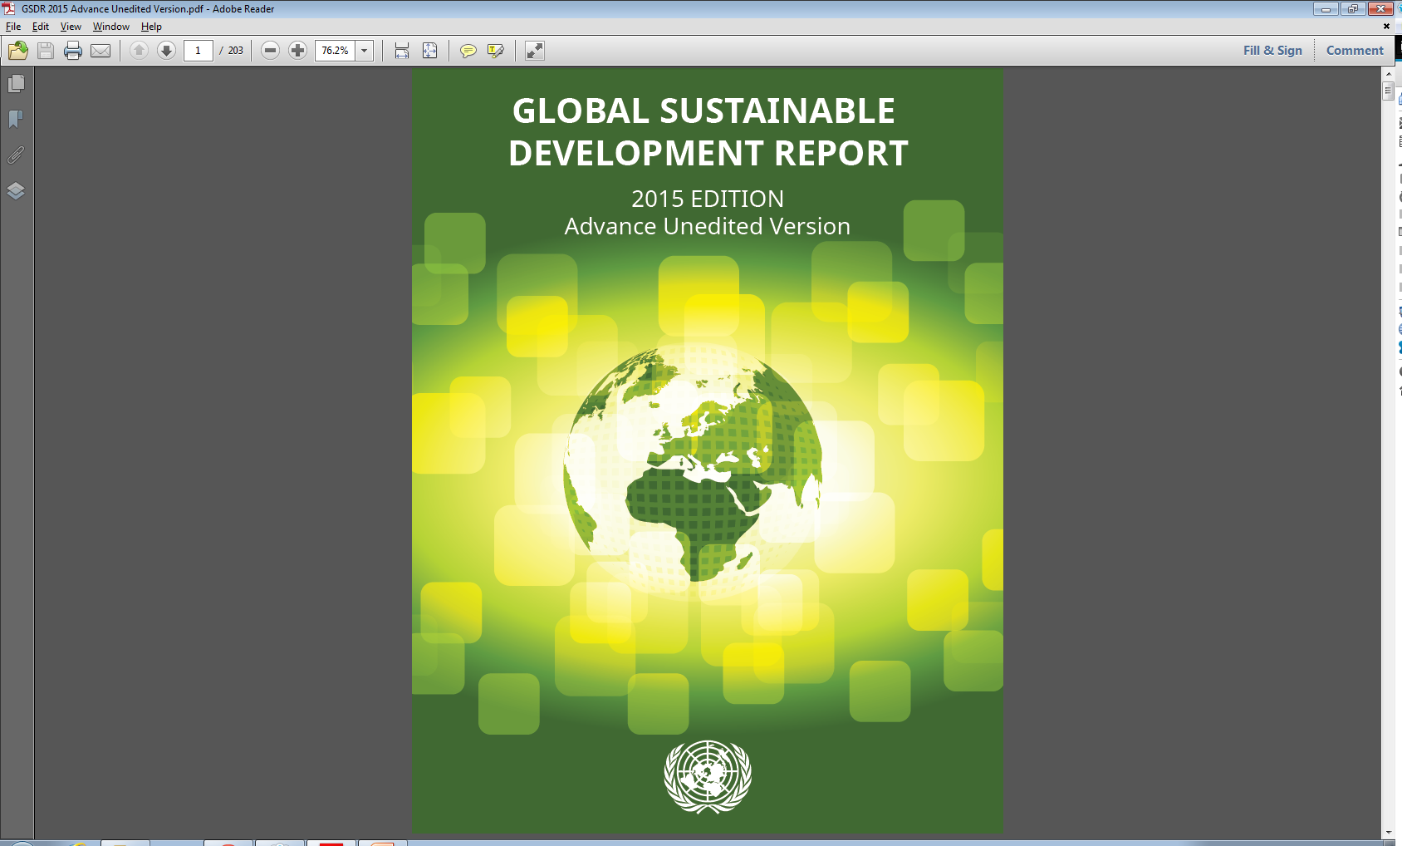
Data Approaches for Monitoring Sustainable
Development Progress: The Case of Africa
The increasing use of geospatial information needs to continue:
Geospatial information is increasingly being used in Africa, but more capacity building will be needed to scale up existing initiatives and to bring innovative applications from other parts of the world to Africa.
The lack of consistent up-to-date base mapping - fundamental geographic datasets such as geodetic control, elevation, drainage, transport, land cover, geographic names, land tenure, etc. – across Africa remains a challenge.
Positioning geospatial information to address global challenges

Slide 9
Data Approaches for Monitoring Sustainable
Development Progress: The Case of Africa
There is an increasing tendency to now make use of multiple data sources: official statistics, geospatial and satellite data, big data, scientific data, data produced by NGOs and research foundations, data from the media, from the crowd and from the business sector.
To explore the full potential of these data sources, the data needs to be easily accessible, interoperable and standardized – so that users are able to integrate difference sources and types of information.
Data, and its metadata, needs to be open access (i.e. free and accessible).
Positioning geospatial information to address global challenges

Slide 10

Sustainable Data for Sustainable Development
The monitoring of the MDGs taught us that data are an indispensable element of the development agenda:
Despite improvement, critical data for development policymaking are still lacking.
Real-time data are needed to deliver better decisions faster.
Geospatial data can support monitoring in many aspects of development, from health care to natural resource management.
New technology is changing the way data are collected and disseminated.
Global standards and an integrated statistics system are key elements for effective monitoring.
Data should be open, easily accessible and effective for decision-making.
Positioning geospatial information to address global challenges

Slide 11

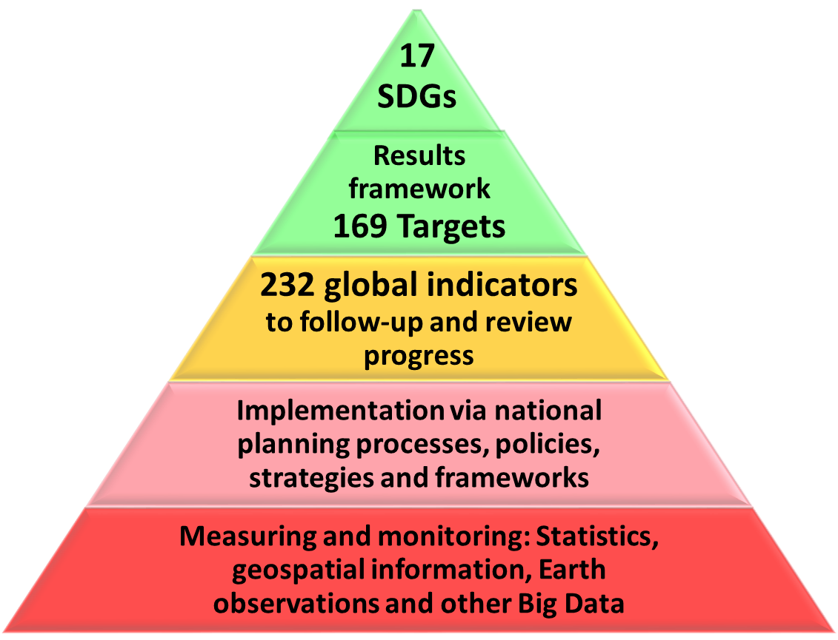
2030 Agenda: Goals, targets, indicators, measuring…
Positioning geospatial information to address global challenges
Notes:
With 17 SDGs, 169 targets and presently 232 global indicators, the 2030 Agenda articulates in great detail means of implementation, measuring and monitoring progress, and annual reporting by all countries through to 2030.
It also demands the need for much greater science and technologies, new sources of data, to exploit the contributions to be made by Earth observations and geospatial information, and to increase significantly the availability of high-quality, timely and reliable data disaggregated by income, gender, age, race, ethnicity, migratory status, disability, and geographic location.

Slide 12
The Sustainable Development Goals Report 2017
“Implementation has begun, but the clock is ticking. This report shows that the rate of progress in many areas is far slower than needed to meet the targets by 2030”
“This report provides a snapshot of our efforts to date. It stresses that high-level political leadership and new partnerships will be essential for sustaining momentum. It also underscores the need for reliable, timely, accessible and disaggregated data to measure progress, inform decision-making and ensure that everyone is counted”
António Guterres
Secretary-General, United Nations
Positioning geospatial information to address global challenges

Slide 13
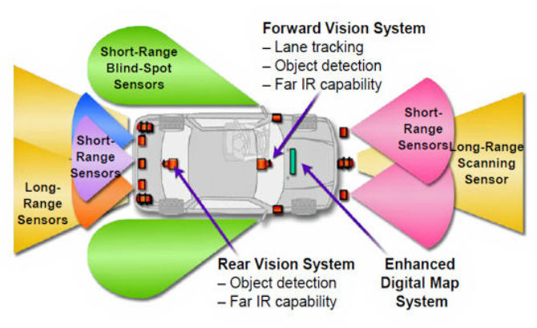
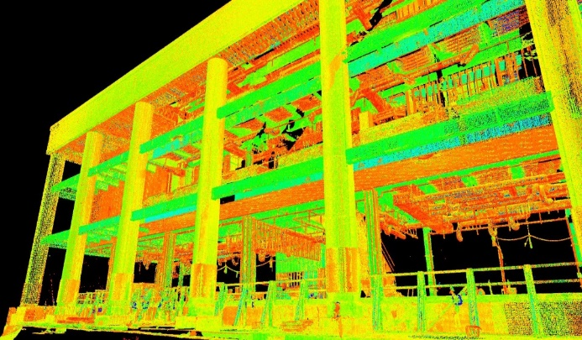
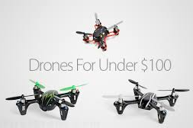
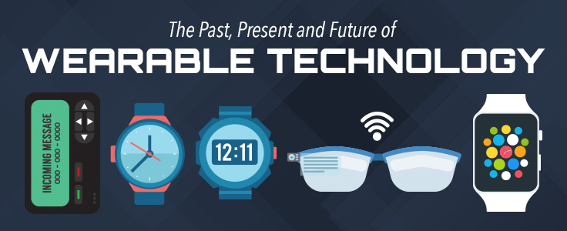

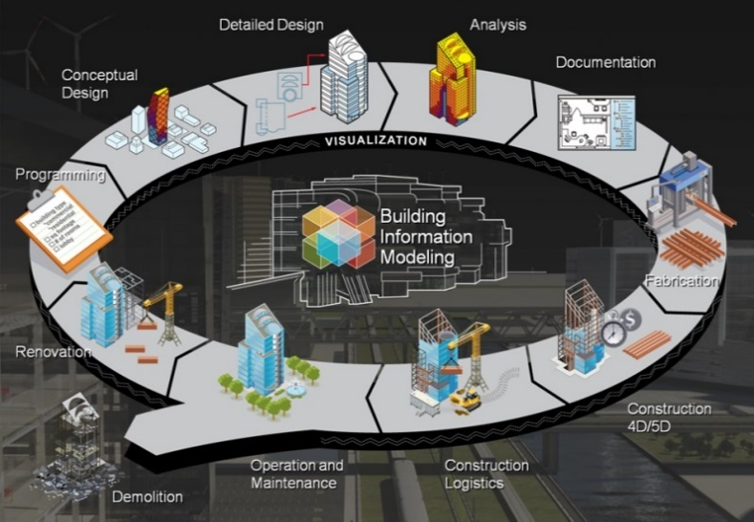

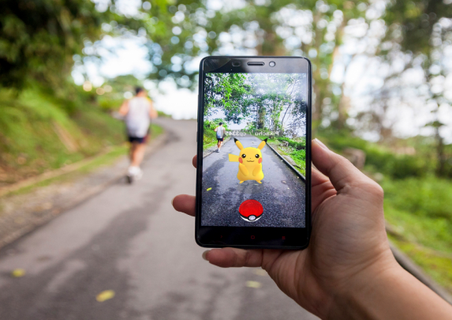
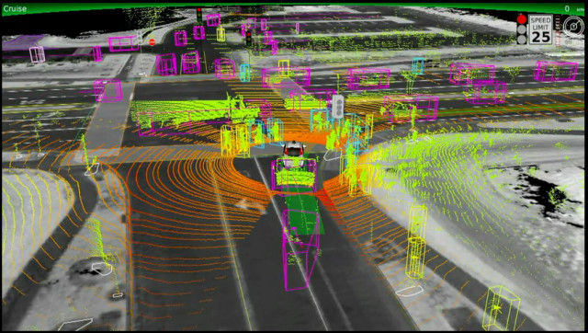
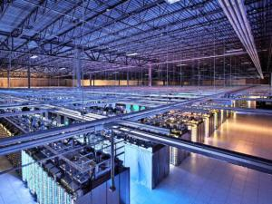



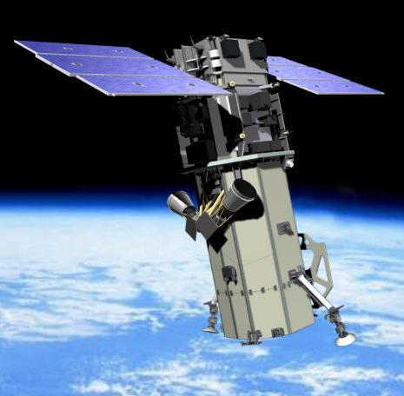
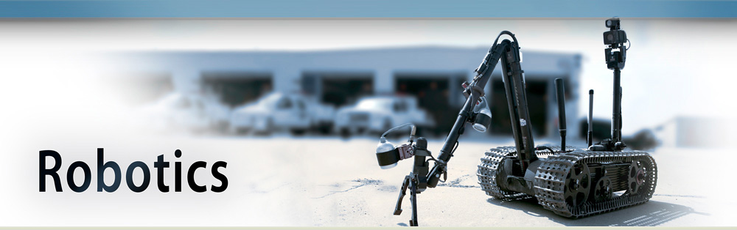

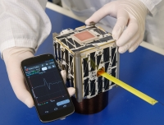
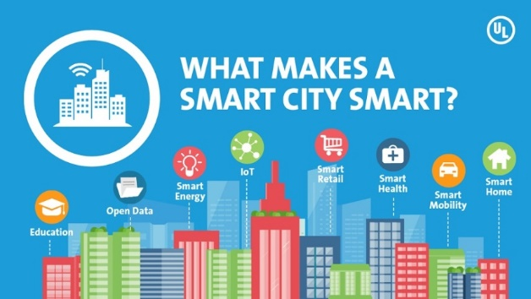
Technology and society are driving digital transformation, but are we yet leveraging this new ‘data ecosystem’ effectively?
Notes:
On one hand, we have amazing technology and more data, in volume, resolution and temporality or repeat rate, than we have ever had before.
Satellites and sensors are proliferating – getting smaller in size (in the palm of our hands) and larger in acquisition capabilities. This was well demonstrated in February when the Indian Space Research Organisation (ISRO) placed 104 satellites from 7 countries in orbit, including a flock of 88 ‘Dove’ satellites from Planet.
Sensors now include: UAS, autonomous vehicles, and wearable technologies.
Compute, including in the cloud, is getting faster and cheaper with growing Big Data Analytics.
This is driving the Internet of Things, robotics, artificial intelligence, virtual reality, machine and cognitive learning, and gaming.
Smart cities are the in thing – and using LiDAR, BIM, 3 and 4D acquisition, virtual reality, and soon “building drones”.
This IS the digital transformation, data revolution, I call it the new “data ecosystem” that we, and many before us, envisioned….and interestingly it is being driven by technology and societal demand….not governments so much!! That is perfectly appropriate.
But who gets to use those technologies and the commensurate data?
Are we yet leveraging the new “data ecosystem” effectively? Especially in a sustainable future and the long-term environmental challenges we face.
Put another way…..are those that need the information most, actually getting to use it?

Slide 14
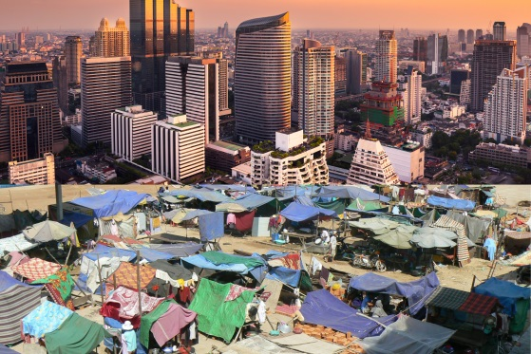

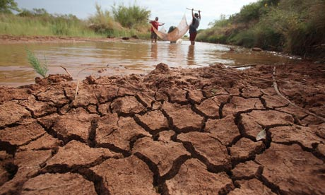
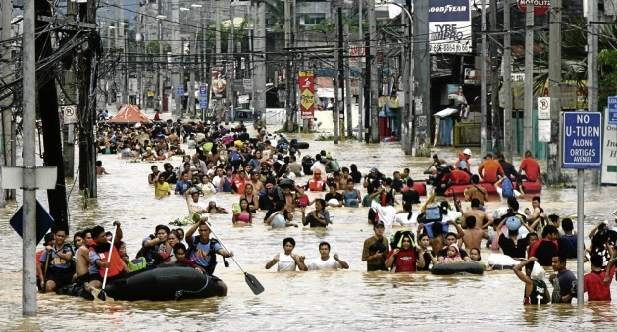





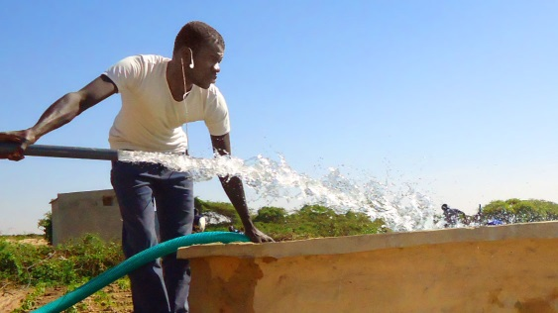
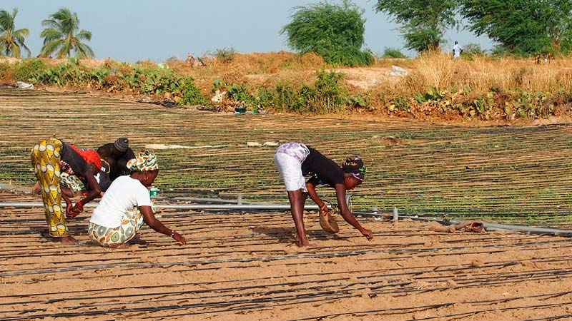
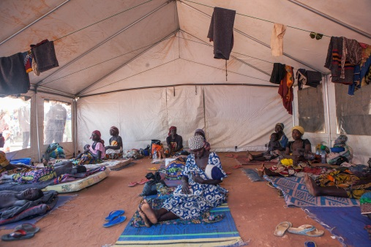
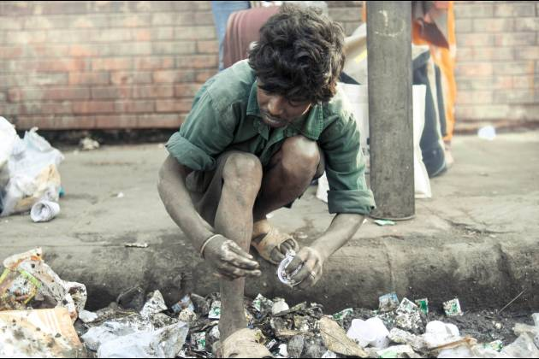







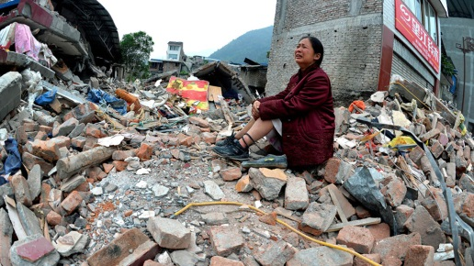
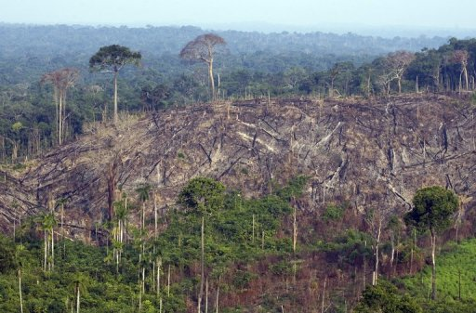
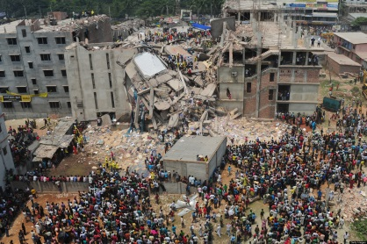






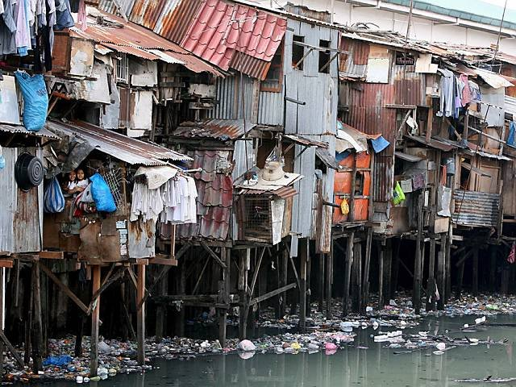
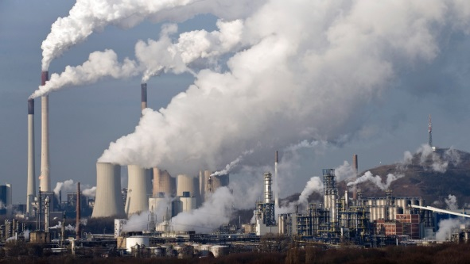
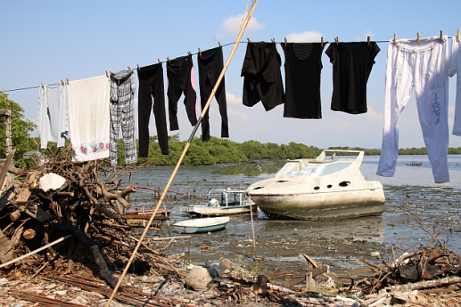


Do we have the data for development??
Can we make it ‘production ready’ information for all?
Notes:
The developing countries have no capacity or capability to implement technologies and/or consume the data. Yet, they need it most.
Achieving sustainable development really does require digital transformation…but at the moment, those countries that need it most do not even know what it means.

Slide 15
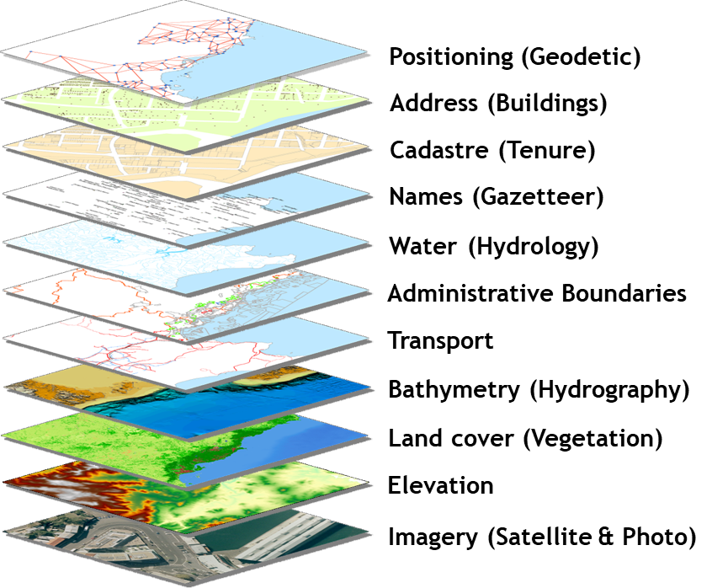
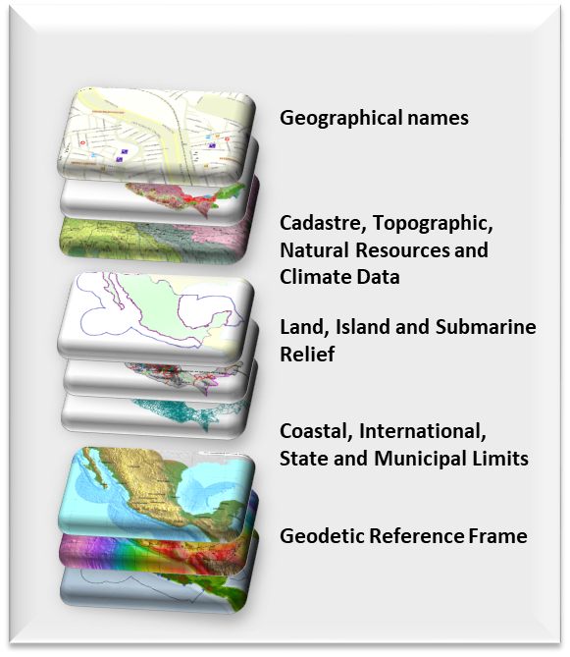
Global fundamental geospatial data themes
Positioning geospatial information to address global challenges

Slide 16
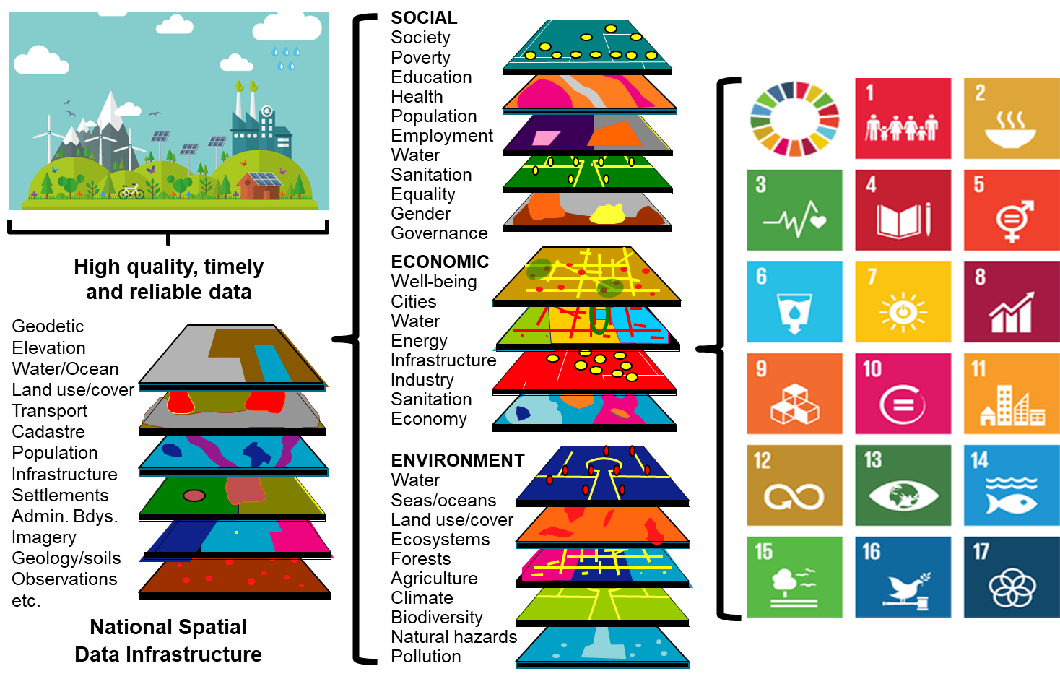
Positioning geospatial information to address global challenges

Slide 17

17
Goals
Global
Outputs and
Reporting
169
Targets
232
Global Indicators
An integrative data ecosystem
Official Aggregation and Integration into
Indicator Framework by National Statistical Offices.
Captures data integrity and validation.
National
Sustainable
Development
Indicators
SDG metrics for measuring and monitoring progress.
Data compiled and disaggregated by income, gender, age, race, ethnicity, migratory status, disability, geographic location, etc.
Earth
Observations
and Monitoring
National
Spatial Data
Infrastructure
National Statistics,
Accounts, Administrative
Registers, Demographics
Other Sources
of Data,
incl. Big Data
National
Information
Systems
Imagery
Water/Ocean
Land use/cover
Observations
In situ monitoring
Air/Pollution
Ecosystems
Forest/Agriculture
Climate
Geodetic positioning
Elevation
Topography
Land use & cover
Transport/Infrastruct.
Cadastre/Parcels
Water & Oceans
Cities & Settlements
Administrative Bdys.
Population
Demographics
Poverty
Trade/Business
Environment
Labour/Economics
Agriculture
Disability/Gender
Civil Registration & Vital Stats.
Mobile phone
Social media
Sensors
Automated devices
Satellite imagery
VGI
Crowd sourcing
??
Data
Inputs
Fundamental
baseline data
and new
data sources
Local to national social, economic and environmental conditions and circumstances
Positioning geospatial information to address global challenges

Slide 18
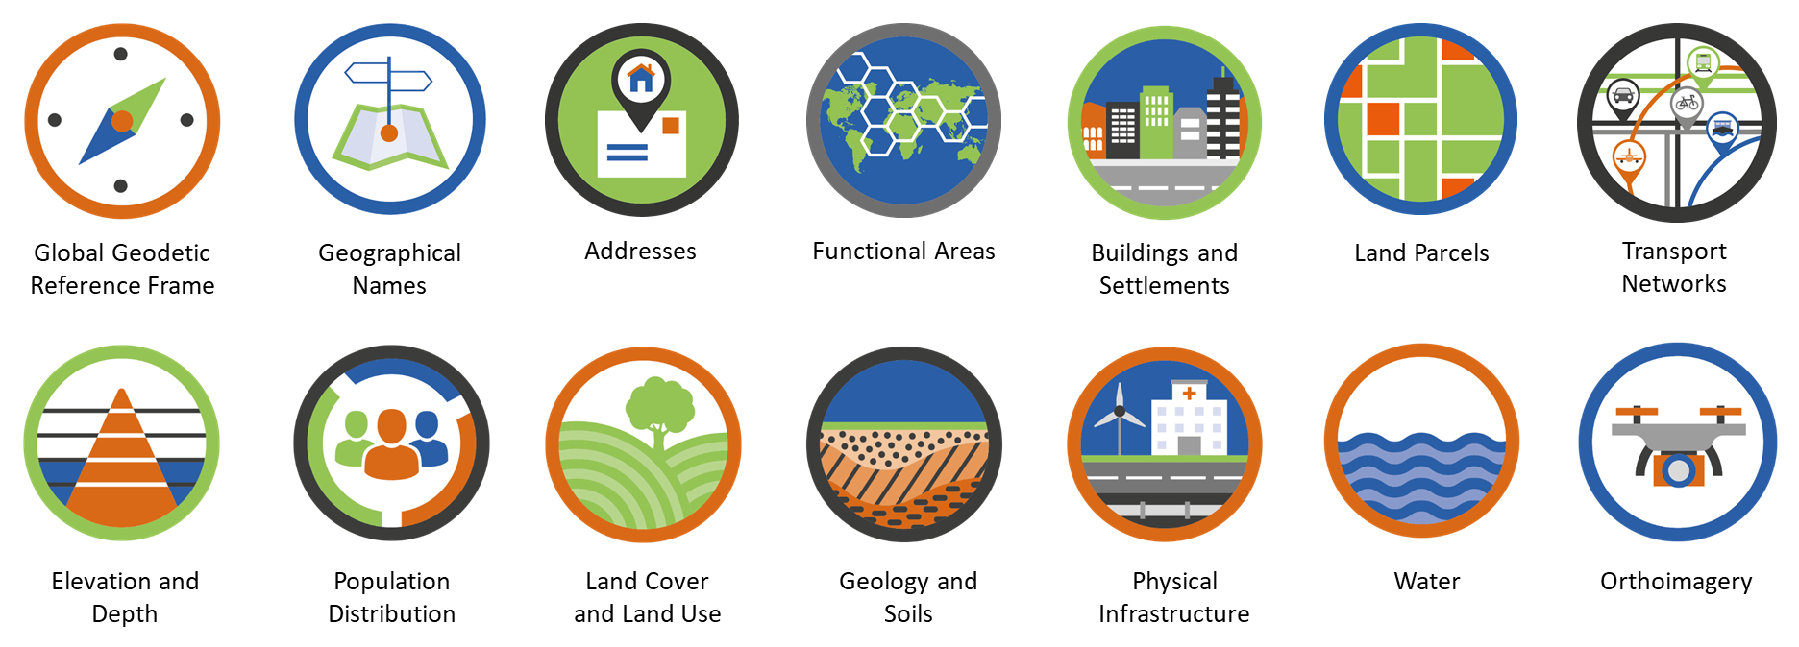
Goals, targets, indicators, measuring…fundamental data
Positioning geospatial information to address global challenges

